Slide 1
Section 10.2
Composition of Functions and Inverse Functions

Slide 2
Example 1: Evaluating a Function at an Algebraic Expression
Find the following function values when
Solution
Substitute 2a in for x everywhere x appears and simplify.

Slide 3
Example 1: Evaluating a Function at an Algebraic Expression (cont.)
Substitute g + 3 in for x everywhere x appears and simplify.

Slide 4
Definition: Composite Function
For two functions f and g, the composite function is defined as follows.
The domain of consists of those values of x in the domain of g for which g(x) is in the domain of f.

Slide 5
Example 2: Forming Compositions
Form the compositions if and
Solution
Note: Both and are defined for all real numbers.

Slide 6
Example 3: Forming Compositions
Form the composite functions if and
Solution
Note: For the expression under the radical to be defined, we must have g(x) ≥ 3. Because x² + 4 ≥ 3 for all real numbers, the domain of is all real numbers.

Slide 7
Example 3: Forming Compositions (cont.)
Now, for the domain is restricted by That is, the domain is restricted to x ≥ 3 regardless of the simplified result.

Slide 8
Example 4: Finding Compositions
Find if and
Solution
Note: is defined only for

Slide 9
Example 4: Finding Compositions (cont.)
Note: is defined only for

Slide 10
Definition: One-to-One Functions
A function is a one-to-one function (or 1-1 function) if for each value of y in the range there is only one corresponding value of x in the domain.

Slide 11
Definition: Horizontal Line Test
A function is one-to-one if no horizontal line intersects the graph of the function at more than one point.

Slide 12
Example 5: Determining One-to-One Functions
Determine whether each function is one-to-one.

Slide 13
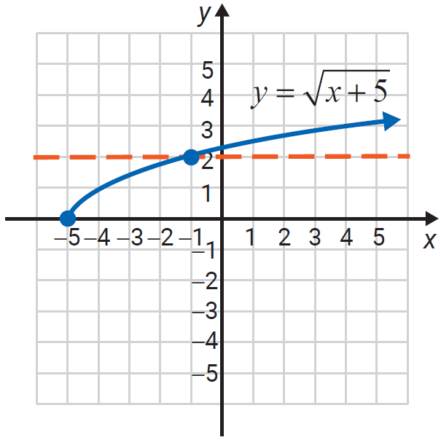
Example 5: Determining One-to-One Functions (cont.)
Solution
The horizontal line test shows that this function is one-to-one.

Slide 14
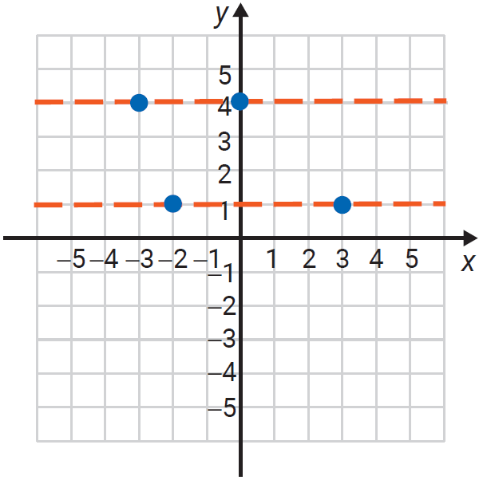
Example 5: Determining One-to-One Functions (cont.)
This function is not one-to-one. Both y-values, 4 and 1, have more than one corresponding x-value.

Slide 15
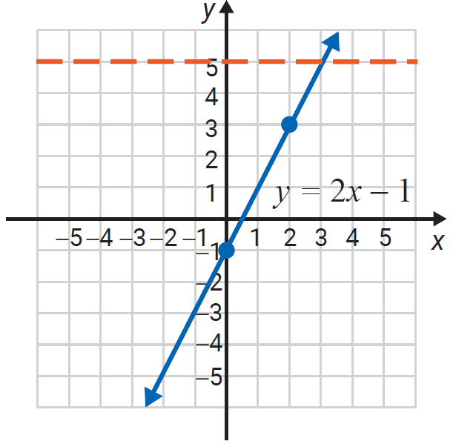
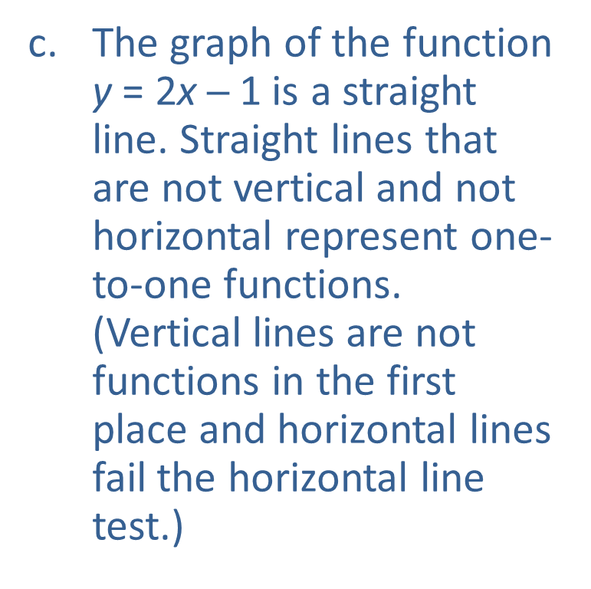
Example 5: Determining One-to-One Functions (cont.)
The graph of the function y = 2x ─ 1 is a straight line. Straight lines that are not vertical and not horizontal represent one-to-one functions. (Vertical lines are not functions in the first place and horizontal lines fail the horizontal line test.)

Slide 16
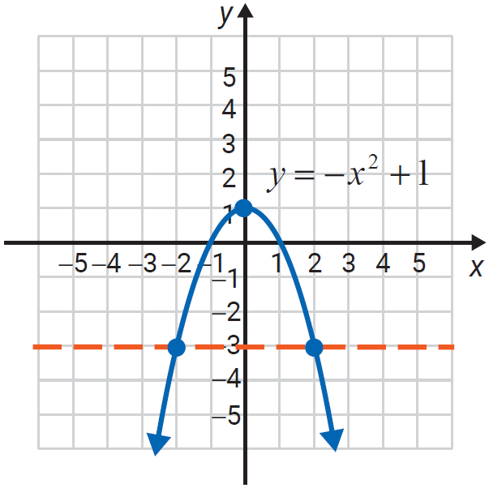
Example 5: Determining One-to-One Functions (cont.)
The graph of the function is a parabola and the horizontal line test shows that the function is not one-to-one.

Slide 17
Definition: Inverse Functions
If f is a one-to-one function with ordered pairs of the form (x, y), then its inverse function, denoted as f ⁻¹, is also a one-to-one function with ordered pairs of the form (y, x).

Slide 18
Note
The notation f ⁻¹(x) represents the inverse of a one-to-one function. This inverse is a new function in which the x- and y-values have been interchanged. f ⁻¹(x) does
NOT mean because the −1 is NOT an exponent.

Slide 19
Procedure: Determining Whether Two Functions Are Inverses
If f and g are one-to-one functions and
then f and g are inverse functions.
That is, g = f ⁻¹ and f = g ⁻¹.

Slide 20
Example 6: Verifying Inverse Functions
Use the definition of inverse functions to show that f and g are inverse functions.
Solution
The domain of both
functions is the set of all real numbers.

Slide 21
Example 6: Verifying Inverse Functions (cont.)
We have
Replace the x in f(x) with g(x) and simplify.
Also,
Replace the x in g(x) with f(x) and simplify.

Slide 22
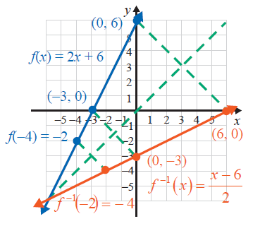
Example 6: Verifying Inverse Functions (cont.)
Therefore, g = f ⁻¹ and g = f ⁻¹.
The graph shows that the line y = x is a line of symmetry for the graphs of the inverse functions.

Slide 23
Example 7: Verifying Inverse Functions
Use the definition of inverse functions to show that f and g are inverse functions.
Solution
The domain of f is the interval [3, ∞) and the domain of g is the interval [0, ∞).

Slide 24
Example 7: Verifying Inverse Functions (cont.)
We have,
Replace the x in f(x) with g(x) and simplify.
Also,
Replace the x in g(x) with f(x) and simplify.
Therefore, g = f ⁻¹ and f = g ⁻¹.

Slide 25
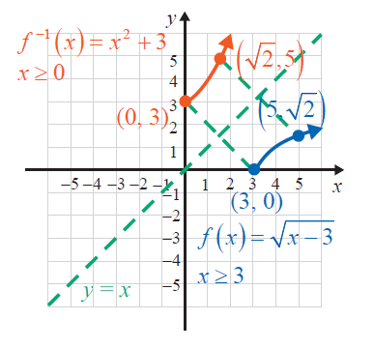
Example 7: Verifying Inverse Functions (cont.)
The graph shows that the line y = x is a line of symmetry for the graphs of the inverse functions. Note that the figure only shows a portion of each graph and the domains have been restricted accordingly.

Slide 26
Example 8: Evaluating Compositions of Inverses
Given for x ≥ −4 and for x ≥ 0, evaluate the indicated compositions.

Slide 27
Example 8: Evaluating Compositions of Inverses (cont.)
Solution
so
so

Slide 28
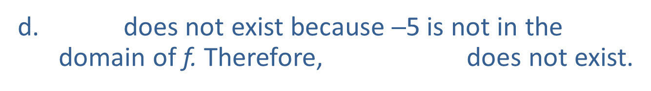
Example 8: Evaluating Compositions of Inverses (cont.)
so
does not exist because ─5 is not in the domain of f. Therefore, does not exist.

Slide 29
Procedure: Finding the Inverse of a One-to-One Function
Let y = f(x). (In effect, substitute y for f(x).)
Interchange x and y.
In the new equation, solve for y in terms of x.
Substitute f ⁻¹ (x) for y. (This new function is the inverse of f.)

Slide 30
Example 9: Finding the Inverse
Find
Solution
Substitute y for f(x).
Interchange x and y.
Solve for y in terms of x.
Substitute f ⁻¹ (x) for y.

Slide 31
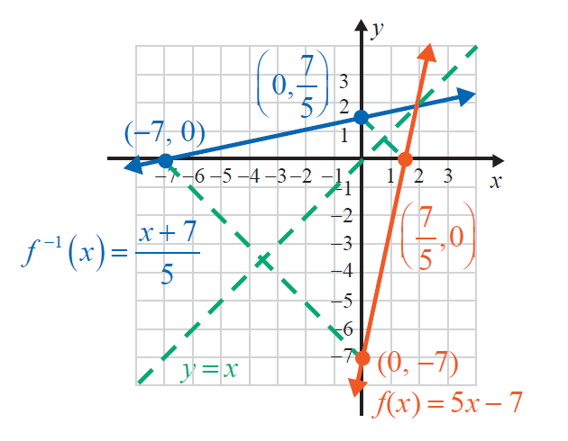
Example 9: Finding the Inverse (cont.)

Slide 32
Example 10: Finding the Inverse
Find g⁻¹ (x) if g(x) = x² − 2 for x ≥ 0.
Solution
For x ≥ 0 (Note that g is one-to-one for x ≥ 0.)
Substitute y for g(x).
Interchange y and x.
Solve for y in terms of x.
Take the positive square root because we must have y ≥ 0. (The domain of g is x ≥ 0, so the range of g ⁻¹ is y ≥ 0.)

Slide 33
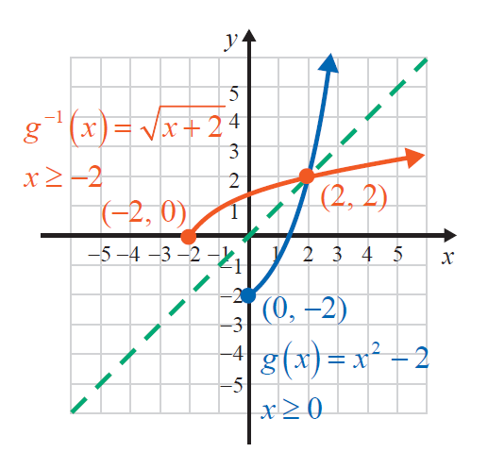
Example 10: Finding the Inverse (cont.)

