Slide 1
Section 11.4
Ellipses and Hyperbolas

Slide 2
Definition: Ellipse
An ellipse is the set of all points in a plane for which the sum of the distances from two fixed points is constant.
Each of the fixed points is called a focus (plural foci).
The center of an ellipse is the point midway between the foci.

Slide 3
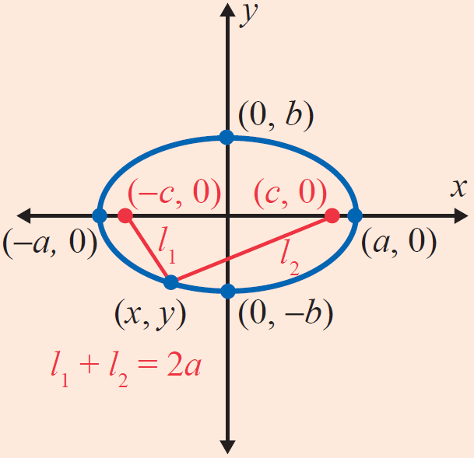
Definition: Ellipse (cont.)
The graph of an ellipse with its center at the origin (0,0), foci at (−c, 0) and (c, 0),
x-intercepts at (−a, 0) and
(a, 0), and y-intercepts at (0, −b)
and (0, b) (where a² > b²) is shown.

Slide 4
Definition: Equation of an Ellipse
The standard form for the equation of an ellipse with its center at the origin is
The points (a, 0) and (−a, 0) are the x-intercepts.
The points (0, b) and (0, −b) are the y-intercepts.

Slide 5
Note
The endpoints of the major axis of an ellipse are called the vertices.
The endpoints of the minor axis of an ellipse are called the co-vertices.

Slide 6
Definition: Equation of an Ellipse (cont.)
When a² > b²:
The segment of length 2a joining the x-intercepts is called the major axis.
The segment of length 2b joining the y-intercepts is called the minor axis.

Slide 7
Definition: Equation of an Ellipse (cont.)
When b² > a²:
The segment of length 2b joining the y-intercepts is called the major axis.
The segment of length 2a joining the x-intercepts is called the minor axis.
Note: In either case, the foci lie on the major axis.

Slide 8
Example 1: Graphing an Ellipse with a Horizontal Major Axis
Graph the ellipse
Solution
First, divide both sides of the given equation by 64 to find the standard form.

Slide 9
Example 1: Graphing an Ellipse with a Horizontal Major Axis (cont.)
The curve is an ellipse. In this case and the major axis has length 2a = 8. Also, and the minor axis has length 2b = 4. The endpoints of the major axis are The endpoints of the minor axis are The major and minor axes intersect at the center of the ellipse, (0, 0).

Slide 10
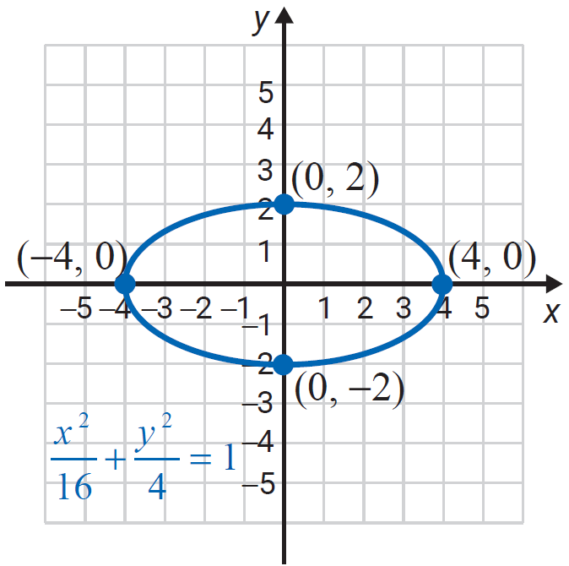
Example 1: Graphing an Ellipse with a Horizontal Major Axis (cont.)

Slide 11
Example 2: Graphing an Ellipse with a Vertical Major Axis
Graph the ellipse
Solution
The equation is in standard form with a² = 1 and b² = 9.
Because b² > a², we know the major axis is vertical. That is, the ellipse is elongated along the y-axis.
The points are the endpoints of the major axis.
The points are the endpoints of the minor axis.

Slide 12
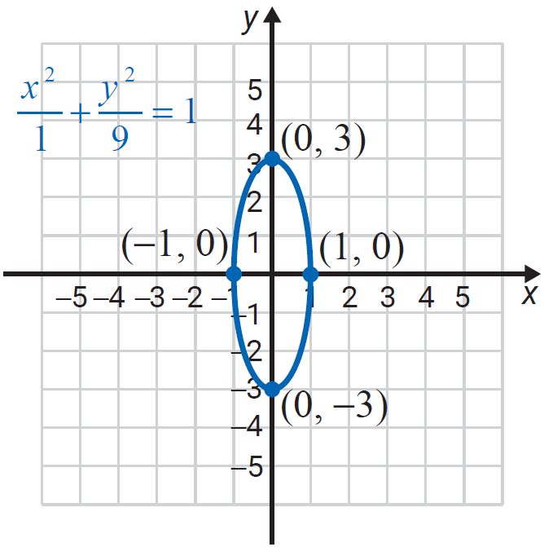
Example 2: Graphing an Ellipse with a Vertical Major Axis (cont.)

Slide 13
Definition: Hyperbola
A hyperbola is the set of all points in a plane such that the absolute value of the difference of the distances from two fixed points is constant.
Each of the fixed points is called a focus (plural foci).
The center of a hyperbola is the point midway between the foci.

Slide 14
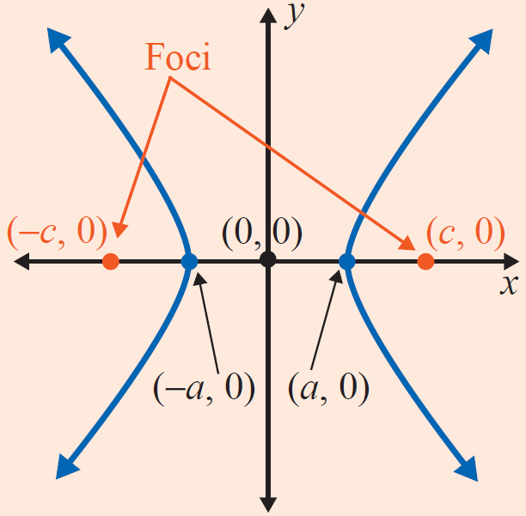
Definition: Hyperbola (cont.)
The graph of a hyperbola with its center at the origin (0,0), foci along the x-axis at
(−c, 0) and (c, 0), and
x-intercepts at (−a, 0) and
(a, 0) is shown. There are
no y-intercepts.

Slide 15
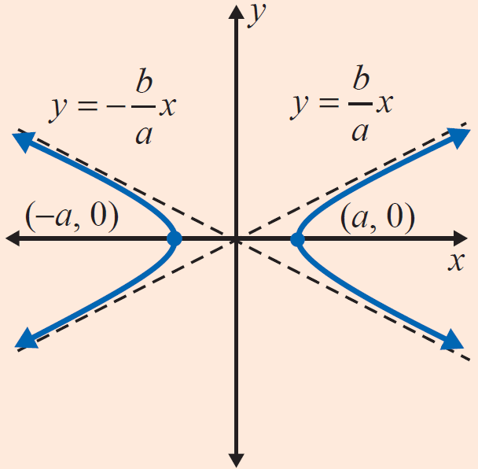
Definition: Equations of Hyperbolas
In general, there are two standard forms for equations of hyperbolas with their centers at the origin.
x-intercepts (vertices) at
(a, 0) and (−a, 0)
No y-intercepts
Asymptotes:
The curves “open” left and right.

Slide 16
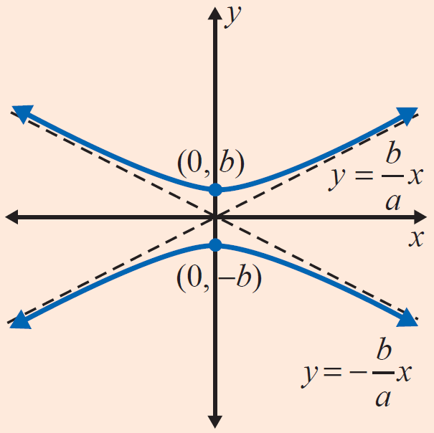
Definition: Equations of Hyperbolas (cont.)
y-intercepts (vertices) at
(0, b) and (0, −b)
No x-intercepts
Asymptotes:
The curves “open” up and down.

Slide 17
Example 3: Graphing a Hyperbola Opening Left and Right
Graph the hyperbola
Solution
Write the equation in standard form by dividing both sides by 16.
Here a² = 16 and b² = 4. So, using a = 4 and b = 2, the
asymptotes are and

Slide 18
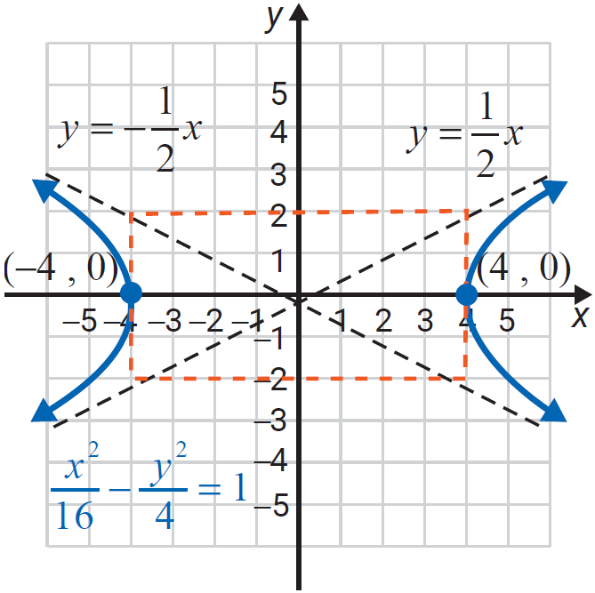
Example 3: Graphing a Hyperbola Opening Left and Right (cont.)
The vertices are (−4, 0) and (4,0) and the curve opens left and right.
(Note that the fundamental
rectangle has sides of lengths
2a = 8 and 2b = 4.)

Slide 19
Example 4: Graphing a Hyperbola Opening Up and Down
Graph the hyperbola
Solution
Here a² = 9 and b² = 1. So a = 3 and b = 1 and the
asymptotes are
The vertices are (0, −1) and (0,1) and the curve opens up and down.
(Note that the fundamental rectangle has sides of lengths 2a = 6 and 2b = 2.)

Slide 20
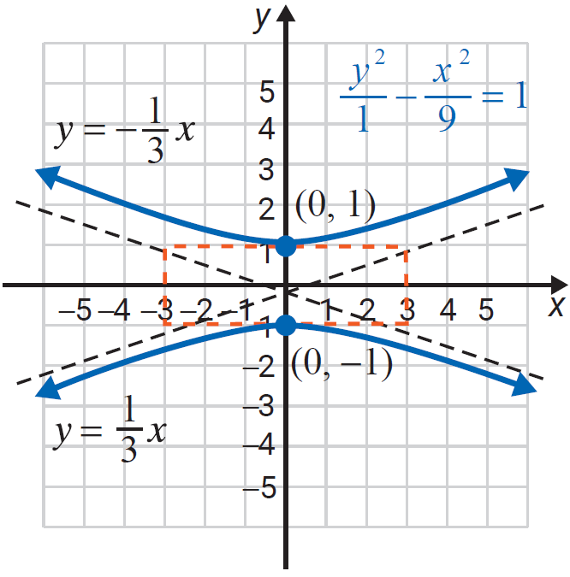
Example 4: Graphing a Hyperbola Opening Up and Down (cont.)

Slide 21
Definition: Ellipse with Center at (h, k)
The equation of an ellipse with its center at (h, k) is
where a and b are distances from (h, k) to the vertices.

Slide 22
Example 5: Graphing an Ellipse with Center at (h, k)
Graph the ellipse
Solution
The graph of is translated 2 units left and 1
unit up so that the center is at (−2,1) with a = 4 and b = 3. The graph is shown here with the center and vertices labeled.

Slide 23
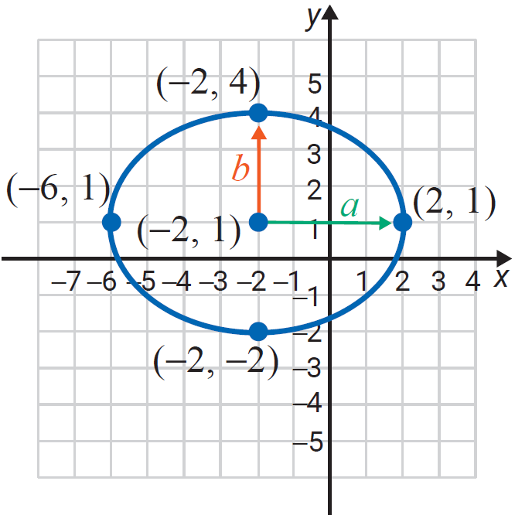
Example 5: Graphing an Ellipse with Center at (h, k) (cont.)

Slide 24
Definition: Hyperbola with Center at (h, k)
The equation of a hyperbola with its center at (h, k) is
where a and b are distances from (h, k) to the vertices.

Slide 25
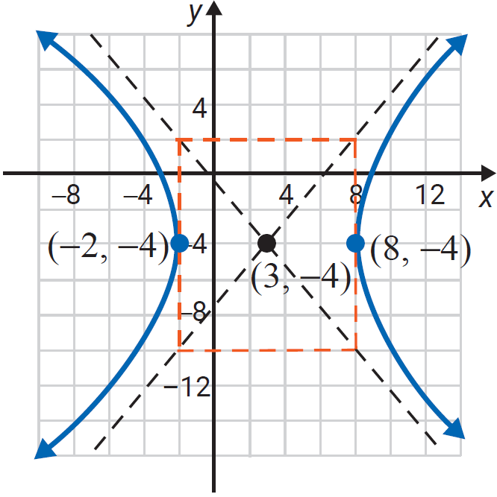
Example 6: Graphing a Hyperbola with Center at (h, k)
Graph the hyperbola
Solution
The graph of is translated 3 units right and
4 units down so that the
center is at (3, −4) with a = 5
and b = 6. The graph is shown
here with its asymptotes. The center and the vertices are labeled.

