Slide 1
Section 12.2
Sigma Notation

Slide 2
Definition: Partial Sums Using Sigma Notation
The n^{th} partial sum S_{n} of the first n terms of a sequence {a_{n}} is written in sigma notation as follows.
In this equation,
k is called the index of summation and takes the integer values 1, 2, 3, ... , n,
n is the upper limit of summation, and
1 is the lower limit of summation.

Slide 3
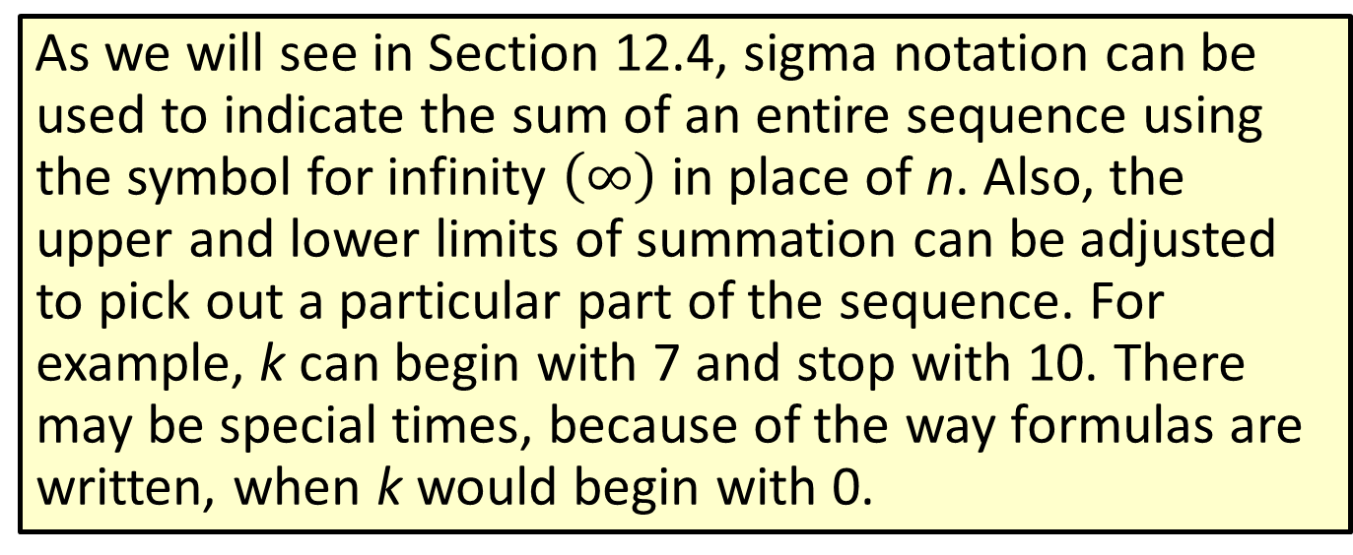
Note
As we will see in Section 12.4, sigma notation can be used to indicate the sum of an entire sequence using the symbol for infinity $\left(∞\right)$ in place of n. Also, the upper and lower limits of summation can be adjusted to pick out a particular part of the sequence. For example, k can begin with 7 and stop with 10. There may be special times, because of the way formulas are written, when k would begin with 0.

Slide 4
Example 1: Evaluating Sums
Write the indicated sums as expanded sums of the terms and find the value of each sum.
a.

Slide 5
Example 1: Evaluating Sums (cont.)

Slide 6
Example 2: Writing Sums in Sigma Notation
Write each sum using sigma notation. There may be more than one correct answer.
a. 4 + 9 + 16 + 25
Solution
Notice that each number is a square beginning with 2². Two possible forms are as follows.

Slide 7
Example 2: Writing Sums in Sigma Notation (cont.)
Notice that each numerator is a multiple of 5 and each denominator is 1 larger than its position. One possible form is as follows.

Slide 8
Properties: Properties of Sigma Notation
For sequences {a_{n}} and {b_{n}} and any real number c, the following are true.

Slide 9
Example 3: Using the Properties of Sigma Notation

Slide 10
Example 3: Using the Properties of Sigma Notation (cont.)

