Slide 1
Section 2.5
Applications: Number Problems
and Consecutive Integers

Slide 2
Example 1: Solving Number Problems
If a number is decreased by 36 and the result is 76 less than twice the number, what is the number?
Solution Let n = the unknown number.
The number is 40.

Slide 3
Example 2: Solving Number Problems
Three times the sum of a number and 5 is equal to twice the number plus 5. Find the number.
Solution Let x = the unknown number.
The number is −10.

Slide 4
Example 3: Solving Number Problems
One integer is 4 more than three times a second integer. Their sum is 24. What are the two integers?
Solution
Let n = the second integer,
then 3n + 4 = the first integer.

Slide 5
Example 3: Solving Number Problems (cont.)
The two integers are 5 and 19.

Slide 6
Note
In this section, we will be dealing only with integers. Therefore, if you get a result that has a fraction or decimal number (not an integer), you will know that an error has been made and you should correct some part of your work.

Slide 7
Definition: Consecutive Integers
Integers are consecutive if each is 1 more than the previous integer. Three consecutive integers can be represented as
n, n + 1, and n + 2,
where n is an integer.

Slide 8
Definition: Consecutive Even Integers
Even integers are consecutive if each is 2 more than the previous even integer. Three consecutive even integers can be represented as
n, n + 2, and n + 4,
where n is an even integer.

Slide 9
Definition: Consecutive Odd Integers
Odd integers are consecutive if each is 2 more than the previous odd integer. Three consecutive odd integers can be represented as
n, n + 2, and n + 4,
where n is an odd integer.

Slide 10
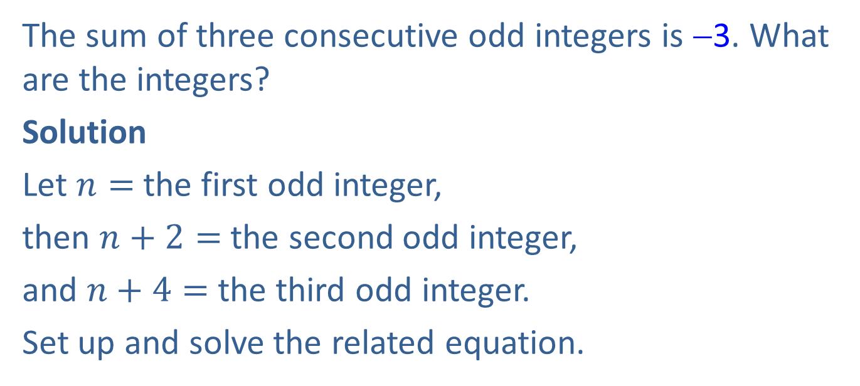
Example 4: Finding Consecutive Integers
The sum of three consecutive odd integers is −3. What are the integers?
Solution
Let $n=$the first odd integer,
then $n+2=$the second odd integer,
and $n+4=$ the third odd integer.
Set up and solve the related equation.

Slide 11
Example 4: Finding Consecutive Integers (cont.)
The three consecutive odd integers are −3, −1, and 1.

Slide 12
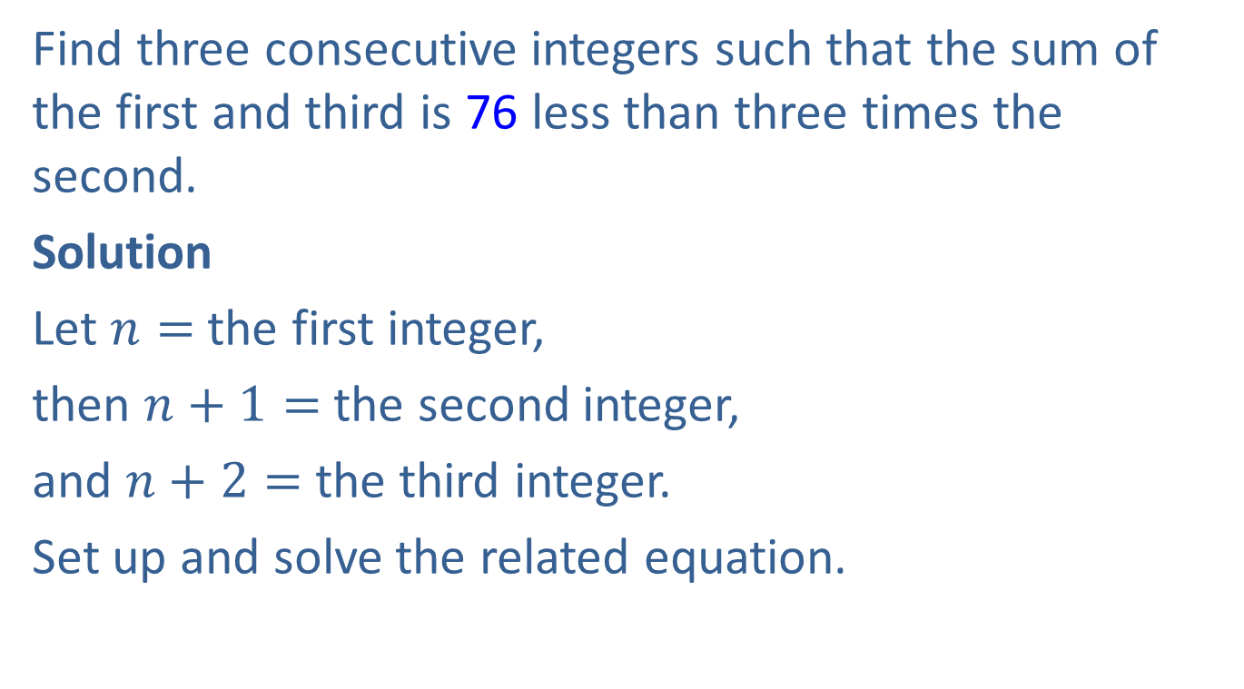
Example 5: Finding Consecutive Integers
Find three consecutive integers such that the sum of the first and third is 76 less than three times the second.
Solution
Let $n=$ the first integer,
then $n+1=$the second integer,
and $n+2=$the third integer.
Set up and solve the related equation.

Slide 13
Example 5: Finding Consecutive Integers (cont.)
The three consecutive integers are 75, 76, and 77.

Slide 14
Example 5: Finding Consecutive Integers (cont.)
Check

Slide 15
Example 6: Application: Calculating Living Expenses
Joe wants to budget of his monthly income for rent.
He found an apartment he likes for $800 a month. What monthly income does he need to be able to afford this apartment?
Solution
Let x = Joe’s monthly income, then

Slide 16
Example 6: Application: Calculating Living Expenses (cont.)
Joe’s monthly income should be $2000.

Slide 17

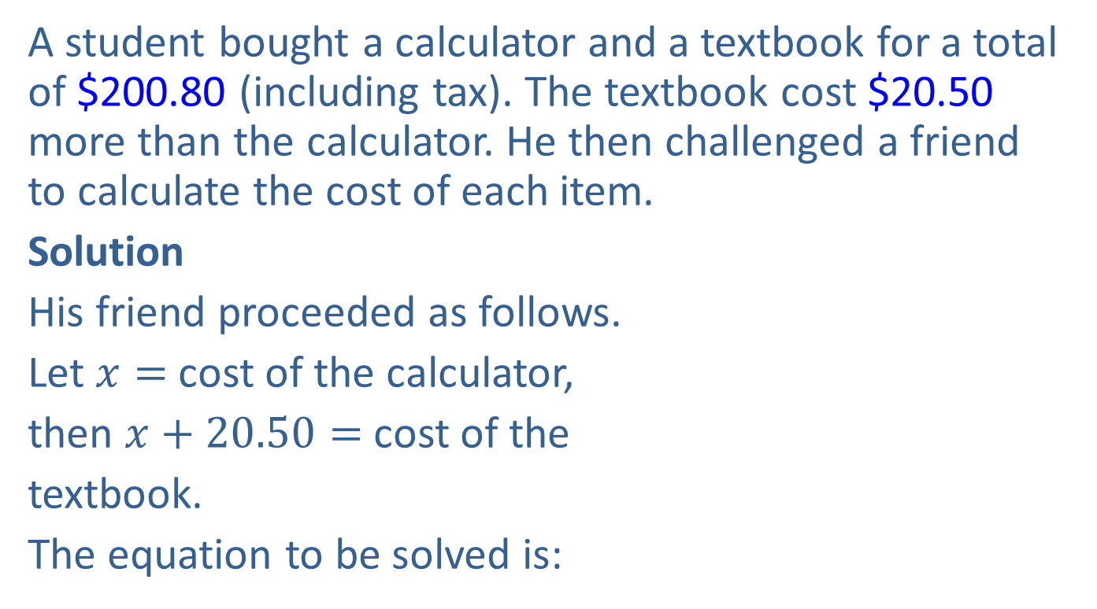
Example 7: Application: Calculating Costs of Purchases
A student bought a calculator and a textbook for a total of $200.80 (including tax). The textbook cost $20.50 more than the calculator. He then challenged a friend to calculate the cost of each item.
Solution
His friend proceeded as follows.
Let $x=$ cost of the calculator,
then $x+20.50=$cost of the
textbook.
The equation to be solved is:

Slide 18
Example 7: Application: Calculating Costs of Purchases (cont.)

Slide 19
Example 7: Application: Calculating Costs of Purchases (cont.)
The calculator costs $90.15 and the textbook costs $90.15 + $20.50 = $110.65, with tax included in each price.

