Slide 1
Section 4.8
Determinants

Slide 2
Definition: Determinant
A determinant is a real number associated with a square array of real numbers and is indicated by enclosing the array between two vertical bars. For a matrix A, the corresponding determinant is designated as det⁡(A) and is read “determinant of A.”

Slide 3
Definition: Determinant of a 2 × 2 Matrix

Slide 4
Example 1: Evaluating the Determinant of 2 × 2 Matrices
Evaluate the determinant for each square matrix.

Slide 5
Example 1: Evaluating the Determinant of 2 × 2 Matrices (cont.)
Solution

Slide 6
Example 2: Finding Minors of a Determinant
Given the following determinant, find the minor of each chosen entry.
a. a₁₃ b. a₂₂ c. a₃₁

Slide 7
Example 2: Finding Minors of a Determinant (cont.)
Solution
To find the minor of a₁₃, we need to mentally cross out the first row and the third column. The remaining entries in the determinant form the minor of a₁₃.

Slide 8
Example 2: Finding Minors of a Determinant (cont.)
To find the minor of a₂₂, we need to mentally cross out the second row and the second column.

Slide 9
Example 2: Finding Minors of a Determinant (cont.)
To find the minor of a₃₁, we need to mentally cross out the third row and the first column.

Slide 10
Definition: Determinant of a 3 × 3 Matrix

Slide 11
Note
The negative sign in the middle term of the expansion (representing ─1 times a₁₂) is a critical part of the method and is a source of error for many students. Be careful.

Slide 12
Example 3: Evaluating the Determinant of 3 × 3 Matrices
Evaluate the determinant for each square matrix.
a. b.
Solution
Using Row 1, determine the minors and then simplify.

Slide 13
Example 3: Evaluating the Determinant of 3 × 3 Matrices (cont.)

Slide 14
Example 3: Evaluating the Determinant of 3 × 3 Matrices (cont.)
Using Row 1, determine the minors and then simplify.

Slide 15
Example 3: Evaluating the Determinant of 3 × 3 Matrices (cont.)

Slide 16
Example 4: Solving Equations with Determinants
Solve:
Solution
First, expand the minors and simplify.

Slide 17
Example 4: Solving Equations with Determinants (cont.)
Now, set this expression equal to 53 and solve the resulting equation.

Slide 18
Example 5: Evaluating Determinants with a Graphing Calculator
Use a graphing calculator to find the value of det⁡(A) for the following matrix.

Slide 19


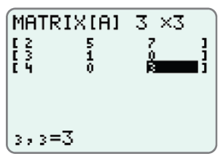
Example 5: Evaluating Determinants with a Graphing Calculator (cont.)
Solution
Step 1: Press MATRIX, then go to the EDIT menu. Press to open matrix [A]. Enter the appropriate dimensions (in this case, 3 × 3) and coefficients in matrix A. The display should appear as follows.

Slide 20

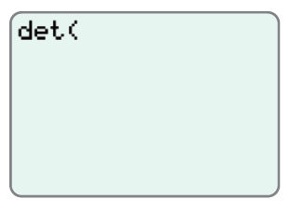
Example 5: Evaluating Determinants with a Graphing Calculator (cont.)
Step 2: Press QUIT to exit the matrix edit menu. Next, press MATRIX and go to the menu. On the menu, choose det ( and press .

Slide 21

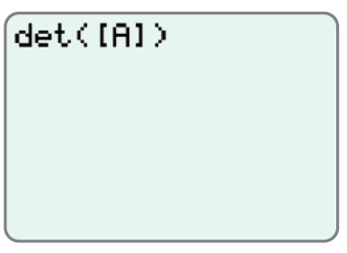
Example 5: Evaluating Determinants with a Graphing Calculator (cont.)
Step 3: Press MATRIX again and on the NAMES menu, choose [A] 3 × 3. Press and press .

Slide 22
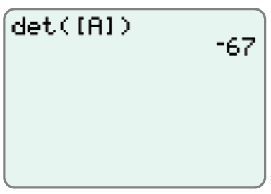
Example 5: Evaluating Determinants with a Graphing Calculator (cont.)
Step 4: Press and the display will appear with the solution, det⁡(A) = ─67.

