Slide 1
Section 4.9
Determinants and Systems of Linear Equations: Cramer’s Rule

Slide 2
Formula: Cramer’s Rule for a 2 × 2 System

Slide 3
Formula: Cramer’s Rule for a 3 × 3 System

Slide 4

Formula: Cramer’s Rule for a 3$×$3 System (cont.)

Slide 5
Caution!
If D = 0, Cramer’s Rule cannot be used. In a case where D = 0 (either for a 2 × 2 or a 3 × 3 matrix), use the algebraic method of elimination or substitution. You will find that the system is either dependent (infinite solutions) or inconsistent (no solution).

Slide 6
Example 1: Using Cramer’s Rule
Use Cramer’s Rule to solve the system,
if possible:
Solution
First, determine the value of D, since Cramer’s Rule cannot be used if D = 0.

Slide 7
Example 1: Using Cramer’s Rule (cont.)
Since D ≠ 0, the system has a unique solution. Next, find D_{x} and D_{y}.
and
Applying Cramer’s rule, we can solve for x and y.
and

Slide 8
Example 1: Using Cramer’s Rule (cont.)
Therefore, the solution to the system is .

Slide 9
Example 2: Using Cramer’s Rule
Use Cramer’s Rule to solve the system, if possible:
Solution
First, determine the value of D, since Cramer’s Rule cannot be used if D = 0.

Slide 10
Example 2: Using Cramer’s Rule (cont.)
Since D ≠ 0, the system has a unique solution. Next, find D_{x} and D_{y}.
and
Applying Cramer’s rule, we can solve for x and y.
Therefore, the solution to the system is .

Slide 11
Example 3: Using Cramer’s Rule
Use Cramer’s Rule to solve the system, if possible:

Slide 12
Example 3: Using Cramer’s Rule (cont.)
Solution
First, determine the value of D, since Cramer’s Rule cannot be used if D = 0.
Because D = 0, Cramer’s Rule cannot be used to solve the system. (You might try to solve the system by using the elimination method to see what happens in this case.)

Slide 13
Example 4: Using Cramer’s Rule
Use Cramer’s Rule to solve the system, if possible:
Solution
First, determine the value of D, since Cramer’s Rule cannot be used if D = 0.

Slide 14
Example 4: Using Cramer’s Rule (cont.)
Since D ≠ 0, the system has a unique solution. Next, find D_{x}, D_{y}, and D_{z}.

Slide 15
Example 4: Using Cramer’s Rule (cont.)

Slide 16
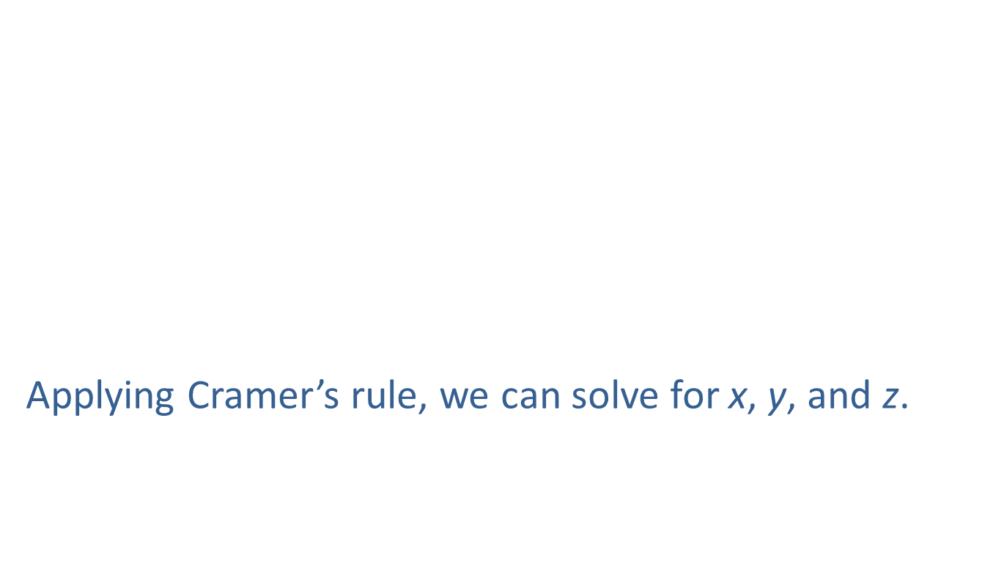
Example 4: Using Cramer’s Rule (cont.)
Applying Cramer’s rule, we can solve for x, y, and z.

Slide 17
Example 4: Using Cramer’s Rule (cont.)
Therefore, the solution to the system is .

