Slide 1
Section 5.2
Power Rules for Exponents

Slide 2
Properties: Summary of the Rules for Exponents
The following rules are true for any nonzero real number a and integers m and n.
The exponent 1: a = a¹
The exponent 0: a⁰ = 1
The product rule: a^{m} · a^{n} = a^{m + n}
The quotient rule:
Negative exponents:

Slide 3
Properties: Power Rule for Exponents
If a is a nonzero real number and m and n are integers, then
In other words, the value of a power raised to a power can be found by multiplying the exponents and keeping the base.

Slide 4
Example 1: Using the Power Rule for Exponents
Simplify each expression by using the power rule for exponents.
Solution
b.
c.
d.

Slide 5
Example 1: Using the Power Rule for Exponents (cont.)
Another approach, because we have a numerical base, would be
We see that while the base and exponent may be different, the value is the same.

Slide 6
Properties: Rule for Power of a Product
If a and b are nonzero real numbers and n is an integer, then
In words, a power of a product is found by raising each factor to that power.

Slide 7
Example 2: Using the Rule for Power of a Product
Simplify each expression by using the rule for power of a product.
Solution
b.
c.
d.
e.
(5x)²
= 5² · x²
= 25x²
(xy)³
= x³ · y³
= x³y³
(−7ab)²
= (−7)² a²b²
= 49a²b²

Slide 8
Example 2: Using the Rule for Power of a Product (cont.)
or, using the rule of
negative exponents first and then the rule for the
power of a product,

Slide 9
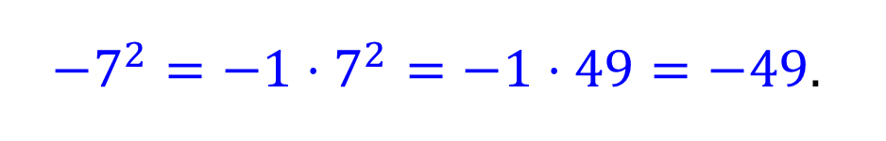

Caution: Negative Numbers and Exponents
In an expression such as $−x^{2}$, we know that $−1$is understood to be the coefficient of $x^{2}$. That is, $−x^{2}=−1⋅x^{2}$.
The same is true for expressions with numbers such as $−7^{2}$. That is,
$$−7^{2}=−1⋅7^{2}=−1⋅49=−49.$$

Slide 10
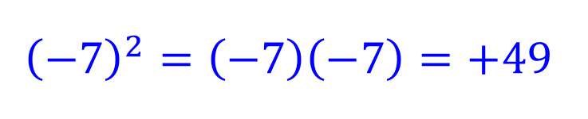
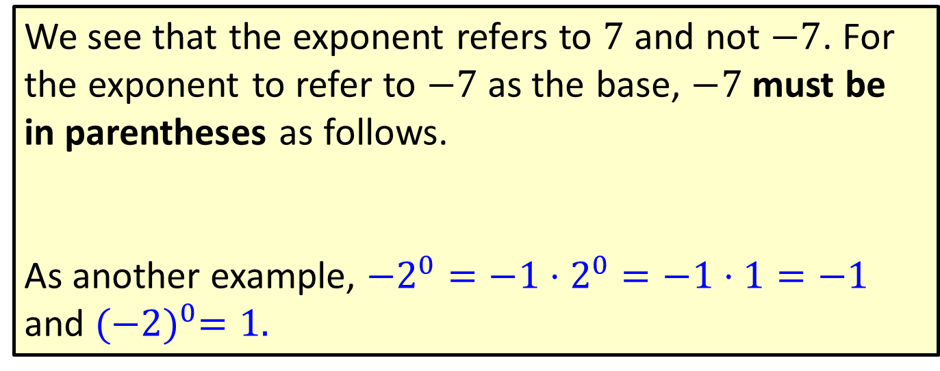
Caution: Negative Numbers and Exponents (cont.)
We see that the exponent refers to $7$ and not $−7$. For the exponent to refer to $−7$as the base, $−7$must be in parentheses as follows.
As another example, $−2^{0}=−1⋅2^{0}=−1⋅1=−1$ and ${(−2)}^{0}=1.$
$${\left(−7\right)}^{2}=\left(−7\right)\left(−7\right)=+49$$

Slide 11
Properties: Rule for Power of a Quotient
If a and b are nonzero real numbers and n is an integer, then
In words, a power of a quotient (in fraction form) is found by raising both the numerator and the denominator to that power.

Slide 12
Example 3: Using the Rule for Power of a Quotient
Simplify each expression by using the rule for the power of a quotient.
Solution
b.
c.
d.

Slide 13
Example 3: Using the Rule for Power of a Quotient (cont.)

Slide 14
Example 4: Using Combinations of Rules for Exponents
Simplify each expression by using the appropriate rules for exponents.
Solution
b.

Slide 15
Example 4: Using Combinations of Rules for Exponents (cont.)
Method 1: Simplify inside the parentheses first.
Method 2: Apply the power of a quotient rule first.

Slide 16
Example 4: Using Combinations of Rules for Exponents (cont.)
Note that the answer is the same even though the rules were applied in a different order.

Slide 17
Example 5: Using Two Approaches with Fractional Expressions and Negative Exponents
Simplify:
Solution
Method 1: Use the ideas of reciprocals first.
Method 2: Apply the power of a quotient rule first.

Slide 18
Example 6: Simplifying A More Complex Problem
This example involves the application of a variety of steps. Study it carefully and see if you can get the same result by following a different sequence of steps.
Simplify:
Solution
Method 1: Simplify inside the parentheses first.

Slide 19
Example 6: Simplifying A More Complex Problem (cont.)

Slide 20
Example 6: Simplifying A More Complex Problem (cont.)
Method 2: Apply the power of a quotient rule first.

Slide 21
Example 6: Simplifying A More Complex Problem (cont.)

Slide 22
Properties: Summary of the Rules for Exponents
The following rules are true for any nonzero real numbers a and b and integers m and n.
The exponent 1: a = a¹
The exponent 0: a⁰ = 1
The product rule: a^{m} · a^{n}= a^{m + n}
The quotient rule:

Slide 23
Properties: Summary of the Rules for Exponents (cont.)
Negative exponents:
Power rule:
Power of a product: (ab)^{n} = a^{n}b^{n}.
Power of a quotient:

