Slide 1
Section 7.6
Solving Rational Equations

Slide 2
Definition: Proportion
A proportion is an equation stating that two ratios are equal.
In symbols, is a proportion.

Slide 3
Example 1: Solving Proportions
Solve the following proportions.
b.
Solution
a. LCD = 6x

Slide 4
Example 1: Solving Proportions (cont.)
Check

Slide 5
Example 1: Solving Proportions (cont.)

Slide 6
Example 1: Solving Proportions (cont.)
Check

Slide 7
Example 2 Application: Solving Proportions
On an architect’s scale drawing of a home, inch
represents 10 feet. What length does a measure of inches represent?
Solution
Set up a proportion representing the information. In this example the numerators are the same type (inches) and the denominators are the same type (feet).

Slide 8
Example 2: Application: Solving Proportions (cont.)
On this drawing, inches represent 50 feet.

Slide 9
Note
Any of the following four equations could have been used to solve the problem in Example 2.
Agree in Type:

Slide 10
Note (cont.)
Correspond:

Slide 11
Procedure: Solving an Equation Containing Rational Expressions
Find the LCD of the fractions.
List any restrictions on the variables.
Multiply both sides of the equation by this LCD and simplify.
Solve the resulting equation. (This equation will have only polynomials on both sides.)
Check each solution in the original equation. (Remember that no denominator can be 0. If one of the potential solutions matches a restriction on the variables, then that potential solution must be rejected.)

Slide 12
Example 3: Solving Rational Equations
State any restrictions on the variable, then solve the equation.
Solution
First, find the LCD of the fractions, and then multiply both sides of the equation by the LCD.

Slide 13
Example 3: Solving Rational Equations (cont.)

Slide 14
Example 4: Solving Rational Equations
State any restrictions on the variable, then solve the equation.
Solution
First, find the LCD of the fractions and then multiply each term on both sides of the equation by the LCD.

Slide 15
Example 4: Solving Rational Equations (cont.)

Slide 16
Example 4: Solving Rational Equations (cont.)
The only solution is since 2 is a restricted value
(x ≠ 0, 2) and thus not a solution. No denominator can be 0.

Slide 17
Example 5: Solving Rational Equations
State any restrictions on the variable, then solve the equation.
Solution
First, find the LCD of the fractions and then multiply each term on both sides of the equation by the LCD.

Slide 18
Example 5: Solving Rational Equations (cont.)

Slide 19
Example 5: Solving Rational Equations (cont.)
There is no solution. The solution set is the empty set, ∅. The original equation is a contradiction.

Slide 20
Completion Example 6: Solving Rational Equations
State any restrictions on the variable, then solve the equation.
Solution
−5
1

Slide 21
Completion Example 6: Solving Rational Equations (cont.)
x − 1
x − 1
x − 1
3x + 1
x − 1
3x
1
x² + x −2
2x − 1
x − 2
−1

Slide 22
Example 7: Solving a Formula for a Specified Variable
The formula is used to find the surface area (S) of a right circular cylinder, where r is the radius of the cylinder and h is the height of the cylinder. Solve the formula for h.
Solution
Thus, the formula solved for h is

Slide 23
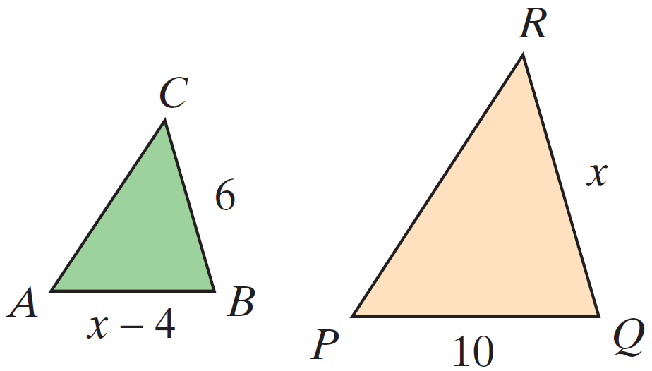
Example 8: Similar Triangles
In the figure shown, ΔABC ∼ ΔPQR. Find the lengths of AB and QR.

Slide 24
Example 8: Similar Triangles (cont.)
Solution
Set up a proportion involving corresponding sides and solve for x.

Slide 25
Example 8: Similar Triangles (cont.)
Because the length of a side cannot be negative, the only acceptable solution is x = 10. Thus, QR = 10. Substituting 10 for x gives AB = 10 − 4 = 6.

