Slide 1
Section 1.2
Introduction to Real Numbers

Slide 2
Objectives
Identify given numbers as members of one or more of the following sets: natural numbers, whole numbers, integers, rational numbers, irrational numbers, and real numbers.
Write rational numbers as infinite repeating decimals.
Graph sets of numbers on real number lines.
Describe sets of numbers using set-builder notation given their graphs.

Slide 3
Objectives (cont.)
Name the properties of real numbers that justify given statements.
Complete statements using the real number properties.

Slide 4
Types of Numbers
Variable
A variable is a symbol (generally a letter of the alphabet) that is used to represent an unknown number or any one of several numbers.

Slide 5
Types of Numbers
Rational Number
A rational number is any number that can be written in the form where a and b are integers and b ≠ 0. (The letter ℚ represents the set of all rational numbers.)

Slide 6
Example 1: Rational Numbers
a. are all rational
numbers. Each is in the form where a and b are
integers and b ≠ 0.
b. and 2.33 are also rational numbers. They are
not in the form but they can be written in that form:

Slide 7
Example 1: Rational Numbers (cont.)
c. are in the form but the numerator
in each case is not an integer and cannot be written as an integer. Thus, the fractions are not rational numbers. Instead, as we will see, they are called irrational numbers.

Slide 8
Types of Numbers
Irrational Number
An irrational number is any number that can be written as an infinite, nonrepeating decimal.

Slide 9
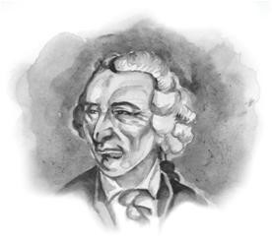
Example 2: Irrational Numbers
The following are irrational numbers. Note that there is no repeating pattern in their decimal representation. The three dots indicate that the digits continue indefinitely.
The notation for π and e is attributed to Swiss mathematician Leonhard Euler (1707 – 1783).

Slide 10
Example 2: Irrational Numbers (cont.)

Slide 11
Types of Numbers
Notes
The number π is particularly fascinating to mathematicians and has recently been represented to 1.24 trillion decimal places. A discussion of π and a representation to 3742 decimal places is in Appendix 3 at the back of this text.

Slide 12
Types of Numbers
Rational Number
1. Every natural number is also a whole number, an integer, a rational number, and a real number.
2. Every whole number is also an integer, a rational number, and a real number.
3. Every integer is also a rational number and a real number.
4. Every rational number is also a real number.
5. Every irrational number is also a real number.

Slide 13
Example 3: Classifying Numbers
Given the set tell what classification
each number fits.
Solution:

Slide 14
Example 4: Identifying Types of Numbers
Given the set of real numbers
a. Tell which numbers are integers.
Solution: −2 and 0 are integers.
b. Tell which numbers are rational numbers.
Solution: −2, −1.1, 0, and 1.7 are rational numbers.

Slide 15
Example 4: Identifying Types of Numbers (cont.)
c. Tell which numbers are irrational numbers.
Solution: are irrational numbers. As you can find with a calculator, is approximately −1.732 and is approximately 1.304.

Slide 16
Practice Problems
Given the set of real numbers
1. List the numbers in A that are integers.
2. List the numbers in A that are rational numbers.
3. List the numbers in A that are irrational numbers.

Slide 17
Practice Problem Answers

Slide 18
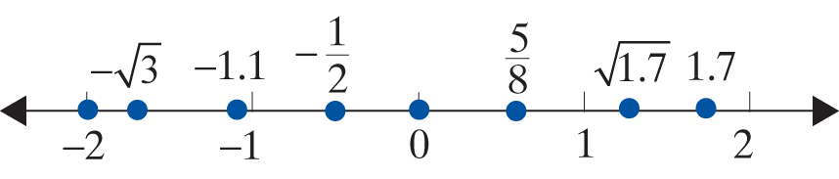
Example 5: Graphing Real Numbers on a Real Number Line
Given the set of real numbers
graph the numbers on a number line.
Solution:

Slide 19
Sets and Set-Builder Notation
Inequality Symbols
< “less than” ≤ “less than or equal to”
> “greater than” ≥ “greater than or equal to”

Slide 20
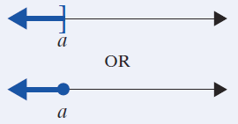
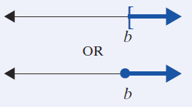
Using Set Notation and Graphs to Indicate Sets of Real Numbers
Set Notation | Meaning | Graph
 | “the set of all x such that x is less than or equal to a”
 | “the set of all x such that x is greater than or equal to b”

Slide 21
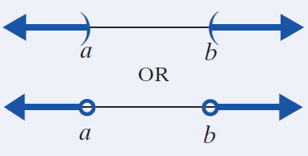
Using Set Notation and Graphs to Indicate Sets of Real Numbers
Set Notation | Meaning | Graph
(This is also known as the union of two sets of numbers.) | “the set of all x such that x is less than a or x is greater than b”

Slide 22
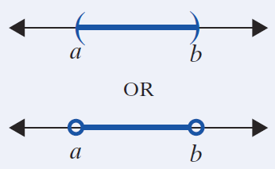
Using Set Notation and Graphs to Indicate Sets of Real Numbers
Set Notation | Meaning | Graph
(This is also known as the intersection of two sets of numbers.) | “the set of all x such that x is greater than a and x is less than b”

Slide 23
Sets and Set-Builder Notation
Notes
Comment on Graphing Techniques
Note that we have shown two types of symbols for indicating whether a number is or is not included in a graph. Parentheses such as ) and ( are used to indicate that a number is not included in a graph. Brackets such as ] and [ are used to indicate that a number is included in a graph.

Slide 24
Sets and Set-Builder Notation
Notes (cont.)
Similarly, open circles can be used in place of parentheses to indicate a point is not included, and closed circles can be used in place of brackets to indicate a point is included. In this text we will use the parentheses and brackets as illustrated in Example 6.

Slide 25
Sets and Set-Builder Notation
Notes
Comment about Union and Intersection
The concepts of union and intersection are part of set theory which is very useful in a variety of courses including abstract algebra, probability, and statistics. These concepts are also used in analyzing inequalities and analyzing relationships among sets in general. The union (symbolized ∪, as in A ∪ B) of two (or more) sets is the set of all elements that belong to either one set or the other set or to both sets.

Slide 26
Sets and Set-Builder Notation
Notes (cont.)
The intersection (symbolized ∩, as in A ∩ B) of two (or more) sets is the set of all elements that belong to both sets. The word or is used to indicate union and the word and is used to indicate intersection. For example, if A = {1, 2, 3} and B = {2, 3, 4}, then the numbers that belong to A or B is the set A ∪ B = {1, 2, 3, 4}. The set of numbers that belong to A and B is the set
A ∩ B = {2, 3}.

Slide 27
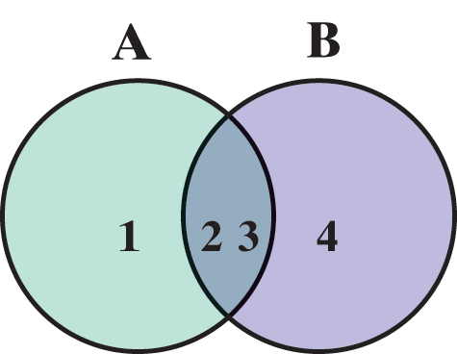
Sets and Set-Builder Notation
Notes (cont.)
These relationships can be illustrated using the following Venn diagram.
Similarly, union and intersection notation can be used for sets with inequalities.

Slide 28
Sets and Set-Builder Notation
Notes (cont.)
For example, can be written in the form
Also, and can be written in the form

Slide 29
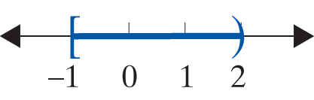
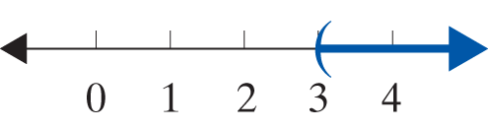
Example 6: Graphs Indicated by Inequalities
a. Graph the set of real numbers
Solution:
b. Graph the set
Solution:

Slide 30
Example 6: Graphs Indicated by Inequalities (cont.)
In Example 6c note carefully the use of the word and to indicate an intersection ∩, and in Example 6d the use of or to indicate a union ∪.
c. Graph the set The word and implies those values of x that satisfy both inequalities. The solution graph shows the intersection ∩ of the first two graphs.

Slide 31
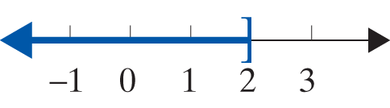
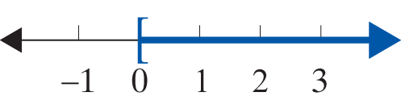
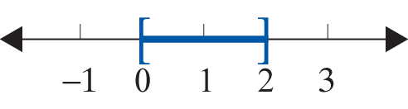
Example 6: Graphing Real Numbers on a Real Number Line (cont.)
Solution:
This set can also be indicated as

Slide 32
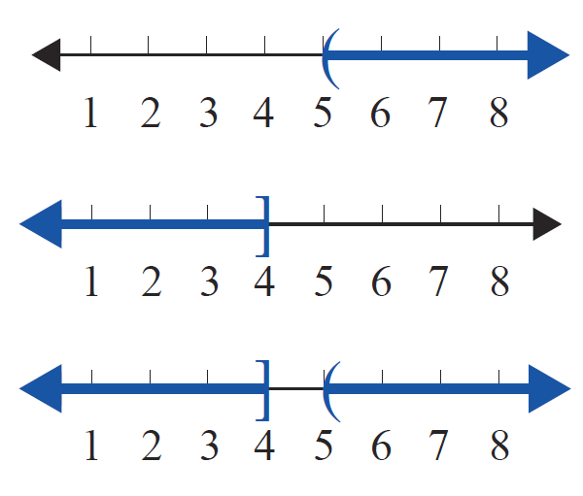
Example 6: Graphing Real Numbers on a Real Number Line (cont.)
d. Graph the set The word or implies those values of x that satisfy at least one of the inequalities. The solution graph shows the union ∪ of the first two graphs.

Slide 33
Properties of Addition and Multiplication with Real Numbers
Properties of Addition and Multiplication
For real numbers a, b, and c:
For Addition Name of Property For Multiplication

Slide 34
Properties of Addition and Multiplication with Real Numbers
Properties of Addition and Multiplication (cont.)

Slide 35
Properties of Addition and Multiplication with Real Numbers
Properties of Addition and Multiplication (cont.)
Zero Factor Law
Distributive Property of Multiplication over Addition

Slide 36
Properties of Addition and Multiplication with Real Numbers
Notes
The number 0 is called the additive identity because when 0 is added to a number the result is the same number. Likewise, the number 1 is called the multiplicative identity because when 1 is multiplied by a number the result is the same number. Also, the additive inverse of a number a is its opposite, −a. The multiplicative inverse of a nonzero number a is its
reciprocal,

Slide 37
Example 7: Identify the Property
Tell which property justifies each statement.

Slide 38
Example 7: Identify the Property (cont.)

Slide 39
Properties of Addition and Multiplication with Real Numbers
Properties of Inequality (Order)
For real numbers a, b, and c:
Trichotomy Property: Exactly one of the following is true: a < b, a = b, or a > b.
Transitive Property: If a < b and b < c, then a < c.
Note: The transitive property applies to >, ≥, and ≤ as well.

Slide 40
Example 8: Identify the Property
State which property of inequality or order is illustrated.
a. If x < 3 and 3 < y, then x < y.
b. If a is a real number, then either
a = 5 or a > 5 or a < 5.
c. If x and y are real numbers, then either
x = y or x > y or x < y.
d. If t > x and x > −7, then t > −7.

Slide 41
Practice Problems
1. List the integers.
2. What type of number is π?
3. Graph the set
4. a + 3 = 3 + a illustrates which property of addition?
5. 2(x + y) = 2x + 2y illustrates which property?

Slide 42
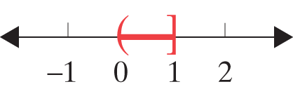
Practice Problem Answers

