Slide 1
Section 1.5
Evaluating and Solving Formulas

Slide 2
Objectives
Solve applied problems by using known formulas.
Solve formulas for specified variables in terms of the other variables.

Slide 3
Using Formulas
Formula | Meaning
 | The simple interest (I), earned by investing money, is equal to the product of the principal (P) times the rate of interest (r) times the time (t) in years.
 | Temperature in degrees Celsius (C) equals times the difference between the Fahrenheit temperature (F) and 32.

Slide 4
Using Formulas
Formula | Meaning
 | Intelligence Quotient (IQ) is calculated by multiplying 100 times mental age (M), as measured by some test, and dividing by chronological age (C).
 | The sum of the measures of the angles (α, β, γ) of a triangle is 180°. (Note: α, β, and γ are the Greek letters alpha, beta, and gamma, respectively.)

Slide 5
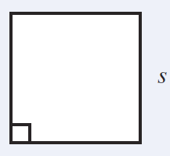
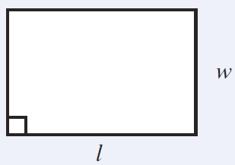
Using Formulas
Formula | Figure Name | Figure
 | SQUARE s = side
 | RECTANGLE l = length w = width

Slide 6
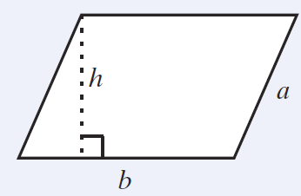
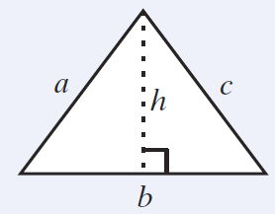
Using Formulas (cont.)
Formula | Figure Name | Figure
 | PARALLELOGRAM b = base a = side h = height
 | TRIANGLE b = base a, c = sides h = height

Slide 7
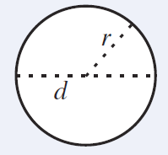
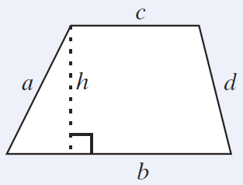
Using Formulas (cont.)
Formula | Figure Name | Figure
 | CIRCLE r = radius d = diameter C = circumference or perimeter of a circle
 | TRAPEZOID b, c = parallel sides a, d = other sides h = height

Slide 8
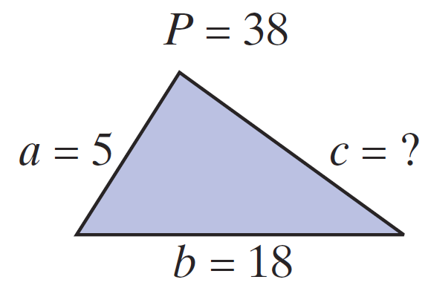
Example 1: Triangle
The perimeter of a triangle is 38 feet. One side is 5 feet long and a second side is 18 feet long. How long is the third side?
Solution 1:
Using the formula P = a + b + c, substitute P = 38, a = 5, and b = 18. Then solve for the third side.
The third side is 15 feet long.

Slide 9
Example 1: Triangle (cont.)
Solution 2: First, solve for c in terms of P, a, and b. Then substitute for P, a, and b.
Treat a and b as constants.
Add −a − b to both sides.

Slide 10
Example 2: Solving Formulas
Solution:

Slide 11
Example 2: Solving Formulas (cont.)
Thus the formula for Celsius and Fahrenheit solved for C is
and the same formula solved for F is
These are two forms of the same formula.

Slide 12
Example 2: Solving Formulas (cont.)
b. Solve for l given P = 2l + 2w.
Solution:

Slide 13
Example 2: Solving Formulas (cont.)
c. Solve the formula y = mx + b for x.
Solution:

Slide 14
Example 2: Solving Formulas (cont.)
d. Solve for R given the formula
Solution:

Slide 15
Example 2: Solving Formulas (cont.)
This problem illustrates the importance of writing the correct form of a variable in a formula. Note that the uppercase R and the lowercase r represent completely different quantities.

Slide 16
Practice Problems
In each formula, solve for the indicated variable.
1. P = a + 2b; solve for b.
2. y = mx + b; solve for m.
3. α + β + γ = 180; solve for α.
4. solve for r.
5. The perimeter of a square is 12.8 cm. Find the length of the sides.

Slide 17
Practice Problem Answers

