Slide 1
Section 1.6
Applications

Slide 2
Objectives
Solve the following by using first degree equations:
Number problems,
Distance-rate-time problems,
Cost-profit problems,
Simple interest problems, and
Average problems.

Slide 3
Solving Word Problems
Strategy for Solving Word Problems
1. Understand the problem.
a. Read the problem carefully. (Read it several times if necessary.)
b. If it helps, restate the problem in your own words.
2. Devise a plan.
a. Decide what is asked for. Assign a variable to the unknown quantity. Label this variable so you know exactly what it represents.

Slide 4
Solving Word Problems
Strategy for Solving Word Problems (cont.)
b. Draw a diagram or set up a chart whenever possible.
c. Write an equation that relates the information provided.
3. Carry out the plan.
a. Study your picture or diagram for insight into the solution.
b. Solve the equation.

Slide 5
Solving Word Problems
Strategy for Solving Word Problems (cont.)
4. Look back over the results.
a. Does your solution make sense in terms of the wording of the problem?
b. Check your solution in the equation.

Slide 6
Solving Word Problems
Addition Subtraction Multiplication Division Equality
add subtract multiply divide gives
sum difference product quotient represents
plus minus times ratio amounts to
more than less than twice is / was
increased by decreased by of (with fractions is the same as
and percents)

Slide 7
Example 1: Number Problem
The sum of two numbers is 36. If of the smaller number is equal to of the larger number, find the two numbers.
Solution:
Analyze the problem and identify the key words.
The key words are sum (indicating addition) and of (indicating multiplication when used with fractions).
Assign variables to the unknown quantities.

Slide 8
Example 1: Number Problem (cont.)
Let x = smaller number.
Since x + (larger number) = 36,
36 − x = larger number.
Write an equation relating the given information.

Slide 9
Example 1: Number Problem (cont.)
Solve the equation.
Multiplying both sides of the equation by the LCD 4 yields integer coefficients.

Slide 10
Example 1: Number Problem (cont.)
Check:
The two numbers are 12 and 24.

Slide 11
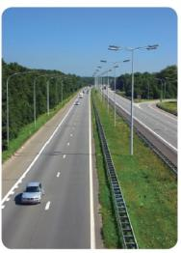
Example 2: Distance-Rate-Time
A motorist averaged 45 mph for the first part of a trip and 54 mph for the last part of the trip. If the total trip of 303 miles took 6 hours, what was the time for each part?
Solution:
Analysis of Strategy:
  Let t = time for 1st part of trip
6 − t = time for 2nd part of trip
  What is being asked for?
  Total time minus time for 1st part of trip gives time for 2nd part of trip.

Slide 12
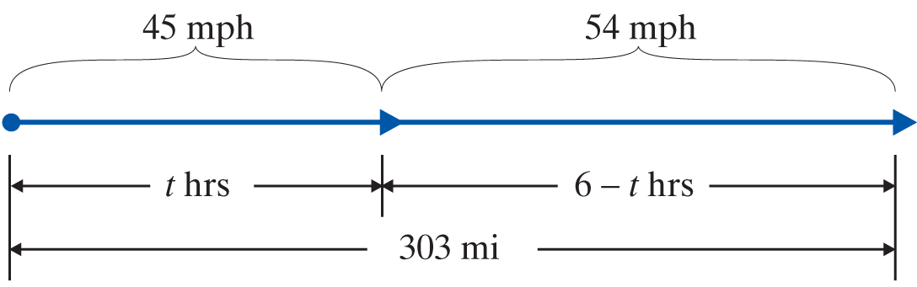
Example 2: Distance-Rate-Time (cont.)
rate ⋅ time = distance
1st Part | 45 | t | 45 ⋅ t
2nd Part | 54 | 6 − t | 54(6 − t)

Slide 13
Example 2: Distance-Rate-Time (cont.)
Form the equation relating the given information.
Solve the equation.
1st part of the trip
2nd part of the trip

Slide 14
Example 2: Distance-Rate-Time (cont.)
Check:
105 + 198 = 303 miles total

Slide 15
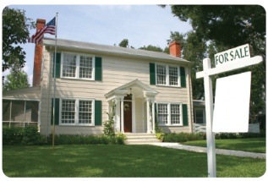
Example 3: Cost
a. The Berrys sold their house. After paying the real estate agent a commission of 6% of the selling price and then paying $1486 in other costs and $90,000 on the mortgage, they received $49,514. What was the selling price of the house?
Solution: Use the relationship :
selling price − cost = profit (S − C = P).
Let S = selling price
cost = 0.06S + 1486 + 90,000

Slide 16
Example 3: Cost (cont.)

Slide 17
Example 3: Cost (cont.)
Check:
The selling price was $150,000.

Slide 18
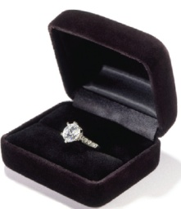
Example 3: Cost (cont.)
b. A jeweler paid $350 for a ring. He wants to price the ring for sale so that he can give a 30% discount on the marked selling price and still make a profit of 20% on his cost. What should be the marked selling price of the ring?
Solution:
Again, we make use of the relationship
SP − C = P.
Let x = marked selling price,
then x − 0.30x = actual selling price and 350 = cost.

Slide 19
Example 3: Cost (cont.)
The actual selling price is the marked selling price minus the 30% discount on the ring.
The profit is 20% of what he paid originally.

Slide 20
Example 3: Cost (cont.)
Check: Step 1:
Step 2:
Step 3:

Slide 21
Example 3: Cost (cont.)
The jeweler should set the selling price at $600.

Slide 22
Example 4: Interest
Kara has had $40,000 invested for one year, some with a savings account which paid 7%, the rest in a high-risk stock which yielded 12% for the year. If her interest income last year was $3550, how much did she have in the savings account and how much did she invest in the stock?
Solution:
Let x = amount invested at 7%
40,000 − x = amount invested at 12%
Total amount invested minus amount invested at 7% represents amount invested at 12%.

Slide 23
Example 4: Interest (cont.)
principal ⋅ rate = interest
Savings Account | x | 0.07 | 0.07(x)
Stock | 40,000 − x | 0.12 | 0.12(40,000 − x)
Multiply both sides of the equation by 100 to eliminate the decimal.

Slide 24
Example 4: Interest (cont.)
Amount invested at 7%
Amount invested at 12%
Check:
25,000(0.07) = 1750 and 15,000(0.12) = 1800
and $1750 + $1800 = $3550.
Kara had $25,000 in the savings account at 7% interest and invested $15,000 in the stock at 12% interest.

Slide 25
Average (or Mean)
Average
The average (or mean) of a set of numbers is the value found by adding the numbers and then dividing the sum by the quantity of numbers in the set.

Slide 26
Example 5: Average (or Mean)
Suppose that you have scores of 85, 92, 82 and 88 on four exams in your English class. What score will you need on the fifth exam to have an average of 90?
Solution:
Let x = your score on the fifth exam.
The sum of all the scores, including the unknown fifth exam, divided by 5 must equal 90.

Slide 27
Example 5: Average (or Mean) (cont.)
Assuming that each exam is worth 100 points, you cannot attain an average of 90 on the five exams.

Slide 28
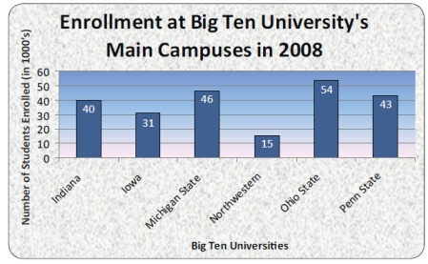
Example 6: Bar Graphs
Given the enrollment at the main campuses of the following Big Ten Universities:
a. Find the average enrollment over the six schools. (Round to the nearest thousand.)
b. Find the university with the lowest enrollment.
c. Find the difference in enrollment between Ohio State and Penn State.

Slide 29
Example 6: Bar Graphs (cont.)
Solution:
Note that the units on the graph are in thousands.
a. Find the sum: 40 + 31 + 46 + 15 + 54 + 43 = 229.
Divide by 6: 229 ÷ 6 ≈ 38.
The average enrollment is 38,000 students.
b. Northwestern has the lowest enrollment: 15,000 students.
c. The difference is 54,000 − 43,000 = 11,000 students.

