Slide 1
Section 1.7
Solving Inequalities in One Variable

Slide 2
Objectives
Understand and use interval notation.
Solve linear inequalities.
Solve compound inequalities.
Solve absolute value inequalities.

Slide 3




Intervals of Real Numbers
Algebraic
Notation
Interval
Notation
Graph
Type of Interval
Open interval
Closed interval
Half-open
interval

Slide 4




Intervals of Real Numbers
Algebraic
Notation
Interval
Notation
Graph
Type of Interval
Open interval
Half-open
interval

Slide 5
Intervals of Real Numbers
Variable
The symbol for infinity is not a number. It is used to indicate that the interval is to include all real numbers from some point on (either in the positive direction or the negative direction) without end.

Slide 6
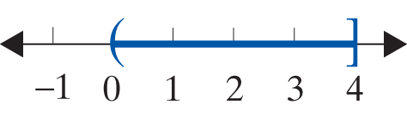
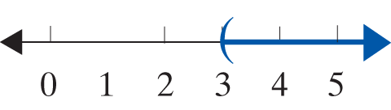
Example 1: Graphing Intervals
a. Graph the half-open interval
Solution:
b. Graph the open interval (3, ∞).
Solution:

Slide 7
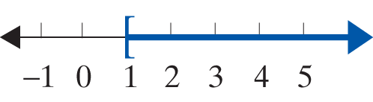
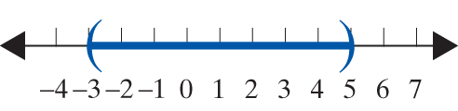
Example 1: Graphing Intervals (cont.)
c. Represent the following graph using algebraic notation, and state what kind of interval it is.
Solution: x ≥ 1 is a half-open interval.
d. Represent the following graph using interval notation, and state what kind of interval it is.
Solution: (−3, 5) is an open interval.

Slide 8
Solving Linear Inequalities
Linear Inequalities
Inequalities of the given form, where a, b, and c are real numbers and a ≠ 0,
are called linear inequalities.
The inequalities c < ax + b < d and are called compound linear inequalities. (This includes as well.)

Slide 9
Solving Linear Inequalities
Rules for Solving Linear Inequalities
1. Simplify each side of the inequality by removing any grouping symbols and combining like terms.
2. Use the addition property of equality to add the opposites of constants or variable expressions so that variable expressions are on one side of the inequality and constants on the other.

Slide 10
Solving Linear Inequalities
Rules for Solving Linear Inequalities
3. Use the multiplication property of equality to multiply both sides by the reciprocal of the coefficient of the variable (that is, divide both sides by the coefficient) so that the new coefficient is 1. If this coefficient is negative, reverse the sense of the inequality.
4. A quick (and generally satisfactory) check is to select any one number in your solution and substitute it into the original inequality.

Slide 11
Example 2: Solving Linear Inequalities
Solve the following linear inequalities and graph the solutions.
Solution:

Slide 12
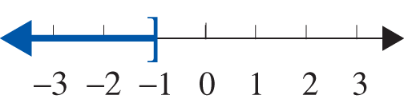
Example 2: Solving Linear Inequalities (cont.)

Slide 13
Example 2: Solving Linear Inequalities (cont.)
Solution:

Slide 14
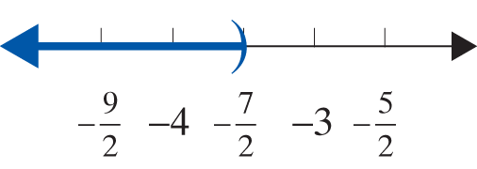
Example 2: Solving Linear Inequalities (cont.)

Slide 15
Example 2: Solving Linear Inequalities (cont.)
Solution:

Slide 16
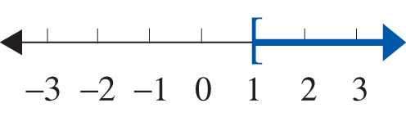
Example 2: Solving Linear Inequalities (cont.)

Slide 17
Example 2: Solving Linear Inequalities (cont.)
Solution:

Slide 18
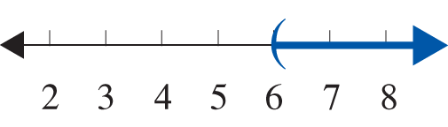
Example 2: Solving Linear Inequalities (cont.)

Slide 19
Example 3: Solving Compound Inequalities
a. Solve the compound inequality −5 ≤ 4x −1 < 11 and graph the solution set.
Solution:

Slide 20
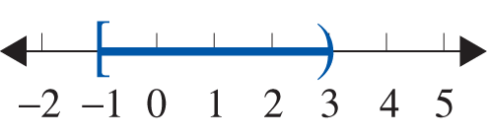
Example 3: Solving Compound Inequalities (cont.)
The solution set is the half-open interval

Slide 21
Example 3: Solving Compound Inequalities (cont.)
b. Solve the compound inequality 5 ≤ −3 − 2x ≤ 13 and graph the solution set.
Solution:

Slide 22
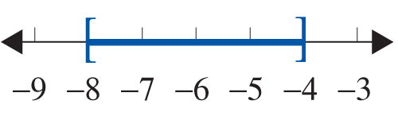
Example 3: Solving Compound Inequalities (cont.)
The solution set is the closed interval [−8, −4].

Slide 23
Example 3: Solving Compound Inequalities (cont.)
c. Solve the compound inequality and graph the solution set.
Solution:

Slide 24
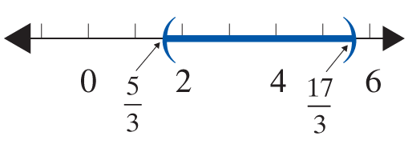
Example 3: Solving Compound Inequalities (cont.)
The solution set is the open interval

Slide 25
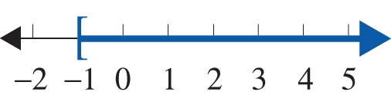
Solving Compound Inequalities
Notes
You should note that a compound inequality is actually two linear inequalities in one expression and the solution set is the intersection ∩ of the two solution sets. Thus, in Example 3a, you found the intersection of the solutions sets of
For Graphs

Slide 26
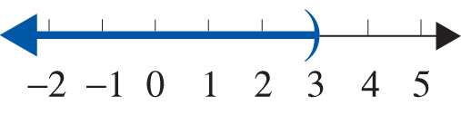
Solving Compound Inequalities
Notes (cont.)
Graph
The solution set is the
intersection.

Slide 27
Solving Compound Inequalities
Solving Absolute Value Inequalities with < (or )
For c > 0:
a. If |x| < c, then −c < x < c.
b. If |ax + b| < c, then −c < ax + b < c.
The inequalities in a. and b. are also true if < is replaced by ≤.
Note: If the absolute value expression is isolated on one side of the inequality, we say that the expression is in standard form.

Slide 28
Solving Compound Inequalities
Solving Absolute Value Inequalities with < (or ) (cont.)
You may need to manipulate the absolute value inequality to get it into standard form before you can solve it. (See Example 4c.)

Slide 29
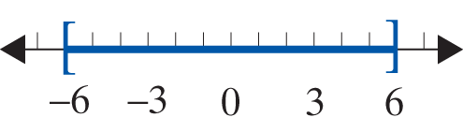
Example 4: Solving Absolute Value Inequalities
Solve the following absolute value inequalities and graph the solution sets.
Solution:

Slide 30
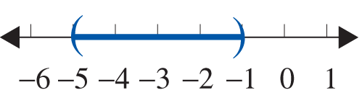
Example 4: Solving Absolute Value Inequalities (cont.)
Solution:

Slide 31
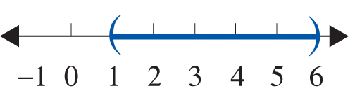
Example 4: Solving Absolute Value Inequalities (cont.)
Solution:
or x is in (1, 6)

Slide 32
Solving Compound Inequalities
Notes
The expression x > 3 or x < −3 cannot be combined into one inequality expression. The word or must separate the inequalities since any number that satisfies one or the other is a solution to the absolute value inequality. There are no numbers that satisfy both inequalities.

Slide 33
Solving Absolute Value Inequalities
Solving Absolute Value Inequalities with > (or ≥ )
For c > 0:
a. If |x| > c, then x < −c or x > c.
b. If |ax + b| > c, then ax + b < −c or ax + b > c.
Note: The inequalities in a. and b. are true if > is replaced by ≥.

Slide 34
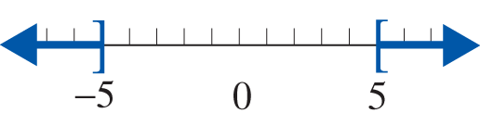
Example 5: Solving Absolute Value Inequalities
Solve the following absolute value inequalities and graph the solution set.
Solution:

Slide 35
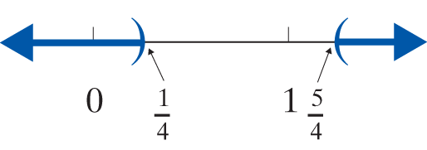
Example 5: Solving Absolute Value Inequalities (cont.)
Solution:

Slide 36

Example 5: Solving Absolute Value Inequalities (cont.)
Solution: There is nothing to do here except observe that no matter what is substituted for x, the absolute value will be greater than −6.
Absolute value is always nonnegative (greater than or equal to 0). The solution to the inequality is all real numbers, so shade the entire number line. In interval notation, x is in

Slide 37
Example 5: Solving Absolute Value Inequalities (cont.)
Solution: Since absolute value is always nonnegative (greater than or equal to 0), no number has an absolute
value less than Thus there is no solution, ∅.

Slide 38
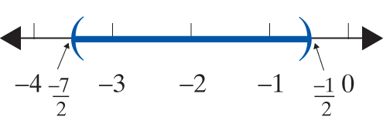
Example 5: Solving Absolute Value Inequalities (cont.)
Solution:

