Slide 1
Section 3.7
Graphing systems of Linear Inequalities

Slide 2
Objectives
Solve systems of linear inequalities graphically.

Slide 3
Solve Systems of Linear Inequalities Graphically
To Solve a System of Two Linear Inequalities
1. For each inequality, graph the boundary line and shade the appropriate half-plane. (Refer to Section 2.5 to review this process.)
2. Determine the region of the graph that is common to both half-planes (the region where the shading overlaps).
(This region is called the intersection of the two half-planes.)

Slide 4
Solve Systems of Linear Inequalities Graphically
To Solve a System of Two Linear Inequalities
3. To check, pick one test-point in the intersection and verify that it satisfies both inequalities.
Note: If there is no intersection, then the system is inconsistent and has no solution.

Slide 5
Example 1: Graphing Systems of Linear Inequalities
a. Graph the points that satisfy the system of
inequalities:
Solution:
Step 1: For x ≤ 2, the points are to the left of and on the line x = 2.
Step 2: For y ≥ −x + 1, the points are above and on the line y = −x + 1.

Slide 6
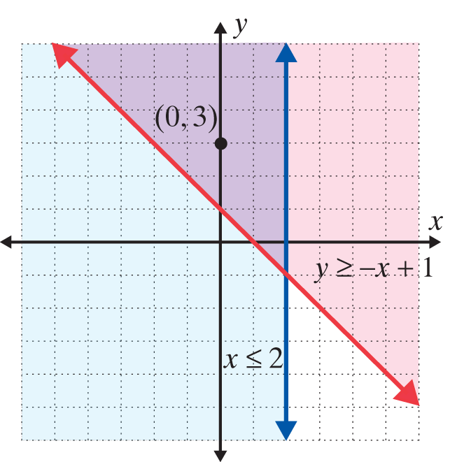
Example 1: Graphing Systems of Linear Inequalities (cont.)
Step 3: Determine the region that is common to both half-planes. In this case, we test the point (0, 3). On the graph below, the solution is the purple-shaded region and its boundary lines.
0 ≤ 2 A true statement
3 ≥ −0 + 1 A true statement

Slide 7
Example 1: Graphing Systems of Linear Inequalities (cont.)
b. Solve the system of linear inequalities graphically:
Solution:
Step 1: Solve each inequality for y:
Step 2: For y ≤ −2x + 6, the points are below and on the line y = −2x + 6.
Step 3: For y < −x + 4, the points are below but not on the line y = −x + 4.

Slide 8
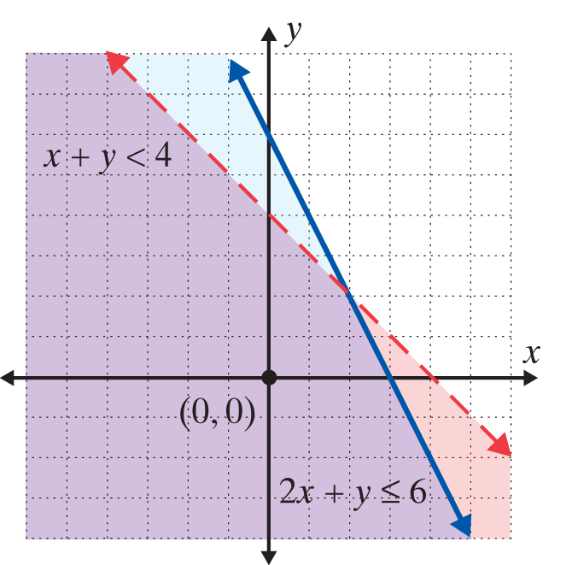
Example 1: Graphing Systems of Linear Inequalities (cont.)
Step 4: Determine the region that is common to both half-planes. Note that the line y = −x + 4 is dashed to indicate that the points on the line are not included. In this case, we test the point (0, 0).
2 ∙ 0 + 0 ≤ 6 A true statement
0 + 0 < 4 A true statement

Slide 9
Example 1: Graphing Systems of Linear Inequalities (cont.)
c. Solve the system of linear inequalities graphically:
Solution:
For y ≥ x, the points are above and on the line y = x.
For y ≤ x + 2, the points are below and on the line y = x + 2.

Slide 10
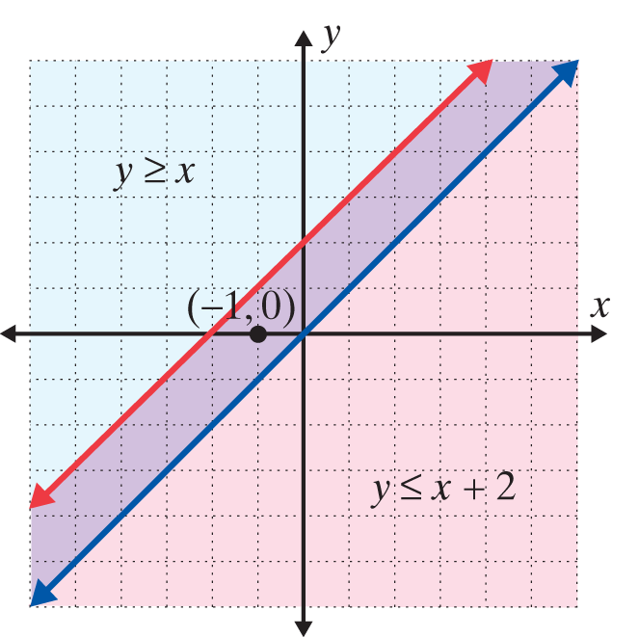
Example 1: Graphing Systems of Linear Inequalities (cont.)
The solution set consists of the boundary lines and the region between them.

Slide 11
Example 1: Graphing Systems of Linear Inequalities (cont.)
Note: When the boundary lines are parallel there are three possibilities:
1. The common region will be in the form of a strip between two lines (as in this example).
2. The common region will be a half-plane, as the solution to one inequality will be entirely contained within the solution of the other inequality.
3. There will be no common region and the solution set will be the empty set, ∅.

Slide 12
Example 2: Graphing Systems of Linear Inequalities
Use a TI-84 Plus graphing calculator to graph the following system of linear inequalities:
Solution:
Step 1: Solve each inequality for y:
[Note: When solving 2x − y ≤ 0 for y, we write the inequality as 2x ≤ y and then as y ≥ 2x.]

Slide 13

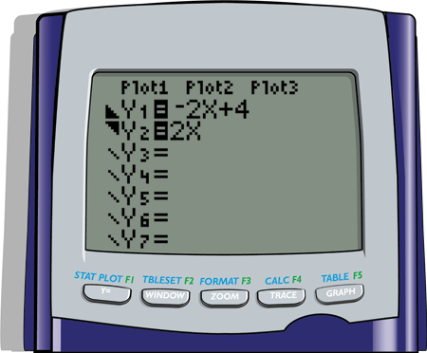

Example 2: Graphing Systems of Linear Inequalities (cont.)
Step 2: Press the key and enter both functions and the corresponding symbols as they appear here.
[Remember: To shade your graphs, position the cursor over the slash next to Y₁ (or Y₂) and hit repeatedly until the appropriate shading is displayed.]

Slide 14

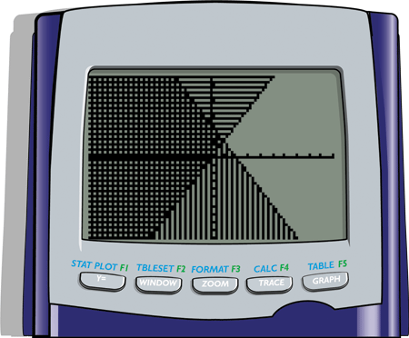
Example 2: Graphing Systems of Linear Inequalities (cont.)
Step 3: Press . The display should appear as follows. The solution is the cross-hatched region.

