Slide 1
Section 5.4
Solving Equations with Rational Expressions

Slide 2
Objectives
Solve proportions.
Solve other equations with rational expressions.

Slide 3
Proportions
Proportion
A proportion is an equation stating that two ratios are equal.

Slide 4
Example 1: Proportions
Solve the following proportions.
Solution:

Slide 5
Example 1: Proportions (cont.)
Check:
Thus the solution is x = 9.

Slide 6
Example 1: Proportions (cont.)
Solution:

Slide 7
Example 1: Proportions (cont.)
Check:
Thus the solution is x = 15.

Slide 8
Example 2: Applications of Proportions
On an architect’s scale drawing of a home, inch represents 10 feet. What length does a measure of inches represent?
Solution:
Set up a proportion representing the information. In this example the numerators are the same type and the denominators are the same type.

Slide 9
Example 2: Applications of Proportions (cont.)

Slide 10
Example 2: Applications of Proportions (cont.)
On this drawing, inches represent 50 feet.

Slide 11
Proportions
Notes
Any of the following four equations could have been used to solve the problem in Example 2:

Slide 12
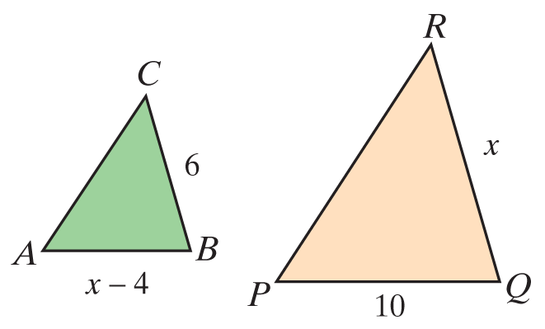
Example 3: Similar Triangles
In the figure shown, ΔABC ∼ ΔPQR. Find the lengths of the sides
Solution:
Set up a proportion involving the corresponding sides and solve for x.

Slide 13
Example 3: Similar Triangles (cont.)

Slide 14
Example 3: Similar Triangles (cont.)
Because the length of a side cannot be negative, the only acceptable solution is x = 10. Thus QR = 10. Substituting 10 for x gives AB = 10 − 4 = 6.

Slide 15
Solving Equations with Rational Expressions
To Solve an Equation Containing Rational Expressions
1. Find the LCM of the denominators.
2. Multiply both sides of the equation by this LCM and simplify.
3. Solve the resulting equation. (This equation will have only polynomials on both sides.)
4. Check each solution in the original equation. (Remember that no denominator can be 0 and any solution that gives a 0 denominator is to be discarded.)

Slide 16
Example 4: Solving Equations Involving Rational Expressions
State any restrictions on the variable, and then solve the equation.
Solution:
First find the LCM of the denominators and then multiply both sides of the equation by the LCM.

Slide 17
Example 4: Solving Equations Involving Rational Expressions

Slide 18
Example 4: Solving Equations Involving Rational Expressions (cont.)
Since 6 and 2 are not restrictions, there are two solutions, x = 6 and x = 2.

Slide 19
Example 4: Solving Equations Involving Rational Expressions (cont.)
Solution:
First find the LCM of the denominators and then multiply each term on both sides of the equation by the LCM.

Slide 20
Example 4: Solving Equations Involving Rational Expressions (cont.)

Slide 21
Example 4: Solving Equations Involving Rational Expressions (cont.)
The only solution is since 2 is a restricted value
(x ≠ 0, 2) and thus not a solution. No denominator can be 0.

Slide 22
Example 4: Solving Equations Involving Rational Expressions (cont.)
Solution: First find the LCM of the denominators and then multiply each term on both sides of the equation by the LCM.

Slide 23
Example 4: Solving Equations Involving Rational Expressions (cont.)

Slide 24
Example 4: Solving Equations Involving Rational Expressions (cont.)
There is no solution. The solution set is the empty set, ∅. The original equation is a contradiction.

Slide 25
Example 5: Solving a Formula for a Specified Variable
The formula is used to find the surface area (S) of a right circular cylinder, where r is the radius of the cylinder and h is the height of the cylinder. Solve the formula for h.
Solution:

Slide 26
Example 5: Solving a Formula for a Specified Variable (cont.)
Thus the formula solved for h is:

Slide 27
Practice Problems
Solve each proportion in Exercises 1 and 2. State any restrictions on the variable.
3. On a road map, each inch represents 50 miles. What distance is represented by 4.5 inches on the map?

Slide 28
Practice Problems (cont.)
Solve each equation in Exercises 4 and 5. State any restrictions on the variable.
6. Solve the formula A = P + Pr for r.

Slide 29
Practice Problem Answers

