Slide 1
Section 6.2
Rational Exponents

Slide 2
Objectives
Understand the meaning of n^{th} root.
Translate expressions using radicals into expressions using rational exponents and translate expressions using rational exponents into expressions using radicals.
Simplify expressions using the properties of rational exponents.
Evaluate expressions of the form with a calculator.

Slide 3
Radical Notation
If n is a positive integer and then (assuming is a real number).
The expression is called a radical.
The symbol is called a radical sign.
n is called the index.
a is called the radicand.
(Note: If no index is given, it is understood to be 2. For
example, )

Slide 4
Notes
Special Notes about the Index n:
For the expression to be a real number:
1. when a is nonnegative, n can be any index, and
2. when a is negative, n must be odd.
(If a is negative and n is even, then is nonreal.)

Slide 5
Example 1: Evaluating Principal n^{th} Roots

Slide 6


Example 2: Using the TI-84 Plus to find principal n^{th} roots
Use a TI-84 Plus calculator to find the value of each of the following roots accurate to four decimal places.
Solution: To find proceed as follows:
Step 1: Enter 5. (Note: This 5 is the index.)
Step 2: Press
Step 3: Choose 5:
Step 4: Enter 200 and press

Slide 7
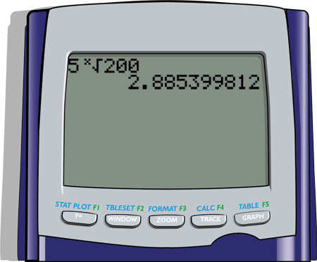
Example 2: Using the TI-84 Plus to find principal n^{th} roots (cont.)
The display will appear as follows.
Thus accurate to four decimal places.

Slide 8


Example 2: Using the TI-84 Plus to find principal n^{th} roots (cont.)
Solution: To find proceed as follows:
Step 1: Enter 6. (Note: This 6 is the index.)
Step 2: Press
Step 3: Choose 5:
Step 4: Enter 1.25 and press

Slide 9
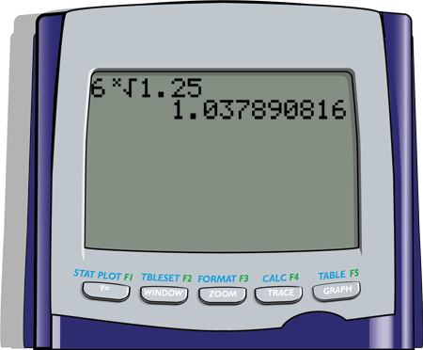
Example 2: Using the TI-84 Plus to find principal n^{th} roots (cont.)
The display will appear as follows.
Thus accurate to four decimal places.

Slide 10
Summary of Properties of Exponents
For nonzero real numbers a and b and rational numbers m and n,
The Exponent 1: (a is any real number.)
The Exponent 0:
Product Rule:
Quotient Rule:

Slide 11
Summary of Properties of Exponents (cont.)
Negative Exponents:
Power Rule:
Power Rule for Products:
Power Rule for Fractions:

Slide 12
If n is a positive integer, m is any integer, and is a real number, then
In radical notation:

Slide 13
Example 3: Conversion from Exponential Notation to Radical Notation
Assume that each variable represents a positive real number. Each expression is changed to an equivalent expression in either radical or exponential notation.

Slide 14
Example 3: Conversion from Exponential Notation to Radical Notation (cont.)

Slide 15
Notes
Unless otherwise stated, we will assume, for the remainder of this chapter, that all variables represent nonnegative real numbers.

Slide 16
Example 4: Simplifying Expressions with Rational Exponents
Each expression is simplified by using one or more of the rules of exponents.

Slide 17
Example 4: Simplifying Expressions with Rational Exponents (cont.)

Slide 18
Example 4: Simplifying Expressions with Rational Exponents (cont.)

Slide 19
Example 4: Simplifying Expressions with Rational Exponents (cont.)

Slide 20
Example 5: Simplifying Radical Notation by Changing to Exponential Notation
Simplify each expression by first changing it into an equivalent expression with rational exponents. Then, rewrite the answer in simplified radical form.

Slide 21
Example 5: Simplifying Radical Notation by Changing to Exponential Notation (cont.)

Slide 22


Evaluating Roots with a TI-84 Plus Calculator (The key)
To Find the Value of with a Calculator
1. Enter the value of the base, a.
2. Press the caret key .
3. Enter the fractional exponent enclosed in parentheses.
(This exponent may be positive or negative.)
4. Press .

Slide 23
Example 6: Using the TI-84 Plus
Solution: To find proceed as follows.
Step 1: Enter the base, 125.
Step 2: Press the caret key .
Step 3: Enter the exponent in parentheses,
Step 4: Press .

Slide 24
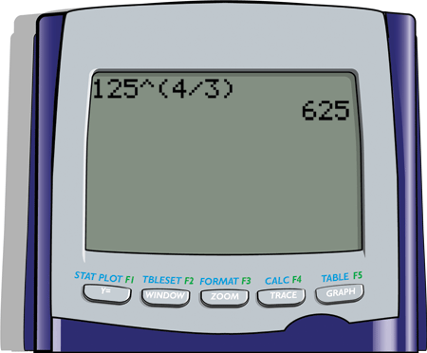
Example 6: Using the TI-84 Plus (cont.)
The display should read as follows.

Slide 25
Example 6: Using the TI-84 Plus (cont.)
Solution: To find proceed as follows.
Step 1: Enter the base, 36.
Step 2: Press the caret key .
Step 3: Enter the exponent in parentheses,
Step 4: Press .

Slide 26
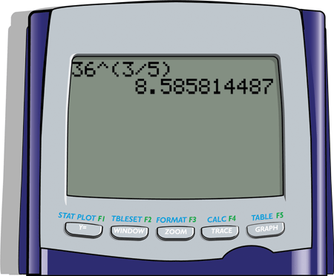
Example 6: Using the TI-84 Plus (cont.)
The display should read as follows:

Slide 27
Practice Problems
Simplify each of the following expressions. Leave the answers with rational exponents.
Simplify each expression by first changing to an equivalent expression

Slide 28
Practice Problems (cont.)
Use a graphing calculator to find the following values accurate to 4 decimal places.

Slide 29
Practice Problem Answers

