Slide 1
Section 6.3
Operations with Radicals

Slide 2
Objectives
Perform arithmetic operations with radical expressions.
Rationalize the denominators of radicals.
Use a TI-84 Plus graphing calculator to evaluate radical expressions.

Slide 3
Example 1: Addition and Subtraction with Radicals
Perform the indicated operation and simplify, if possible. Assume that all variables are positive.

Slide 4
Example 1: Addition and Subtraction with Radicals (cont.)

Slide 5
Example 1: Addition and Subtraction with Radicals (cont.)

Slide 6
Example 2: Multiplication of Radicals
Multiply and simplify the following expressions.

Slide 7
Example 2: Multiplication of Radicals (cont.)

Slide 8
Example 2: Multiplication of Radicals (cont.)

Slide 9
Example 2: Multiplication of Radicals (cont.)

Slide 10
Rationalizing Denominators of Rational Expressions
To Rationalize a Denominator Containing a Square Root or a Cube Root
1. If the denominator contains a square root, multiply both the numerator and denominator by an expression that will give a denominator with no square roots.
2. If the denominator contains a cube root, multiply both the numerator and denominator by an expression that will give a denominator with no cube roots.

Slide 11
Example 3: Rationalizing the Denominator
Simplify each radical expression so that the denominator contains no radicals. Assume all variables are positive.
Solution:
Multiply the numerator and denominator by
a perfect square expression.

Slide 12
Example 3: Rationalizing the Denominator (cont.)
Solution:
Multiply the numerator and denominator by
a perfect cube expression.

Slide 13
Rationalizing Denominators of Rational Expressions
To Rationalize a Denominator Containing a Sum or Difference Involving Square Roots
If the denominator of a fraction contains a sum or difference involving a square root, rationalize the denominator by multiplying both the numerator and denominator by the conjugate of the denominator.
1. If the denominator is of the form a − b, multiply both the numerator and denominator by a + b.

Slide 14
Rationalizing Denominators of Rational Expressions
To Rationalize a Denominator Containing a Sum or Difference Involving Square Roots (cont.)
2. If the denominator is of the form a + b, multiply both the numerator and denominator by a − b.
The new denominator will be the difference of two squares and therefore will not contain a radical term.

Slide 15
Example 4: Rationalizing a Denominator with a Sum or Difference Involving a Square Root
Simplify each expression by rationalizing the denominator.
Solution:
Multiply the numerator and denominator by

Slide 16
Example 4: Rationalizing a Denominator with a Sum or Difference Involving a Square Root (cont.)
The denominator is the difference of two squares.
The denominator is a rational number. Note that the numerator is now irrational. However, this is generally preferred to having an irrational denominator.

Slide 17
Example 4: Rationalizing a Denominator with a Sum or Difference Involving a Square Root (cont.)
Solution:
Multiply the numerator and denominator by

Slide 18
Example 4: Rationalizing a Denominator with a Sum or Difference Involving a Square Root (cont.)
Solution:
Multiply the numerator and denominator by

Slide 19
Example 4: Rationalizing a Denominator with a Sum or Difference Involving a Square Root (cont.)
Solution:

Slide 20
Example 4: Rationalizing a Denominator with a Sum or Difference Involving a Square Root (cont.)
Solution:

Slide 21
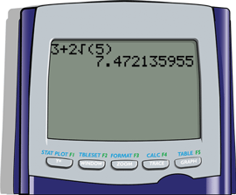
Example 5: Using a TI-84 Graphing Calculator to Evaluate Radical Expressions
Use a TI-84 Plus graphing calculator to evaluate each expression. Round answers to 4 decimal places.
Solution: The display should appear as follows.
Rounded to 4 decimal places.

Slide 22
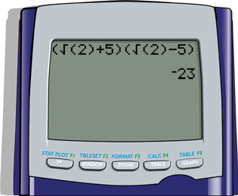
Example 5: Using a TI-84 Graphing Calculator to Evaluate Radical Expressions (cont.)
Solution: The display should appear as follows.
Note that the right parenthesis on 2 must be included. Otherwise, the calculator will interpret the expression as
which is not intended.

Slide 23
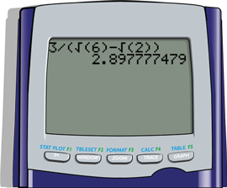
Example 5: Using a TI-84 Graphing Calculator to Evaluate Radical Expressions (cont.)
Solution: The display should appear as follows.
Count the parentheses in pairs.
Rounded to 4 decimal places.

Slide 24
Practice Problems
Simplify each expression. Assume that all variables are positive.

Slide 25
Practice Problems (cont.)
Simplify each expression. Assume that all variables are positive.

Slide 26
Practice Problem Answers

