Slide 1
Section 7.5
Graphing Quadratic Functions: Parabolas

Slide 2
Objectives
Graph a parabola (a quadratic function) and determine its vertex, domain, range, line of symmetry, and zeros.
Solve applied problems by using quadratic functions and the concepts of maximum and minimum.

Slide 3
Introduction to Quadratic Functions: y = ax² + bx + c (a ≠ 0)
Vertical Line Test
If any vertical line intersects a graph in more than one point, then the relation graphed is not a function.

Slide 4
Introduction to Quadratic Functions: y = ax² + bx + c (a ≠ 0)
Quadratic Functions
Any function that can be written in the form
y = ax² + bx + c
where a, b, and c are real numbers and a ≠ 0 is a quadratic function.

Slide 5
Example 1: Quadratic Functions
Graph the following quadratic functions. Set up a table of values for x and y as an aid, and choose values of x on each side of the line of symmetry. Find the line of symmetry and the vertex, and state the domain and range of each function.
a. y = 2x² − 3
Solution: Line of symmetry is x = 0. (The parabola opens upward since a is positive.)

Slide 6
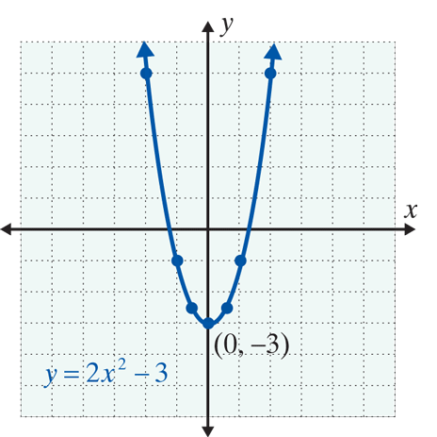
Example 1: Quadratic Functions (cont.)
x | y
0 | −3
1 | −1
−1 | −1
2 | 5
−2 | 5

Slide 7
Example 1: Quadratic Functions (cont.)
Solution: Line of symmetry is (The parabola
opens down since a is negative.)

Slide 8
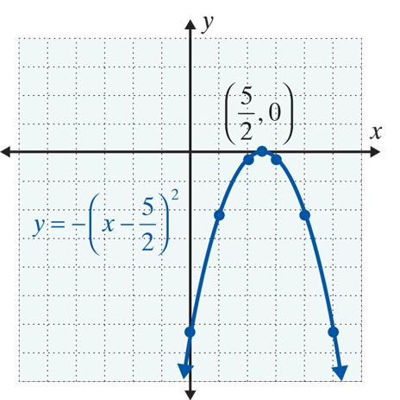
Example 1: Quadratic Functions (cont.)
x | y
 | 0
2
3
1
4
0
5

Slide 9
Functions of the Form y = a(x − h)² + k and y = ax² + bx + c
NOTES
Rather than memorize the formula for the coordinates of the vertex, you should just remember that the
x­-coordinate of the vertex is Substituting this
value for x in the function will give the y-value for the vertex.

Slide 10
Example 2: Graphing Quadratic Equations
a. For y = x² − 6x + 1, find the zeros of the function, the line of symmetry, the vertex, the domain, the range, and graph the parabola.
Solution:

Slide 11
Example 2: Graphing Quadratic Equations (cont.)
Change the form of the function for easier graphing.

Slide 12
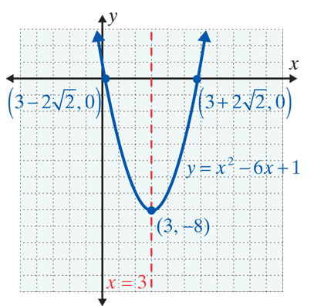
Example 2: Graphing Quadratic Equations (cont.)
Summary:

Slide 13
Example 2: Graphing Quadratic Equations (cont.)
b. For y = −x² − 4x + 2, find the zeros of the function, the line of symmetry, the vertex, the domain, the range, and graph the parabola.
Solution:

Slide 14
Example 2: Graphing Quadratic Equations (cont.)
Change the form of the function for easier graphing.

Slide 15
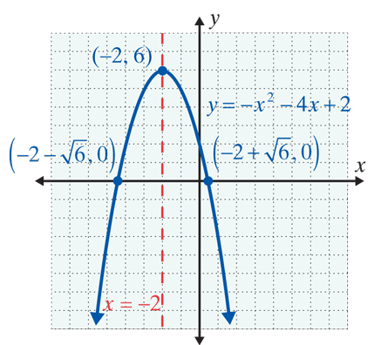
Example 2: Graphing Quadratic Equations (cont.)
Summary:

Slide 16
Example 2: Graphing Quadratic Equations (cont.)
c. For y = 2x² − 6x + 5, find the zeros of the function, the line of symmetry, the vertex, the domain, the range, and graph the parabola.
Solution:

Slide 17
Example 2: Graphing Quadratic Equations (cont.)
There are no real zeros because the discriminant is negative. The graph will not cross the x-axis. Now, using another approach, the vertex is at

Slide 18
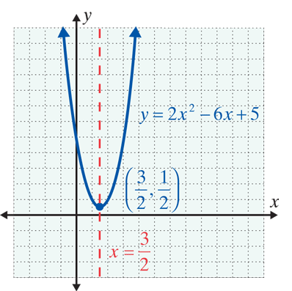
Example 2: Graphing Quadratic Equations (cont.)
Summary:

Slide 19
Applications with Maximum and
Minimum Values
Minimum and Maximum Values
For a parabola with its equation in the form
1. If a > 0, then the parabola opens upward and (h, k) is the lowest point and y = k is called the minimum value of the function.
2. If a < 0, then the parabola opens downward and
(h, k) is the highest point and y = k is called the maximum value of the function.

Slide 20
Example 3: Minimum and Maximum Values
a. A sandwich company sells hot dogs at the local baseball stadium for $3.00 each. On average they sell 2000 hot dogs per game. The company estimates that each time the price is raised by 25¢, they will sell 100 fewer hot dogs. What price should they charge to maximize their revenue (income) per game? What will be the maximum revenue?
Solution: Let x = number of 25¢ increases in price.
Then 3.00 + 0.25x = price per hot dog
and 2000 − 100x = number of hot dogs sold.

Slide 21
Example 3: Minimum and Maximum Values
Revenue = (price per unit) ⋅ (number of units sold)
So,
The revenue is represented by a quadratic function and the maximum revenue occurs at the point where

Slide 22
Example 3: Minimum and Maximum Values
For x = 4,
price per hot dog = 3.00 + 0.25(4) = $4.00
and Revenue = R = (4)(2000 − 100 ⋅ 4) = $6400.
Thus the company will make its maximum revenue of $6400 by charging $4 per hot dog.

Slide 23
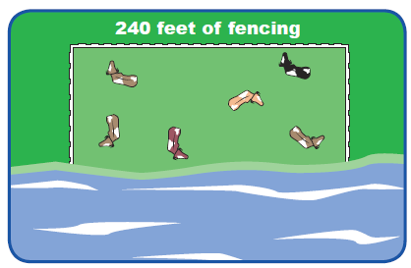
Example 3: Minimum and Maximum Values
b. A rancher is going to build three sides of a rectangular corral next to a river. He has 240 feet of fencing and wants to enclose the maximum area possible inside the corral. What are the dimensions of the corral with the maximum area and what is this area?
Solution: Let x = length of one of the two equal sides of the rectangle.
Then 240 − 2x = length of third side of the rectangle.

Slide 24
Example 3: Minimum and Maximum Values
Since area equals length times width, the area, A, of the corral is represented by the quadratic function
the maximum area occurs at the point where
Two sides of the rectangle are 60 feet and the third side is 240 − 2(60) = 120 feet.
The maximum area possible is 60(120)= 7200 ft².

Slide 25
Practice Problems
1. Write the function y = 2x² − 4x + 3 in the form
y = a(x − h)² + k.
2. Find the zeros of the function y = x² − 7x + 10.
3. Find the vertex and the range of the function
y = −x² + 4x − 5.

Slide 26
Practice Problem Answers

