Slide 1
Section 8.6
Common Logarithms and Natural Logarithms

Slide 2
Objectives
Understand that base 10 logarithms are called common logarithms.
Use a calculator to find the values of expressions with common logarithms.
Understand that base e logarithms are called natural logarithms.
Use a calculator to find the values of expressions with natural logarithms.
Use a calculator to find inverse logarithms (called antilogs) for common and for natural logarithms.

Slide 3
Example 1: Translations Between Exponential Form and Logarithmic Form Using Common Logarithms
Exponential Form Logarithmic Form
This is a common logarithm that equals 4.
⇔
This is a common logarithm that equals −2.
⇔
This is a common logarithm that equals x.
⇔

Slide 4



Common Logarithms (Base 10 Logarithms)
Using a Calculator to Evaluate Common Logarithms (Base 10)
To evaluate a common logarithm on a TI-84 Plus graphing calculator:
1. Press the key. log( will appear on the display.
2. Enter the number and a right-hand parenthesis,
3. Press .

Slide 5
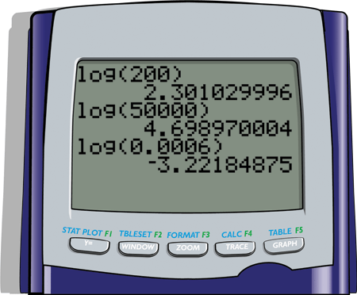
Example 2: Evaluating Common Logarithms Using a TI-84 Plus Graphing Calculator
Use a TI-84 Plus graphing calculator to find the values of the following common logarithms.
Solutions:

Slide 6
Example 2: Evaluating Common Logarithms Using a TI-84 Plus Graphing Calculator (cont.)
From the display we see the results (accurate to 8 or 9 decimal places).

Slide 7

Using a TI-84 Plus Graphing Calculator to find the Inverse Log of N
Using a Calculator to Find the Inverse Log of N
To evaluate the inverse log of N on a TI-84 Plus graphing calculator:
1. Press and . The expression 10^( will appear on the display.
2. Enter the value of N and a right-hand parenthesis .
3. Press .

Slide 8
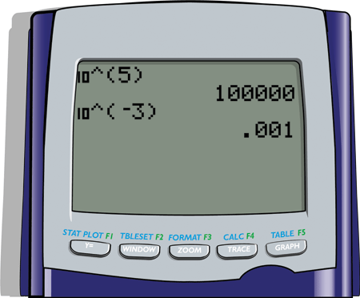
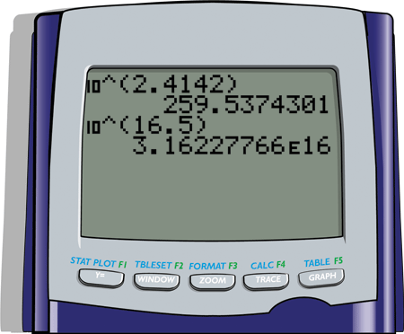
Example 3: Using a TI-84 Plus Graphing Calculator to find the Inverse Log of N
Use a TI-84 Plus graphing calculator to find the inverse log of N for each expression. (That is, find the value of x.)
Solutions:

Slide 9
Example 3: Using a TI-84 Plus Graphing Calculator to find the Inverse Log of N (cont.)
Thus the calculator gives,
The letter E in the solution is the calculator version of scientific notation. Thus,

Slide 10
Example 4: Translations Between Exponential Form and Logarithmic Form Using Natural Logarithms
Exponential Form Logarithmic Form
This is a natural logarithm that equals t.
This is a natural logarithm that equals 0.
This is a natural logarithm that equals 2.

Slide 11

Natural Logarithms (Base e Logarithms)
Using a Calculator to Evaluate Natural Logarithms (Base e)
To evaluate a natural logarithm on a TI-84 Plus graphing calculator:
1. Press the key. ln( will appear on the display.
2. Enter the number and a right-hand parenthesis,
3. Press .

Slide 12
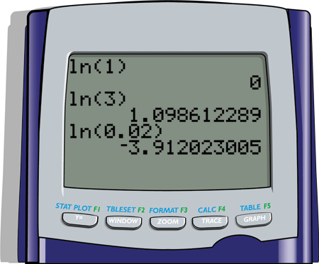
Example 5: Evaluating Natural Logarithms by Using a TI-84 Plus Graphing Calculator
Use a TI-84 Plus graphing calculator to find the values of the following natural logarithms.
Solutions:

Slide 13
Example 5: Evaluating Natural Logarithms by Using a TI-84 Plus Graphing Calculator (cont.)
From the display we see the results (accurate to 9 decimal places).

Slide 14
Finding the Inverse of a Natural Logarithm
(Base e)
Using a Calculator to Find the Inverse ln of N
To evaluate the inverse ln of N on a TI-84 Plus graphing calculator:
1. Press and . The expression e^( will appear on the display.
2. Enter the value of N and a right-hand parenthesis .
3. Press .

Slide 15
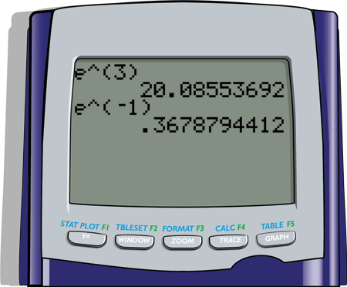

Example 6: Using a TI-84 Plus Graphing Calculator to find the Inverse ln of N
Use a TI-84 Plus graphing calculator to find the inverse ln of N for each expression. (That is, find the value of x.)
Solutions:

Slide 16
Example 6: Using a TI-84 Plus Graphing Calculator to find the Inverse ln of N (cont.)
Thus the calculator gives,

Slide 17
Practice Problems
Express each equation in logarithmic form.
Express each equation in exponential form.
Use a calculator to evaluate each logarithm (accurate to 5 decimal places).

Slide 18
Practice Problems (cont.)
Use a calculator to find the value of x in each equation (accurate to 5 decimal places).

Slide 19
Practice Problem Answers

