Slide 1
Section 9.1
Translations

Slide 2
Objectives
Calculate and understand the difference quotient.
Understand the concepts of horizontal and vertical translations.
Graph translations and reflections of functions. That is, given the graph of a function y = f(x), graph translations and reflections of the form

Slide 3
Example 1: Using f(x) Notation
For the function find:
Solution:
Solution:

Slide 4
Example 1: Using f(x) Notation (cont.)
Solution:
Replace x with (a + 1) and simplify.

Slide 5
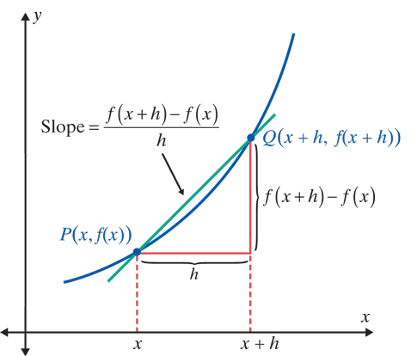
The Difference Quotient
Notes
The line illustrated in the figure (through two points on the graph) is called a secant line. The secant line is used in calculus to help in understanding a new function called a derivative.

Slide 6
The Difference Quotient
Notes
Note carefully that f(x + h) is not the same as f(x) + h. For example,

Slide 7
Example 2: Finding the Difference Quotient for a Given Function
a. Find the difference quotient for the function
f(x) = 2 − 6x.
Solution:
Substituting gives:

Slide 8
Example 2: Finding the Difference Quotient for a Given Function (cont.)
b. Find the difference quotient for the function
Solution:
Substituting gives:

Slide 9
Example 2: Finding the Difference Quotient for a Given Function (cont.)

Slide 10
Horizontal and Vertical Translations
Horizontal and Vertical Translations
Given the graph of y = f(x), the graph of y = f (x − h) + k is
1. a horizontal translation of h units and
2. a vertical translation of k units of the graph of
y = f(x).
Think of the origin (0, 0) being moved to the point
(h, k).

Slide 11
Horizontal and Vertical Translations
Horizontal and Vertical Translations (cont.)
Then draw the graph of y = f(x) in relation to (h, k) as if (h, k) were the origin, (0, 0).
This new graph will be the graph of y = f(x − h) + k.

Slide 12
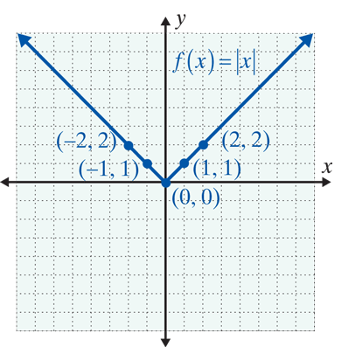
Example 3: Horizontal and Vertical Translations of the Function y = |x|
Graph each of the following functions. Use the graph in the figure as a reference.
Solution:
Here (h, k) = (3, 2), so there is a horizontal translation of 3 units right and 2 units up.

Slide 13
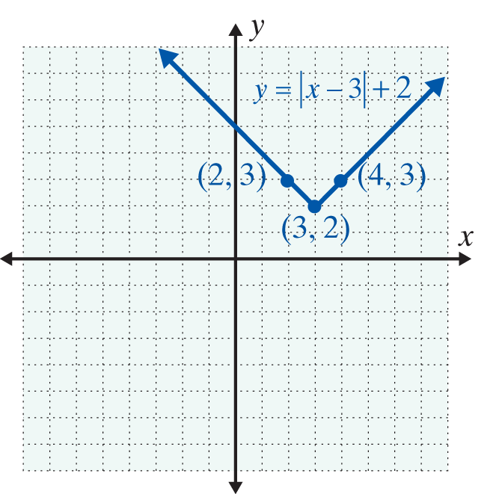
Example 3: Horizontal and Vertical Translations of the Function y = |x| (cont.)
In effect, (3, 2) is now the vertex of the new graph just as (0, 0) is the vertex of the original graph. You should check that the points shown on the graph here do indeed satisfy the function.

Slide 14
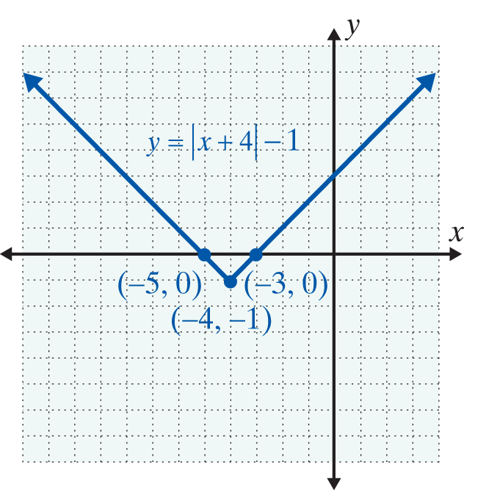
Example 3: Horizontal and Vertical Translations of the Function y = |x| (cont.)
Solution:
Here (h, k) = (−4, −1), so the horizontal translation is −4 (4 units left) and the vertical translation is −1 (1 unit down). The effect is that the vertex is now at the point (−4, −1).

Slide 15
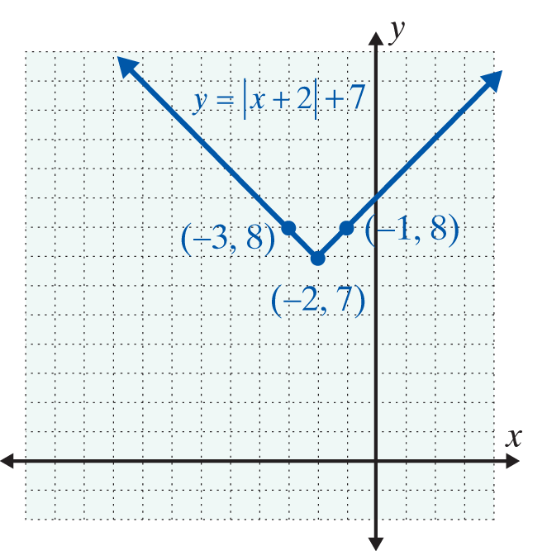
Example 3: Horizontal and Vertical Translations of the Function y = |x| (cont.)
Solution:
Here (h, k) = (−2, 7), so the horizontal translation is −2 (2 units left) and the vertical translation is 7 (7 units up). The effect is that the vertex is now at the point (−2, 7).

Slide 16
Example 4: Reflections and Translations of the Function y = |x|
Graph the function
Solution:
The reflection is performed first, followed by the translations.
Here (h, k) = (−2, 5), and the graph is reflected across the x-axis. We show step-by-step how to “arrive” at the graph. (You should do these steps mentally and graph only the last step.)

Slide 17
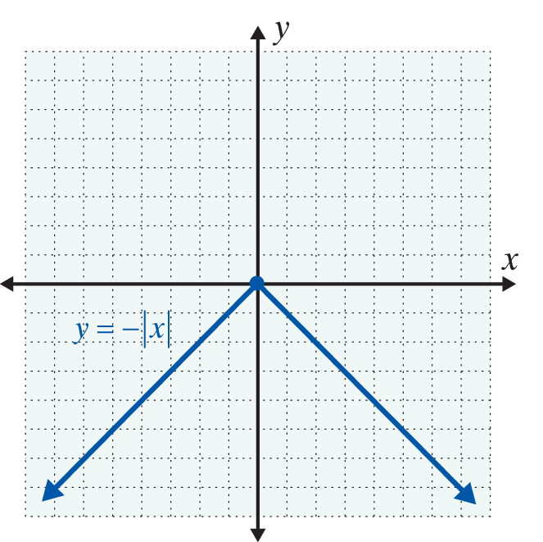
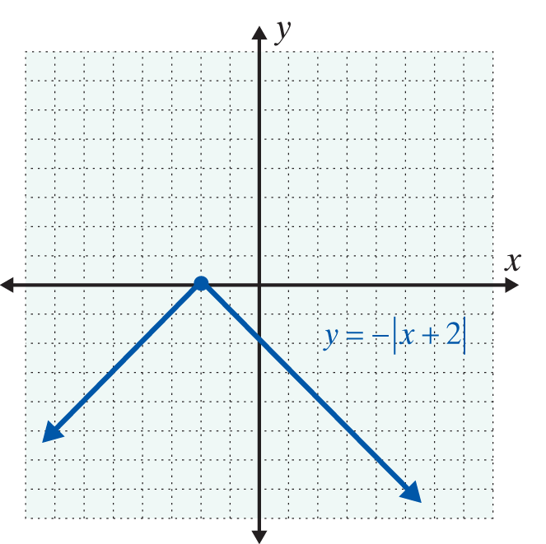
Example 4: Reflections and Translations of the Function y = |x| (cont.)
Step 1:
Graph the reflection y = −|x|.
Step 2:
Translate the graph
2 units to the left

Slide 18
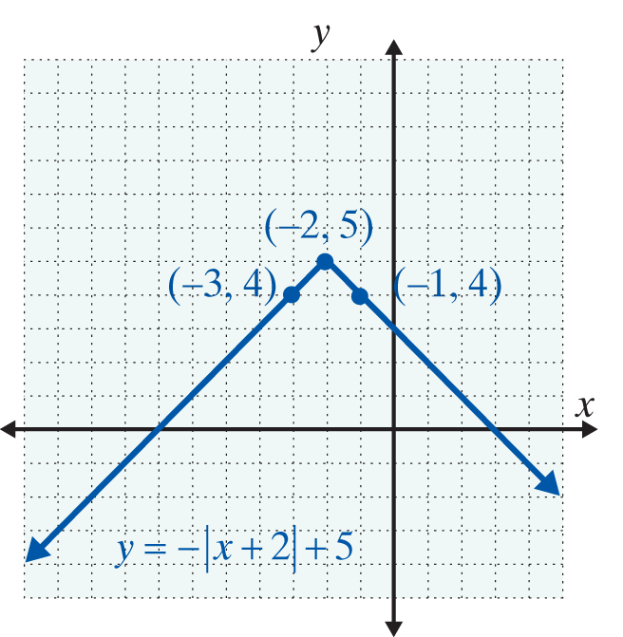
Example 4: Reflections and Translations of the Function y = |x| (cont.)
Step 3:
Translate the graph 5 units up.

Slide 19
Example 5: Translations of Functions with Graphs Given
a. The graph of is given. Graph the function
Solution:
If is written y = f (x), then
is the same as y = f(x − 2) + 1. So (h, k) = (2, 1), and there is a horizontal translation of 2 units to the right and a vertical translation of 1 unit up.

Slide 20
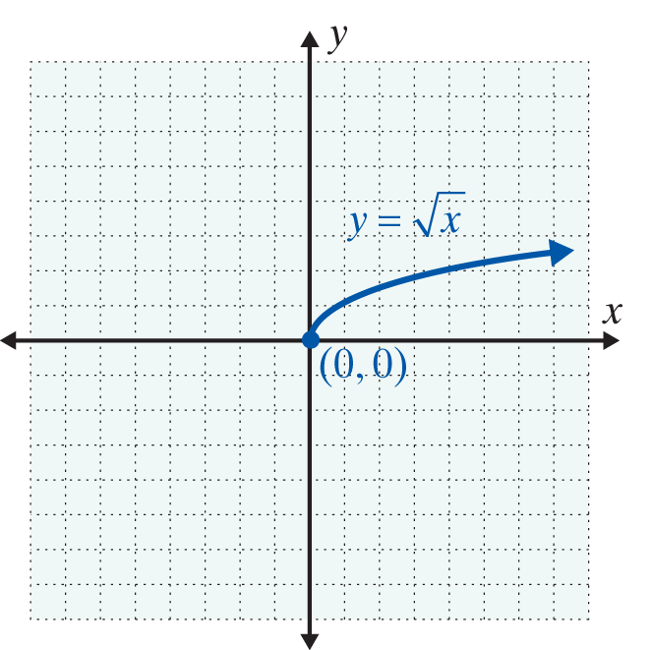
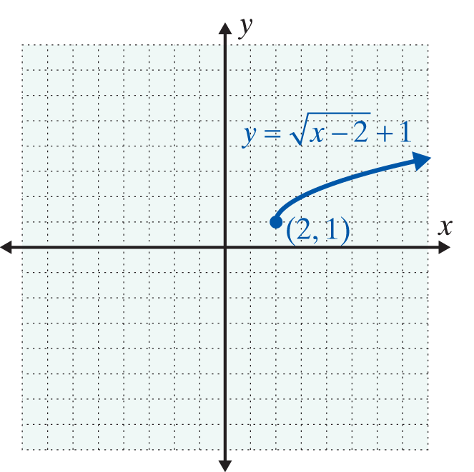
Example 5: Translations of Functions with Graphs Given (cont.)

Slide 21
Example 5: Translations of Functions with Graphs Given (cont.)
b. The graph of y = f(x) is given. Graph the function
y = f(x − 3) − 2.
Solution:
Here (h, k) = (3, −2), so translate the graph horizontally 3 units and vertically −2 units. (Add 3 to each x-value and −2 to each y-value.)

Slide 22
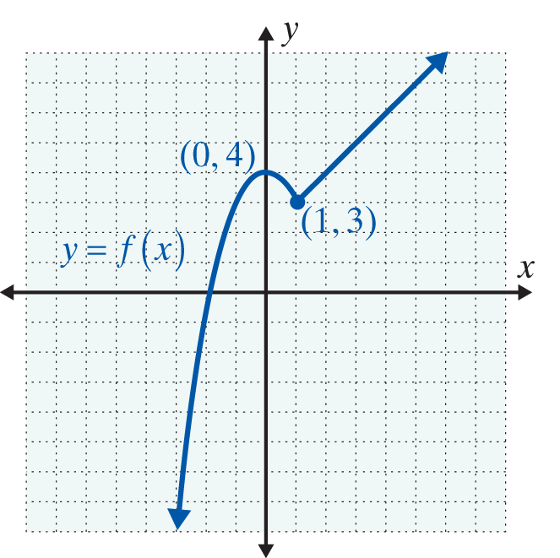
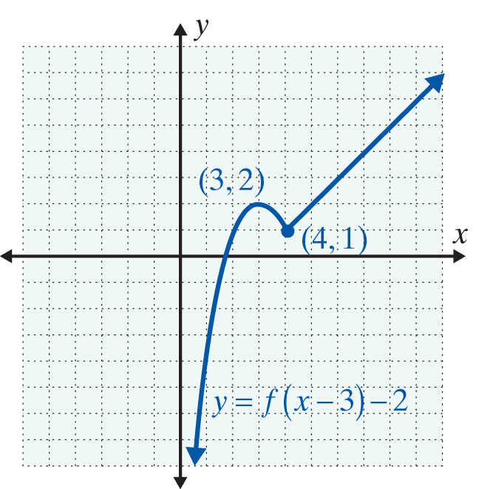
Example 5: Translations of Functions with Graphs Given (cont.)

Slide 23
Practice Problems
1. For find:
2. If g(x) = 3x + 7, find:
(When evaluating the difference quotient, remember that )

Slide 24
Practice Problem Answers

