Slide 1
Section 9.5
Nonlinear Systems of Equations

Slide 2
Objectives
Solve systems of equations where one or both equations are nonlinear.

Slide 3
Example 1: A System of One Quadratic and One Linear Equation
Solve the following systems of equations and graph both curves in each system.
Solution: Solve x + y = 5 for y (or x). Then substitute into the other equation.

Slide 4
Example 1: A System of One Quadratic and One Linear Equation (cont.)
The solutions (points of intersection) are (0, 5) and (5, 0).

Slide 5
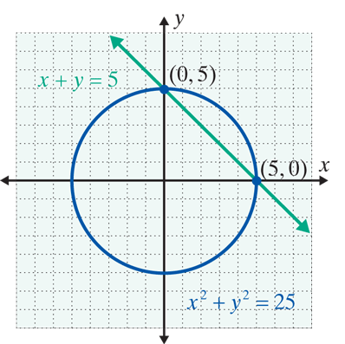
Example 1: A System of One Quadratic and One Linear Equation (cont.)

Slide 6
Example 1: A System of One Quadratic and One Linear Equation (cont.)
Solution: Solve the linear equation for y, then substitute into the quadratic equation. (In this case, the quadratic equation is already solved for y, so we could have chosen to make the substitution the other way.)

Slide 7
Example 1: A System of One Quadratic and One Linear Equation (cont.)
The solutions are (2, −9) and (1, −8).

Slide 8
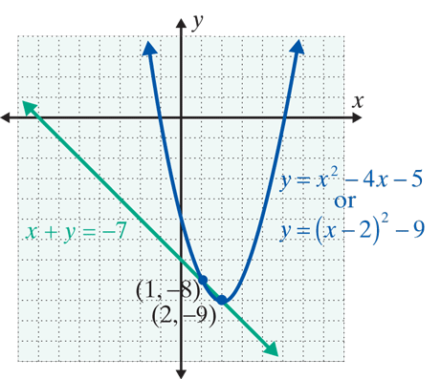
Example 1: A System of One Quadratic and One Linear Equation (cont.)

Slide 9
Example 2: A System of Two Quadratic Equations
Solution: Here addition will eliminate y².

Slide 10
Example 2: A System of Two Quadratic Equations (cont.)
There are four points of intersection:

Slide 11
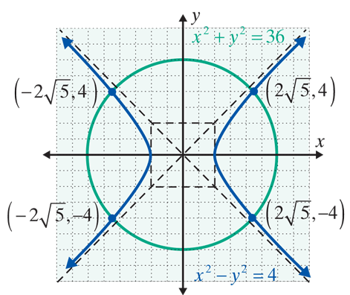
Example 2: A System of Two Quadratic Equations (cont.)

Slide 12
Solving a System of Two Quadratic Equations
Notes
In the examples and the exercises the curves do intersect. However, there are many situations where the curves do not intersect. This can be confirmed both algebraically and geometrically.

Slide 13
Practice Problems
Solve each of the following systems algebraically and geometrically.

Slide 14
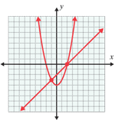
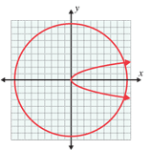
Practice Problem Answers

