Slide 1
Section 1.1
Real Numbers

Slide 2
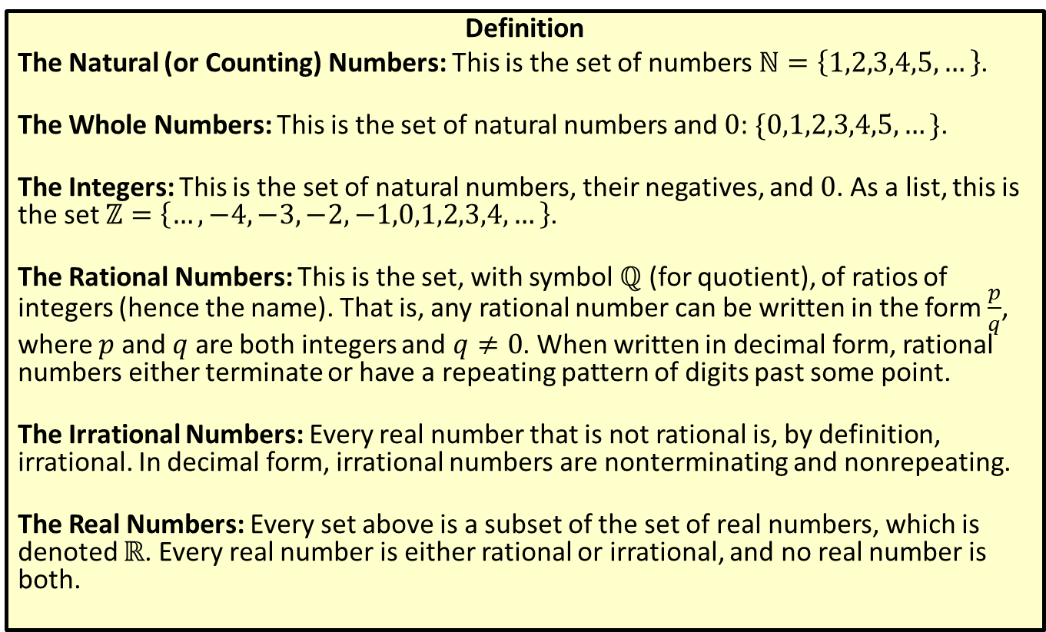
Types of Real Numbers
Definition
The Natural (or Counting) Numbers: This is the set of numbers $ℕ=\left\{1,2,3,4,5,…\right\}$.
The Whole Numbers: This is the set of natural numbers and 0: $\{0,1,2,3,4,5,…\}$.
The Integers: This is the set of natural numbers, their negatives, and 0. As a list, this is the set $ℤ=\left\{…,−4,−3,−2,−1,0,1,2,3,4,…\right\}$.
The Rational Numbers: This is the set, with symbol $ℚ$ (for quotient), of ratios of integers (hence the name). That is, any rational number can be written in the form $\frac{p}{q}$, where $p$ and $q$ are both integers and $q≠0$. When written in decimal form, rational numbers either terminate or have a repeating pattern of digits past some point.
The Irrational Numbers: Every real number that is not rational is, by definition, irrational. In decimal form, irrational numbers are nonterminating and nonrepeating.
The Real Numbers: Every set above is a subset of the set of real numbers, which is denoted $ℝ$. Every real number is either rational or irrational, and no real number is both.

Slide 3
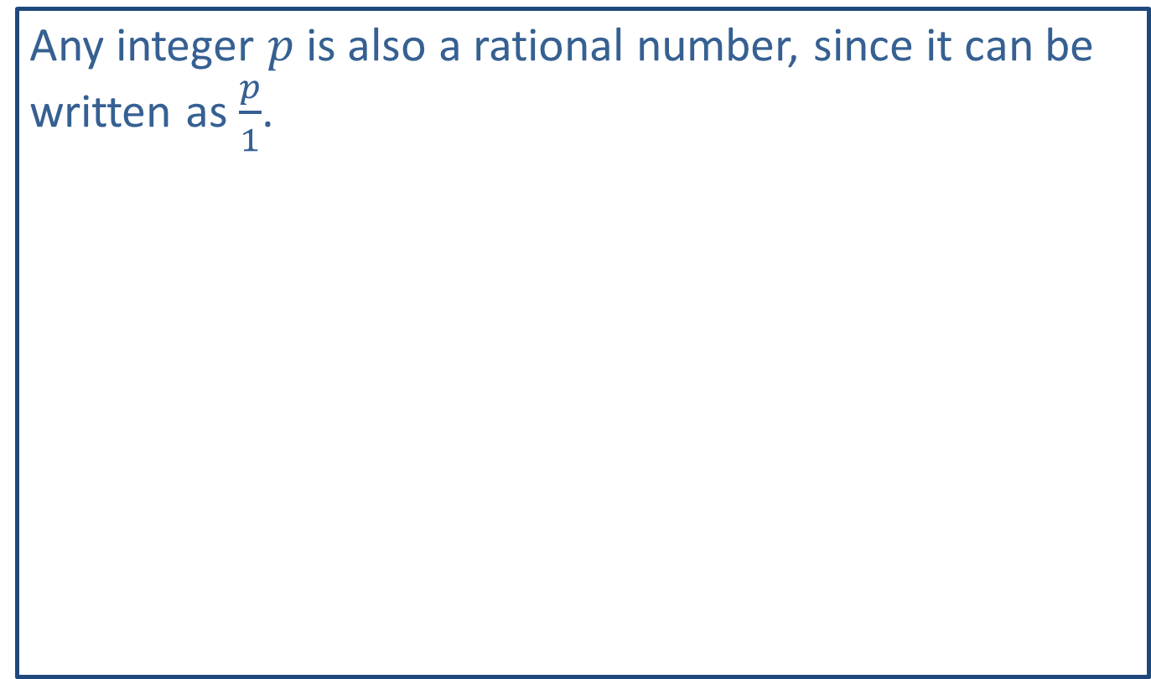
Note:
Any integer $p$ is also a rational number, since it can be written as $\frac{p}{1}$.

Slide 4
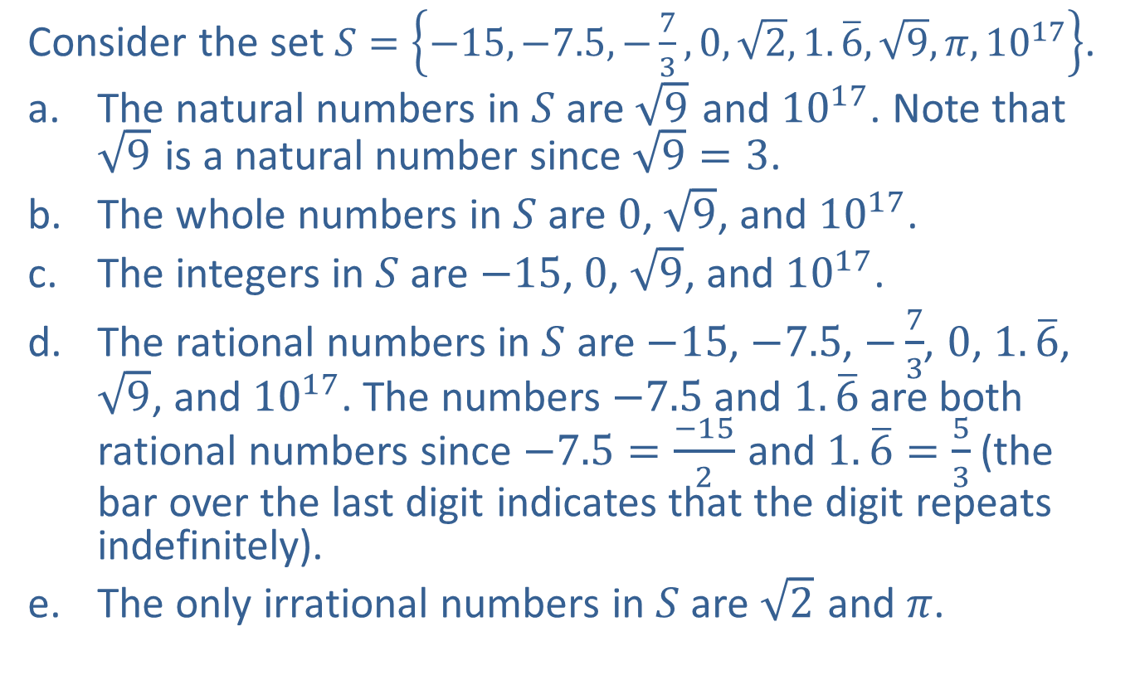
Example 1: Types of Real Numbers
Consider the set $S=\left\{−15,−7.5,−\frac{7}{3},0,\sqrt{2},1.\overline{6},\sqrt{9},π,{10}^{17}\right\}$.
​The natural numbers in $S$ are $\sqrt{9}$ and ${10}^{17}$. Note that $\sqrt{9}$ is a natural number since $\sqrt{9}=3$.
​The whole numbers in $S$ are 0, $\sqrt{9}$, and ${10}^{17}$.
​The integers in $S$ are $−15$, 0, $\sqrt{9}$, and ${10}^{17}$.
​The rational numbers in $S$ are $−15$, $−7.5$, $−\frac{7}{3}$, $0$, $1.\overline{6}$, $\sqrt{9}$, and ${10}^{17}$. The numbers $−7.5$ and $1.\overline{6}$ are both rational numbers since $−7.5=\frac{−15}{2}$ and $1.\overline{6}=\frac{5}{3}$ (the bar over the last digit indicates that the digit repeats indefinitely).
​The only irrational numbers in $S$ are $\sqrt{2}$ and $π$.

Slide 5
Example 2: Drawing the Real Number Line
We choose which portion of the real number line to show and the physical length that represents one unit based on the numbers that we wish to plot.
​If we want to plot the numbers 101, 106, and 107, we might construct the graph below.
​
Figure 3

Slide 6
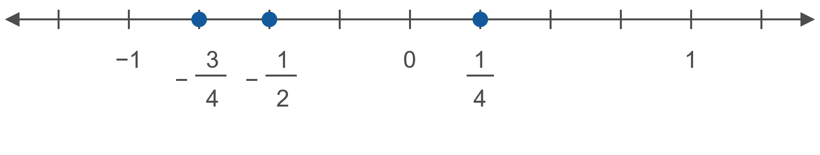

Example 2: Drawing the Real Number Line (cont.)
​If we want to plot the numbers $−\frac{3}{4}$, $−\frac{1}{2}$, and $\frac{1}{4}$, we might make the unit interval longer.
​
Figure 4

Slide 7
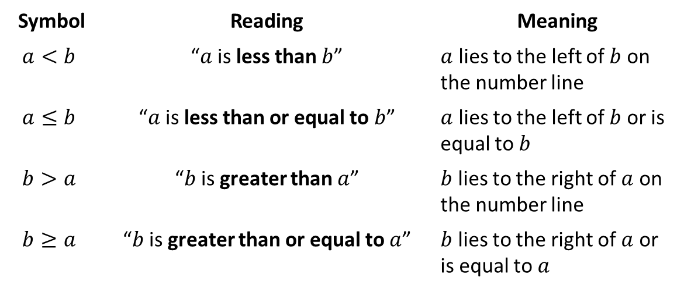

Inequality Symbols (Order)
Definition
The two symbols $<$ and $>$ are called strict inequality signs, while the symbols $≤$ and $≥$ are nonstrict inequality signs.
Symbol | Reading | Meaning
$$a<b$$ | “$a$ is less than $b$” | $a$ lies to the left of $b$ on the number line
$$a≤b$$ | “$a$ is less than or equal to $b$” | $a$ lies to the left of $b$ or is equal to $b$
$$b>a$$ | “$b$ is greater than $a$” | $b$ lies to the right of $a$ on the number line
$$b≥a$$ | “$b$ is greater than or equal to $a$” | $b$ lies to the right of $a$ or is equal to $a$

Slide 8
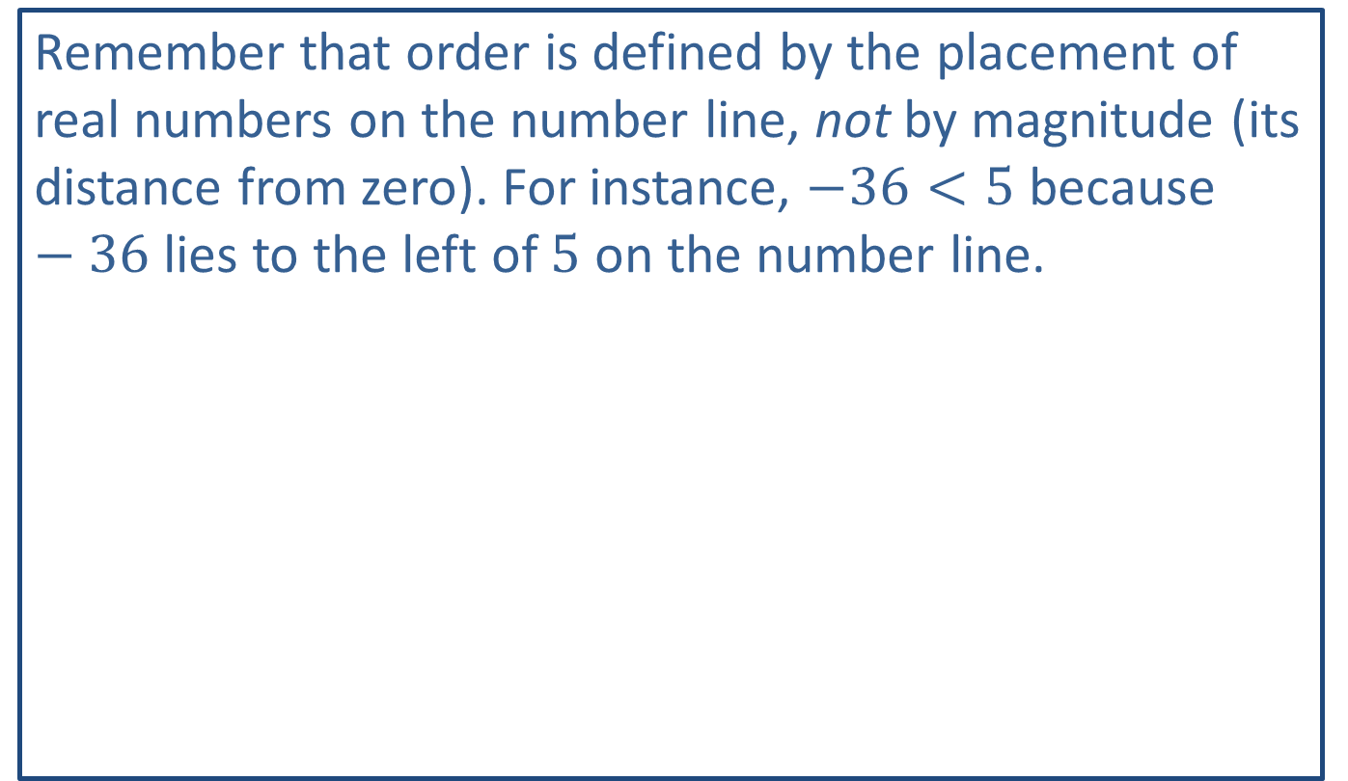
CAUTION!
Remember that order is defined by the placement of real numbers on the number line, not by magnitude (its distance from zero). For instance, $−36<5$ because $−36$ lies to the left of 5 on the number line.

Slide 9
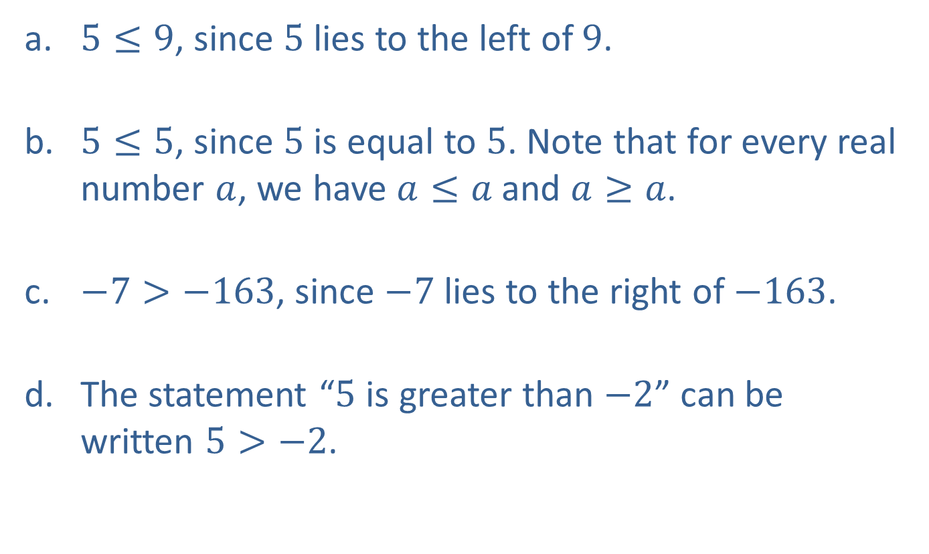
Example 3: Working with Order
​$5≤9$, since 5 lies to the left of 9.
​$5≤5$, since 5 is equal to 5. Note that for every real number $a$, we have $a≤a$ and $a≥a$.
​$−7>−163$, since $−7$ lies to the right of $−163$.
​The statement “5 is greater than $−2$” can be written $5>−2$.​

Slide 10
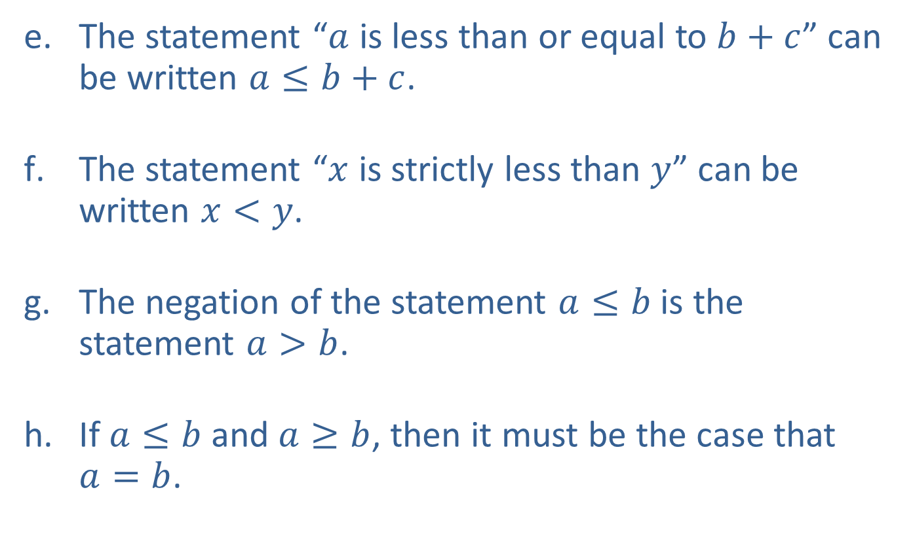
Example 3: Working with Order (cont.)
​The statement “$a$ is less than or equal to $b+c$” can be written $a≤b+c$.
​The statement “$x$ is strictly less than $y$” can be written $x<y$.
​The negation of the statement $a≤b$ is the statement $a>b$.
​If $a≤b$ and $a≥b$, then it must be the case that
$a=b$.

Slide 11
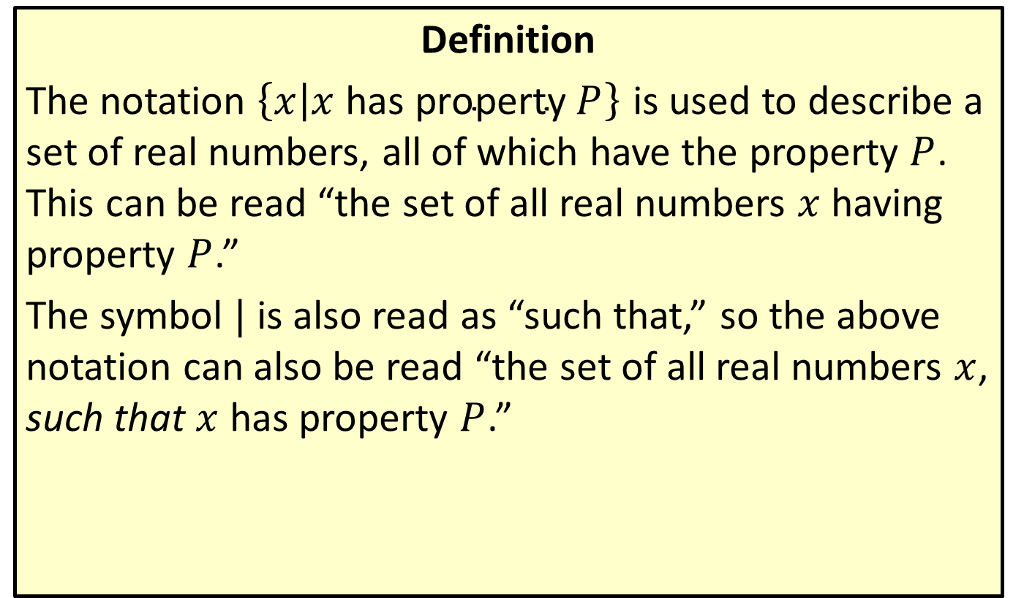
Set-Builder Notation
Definition
The notation $\left\{x | x \text{has} \text{property} P\right\}$ is used to describe a set of real numbers, all of which have the property $P$. This can be read “the set of all real numbers $x$ having property $P$.”
The symbol | is also read as “such that,” so the above notation can also be read “the set of all real numbers $x$, such that $x$ has property $P$.”

Slide 12
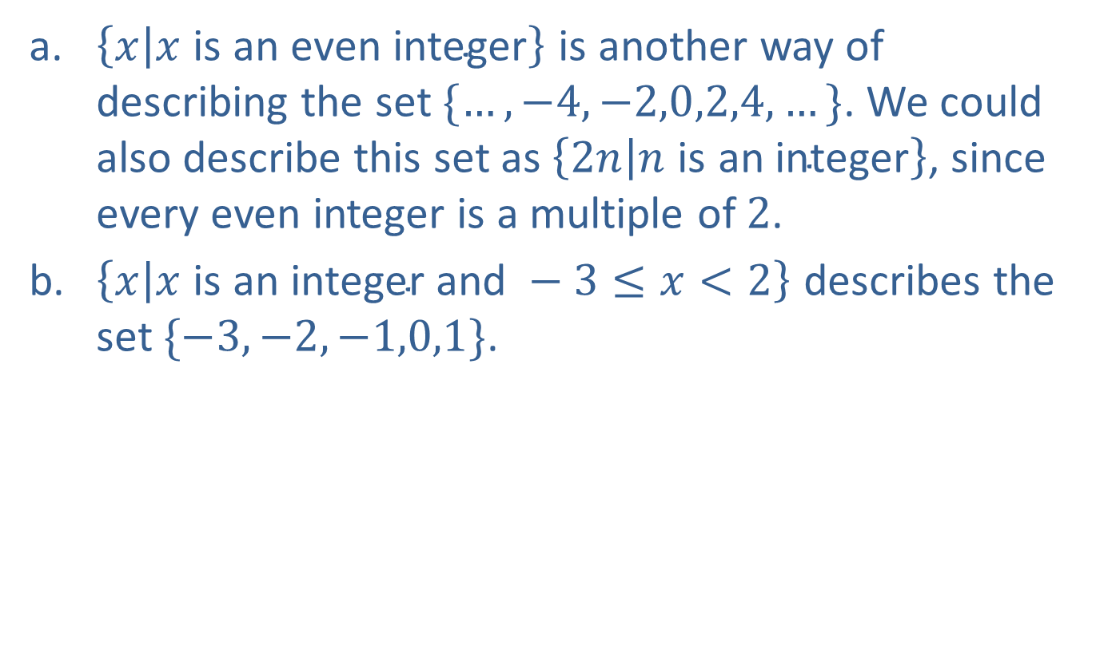
Example 4: Set-Builder Notation
​$\left\{x | x \text{is} \text{an} \text{even} \text{integer}\right\}$ is another way of describing the set $\{…,−4,−2,0,2,4,…\}$. We could also describe this set as $\left\{2n | n \text{is} \text{an} \text{integer}\right\}$, since every even integer is a multiple of 2.
​$\left\{x | x \text{is} \text{an} \text{integer} \text{and} −3≤x<2\right\}$ describes the set $\{−3,−2,−1,0,1\}$.

Slide 13
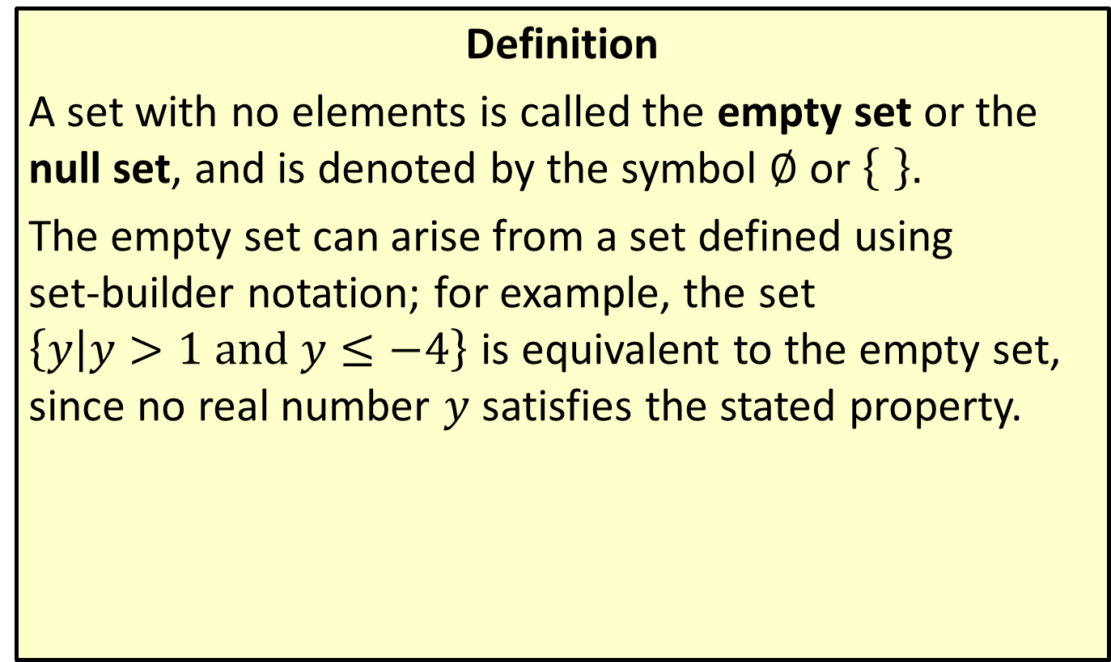
The Empty Set
Definition
A set with no elements is called the empty set or the null set, and is denoted by the symbol $∅$ or ..
The empty set can arise from a set defined using
set-builder notation; for example, the set $\left\{y | y>1 and y≤−4\right\}$ is equivalent to the empty set, since no real number $y$ satisfies the stated property.

Slide 14
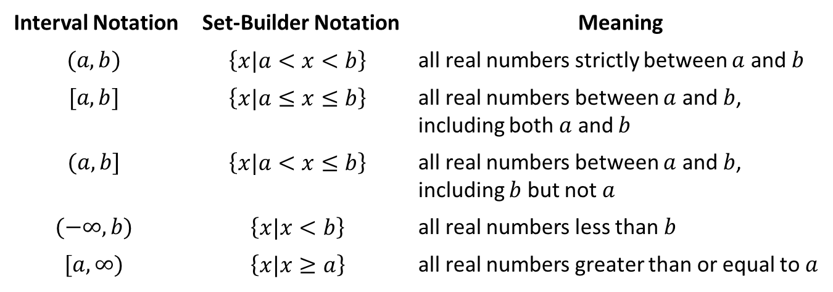
Interval Notation
Definition
Interval Notation | Set-Builder Notation | Meaning
$$(a,b)$$ | $$\left\{x|a<x<b\right\}$$ | all real numbers strictly between $a$ and $b$
$$[a,b]$$ | $$\left\{x|a≤x≤b\right\}$$ | all real numbers between $a$ and $b$, including both $a$ and $b$
$$(a,b]$$ | $$\left\{x|a<x≤b\right\}$$ | all real numbers between $a$ and $b$, including $b$ but not $a$
$$(−∞,b)$$ | $$\left\{x|x<b\right\}$$ | all real numbers less than $b$
$$[a,∞)$$ | $$\left\{x|x≥a\right\}$$ | all real numbers greater than or equal to $a$

Slide 15
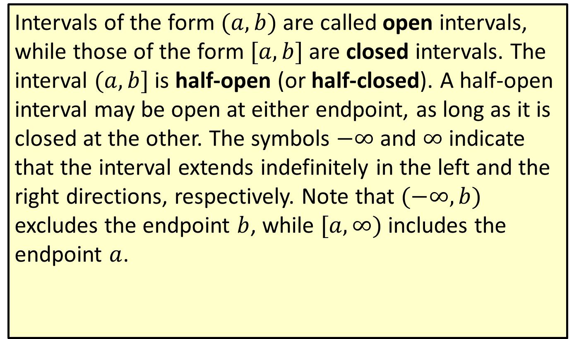
Interval Notation (cont.)
Intervals of the form $(a,b)$ are called open intervals, while those of the form $[a,b]$ are closed intervals. The interval $(a,b]$ is half-open (or half-closed). A half-open interval may be open at either endpoint, as long as it is closed at the other. The symbols $−∞$ and $∞$ indicate that the interval extends indefinitely in the left and the right directions, respectively. Note that $(−∞,b)$ excludes the endpoint $b$, while $[a,∞)$ includes the endpoint $a$.

Slide 16
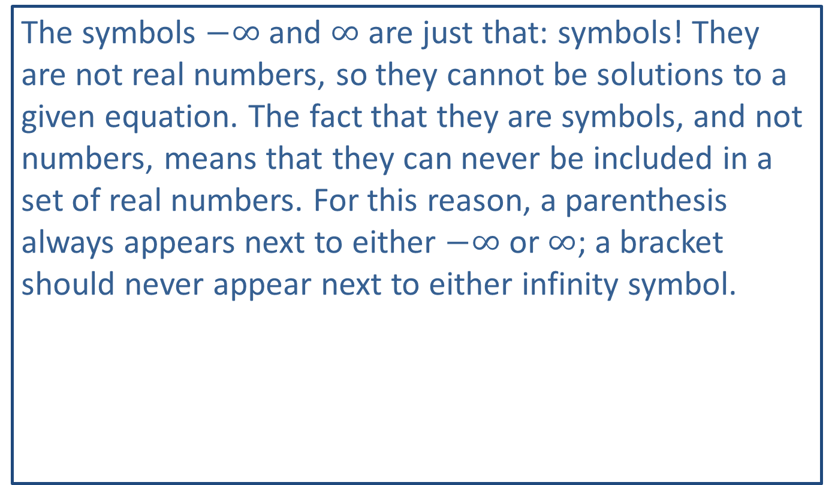
CAUTION!
The symbols $−∞$ and $∞$ are just that: symbols! They are not real numbers, so they cannot be solutions to a given equation. The fact that they are symbols, and not numbers, means that they can never be included in a set of real numbers. For this reason, a parenthesis always appears next to either $−∞$ or $∞$; a bracket should never appear next to either infinity symbol.

Slide 17
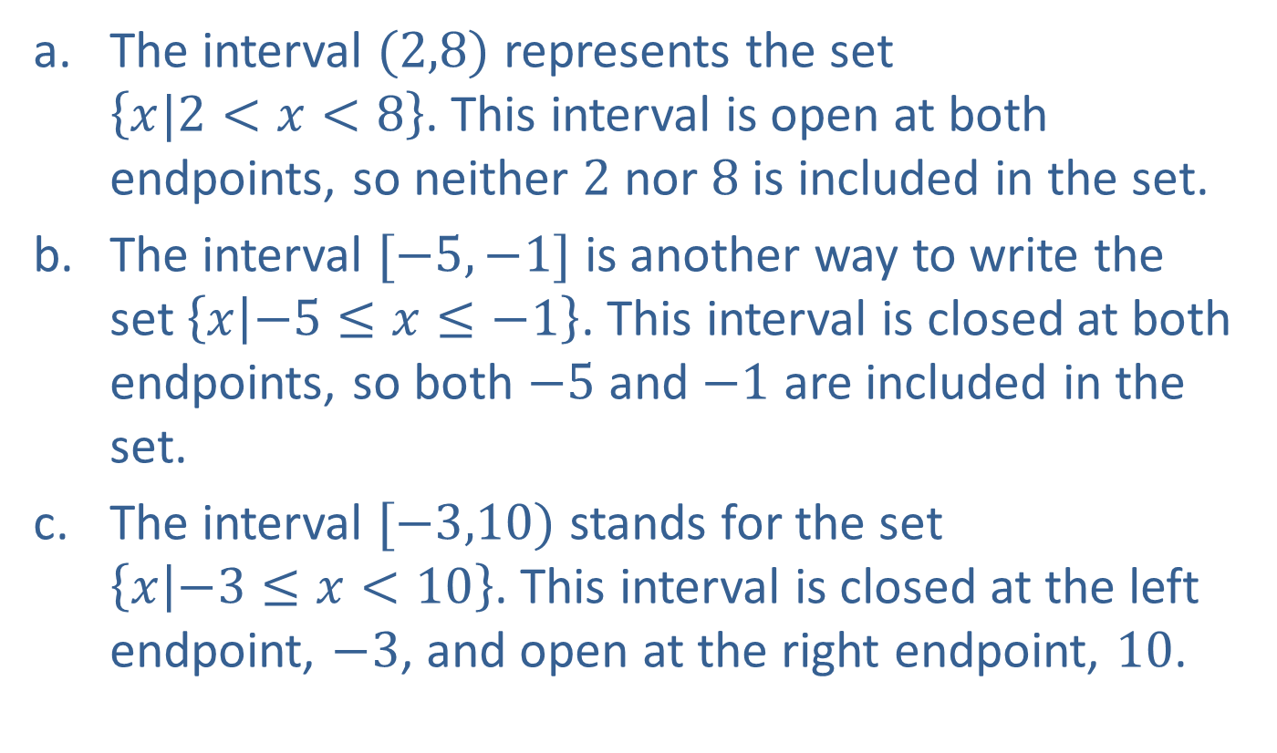
Example 5: Intervals of Real Numbers
​The interval $(2,8)$ represents the set
$\left\{x|2<x<8\right\}$. This interval is open at both endpoints, so neither 2 nor 8 is included in the set.
​The interval $[−5,−1]$ is another way to write the set $\left\{x | −5≤x≤−1\right\}$. This interval is closed at both endpoints, so both $−5$ and $−1$ are included in the set.
​The interval $[−3,10)$ stands for the set $\left\{x | −3≤x<10\right\}$. This interval is closed at the left endpoint, $−3$, and open at the right endpoint, 10.

Slide 18
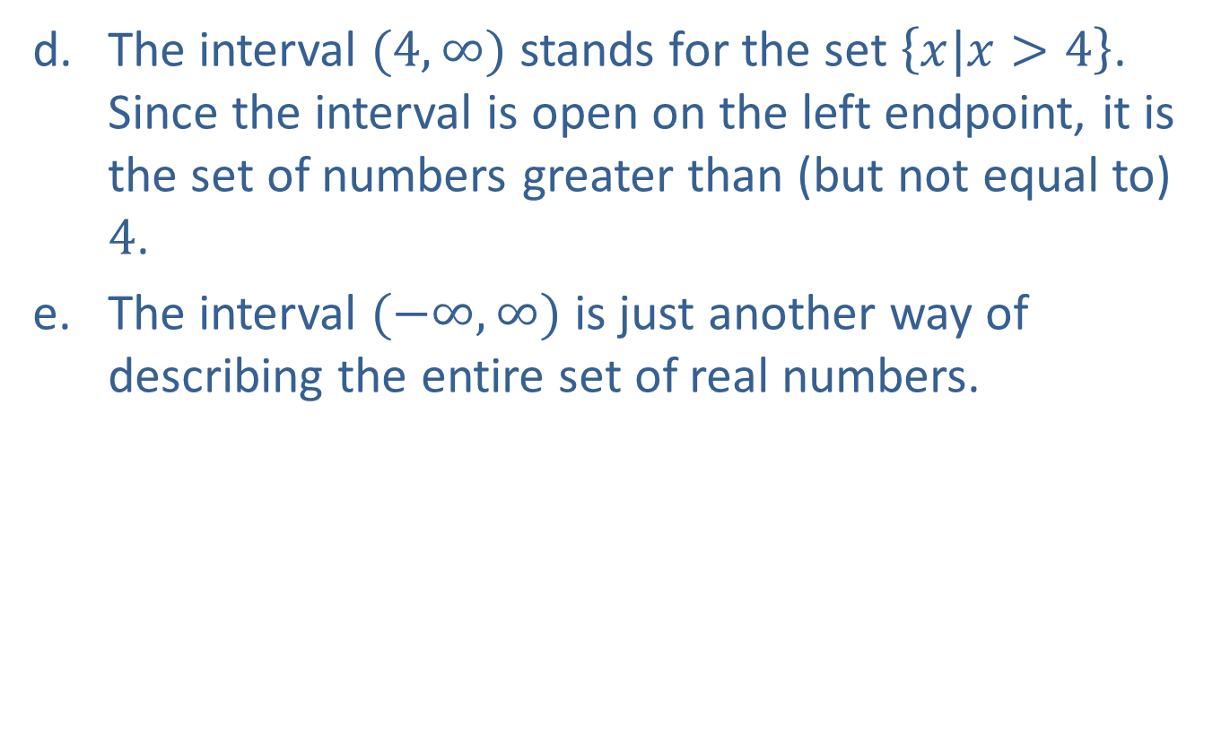
Example 5: Intervals of Real Numbers (cont.)
​The interval $(4,∞)$ stands for the set $\left\{x|x>4\right\}$. Since the interval is open on the left endpoint, it is the set of numbers greater than (but not equal to) 4.
​The interval $(−∞,∞)$ is just another way of describing the entire set of real numbers.

Slide 19
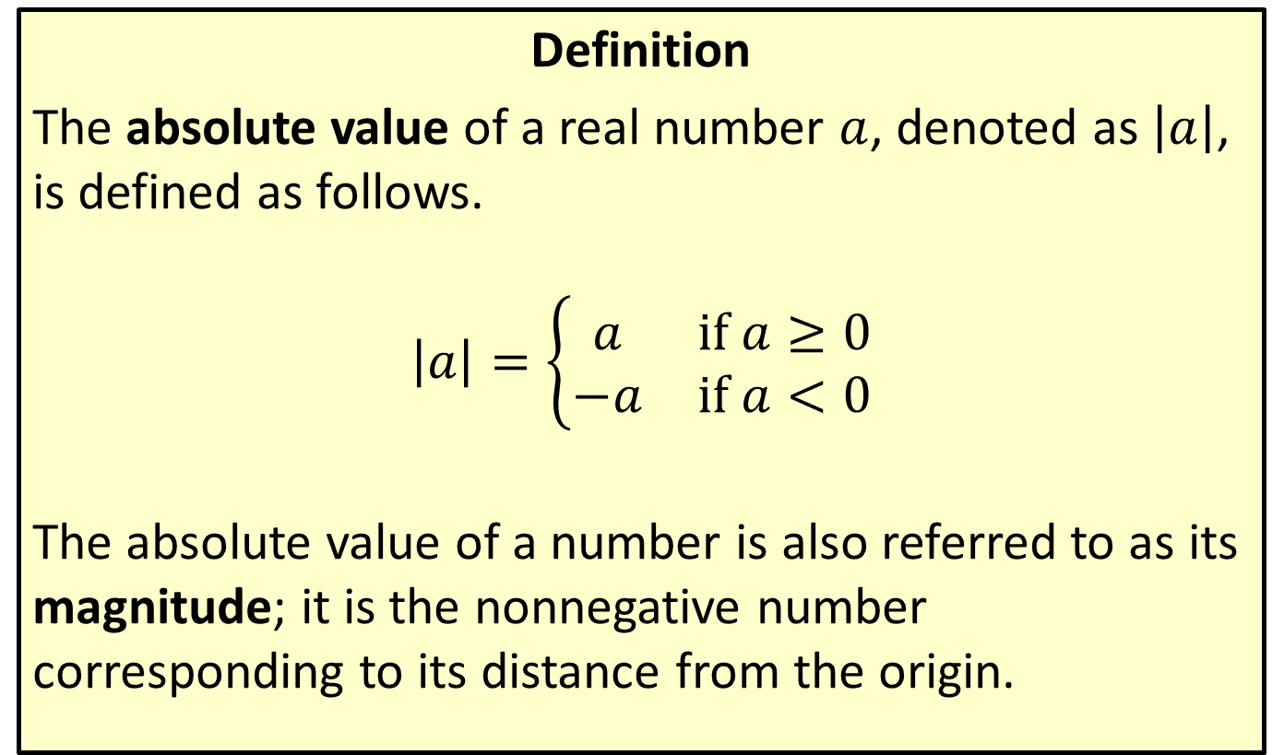
Absolute Value
Definition
The absolute value of a real number $a$, denoted as $\left|a\right|$, is defined as follows.
$$\left|a\right|=\left\{\begin{matrix}a & \text{if} a≥0 \\ −a & \text{if} a<0\end{matrix}\right.$$
The absolute value of a number is also referred to as its magnitude; it is the nonnegative number corresponding to its distance from the origin.

Slide 20
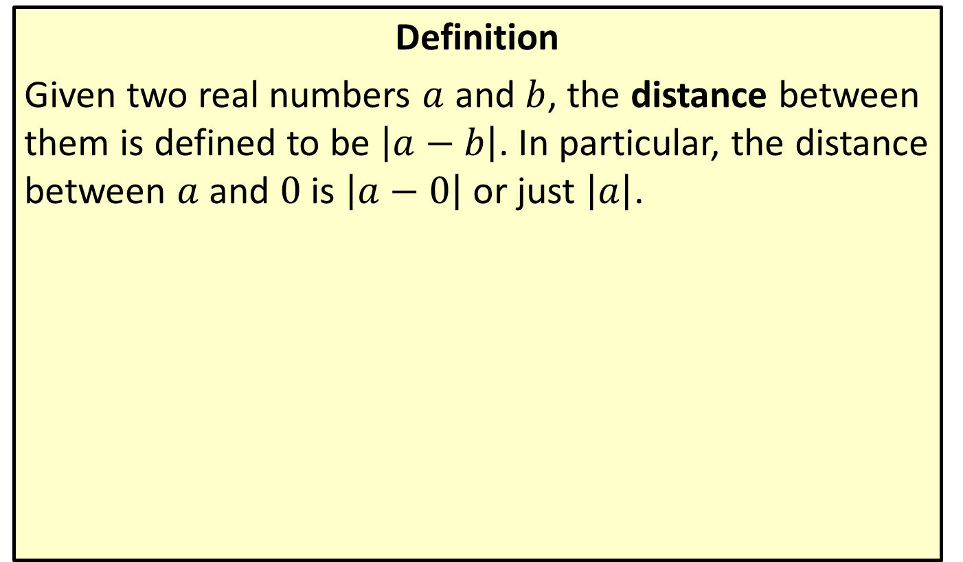
Distance on the Real Number Line
Definition
Given two real numbers $a$ and $b$, the distance between them is defined to be $\left|a−b\right|$. In particular, the distance between $a$ and 0 is $\left|a−0\right|$ or just $\left|a\right|$.

Slide 21

Example 6: Absolute Value
​$\left|17−3\right|=\left|3−17\right|=14$
$17$ and 3 are 14 units apart.
​$\left|−π\right|=\left|π\right|=π$
Both $−π$ and $π$ are $π$ units from 0.
​$\frac{\left|7\right|}{7}=\frac{7}{7}=1$
​$\frac{\left|−7\right|}{−7}=\frac{7}{−7}=−1$

Slide 22
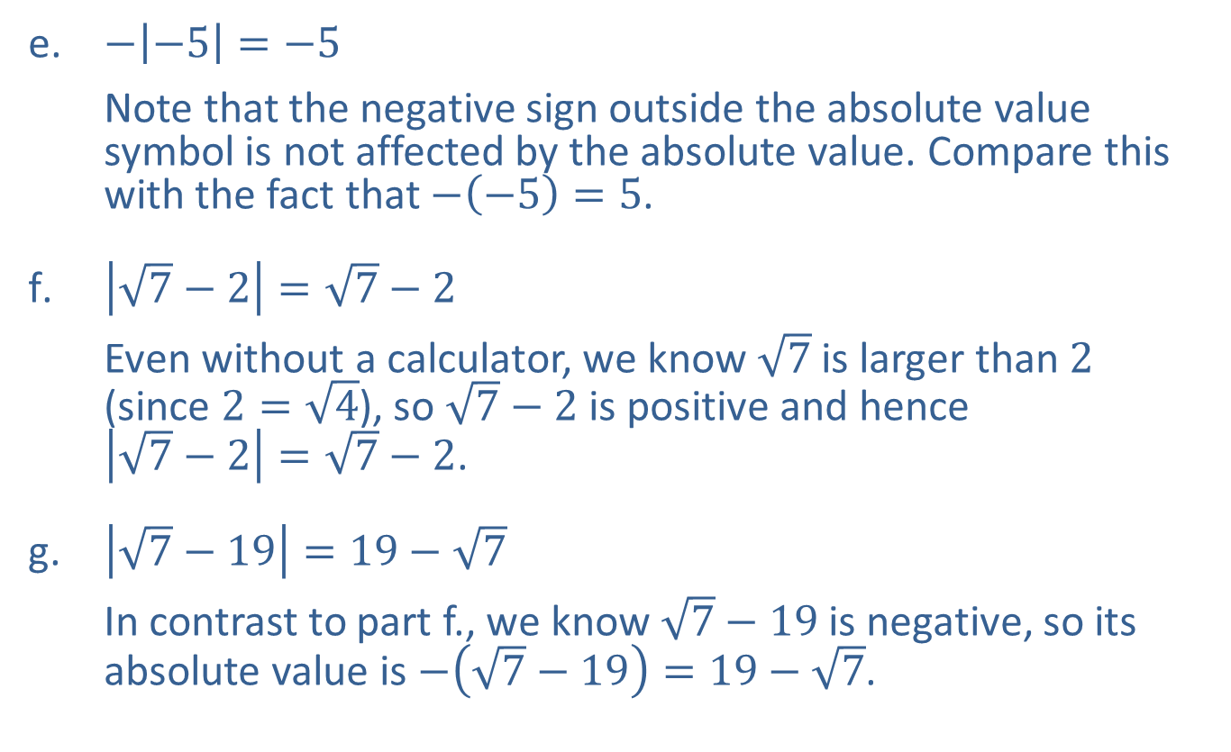
Example 6: Absolute Value (cont.)
​$−\left|−5\right|=−5$
Note that the negative sign outside the absolute value symbol is not affected by the absolute value. Compare this with the fact that $−\left(−5\right)=5$.
​$\left|\sqrt{7}−2\right|=\sqrt{7}−2$
Even without a calculator, we know $\sqrt{7}$ is larger than 2
(since $2=\sqrt{4}$), so $\sqrt{7}−2$ is positive and hence
$\left|\sqrt{7}−2\right|=\sqrt{7}−2$.
​$\left|\sqrt{7}−19\right|=19−\sqrt{7}$
In contrast to part f., we know $\sqrt{7}−19$ is negative, so its absolute value is $−\left(\sqrt{7}−19\right)=19−\sqrt{7}$.

Slide 23
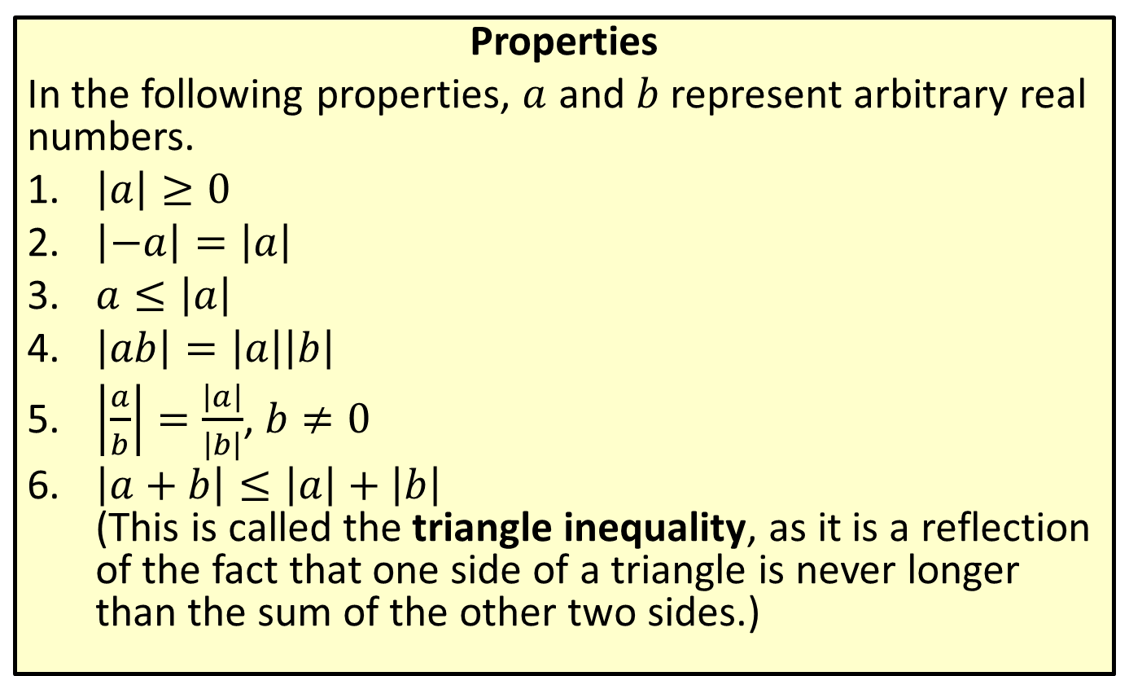
Properties of Absolute Value
Properties
In the following properties, $a$ and $b$ represent arbitrary real numbers.
​$\left|a\right|≥0$
​$\left|−a\right|=\left|a\right|$
​$a≤\left|a\right|$
​$\left|ab\right|=\left|a\right|\left|b\right|$
​$\left|\frac{a}{b}\right|=\frac{\left|a\right|}{\left|b\right|}$, $b≠0$
​$\left|a+b\right|≤\left|a\right|+\left|b\right|$
(This is called the triangle inequality, as it is a reflection of the fact that one side of a triangle is never longer than the sum of the other two sides.)

Slide 24

Example 7: Using Absolute Value Properties
​$\left|\left(−3\right)\left(5\right)\right|=\left|−15\right|=15=\left|−3\right|\left|5\right|$
​$1=\left|−3+4\right|≤\left|−3\right|+\left|4\right|=7$
​$7=\left|−3−4\right|≤\left|−3\right|+\left|−4\right|=7$
​$\left|\frac{−3}{7}\right|=\frac{\left|−3\right|}{\left|7\right|}=\frac{3}{7}$

Slide 25
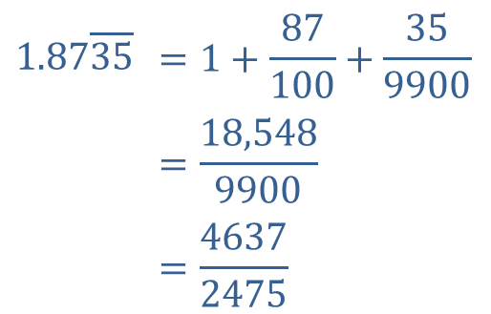
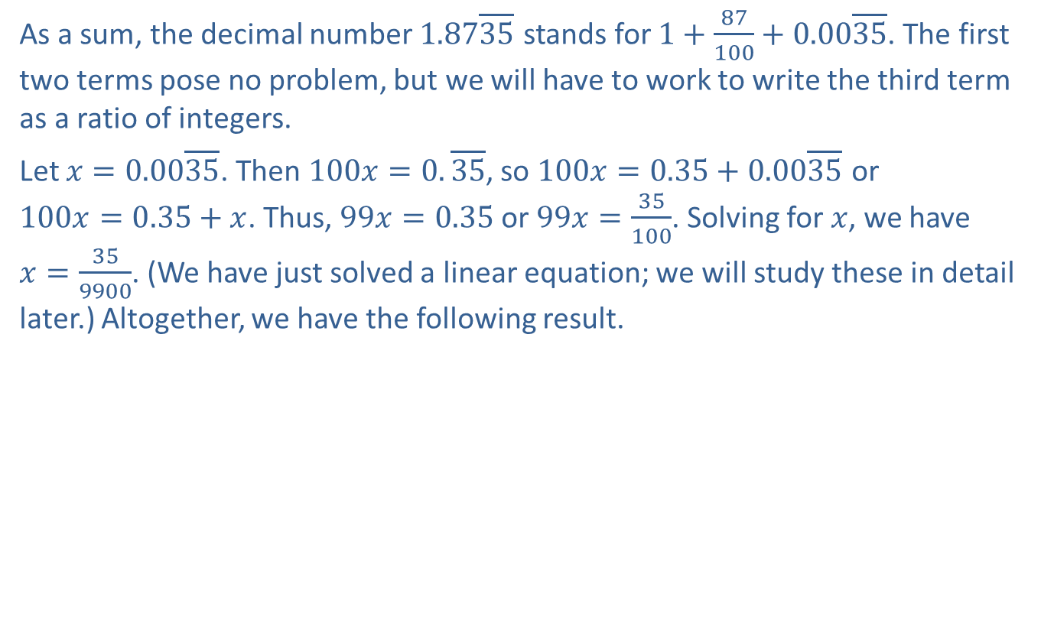
Example 8: Working With Repeating Digits
As a sum, the decimal number $1.87⁤\overline{35}$ stands for $1+\frac{87}{100}+0.00⁤\overline{35}$. The first two terms pose no problem, but we will have to work to write the third term as a ratio of integers.
Let $x=0.00⁤\overline{35}$. Then $100x=0.⁤\overline{35}$, so $100x=0.35+0.00⁤\overline{35}$ or
$100x=0.35+x$. Thus, $99x=0.35$ or $99x=\frac{35}{100}$. Solving for $x$, we have
$x=\frac{35}{9900}$. (We have just solved a linear equation; we will study these in detail later.) Altogether, we have the following result.
$$1.87⁤\overline{35}$$ | $$=1+\frac{87}{100}+\frac{35}{9900}$$
 | $$=\frac{18,548}{9900}$$
 | $$=\frac{4637}{2475}$$

