Slide 1
Section 1.2
The Arithmetic of Algebraic Expressions

Slide 2
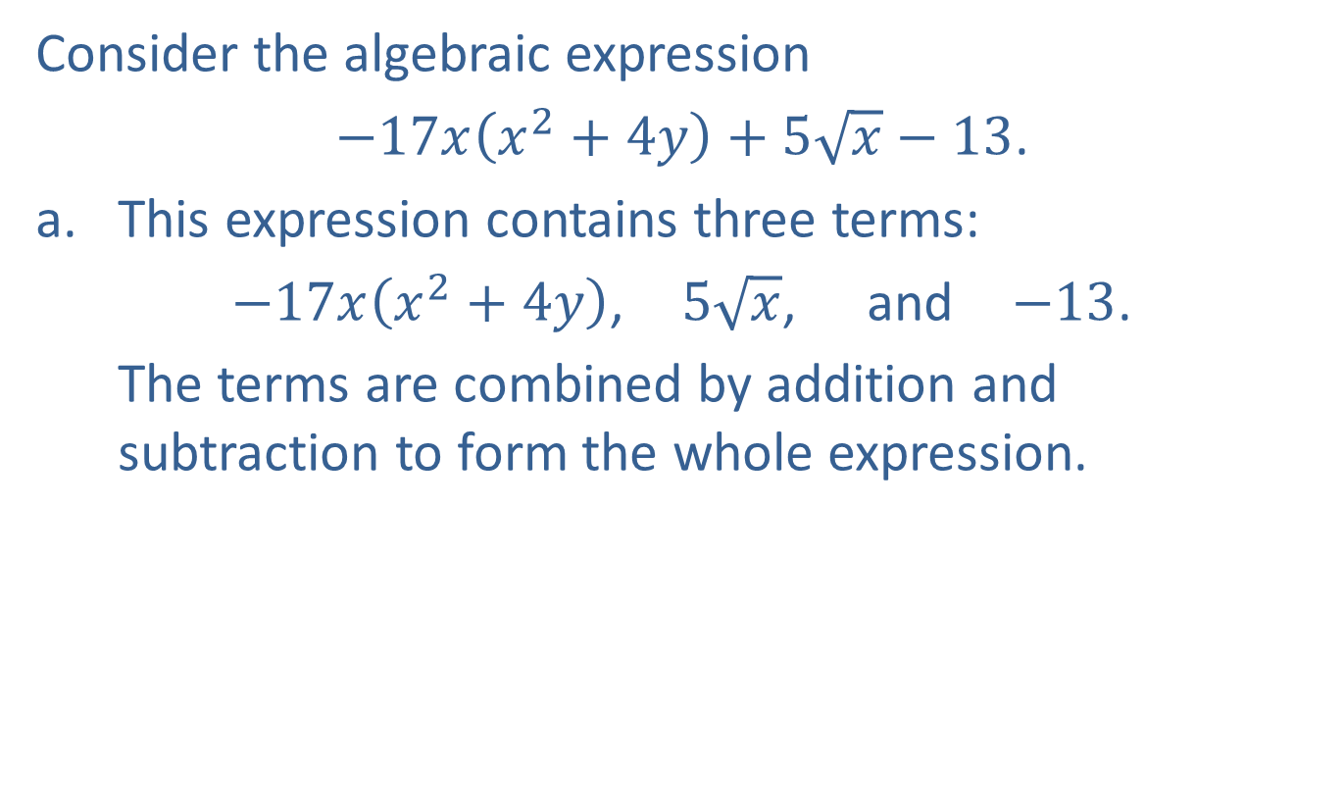
Example 1: Terminology of Algebraic Expressions
Consider the algebraic expression
$−17x\left(x^{2}+4y\right)+5\sqrt{x}−13$.
​This expression contains three terms:
$−17x\left(x^{2}+4y\right)$, $5\sqrt{x}$, and $−13$.
The terms are combined by addition and subtraction to form the whole expression.

Slide 3

Example 1: Terminology of Algebraic Expressions (cont.)
​The factors of the term $−17x\left(x^{2}+4y\right)$ are
$−17$, $x$, and $\left(x^{2}+4y\right)$.
The factors are combined by multiplication to form the whole term. The coefficient of $−17x\left(x^{2}+4y\right)$ is $−17$, and the variable factor is $x\left(x^{2}+4y\right)$.

Slide 4

Example 2: Evaluating Algebraic Expressions
Evaluate the following algebraic expressions.
​$5x^{3}−16$ for $x=4$
​$−3x^{2}−2\left(x+y\right)$ for $x=−2$ and $y=3$

Slide 5
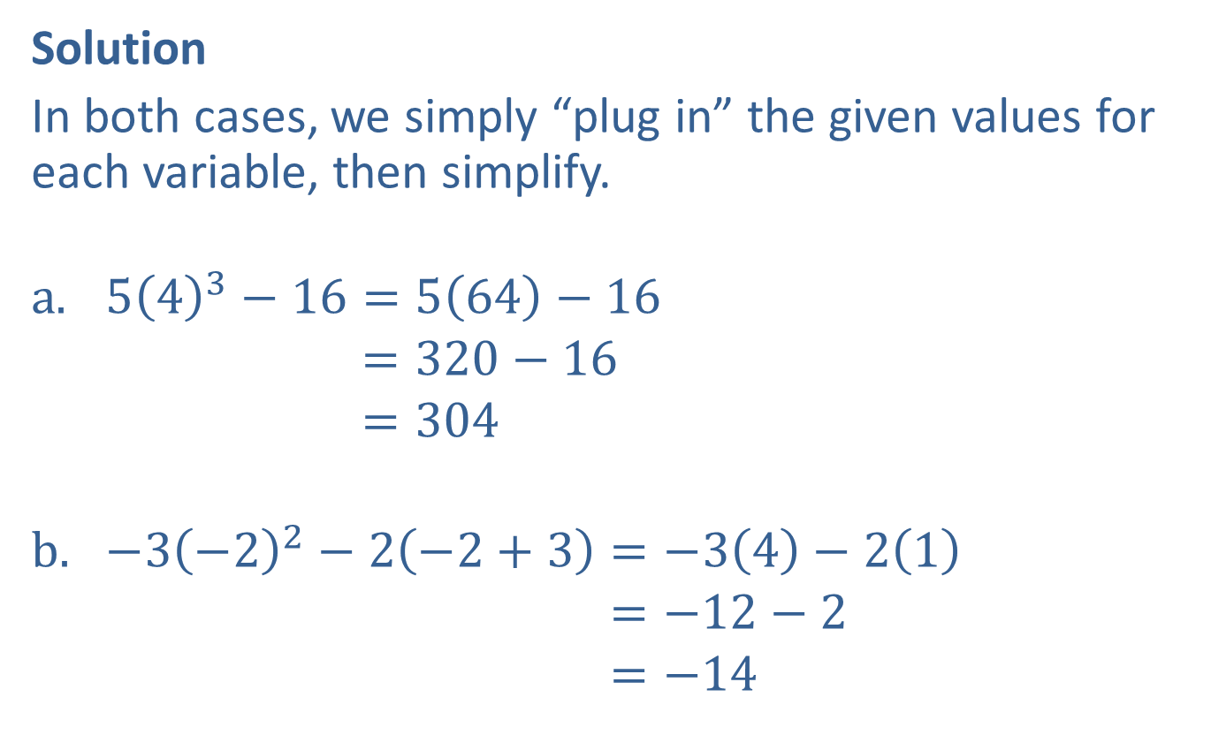
Example 2: Evaluating Algebraic Expressions (cont.)
Solution
In both cases, we simply “plug in” the given values for each variable, then simplify.
$5{\left(4\right)}^{3}−16=5\left(64\right)−16$
543−16=320−16543−16=304
$−3{\left(−2\right)}^{2}−2\left(−2+3\right)=−3\left(4\right)−2\left(1\right)$
−3−22−2−2+3=−12−2−3−22−2−2+3=−14

Slide 6
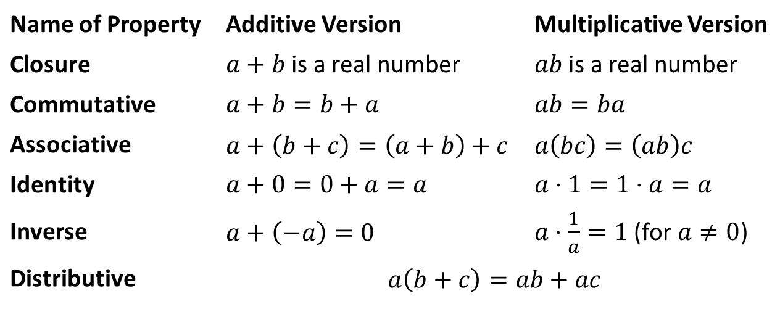

Field Properties
Properties
In the following properties, $a$, $b$, and $c$ represent arbitrary real numbers. The first five properties apply to addition and multiplication, while the last combines the two.
Name of Property | Additive Version | Multiplicative Version
Closure | $a+b$ is a real number | $ab$ is a real number
Commutative | $$a+b=b+a$$ | $$ab=ba$$
Associative | $$a+\left(b+c\right)=\left(a+b\right)+c$$ | $$a\left(bc\right)=\left(ab\right)c$$
Identity | $$a+0=0+a=a$$ | $$a⋅1=1⋅a=a$$
Inverse | $$a+\left(−a\right)=0$$ | $a⋅\frac{1}{a}=1$ (for $a≠0$)
Distributive | $$a\left(b+c\right)=ab+ac$$

Slide 7
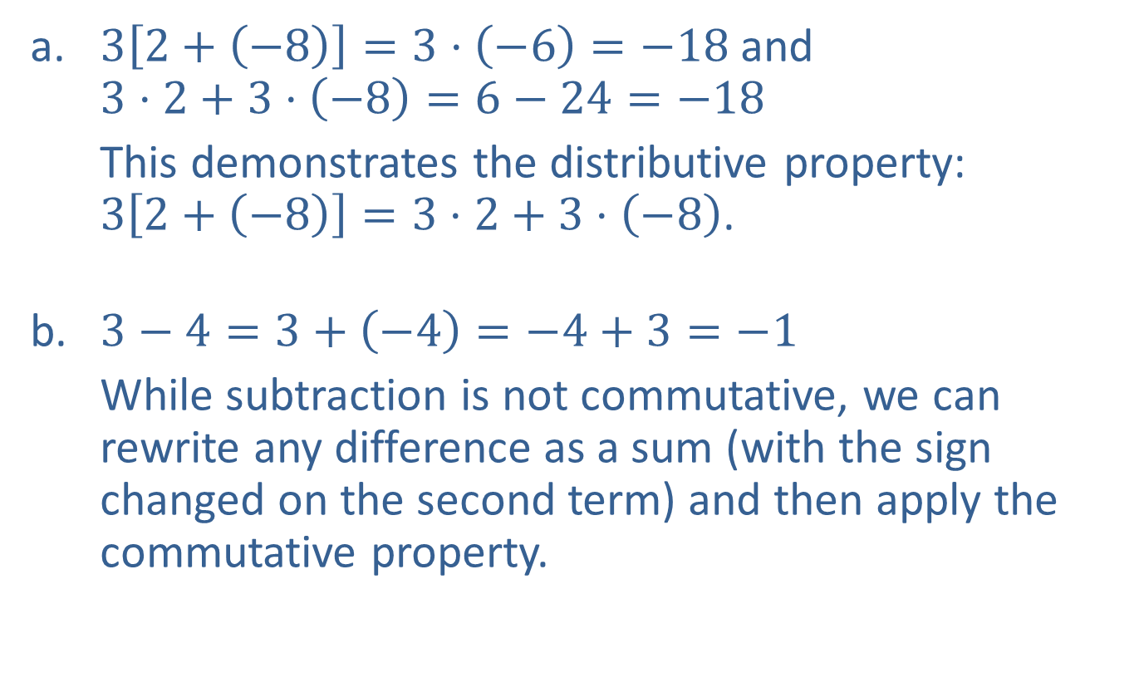
Example 3: Using the Field Properties
​$3\left[2+\left(−8\right)\right]=3⋅\left(−6\right)=−18$ and
$3⋅2+3⋅\left(−8\right)=6−24=−18$
​This demonstrates the distributive property:
$3\left[2+\left(−8\right)\right]=3⋅2+3⋅\left(−8\right)$.
​$3−4=3+\left(−4\right)=−4+3=−1$
​While subtraction is not commutative, we can rewrite any difference as a sum (with the sign changed on the second term) and then apply the commutative property.
​

Slide 8
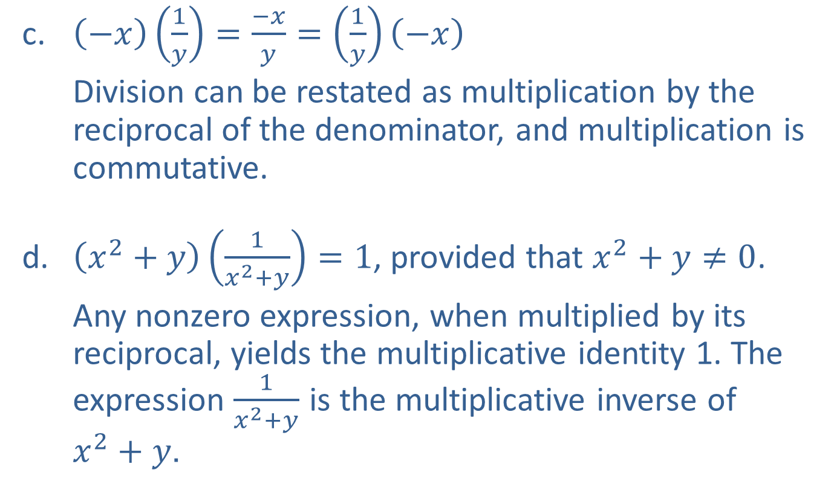
Example 3: Using the Field Properties (cont.)
​$\left(−x\right)\left(\frac{1}{y}\right)=\frac{−x}{y}=\left(\frac{1}{y}\right)\left(−x\right)$
​Division can be restated as multiplication by the reciprocal of the denominator, and multiplication is commutative.
​$\left(x^{2}+y\right)\left(\frac{1}{x^{2}+y}\right)=1$, provided that $x^{2}+y≠0$.
​Any nonzero expression, when multiplied by its reciprocal, yields the multiplicative identity 1. The expression $\frac{1}{x^{2}+y}$ is the multiplicative inverse of
$x^{2}+y$.

Slide 9

Example 4: Visualizing the Distributive Property
Consider the equation $a\left(b+c\right)=ab+ac$, which demonstrates the distributive property. We can represent the equation geometrically to understand why the distributive property works.

Slide 10
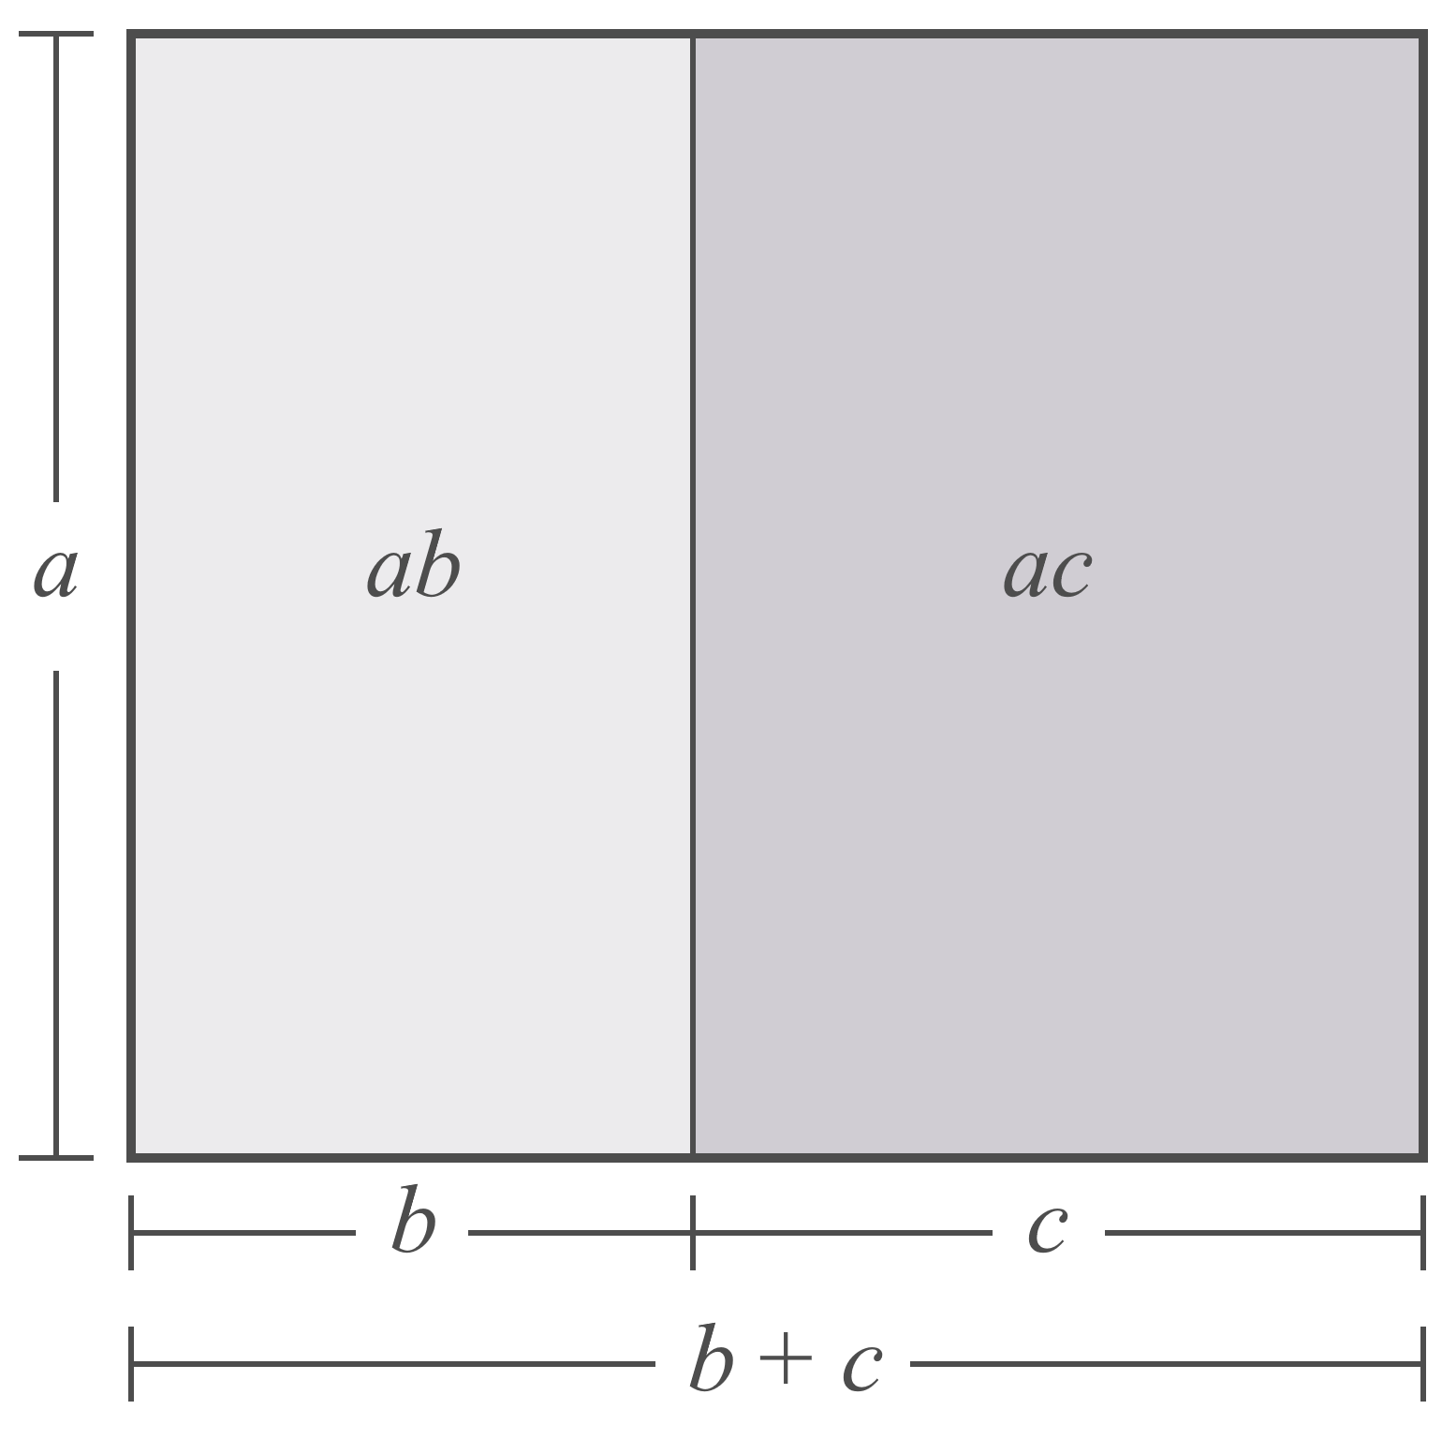
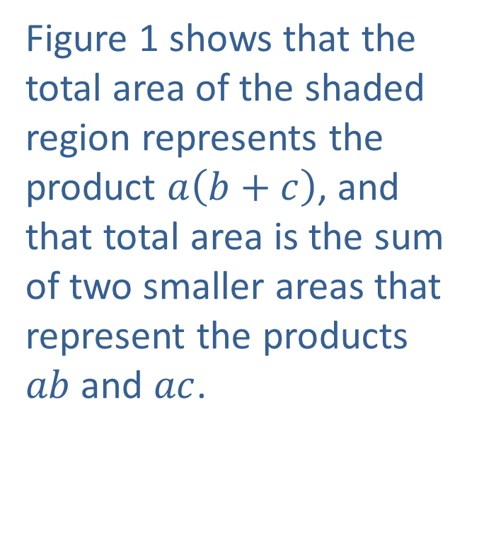
Example 4: Visualizing the Distributive Property (cont.)
Figure 1 shows that the total area of the shaded region represents the product $a\left(b+c\right)$, and that total area is the sum of two smaller areas that represent the products $ab$ and $ac$.
Figure 1

Slide 11
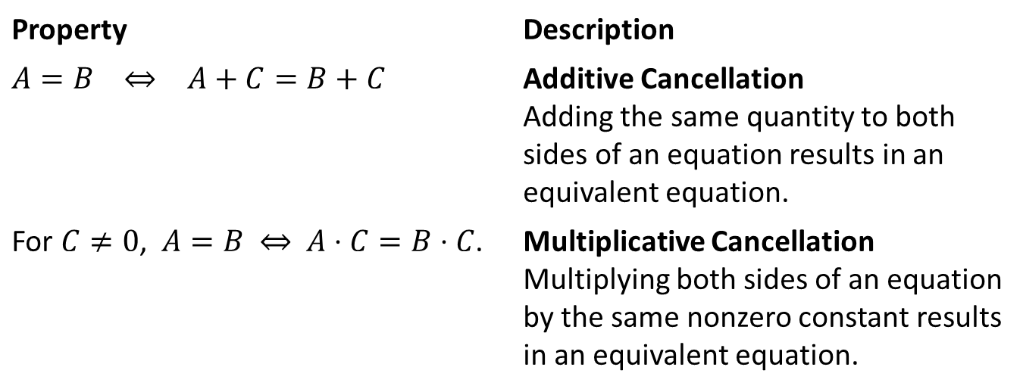

Cancellation Properties
Properties
In the following properties, $A$, $B$, and $C$ represent algebraic expressions. The symbol ⇔ can be read as “if and only if” or “is equivalent to.”
Property | Description
​$A=B$ ⇔ $A+C=B+C$ | Additive Cancellation Adding the same quantity to both sides of an equation results in an equivalent equation.
For $C≠0$, $A=B$ ⇔ $A⋅C=B⋅C$. | Multiplicative Cancellation Multiplying both sides of an equation by the same nonzero constant results in an equivalent equation.

Slide 12
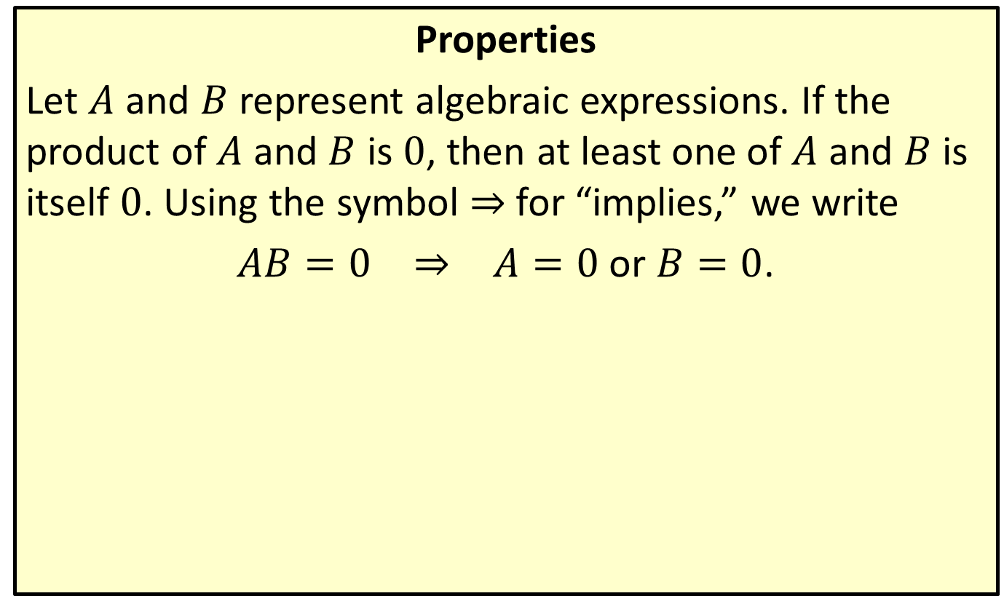
Zero-Factor Property
Properties
Let $A$ and $B$ represent algebraic expressions. If the product of $A$ and $B$ is 0, then at least one of $A$ and $B$ is itself 0. Using the symbol ⇒ for “implies,” we write
$AB=0$ ⇒ $A=0$ or $B=0$.

Slide 13
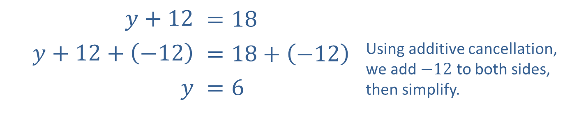

Example 5: Using the Cancellation and
Zero-Factor Properties
​$y+12$ | $$=18$$
​$y+12+\left(−12\right)$ | ​$=18+\left(−12\right)$ | Using additive cancellation, we add $−12$ to both sides, then simplify.
$$y$$ | ​$=6$
This shows that the equation $y+12=18$ is equivalent to the equation $y=6$.

Slide 14
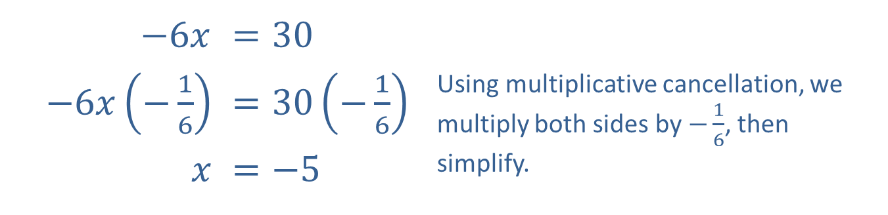

Example 5: Using the Cancellation and
Zero-Factor Properties (cont.)
​$−6x$ | ​$=30$
​$−6x\left(−\frac{1}{6}\right)$ | ​$=30\left(−\frac{1}{6}\right)$ | Using multiplicative cancellation, we multiply both sides by $−\frac{1}{6}$, then simplify.
$$x$$ | ​$=−5$
​
Alternatively, dividing both sides by $−6$ yields the same result. Thus, the equation $−6x=30$ is equivalent to $x=−5$. We can see how cancellation properties can help us solve equations for variables.

Slide 15
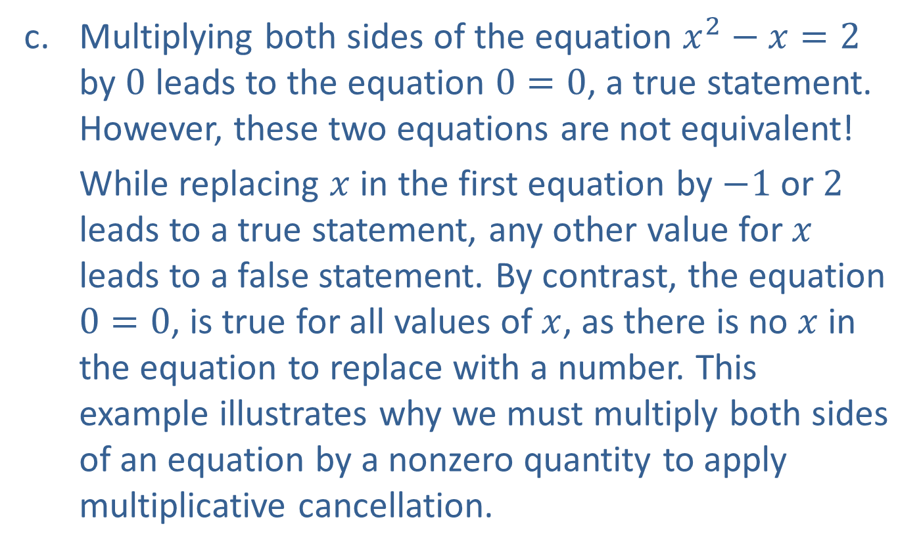
Example 5: Using the Cancellation and
Zero-Factor Properties (cont.)
​Multiplying both sides of the equation $x^{2}−x=2$ by 0 leads to the equation $0=0$, a true statement. However, these two equations are not equivalent!
​While replacing $x$ in the first equation by $−1$ or 2 leads to a true statement, any other value for $x$ leads to a false statement. By contrast, the equation $0=0$, is true for all values of $x$, as there is no $x$ in the equation to replace with a number. This example illustrates why we must multiply both sides of an equation by a nonzero quantity to apply multiplicative cancellation.

Slide 16
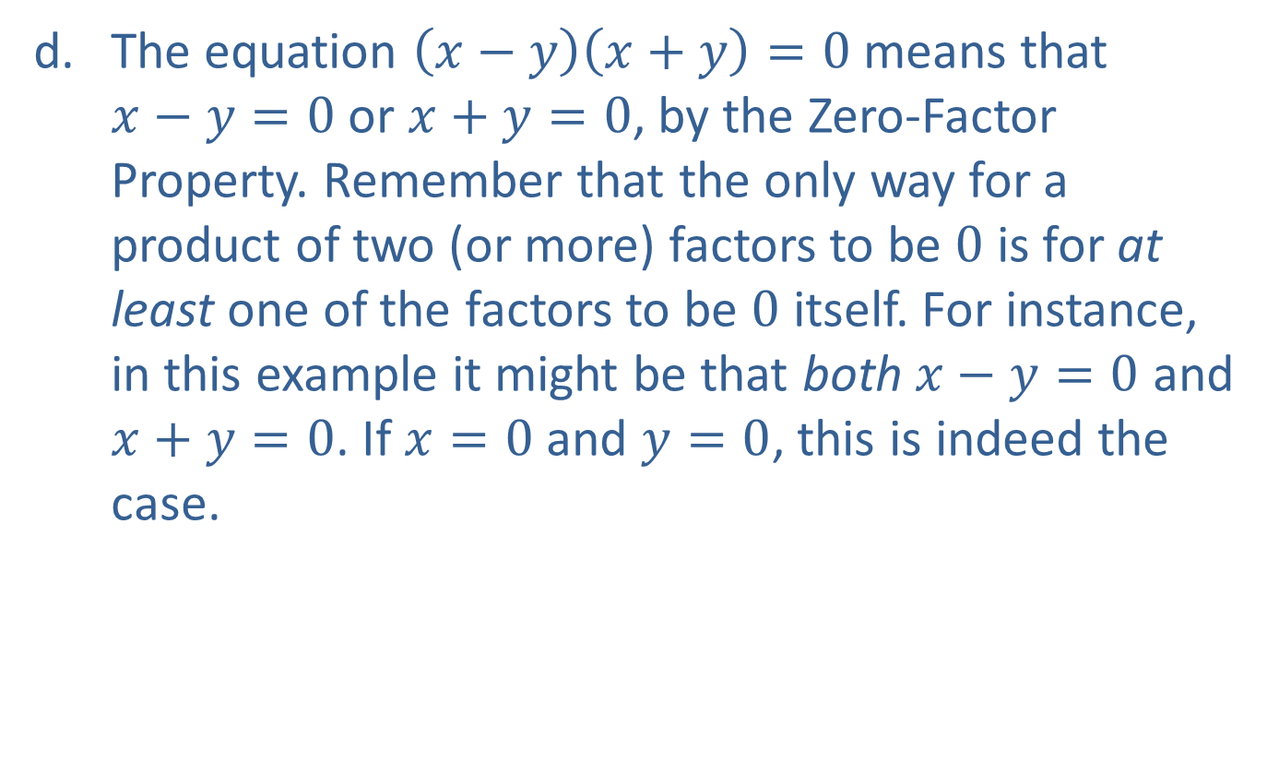
Example 5: Using the Cancellation and
Zero-Factor Properties (cont.)
​The equation $\left(x−y\right)\left(x+y\right)=0$ means that
$x−y=0$ or $x+y=0$, by the Zero-Factor Property. Remember that the only way for a product of two (or more) factors to be 0 is for at least one of the factors to be 0 itself. For instance, in this example it might be that both $x−y=0$ and $x+y=0$. If $x=0$ and $y=0$, this is indeed the case.

Slide 17
Order of Operations
Procedure
Step 1: If the expression is a fraction, simplify the numerator and denominator individually, according to the guidelines in the following steps.
Step 2: Parentheses, braces, and brackets are all used as grouping symbols. Simplify expressions within each set of grouping symbols, if any are present, working from the innermost outward.

Slide 18
Order of Operations (cont.)
Step 3: Simplify all powers (exponents) and roots.
Step 4: Perform all multiplication and division in the expression in the order that these operations occur, working from left to right.
Step 5: Perform all addition and subtraction in the expression in the order that these operations occur, working from left to right.

Slide 19

Example 6: Order of Operations
Simplify the following expressions using the correct order of operations.
​$4−\frac{6}{2}$
​$−3^{2}$
​$\frac{3−\left(3\sqrt{4}−2^{2}\right)\left(\frac{6}{−2}\right)}{3+2\left(−2\right)}$

Slide 20
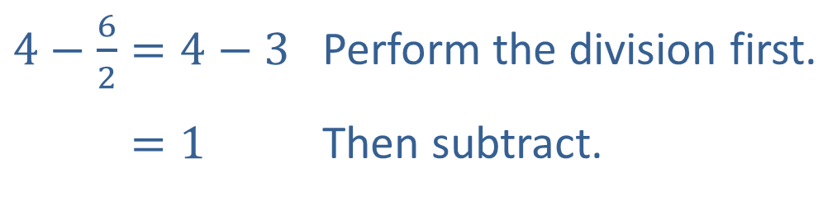
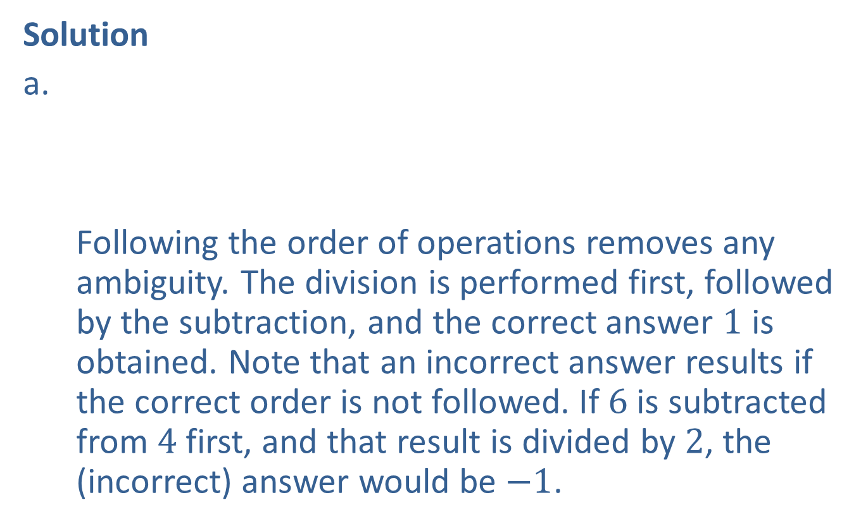
Example 6: Order of Operations (cont.)
Solution
Following the order of operations removes any ambiguity. The division is performed first, followed by the subtraction, and the correct answer 1 is obtained. Note that an incorrect answer results if the correct order is not followed. If 6 is subtracted from 4 first, and that result is divided by 2, the (incorrect) answer would be $−1$.​
​$4−\frac{6}{2}=4−3$ | Perform the division first.
​4−62=1 | Then subtract.

Slide 21
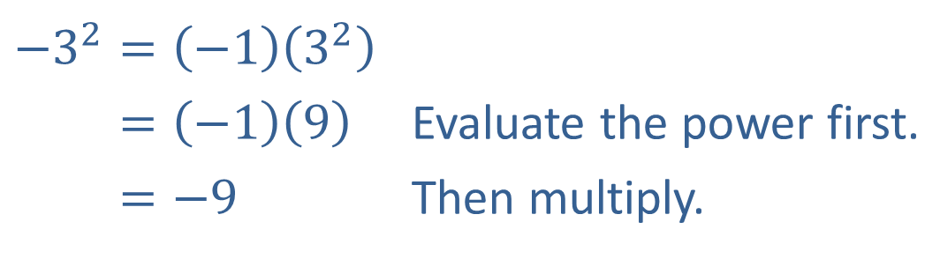
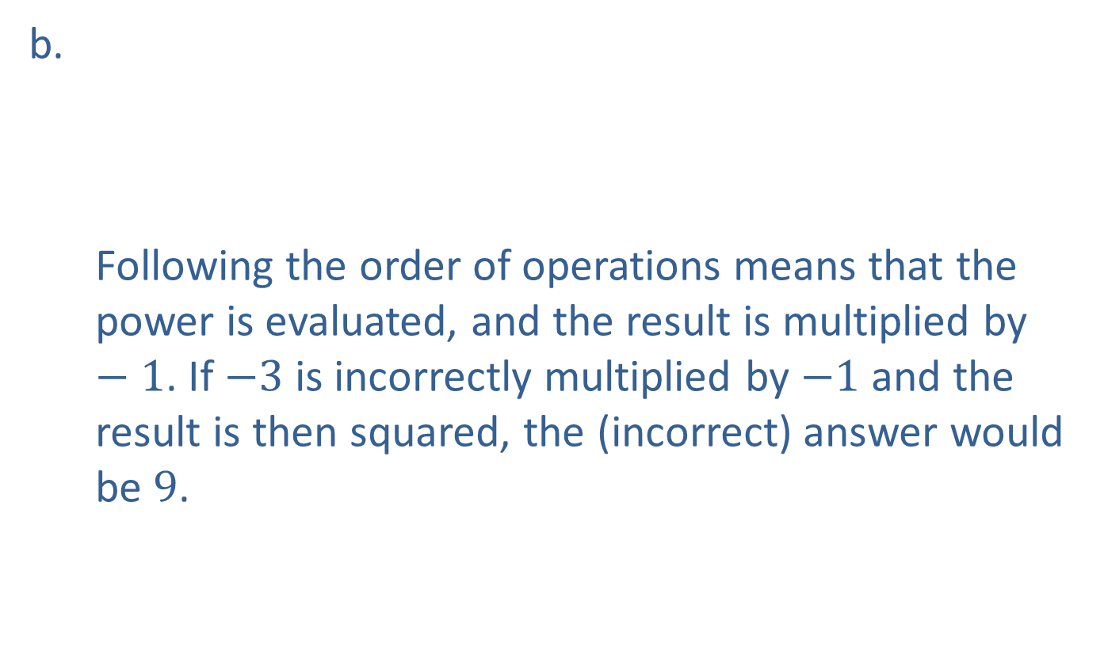
Example 6: Order of Operations (cont.)
​$−3^{2}=\left(−1\right)\left(3^{2}\right)$
​−32=−19 | Evaluate the power first.
​−32=−9 | Then multiply.
Following the order of operations means that the power is evaluated, and the result is multiplied by $−1$. If $−3$ is incorrectly multiplied by $−1$ and the result is then squared, the (incorrect) answer would be 9.​

Slide 22
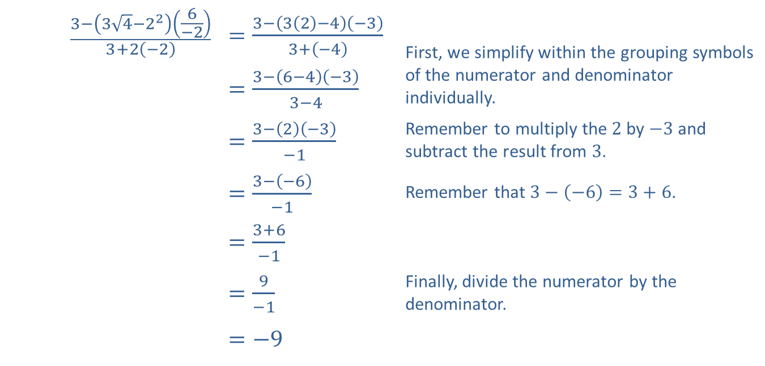
Example 6: Order of Operations (cont.)
$$\frac{3−\left(3\sqrt{4}−2^{2}\right)\left(\frac{6}{−2}\right)}{3+2\left(−2\right)}$$ | ​$=\frac{3−\left(3\left(2\right)−4\right)\left(−3\right)}{3+\left(−4\right)}$ | First, we simplify within the grouping symbols of the numerator and denominator individually.
 | ​$=\frac{3−\left(6−4\right)\left(−3\right)}{3−4}$
 | ​$=\frac{3−\left(2\right)\left(−3\right)}{−1}$ | Remember to multiply the 2 by $−3$ and subtract the result from 3.
 | ​$=\frac{3−\left(−6\right)}{−1}$ | Remember that $3−\left(−6\right)=3+6$.
 | ​$=\frac{3+6}{−1}$
 | ​$=\frac{9}{−1}$ | Finally, divide the numerator by the denominator.
 | ​$=−9$
​

Slide 23
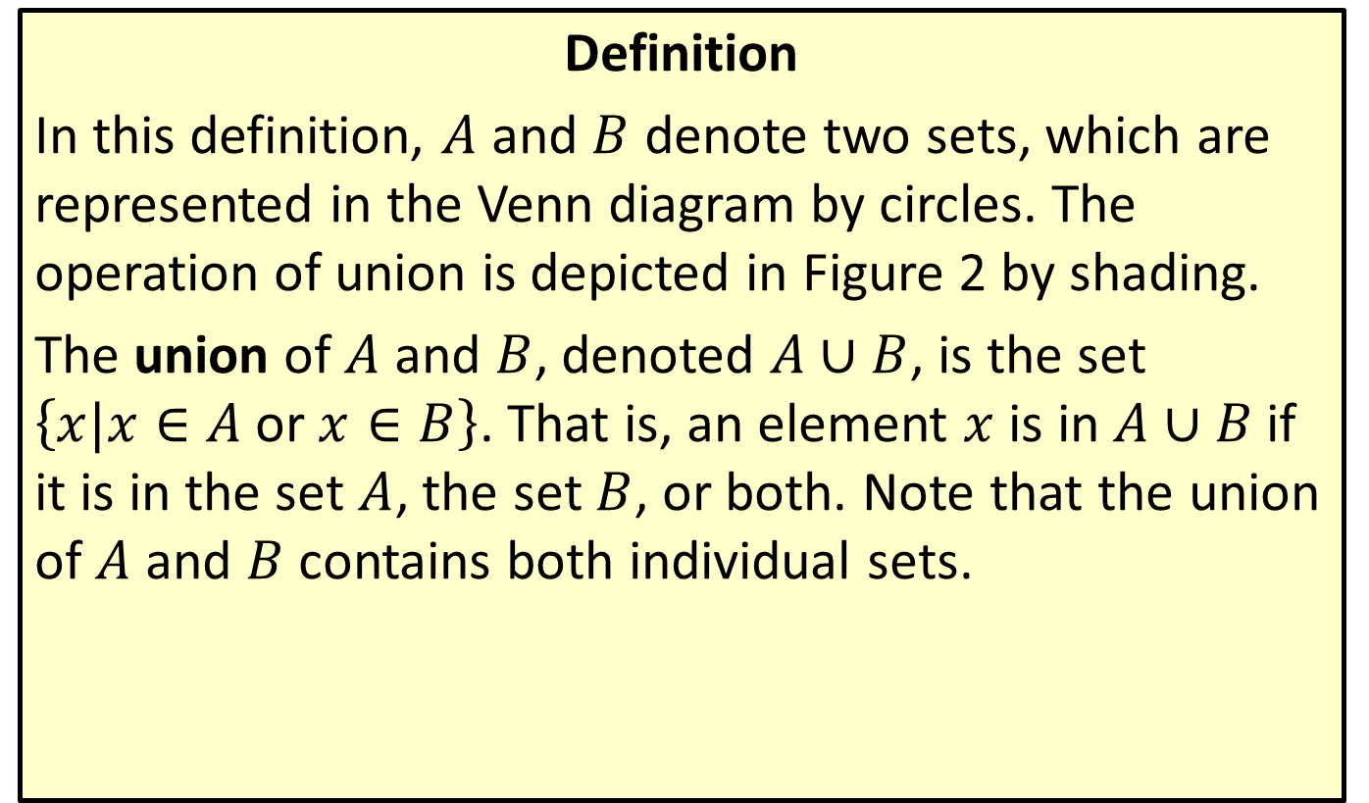
Union
Definition
In this definition, $A$ and $B$ denote two sets, which are represented in the Venn diagram by circles. The operation of union is depicted in Figure 2 by shading.
The union of $A$ and $B$, denoted $A∪B$, is the set $\left\{x|x∈A \text{or} x∈B\right\}$. That is, an element $x$ is in $A∪B$ if it is in the set $A$, the set $B$, or both. Note that the union of $A$ and $B$ contains both individual sets.

Slide 24
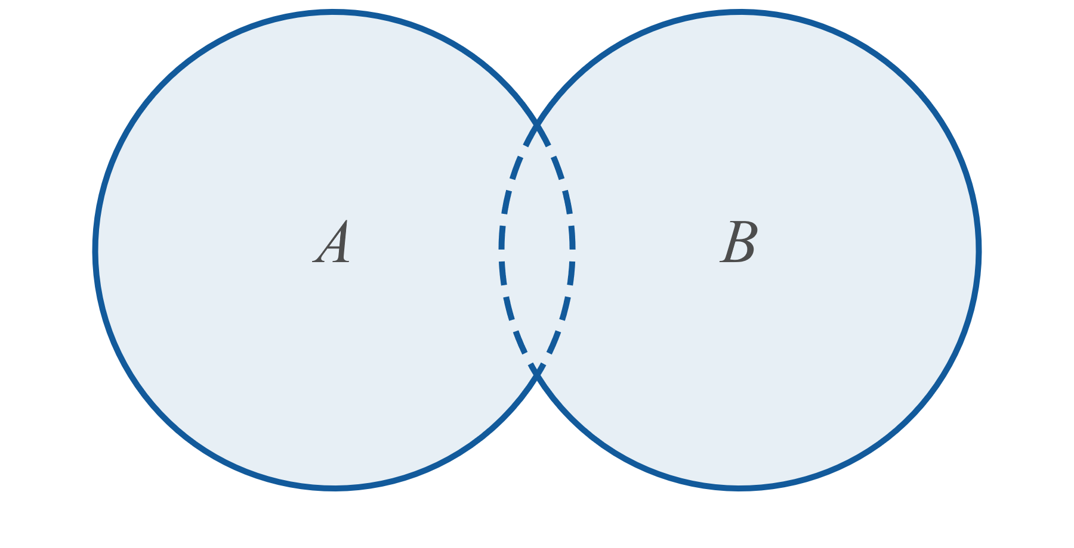
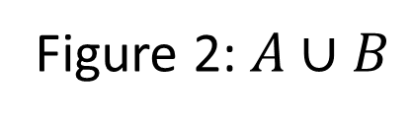
Union (cont.)
Figure 2: $A∪B$

Slide 25
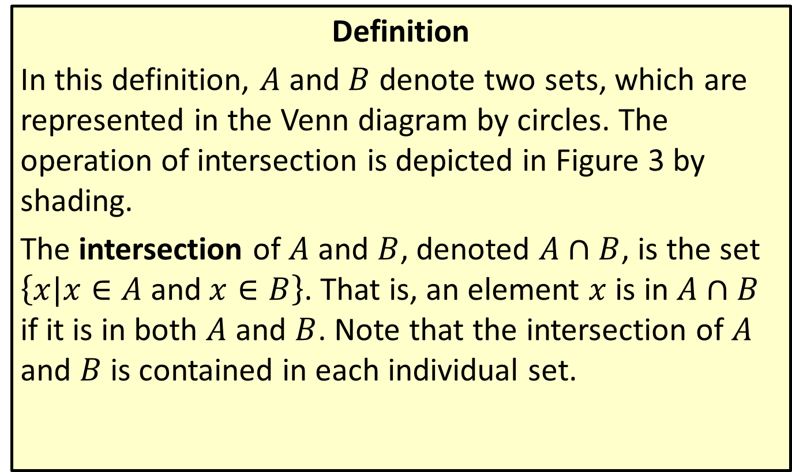
Intersection
Definition
In this definition, $A$ and $B$ denote two sets, which are represented in the Venn diagram by circles. The operation of intersection is depicted in Figure 3 by shading.
The intersection of $A$ and $B$, denoted $A∩B$, is the set $\left\{x|x∈A \text{and} x∈B\right\}$. That is, an element $x$ is in $A∩B$ if it is in both $A$ and $B$. Note that the intersection of $A$ and $B$ is contained in each individual set.

Slide 26
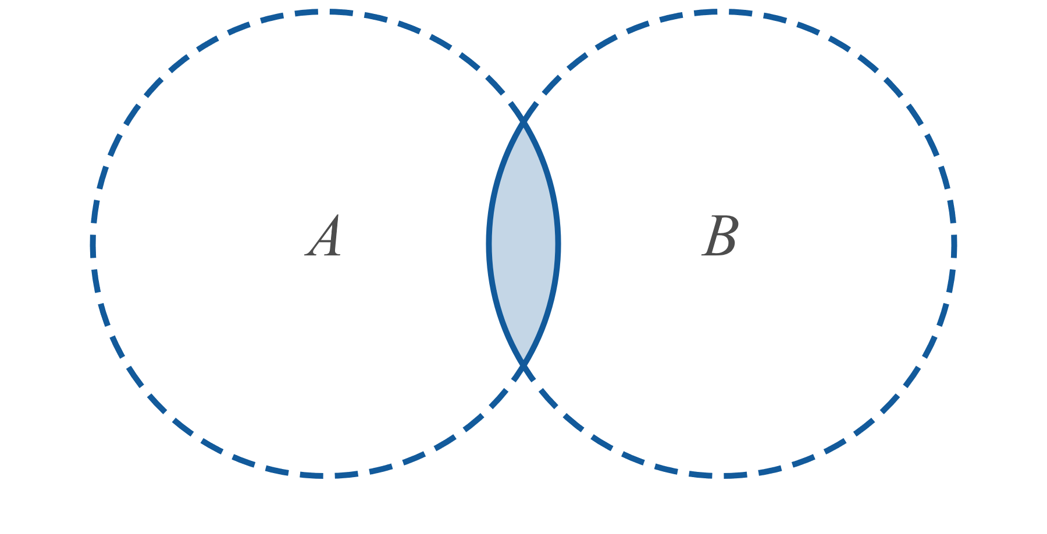
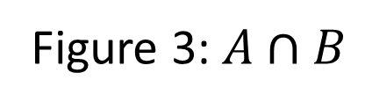
Intersection (cont.)
Figure 3: $A∩B$

Slide 27

Example 7: Union and Intersection of Intervals
Simplify the following set expressions.
​$\left(−2,4\right]∪\left[0,9\right]$
​$\left(−2,4\right]∩\left[0,9\right]$
​$\left[3,4\right)∩\left(4,9\right)$
​$\left(−∞,4\right]∪\left(−1,∞\right)$

Slide 28
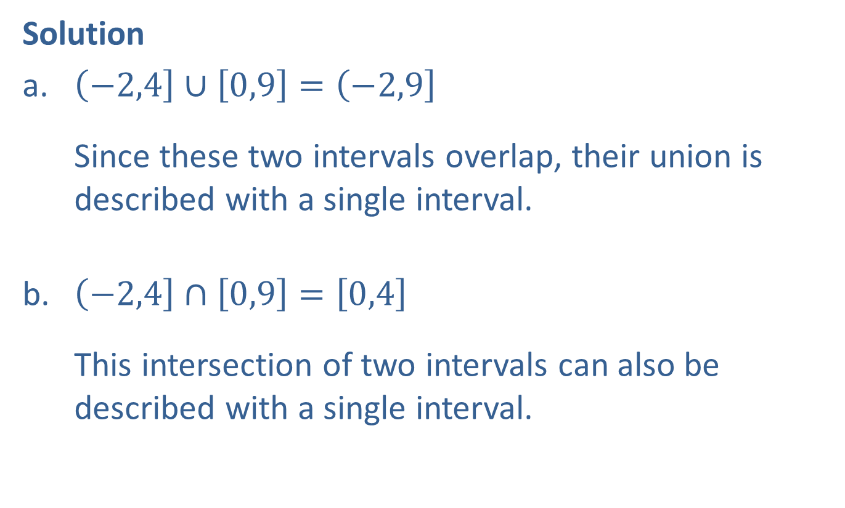
Example 7: Union and Intersection of Intervals (cont.)
Solution
​$\left(−2,4\right]∪\left[0,9\right]=\left(−2,9\right]$
Since these two intervals overlap, their union is described with a single interval.
​$\left(−2,4\right]∩\left[0,9\right]=\left[0,4\right]$
This intersection of two intervals can also be described with a single interval.

Slide 29
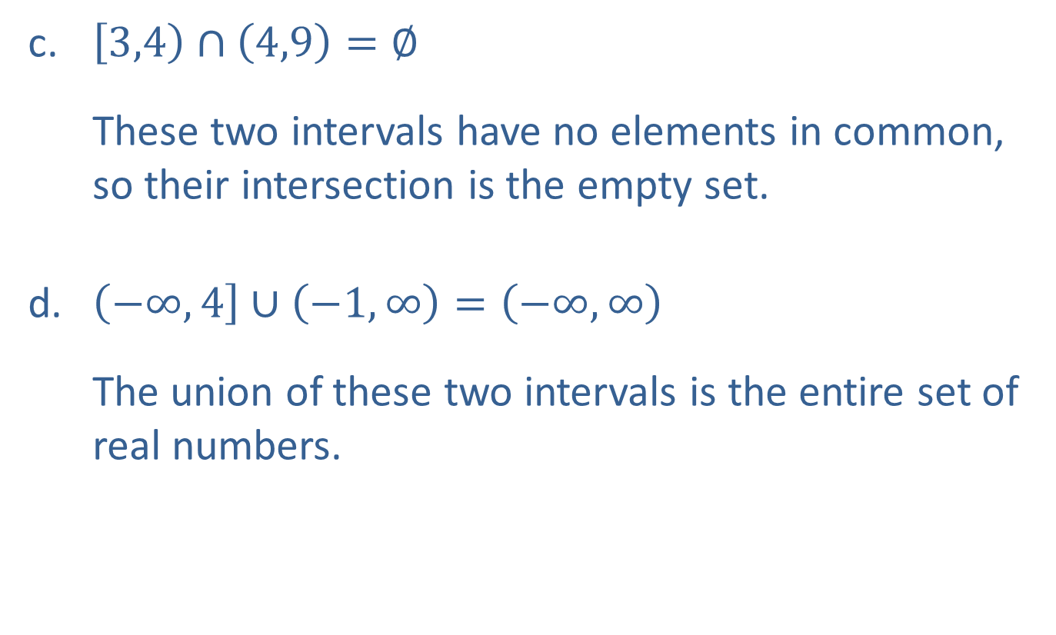
Example 7: Union and Intersection of Intervals (cont.)
​$\left[3,4\right)∩\left(4,9\right)=∅$
These two intervals have no elements in common, so their intersection is the empty set.
​$\left(−∞,4\right]∪\left(−1,∞\right)=\left(−∞,∞\right)$
The union of these two intervals is the entire set of real numbers.

Slide 30

Example 8: Union and Intersection
Simplify the following set expressions.
​$\left\{1,2\right\}∪\left\{0,3\right\}$
​$\left\{x,y,z\right\}∩\left\{w,x\right\}$
​$ℤ∪ℝ$
​$ℤ∩ℝ$

Slide 31
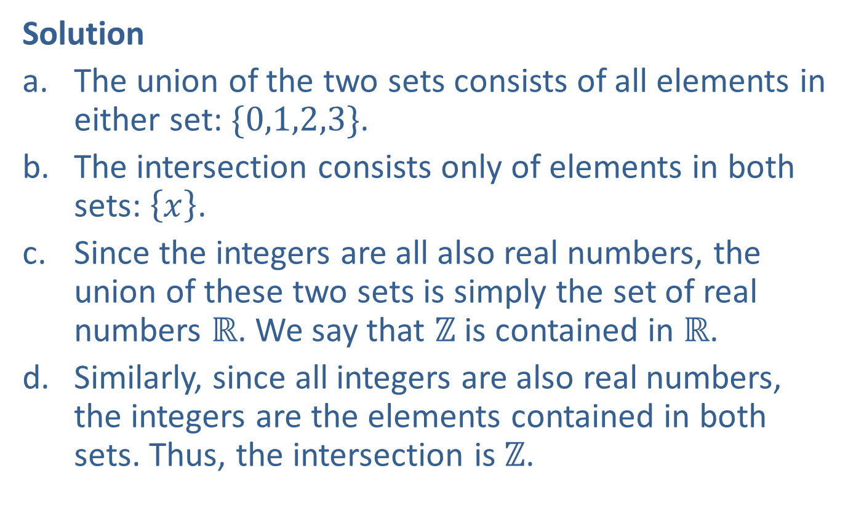
Example 8: Union and Intersection (cont.)
Solution
​The union of the two sets consists of all elements in either set: $\{0,1,2,3\}$.
​The intersection consists only of elements in both sets: $\left\{x\right\}$.
​Since the integers are all also real numbers, the union of these two sets is simply the set of real numbers $ℝ$. We say that $ℤ$ is contained in $ℝ$.
​Similarly, since all integers are also real numbers, the integers are the elements contained in both sets. Thus, the intersection is $ℤ$.

