Slide 1
Section 1.4
Properties of Radicals

Slide 2
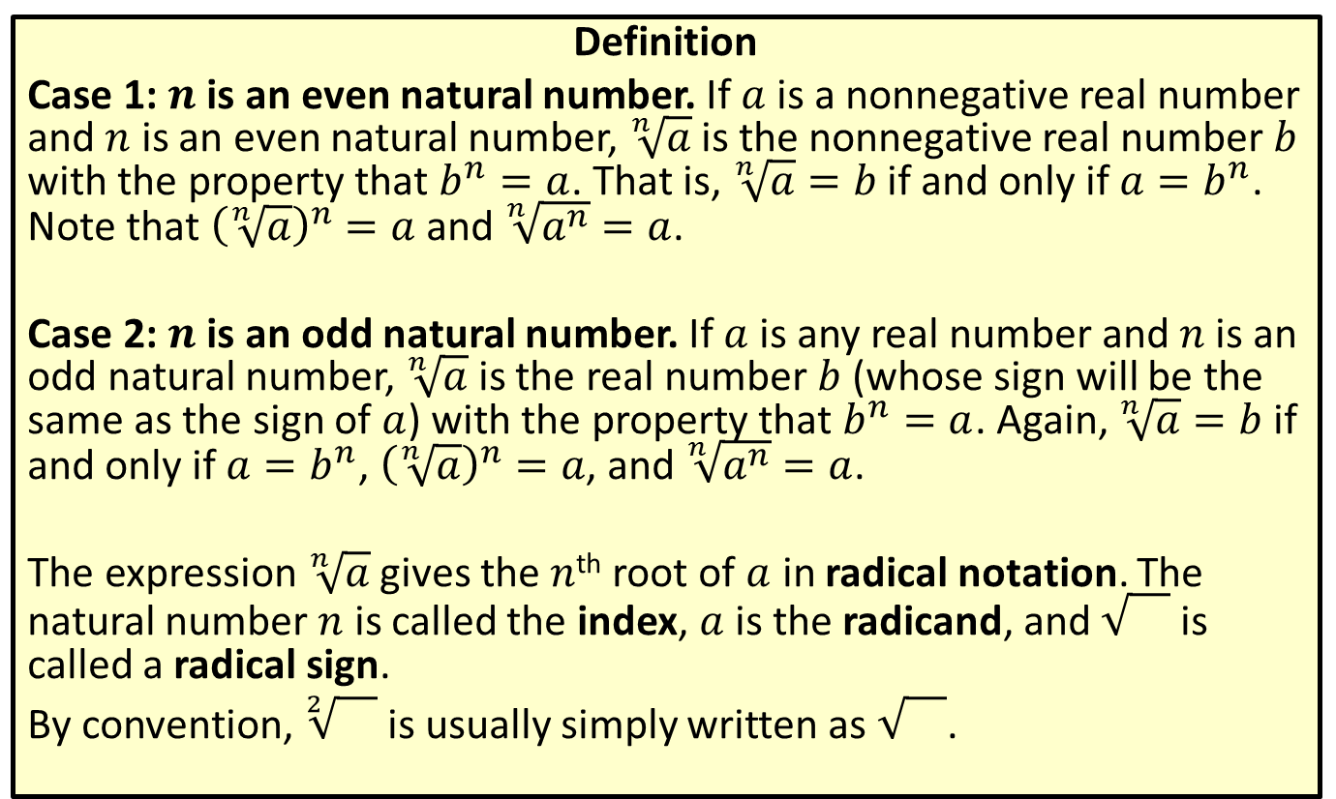
Radical Notation
Definition
Case 1: $n$ is an even natural number. If $a$ is a nonnegative real number and $n$ is an even natural number, $\sqrt[n]{a}$ is the nonnegative real number $b$ with the property that $b^{n}=a$. That is, $\sqrt[n]{a}=b$ if and only if $a=b^{n}$. Note that ${\left(\sqrt[n]{a}\right)}^{n}=a$ and $\sqrt[n]{a^{n}}=a$.
Case 2: $n$ is an odd natural number. If $a$ is any real number and $n$ is an odd natural number, $\sqrt[n]{a}$ is the real number $b$ (whose sign will be the same as the sign of $a$) with the property that $b^{n}=a$. Again, $\sqrt[n]{a}=b$ if and only if $a=b^{n}$, ${\left(\sqrt[n]{a}\right)}^{n}=a$, and $\sqrt[n]{a^{n}}=a$.
The expression $\sqrt[n]{a}$ gives the $n$^{th} root of $a$ in radical notation. The natural number $n$ is called the index, $a$ is the radicand, and is called a radical sign.
By convention, $\sqrt[2]{}$ is usually simply written as .

Slide 3
Perfect Powers
Definition
A perfect square is an integer equal to the square of another integer. The square root of a perfect square is always an integer.
A perfect cube is an integer equal to the cube of another integer. The cube root of a perfect cube is always an integer.

Slide 4
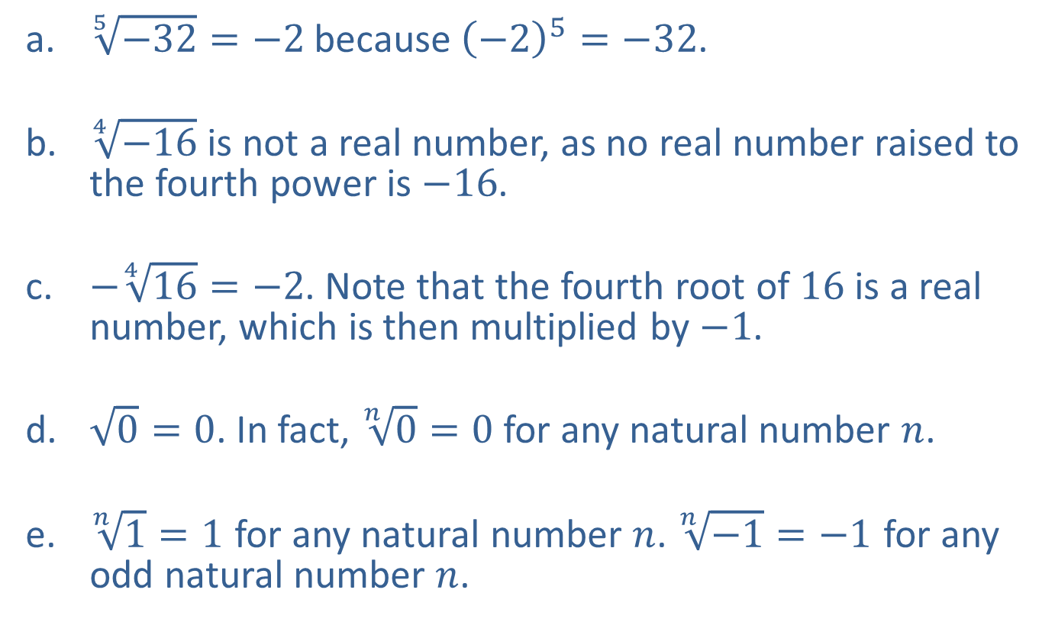
Example 1: Using Radical Notation
​$\sqrt[5]{−32}=−2$ because ${\left(−2\right)}^{5}=−32$.
​$\sqrt[4]{−16}$ is not a real number, as no real number raised to the fourth power is $−16$.
​$−\sqrt[4]{16}=−2$. Note that the fourth root of 16 is a real number, which is then multiplied by $−1$.
​$\sqrt{0}=0$. In fact, $\sqrt[n]{0}=0$ for any natural number $n$.
​​$\sqrt[n]{1}=1$ for any natural number $n$. $\sqrt[n]{−1}=−1$ for any odd natural number $n$.

Slide 5
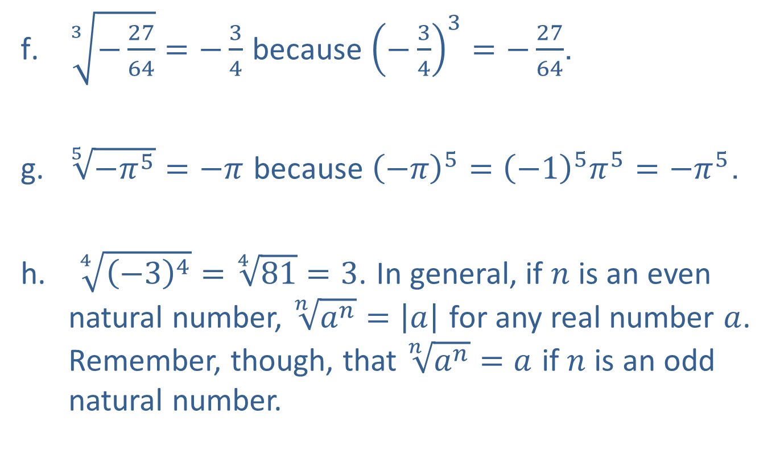
Example 1: Using Radical Notation (cont.)
​$\sqrt[3]{−\frac{27}{64}}=−\frac{3}{4}$ because ${\left(−\frac{3}{4}\right)}^{3}=−\frac{27}{64}$.
​$\sqrt[5]{−π^{5}}=−π$ because ${\left(−π\right)}^{5}={\left(−1\right)}^{5}π^{5}=−π^{5}$.
$\sqrt[4]{{\left(−3\right)}^{4}}=\sqrt[4]{81}=3$. In general, if $n$ is an even natural number, $\sqrt[n]{a^{n}}=\left|a\right|$ for any real number $a$. Remember, though, that $\sqrt[n]{a^{n}}=a$ if $n$ is an odd natural number.

Slide 6
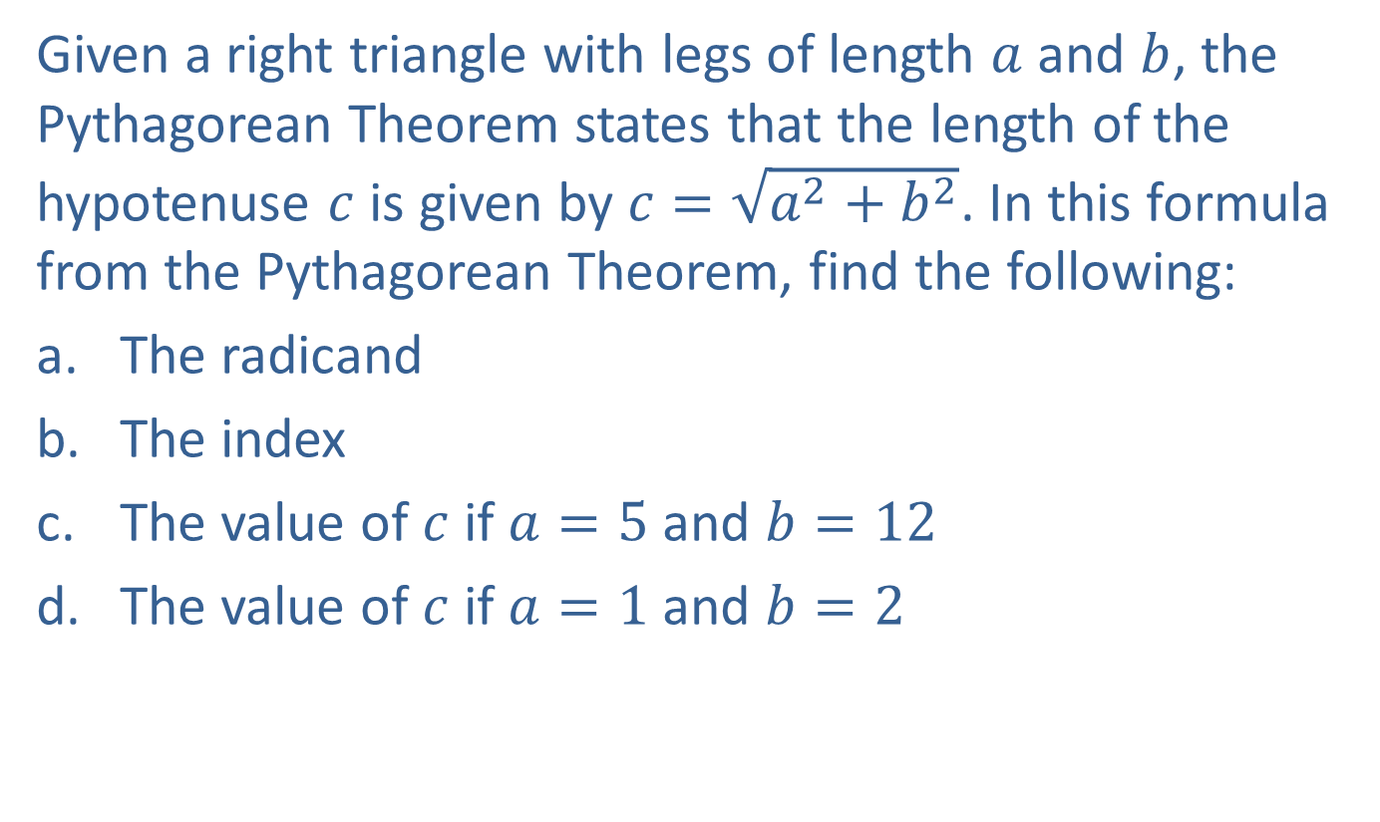
Example 2: Using Radical Notation
Given a right triangle with legs of length $a$ and $b$, the Pythagorean Theorem states that the length of the hypotenuse $c$ is given by $c=\sqrt{a^{2}+b^{2}}$. In this formula from the Pythagorean Theorem, find the following:
​The radicand
​The index
​The value of $c$ if $a=5$ and $b=12$
​The value of $c$ if $a=1$ and $b=2$

Slide 7

Example 2: Using Radical Notation (cont.)
Solution
​The radicand is the quantity beneath the radical sign, $a^{2}+b^{2}$.
​Because no index is indicated, the index is 2.
​

Slide 8
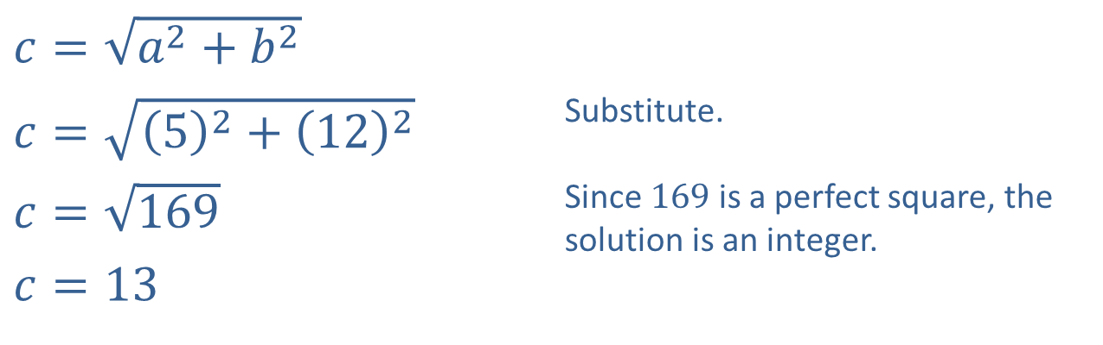
Example 2: Using Radical Notation (cont.)
​$c=\sqrt{a^{2}+b^{2}}$
​$c=\sqrt{{\left(5\right)}^{2}+{\left(12\right)}^{2}}$ | Substitute.
​$c=\sqrt{169}$ | Since 169 is a perfect square, the solution is an integer.
​$c=13$
c. ​

Slide 9
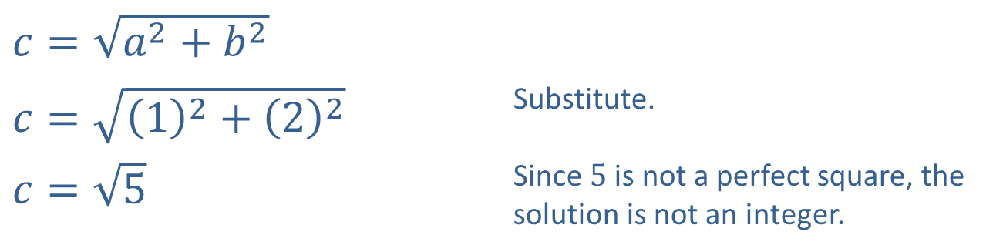
Example 2: Using Radical Notation (cont.)
​$c=\sqrt{a^{2}+b^{2}}$
​$c=\sqrt{{\left(1\right)}^{2}+{\left(2\right)}^{2}}$ | Substitute.
​$c=\sqrt{5}$ | Since 5 is not a perfect square, the solution is not an integer.
​

Slide 10
Simplified Radical Form
Definition
A radical expression is in simplified form when the following conditions are met:
​The radicand contains no factor with an exponent greater than or equal to the index of the radical.
​The radicand contains no fractions.
​The denominator, if there is one, contains no radical.
​The greatest common factor of the index and any exponent occurring in the radicand is 1. That is, the index and any exponent in the radicand have no common factor other than 1.

Slide 11
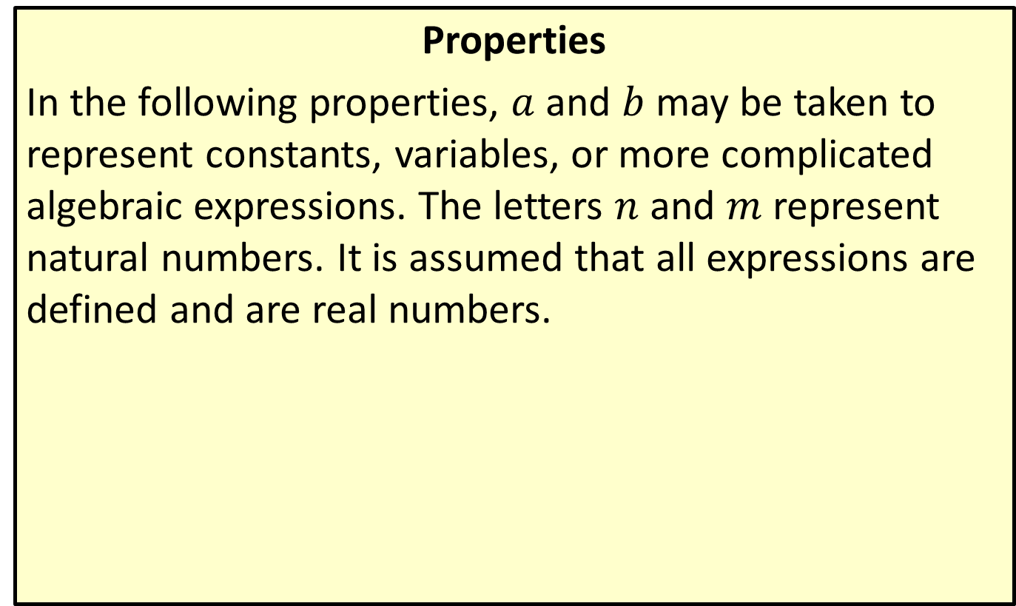
Properties of Radicals
Properties
In the following properties, $a$ and $b$ may be taken to represent constants, variables, or more complicated algebraic expressions. The letters $n$ and $m$ represent natural numbers. It is assumed that all expressions are defined and are real numbers.

Slide 12
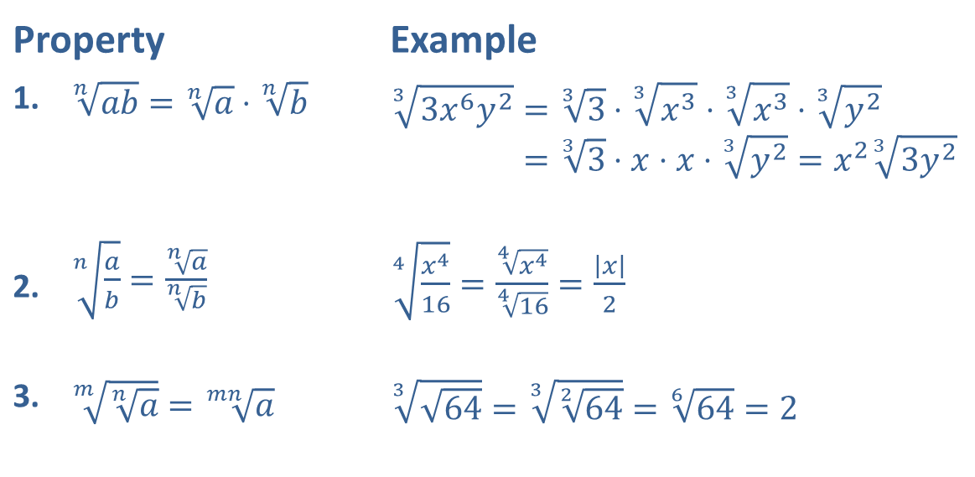
Properties of Radicals (cont.)
Property |  | Example
1. | ​$\sqrt[n]{ab}=\sqrt[n]{a}⋅\sqrt[n]{b}$ | 33𝑥6𝑦2=33⋅3𝑥3⋅3𝑥3⋅3𝑦233𝑥6𝑦2=33⋅𝑥⋅𝑥⋅3𝑦2=𝑥233𝑦2
2. | ​$\sqrt[n]{\frac{a}{b}}=\frac{\sqrt[n]{a}}{\sqrt[n]{b}}$ | ​$\sqrt[4]{\frac{x^{4}}{16}}=\frac{\sqrt[4]{x^{4}}}{\sqrt[4]{16}}=\frac{\left|x\right|}{2}$
3. | ​$\sqrt[m]{\sqrt[n]{a}}=\sqrt[mn]{a}$ | ​$\sqrt[3]{\sqrt{64}}=\sqrt[3]{\sqrt[2]{64}}=\sqrt[6]{64}=2$

Slide 13

Example 3: Simplifying Radical Expressions
Simplify the following radical expressions.
​$\sqrt[3]{−16x^{8}y^{4}}$
​$\sqrt{8z^{6}}$
​$\sqrt[3]{\frac{72x^{2}}{y^{3}}}$

Slide 14
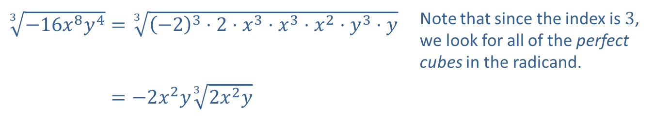
Example 3: Simplifying Radical Expressions (cont.)
Solution
​
​$\sqrt[3]{−16x^{8}y^{4}}=\sqrt[3]{{\left(−2\right)}^{3}⋅2⋅x^{3}⋅x^{3}⋅x^{2}⋅y^{3}⋅y}$ | Note that since the index is 3, we look for all of the perfect cubes in the radicand.
​3−16𝑥8𝑦4=−2𝑥2𝑦32𝑥2𝑦

Slide 15
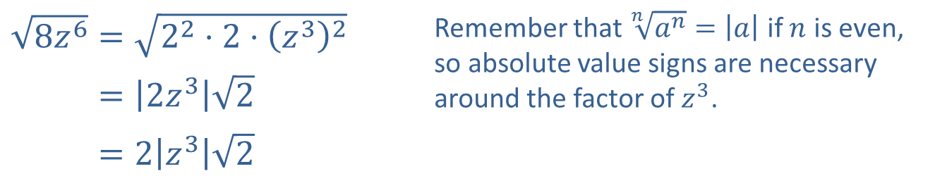
Example 3: Simplifying Radical Expressions (cont.)
​$\sqrt{8z^{6}}=\sqrt{2^{2}⋅2⋅{\left(z^{3}\right)}^{2}}$ | Remember that $\sqrt[n]{a^{n}}=\left|a\right|$ if $n$ is even, so absolute value signs are necessary around the factor of $z^{3}$.
​8𝑧6=2𝑧32
​8𝑧6=2𝑧32
​

Slide 16
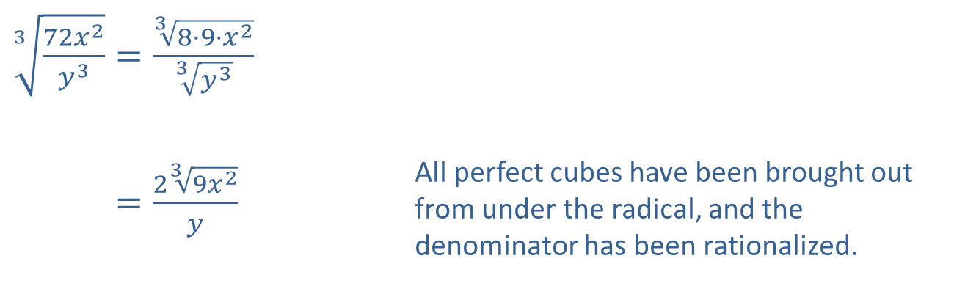
Example 3: Simplifying Radical Expressions (cont.)
​$\sqrt[3]{\frac{72x^{2}}{y^{3}}}=\frac{\sqrt[3]{8⋅9⋅x^{2}}}{\sqrt[3]{y^{3}}}$
​372𝑥2𝑦3=239𝑥2𝑦 | All perfect cubes have been brought out from under the radical, and the denominator has been rationalized.
​

Slide 17
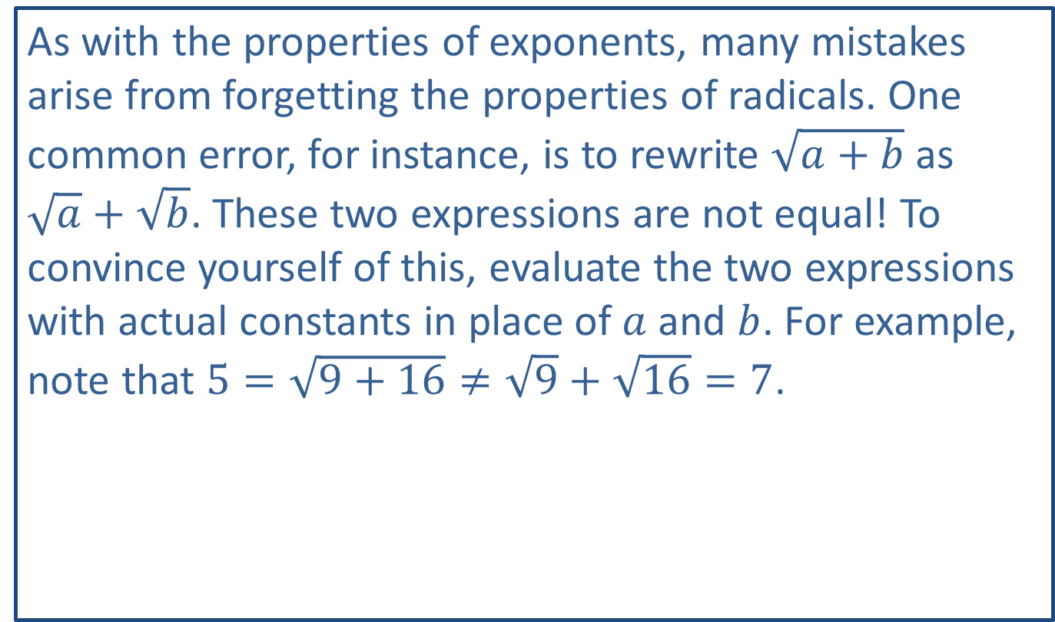
CAUTION!
As with the properties of exponents, many mistakes arise from forgetting the properties of radicals. One common error, for instance, is to rewrite $\sqrt{a+b}$ as
$\sqrt{a}+\sqrt{b}$. These two expressions are not equal! To convince yourself of this, evaluate the two expressions with actual constants in place of $a$ and $b$. For example, note that $5=\sqrt{9+16}≠\sqrt{9}+\sqrt{16}=7$.

Slide 18

Example 4: Rationalizing the Denominator
Simplify the following radical expressions.
​$\sqrt[5]{\frac{−4x^{6}}{8y^{2}}}$
​$\frac{4}{\sqrt{7}+\sqrt{3}}$
​$\frac{−\sqrt{5x}}{5−\sqrt{x}}$

Slide 19
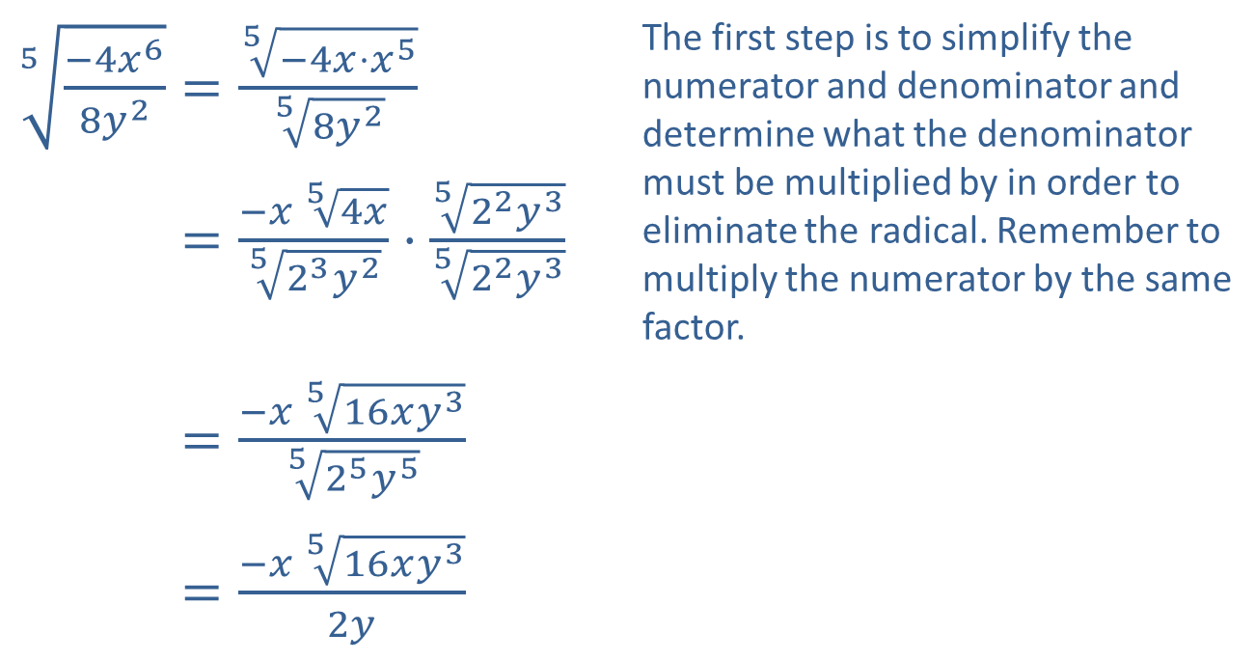
Example 4: Rationalizing the Denominator (cont.)
Solution
​
​$\sqrt[5]{\frac{−4x^{6}}{8y^{2}}}=\frac{\sqrt[5]{−4x⋅x^{5}}}{\sqrt[5]{8y^{2}}}$ | The first step is to simplify the numerator and denominator and determine what the denominator must be multiplied by in order to eliminate the radical. Remember to multiply the numerator by the same factor.
​5−4𝑥68𝑦2=−𝑥 54𝑥523𝑦2⋅522𝑦3522𝑦3
​5−4𝑥68𝑦2=−𝑥 516𝑥𝑦3525𝑦5
​5−4𝑥68𝑦2=−𝑥 516𝑥𝑦32𝑦

Slide 20
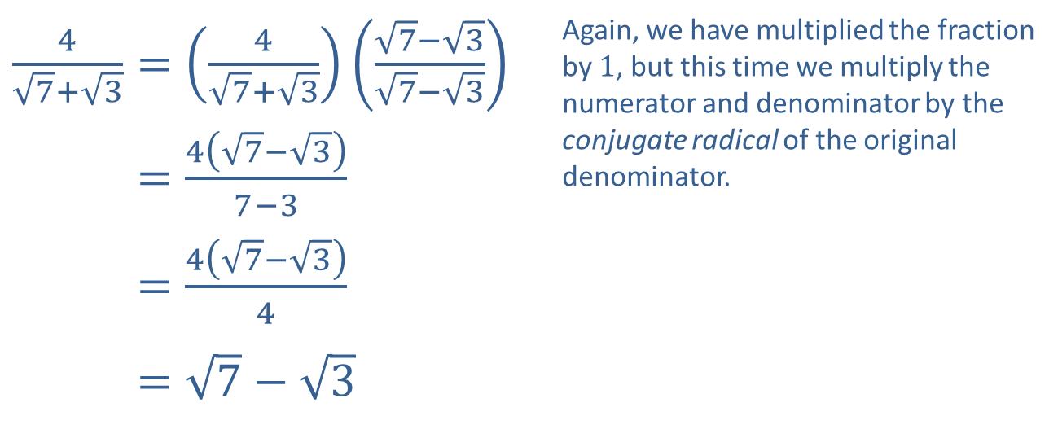
Example 4: Rationalizing the Denominator (cont.)
​$\frac{4}{\sqrt{7}+\sqrt{3}}=\left(\frac{4}{\sqrt{7}+\sqrt{3}}\right)\left(\frac{\sqrt{7}−\sqrt{3}}{\sqrt{7}−\sqrt{3}}\right)$ | Again, we have multiplied the fraction by 1, but this time we multiply the numerator and denominator by the conjugate radical of the original denominator.
​47+3=47−37−3
​47+3=47−34
​47+3=7−3
​

Slide 21
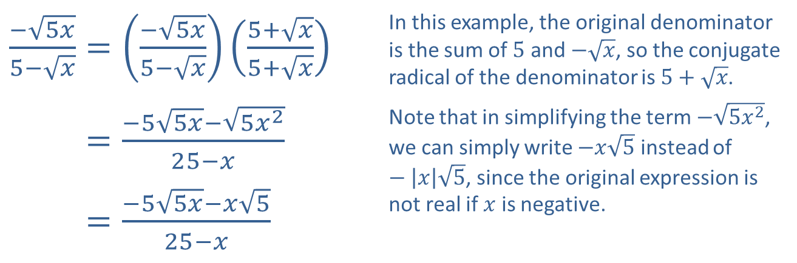
Example 4: Rationalizing the Denominator (cont.)
​$\frac{−\sqrt{5x}}{5−\sqrt{x}}=\left(\frac{−\sqrt{5x}}{5−\sqrt{x}}\right)\left(\frac{5+\sqrt{x}}{5+\sqrt{x}}\right)$ | In this example, the original denominator is the sum of 5 and $−\sqrt{x}$, so the conjugate radical of the denominator is $5+\sqrt{x}$.
​−5𝑥5−𝑥=−55𝑥−5𝑥225−𝑥 | Note that in simplifying the term $−\sqrt{5x^{2}}$, we can simply write $−x\sqrt{5}$ instead of $−\left|x\right|\sqrt{5}$, since the original expression is not real if $x$ is negative.
​−5𝑥5−𝑥=−55𝑥−𝑥525−𝑥
​

Slide 22

Example 5: Rationalizing the Numerator
Rationalize the numerator of the fraction $\frac{\sqrt{4x}−\sqrt{6y}}{2x−3y}$.

Slide 23
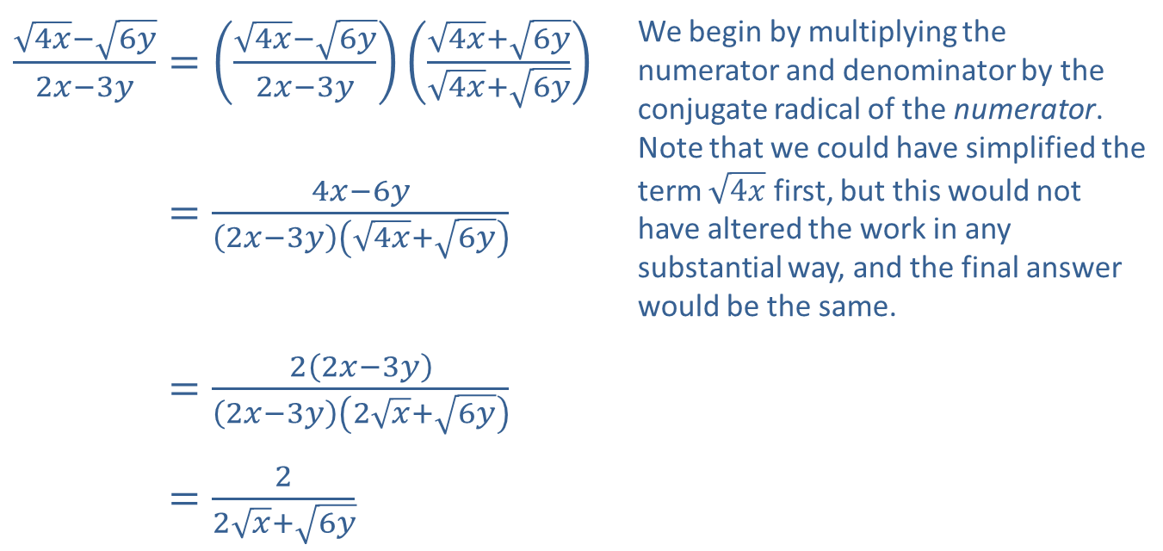
Example 5: Rationalizing the Numerator (cont.)
Solution
​$\frac{\sqrt{4x}−\sqrt{6y}}{2x−3y}=\left(\frac{\sqrt{4x}−\sqrt{6y}}{2x−3y}\right)\left(\frac{\sqrt{4x}+\sqrt{6y}}{\sqrt{4x}+\sqrt{6y}}\right)$ | We begin by multiplying the numerator and denominator by the conjugate radical of the numerator. Note that we could have simplified the term $\sqrt{4x}$ first, but this would not have altered the work in any substantial way, and the final answer would be the same.
​4𝑥−6𝑦2𝑥−3𝑦=4𝑥−6𝑦2𝑥−3𝑦4𝑥+6𝑦
​4𝑥−6𝑦2𝑥−3𝑦=22𝑥−3𝑦2𝑥−3𝑦2𝑥+6𝑦
​4𝑥−6𝑦2𝑥−3𝑦=22𝑥+6𝑦

Slide 24

Example 6: Combining Radical Expressions
Combine the radical expressions, if possible.
​$−3\sqrt{8x^{5}}+\sqrt{18x}$
​$\sqrt[3]{54x^{3}}+\sqrt{50x^{2}}$
​$\sqrt{\frac{1}{12}}−\sqrt{\frac{25}{48}}$

Slide 25
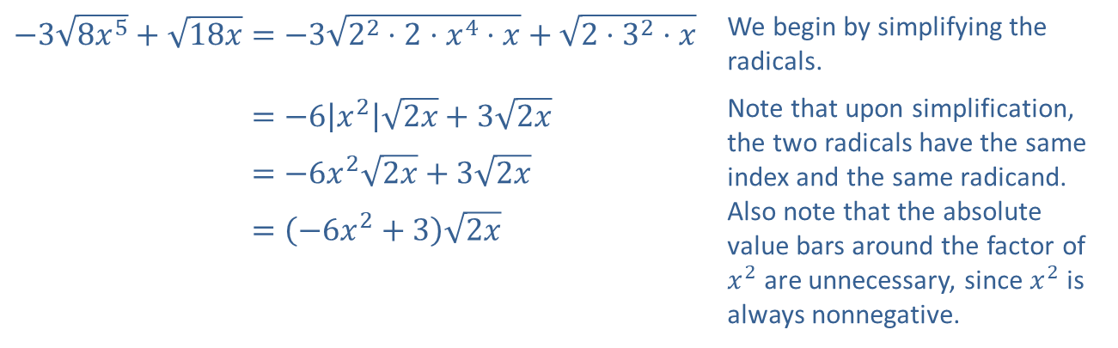
Example 6: Combining Radical Expressions (cont.)
Solution
​
​$−3\sqrt{8x^{5}}+\sqrt{18x}=−3\sqrt{2^{2}⋅2⋅x^{4}⋅x}+\sqrt{2⋅3^{2}⋅x}$ | We begin by simplifying the radicals.
​−38𝑥5+18𝑥=−6𝑥22𝑥+32𝑥 | Note that upon simplification, the two radicals have the same index and the same radicand. Also note that the absolute value bars around the factor of $x^{2}$ are unnecessary, since $x^{2}$ is always nonnegative.
​−38𝑥5+18𝑥=−6𝑥22𝑥+32𝑥
​−38𝑥5+18𝑥=−6𝑥2+32𝑥

Slide 26
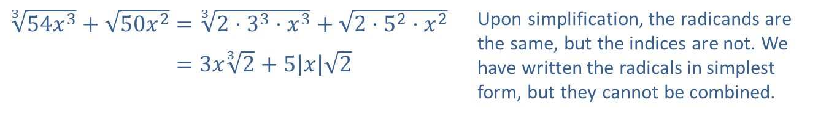
Example 6: Combining Radical Expressions (cont.)
​
​$\sqrt[3]{54x^{3}}+\sqrt{50x^{2}}=\sqrt[3]{2⋅3^{3}⋅x^{3}}+\sqrt{2⋅5^{2}⋅x^{2}}$ | Upon simplification, the radicands are the same, but the indices are not. We have written the radicals in simplest form, but they cannot be combined.
​354𝑥3+50𝑥2=3𝑥32+5𝑥2

Slide 27
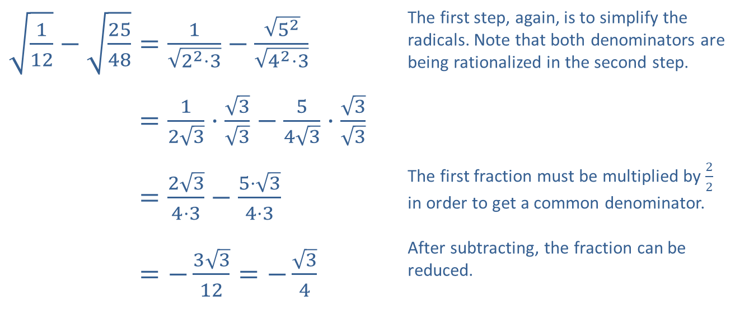
Example 6: Combining Radical Expressions (cont.)
​$\sqrt{\frac{1}{12}}−\sqrt{\frac{25}{48}}=\frac{1}{\sqrt{2^{2}⋅3}}−\frac{\sqrt{5^{2}}}{\sqrt{4^{2}⋅3}}$ | The first step, again, is to simplify the radicals. Note that both denominators are being rationalized in the second step.
​112−2548=123⋅33−543⋅33
​112−2548=234⋅3−5⋅34⋅3 | The first fraction must be multiplied by $\frac{2}{2}$ in order to get a common denominator.
​112−2548=−3312=−34 | After subtracting, the fraction can be reduced.
​

Slide 28
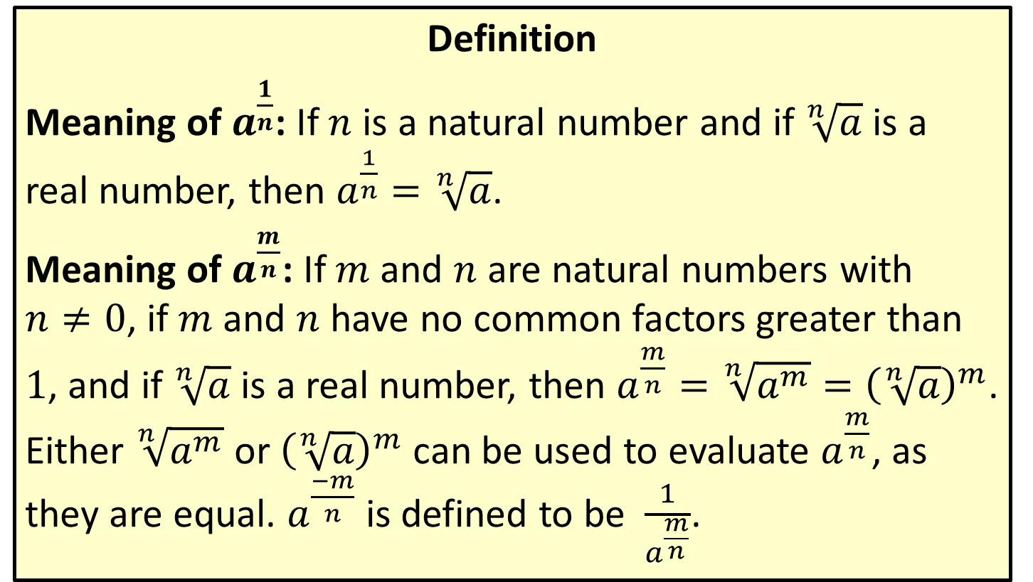
Rational Number Exponents
Definition
Meaning of $a^{\frac{1}{n}}$: If $n$ is a natural number and if $\sqrt[n]{a}$ is a real number, then $a^{\frac{1}{n}}=\sqrt[n]{a}$.
Meaning of $a^{\frac{m}{n}}$: If $m$ and $n$ are natural numbers with
$n≠0$, if $m$ and $n$ have no common factors greater than 1, and if $\sqrt[n]{a}$ is a real number, then $a^{\frac{m}{n}}=\sqrt[n]{a^{m}}={\left(\sqrt[n]{a}\right)}^{m}$. Either $\sqrt[n]{a^{m}}$ or ${\left(\sqrt[n]{a}\right)}^{m}$ can be used to evaluate $a^{\frac{m}{n}}$, as they are equal. $a^{\frac{−m}{n}}$ is defined to be $\frac{1}{a^{\frac{m}{n}}}$.

Slide 29
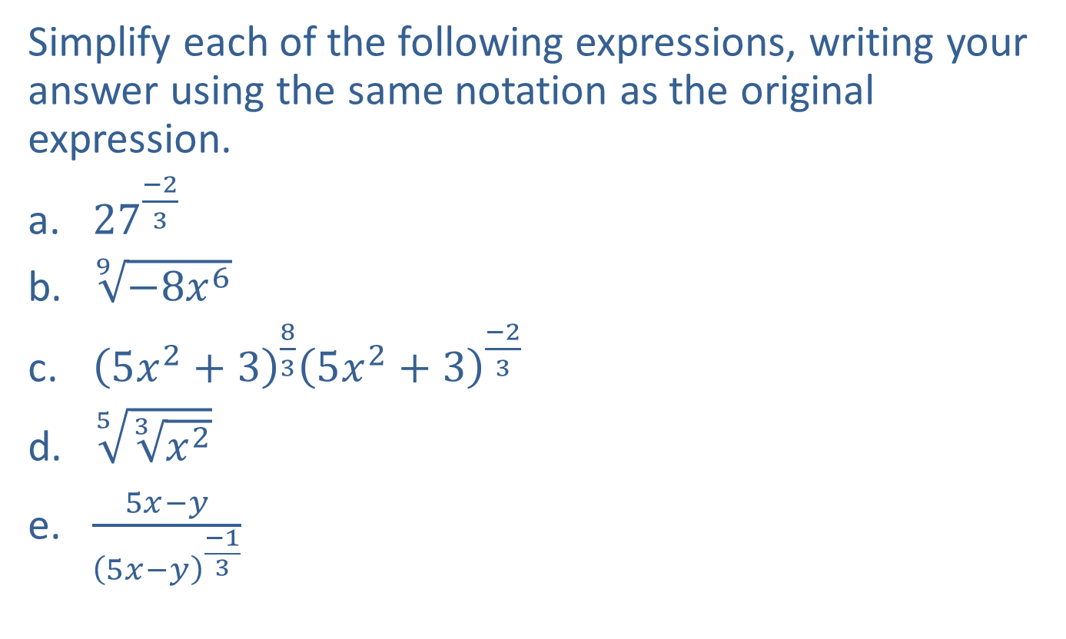
Example 7: Simplifying Expressions
Simplify each of the following expressions, writing your answer using the same notation as the original expression.
​${27}^{\frac{−2}{3}}$
​$\sqrt[9]{−8x^{6}}$
​${\left(5x^{2}+3\right)}^{\frac{8}{3}}{\left(5x^{2}+3\right)}^{\frac{−2}{3}}$
​$\sqrt[5]{\sqrt[3]{x^{2}}}$
​$\frac{5x−y}{{\left(5x−y\right)}^{\frac{−1}{3}}}$

Slide 30
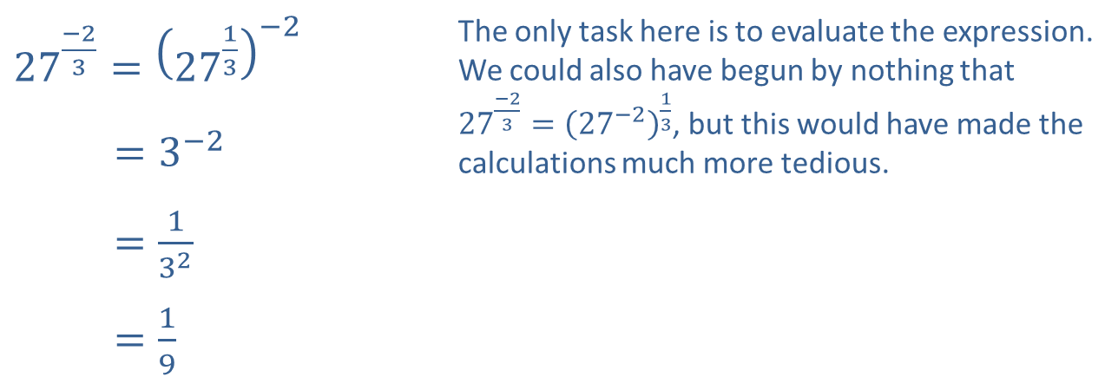
Example 7: Simplifying Expressions (cont.)
Solution
​
​${27}^{\frac{−2}{3}}={\left({27}^{\frac{1}{3}}\right)}^{−2}$ | The only task here is to evaluate the expression. We could also have begun by nothing that ${27}^{\frac{−2}{3}}={\left({27}^{−2}\right)}^{\frac{1}{3}}$, but this would have made the calculations much more tedious.
​27−23=3−2
​27−23=132
​27−23=19

Slide 31
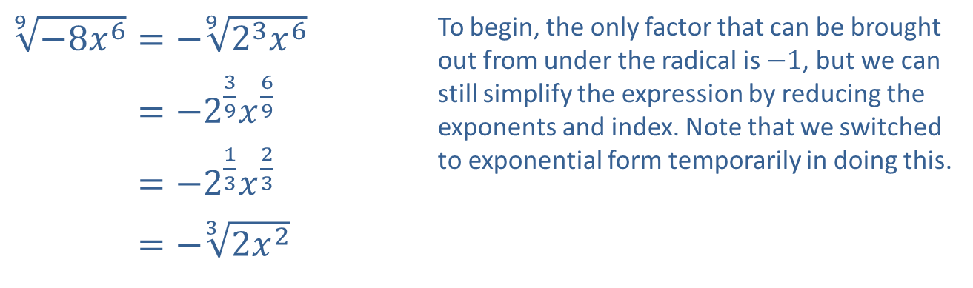
Example 7: Simplifying Expressions (cont.)
b. ​
​$\sqrt[9]{−8x^{6}}=−\sqrt[9]{2^{3}x^{6}}$ | To begin, the only factor that can be brought out from under the radical is $−1$, but we can still simplify the expression by reducing the exponents and index. Note that we switched to exponential form temporarily in doing this.
​9−8𝑥6=−239𝑥69
​9−8𝑥6=−213𝑥23
​9−8𝑥6=−32𝑥2

Slide 32
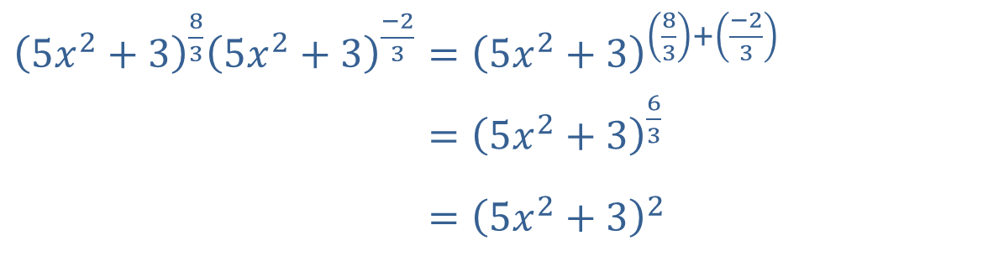

Example 7: Simplifying Expressions (cont.)
c. Since the bases are the same, we only have to apply the property $a^{n}{a^{m}}=a^{n+m}$.
​${\left(5x^{2}+3\right)}^{\frac{8}{3}}{\left(5x^{2}+3\right)}^{\frac{−2}{3}}={\left(5x^{2}+3\right)}^{\left(\frac{8}{3}\right)+\left(\frac{−2}{3}\right)}$
​5𝑥2+3835𝑥2+3−23=5𝑥2+363
​5𝑥2+3835𝑥2+3−23=5𝑥2+32

Slide 33

Example 7: Simplifying Expressions (cont.)
d. ​Use the property stating $\sqrt[m]{\sqrt[n]{a}}=\sqrt[mn]{a}$ to simplify this expression.
$\sqrt[5]{\sqrt[3]{x^{2}}}=\sqrt[15]{x^{2}}$

Slide 34
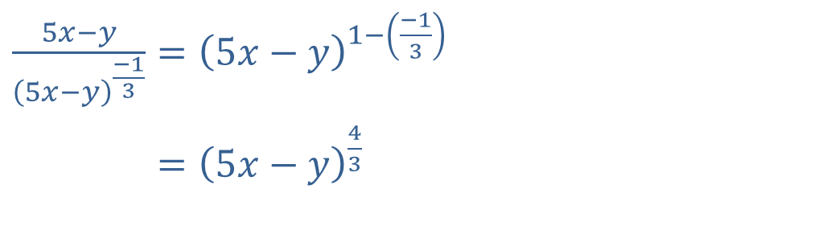

Example 7: Simplifying Expressions (cont.)
e. We use the property $\frac{a^{n}}{a^{m}}=a^{n−m}$ to simplify this expression.
​$\frac{5x−y}{{\left(5x−y\right)}^{\frac{−1}{3}}}={\left(5x−y\right)}^{1−\left(\frac{−1}{3}\right)}$
​5𝑥−𝑦5𝑥−𝑦−13=5𝑥−𝑦43

Slide 35

Example 8: Simplifying Radical Expressions
​Simplify the expression $\sqrt[4]{x^{2}}$.
​Write $\sqrt[3]{2}⋅\sqrt{3}$ as a single radical.

Slide 36
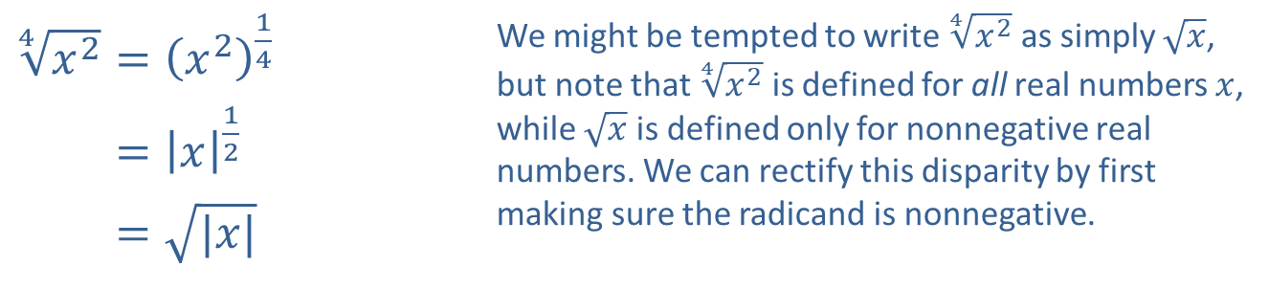
Example 8: Simplifying Radical Expressions (cont.)
Solution
​
​$\sqrt[4]{x^{2}}={\left(x^{2}\right)}^{\frac{1}{4}}$ | We might be tempted to write $\sqrt[4]{x^{2}}$ as simply $\sqrt{x}$, but note that $\sqrt[4]{x^{2}}$ is defined for all real numbers $x$, while $\sqrt{x}$ is defined only for nonnegative real numbers. We can rectify this disparity by first making sure the radicand is nonnegative.
​4𝑥2=𝑥12
​4𝑥2=|𝑥|

Slide 37
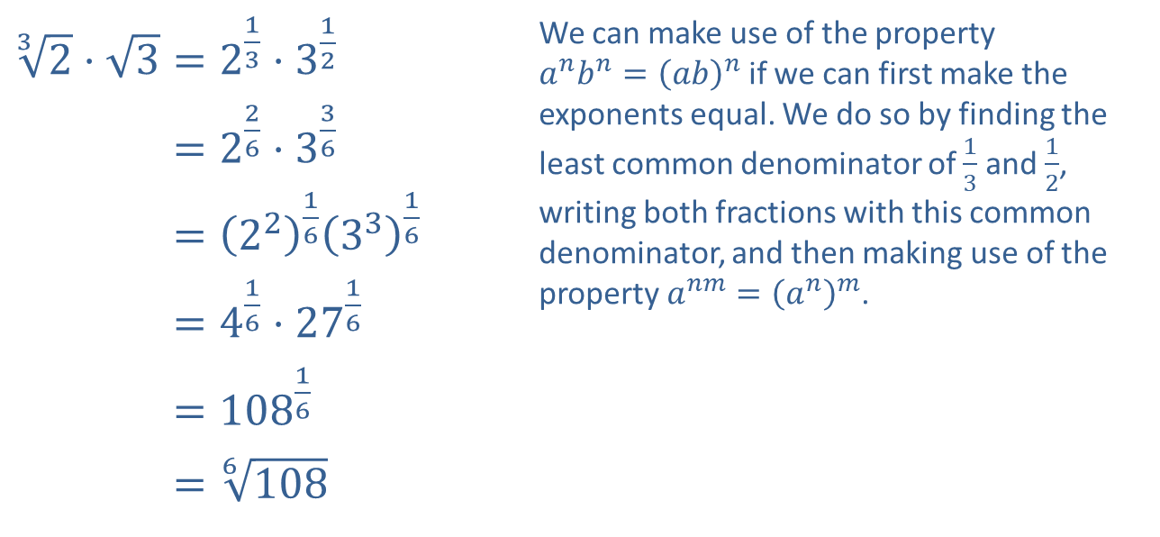
Example 8: Simplifying Radical Expressions (cont.)
​$\sqrt[3]{2}⋅\sqrt{3}=2^{\frac{1}{3}}⋅3^{\frac{1}{2}}$ | We can make use of the property $a^{n}b^{n}={\left(ab\right)}^{n}$ if we can first make the exponents equal. We do so by finding the least common denominator of $\frac{1}{3}$ and $\frac{1}{2}$, writing both fractions with this common denominator, and then making use of the property $a^{nm}={\left(a^{n}\right)}^{m}$.
​32⋅3=226⋅336
​32⋅3=22163316
​32⋅3=416⋅2716
​32⋅3=10816
​32⋅3=6108
​

Slide 38

Example 9: Using Radical Notation
A regular hexagon is a six-sided plane figure whose sides are all the same length and whose interior angles are all the same. We can use Heron's formula to derive a formula for the area of a regular hexagon with side length $d$ as follows.

Slide 39
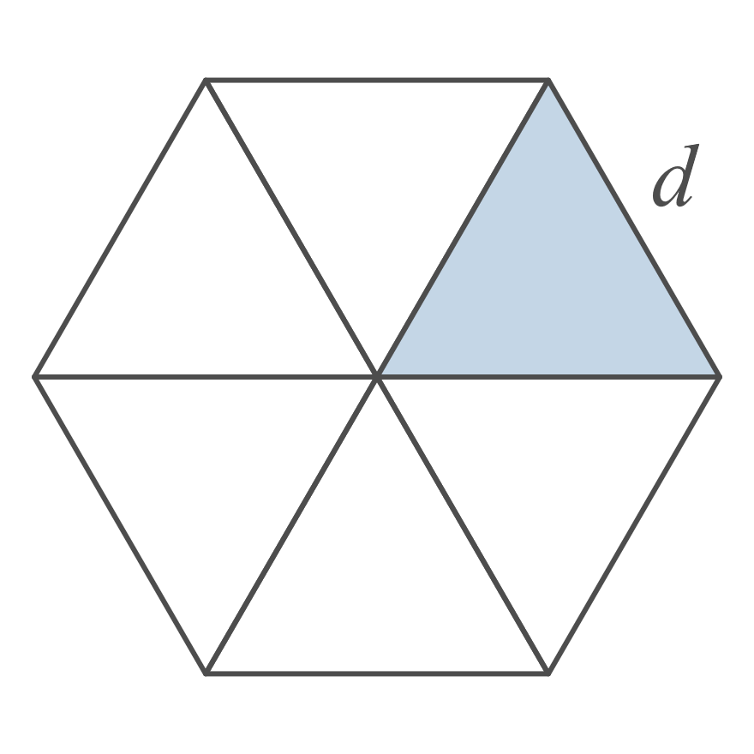
Example 9: Using Radical Notation (cont.)
Solution
Begin by drawing three line segments joining each vertex to the vertex diagonally opposite it. The sum of the six angles meeting in the middle must be 360 degrees and all of the angles are equal, so each one must be a 60-degree angle. By symmetry, each of the six triangles making up the hexagon is isosceles, so each of the remaining two angles in any one triangle must measure 60 degrees as well. Thus each triangle is both equilateral and equiangular.

Slide 40
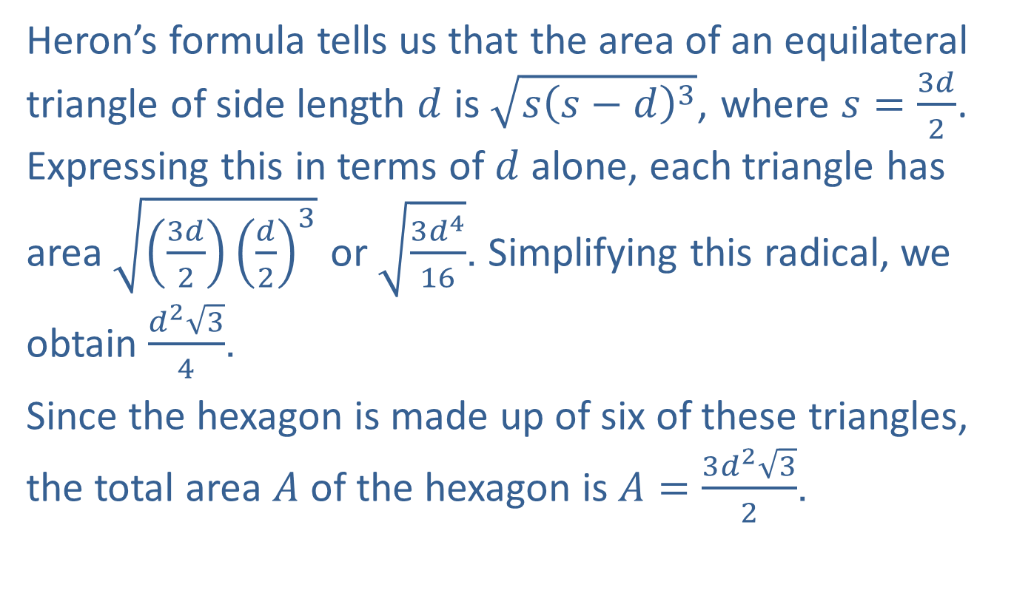
Example 9: Using Radical Notation (cont.)
Heron’s formula tells us that the area of an equilateral triangle of side length $d$ is $\sqrt{s{\left(s−d\right)}^{3}}$, where $s=\frac{3d}{2}$. Expressing this in terms of $d$ alone, each triangle has area $\sqrt{\left(\frac{3d}{2}\right){\left(\frac{d}{2}\right)}^{3}}$ or $\sqrt{\frac{3d^{4}}{16}}$. Simplifying this radical, we obtain $\frac{d^{2}\sqrt{3}}{4}$.
Since the hexagon is made up of six of these triangles, the total area $A$ of the hexagon is $A=\frac{3d^{2}\sqrt{3}}{2}$.

