Slide 1
Section 1.6
Factoring Polynomials

Slide 2
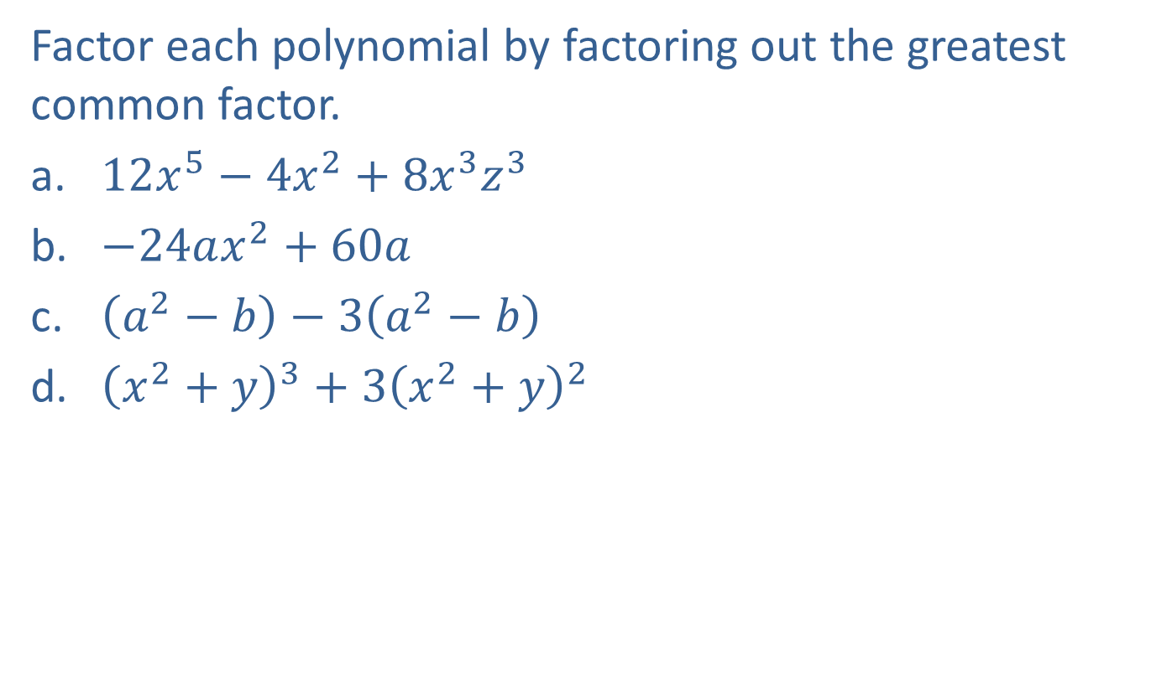
Example 1: Factoring Out the Greatest Common Factor
Factor each polynomial by factoring out the greatest common factor.
​$12x^{5}−4x^{2}+8x^{3}z^{3}$
​$−24ax^{2}+60a$
​$\left(a^{2}−b\right)−3\left(a^{2}−b\right)$
​${\left(x^{2}+y\right)}^{3}+{3\left(x^{2}+y\right)}^{2}$

Slide 3
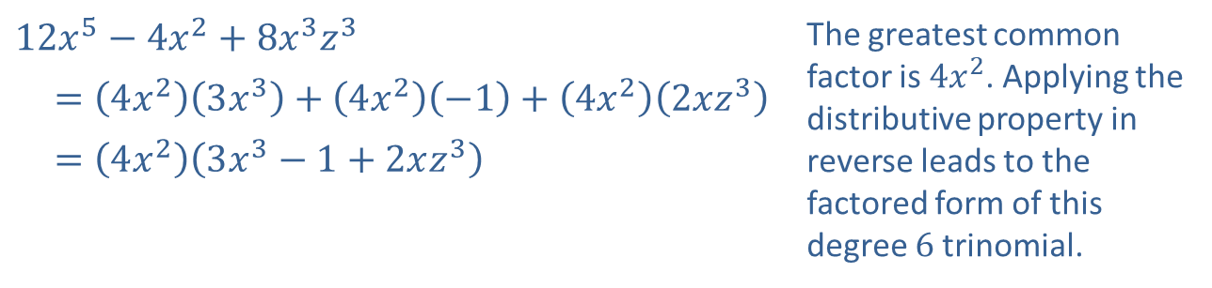
Example 1: Factoring Out the Greatest Common Factor (cont.)
Solution
​
​$12x^{5}−4x^{2}+8x^{3}z^{3}$ | The greatest common factor is $4x^{2}$. Applying the distributive property in reverse leads to the factored form of this degree 6 trinomial.
​ $=\left(4x^{2}\right)\left(3x^{3}\right)+\left(4x^{2}\right)\left(−1\right)+\left(4x^{2}\right)\left(2xz^{3}\right)$
​ $=\left(4x^{2}\right)\left(3x^{3}−1+2xz^{3}\right)$

Slide 4
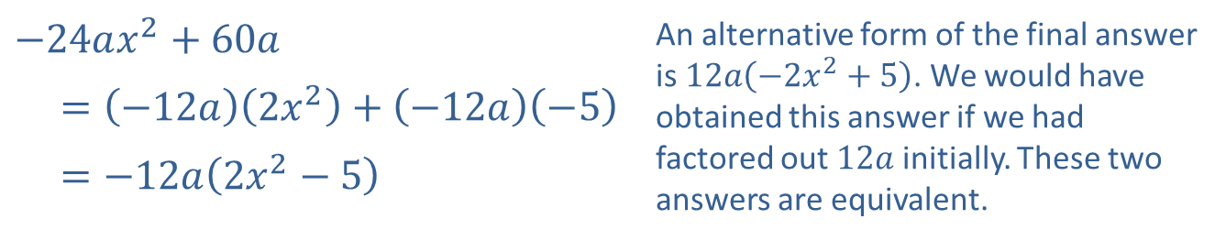
Example 1: Factoring Out the Greatest Common Factor (cont.)
​
​$−24ax^{2}+60a$ | An alternative form of the final answer is $12a\left(−2x^{2}+5\right)$. We would have obtained this answer if we had factored out $12a$ initially. These two answers are equivalent.
​ $=\left(−12a\right)\left(2x^{2}\right)+\left(−12a\right)\left(−5\right)$
​ $=−12a\left(2x^{2}−5\right)$

Slide 5
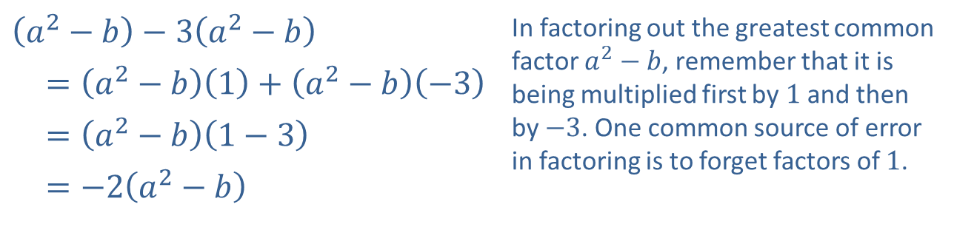
Example 1: Factoring Out the Greatest Common Factor (cont.)
​
​$\left(a^{2}−b\right)−3\left(a^{2}−b\right)$ | In factoring out the greatest common factor $a^{2}−b$, remember that it is being multiplied first by 1 and then by $−3$. One common source of error in factoring is to forget factors of 1.
​ $=\left(a^{2}−b\right)\left(1\right)+\left(a^{2}−b\right)\left(−3\right)$
​ $=\left(a^{2}−b\right)\left(1−3\right)$
​ $=−2\left(a^{2}−b\right)$

Slide 6
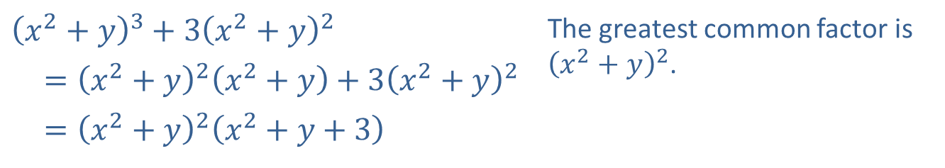
Example 1: Factoring Out the Greatest Common Factor (cont.)
​
​${\left(x^{2}+y\right)}^{3}+{3\left(x^{2}+y\right)}^{2}$ | The greatest common factor is ${\left(x^{2}+y\right)}^{2}$.
​ $={\left(x^{2}+y\right)}^{2}\left(x^{2}+y\right)+3{\left(x^{2}+y\right)}^{2}$
​ $={\left(x^{2}+y\right)}^{2}\left(x^{2}+y+3\right)$

Slide 7

Example 2: Factoring by Grouping
Factor each polynomial by grouping.
​$6x^{2}−y+2x−3xy$
​$ax−ay−bx+by$
​$4x−2x^{2}−2x^{3}+x^{4}$

Slide 8
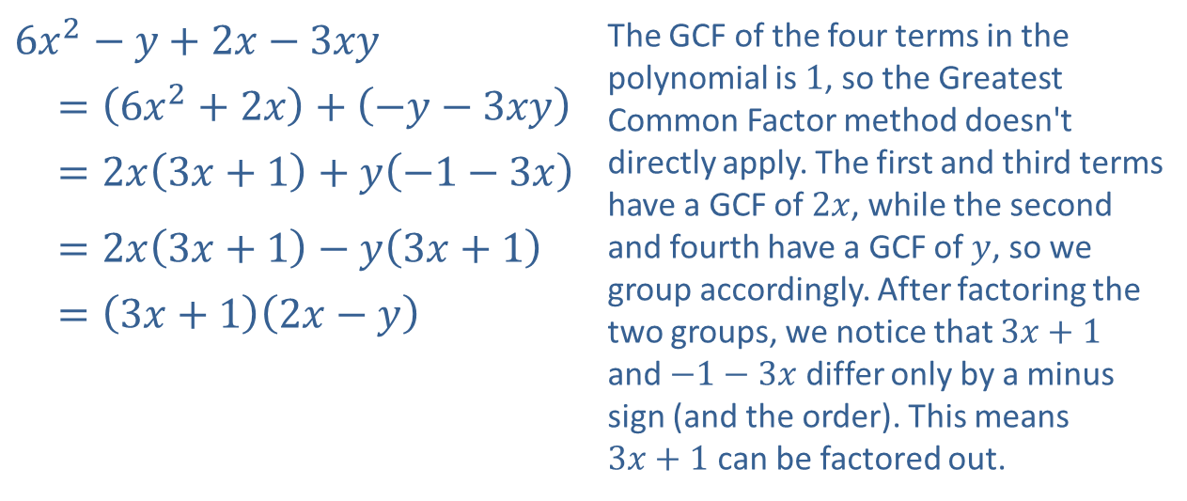
Example 2: Factoring by Grouping (cont.)
Solution
​
​$6x^{2}−y+2x−3xy$ | The GCF of the four terms in the polynomial is 1, so the Greatest Common Factor method doesn't directly apply. The first and third terms have a GCF of $2x$, while the second and fourth have a GCF of $y$, so we group accordingly. After factoring the two groups, we notice that $3x+1$ and $−1−3x$ differ only by a minus sign (and the order). This means $3x+1$ can be factored out.
​$=\left(6x^{2}+2x\right)+\left(−y−3xy\right)$
​ $=2x\left(3x+1\right)+y\left(−1−3x\right)$
​ $=2x\left(3x+1\right)−y\left(3x+1\right)$
​ $=\left(3x+1\right)\left(2x−y\right)$

Slide 9
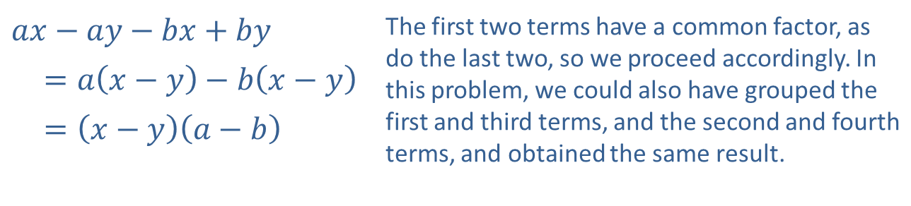
Example 2: Factoring by Grouping (cont.)
​
​$ax−ay−bx+by$ | The first two terms have a common factor, as do the last two, so we proceed accordingly. In this problem, we could also have grouped the first and third terms, and the second and fourth terms, and obtained the same result.
​ $=a\left(x−y\right)−b\left(x−y\right)$
​ $=\left(x−y\right)\left(a−b\right)$

Slide 10
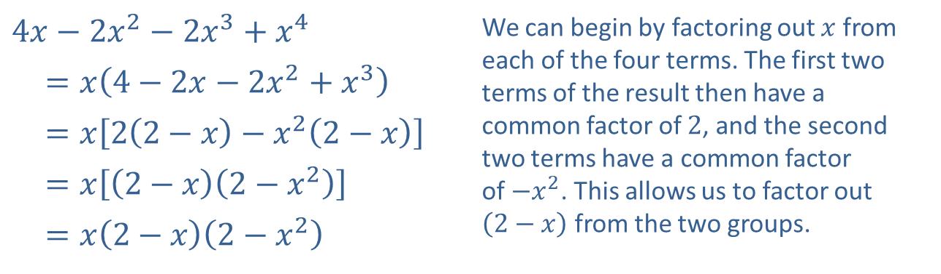
Example 2: Factoring by Grouping (cont.)
​
​$4x−2x^{2}−2x^{3}+x^{4}$ | We can begin by factoring out $x$ from each of the four terms. The first two terms of the result then have a common factor of 2, and the second two terms have a common factor of $−x^{2}$. This allows us to factor out $\left(2−x\right)$ from the two groups.
​ $=x\left(4−2x−2x^{2}+x^{3}\right)$
​ $=x\left[2\left(2−x\right)−x^{2}\left(2−x\right)\right]$
​ $=x\left[\left(2−x\right)\left(2−x^{2}\right)\right]$
​ $=x\left(2−x\right)\left(2−x^{2}\right)$

Slide 11
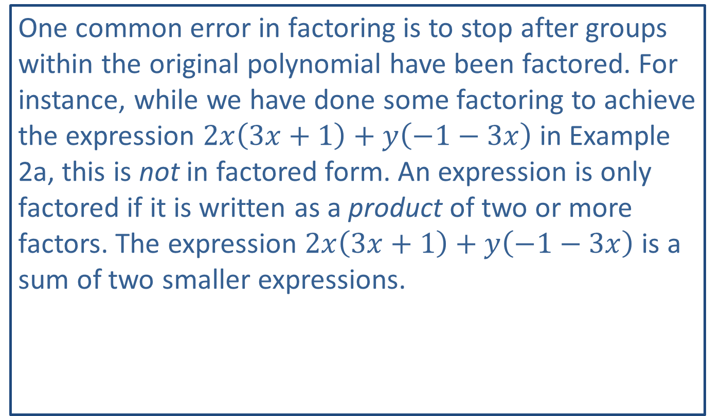
CAUTION!
One common error in factoring is to stop after groups within the original polynomial have been factored. For instance, while we have done some factoring to achieve the expression $2x\left(3x+1\right)+y\left(−1−3x\right)$ in Example 2a, this is not in factored form. An expression is only factored if it is written as a product of two or more factors. The expression $2x\left(3x+1\right)+y\left(−1−3x\right)$ is a sum of two smaller expressions.

Slide 12
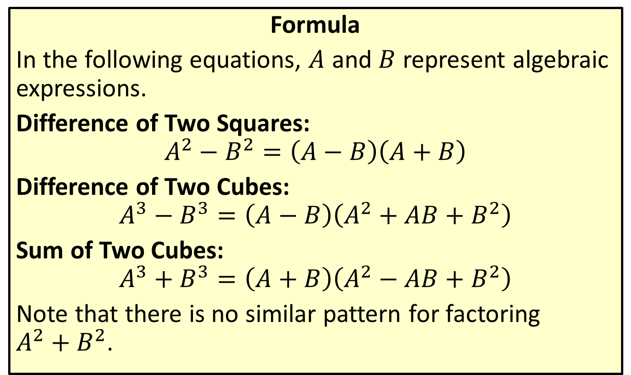
Factoring Special Binomials
Formula
In the following equations, $A$ and $B$ represent algebraic expressions.
Difference of Two Squares:
$$A^{2}−B^{2}=\left(A−B\right)\left(A+B\right)$$
Difference of Two Cubes:
$$A^{3}−B^{3}=\left(A−B\right)\left(A^{2}+AB+B^{2}\right)$$
Sum of Two Cubes:
$$A^{3}+B^{3}=\left(A+B\right)\left(A^{2}−AB+B^{2}\right)$$
Note that there is no similar pattern for factoring
$A^{2}+B^{2}$.

Slide 13

Example 3: Factoring Special Binomials
Use the special factoring patterns to factor the following binomials.
​$49x^{2}−9y^{6}$
​$27a^{6}b^{12}+c^{3}$
​$125y^{3}−8z^{3}$
​$64−{\left(x+y\right)}^{3}$

Slide 14
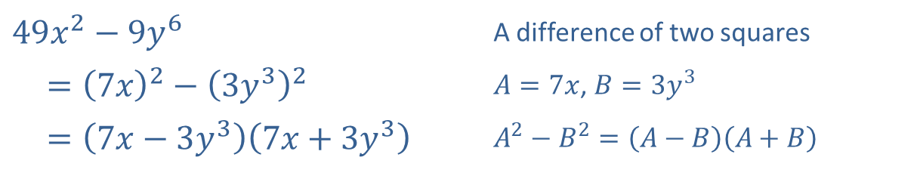
Example 3: Factoring Special Binomials (cont.)
Solution
​
​$49x^{2}−9y^{6}$ | A difference of two squares
​$={\left(7x\right)}^{2}−{\left(3y^{3}\right)}^{2}$ | $A=7x$, $B=3y^{3}$
​ $=\left(7x−3y^{3}\right)\left(7x+3y^{3}\right)$ | $A^{2}−B^{2}=\left(A−B\right)\left(A+B\right)$

Slide 15
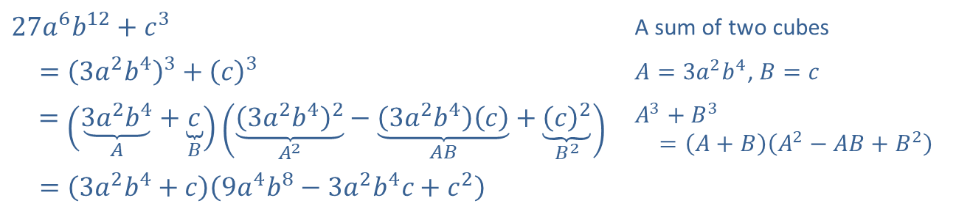
Example 3: Factoring Special Binomials (cont.)
​
​$27a^{6}b^{12}+c^{3}$ | A sum of two cubes
​ $={\left(3a^{2}b^{4}\right)}^{3}+{\left(c\right)}^{3}$ | $A=3a^{2}b^{4}$, $B=c$
$=\left(\underset{A}{\underbrace{3a^{2}b^{4}}}+\underset{B}{\underbrace{c}}\right)\left(\underset{A^{2}}{\underbrace{{\left(3a^{2}b^{4}\right)}^{2}}}−\underset{AB}{\underbrace{\left(3a^{2}b^{4}\right)\left(c\right)}}+\underset{B^{2}}{\underbrace{{\left(c\right)}^{2}}}\right)$ | $A^{3}+B^{3}$ $=\left(A+B\right)\left(A^{2}−AB+B^{2}\right)$
​ $=\left(3a^{2}b^{4}+c\right)\left(9a^{4}b^{8}−3a^{2}b^{4}c+c^{2}\right)$

Slide 16
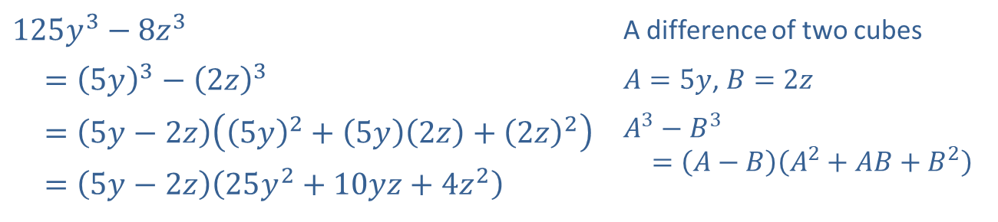
Example 3: Factoring Special Binomials (cont.)
​
​$125y^{3}−8z^{3}$ | A difference of two cubes
​ $={\left(5y\right)}^{3}−{\left(2z\right)}^{3}$ | $A=5y$, $B=2z$
​ $=\left(5y−2z\right)\left({\left(5y\right)}^{2}+\left(5y\right)\left(2z\right)+{\left(2z\right)}^{2}\right)$ | $A^{3}−B^{3}$ $=\left(A−B\right)\left(A^{2}+AB+B^{2}\right)$
​ $=\left(5y−2z\right)\left(25y^{2}+10yz+4z^{2}\right)$

Slide 17
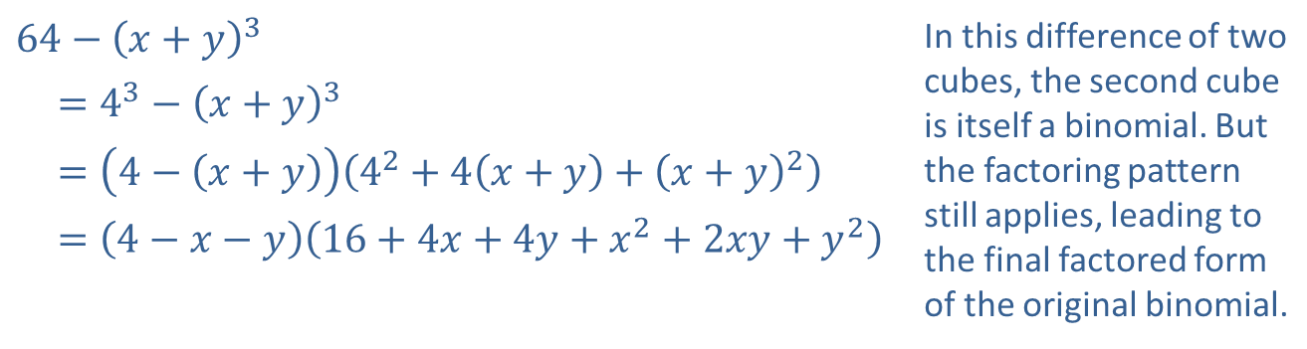
Example 3: Factoring Special Binomials (cont.)
​
​$64−{\left(x+y\right)}^{3}$ | In this difference of two cubes, the second cube is itself a binomial. But the factoring pattern still applies, leading to the final factored form of the original binomial.
​$=4^{3}−{\left(x+y\right)}^{3}$
​ $=\left(4−\left(x+y\right)\right)\left(4^{2}+4\left(x+y\right)+{\left(x+y\right)}^{2}\right)$
​ $=\left(4−x−y\right)\left(16+4x+4y+x^{2}+2xy+y^{2}\right)$

Slide 18
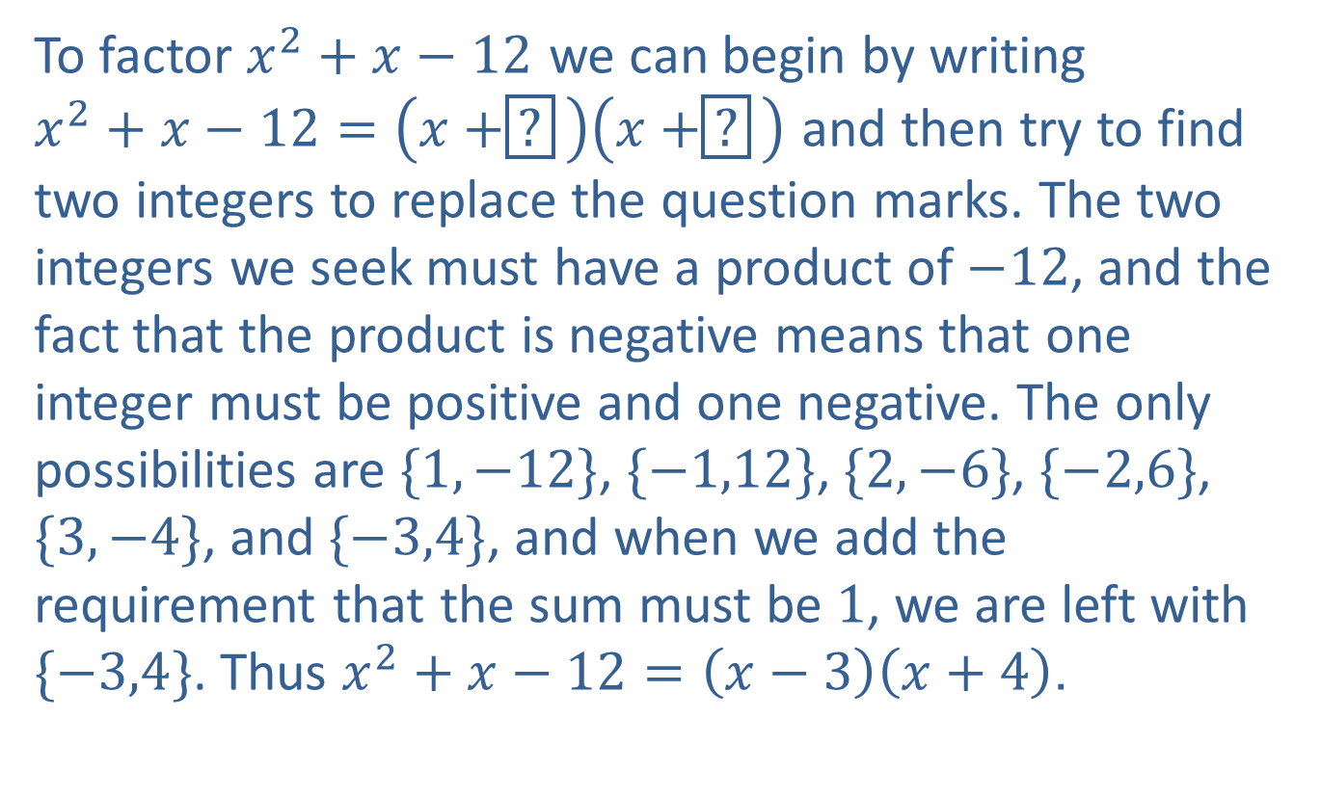
Example 4: Factoring a Trinomial
To factor $x^{2}+x−12$ we can begin by writing
$x^{2}+x−12=\left(x+\boxed{?}\right)\left(x+\boxed{?}\right)$ and then try to find two integers to replace the question marks. The two integers we seek must have a product of $−12$, and the fact that the product is negative means that one integer must be positive and one negative. The only possibilities are $\{1,−12\}$, $\{−1,12\}$, $\{2,−6\}$, $\{−2,6\}$, $\{3,−4\}$, and $\{−3,4\}$, and when we add the requirement that the sum must be 1, we are left with $\{−3,4\}$. Thus $x^{2}+x−12=\left(x−3\right)\left(x+4\right)$.

Slide 19
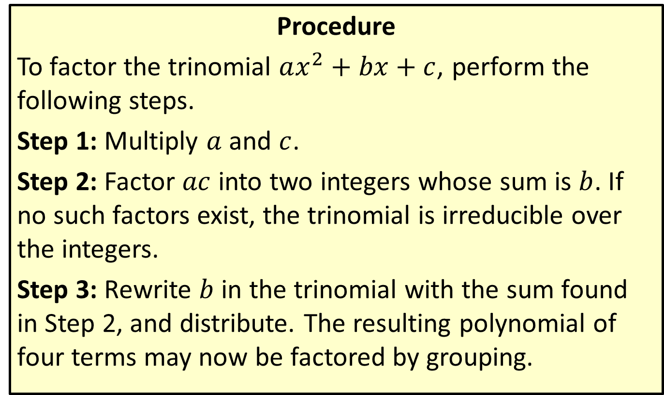
Factoring a Trinomial by Grouping
Procedure
To factor the trinomial $ax^{2}+bx+c$, perform the following steps.
Step 1: Multiply $a$ and $c$.
Step 2: Factor $ac$ into two integers whose sum is $b$. If no such factors exist, the trinomial is irreducible over the integers.
Step 3: Rewrite $b$ in the trinomial with the sum found in Step 2, and distribute. The resulting polynomial of four terms may now be factored by grouping.

Slide 20
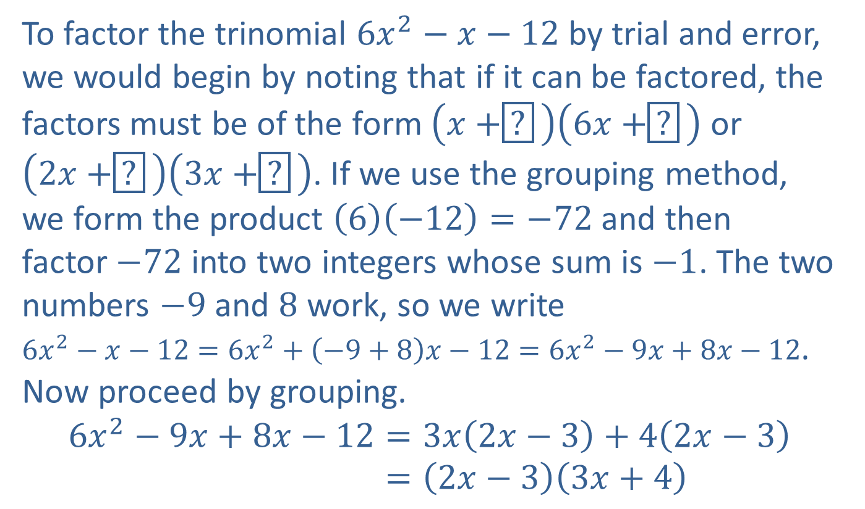
Example 5: Factoring a Trinomial by Grouping
To factor the trinomial $6x^{2}−x−12$ by trial and error, we would begin by noting that if it can be factored, the factors must be of the form $\left(x+\boxed{?}\right)\left(6x+\boxed{?}\right)$ or
$\left(2x+\boxed{?}\right)\left(3x+\boxed{?}\right)$. If we use the grouping method, we form the product $\left(6\right)\left(−12\right)=−72$ and then
factor $−72$ into two integers whose sum is $−1$. The two numbers $−9$ and 8 work, so we write
$6x^{2}−x−12=6x^{2}+\left(−9+8\right)x−12=6x^{2}−9x+8x−12$. Now proceed by grouping.
6𝑥2−9𝑥+8𝑥−12=3𝑥2𝑥−3+42𝑥−36𝑥2−9𝑥+8𝑥−12=2𝑥−33𝑥+4

Slide 21
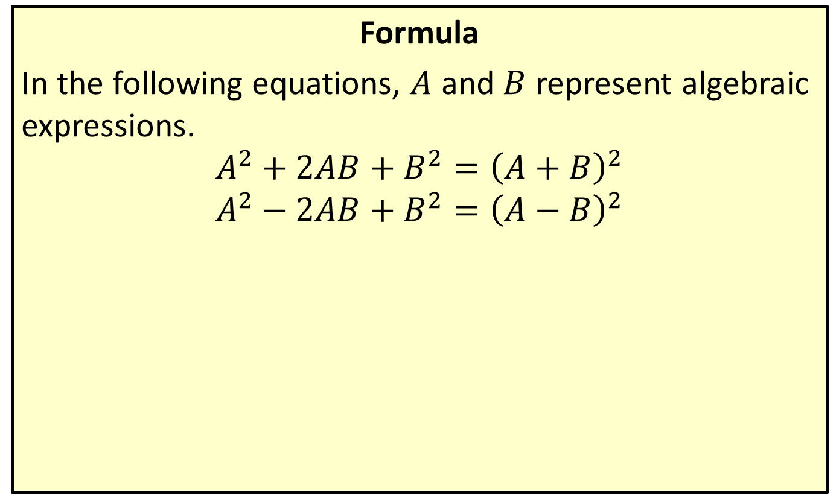
Perfect Square Trinomials
Formula
In the following equations, $A$ and $B$ represent algebraic expressions.
$$A^{2}+2AB+B^{2}={\left(A+B\right)}^{2}$$
$$A^{2}−2AB+B^{2}={\left(A−B\right)}^{2}$$

Slide 22

Example 6: Perfect Square Trinomials
Factor the algebraic expression $x^{2}+10x+25$.

Slide 23
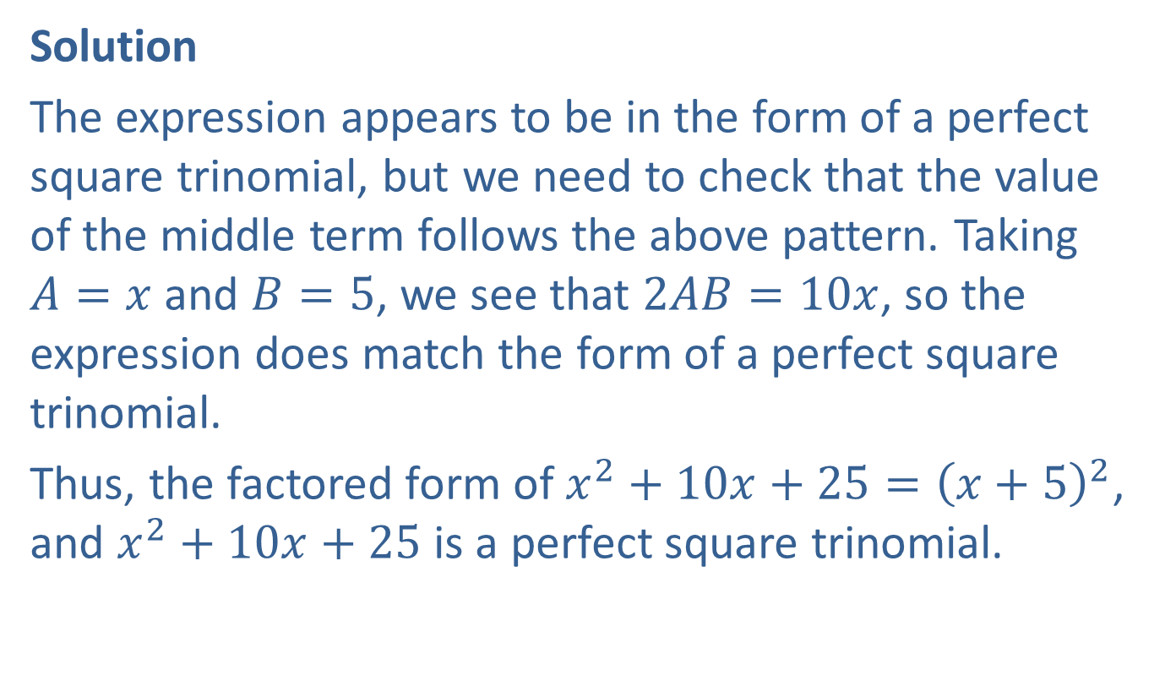
Example 6: Perfect Square Trinomials (cont.)
Solution
The expression appears to be in the form of a perfect square trinomial, but we need to check that the value of the middle term follows the above pattern. Taking
$A=x$ and $B=5$, we see that $2AB=10x$, so the expression does match the form of a perfect square trinomial.
Thus, the factored form of $x^{2}+10x+25={\left(x+5\right)}^{2}$, and $x^{2}+10x+25$ is a perfect square trinomial.

Slide 24

Example 7: Factoring Expressions with Noninteger Rational Exponents
Factor each of the following algebraic expressions.
​$3x^{−\frac{2}{3}}−6x^{\frac{1}{3}}+3x^{\frac{4}{3}}$
​${\left(x−1\right)}^{\frac{1}{2}}−{\left(x−1\right)}^{−\frac{1}{2}}$

Slide 25
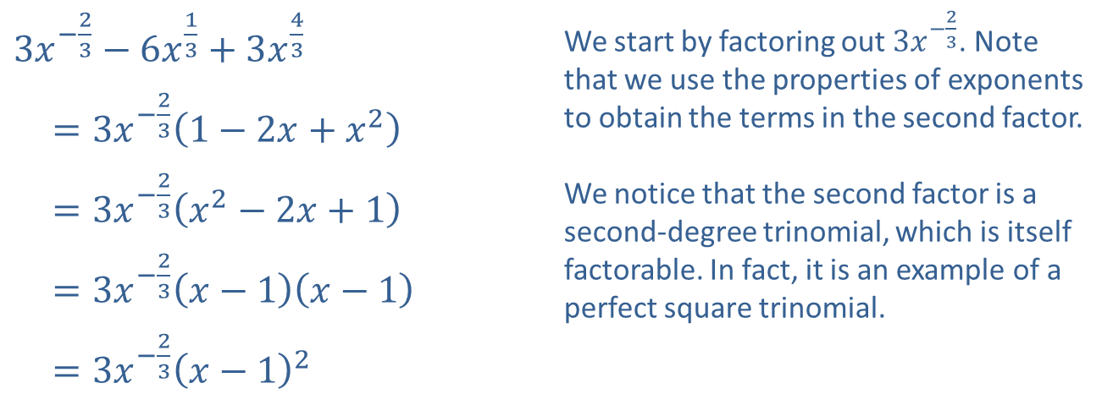
Example 7: Factoring Expressions with Noninteger Rational Exponents (cont.)
Solution
​
​$3x^{−\frac{2}{3}}−6x^{\frac{1}{3}}+3x^{\frac{4}{3}}$ | We start by factoring out $3x^{−\frac{2}{3}}$. Note that we use the properties of exponents to obtain the terms in the second factor. We notice that the second factor is a second-degree trinomial, which is itself factorable. In fact, it is an example of a perfect square trinomial.
​ $=3x^{−\frac{2}{3}}\left(1−2x+x^{2}\right)$
​ $=3x^{−\frac{2}{3}}\left(x^{2}−2x+1\right)$
​ $=3x^{−\frac{2}{3}}\left(x−1\right)\left(x−1\right)$
​ $=3x^{−\frac{2}{3}}{\left(x−1\right)}^{2}$

Slide 26
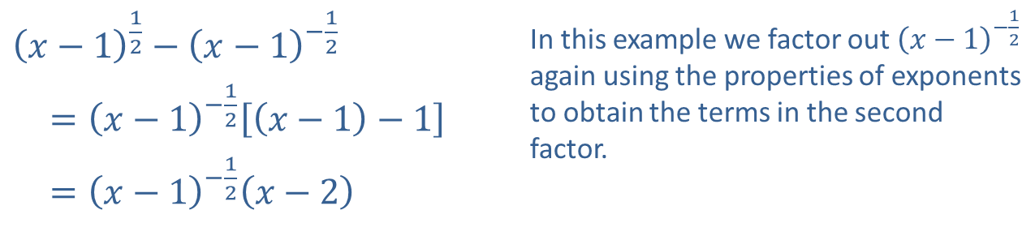
Example 7: Factoring Expressions with Noninteger Rational Exponents (cont.)
​${\left(x−1\right)}^{\frac{1}{2}}−{\left(x−1\right)}^{−\frac{1}{2}}$ | In this example we factor out ${\left(x−1\right)}^{−\frac{1}{2}}$ again using the properties of exponents to obtain the terms in the second factor.
​ $={\left(x−1\right)}^{−\frac{1}{2}}\left[\left(x−1\right)−1\right]$
​ $={\left(x−1\right)}^{−\frac{1}{2}}\left(x−2\right)$
​

