Slide 1
Section 1.7
Rational Expressions

Slide 2
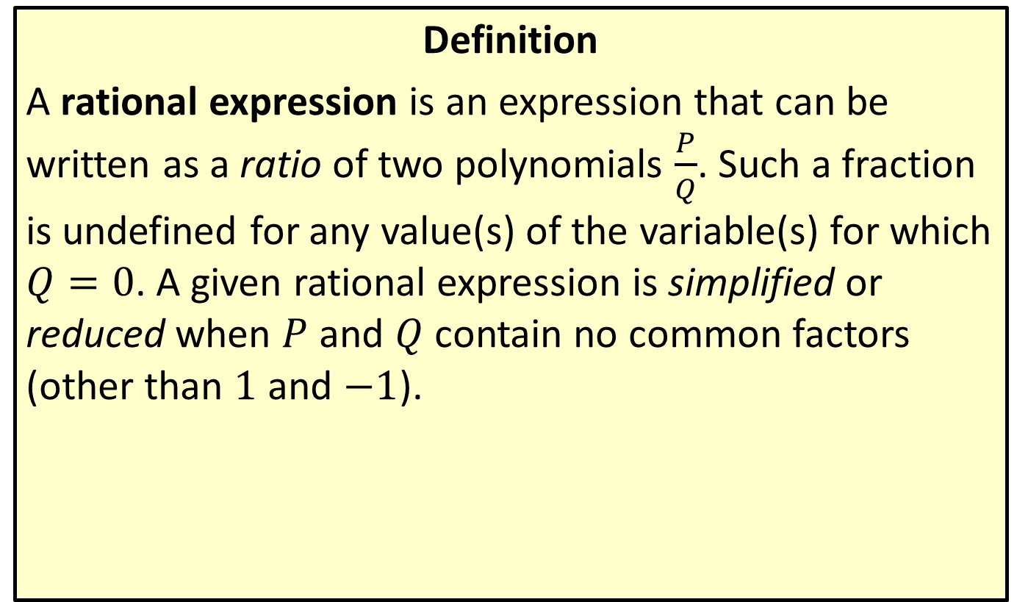
Rational Expressions
Definition
A rational expression is an expression that can be written as a ratio of two polynomials $\frac{P}{Q}$. Such a fraction is undefined for any value(s) of the variable(s) for which $Q=0$. A given rational expression is simplified or reduced when $P$ and $Q$ contain no common factors (other than 1 and $−1$).

Slide 3
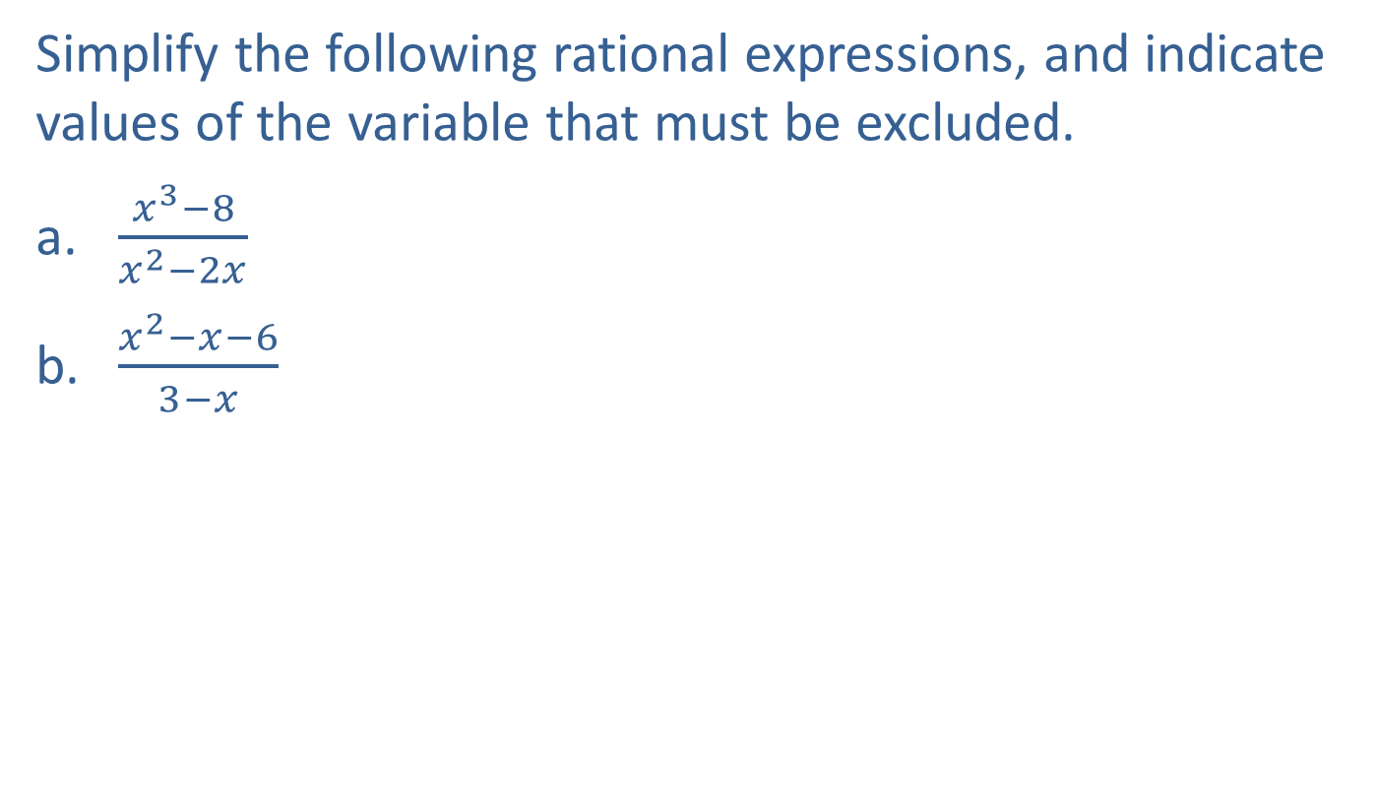
Example 1: Simplifying Rational Expressions
Simplify the following rational expressions, and indicate values of the variable that must be excluded.
​$\frac{x^{3}−8}{x^{2}−2x}$
​$\frac{x^{2}−x−6}{3−x}$

Slide 4
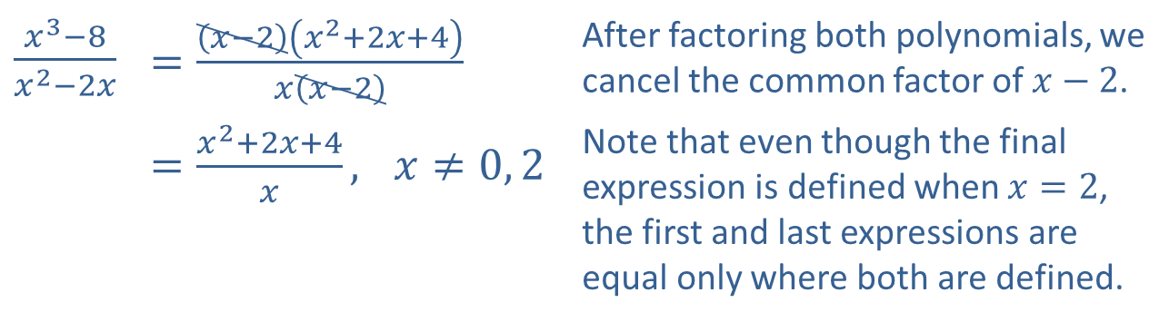
Example 1: Simplifying Rational Expressions (cont.)
Solution
​$\frac{x^{3}−8}{x^{2}−2x}$ | ​$=\frac{\left(x−2\right)\left(x^{2}+2x+4\right)}{x\left(x−2\right)}$ | After factoring both polynomials, we cancel the common factor of $x−2$.
 | ​$=\frac{x^{2}+2x+4}{x}\text{,} x≠0, 2$ | Note that even though the final expression is defined when $x=2$, the first and last expressions are equal only where both are defined.

Slide 5
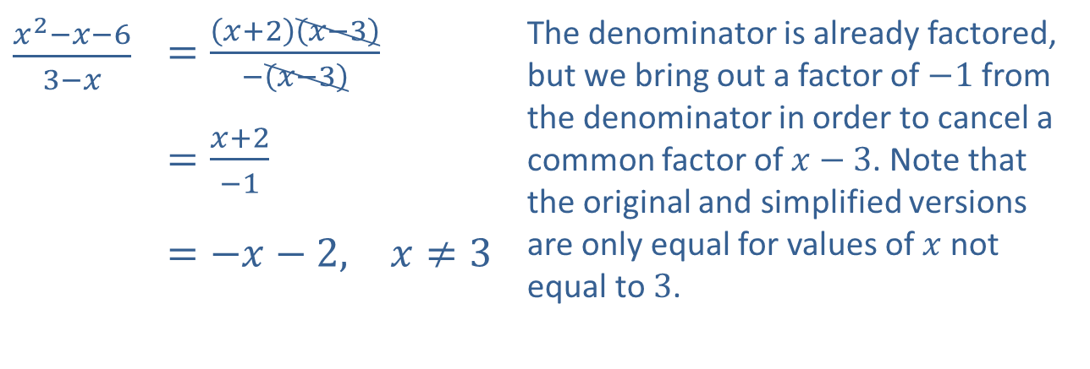
Example 1: Simplifying Rational Expressions (cont.)
​$\frac{x^{2}−x−6}{3−x}$ | ​$=\frac{\left(x+2\right)\left(x−3\right)}{−\left(x−3\right)}$ | The denominator is already factored, but we bring out a factor of $−1$ from the denominator in order to cancel a common factor of $x−3$. Note that the original and simplified versions are only equal for values of $x$ not equal to 3.
 | ​$=\frac{x+2}{−1}$
 | ​$=−x−2\text{,} x≠3$
​

Slide 6
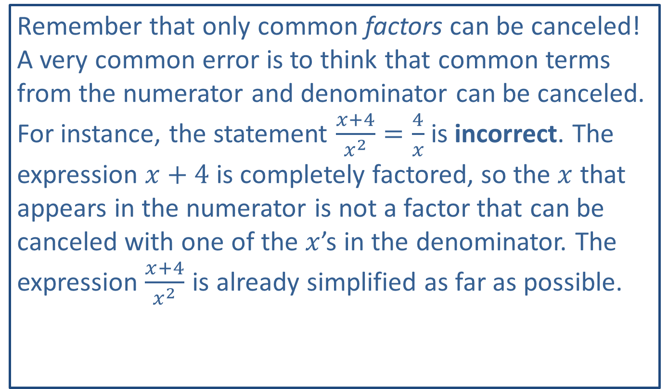
CAUTION!
Remember that only common factors can be canceled! A very common error is to think that common terms from the numerator and denominator can be canceled. For instance, the statement $\frac{x+4}{x^{2}}=\frac{4}{x}$ is incorrect. The expression $x+4$ is completely factored, so the $x$ that appears in the numerator is not a factor that can be canceled with one of the $x$’s in the denominator. The expression $\frac{x+4}{x^{2}}$ is already simplified as far as possible.

Slide 7

Example 2: Combining Rational Expressions
Add or subtract the rational expressions, as indicated.
​$\frac{2x−1}{x^{2}+x−2}−\frac{2x}{x^{2}−4}$
​$\frac{x+1}{x+3}+\frac{x^{2}+x−2}{x^{2}−x−6}−\frac{x^{2}−2x+9}{x^{2}−9}$

Slide 8
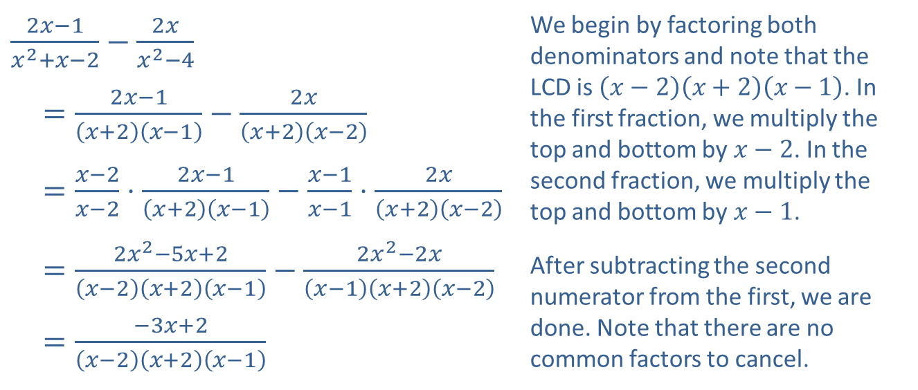
Example 2: Combining Rational Expressions (cont.)
Solution
​
​$\frac{2x−1}{x^{2}+x−2}−\frac{2x}{x^{2}−4}$ | We begin by factoring both denominators and note that the LCD is $\left(x−2\right)\left(x+2\right)\left(x−1\right)$. In the first fraction, we multiply the top and bottom by $x−2$. In the second fraction, we multiply the top and bottom by $x−1$.
​$=\frac{2x−1}{\left(x+2\right)\left(x−1\right)}−\frac{2x}{\left(x+2\right)\left(x−2\right)}$
​$=\frac{x−2}{x−2}⋅\frac{2x−1}{\left(x+2\right)\left(x−1\right)}−\frac{x−1}{x−1}⋅\frac{2x}{\left(x+2\right)\left(x−2\right)}$
​$=\frac{2x^{2}−5x+2}{\left(x−2\right)\left(x+2\right)\left(x−1\right)}−\frac{2x^{2}−2x}{\left(x−1\right)\left(x+2\right)\left(x−2\right)}$ | After subtracting the second numerator from the first, we are done. Note that there are no common factors to cancel.
​$=\frac{−3x+2}{\left(x−2\right)\left(x+2\right)\left(x−1\right)}$

Slide 9
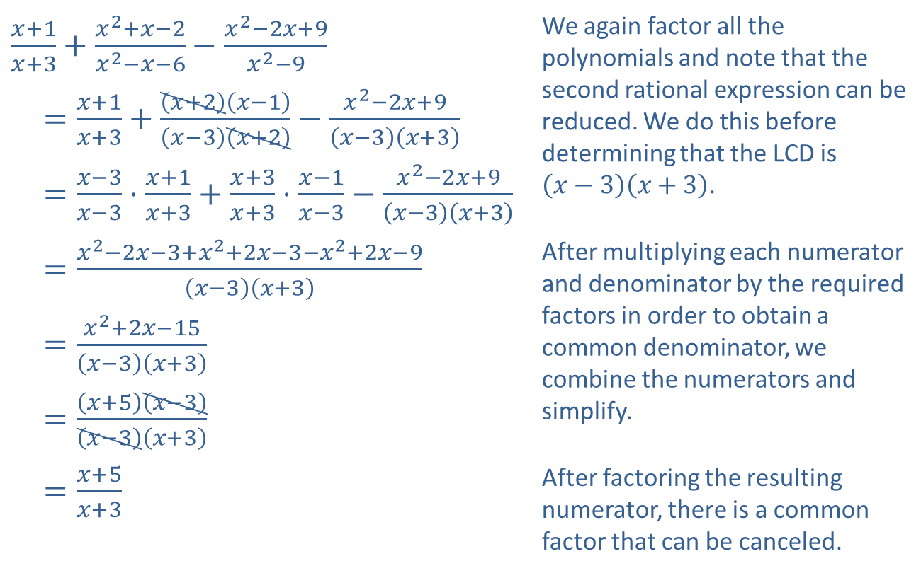
Example 2: Combining Rational Expressions (cont.)
​$\frac{x+1}{x+3}+\frac{x^{2}+x−2}{x^{2}−x−6}−\frac{x^{2}−2x+9}{x^{2}−9}$ | We again factor all the polynomials and note that the second rational expression can be reduced. We do this before determining that the LCD is $\left(x−3\right)\left(x+3\right)$.
​$=\frac{x+1}{x+3}+\frac{\left(x+2\right)\left(x−1\right)}{\left(x−3\right)\left(x+2\right)}−\frac{x^{2}−2x+9}{\left(x−3\right)\left(x+3\right)}$
​$=\frac{x−3}{x−3}⋅\frac{x+1}{x+3}+\frac{x+3}{x+3}⋅\frac{x−1}{x−3}−\frac{x^{2}−2x+9}{\left(x−3\right)\left(x+3\right)}$
​$=\frac{x^{2}−2x−3+x^{2}+2x−3−x^{2}+2x−9}{\left(x−3\right)\left(x+3\right)}$ | After multiplying each numerator and denominator by the required factors in order to obtain a common denominator, we combine the numerators and simplify.
​$=\frac{x^{2}+2x−15}{\left(x−3\right)\left(x+3\right)}$
​$=\frac{\left(x+5\right)\left(x−3\right)}{\left(x−3\right)\left(x+3\right)}$
​$=\frac{x+5}{x+3}$ | After factoring the resulting numerator, there is a common factor that can be canceled.
​

Slide 10

Example 3: Combining Rational Expressions
Multiply or divide the rational expressions, as indicated.
​$\frac{x^{2}+3x−10}{x+3}⋅\frac{x−3}{x^{2}−x−2}$
​$\frac{x^{2}+5x−14}{3x}÷\frac{x^{2}−4x+4}{9x^{3}}$

Slide 11
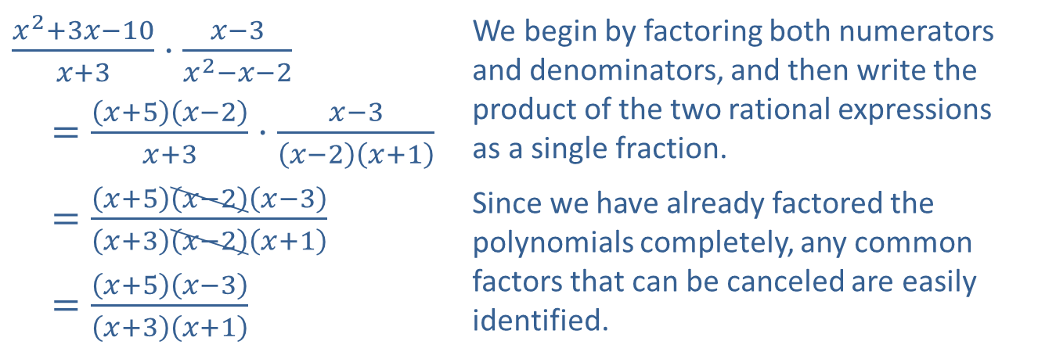
Example 3: Combining Rational Expressions (cont.)
Solution
​
​$\frac{x^{2}+3x−10}{x+3}⋅\frac{x−3}{x^{2}−x−2}$ | We begin by factoring both numerators and denominators, and then write the product of the two rational expressions as a single fraction.
​$=\frac{\left(x+5\right)\left(x−2\right)}{x+3}⋅\frac{x−3}{\left(x−2\right)\left(x+1\right)}$
​$=\frac{\left(x+5\right)\left(x−2\right)\left(x−3\right)}{\left(x+3\right)\left(x−2\right)\left(x+1\right)}$ | Since we have already factored the polynomials completely, any common factors that can be canceled are easily identified.
​$=\frac{\left(x+5\right)\left(x−3\right)}{\left(x+3\right)\left(x+1\right)}$

Slide 12
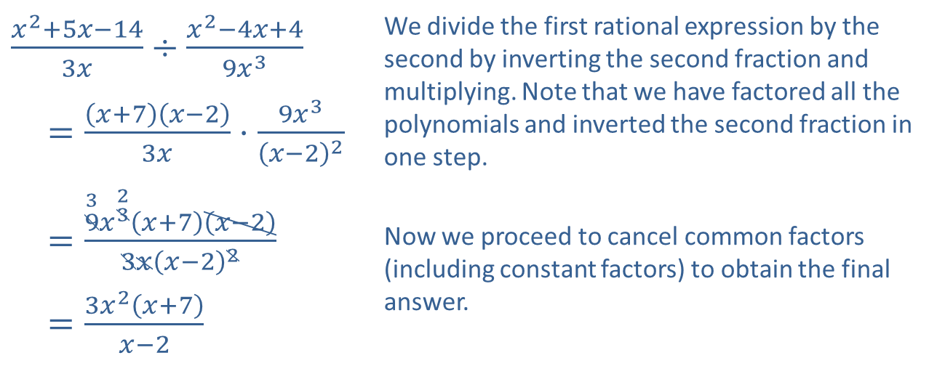
Example 3: Combining Rational Expressions (cont.)
​$\frac{x^{2}+5x−14}{3x}÷\frac{x^{2}−4x+4}{9x^{3}}$ | We divide the first rational expression by the second by inverting the second fraction and multiplying. Note that we have factored all the polynomials and inverted the second fraction in one step.
​$=\frac{\left(x+7\right)\left(x−2\right)}{3x}⋅\frac{9x^{3}}{{\left(x−2\right)}^{2}}$
​$=\frac{\overset{3}{9}x^{\overset{2}{3}}\left(x+7\right)\left(x−2\right)}{3x{\left(x−2\right)}^{2}}$ | Now we proceed to cancel common factors (including constant factors) to obtain the final answer.
​$=\frac{3x^{2}\left(x+7\right)}{x−2}$
​

Slide 13

Example 4: Simplifying Complex Rational Expressions
Simplify the complex rational expressions.
​$\frac{\frac{1}{x+h}−\frac{1}{x}}{h}$
​$\frac{x^{−1}−y^{−1}}{x^{−2}−y^{−2}}$

Slide 14
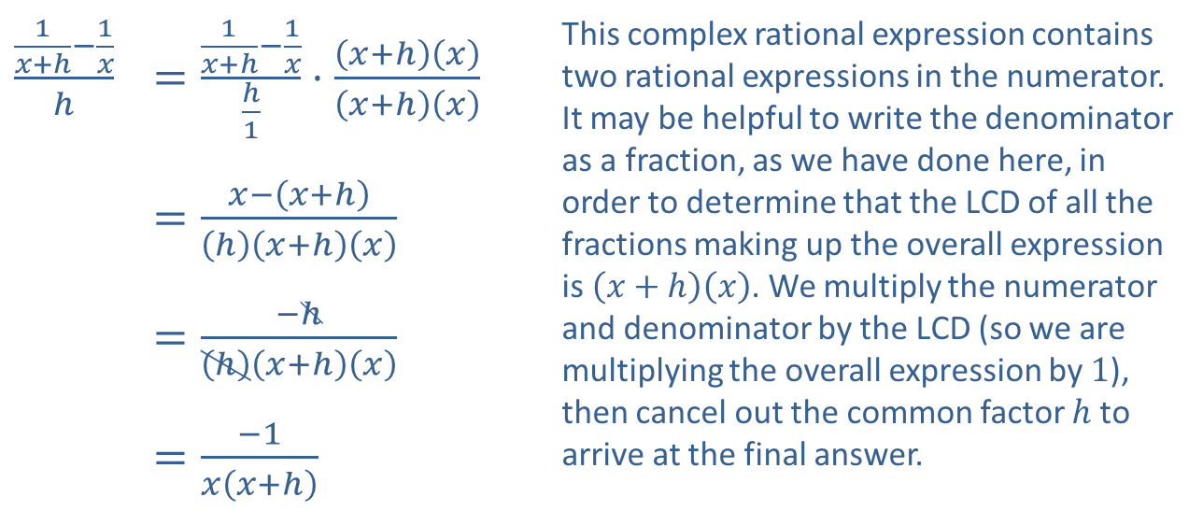
Example 4: Simplifying Complex Rational Expressions (cont.)
Solution
​
​$\frac{\frac{1}{x+h}−\frac{1}{x}}{h}$ | ​$=\frac{\frac{1}{x+h}−\frac{1}{x}}{\frac{h}{1}}⋅\frac{\left(x+h\right)\left(x\right)}{\left(x+h\right)\left(x\right)}$ | This complex rational expression contains two rational expressions in the numerator. It may be helpful to write the denominator as a fraction, as we have done here, in order to determine that the LCD of all the fractions making up the overall expression is $\left(x+h\right)\left(x\right)$. We multiply the numerator and denominator by the LCD (so we are multiplying the overall expression by 1), then cancel out the common factor $h$ to arrive at the final answer.
 | ​$=\frac{x−\left(x+h\right)}{\left(h\right)\left(x+h\right)\left(x\right)}$
 | ​$=\frac{−h}{\left(h\right)\left(x+h\right)\left(x\right)}$
 | ​$=\frac{−1}{x\left(x+h\right)}$

Slide 15
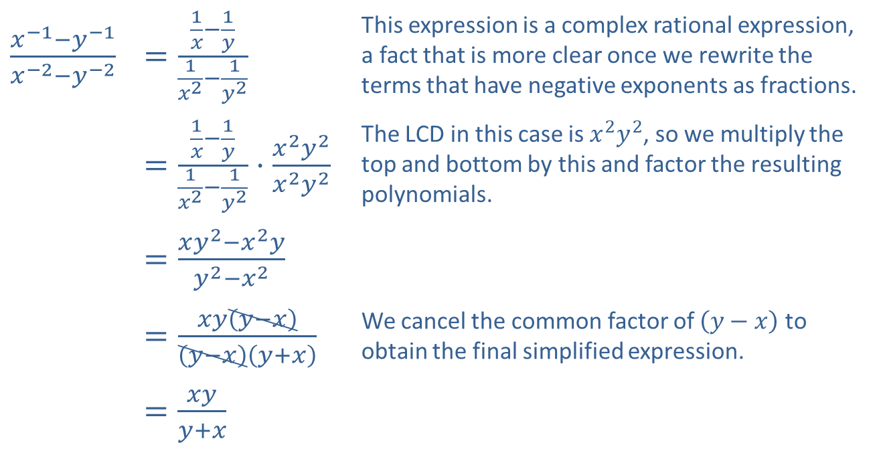
Example 4: Simplifying Complex Rational Expressions (cont.)
​$\frac{x^{−1}−y^{−1}}{x^{−2}−y^{−2}}$ | ​$=\frac{\frac{1}{x}−\frac{1}{y}}{\frac{1}{x^{2}}−\frac{1}{y^{2}}}$ | This expression is a complex rational expression, a fact that is more clear once we rewrite the terms that have negative exponents as fractions.
 | ​$=\frac{\frac{1}{x}−\frac{1}{y}}{\frac{1}{x^{2}}−\frac{1}{y^{2}}}⋅\frac{x^{2}y^{2}}{x^{2}y^{2}}$ | The LCD in this case is $x^{2}y^{2}$, so we multiply the top and bottom by this and factor the resulting polynomials.
 | ​$=\frac{xy^{2}−x^{2}y}{y^{2}−x^{2}}$
 | ​$=\frac{xy\left(y−x\right)}{\left(y−x\right)\left(y+x\right)}$ | We cancel the common factor of $\left(y−x\right)$ to obtain the final simplified expression.
 | ​$=\frac{xy}{y+x}$
​

