Slide 1
Section 1.8
Complex Numbers

Slide 2
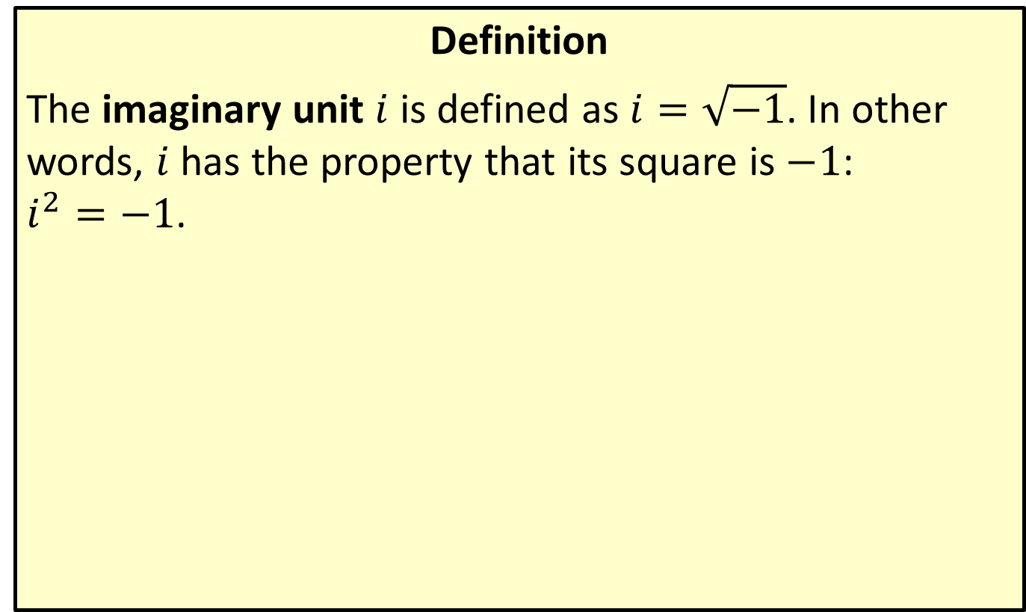

The Imaginary Unit $i$
Definition
The imaginary unit $i$ is defined as $i=\sqrt{−1}$. In other words, $i$ has the property that its square is $−1$: $i^{2}=−1$.

Slide 3
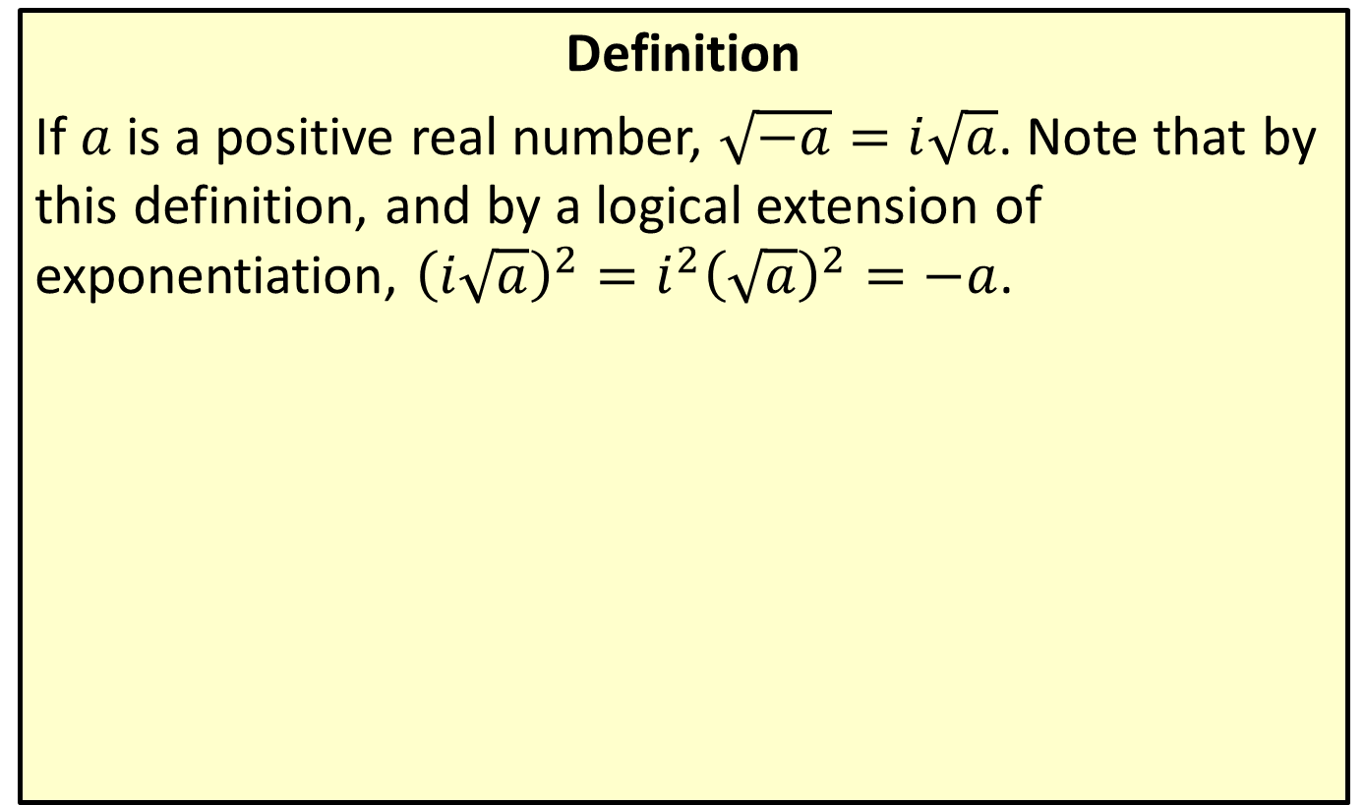
Square Roots of Negative Numbers
Definition
If $a$ is a positive real number, $\sqrt{−a}=i\sqrt{a}$. Note that by this definition, and by a logical extension of exponentiation, ${\left(i\sqrt{a}\right)}^{2}=i^{2}{\left(\sqrt{a}\right)}^{2}=−a$.

Slide 4
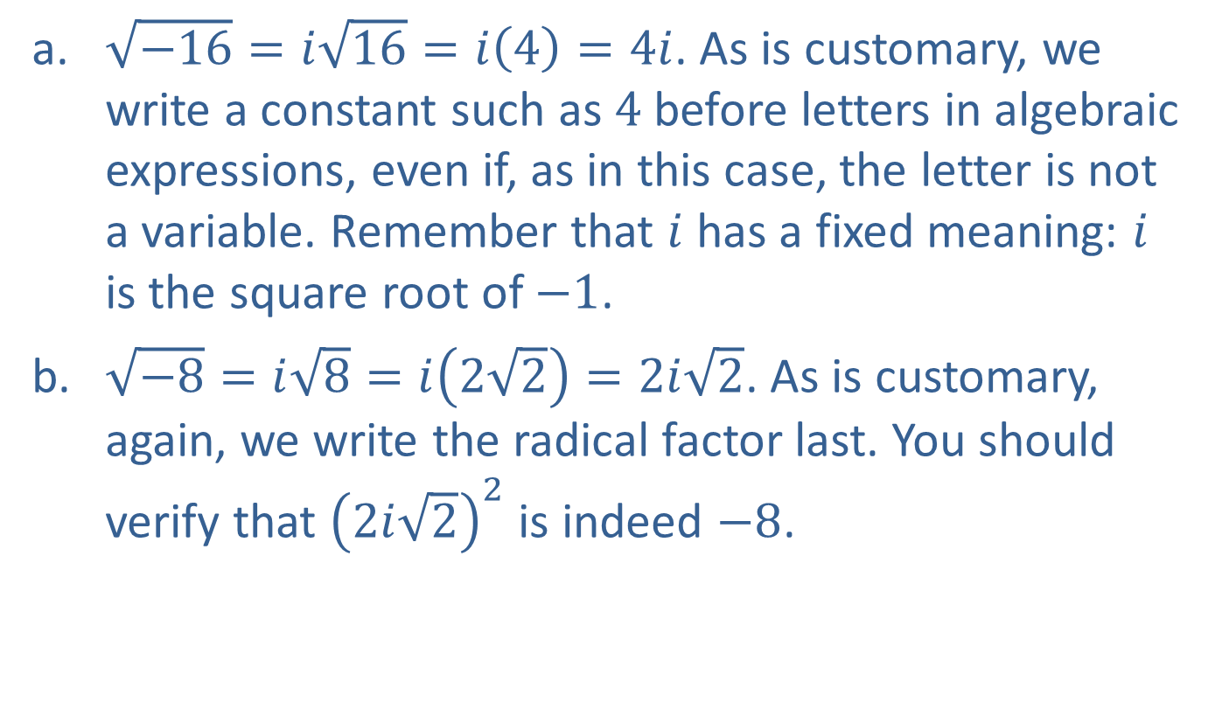

Example 1: The Number $i$
​$\sqrt{−16}=i\sqrt{16}=i\left(4\right)=4i$. As is customary, we write a constant such as 4 before letters in algebraic expressions, even if, as in this case, the letter is not a variable. Remember that $i$ has a fixed meaning: $i$ is the square root of $−1$.
​$\sqrt{−8}=i\sqrt{8}=i\left(2\sqrt{2}\right)=2i\sqrt{2}$. As is customary, again, we write the radical factor last. You should verify that ${\left(2i\sqrt{2}\right)}^{2}$ is indeed $−8$.

Slide 5
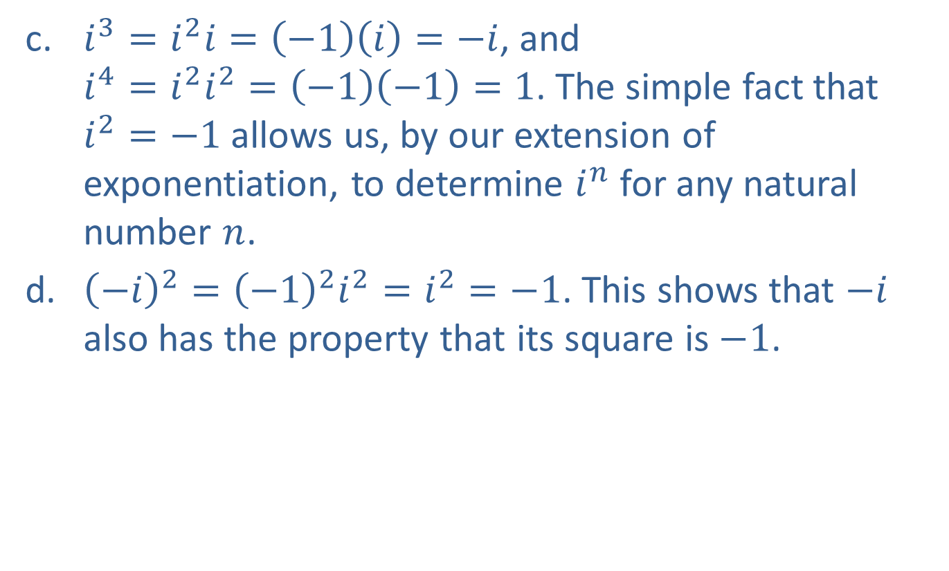

Example 1: The Number $i$ (cont.)
​$i^{3}=i^{2}i=\left(−1\right)\left(i\right)=−i$, and $i^{4}=i^{2}i^{2}=\left(−1\right)\left(−1\right)=1$. The simple fact that $i^{2}=−1$ allows us, by our extension of exponentiation, to determine $i^{n}$ for any natural number $n$.
​${\left(−i\right)}^{2}={\left(−1\right)}^{2}i^{2}=i^{2}=−1$. This shows that $−i$ also has the property that its square is $−1$.

Slide 6


Example 2: Powers of $i$
Compute the following powers of $i$.
​$i^{9}$
​$i^{28}$
​$i^{102}$

Slide 7
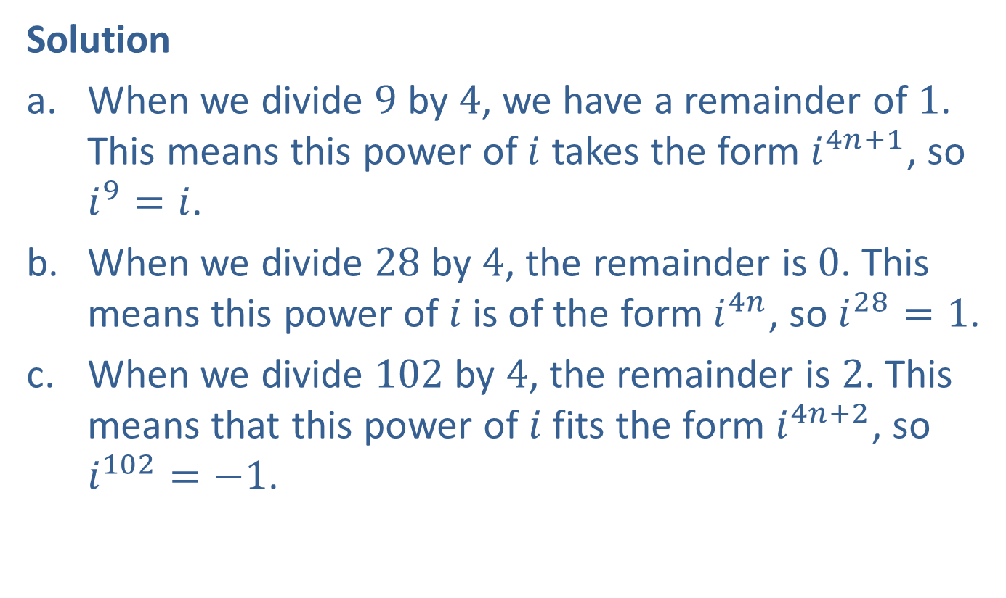

Example 2: Powers of $i$ (cont.)
Solution
​When we divide 9 by 4, we have a remainder of 1. This means this power of $i$ takes the form $i^{4n+1}$, so $i^{9}=i$.
​When we divide 28 by 4, the remainder is 0. This means this power of $i$ is of the form $i^{4n}$, so $i^{28}=1$.
​When we divide 102 by 4, the remainder is 2. This means that this power of $i$ fits the form $i^{4n+2}$, so $i^{102}=−1$.

Slide 8
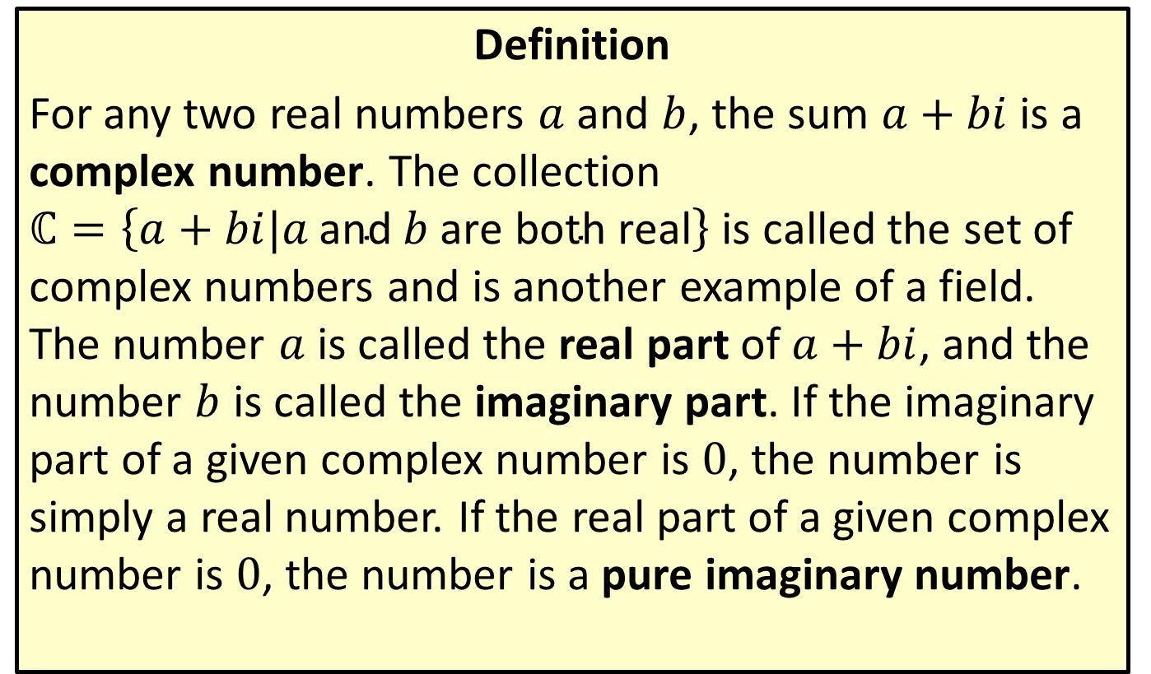
Complex Numbers
Definition
For any two real numbers $a$ and $b$, the sum $a+bi$ is a complex number. The collection $ℂ=\left\{a+bi|a \text{and} b \text{are} \text{both} \text{real}\right\}$ is called the set of complex numbers and is another example of a field. The number $a$ is called the real part of $a+bi$, and the number $b$ is called the imaginary part. If the imaginary part of a given complex number is 0, the number is simply a real number. If the real part of a given complex number is 0, the number is a pure imaginary number.

Slide 9
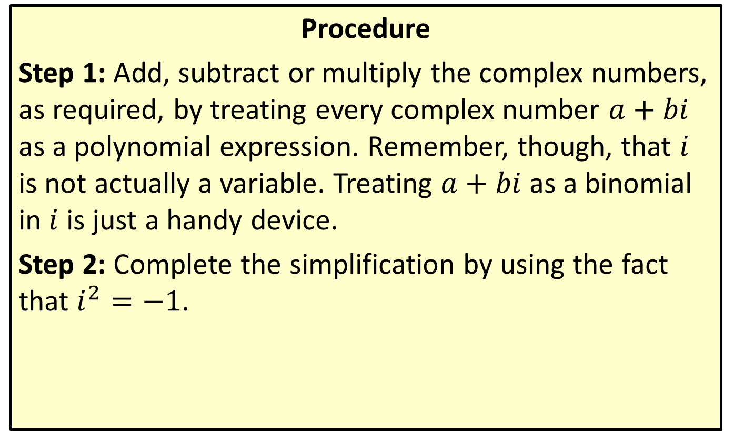
Simplifying Complex Expression
Procedure
Step 1: Add, subtract or multiply the complex numbers, as required, by treating every complex number $a+bi$ as a polynomial expression. Remember, though, that $i$ is not actually a variable. Treating $a+bi$ as a binomial in $i$ is just a handy device.
Step 2: Complete the simplification by using the fact that $i^{2}=−1$.

Slide 10

Example 3: Simplifying Complex Expressions
Simplify the following complex expressions.
​$\left(4+3i\right)+\left(−5+7i\right)$
​$\left(−2+3i\right)−\left(−5+3i\right)$
​$\left(3+2i\right)\left(−2+3i\right)$
​${\left(2−3i\right)}^{2}$

Slide 11
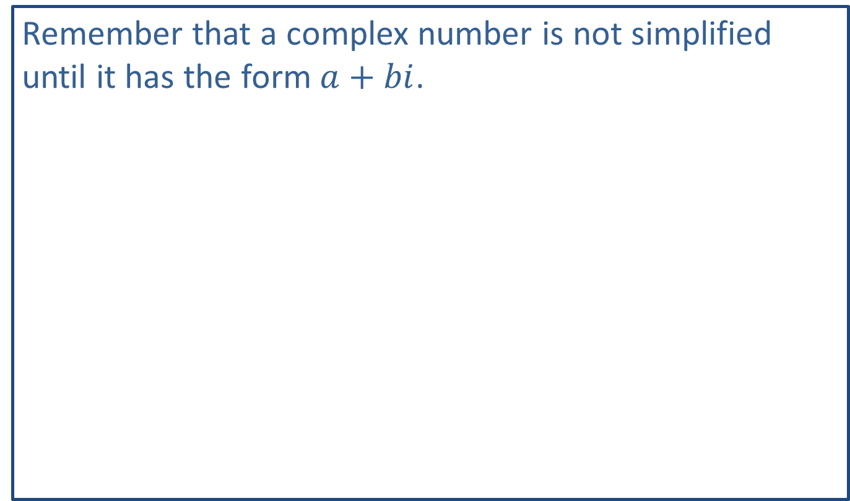
Note:
Remember that a complex number is not simplified until it has the form $a+bi$.

Slide 12
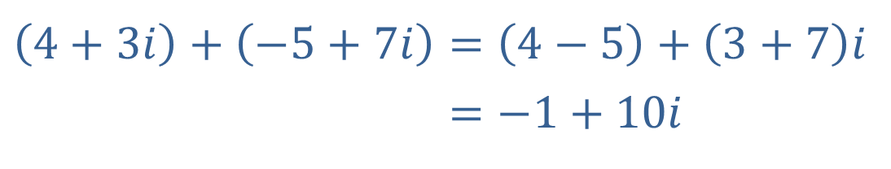
Example 3: Simplifying Complex Expressions (cont.)
Solution
​As if adding polynomials, we combine the real parts, then the imaginary parts.
​$\left(4+3i\right)+\left(−5+7i\right)=\left(4−5\right)+\left(3+7\right)i$
​4+3𝑖+−5+7𝑖=−1+10𝑖

Slide 13
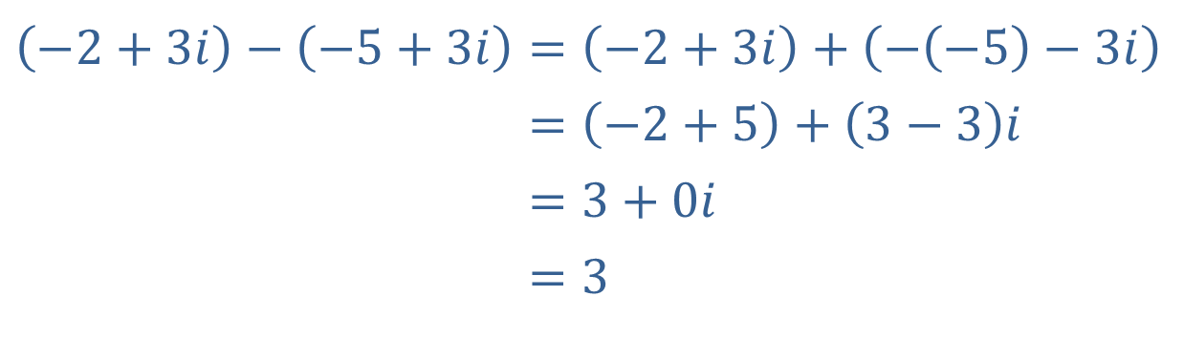
Example 3: Simplifying Complex Expressions (cont.)
Begin by distributing the minus sign over the second complex number.
​$\left(−2+3i\right)−\left(−5+3i\right)=\left(−2+3i\right)+\left(−\left(−5\right)−3i\right)$
​−2+3𝑖−−5+3𝑖=−2+5+3−3𝑖
​−2+3𝑖−−5+3𝑖=3+0𝑖
​−2+3𝑖−−5+3𝑖=3

Slide 14
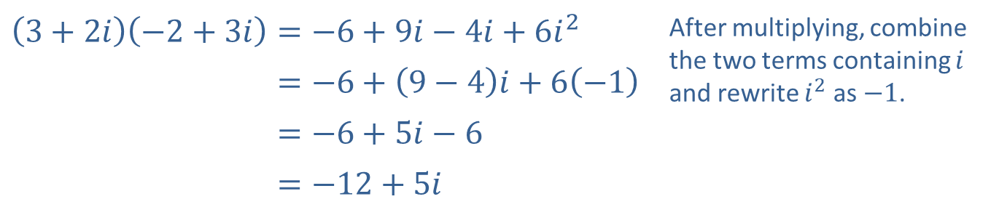
Example 3: Simplifying Complex Expressions (cont.)
​
​$\left(3+2i\right)\left(−2+3i\right)=−6+9i−4i+6i^{2}$ | After multiplying, combine the two terms containing $i$ and rewrite $i^{2}$ as $−1$.
​3+2𝑖−2+3𝑖=−6+9−4𝑖+6−1
​3+2𝑖−2+3𝑖=−6+5𝑖−6
​3+2𝑖−2+3𝑖=−12+5𝑖

Slide 15
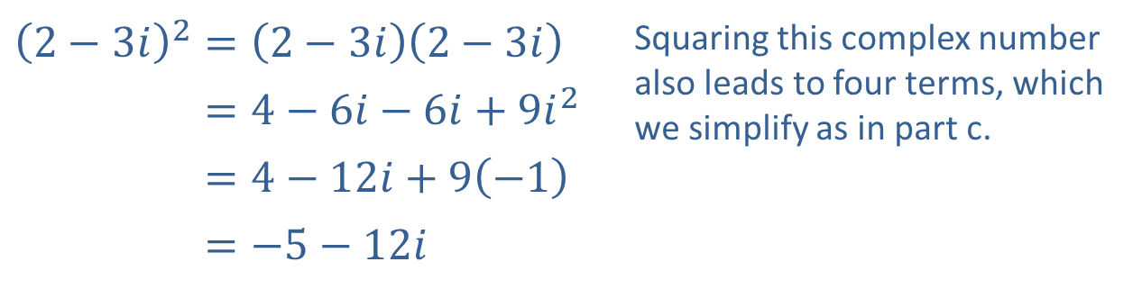
Example 3: Simplifying Complex Expressions (cont.)
​
​${\left(2−3i\right)}^{2}=\left(2−3i\right)\left(2−3i\right)$ | Squaring this complex number also leads to four terms, which we simplify as in part c.
​2−3𝑖2=4−6𝑖−6𝑖+9𝑖2
​2−3𝑖2=4−12𝑖+9−1
​2−3𝑖2=−5−12𝑖

Slide 16
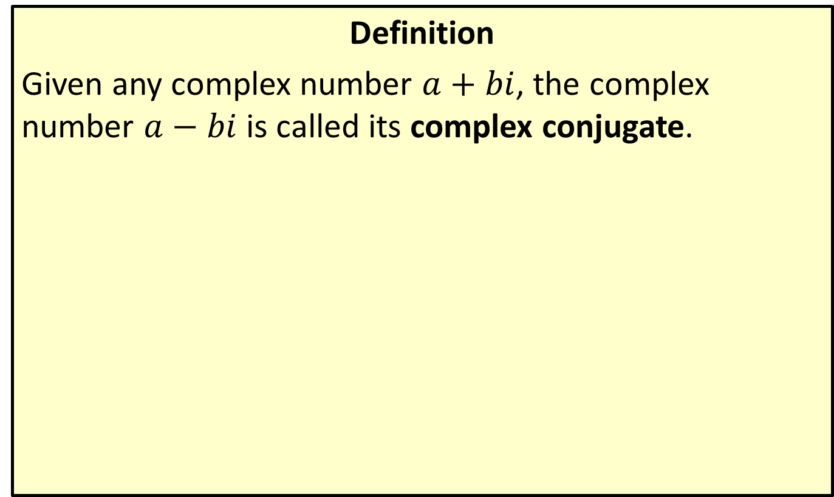
Complex Conjugates
Definition
Given any complex number $a+bi$, the complex number $a−bi$ is called its complex conjugate.

Slide 17

Example 4: Dividing Complex Numbers
Simplify the following expressions.
​$\frac{2+3i}{3−i}$
​${\left(4−3i\right)}^{−1}$
​$\frac{1}{i}$

Slide 18
Note:
Always begin by finding the complex conjugate of the denominator, then multiply the numerator and denominator by this conjugate.

Slide 19
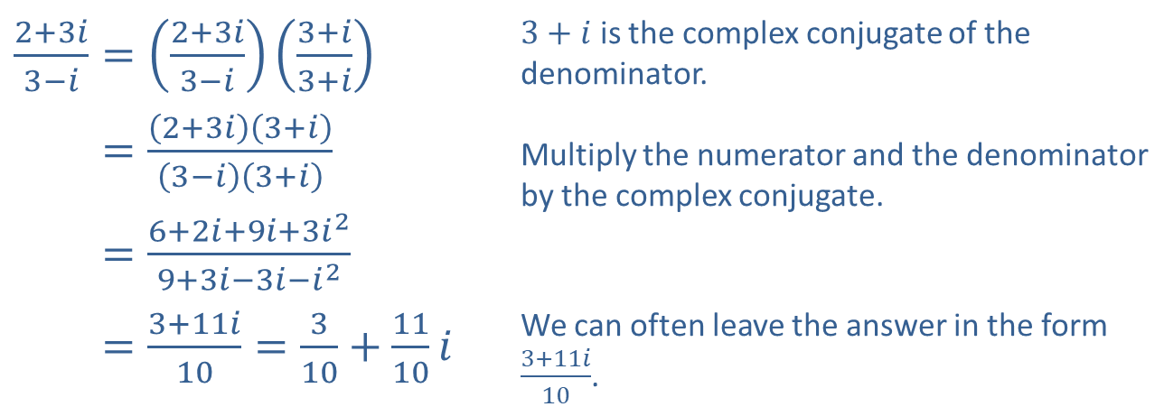
Example 4: Dividing Complex Numbers (cont.)
Solution
​
​$\frac{2+3i}{3−i}=\left(\frac{2+3i}{3−i}\right)\left(\frac{3+i}{3+i}\right)$ | $3+i$ is the complex conjugate of the denominator. Multiply the numerator and the denominator by the complex conjugate.
​2+3𝑖3−𝑖=2+3𝑖3+𝑖3−𝑖3+𝑖
​2+3𝑖3−𝑖=6+2𝑖+9𝑖+3𝑖29+3𝑖−3𝑖−𝑖2
​2+3𝑖3−𝑖=3+11𝑖10=310+1110𝑖 | We can often leave the answer in the form $\frac{3+11i}{10}$.

Slide 20
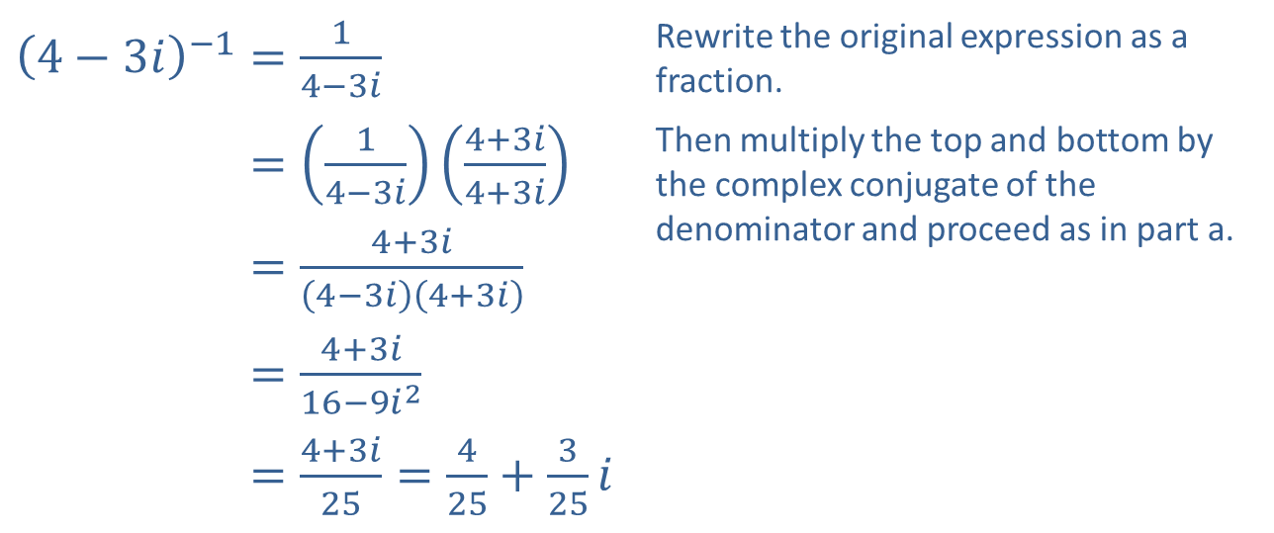
Example 4: Dividing Complex Numbers (cont.)
​${\left(4−3i\right)}^{−1}=\frac{1}{4−3i}$ | Rewrite the original expression as a fraction.
​4−3𝑖−1=14−3𝑖4+3𝑖4+3𝑖 | Then multiply the top and bottom by the complex conjugate of the denominator and proceed as in part a.
​4−3𝑖−1=4+3𝑖4−3𝑖4+3𝑖
​4−3𝑖−1=4+3𝑖16−9𝑖2
​4−3𝑖−1=4+3𝑖25=425+325𝑖
​

Slide 21
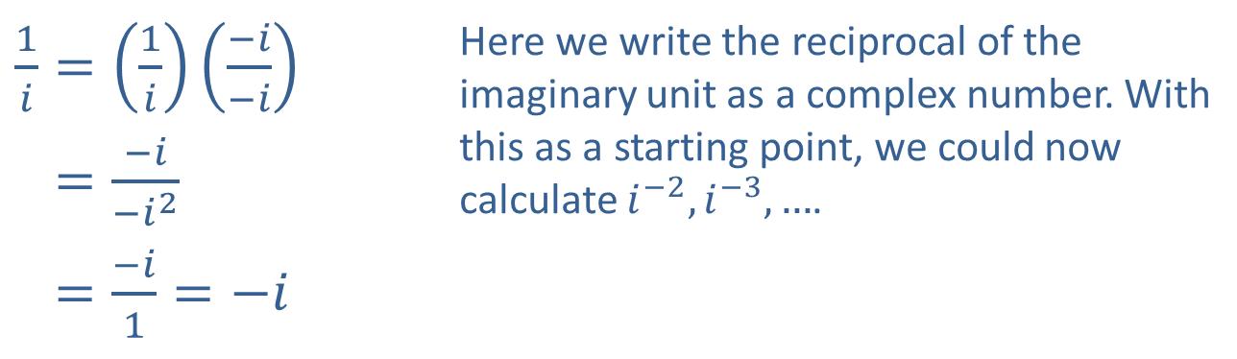
Example 4: Dividing Complex Numbers (cont.)
​$\frac{1}{i}=\left(\frac{1}{i}\right)\left(\frac{−i}{−i}\right)$ | Here we write the reciprocal of the imaginary unit as a complex number. With this as a starting point, we could now calculate $i^{−2},i^{−3},…$.
​1𝑖=−𝑖−𝑖2
​1𝑖=−𝑖1=−𝑖
​

Slide 22
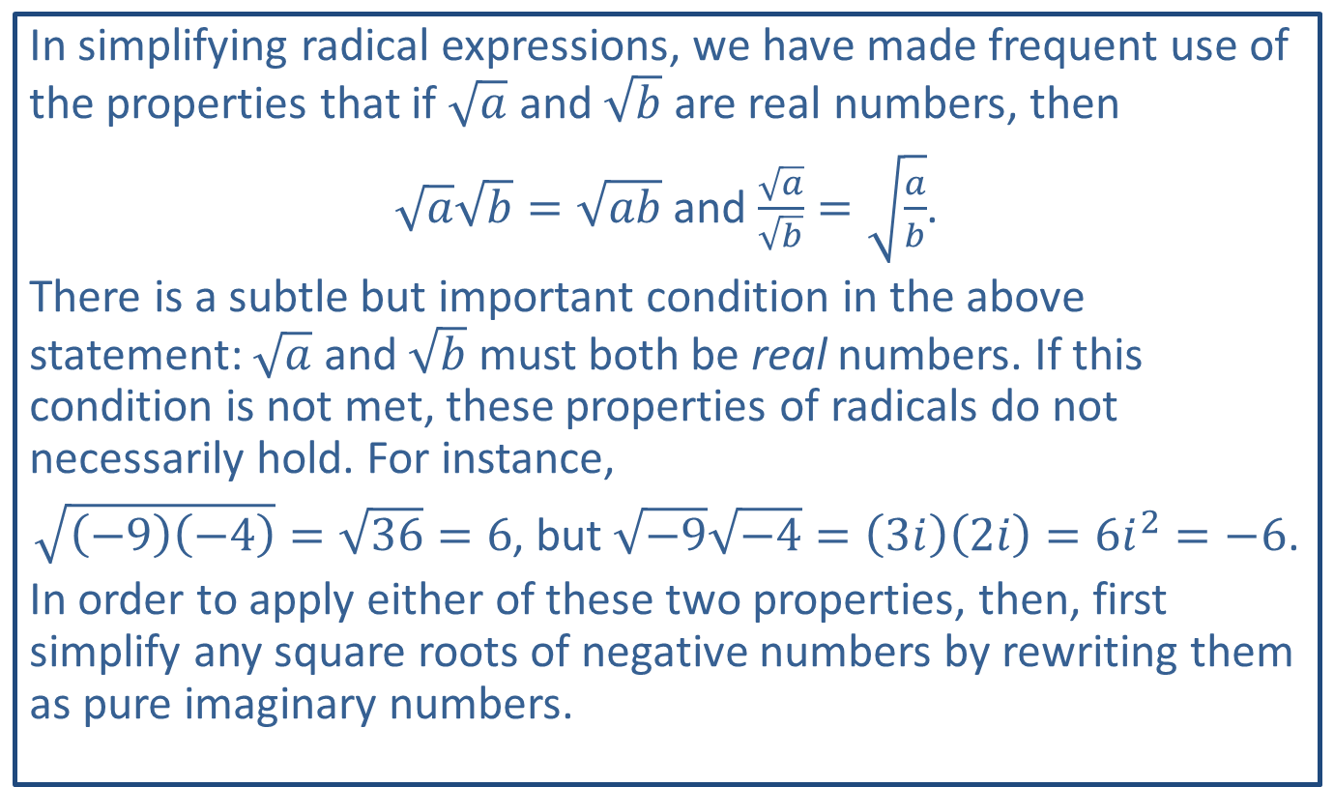
CAUTION!
In simplifying radical expressions, we have made frequent use of the properties that if $\sqrt{a}$ and $\sqrt{b}$ are real numbers, then
$\sqrt{a}\sqrt{b}=\sqrt{ab}$ and $\frac{\sqrt{a}}{\sqrt{b}}=\sqrt{\frac{a}{b}}$.
There is a subtle but important condition in the above statement: $\sqrt{a}$ and $\sqrt{b}$ must both be real numbers. If this condition is not met, these properties of radicals do not necessarily hold. For instance,
$\sqrt{\left(−9\right)\left(−4\right)}=\sqrt{36}=6$, but $\sqrt{−9}\sqrt{−4}=\left(3i\right)\left(2i\right)=6i^{2}=−6$.
In order to apply either of these two properties, then, first simplify any square roots of negative numbers by rewriting them as pure imaginary numbers.

Slide 23

Example 5: Roots and Complex Numbers
Simplify the following expressions.
​${\left(2−\sqrt{−3}\right)}^{2}$
​$\frac{\sqrt{4}}{\sqrt{−4}}$

Slide 24
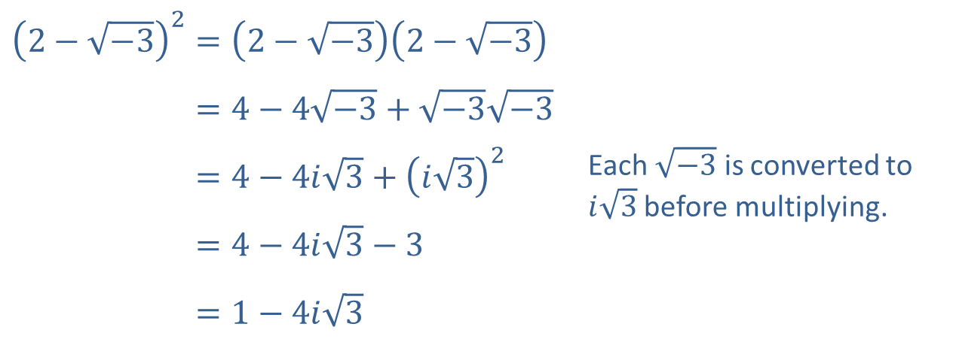
Example 5: Roots and Complex Numbers (cont.)
Solution
​
​${\left(2−\sqrt{−3}\right)}^{2}=\left(2−\sqrt{−3}\right)\left(2−\sqrt{−3}\right)$
​2−−32=4−4−3+−3−3
​2−−32=4−4𝑖3+𝑖32 | Each $\sqrt{−3}$ is converted to $i\sqrt{3}$ before multiplying.
​2−−32=4−4𝑖3−3
​2−−32=1−4𝑖3

Slide 25
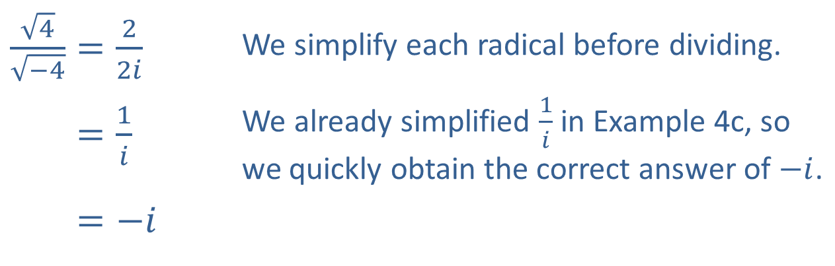
Example 5: Roots and Complex Numbers (cont.)
​$\frac{\sqrt{4}}{\sqrt{−4}}=\frac{2}{2i}$ | We simplify each radical before dividing.
​4−4=1𝑖 | We already simplified $\frac{1}{i}$ in Example 4c, so we quickly obtain the correct answer of $−i$.
​4−4=−𝑖
​

