Slide 1
Section 10.2
The Law of Cosines

Slide 2
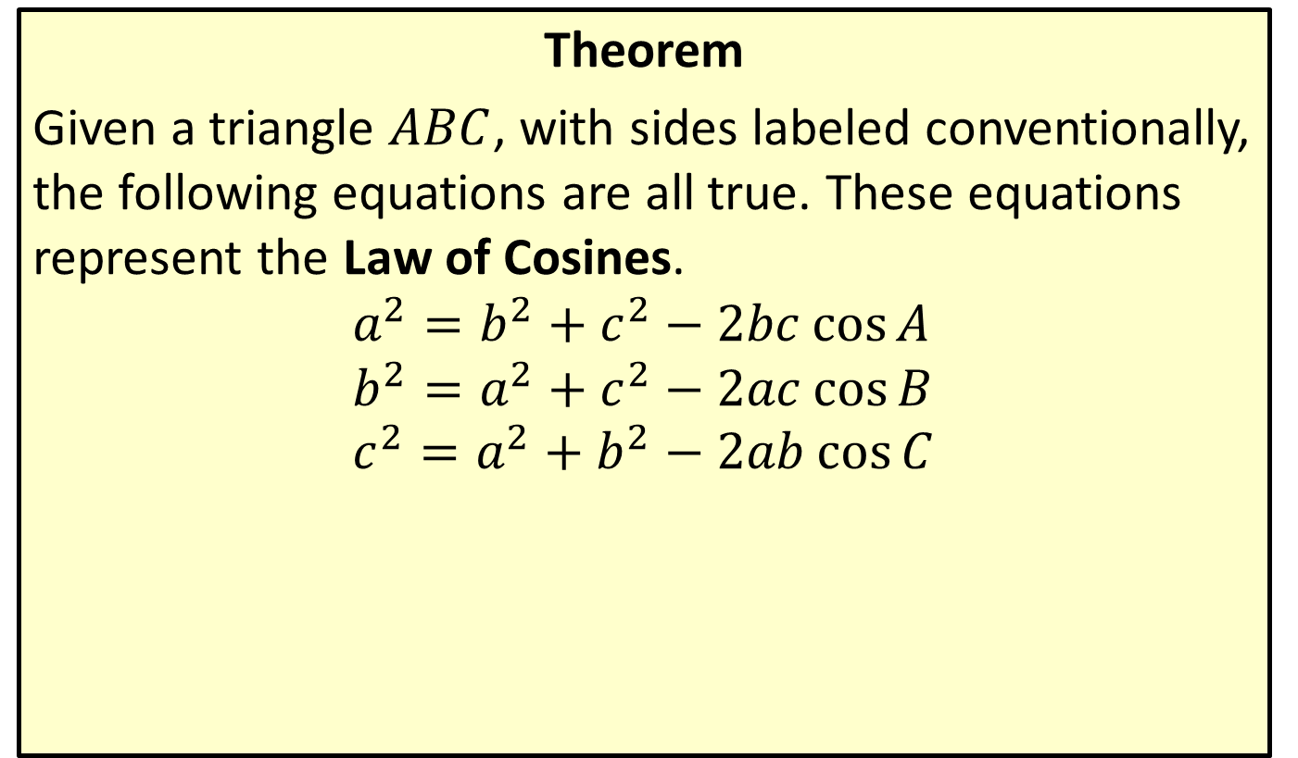
The Law of Cosines
Theorem
Given a triangle $ABC$, with sides labeled conventionally, the following equations are all true. These equations represent the Law of Cosines.
$$a^{2}=b^{2}+c^{2}−2bc\cos{A} \\ b^{2}=a^{2}+c^{2}−2ac\cos{B} \\ c^{2}=a^{2}+b^{2}−2ab\cos{C}$$

Slide 3

Example 1: Using the Law of Cosines in a SSS Situation
Determine the three angles for a triangle in which $a=3 inches$, $b=5 inches$, and $c=7 inches$.

Slide 4
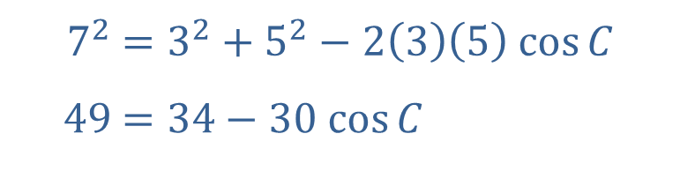
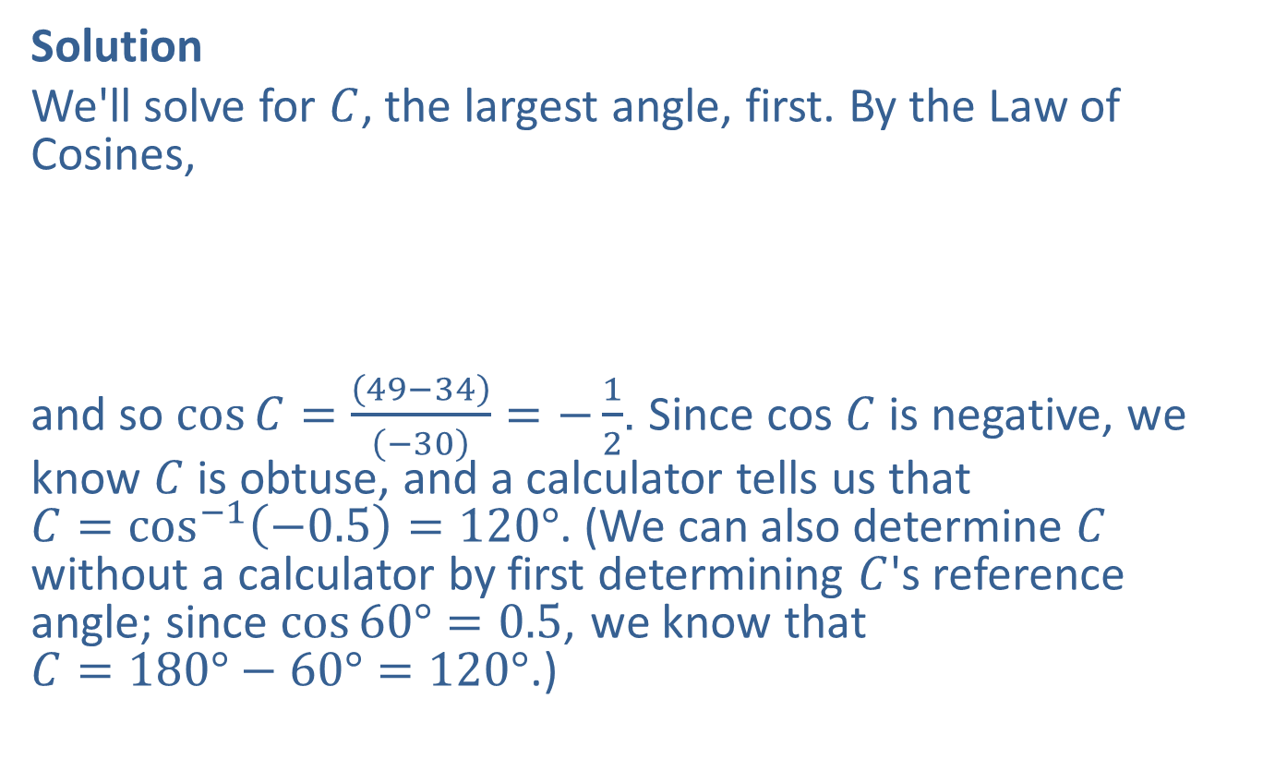
Example 1: Using the Law of Cosines in a SSS Situation (cont.)
Solution
We'll solve for $C$, the largest angle, first. By the Law of Cosines,
​
and so $\cos{C}=\frac{\left(49−34\right)}{\left(−30\right)}=−\frac{1}{2}$. Since cos $C$ is negative, we know $C$ is obtuse, and a calculator tells us that $C=\cos^{−1}\left(−0.5\right)=120°$. (We can also determine $C$ without a calculator by first determining $C$'s reference angle; since $\cos{60°}=0.5$, we know that $C=180°−60°=120°$.)
​$7^{2}$ | ​$=3^{2}+5^{2}−2\left(3\right)\left(5\right) cos⁡C$
​$49$ | ​$=34−30 cos⁡C$

Slide 5
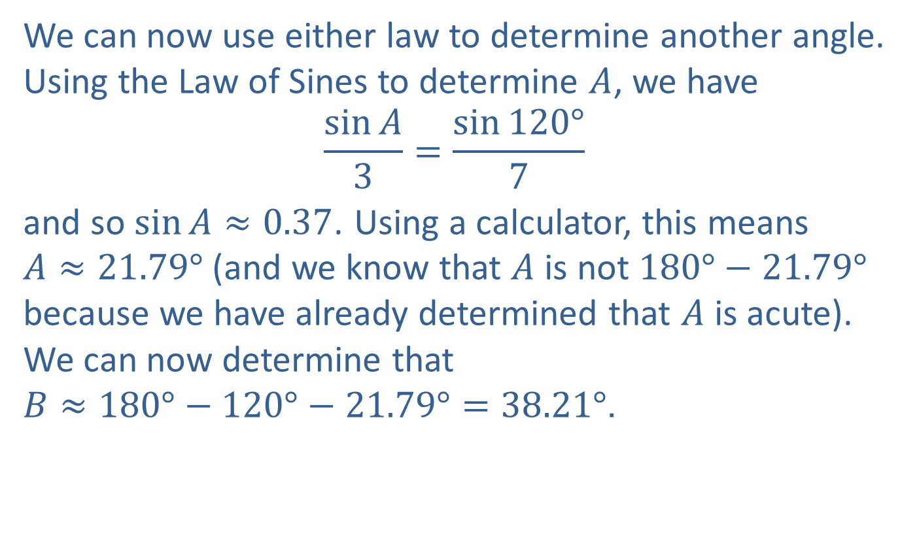
Example 1: Using the Law of Cosines in a SSS Situation (cont.)
We can now use either law to determine another angle. Using the Law of Sines to determine $A$, we have
$$\frac{\sin{A}}{3}=\frac{\sin{120°}}{7}$$
and so $\sin{A}≈0.37$. Using a calculator, this means $A≈21.79°$ (and we know that $A$ is not $180°−21.79°$ because we have already determined that $A$ is acute). We can now determine that $B≈180°−120°−21.79°=38.21°$.

Slide 6
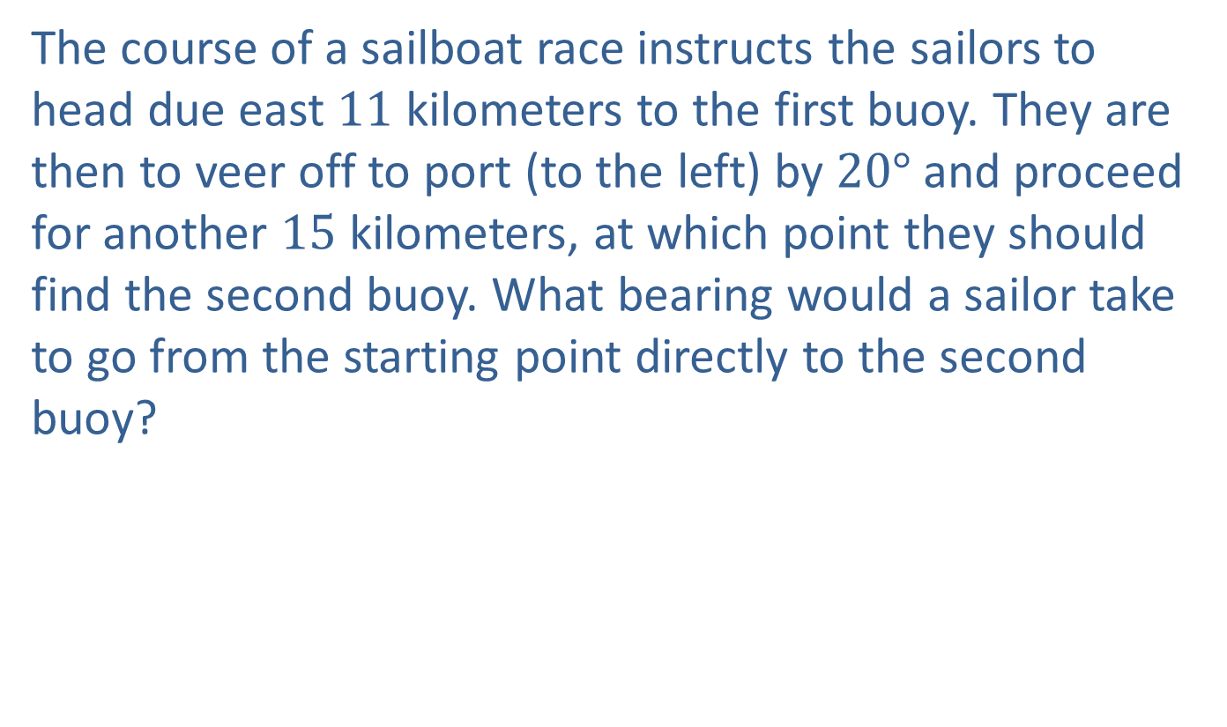
Example 2: Using the Law of Cosines in an SAS Situation
The course of a sailboat race instructs the sailors to head due east 11 kilometers to the first buoy. They are then to veer off to port (to the left) by $20°$and proceed for another 15 kilometers, at which point they should find the second buoy. What bearing would a sailor take to go from the starting point directly to the second buoy?

Slide 7
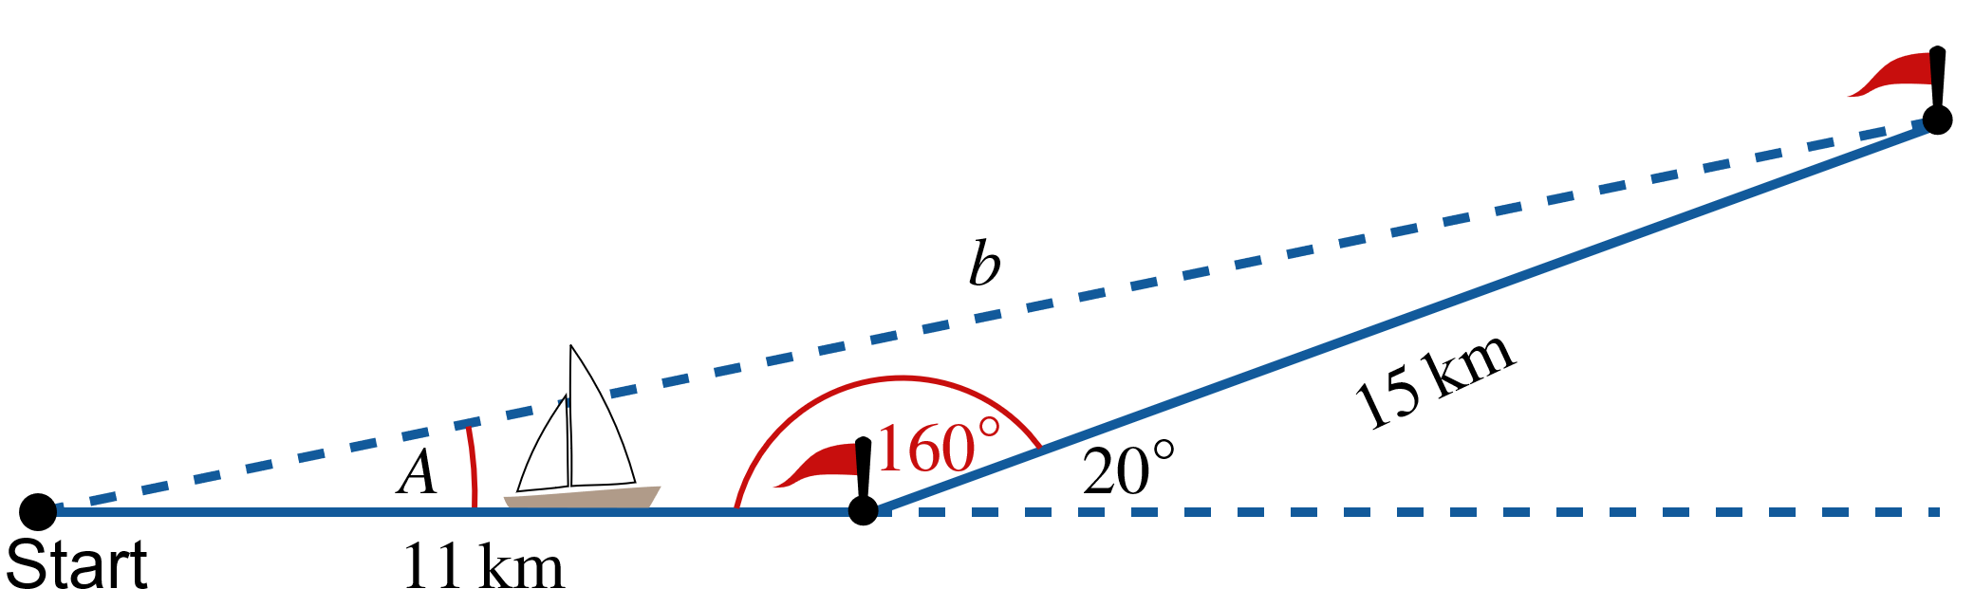
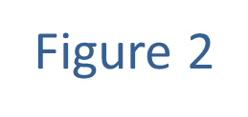
Example 2: Using the Law of Cosines in an SAS Situation (cont.)
Solution
A picture is definitely in order.

Slide 8
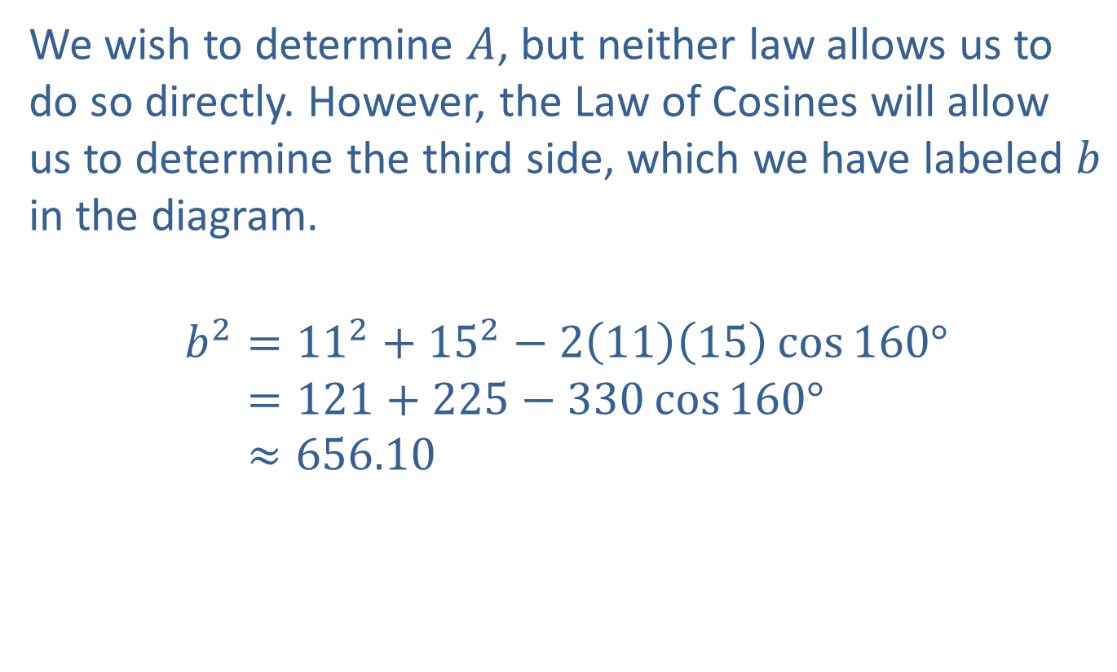
Example 2: Using the Law of Cosines in an SAS Situation (cont.)
We wish to determine $A$, but neither law allows us to do so directly. However, the Law of Cosines will allow us to determine the third side, which we have labeled $b$ in the diagram.
𝑏2=112+152−21115cos160°𝑏2=121+225−330cos160°𝑏2≈656.10

Slide 9
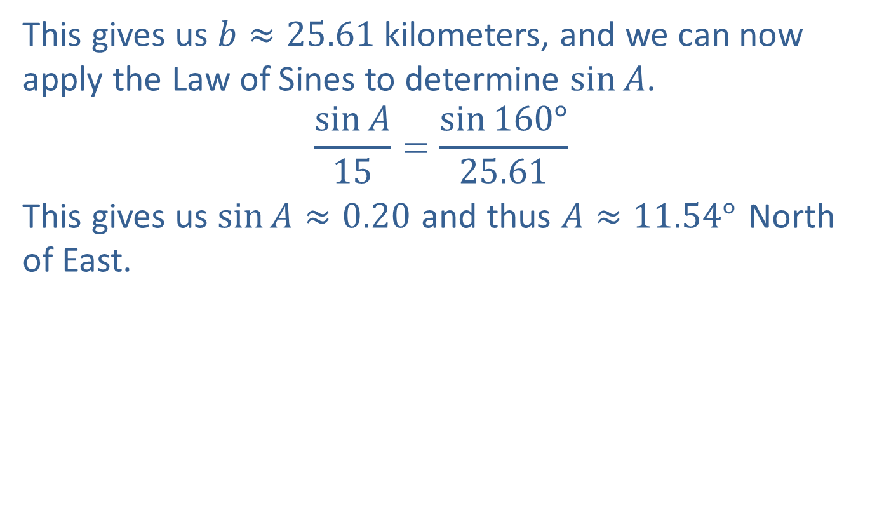
Example 2: Using the Law of Cosines in an SAS Situation (cont.)
This gives us $b≈25.61$ kilometers, and we can now apply the Law of Sines to determine $sin⁡A$.
$$\frac{\sin{A}}{15}=\frac{\sin{160°}}{25.61}$$
This gives us $\sin{A}≈0.20$ and thus $A≈{11.54°}^{ }$North of East.

Slide 10
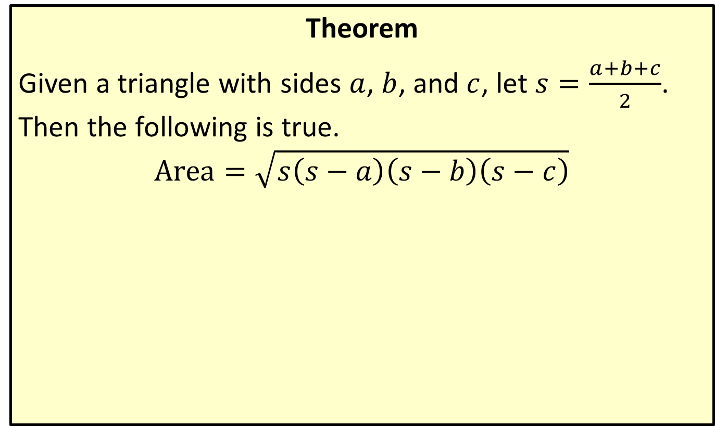
Area of a Triangle (Heron's Formula)
Theorem
Given a triangle with sides $a$, $b$, and $c$, let $s=\frac{a+b+c}{2}$. Then the following is true.
$$Area=\sqrt{s\left(s−a\right)\left(s−b\right)\left(s−c\right)}$$

Slide 11
Example 3: Using Heron's Formula to Find the Area of a Triangle
A set designer is putting together a backdrop for a play, and one element of the scene is a large triangular piece of wood. The edges of the triangle are of lengths 4 meters, 7 meters, and 9 meters. She wants to know the square area of the triangle in order to estimate the amount of paint needed to cover it.

Slide 12
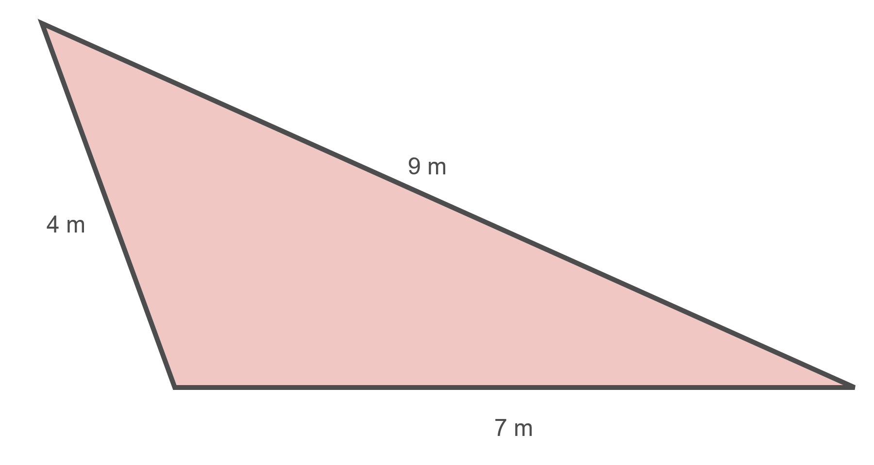
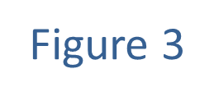
Example 3: Using Heron's Formula to Find the Area of a Triangle (cont.)

Slide 13
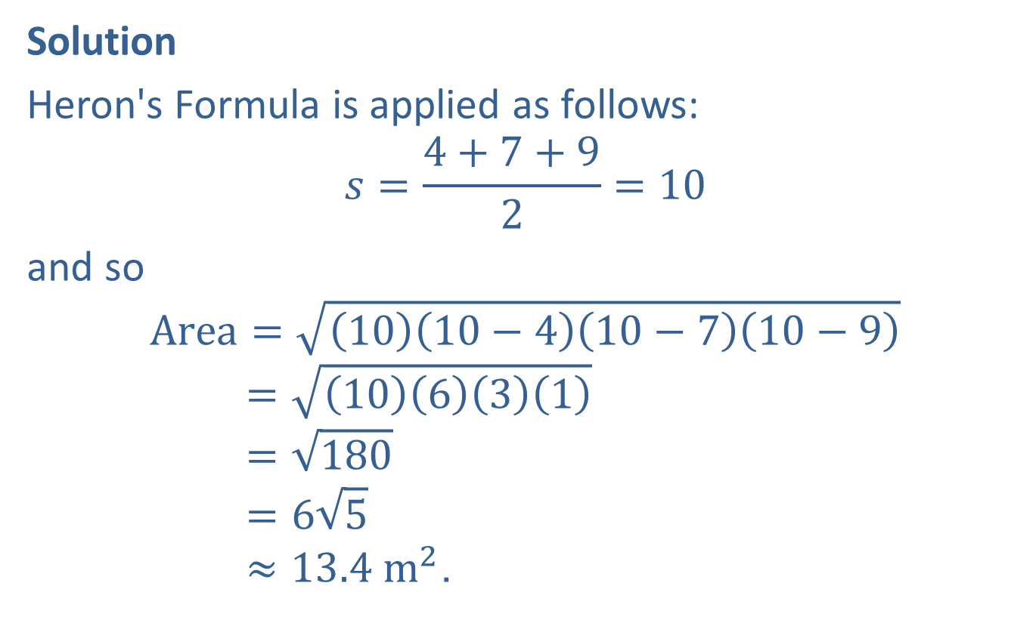
Example 3: Using Heron's Formula to Find the Area of a Triangle (cont.)
Solution
Heron's Formula is applied as follows:
$$s=\frac{4+7+9}{2}=10$$
and so
Area=1010−410−710−9Area=10631Area=180Area=65Area≈13.4 m2.

