Slide 1
Section 10.3
Polar Coordinates and Polar Equations

Slide 2
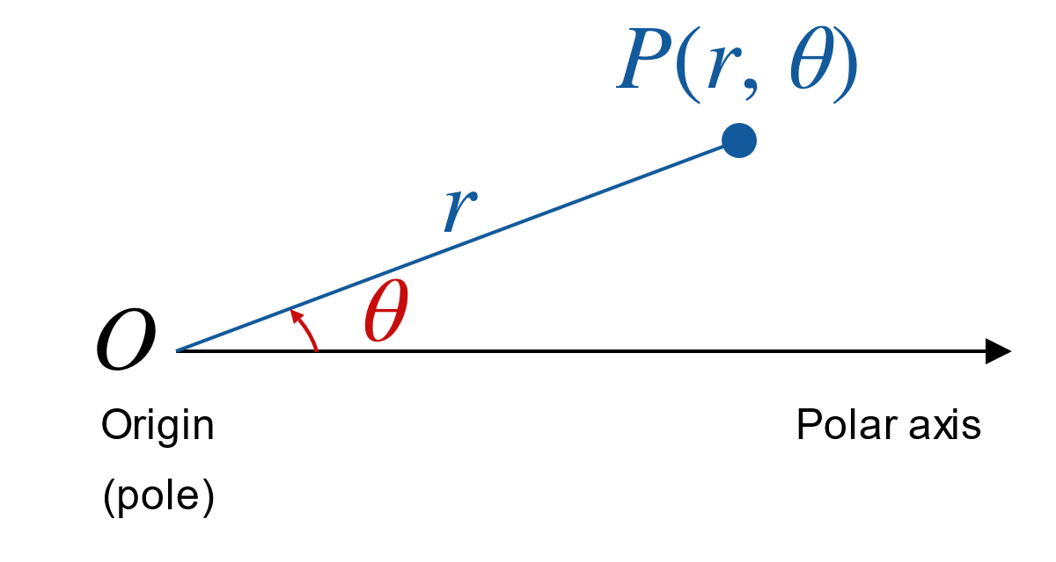
The Polar Coordinate System
Figure 1

Slide 3

Example 1: Plotting in Polar Coordinates
Plot the following points given by the polar coordinates.
​$\left(2,\frac{3π}{4}\right)$
​$\left(3.5,−\frac{5π}{2}\right)$
​$\left(−1,\frac{4π}{3}\right)$

Slide 4
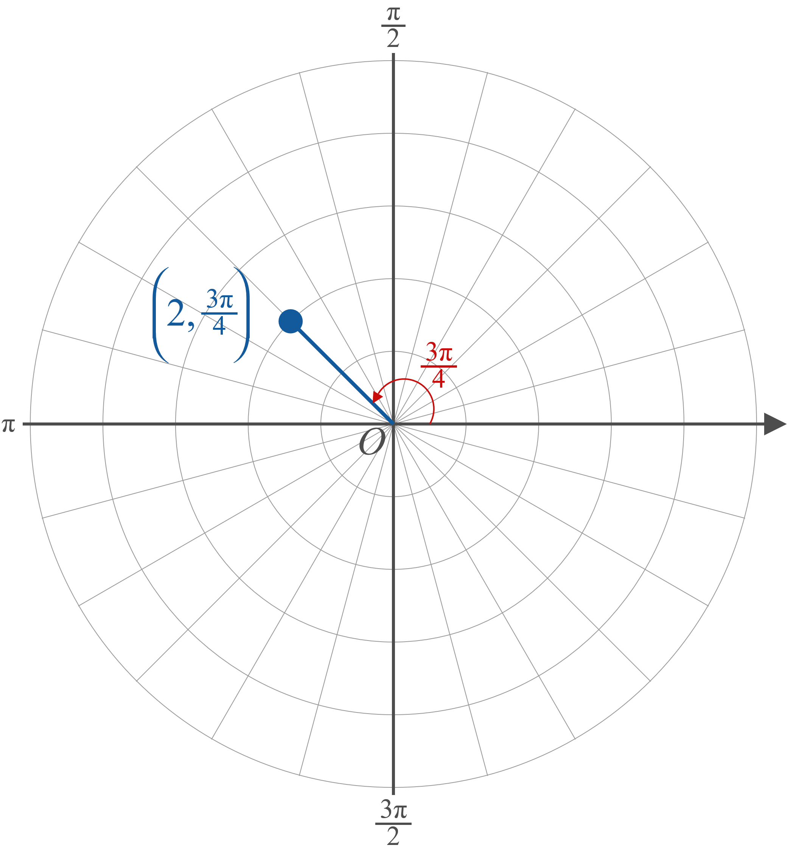
Example 1: Plotting in Polar Coordinates (cont.)
Solution
​
Figure 4a

Slide 5
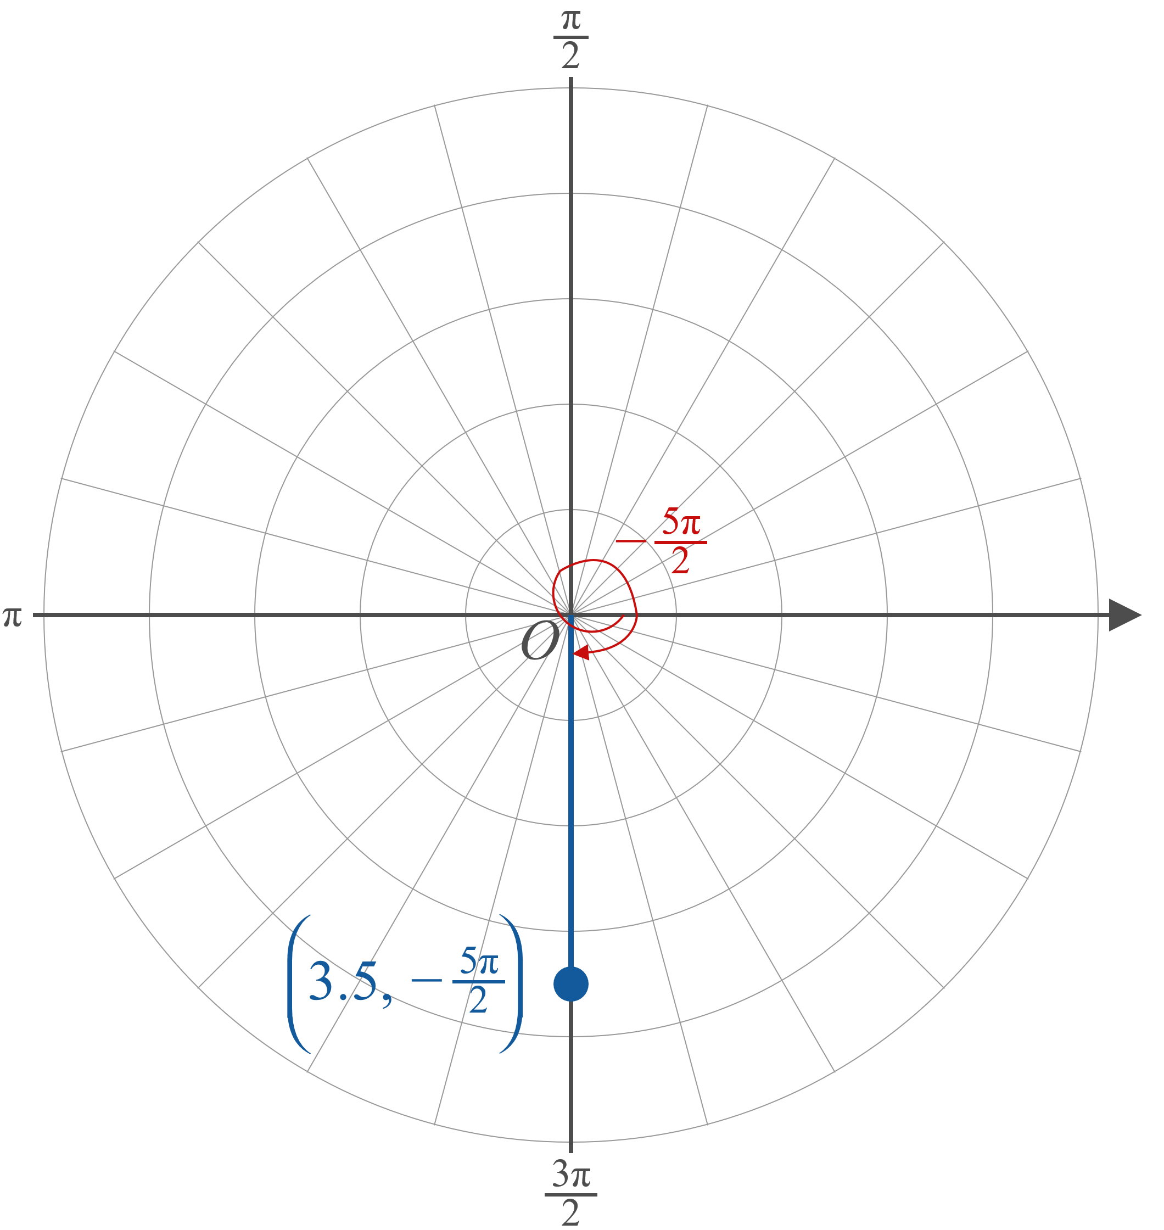
Example 1: Plotting in Polar Coordinates (cont.)
​
Figure 4b

Slide 6
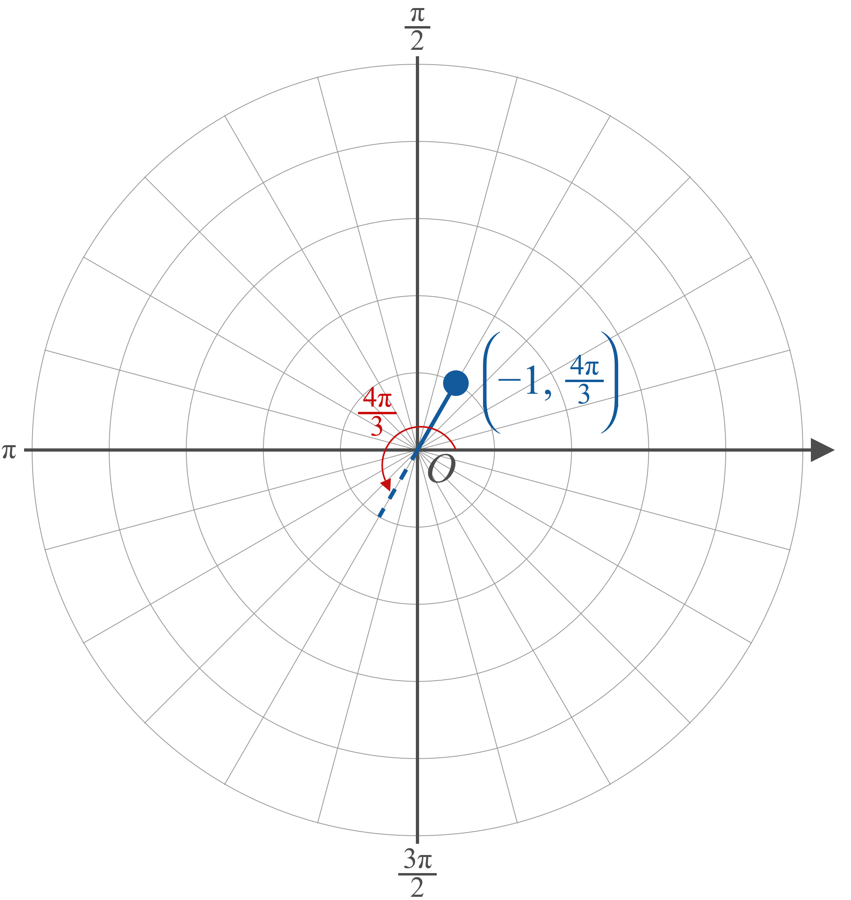
Example 1: Plotting in Polar Coordinates (cont.)
​
Figure 4c

Slide 7
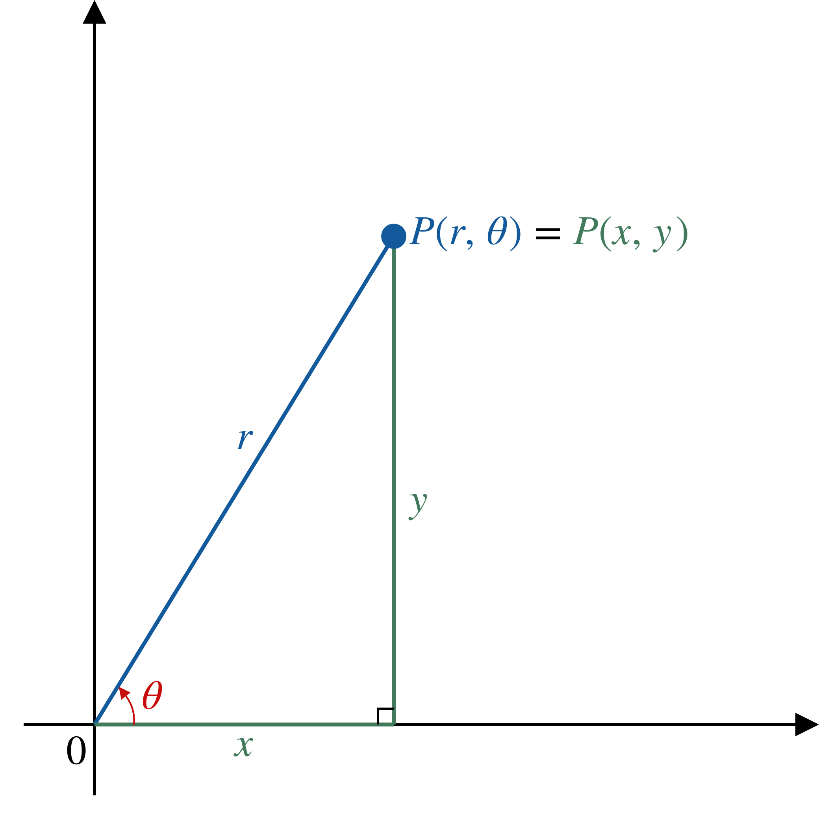
Converting between Polar and Cartesian Coordinates
Figure 5

Slide 8
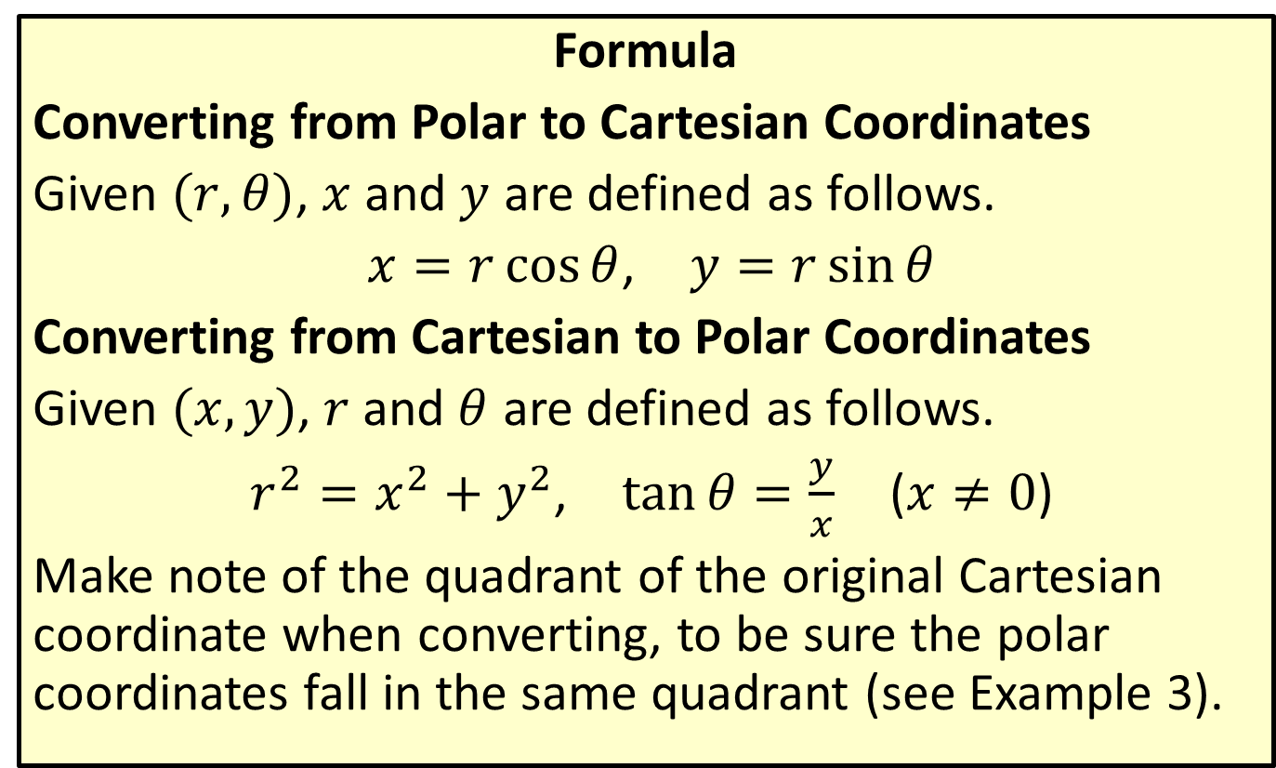
Coordinate Conversion
Formula
Converting from Polar to Cartesian Coordinates
Given $(r,θ)$, $x$ and $y$ are defined as follows.
$x=r\cos{θ}$, $y=r\sin{θ}$
Converting from Cartesian to Polar Coordinates
Given $(x,y)$, $r$ and $θ$ are defined as follows.
$r^{2}=x^{2}+y^{2}$, $\tan{θ}=\frac{y}{x}$ ($x≠0$)
Make note of the quadrant of the original Cartesian coordinate when converting, to be sure the polar coordinates fall in the same quadrant (see Example 3).

Slide 9

Example 2: Converting from Polar to Cartesian Coordinates
Convert the following points from polar to Cartesian coordinates.
​$\left(2,−\frac{π}{3}\right)$
​$\left(−3,\frac{π}{4}\right)$

Slide 10

Example 2: Converting from Polar to Cartesian Coordinates (cont.)
Solution
​We calculate $x=2\cos\left(−\frac{π}{3}\right)=1$ and
$y=2\sin\left(−\frac{π}{3}\right)=−\sqrt{3}$, so the Cartesian coordinates are $(1,−\sqrt{3})$ (see Figure 6).

Slide 11
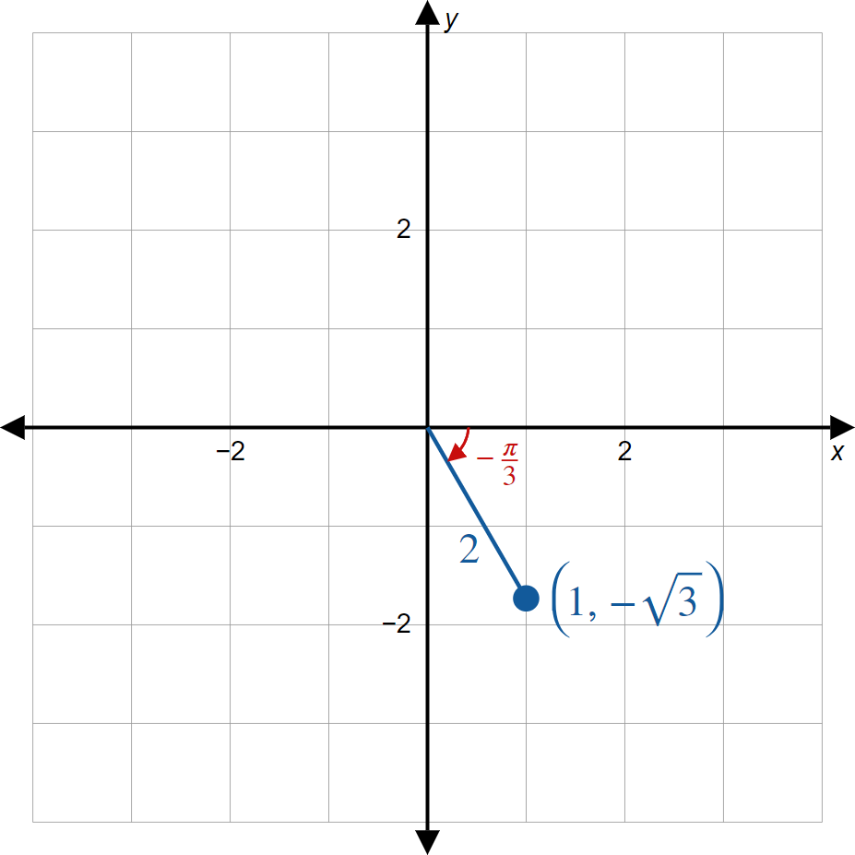
Example 2: Converting from Polar to Cartesian Coordinates (cont.)
Figure 6

Slide 12

Example 2: Converting from Polar to Cartesian Coordinates (cont.)
​We calculate $x=−3cos⁡\left(\frac{π}{4}\right)=−\frac{3}{\sqrt{2}}$ and
$y=−3sin⁡\left(\frac{π}{4}\right)=−\frac{3}{\sqrt{2}}$, so the Cartesian coordinates are $\left(−\frac{3}{\sqrt{2}},−\frac{3}{\sqrt{2}}\right)$ (see Figure 7).
​

Slide 13
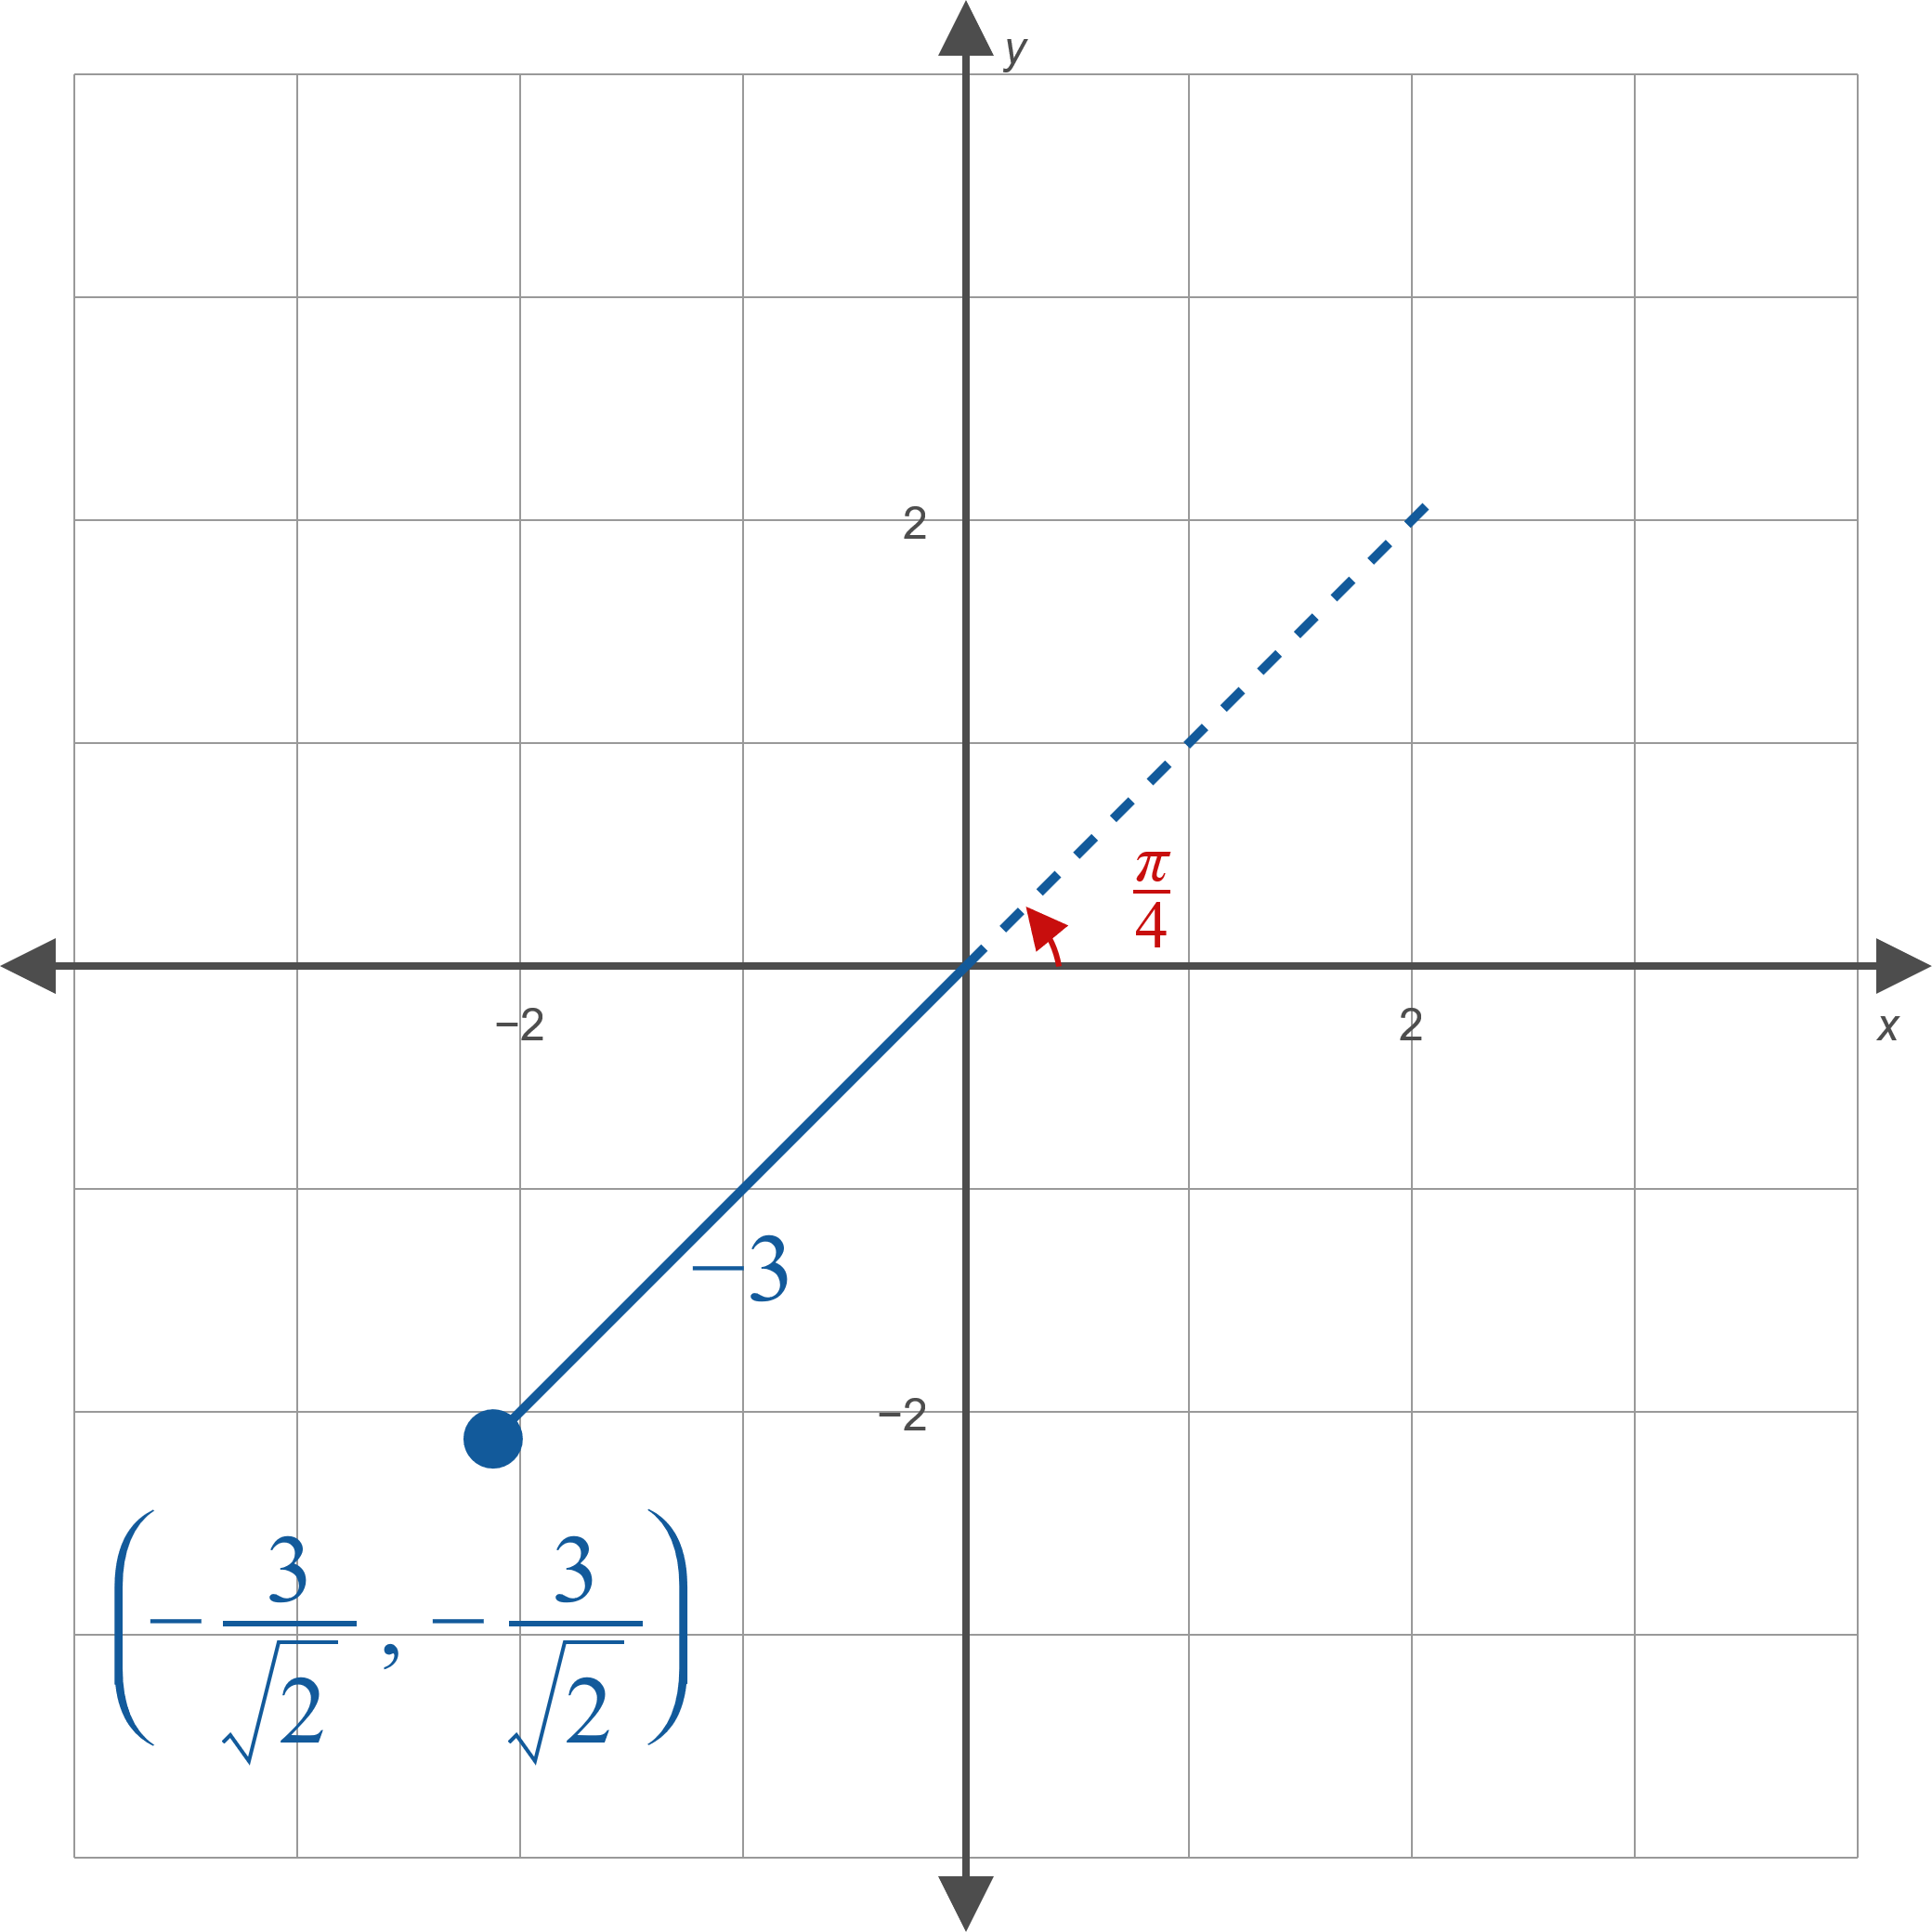
Example 2: Converting from Polar to Cartesian Coordinates (cont.)
Figure 7

Slide 14

Example 3: Converting from Cartesian to Polar Coordinates
Convert the following points from Cartesian to polar coordinates.
​$(−3,2)$
​$\left(\sqrt{3},−1\right)$

Slide 15
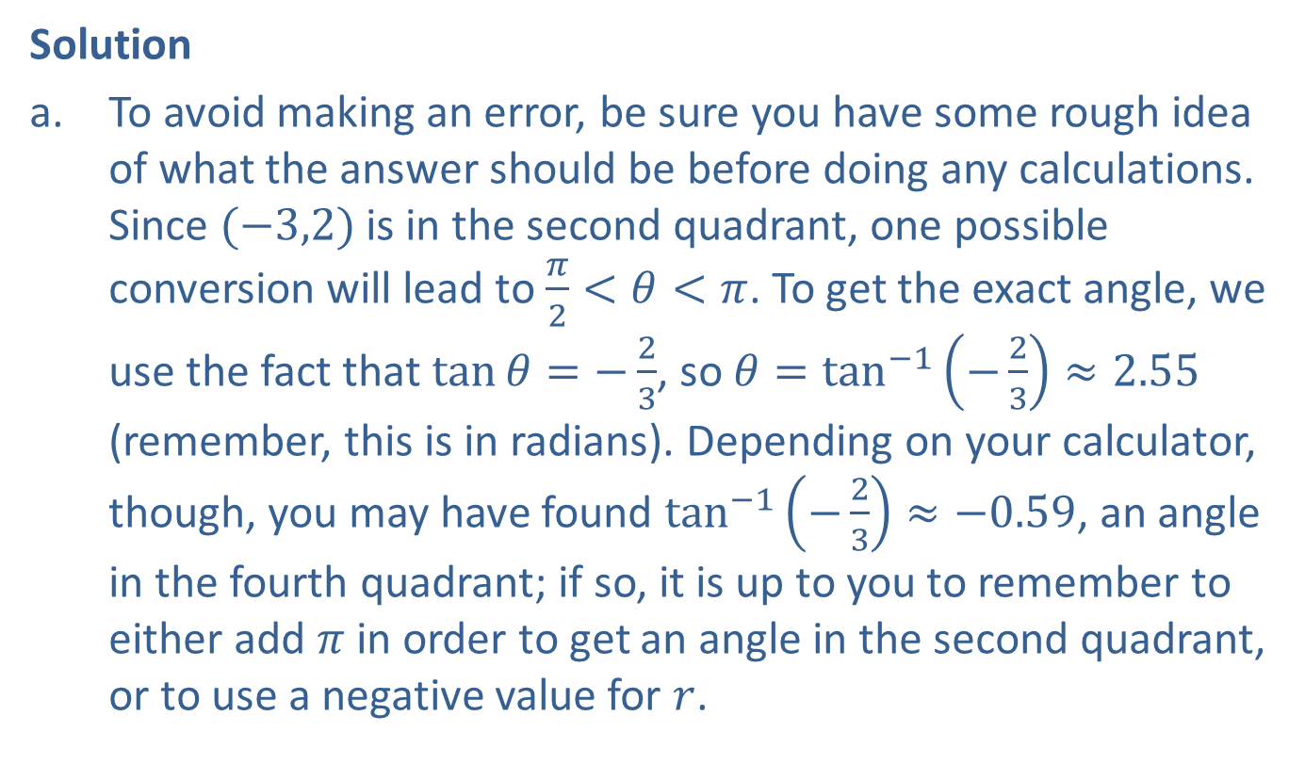
Example 3: Converting from Cartesian to Polar Coordinates (cont.)
Solution
​To avoid making an error, be sure you have some rough idea of what the answer should be before doing any calculations. Since $(−3,2)$ is in the second quadrant, one possible conversion will lead to $\frac{π}{2}<θ<π$. To get the exact angle, we use the fact that $\tan{θ}=−\frac{2}{3}$, so $θ=\tan^{−1}\left(−\frac{2}{3}\right)≈2.55$ (remember, this is in radians). Depending on your calculator, though, you may have found $\tan^{−1}\left(−\frac{2}{3}\right)≈−0.59$, an angle in the fourth quadrant; if so, it is up to you to remember to either add $π$ in order to get an angle in the second quadrant, or to use a negative value for $r$.​

Slide 16

Example 3: Converting from Cartesian to Polar Coordinates (cont.)
The radius is more easily determined:
$r=\sqrt{{\left(−3\right)}^{2}+{\left(2\right)}^{2}}=\sqrt{13}$.
The two answers we have found are thus $\left(\sqrt{13},2.55\right)$ and $\left(−\sqrt{13},−0.59\right)$ (see Figure 8).
​

Slide 17
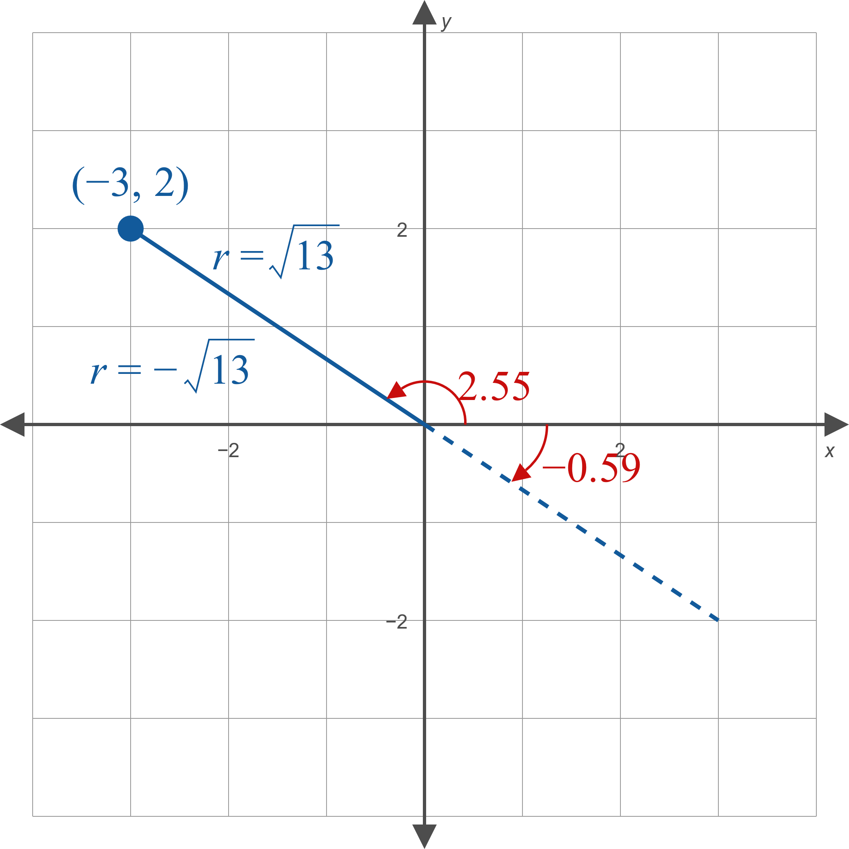
Example 3: Converting from Cartesian to Polar Coordinates (cont.)
Figure 8

Slide 18
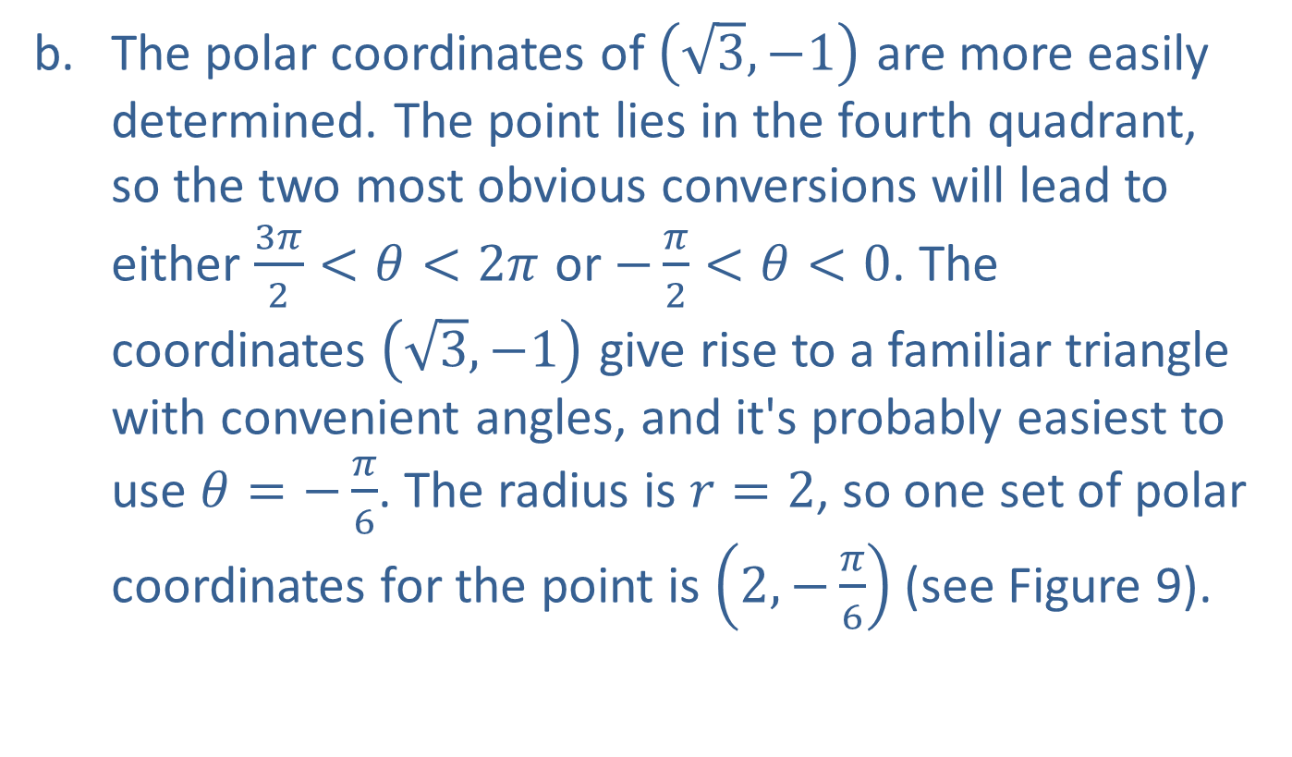
Example 3: Converting from Cartesian to Polar Coordinates (cont.)
​The polar coordinates of $\left(\sqrt{3},−1\right)$ are more easily determined. The point lies in the fourth quadrant, so the two most obvious conversions will lead to either $\frac{3π}{2}<θ<2π$ or $−\frac{π}{2}<θ<0$. The coordinates $\left(\sqrt{3},−1\right)$ give rise to a familiar triangle with convenient angles, and it's probably easiest to use $θ=−\frac{π}{6}$. The radius is $r=2$, so one set of polar coordinates for the point is $\left(2,−\frac{π}{6}\right)$ (see Figure 9).

Slide 19
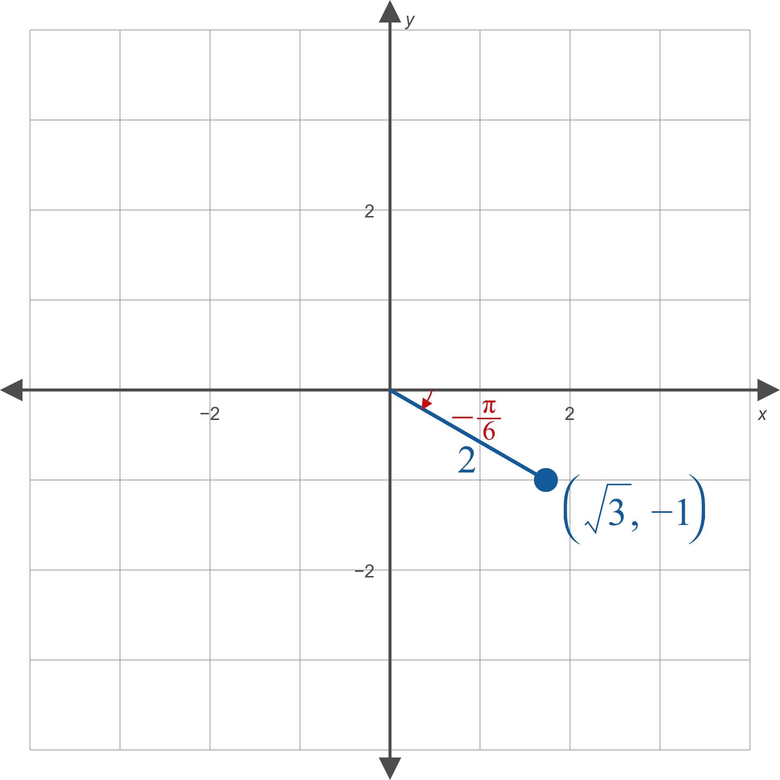
Example 3: Converting from Cartesian to Polar Coordinates (cont.)
Figure 9

Slide 20

Example 4: Rewriting an Equation in Polar Form
Rewrite the equation $x^{2}−2x+y^{2}=0$ in polar form.

Slide 21
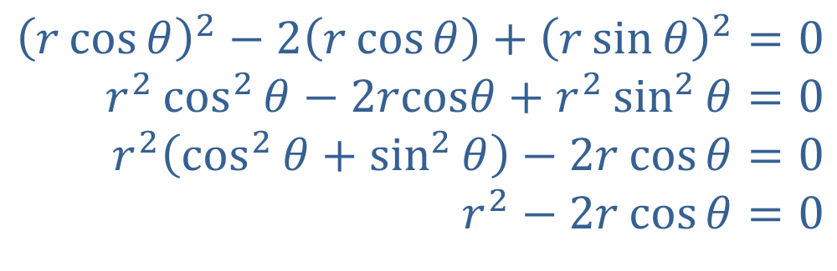
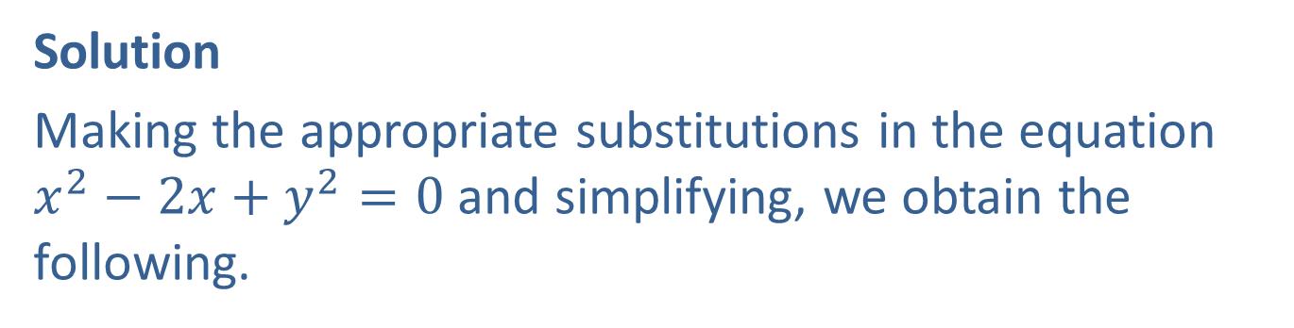
Example 4: Rewriting an Equation in Polar Form (cont.)
Solution
Making the appropriate substitutions in the equation $x^{2}−2x+y^{2}=0$ and simplifying, we obtain the following.
$${\left(r\cos{θ}\right)}^{2}−2\left(r\cos{θ}\right)+{\left(r\sin{θ}\right)}^{2}=0 \\ r^{2}\cos^{2}{θ}−2rcosθ+r^{2}\sin^{2}{θ}=0 \\ r^{2}\left(\cos^{2}{θ}+\sin^{2}{θ}\right)−2r\cos{θ}=0 \\ r^{2}−2r\cos{θ}=0$$

Slide 22

Example 5: Rewriting an Equation in Rectangular Form
Rewrite the equation $2r=\sec{θ}$ in rectangular form.

Slide 23
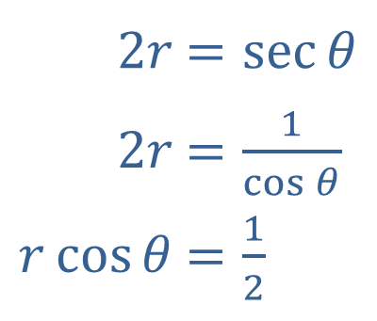
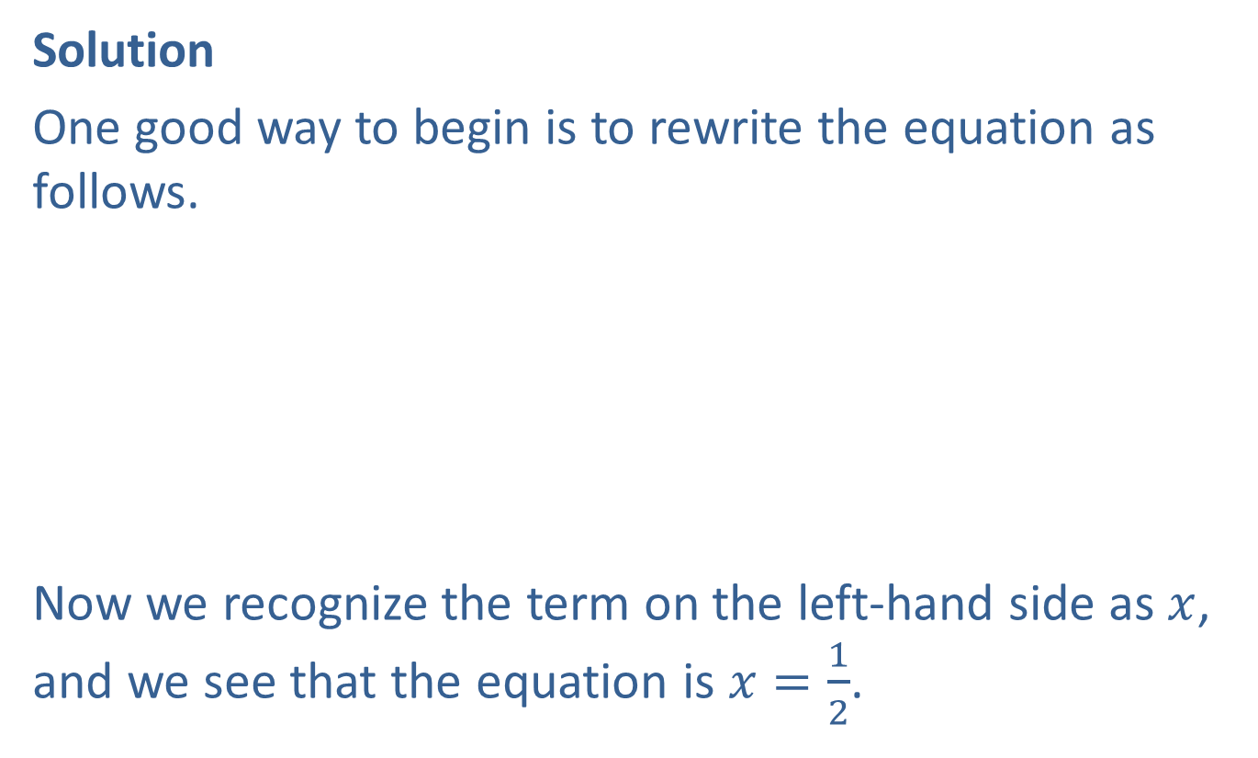
Example 5: Rewriting an Equation in Rectangular Form (cont.)
Solution
One good way to begin is to rewrite the equation as follows.
​
Now we recognize the term on the left-hand side as $x$, and we see that the equation is $x=\frac{1}{2}$.
​$2r$ | ​$=\sec{θ}$
​$2r$ | ​$=\frac{1}{\cos{θ}}$
​$r\cos{θ}$ | ​$=\frac{1}{2}$

Slide 24

Example 6: Graphing Polar Equations
Sketch the graphs of the following polar equations, and then convert the equations to rectangular coordinates.
​$r=3$
​$θ=\frac{2π}{3}$

Slide 25
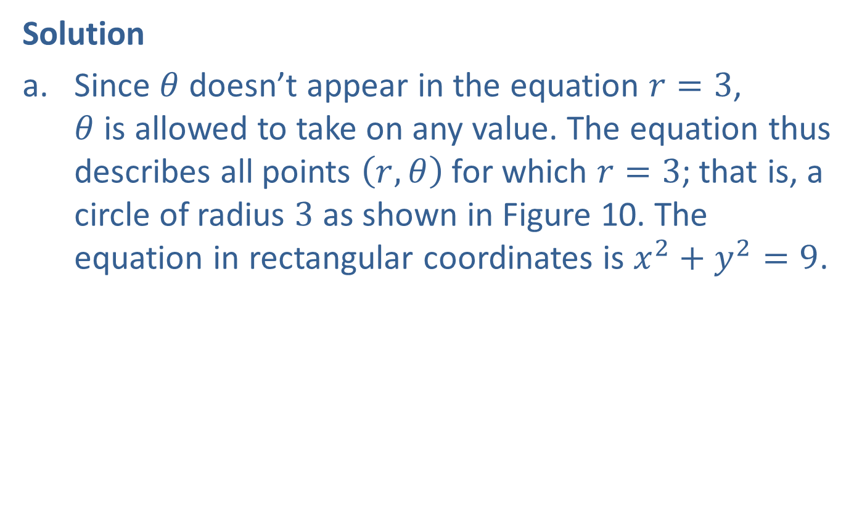
Example 6: Graphing Polar Equations (cont.)
Solution
​Since $θ$ doesn’t appear in the equation $r=3$,
$θ$ is allowed to take on any value. The equation thus describes all points $\left(r,θ\right)$ for which $r=3$; that is, a circle of radius 3 as shown in Figure 10. The equation in rectangular coordinates is $x^{2}+y^{2}=9$.
​

Slide 26
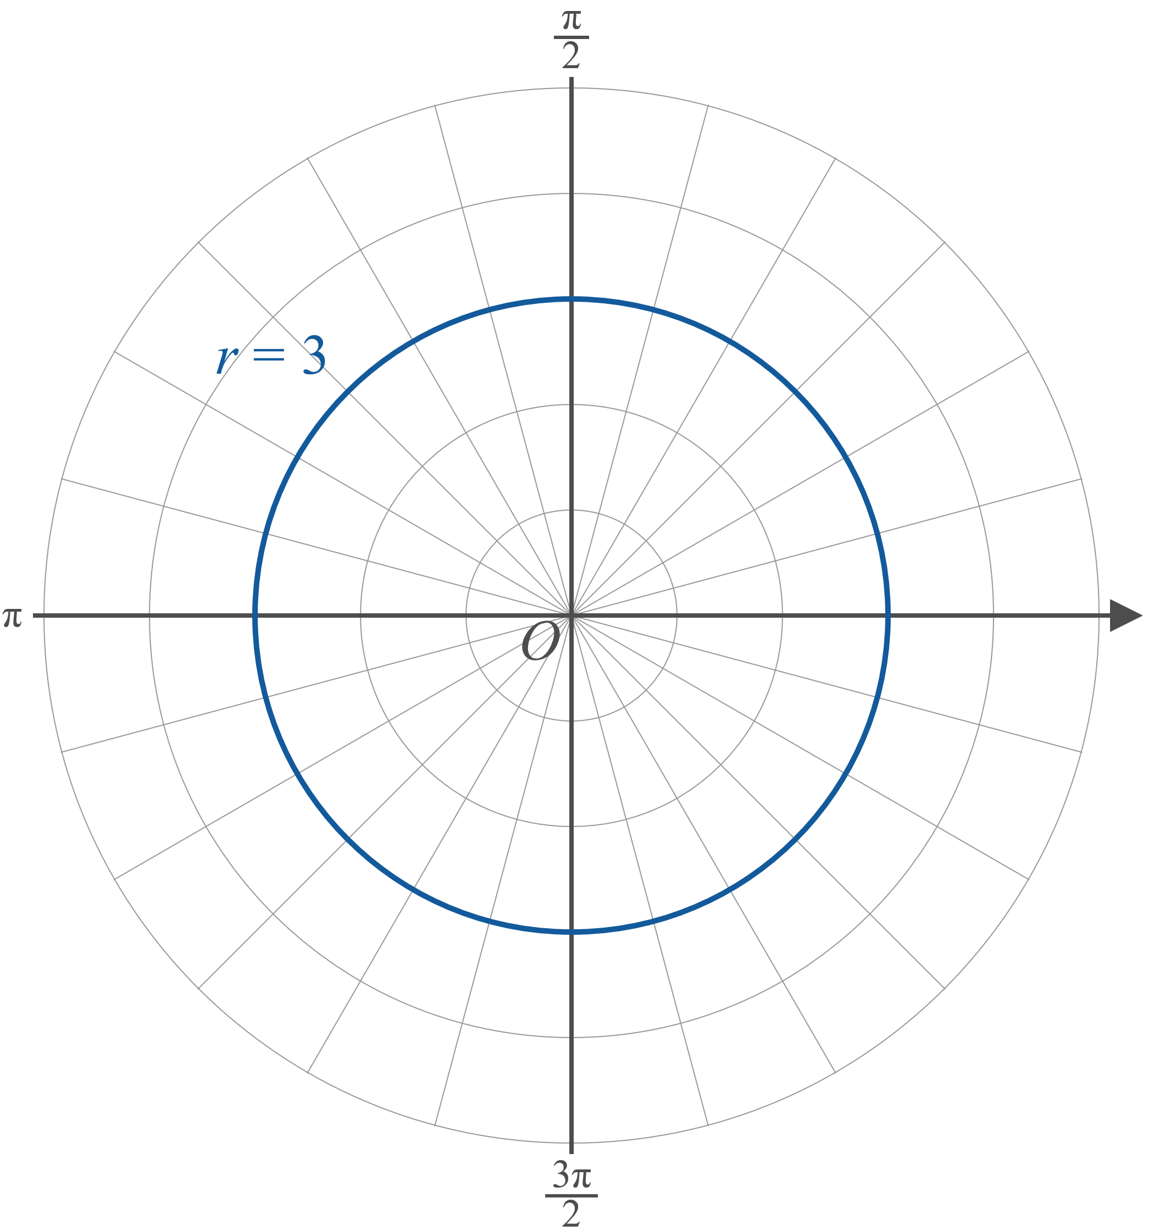
Example 6: Graphing Polar Equations (cont.)
Figure 10

Slide 27
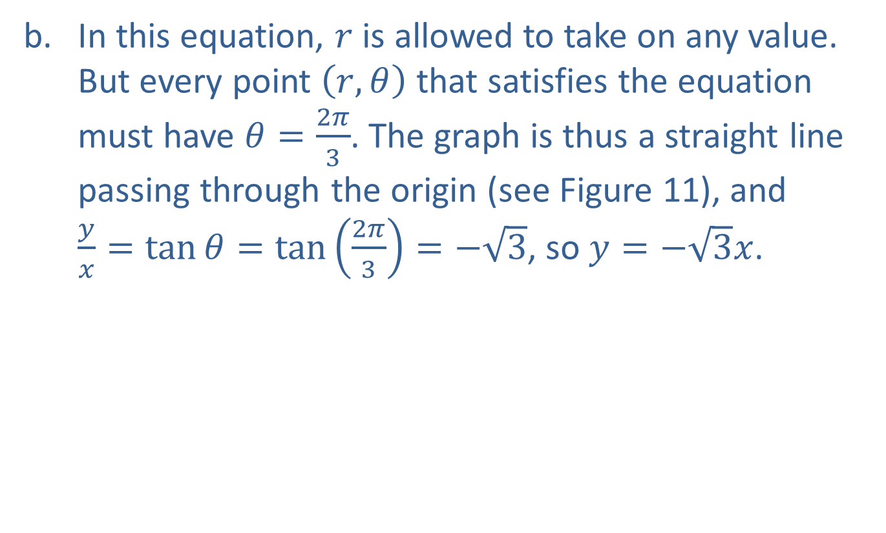
Example 6: Graphing Polar Equations (cont.)
​In this equation, $r$ is allowed to take on any value. But every point $\left(r,θ\right)$ that satisfies the equation must have $θ=\frac{2π}{3}$. The graph is thus a straight line passing through the origin (see Figure 11), and
$\frac{y}{x}=\tan{θ}=tan⁡\left(\frac{2π}{3}\right)=−\sqrt{3}$, so $y=−\sqrt{3}x$.
​

Slide 28
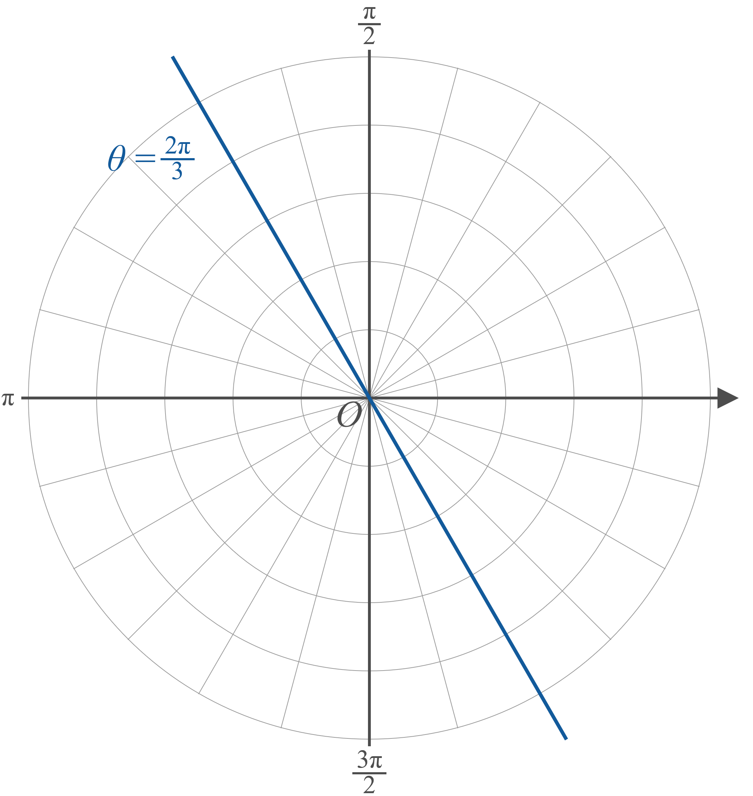
Example 6: Graphing Polar Equations (cont.)
Figure 11

Slide 29

Example 7: Graphing Polar Equations
Sketch the graph of the equation $r=2\cos{θ}$.

Slide 30
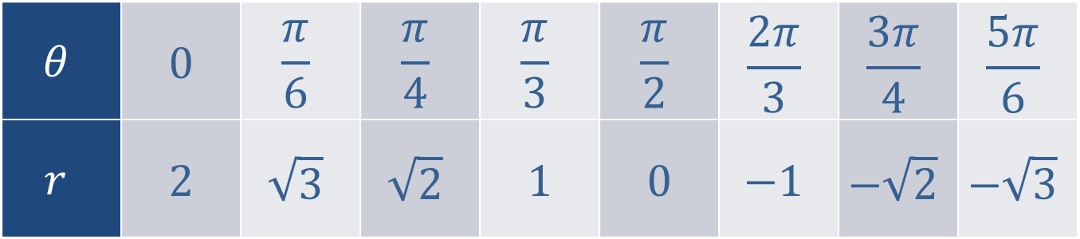

Example 7: Graphing Polar Equations (cont.)
Solution
We can begin by calculating some values of $r$ for given values of $θ$.
Table 1
$$θ$$ | 0 | $$\frac{π}{6}$$ | $$\frac{π}{4}$$ | $$\frac{π}{3}$$ | $$\frac{π}{2}$$ | $$\frac{2π}{3}$$ | $$\frac{3π}{4}$$ | $$\frac{5π}{6}$$
$$r$$ | 2 | $$\sqrt{3}$$ | $$\sqrt{2}$$ | 1 | 0 | $$−1$$ | $$−\sqrt{2}$$ | $$−\sqrt{3}$$

Slide 31

Example 7: Graphing Polar Equations (cont.)
Now if we plot the pairs $(r,θ)$ from Table 1, we obtain the points shown in Figure 12. These certainly appear to lie along the circumference of a circle, so the points have been connected with a curve.

Slide 32
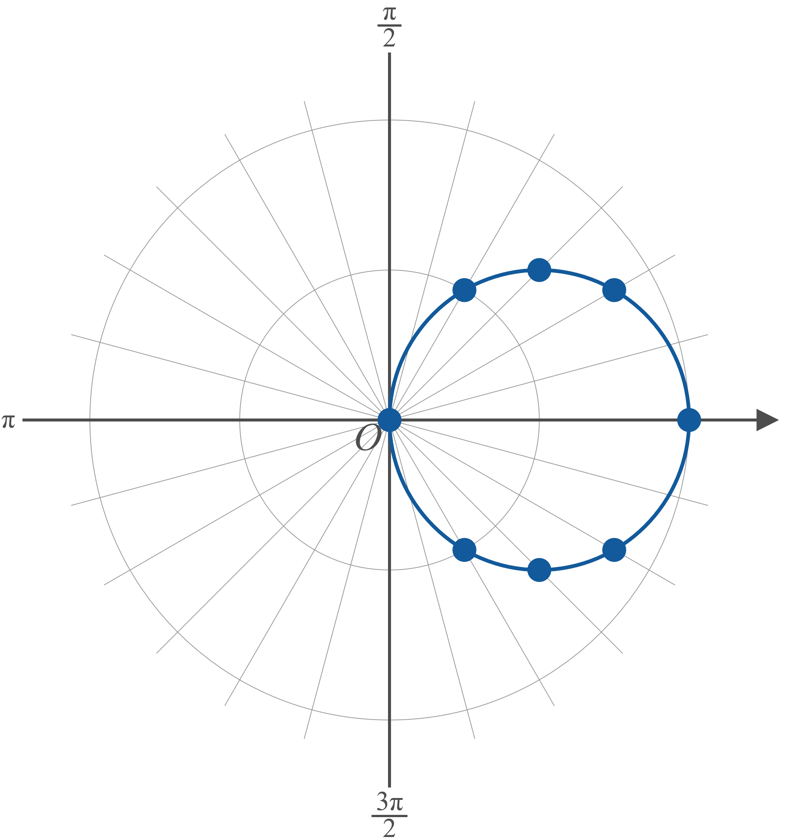

Example 7: Graphing Polar Equations (cont.)
Figure 12: $r=2\cos{θ}$

Slide 33
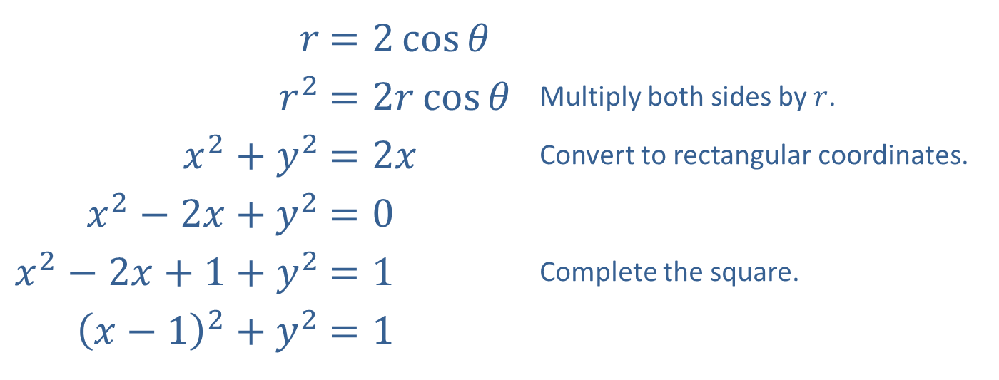

Example 7: Graphing Polar Equations (cont.)
If we convert the equation into rectangular coordinates, we see that the graph indeed is a circle of radius 1 centered at $x=1$, $y=0$.
​
​$r$ | ​$=2\cos{θ}$
​$r^{2}$ | ​$=2r\cos{θ}$ | Multiply both sides by $r$.
​$x^{2}+y^{2}$ | ​$=2x$ | Convert to rectangular coordinates.
​$x^{2}−2x+y^{2}$ | ​$=0$
​$x^{2}−2x+1+y^{2}$ | ​$=1$ | Complete the square.
​${\left(x−1\right)}^{2}+y^{2}$ | ​$=1$

Slide 34
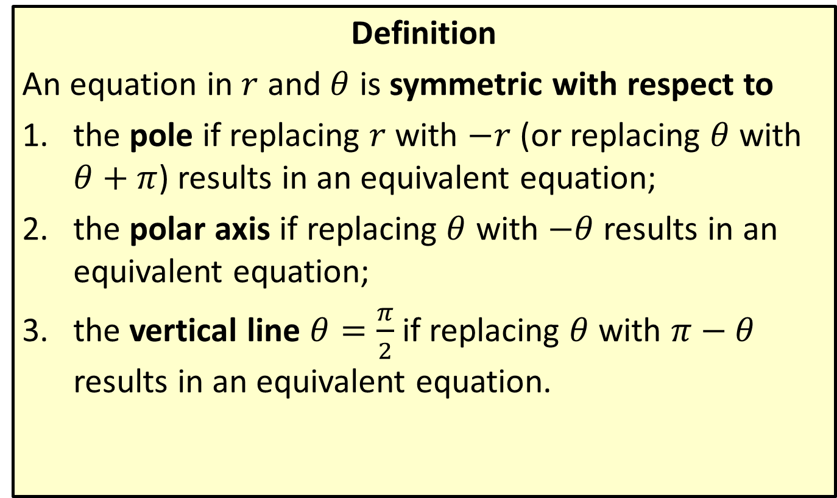
Symmetry of Polar Equations
Definition
An equation in $r$ and $θ$ is symmetric with respect to
​the pole if replacing $r$ with $−r$ (or replacing $θ$ with $θ+π$) results in an equivalent equation;
​the polar axis if replacing $θ$ with $−θ$ results in an equivalent equation;
​the vertical line $θ=\frac{π}{2}$ if replacing $θ$ with $π−θ$ results in an equivalent equation.

Slide 35

Example 8: Graphing Common Polar Equations Using Symmetry
Use symmetry to sketch the graph of $r=3\cos{4θ}$.

Slide 36
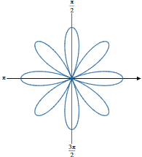

Example 8: Graphing Common Polar Equations Using Symmetry (cont.)
Solution
The equation $r=3\cos{4θ}$ possesses all three kinds of symmetry. Since the equation has the form
$r=a\cos{4θ}$ ($a>0$), its graph is an 8-petaled rose such as the curve shown below.

Slide 37
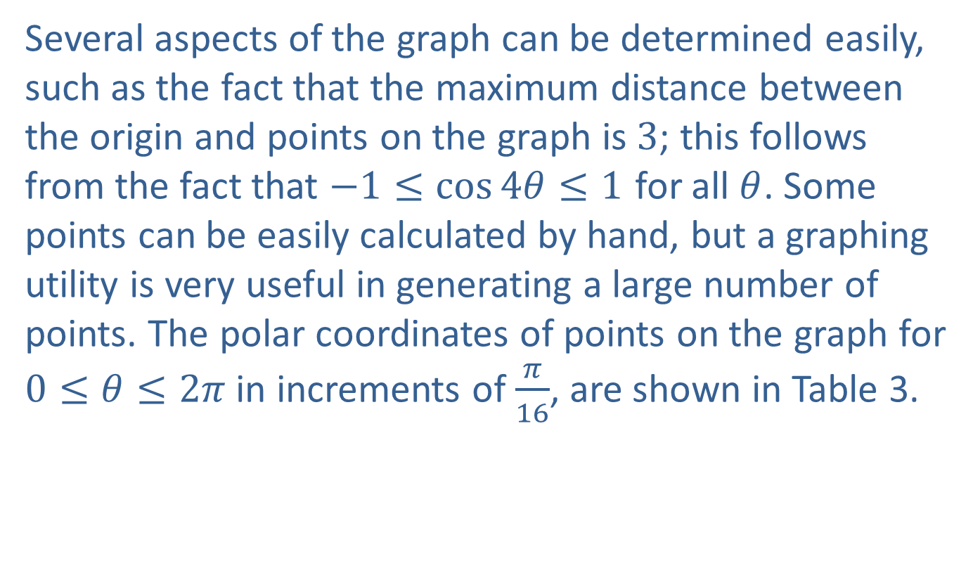
Example 8: Graphing Common Polar Equations Using Symmetry (cont.)
Several aspects of the graph can be determined easily, such as the fact that the maximum distance between the origin and points on the graph is 3; this follows from the fact that $−1≤\cos{4θ}≤1$ for all $θ$. Some points can be easily calculated by hand, but a graphing utility is very useful in generating a large number of points. The polar coordinates of points on the graph for $0≤θ≤2π$ in increments of $\frac{π}{16}$, are shown in Table 3.

Slide 38
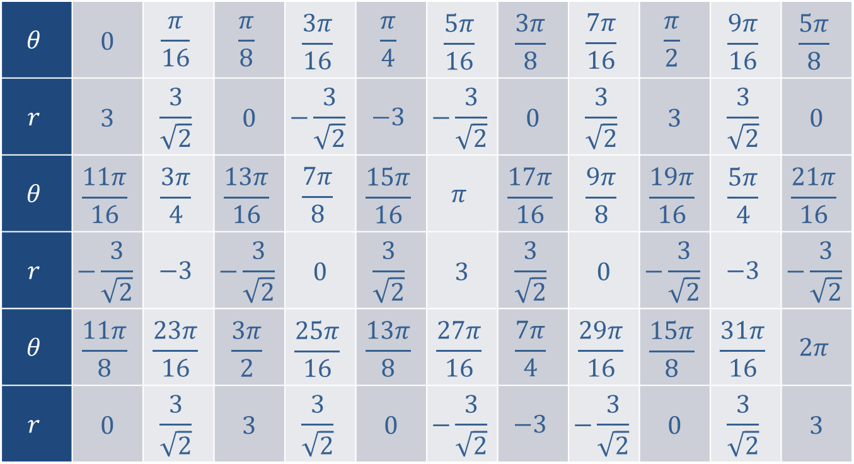
Example 8: Graphing Common Polar Equations Using Symmetry (cont.)
$$θ$$ | 0 | $$\frac{π}{16}$$ | $$\frac{π}{8}$$ | $$\frac{3π}{16}$$ | $$\frac{π}{4}$$ | $$\frac{5π}{16}$$ | $$\frac{3π}{8}$$ | $$\frac{7π}{16}$$ | $$\frac{π}{2}$$ | $$\frac{9π}{16}$$ | $$\frac{5π}{8}$$
$$r$$ | 3 | $$\frac{3}{\sqrt{2}}$$ | 0 | $$−\frac{3}{\sqrt{2}}$$ | $$−3$$ | $$−\frac{3}{\sqrt{2}}$$ | 0 | $$\frac{3}{\sqrt{2}}$$ | 3 | $$\frac{3}{\sqrt{2}}$$ | 0
$$θ$$ | $$\frac{11π}{16}$$ | $$\frac{3π}{4}$$ | $$\frac{13π}{16}$$ | $$\frac{7π}{8}$$ | $$\frac{15π}{16}$$ | $$π$$ | $$\frac{17π}{16}$$ | $$\frac{9π}{8}$$ | $$\frac{19π}{16}$$ | $$\frac{5π}{4}$$ | $$\frac{21π}{16}$$
$$r$$ | $$−\frac{3}{\sqrt{2}}$$ | $$−3$$ | $$−\frac{3}{\sqrt{2}}$$ | 0 | $$\frac{3}{\sqrt{2}}$$ | 3 | $$\frac{3}{\sqrt{2}}$$ | 0 | $$−\frac{3}{\sqrt{2}}$$ | $$−3$$ | $$−\frac{3}{\sqrt{2}}$$
$$θ$$ | $$\frac{11π}{8}$$ | $$\frac{23π}{16}$$ | $$\frac{3π}{2}$$ | $$\frac{25π}{16}$$ | $$\frac{13π}{8}$$ | $$\frac{27π}{16}$$ | $$\frac{7π}{4}$$ | $$\frac{29π}{16}$$ | $$\frac{15π}{8}$$ | $$\frac{31π}{16}$$ | $$2π$$
$$r$$ | 0 | $$\frac{3}{\sqrt{2}}$$ | 3 | $$\frac{3}{\sqrt{2}}$$ | 0 | $$−\frac{3}{\sqrt{2}}$$ | $$−3$$ | $$−\frac{3}{\sqrt{2}}$$ | 0 | $$\frac{3}{\sqrt{2}}$$ | 3
Table 3

Slide 39
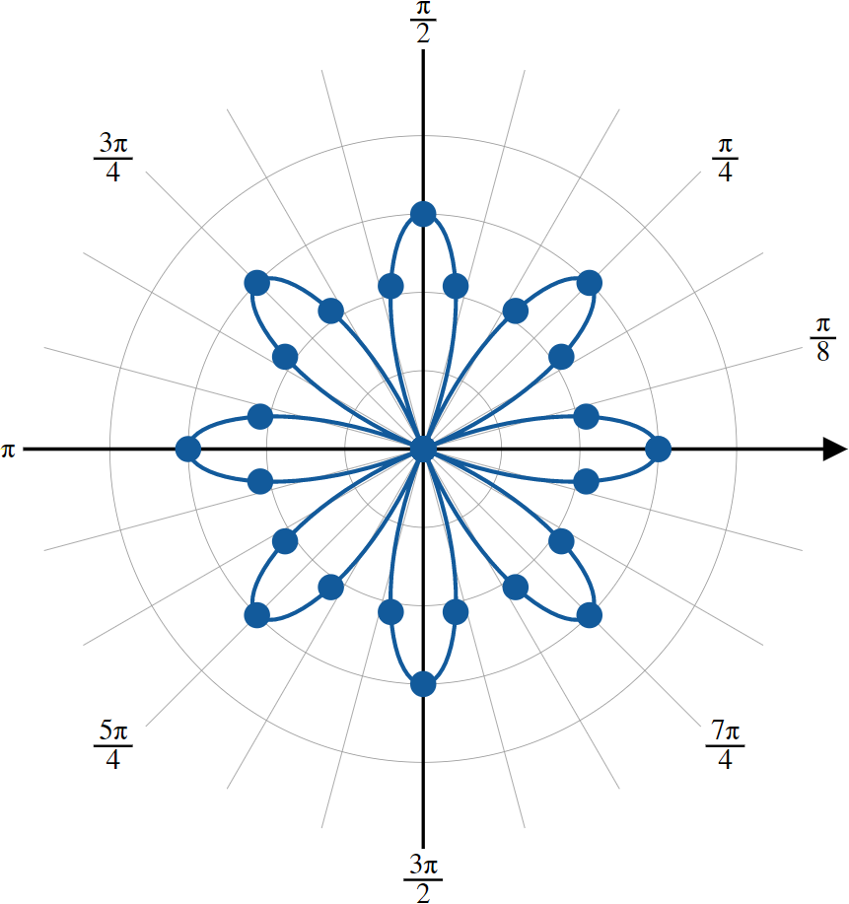
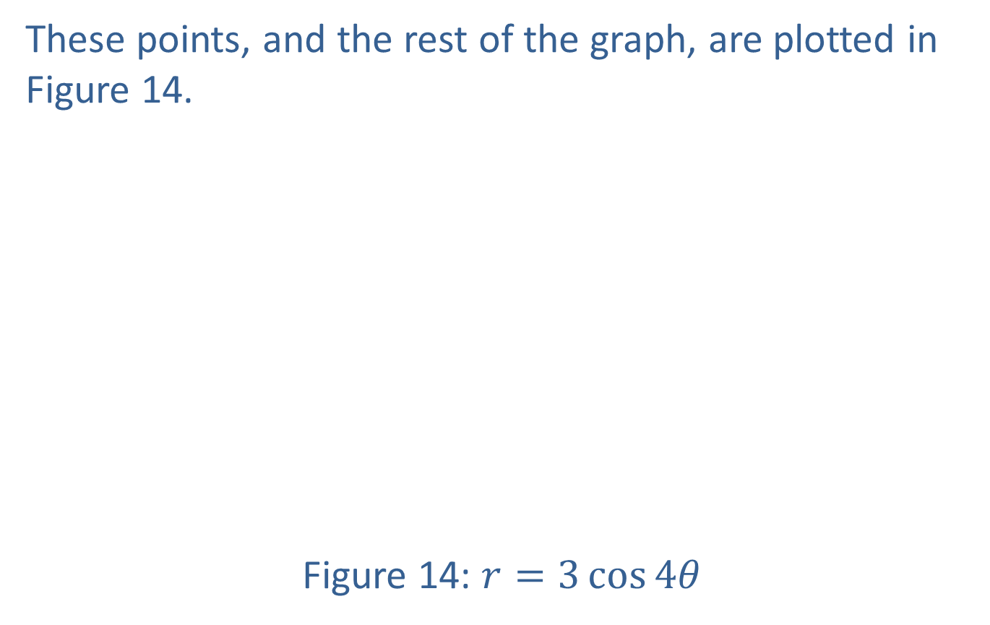
Example 8: Graphing Common Polar Equations Using Symmetry (cont.)
These points, and the rest of the graph, are plotted in Figure 14.
Figure 14: $r=3\cos{4θ}$

Slide 40

Example 9: Graphing Common Polar Equations Using Symmetry
Use symmetry to sketch the graph of $r=1+2\cos{θ}$.

Slide 41
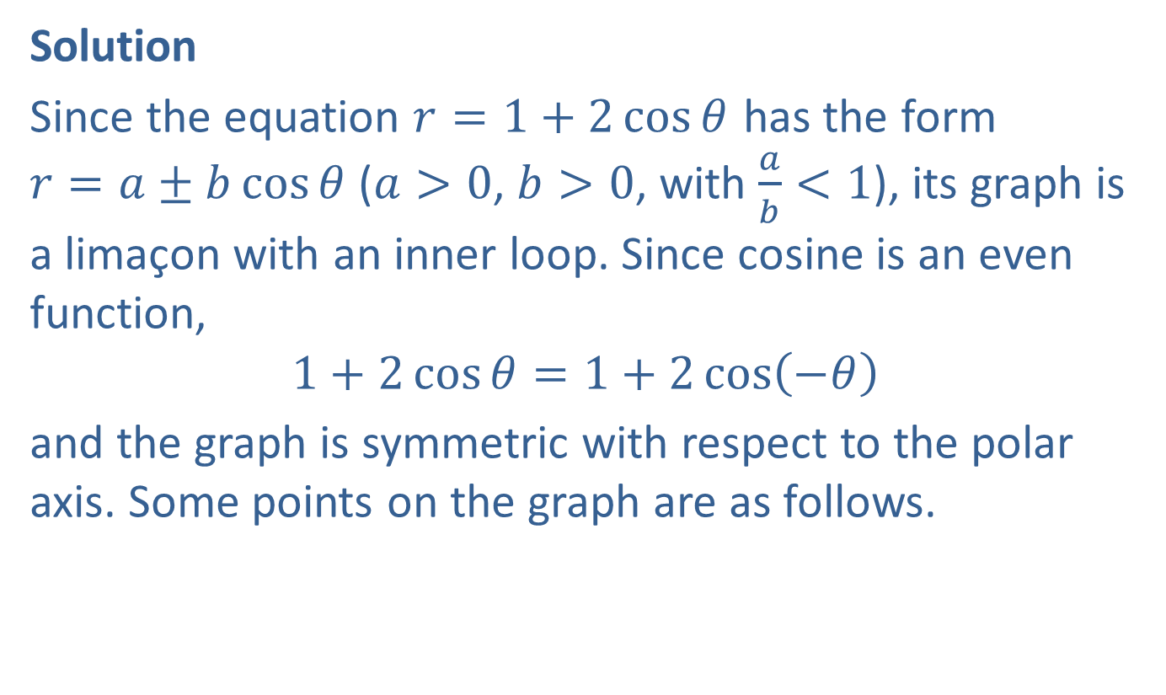
Example 9: Graphing Common Polar Equations Using Symmetry (cont.)
Solution
Since the equation $r=1+2\cos{θ}$ has the form
$r=a±b\cos{θ}$ ($a>0$, $b>0$, with $\frac{a}{b}<1$), its graph is a limaçon with an inner loop. Since cosine is an even function,
$$1+2\cos{θ}=1+2\cos\left(−θ\right)$$
and the graph is symmetric with respect to the polar axis. Some points on the graph are as follows.

Slide 42
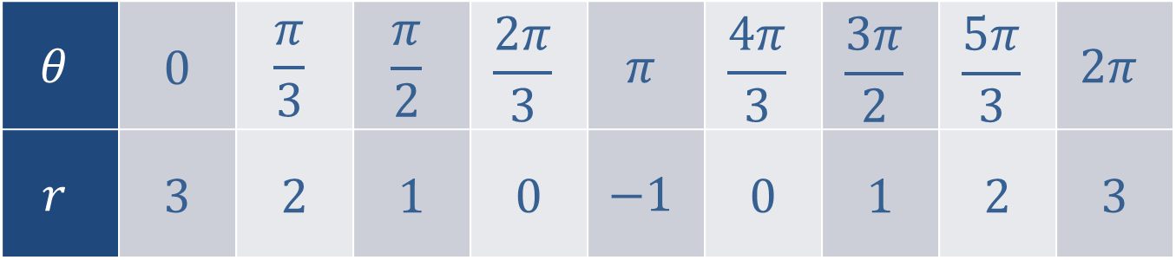

Example 9: Graphing Common Polar Equations Using Symmetry (cont.)
Table 4
The graph of $r=1+2\cos{θ}$ is shown in Figure 15.
$$θ$$ | 0 | $$\frac{π}{3}$$ | $$\frac{π}{2}$$ | $$\frac{2π}{3}$$ | $$π$$ | $$\frac{4π}{3}$$ | $$\frac{3π}{2}$$ | $$\frac{5π}{3}$$ | $$2π$$
$$r$$ | 3 | 2 | 1 | 0 | $$−1$$ | 0 | 1 | 2 | 3

Slide 43
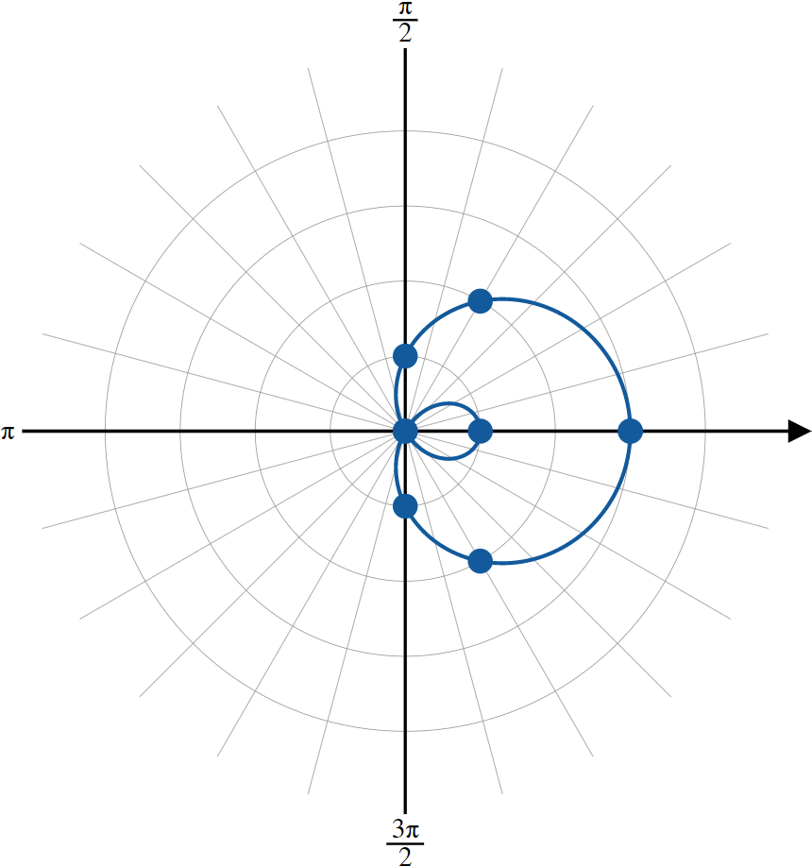
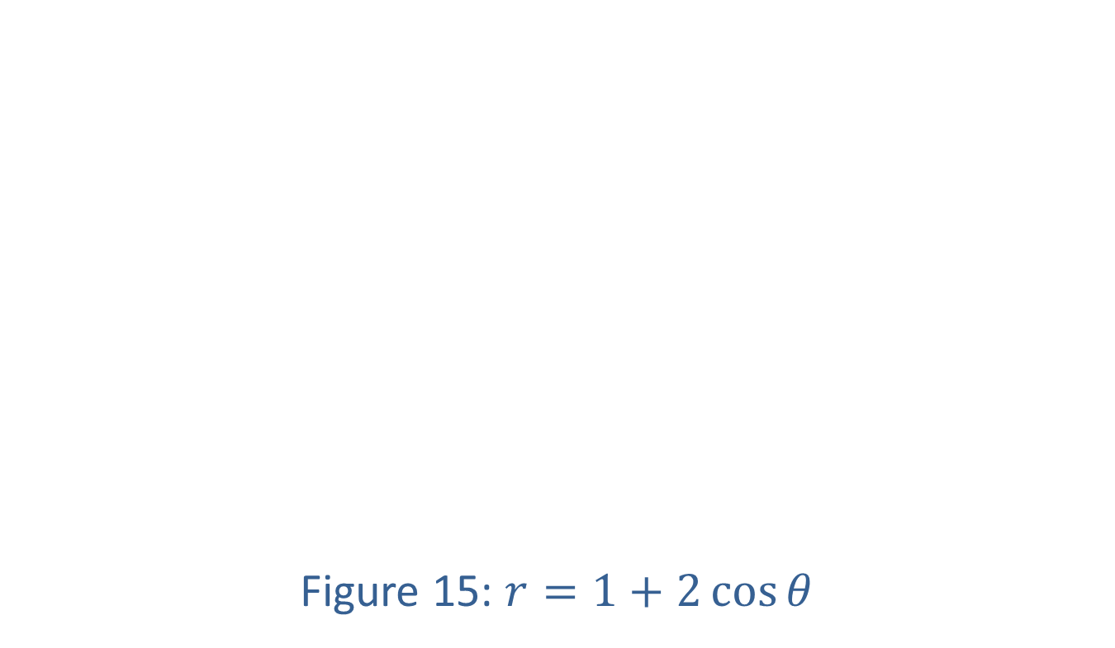
Example 9: Graphing Common Polar Equations Using Symmetry (cont.)
Figure 15: $r=1+2\cos{θ}$

