Slide 1
Section 10.4
Parametric Equations

Slide 2
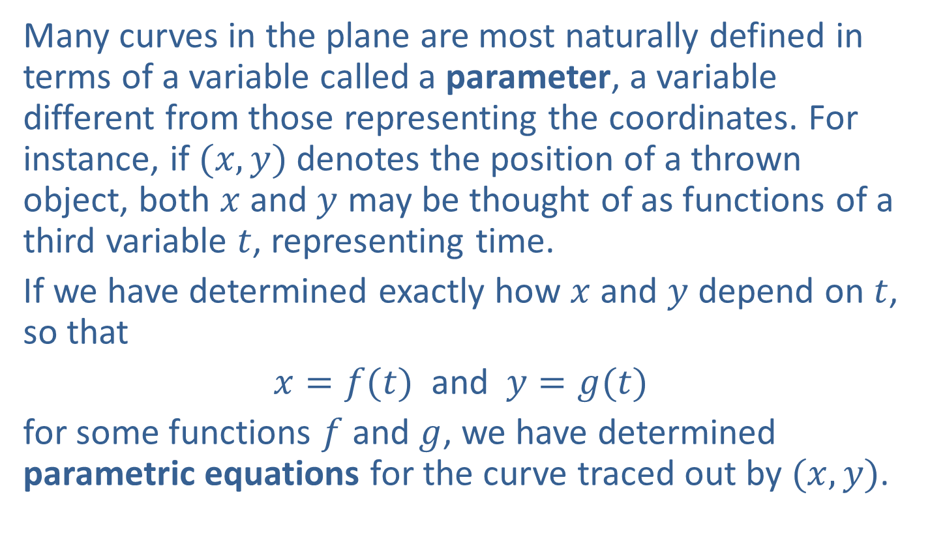
Parametric Equations
Many curves in the plane are most naturally defined in terms of a variable called a parameter, a variable different from those representing the coordinates. For instance, if $(x,y)$ denotes the position of a thrown object, both $x$ and $y$ may be thought of as functions of a third variable $t$, representing time.
If we have determined exactly how $x$ and $y$ depend on $t$, so that
$x=f(t)$ and $y=g(t)$
for some functions $f$and $g$, we have determined parametric equations for the curve traced out by $(x,y)$.

Slide 3
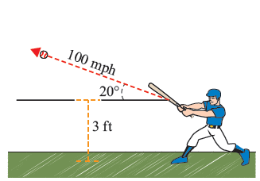
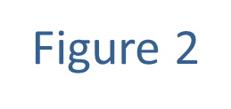

Example 1: Determining Parametric Equations and Their Graphs
Suppose a baseball is hit 3 feet above the ground, and that it leaves the bat at a speed of 100 miles an hour at an angle of $20°$ from the horizontal. Construct a set of parametric equations describing the ball's flight, and sketch a graph of the ball's travel.

Slide 4
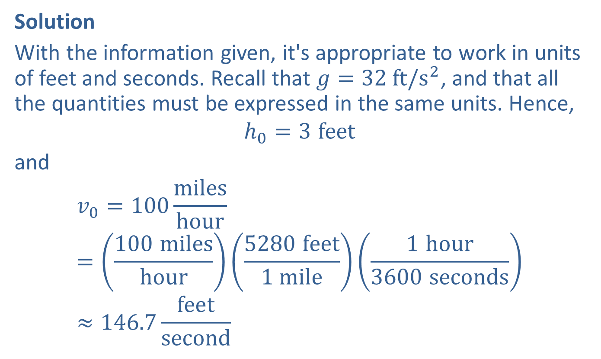
Example 1: Determining Parametric Equations and Their Graphs (cont.)
Solution
With the information given, it's appropriate to work in units of feet and seconds. Recall that $g=32 ft/s^{2}$, and that all the quantities must be expressed in the same units. Hence,
$$h_{0}=3 feet$$
and
$$v_{0}=100\frac{miles}{hour}=\left(\frac{100 miles}{hour}\right)\left(\frac{5280 feet}{1 mile}\right)\left(\frac{1 hour}{3600 seconds}\right)≈146.7\frac{feet}{second}$$

Slide 5
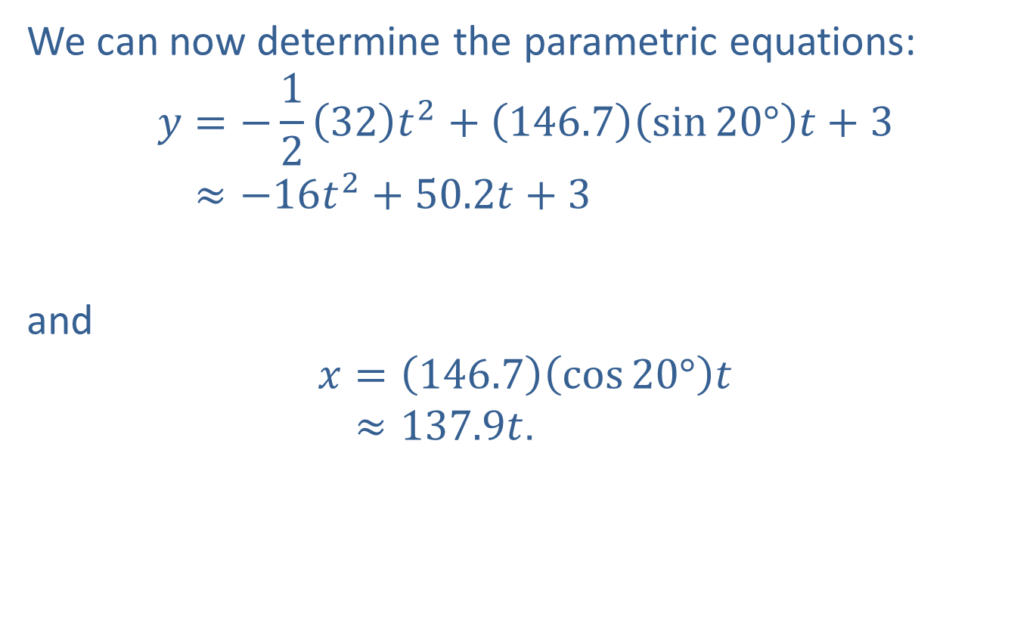
Example 1: Determining Parametric Equations and Their Graphs (cont.)
We can now determine the parametric equations:
𝑦=−1232𝑡2+146.7sin20°𝑡+3𝑦≈−16𝑡2+50.2𝑡+3
and
𝑥=146.7cos20°𝑡𝑥≈137.9𝑡.

Slide 6
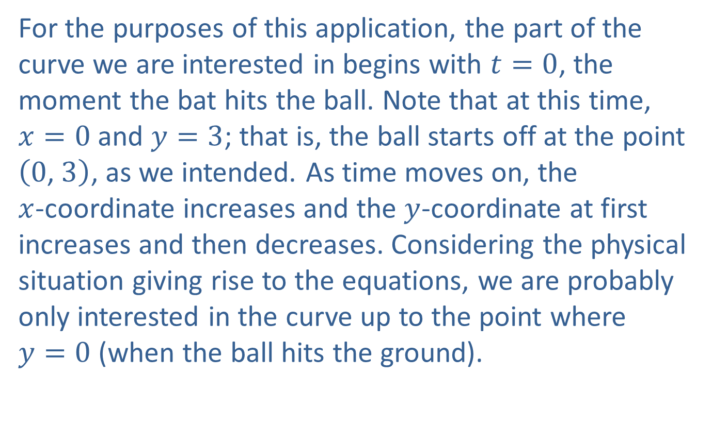
Example 1: Determining Parametric Equations and Their Graphs (cont.)
For the purposes of this application, the part of the curve we are interested in begins with $t=0$, the moment the bat hits the ball. Note that at this time, $x=0$ and $y=3$; that is, the ball starts off at the point $\left(0\text{, }3\right)$, as we intended. As time moves on, the $x$-coordinate increases and the $y$-coordinate at first increases and then decreases. Considering the physical situation giving rise to the equations, we are probably only interested in the curve up to the point where $y=0$ (when the ball hits the ground).

Slide 7
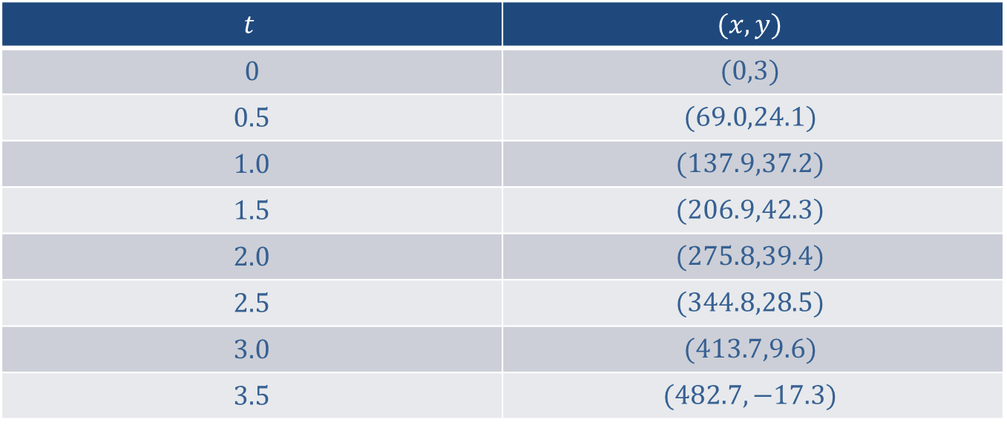

Example 1: Determining Parametric Equations and Their Graphs (cont.)
If we calculate $(x,y)$ for values of $t$ from 0 to 3.5, in half-second increments, we obtain the following table:
$$t$$ | $$(x,y)$$
0 | $$(0,3)$$
0.5 | $$(69.0,24.1)$$
1.0 | $$(137.9,37.2)$$
1.5 | $$(206.9,42.3)$$
2.0 | $$(275.8,39.4)$$
2.5 | $$(344.8,28.5)$$
3.0 | $$(413.7,9.6)$$
3.5 | $$(482.7,−17.3)$$

Slide 8
Example 1: Determining Parametric Equations and Their Graphs (cont.)
We can now plot these points and connect them, as usual, with a smooth curve. The resulting graph is shown in Figure 3.

Slide 9
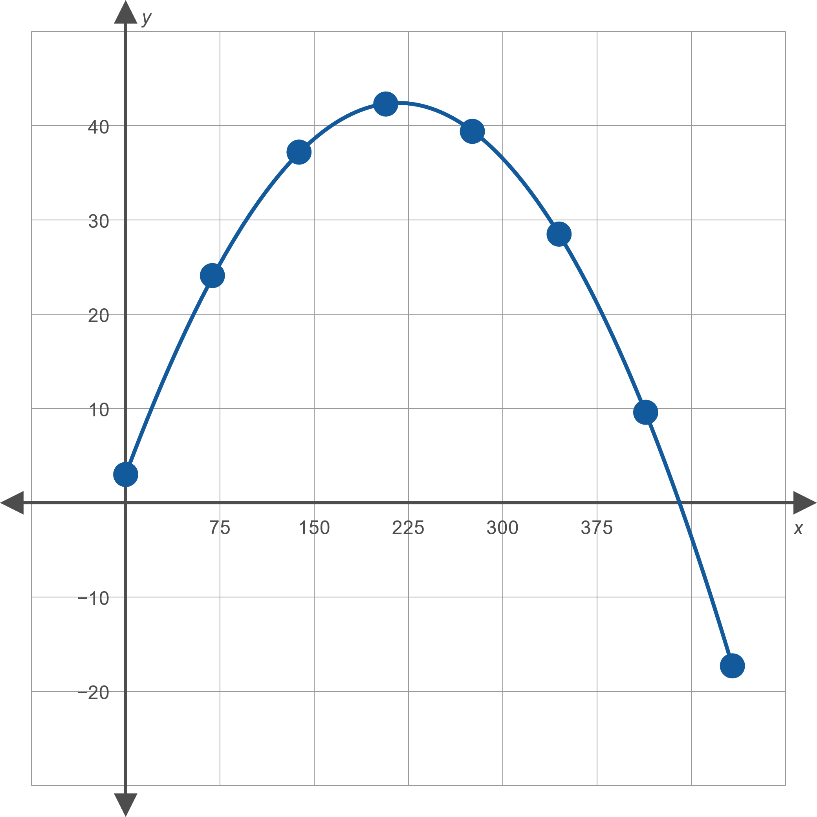
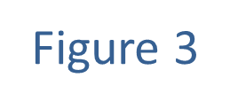
Example 1: Determining Parametric Equations and Their Graphs (cont.)

Slide 10
Example 2: Using Parametric Equations
Suppose the ball in Example 1 has been hit toward a 10-foot-high fence that is 400 feet from home plate. Will the ball clear the fence?

Slide 11
Example 2: Using Parametric Equations (cont.)
Solution
The graph of the ball's flight makes it appear that the answer may be yes, but pictures can be deceptive and a graph is certainly not a proof. However, we can easily resolve the situation in two steps: first, determine the time when the ball is 400 feet from home plate, and then calculate the height of the ball at that time.

Slide 12
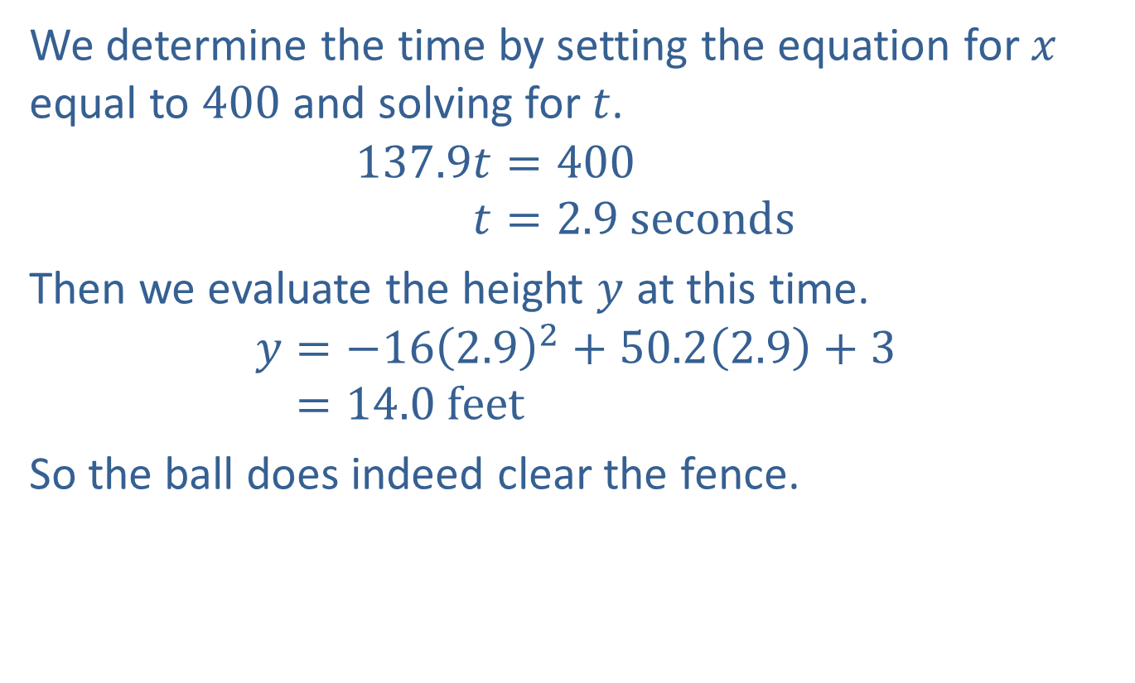
Example 2: Using Parametric Equations (cont.)
We determine the time by setting the equation for $x$ equal to 400 and solving for $t$.
137.9𝑡=400137.9𝑡=2.9 seconds
Then we evaluate the height $y$ at this time.
𝑦=−162.92+50.22.9+3𝑦=14.0 feet
So the ball does indeed clear the fence.

Slide 13

Example 3: Eliminating the Parameter
Sketch the graph described by the parametric equations $x=\frac{1}{\sqrt{t−1}}+1$ and $y=\frac{1}{t−1}$ by eliminating the parameter.

Slide 14
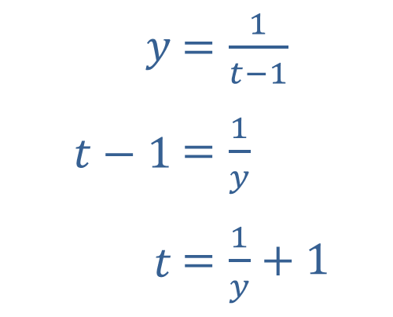

Example 3: Eliminating the Parameter (cont.)
Solution
If we solve the second equation for $t$, the result is as follows.
​
​
​$y$ | ​$=\frac{1}{t−1}$
​$t−1$ | ​$=\frac{1}{y}$
​$t$ | ​$=\frac{1}{y}+1$

Slide 15

Example 3: Eliminating the Parameter (cont.)
Substituting this into the first equation and simplifying, we obtain an equation in $x$ and $y$.
$$x=\frac{1}{\sqrt{\left(\frac{1}{y}+1\right)−1}}+1$$
𝑥=11𝑦+1
𝑥=𝑦+1
​

Slide 16
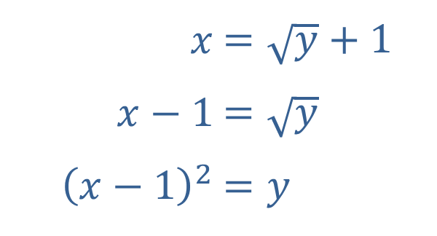

Example 3: Eliminating the Parameter (cont.)
We are more accustomed to graphing such equations in $x$ and $y$ if they are solved for $y$, and doing so in this case leads to a curve we know well.
​
​$x$ | ​$=\sqrt{y}+1$
​$x−1$ | ​$=\sqrt{y}$
​${\left(x−1\right)}^{2}$ | ​$=y$

Slide 17
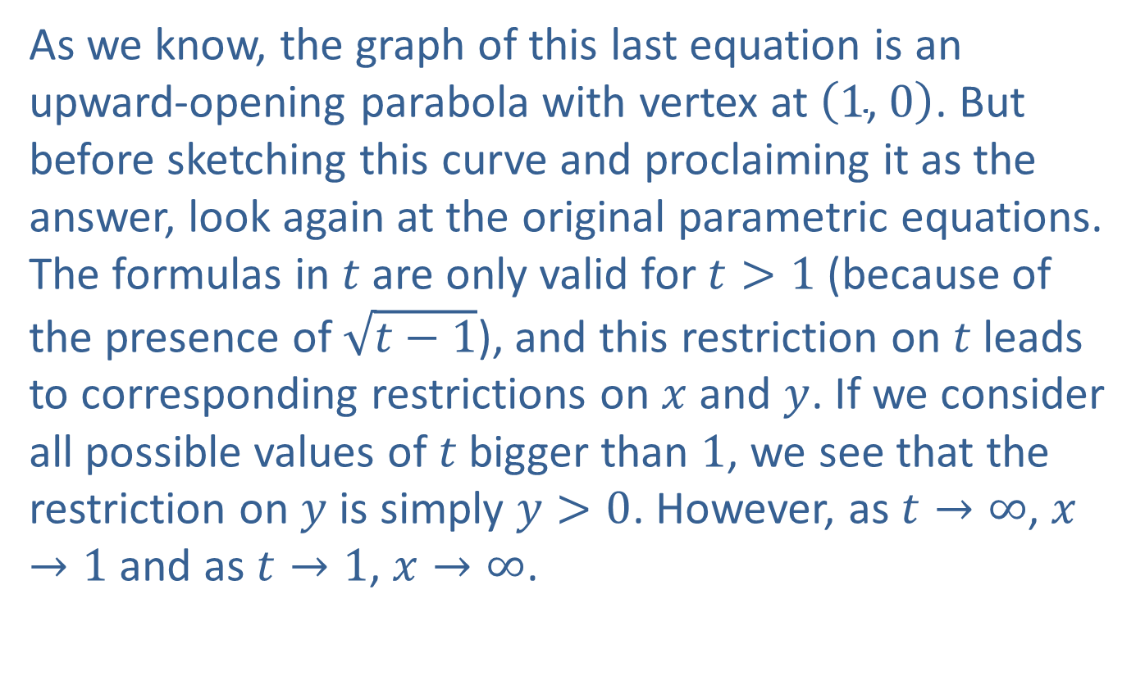
Example 3: Eliminating the Parameter (cont.)
As we know, the graph of this last equation is an upward-opening parabola with vertex at $\left(1\text{, }0\right)$. But before sketching this curve and proclaiming it as the answer, look again at the original parametric equations. The formulas in $t$ are only valid for $t>1$ (because of the presence of $\sqrt{t−1}$), and this restriction on $t$ leads to corresponding restrictions on $x$ and $y$. If we consider all possible values of $t$ bigger than 1, we see that the restriction on $y$ is simply $y>0$. However, as $t→∞$, $x→1$ and as $t→1$, $x→∞$.

Slide 18

Example 3: Eliminating the Parameter (cont.)
In particular, note that there is no value of $t$ for which $x=1$ (or anything smaller than 1). The graph defined by the original parametric equations is thus only half of the parabola, as shown in Figure 4.

Slide 19
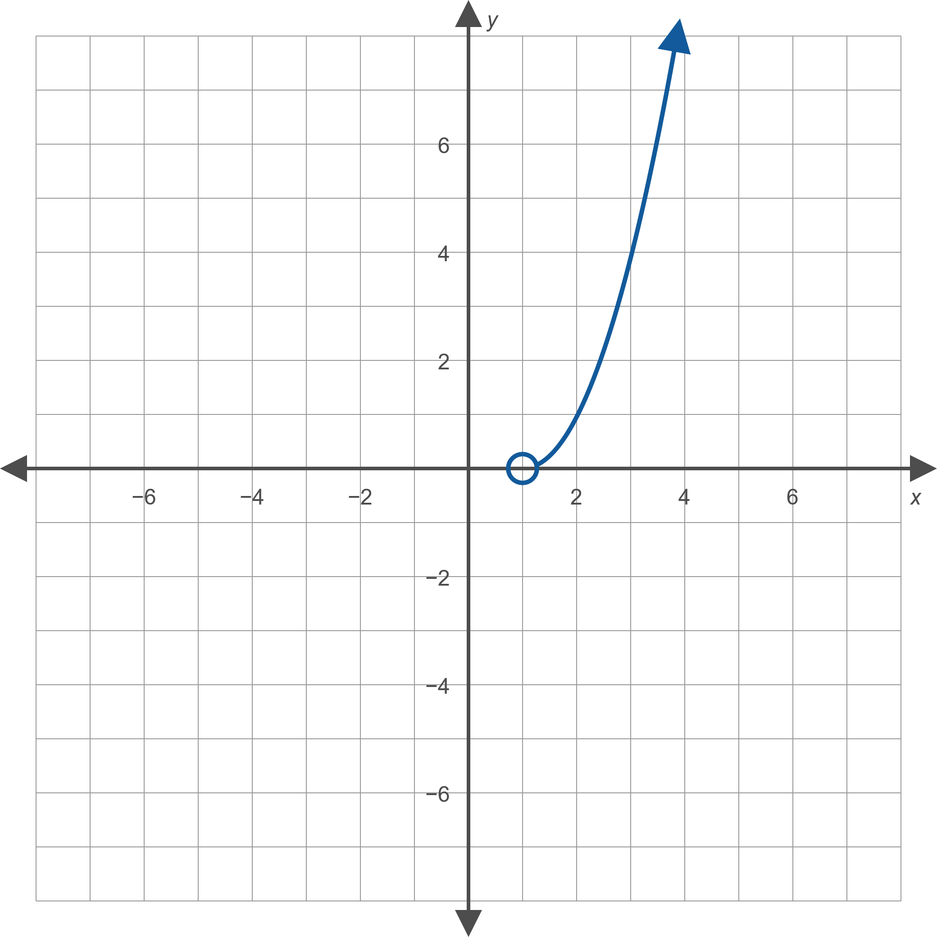
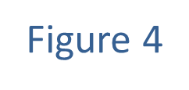
Example 3: Eliminating the Parameter (cont.)

Slide 20

Example 4: Eliminating the Parameter
Sketch the graph described by the parametric equations $x=5\cos{θ}$ and $y=5\sin{θ}$ for $0≤θ≤2π$.

Slide 21
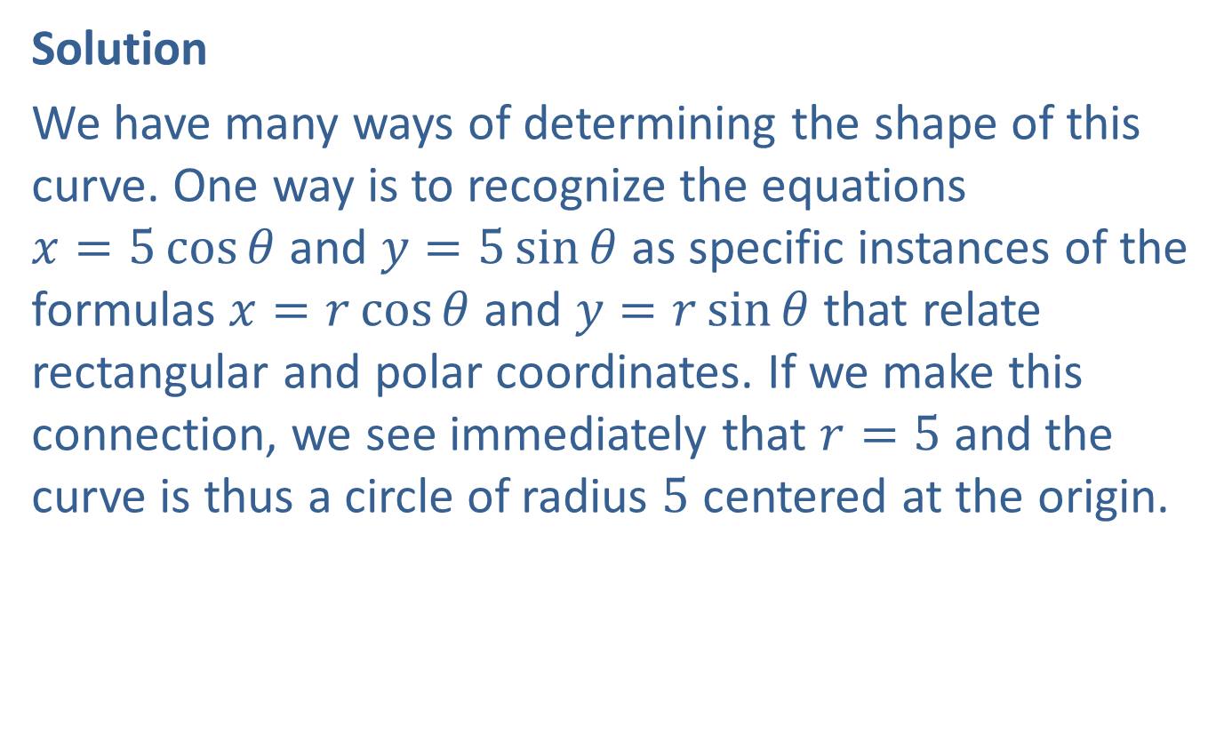
Example 4: Eliminating the Parameter (cont.)
Solution
We have many ways of determining the shape of this curve. One way is to recognize the equations $x=5\cos{θ}$ and $y=5\sin{θ}$ as specific instances of the formulas $x=r\cos{θ}$ and $y=r\sin{θ}$ that relate rectangular and polar coordinates. If we make this connection, we see immediately that $r=5$ and the curve is thus a circle of radius 5 centered at the origin.
​

Slide 22
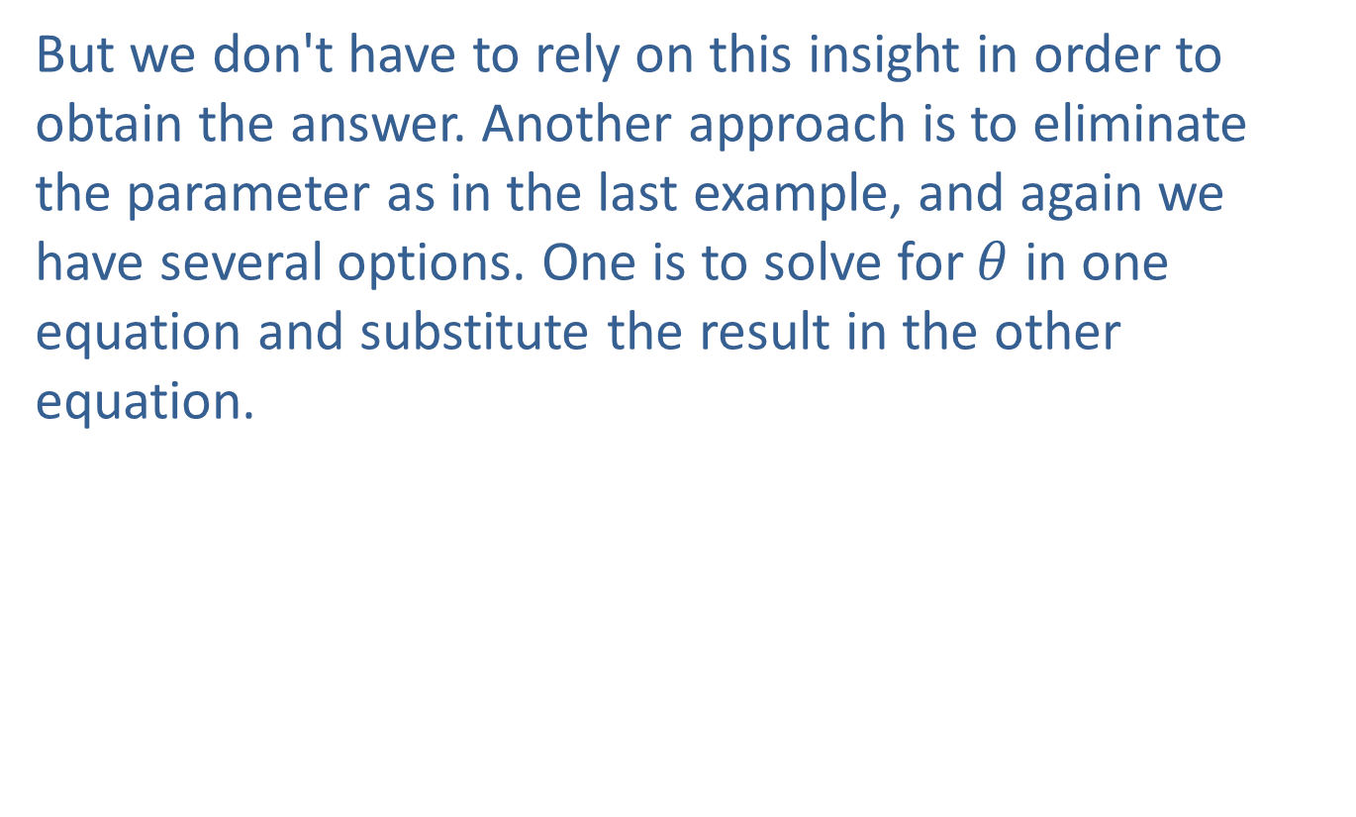
Example 4: Eliminating the Parameter (cont.)
But we don't have to rely on this insight in order to obtain the answer. Another approach is to eliminate the parameter as in the last example, and again we have several options. One is to solve for $θ$ in one equation and substitute the result in the other equation.
​

Slide 23
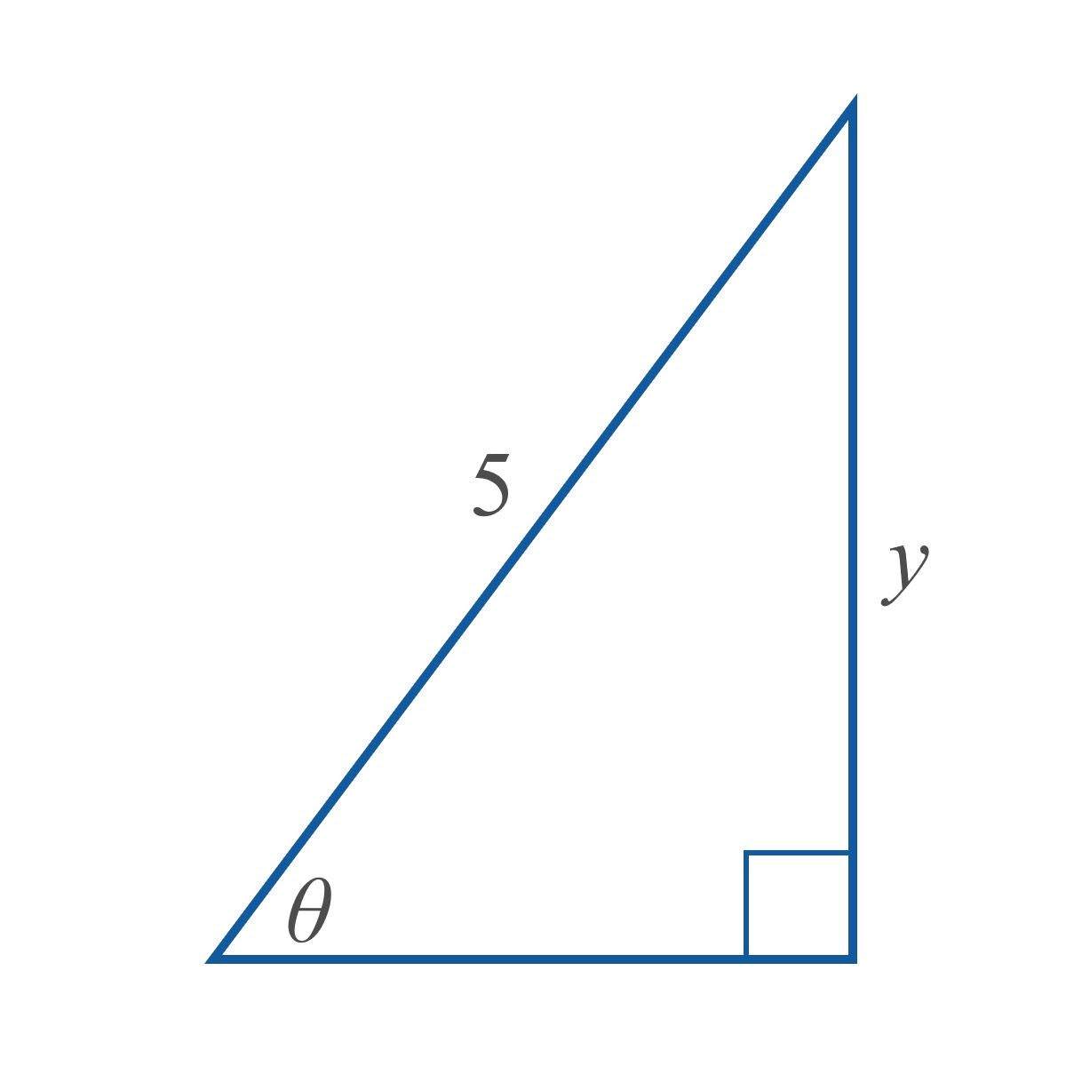
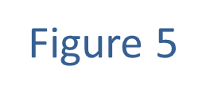
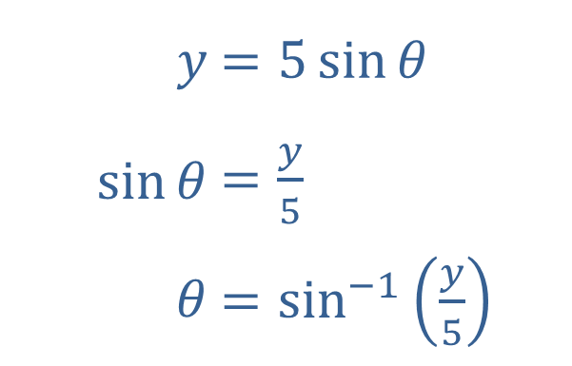

Example 4: Eliminating the Parameter (cont.)
The process for $0<θ<\frac{π}{2}$ is as follows:
​
​$y$ | ​$=5\sin{θ}$
​$sin⁡θ$ | ​$=\frac{y}{5}$
​$θ$ | ​$=\sin^{−1}\left(\frac{y}{5}\right)$

Slide 24
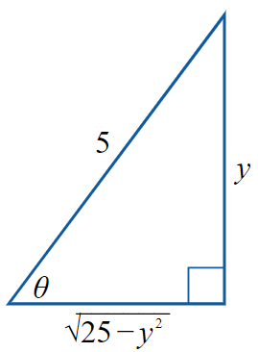
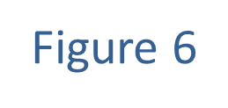
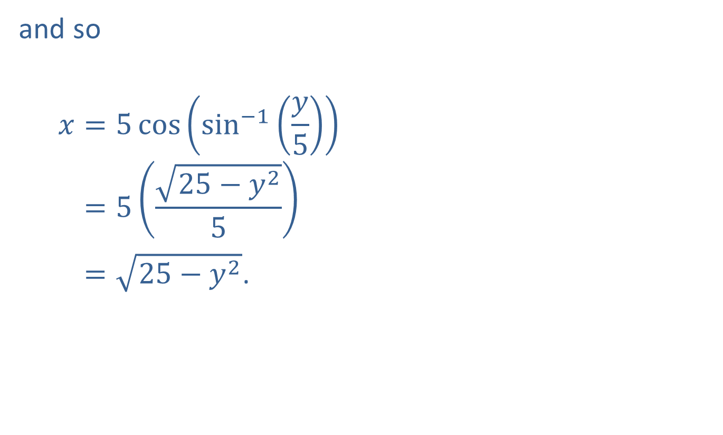
Example 4: Eliminating the Parameter (cont.)
and so
𝑥=5cossin−1𝑦5𝑥=525−𝑦25 𝑥=25−𝑦2.

Slide 25
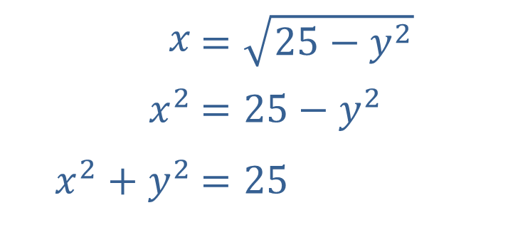
Example 4: Eliminating the Parameter (cont.)
This last equation is more meaningful if we square both sides and rearrange terms slightly.
​
Using this method, we arrive at the rectangular form for the equation of a circle of radius 5 centered at the origin.
​$x$ | ​$=\sqrt{25−y^{2}}$
​$x^{2}$ | ​$=25−y^{2}$
​$x^{2}+y^{2}$ | ​$=25$

Slide 26
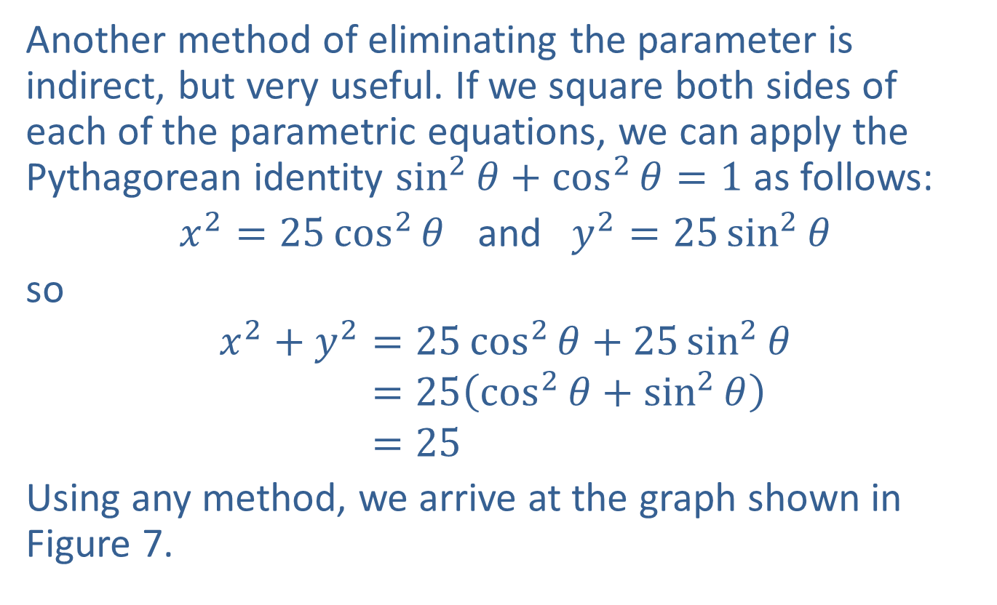
Example 4: Eliminating the Parameter (cont.)
Another method of eliminating the parameter is indirect, but very useful. If we square both sides of each of the parametric equations, we can apply the Pythagorean identity $\sin^{2}{θ}+\cos^{2}{θ}=1$ as follows:
$x^{2}=25\cos^{2}{θ}$ and $y^{2}=25\sin^{2}{θ}$
so
𝑥2+𝑦2=25cos2𝜃+25sin2𝜃𝑥2+𝑦2=25cos2𝜃+sin2𝜃𝑥2+𝑦2=25
Using any method, we arrive at the graph shown in Figure 7.

Slide 27
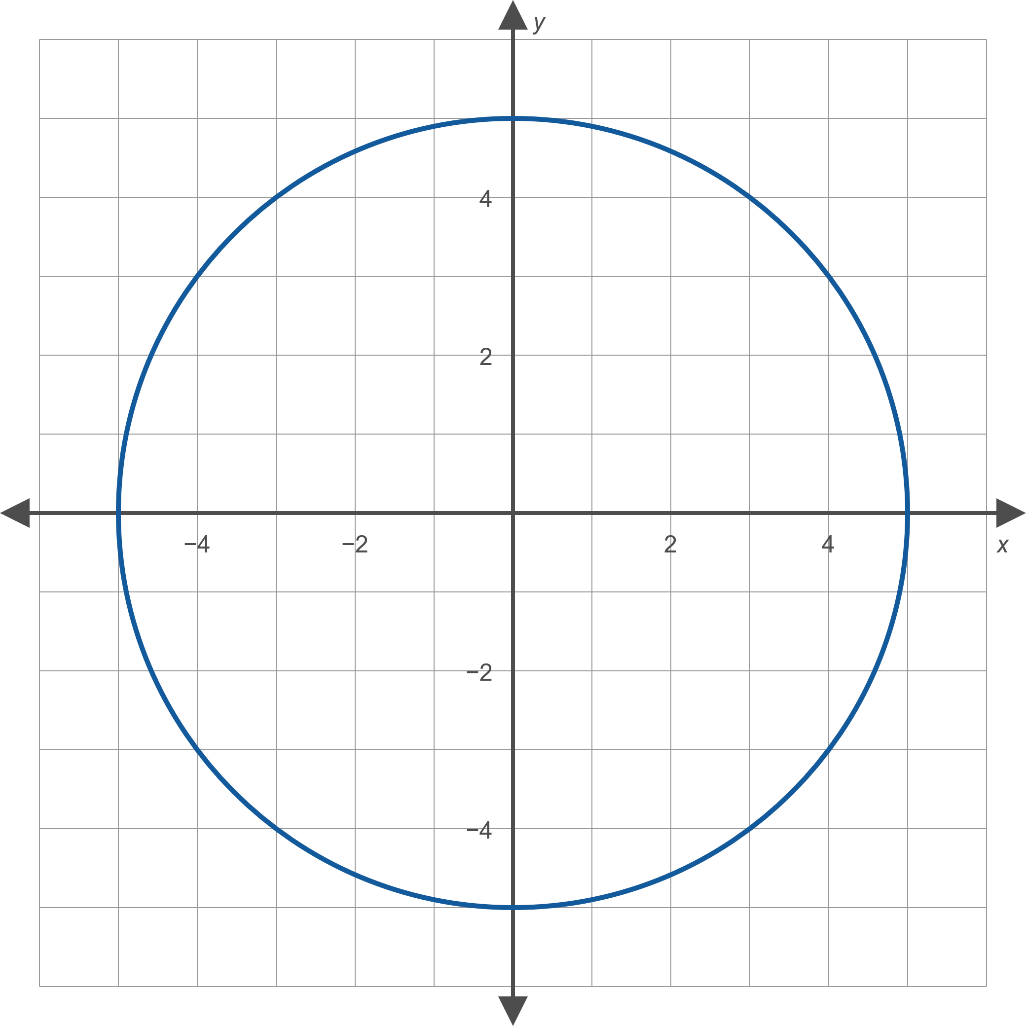
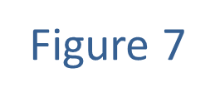
Example 4: Eliminating the Parameter (cont.)

Slide 28

Example 5: Constructing Parametric Equations
Construct parametric equations describing the graph of $y=x^{2}+3$.

Slide 29
Example 5: Constructing Parametric Equations (cont.)
Solution
One hallmark of parametric descriptions of graphs is that they are not unique. Geometrically, the reason for this is that a given curve can be traced out by two parameters at different "speeds" or even in opposite directions. We will illustrate this point with two solutions to the problem in this example.

Slide 30

Example 5: Constructing Parametric Equations (cont.)
Solution 1: One parameterization of the graph is achieved by letting $x=t$ and thereby defining $y=t^{2}+3$. As $t$ increases, the parabola defined by the parametric equations is traced out from left to right. Plot a few points to verify this claim.

Slide 31
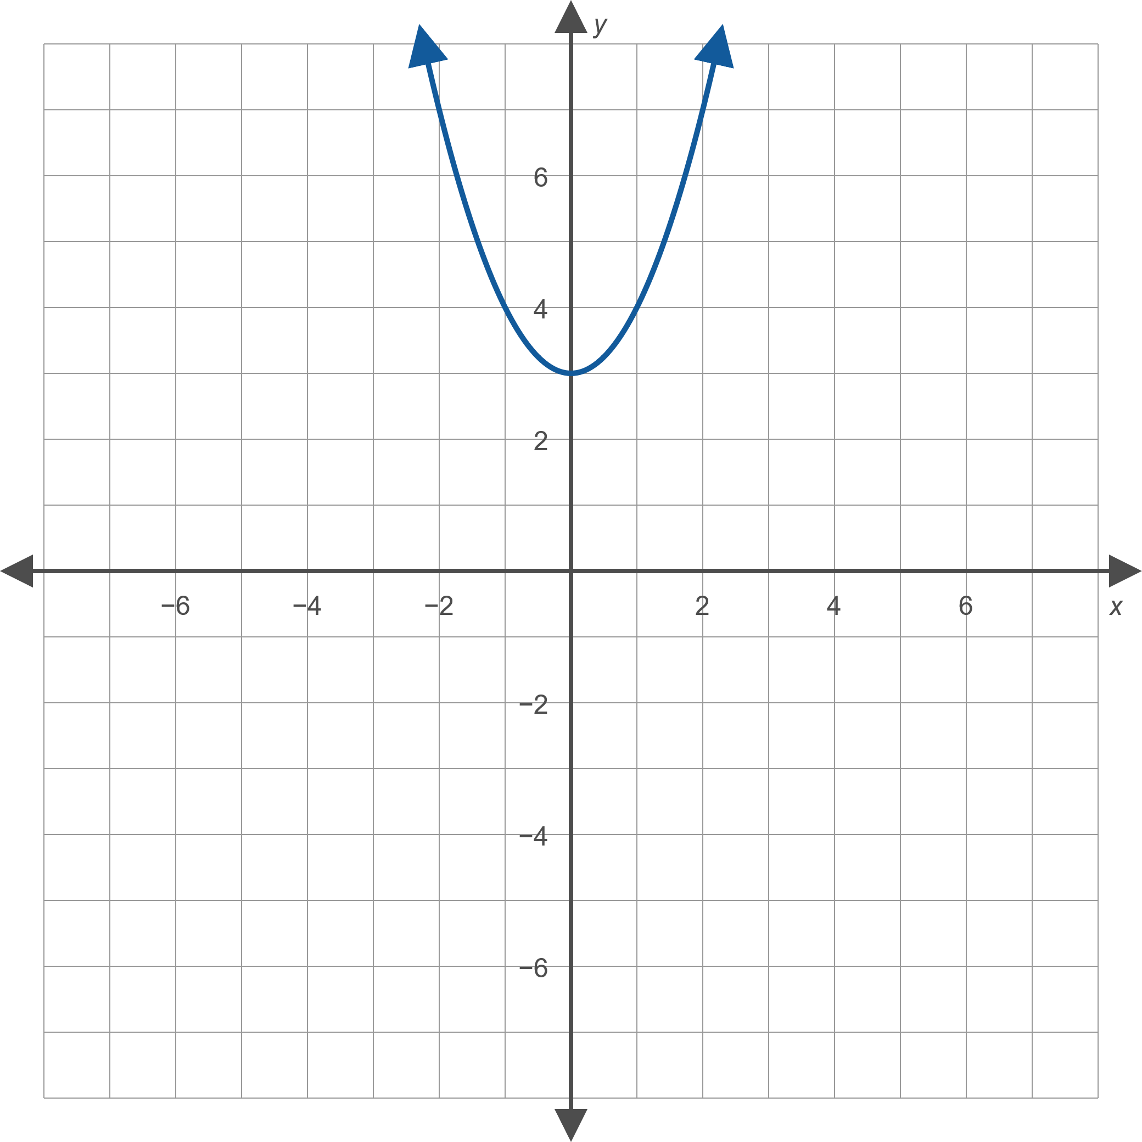
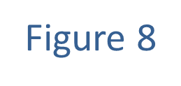
Example 5: Constructing Parametric Equations (cont.)

Slide 32
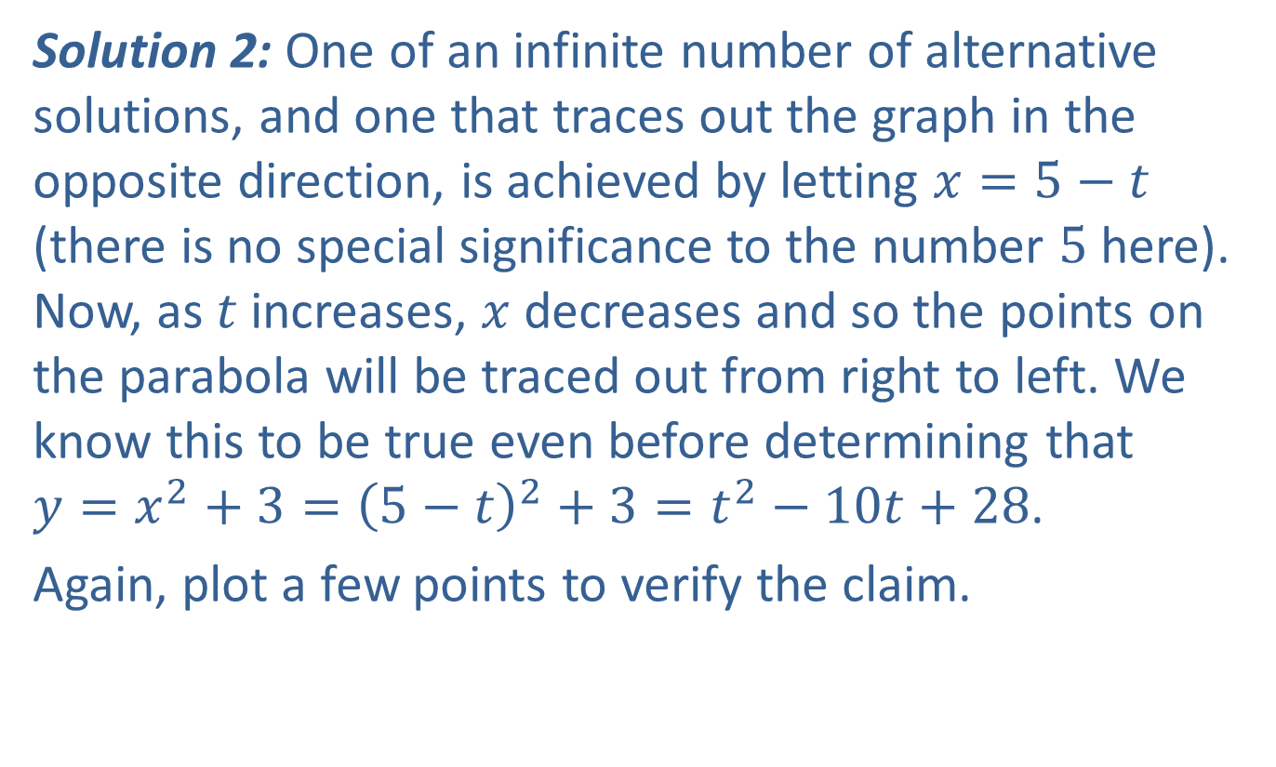
Example 5: Constructing Parametric Equations (cont.)
Solution 2: One of an infinite number of alternative solutions, and one that traces out the graph in the opposite direction, is achieved by letting $x=5−t$ (there is no special significance to the number 5 here). Now, as $t$ increases, $x$ decreases and so the points on the parabola will be traced out from right to left. We know this to be true even before determining that $y=x^{2}+3={\left(5−t\right)}^{2}+3=t^{2}−10t+28$.
Again, plot a few points to verify the claim.

Slide 33
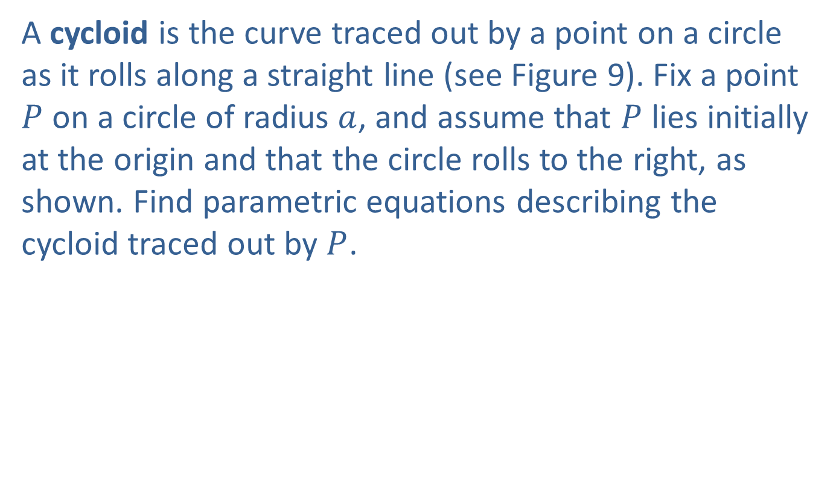
Example 6: Constructing Parametric Equations
A cycloid is the curve traced out by a point on a circle as it rolls along a straight line (see Figure 9). Fix a point $P$ on a circle of radius $a$, and assume that $P$ lies initially at the origin and that the circle rolls to the right, as shown. Find parametric equations describing the cycloid traced out by $P$.

Slide 34
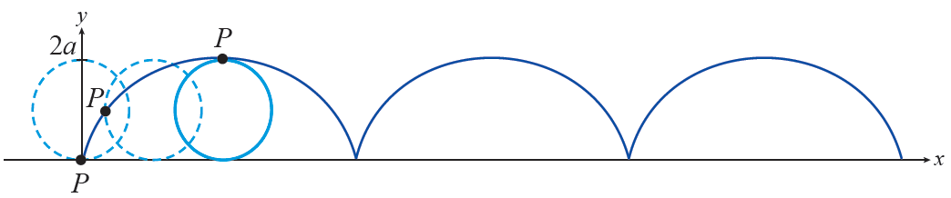
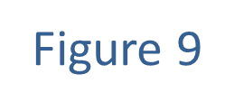
Example 6: Constructing Parametric Equations (cont.)

Slide 35
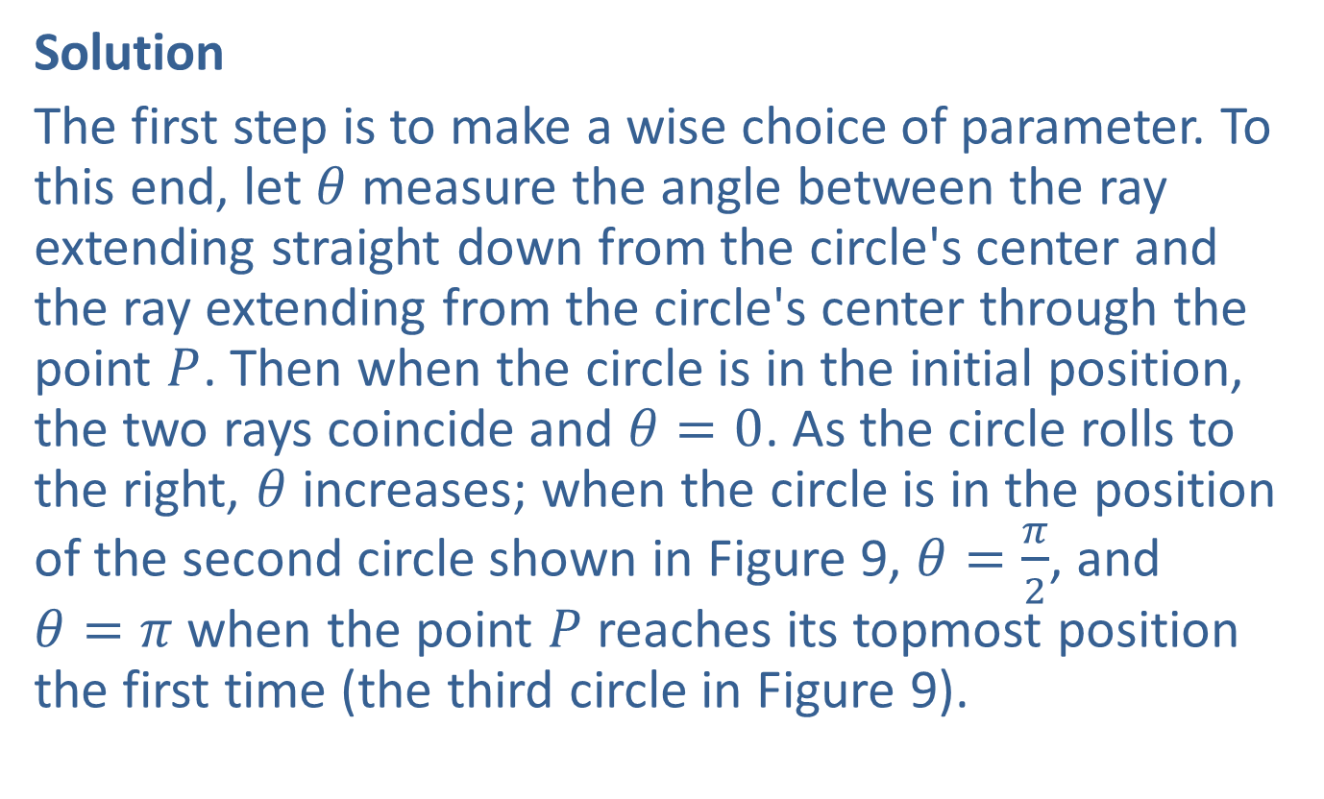
Example 6: Constructing Parametric Equations (cont.)
Solution
The first step is to make a wise choice of parameter. To this end, let $θ$ measure the angle between the ray extending straight down from the circle's center and the ray extending from the circle's center through the point $P$. Then when the circle is in the initial position, the two rays coincide and $θ=0$. As the circle rolls to the right, $θ$ increases; when the circle is in the position of the second circle shown in Figure 9, $θ=\frac{π}{2}$, and $θ=π$ when the point $P$ reaches its topmost position the first time (the third circle in Figure 9).

Slide 36

Example 6: Constructing Parametric Equations (cont.)
Consider the enlarged diagram in Figure 10. If we let $\left(x\text{, }y\right)$ denote the coordinates of the point $P$, our goal is to write $x$ and $y$ as functions of $θ$.

Slide 37
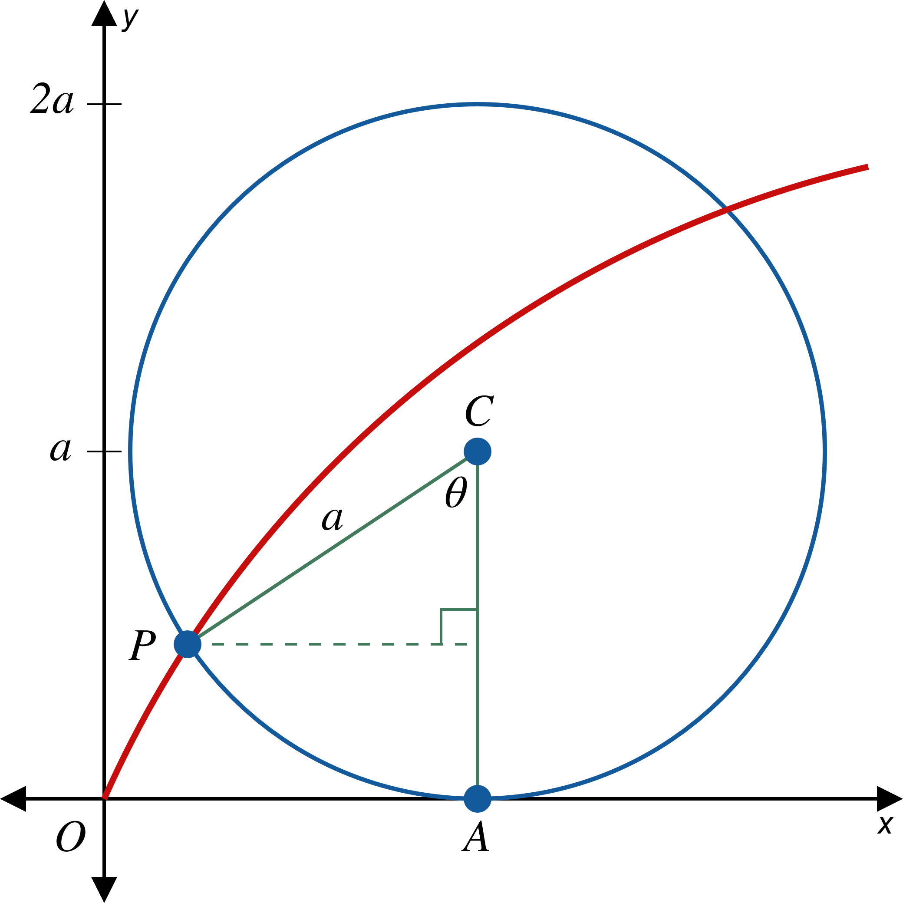

Example 6: Constructing Parametric Equations (cont.)

Slide 38
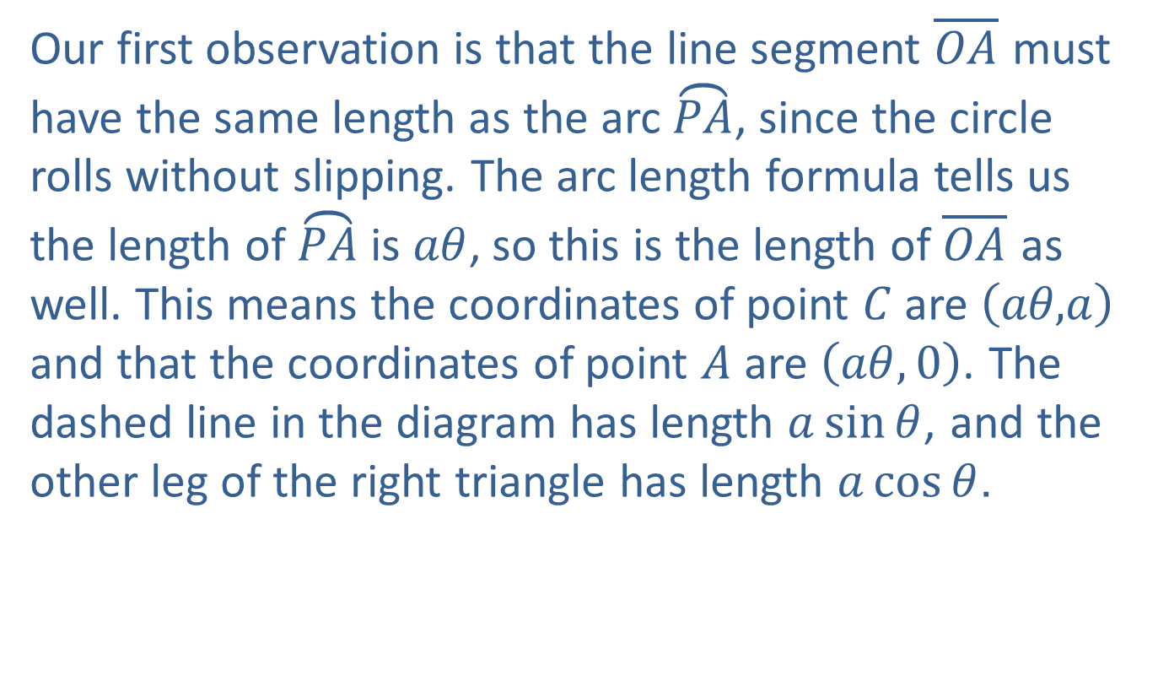
Example 6: Constructing Parametric Equations (cont.)
Our first observation is that the line segment $\overline{OA}$ must have the same length as the arc $\overset{⏜}{PA}$, since the circle rolls without slipping. The arc length formula tells us the length of $\overset{⏜}{PA}$is $aθ$, so this is the length of $\overline{OA}$ as well. This means the coordinates of point $C$ are $\left(aθ\text{,}a\right)$ and that the coordinates of point $A$ are $\left(aθ,0\right)$. The dashed line in the diagram has length $a\sin{θ}$, and the other leg of the right triangle has length $a\cos{θ}$.

Slide 39
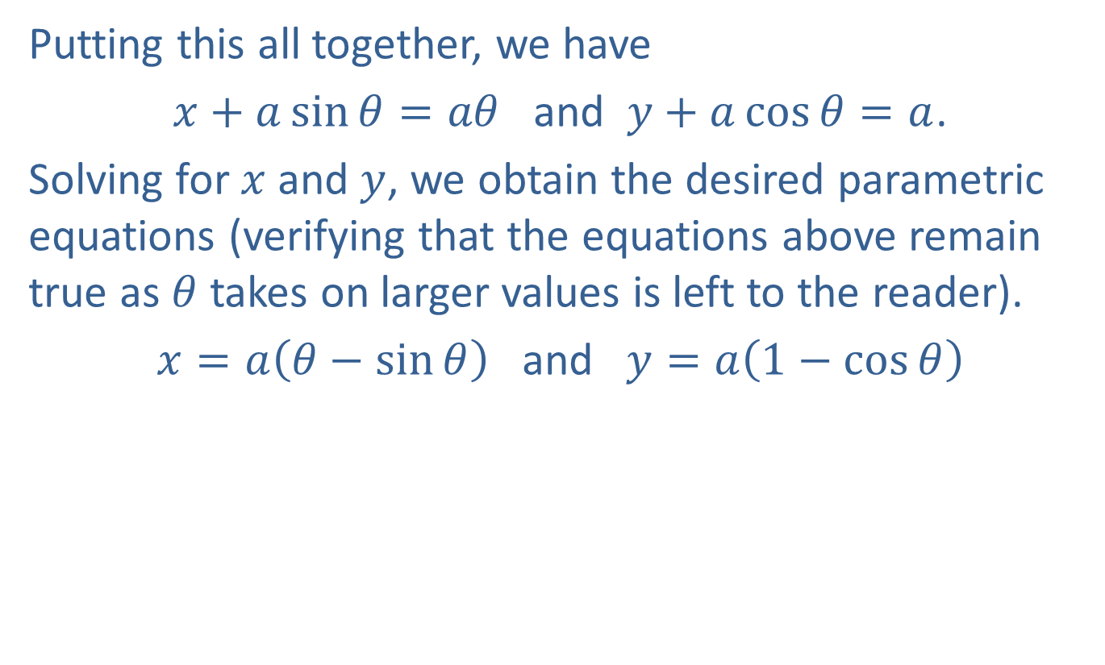
Example 6: Constructing Parametric Equations (cont.)
Putting this all together, we have
$x+a\sin{θ}=aθ$ and $y+a\cos{θ}=a$.
Solving for $x$ and $y$, we obtain the desired parametric equations (verifying that the equations above remain true as $θ$ takes on larger values is left to the reader).
$x=a\left(θ−\sin{θ}\right)$ and $y=a\left(1−\cos{θ}\right)$

