Slide 1
Section 10.5
Trigonometric Form of Complex Numbers

Slide 2
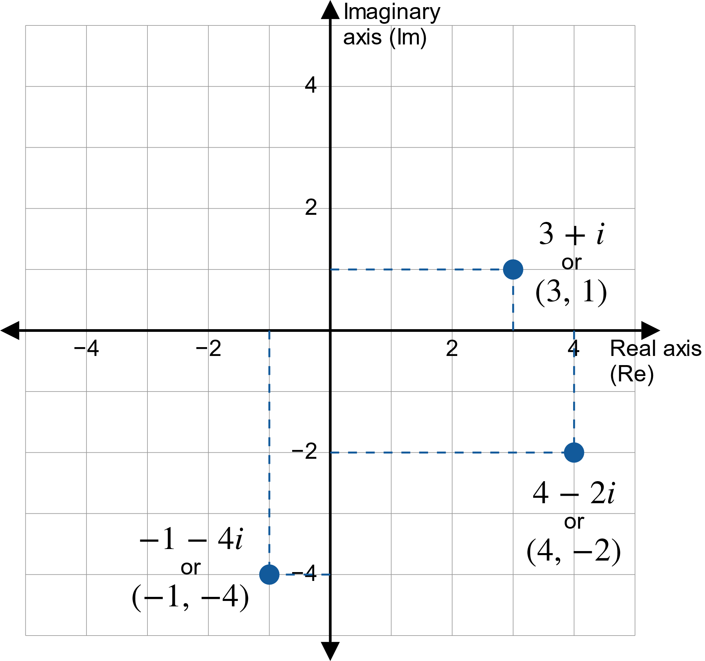
Figure 1: The Complex Plane

Slide 3
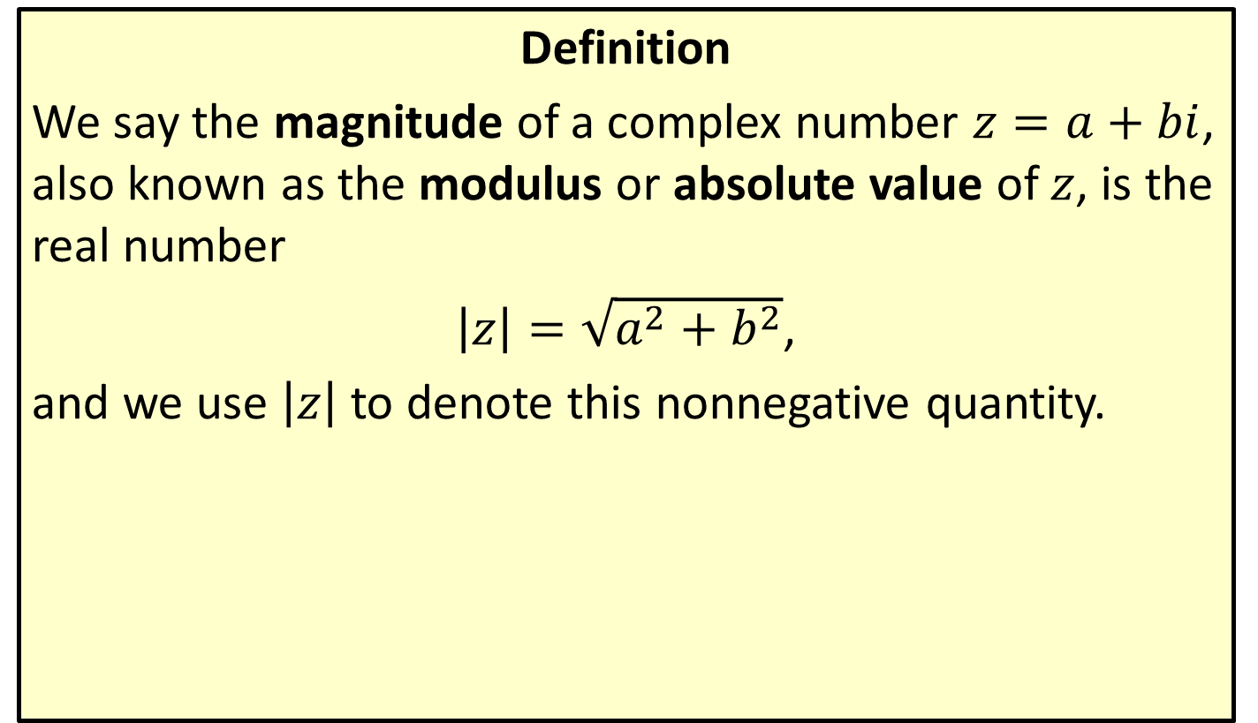
Magnitude of a Complex Number
Definition
We say the magnitude of a complex number $z=a+bi$, also known as the modulus or absolute value of $z$, is the real number
$\left|z\right|=\sqrt{a^{2}+b^{2}}$,
and we use $\left|z\right|$ to denote this nonnegative quantity.

Slide 4

Example 1: Finding the Magnitude
Determine the magnitudes of the following complex numbers.
​$−2+5i$
​$1−3i$

Slide 5

Example 1: Finding the Magnitude (cont.)
Solution
​$\left|−2+5i\right|=\sqrt{{\left(−2\right)}^{2}+{\left(5\right)}^{2}}=\sqrt{29}$
​$\left|1−3i\right|=\sqrt{{\left(1\right)}^{2}+{\left(−3\right)}^{2}}=\sqrt{10}$

Slide 6

Example 2: Graphing Regions in the Complex Plane
Graph the regions of the complex plane defined by the following.
​$\left\{z\left|\left|z\right|≤\right. 1\right\}$
​$\left\{z=a+bi\left|\left|z\right|≤1 \text{and} b≥\right.0\right\}$

Slide 7

Example 2: Graphing Regions in the Complex Plane (cont.)
Solution
​In words, $\left\{z\left|\left|z\right|≤\right.1\right\}$ is the set of all complex numbers with magnitude less than or equal to 1. The region appears in Figure 2.
​

Slide 8
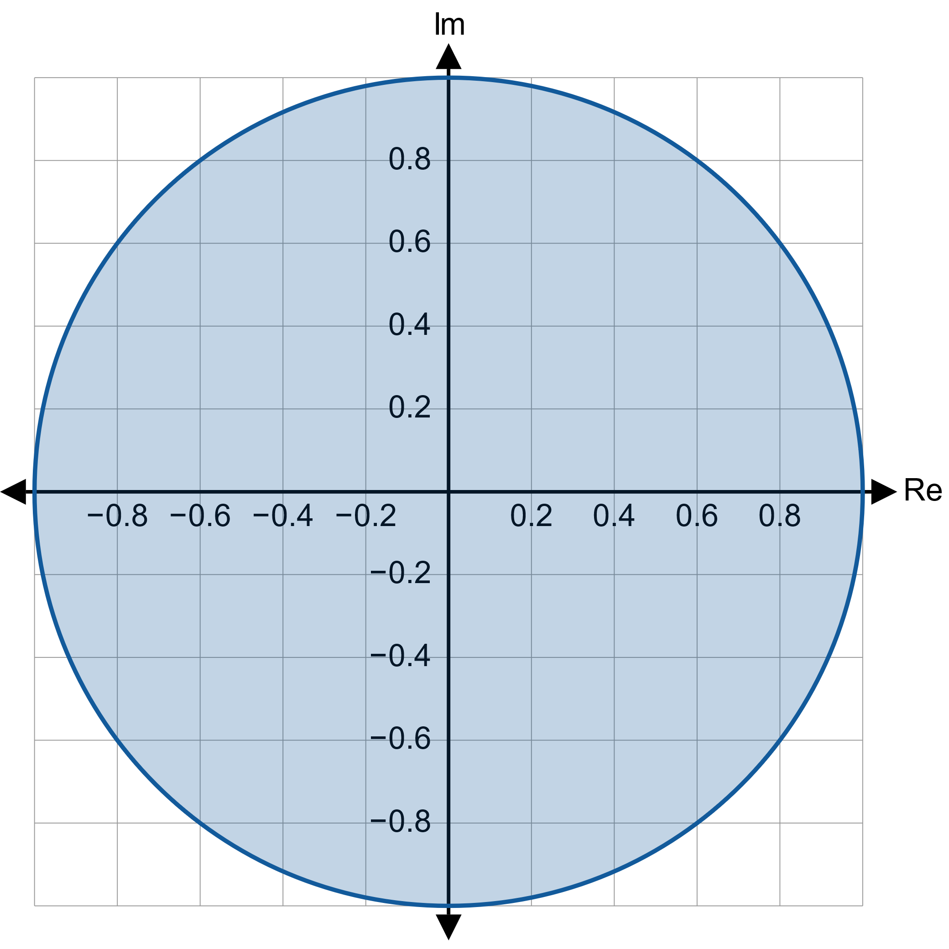

Example 2: Graphing Regions in the Complex Plane (cont.)

Slide 9

Example 2: Graphing Regions in the Complex Plane (cont.)
​The region $\left\{z=a+bi\left|\left|z\right|≤1 \text{and} b≥\right. 0\right\}$ consists of only those complex numbers with magnitude less than or equal to 1 and nonnegative coefficients of $i$. The graph of the region is a half circle as shown in Figure 3.
​

Slide 10
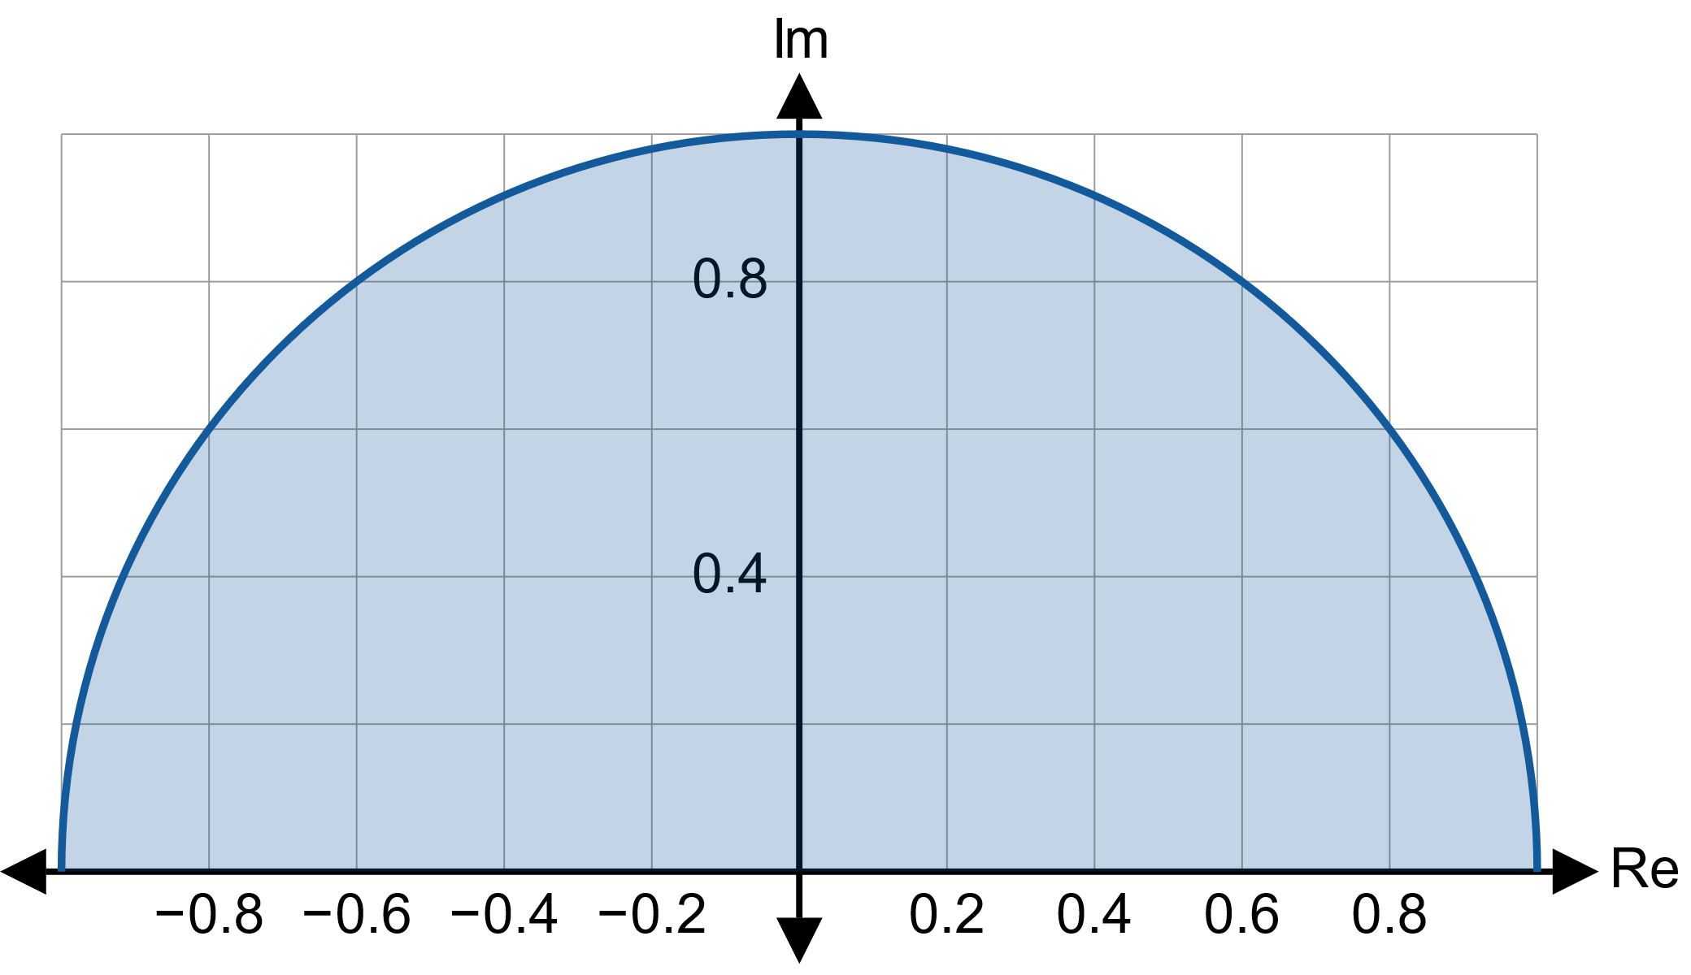

Example 2: Graphing Regions in the Complex Plane (cont.)

Slide 11
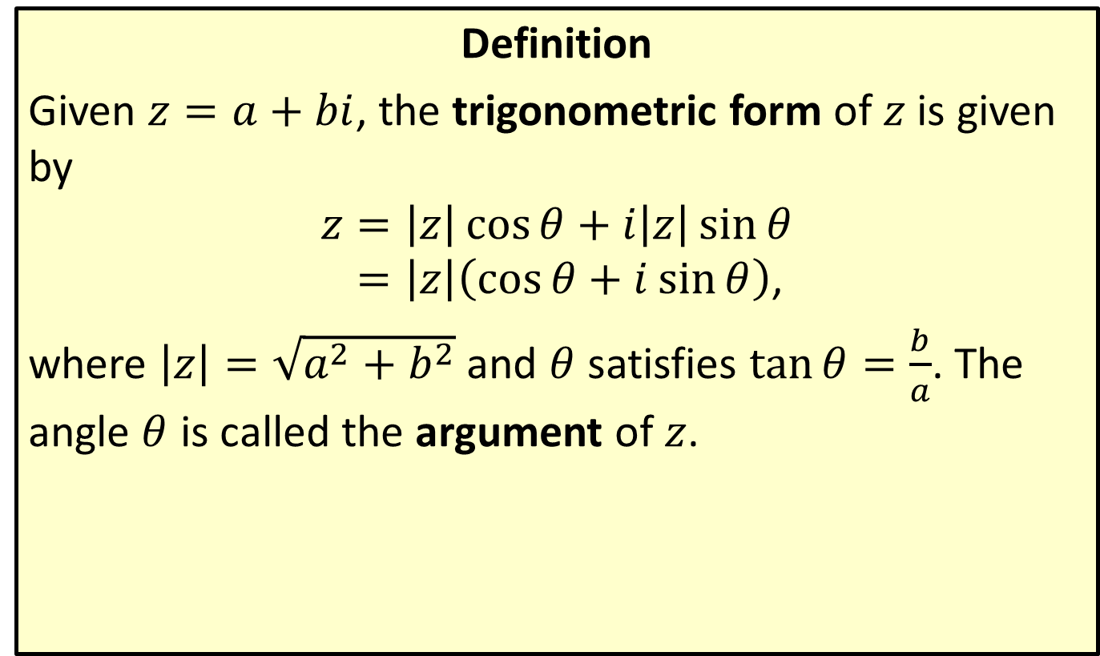

Trigonometric Form of $z=a+bi$
Definition
Given $z=a+bi$, the trigonometric form of $z$ is given by
𝑧=𝑧cos𝜃+𝑖𝑧sin𝜃𝑧=𝑧cos𝜃+𝑖sin𝜃,
where $\left|z\right|=\sqrt{a^{2}+b^{2}}$ and $θ$ satisfies $\tan{θ}=\frac{b}{a}$. The angle $θ$ is called the argument of $z$.

Slide 12
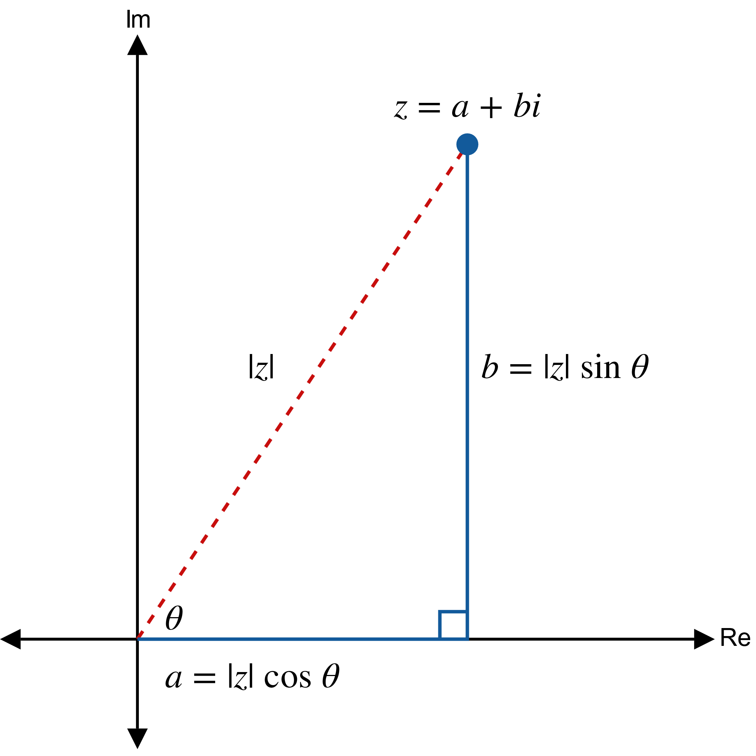

Trigonometric Form of $z=a+bi$

Slide 13

Example 3: Writing Complex Numbers in Trigonometric Form
Write each of the following complex numbers in trigonometric form.
​$−1+i$
​$3−4i$

Slide 14
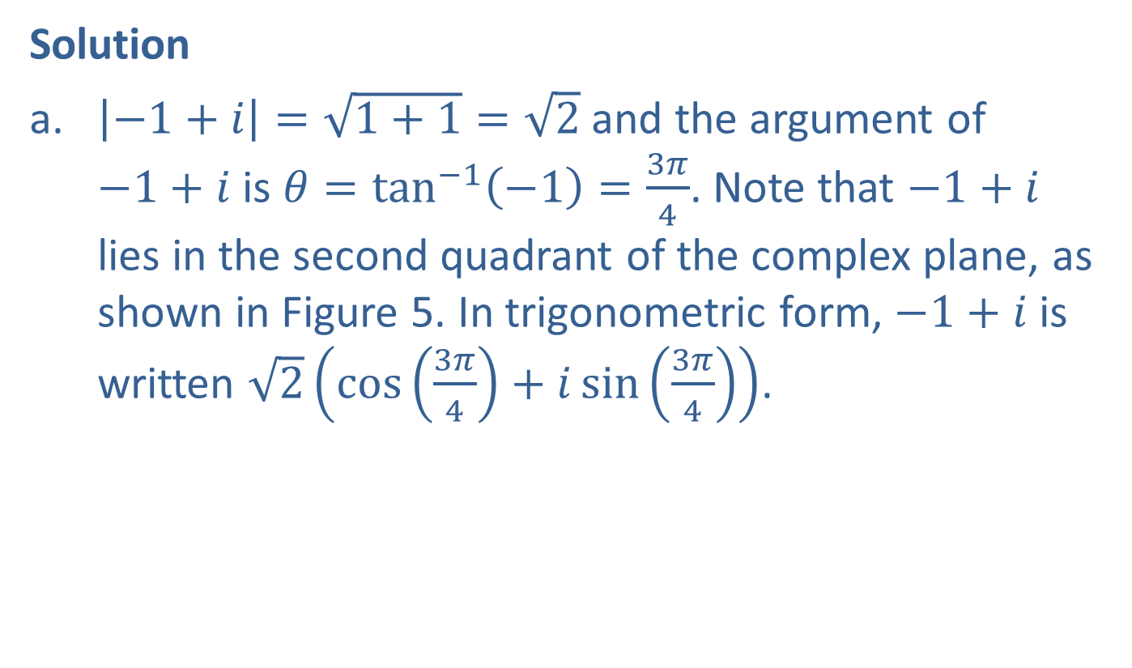
Example 3: Writing Complex Numbers in Trigonometric Form (cont.)
Solution
​$\left|−1+i\right|=\sqrt{1+1}=\sqrt{2}$ and the argument of $−1+i$ is $θ=\tan^{−1}⁡\left(−1\right)=\frac{3π}{4}$. Note that $−1+i$ lies in the second quadrant of the complex plane, as shown in Figure 5. In trigonometric form, $−1+i$ is written $\sqrt{2}\left(\cos\left(\frac{3π}{4}\right)+i\sin\left(\frac{3π}{4}\right)\right)$.
​

Slide 15
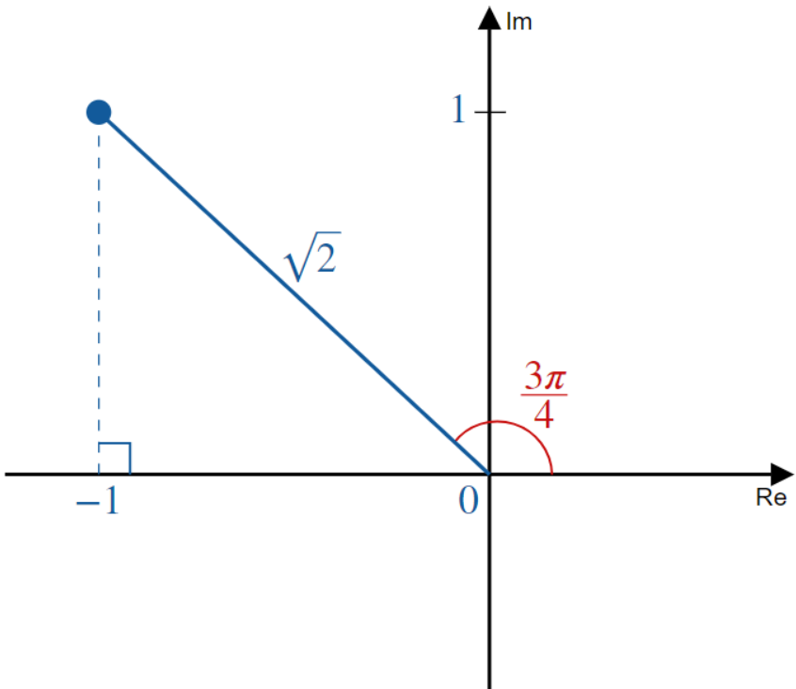

Example 3: Writing Complex Numbers in Trigonometric Form (cont.)

Slide 16

Example 3: Writing Complex Numbers in Trigonometric Form (cont.)
​The magnitude of $3−4i$ is 5, but the argument is not so neatly expressed. In degrees, $θ=\tan^{−1}\left(−\frac{4}{3}\right)≈−53.1°$. So $3−4i≈5\left(\cos\left(−53.1°\right)+i\sin\left(−53.1°\right)\right)$.

Slide 17

Example 4: Writing Complex Numbers in Standard Form
Write the complex number $2\left(\cos\left(\frac{π}{6}\right)+i\sin\left(\frac{π}{6}\right)\right)$ in standard form.

Slide 18

Example 4: Writing Complex Numbers in Standard Form (cont.)
Solution
$$2\left(\cos\left(\frac{π}{6}\right)+i\sin\left(\frac{π}{6}\right)\right)=2\left(\frac{\sqrt{3}}{2}+i\frac{1}{2}\right)=\sqrt{3}+i$$

Slide 19
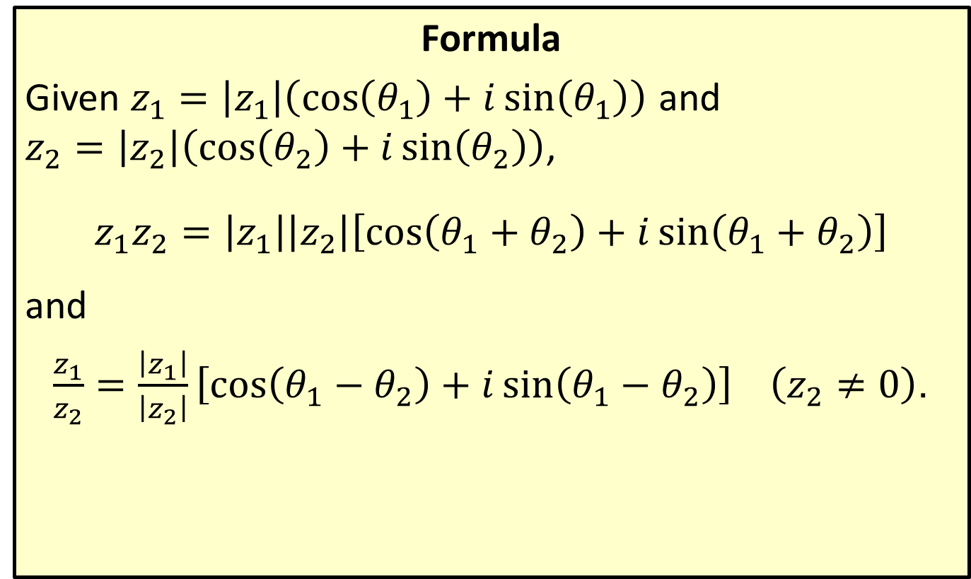
Product and Quotient of Complex Numbers
Formula
Given $z_{1}=\left|z_{1}\right|\left(\cos\left(θ_{1}\right)+i\sin\left(θ_{1}\right)\right)$ and $z_{2}=\left|z_{2}\right|\left(\cos\left(θ_{2}\right)+i\sin\left(θ_{2}\right)\right)$,
$$z_{1}z_{2}=\left|z_{1}\right|\left|z_{2}\right|\left[\cos\left(θ_{1}+θ_{2}\right)+i\sin\left(θ_{1}+θ_{2}\right)\right]$$
and
$\frac{z_{1}}{z_{2}}=\frac{\left|z_{1}\right|}{\left|z_{2}\right|}\left[\cos\left(θ_{1}−θ_{2}\right)+i\sin\left(θ_{1}−θ_{2}\right)\right] \left(z_{2}≠0\right)$.

Slide 20

Example 5: Multiplying Complex Numbers
Use the product formula to find the product of $z_{1}=3\left(\cos\left(\frac{5π}{6}\right)+i\sin\left(\frac{5π}{6}\right)\right)$ and $z_{2}=2\left(\cos\left(\frac{2π}{3}\right)+i\sin\left(\frac{2π}{3}\right)\right)$.

Slide 21
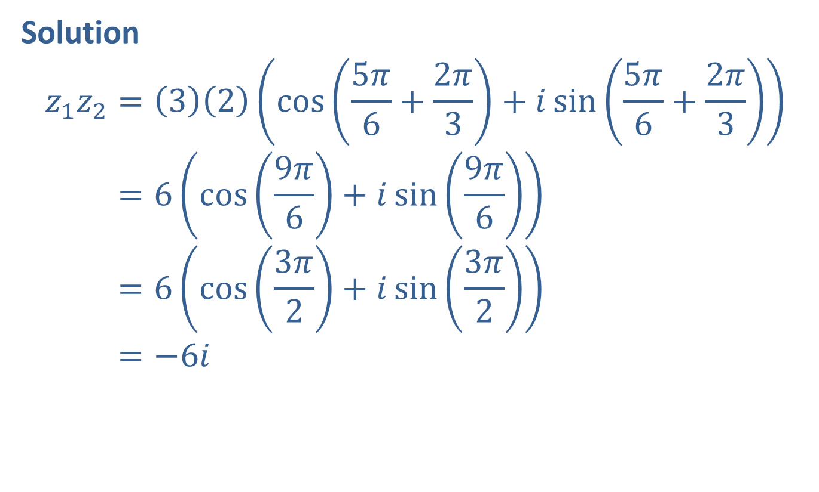
Example 5: Multiplying Complex Numbers (cont.)
Solution
𝑧1𝑧2=32cos5𝜋6+2𝜋3+𝑖sin5𝜋6+2𝜋3𝑧1𝑧2=6cos9𝜋6+𝑖sin9𝜋6𝑧1𝑧2=6cos3𝜋2+𝑖sin3𝜋2𝑧1𝑧2=−6𝑖

Slide 22

Example 6: Dividing Complex Numbers
Use the quotient formula to divide $z_{1}=6\left(\cos\left(117°\right)+i\sin\left(117°\right)\right)$ by $z_{2}=2\left(\cos\left(72°\right)+i\sin\left(72°\right)\right)$.

Slide 23
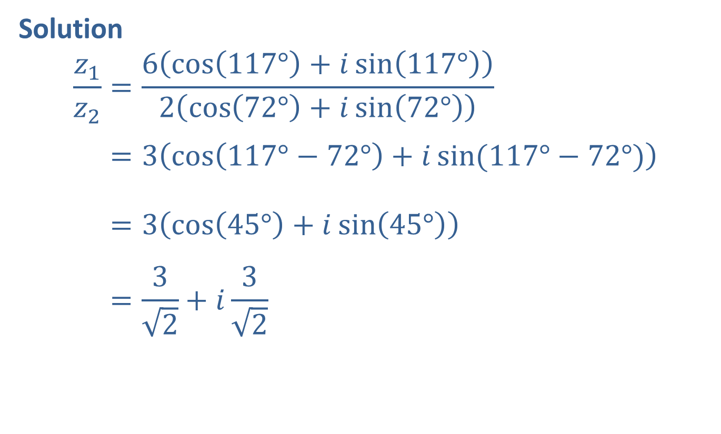
Example 6: Dividing Complex Numbers (cont.)
Solution
𝑧1𝑧2=6cos117°+𝑖sin117°2cos72°+𝑖sin72°𝑧1𝑧2=3cos117°−72°+𝑖sin(117°−72°)𝑧1𝑧2=3cos45°+𝑖sin45°𝑧1𝑧2=32+𝑖32

Slide 24

Example 7: Graphing Complex Numbers and Their Product
Plot the two complex numbers $2e^{i\left(\frac{π}{3}\right)}$ and $3e^{i\left(\frac{5π}{6}\right)}$ and then, on the same graph, plot their product.

Slide 25
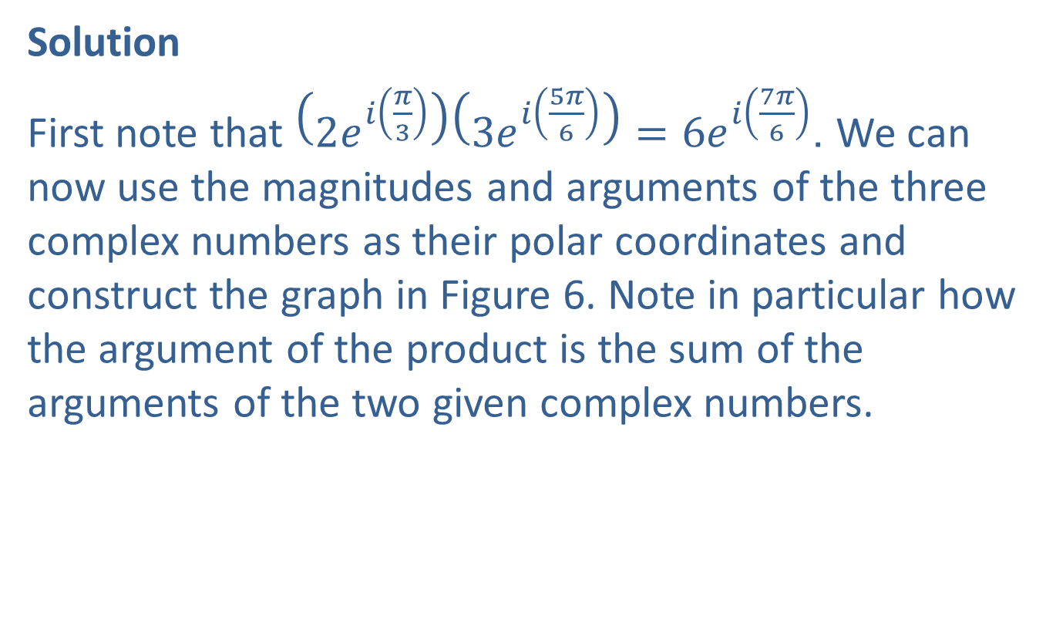
Example 7: Graphing Complex Numbers and Their Product (cont.)
Solution
First note that $\left(2e^{i\left(\frac{π}{3}\right)}\right)\left(3e^{i\left(\frac{5π}{6}\right)}\right)=6e^{i\left(\frac{7π}{6}\right)}$. We can now use the magnitudes and arguments of the three complex numbers as their polar coordinates and construct the graph in Figure 6. Note in particular how the argument of the product is the sum of the arguments of the two given complex numbers.

Slide 26
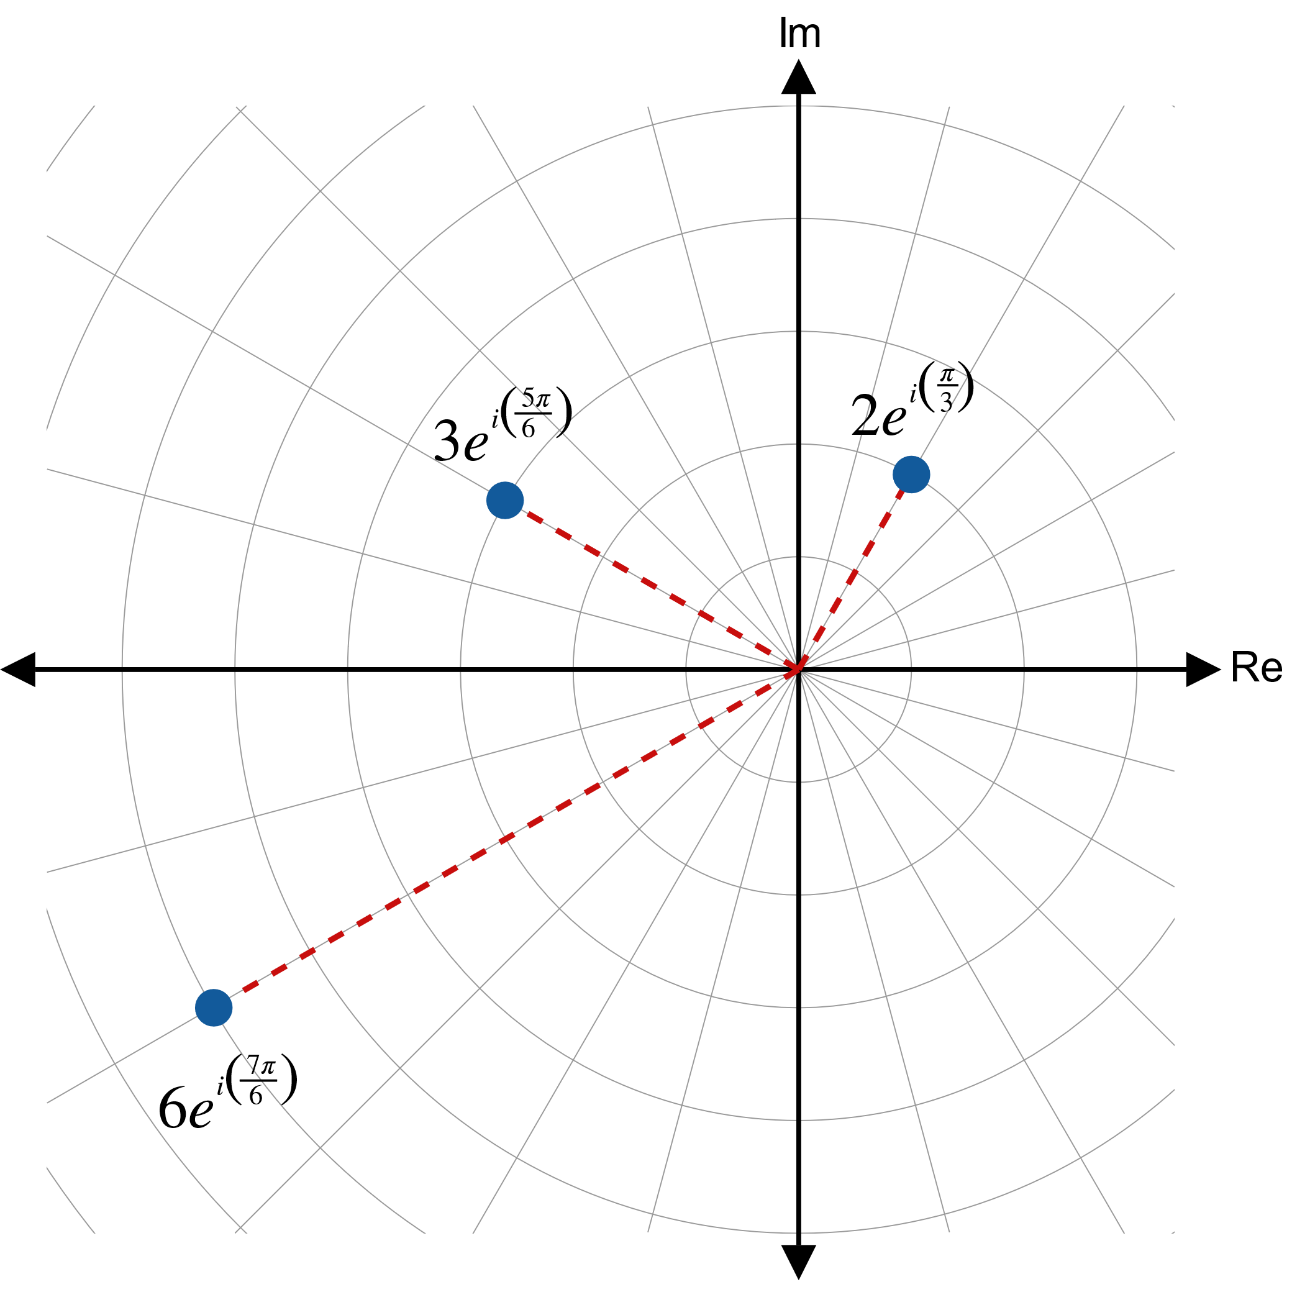

Example 7: Graphing Complex Numbers and Their Product (cont.)

Slide 27
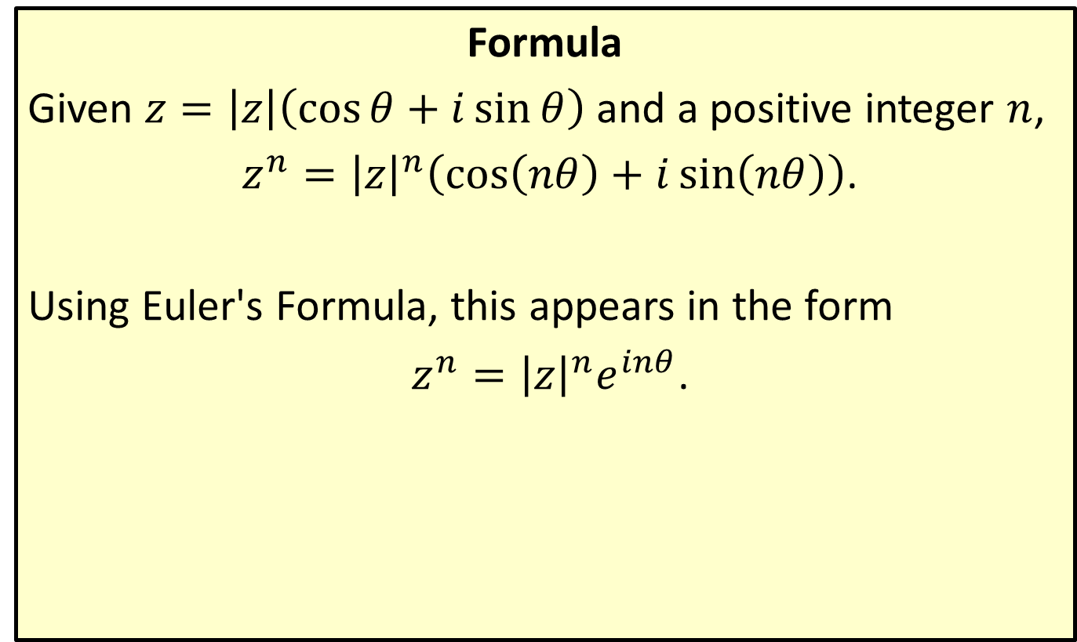
Powers of Complex Numbers (De Moivre's Theorem)
Formula
Given $z=\left|z\right|\left(\cos{θ}+i\sin{θ}\right)$ and a positive integer $n$,
$z^{n}={\left|z\right|}^{n}\left(\cos\left(nθ\right)+i\sin\left(nθ\right)\right)$.
Using Euler's Formula, this appears in the form
$z^{n}={\left|z\right|}^{n}e^{inθ}$.

Slide 28

Example 8: Using De Moivre's Theorem
Use De Moivre's Theorem to calculate ${\left(\sqrt{3}−i\right)}^{7}$.

Slide 29
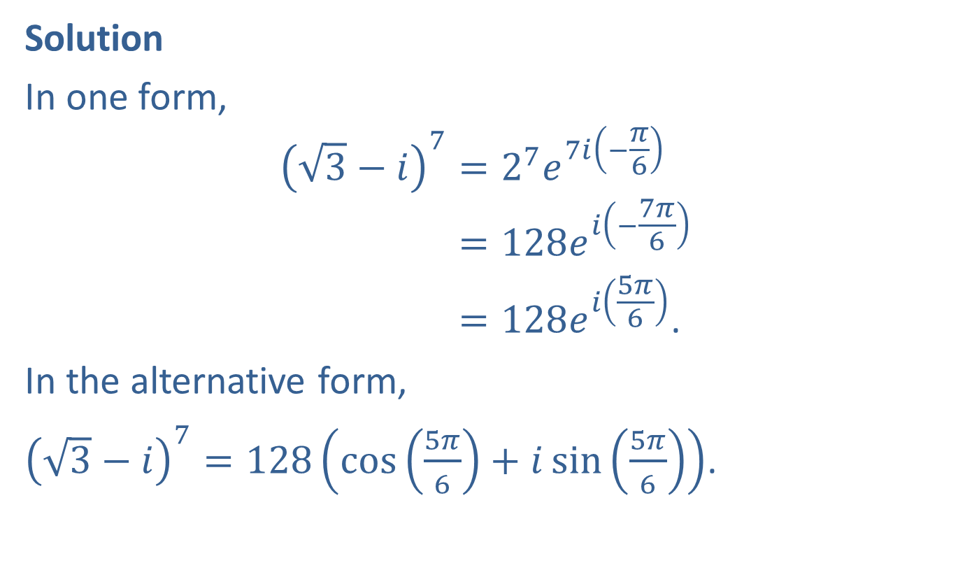
Example 8: Using De Moivre's Theorem (cont.)
Solution
In one form,
3−𝑖7=27𝑒7𝑖−𝜋63−𝑖7=128𝑒𝑖−7𝜋63−𝑖7=128𝑒𝑖5𝜋6.
In the alternative form,
${\left(\sqrt{3}−i\right)}^{7}=128\left(\cos\left(\frac{5π}{6}\right)+i\sin\left(\frac{5π}{6}\right)\right)$.

Slide 30
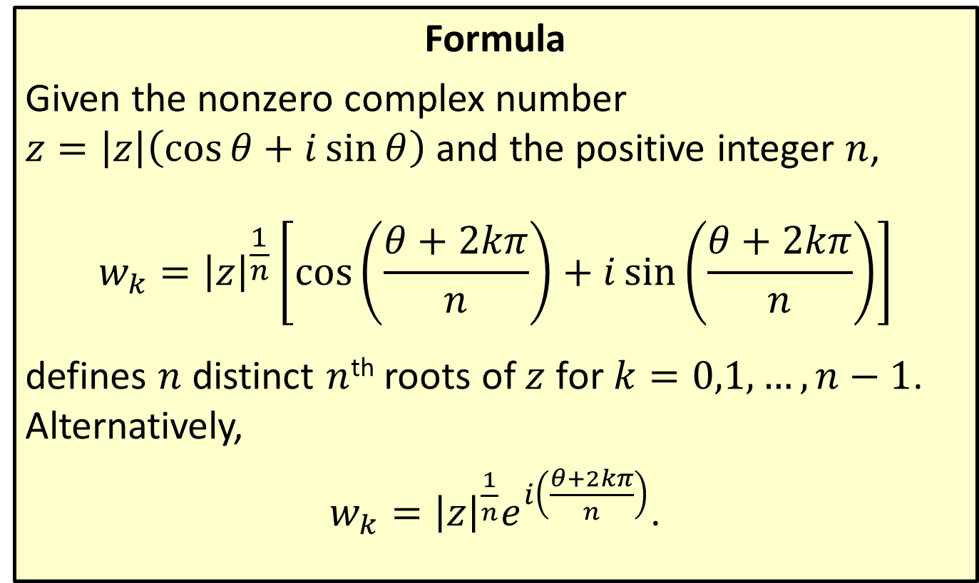
Roots of Complex Numbers
Formula
Given the nonzero complex number $z=\left|z\right|\left(\cos{θ}+i\sin{θ}\right)$ and the positive integer $n$,
$$w_{k}={\left|z\right|}^{\frac{1}{n}}\left[\cos\left(\frac{θ+2kπ}{n}\right)+i\sin\left(\frac{θ+2kπ}{n}\right)\right]$$
defines $n$ distinct $n$^{th} roots of $z$ for $k=0,1,…,n−1$. Alternatively,
$w_{k}={\left|z\right|}^{\frac{1}{n}}e^{i\left(\frac{θ+2kπ}{n}\right)}$.

Slide 31
Example 9: Finding Roots of Complex Numbers
Find all the fifth roots of 1, and graph their locations in the complex plane.

Slide 32
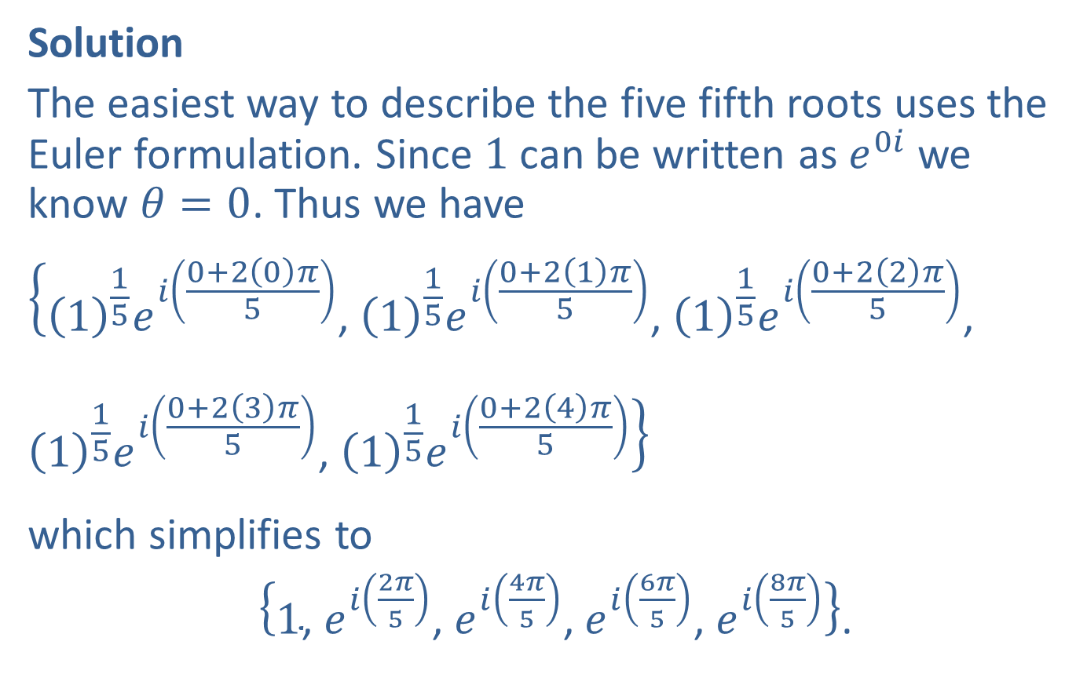
Example 9: Finding Roots of Complex Numbers (cont.)
Solution
The easiest way to describe the five fifth roots uses the Euler formulation. Since 1 can be written as $e^{0i}$ we know $θ=0$. Thus we have
$$\left\{{\left(1\right)}^{\frac{1}{5}}e^{i\left(\frac{0+2\left(0\right)π}{5}\right)}\text{, }{\left(1\right)}^{\frac{1}{5}}e^{i\left(\frac{0+2\left(1\right)π}{5}\right)}\text{, }{\left(1\right)}^{\frac{1}{5}}e^{i\left(\frac{0+2\left(2\right)π}{5}\right)}\text{, }{\left(1\right)}^{\frac{1}{5}}e^{i\left(\frac{0+2\left(3\right)π}{5}\right)}\text{, }{\left(1\right)}^{\frac{1}{5}}e^{i\left(\frac{0+2\left(4\right)π}{5}\right)}\right\}$$
which simplifies to
$\left\{1\text{, }e^{i\left(\frac{2π}{5}\right)}\text{, }e^{i\left(\frac{4π}{5}\right)}\text{, }e^{i\left(\frac{6π}{5}\right)}\text{, }e^{i\left(\frac{8π}{5}\right)}\right\}$.

Slide 33
Example 9: Finding Roots of Complex Numbers (cont.)
The graph of the five roots appears in Figure 7. Note that they are evenly spaced around a circle of radius 1.

Slide 34
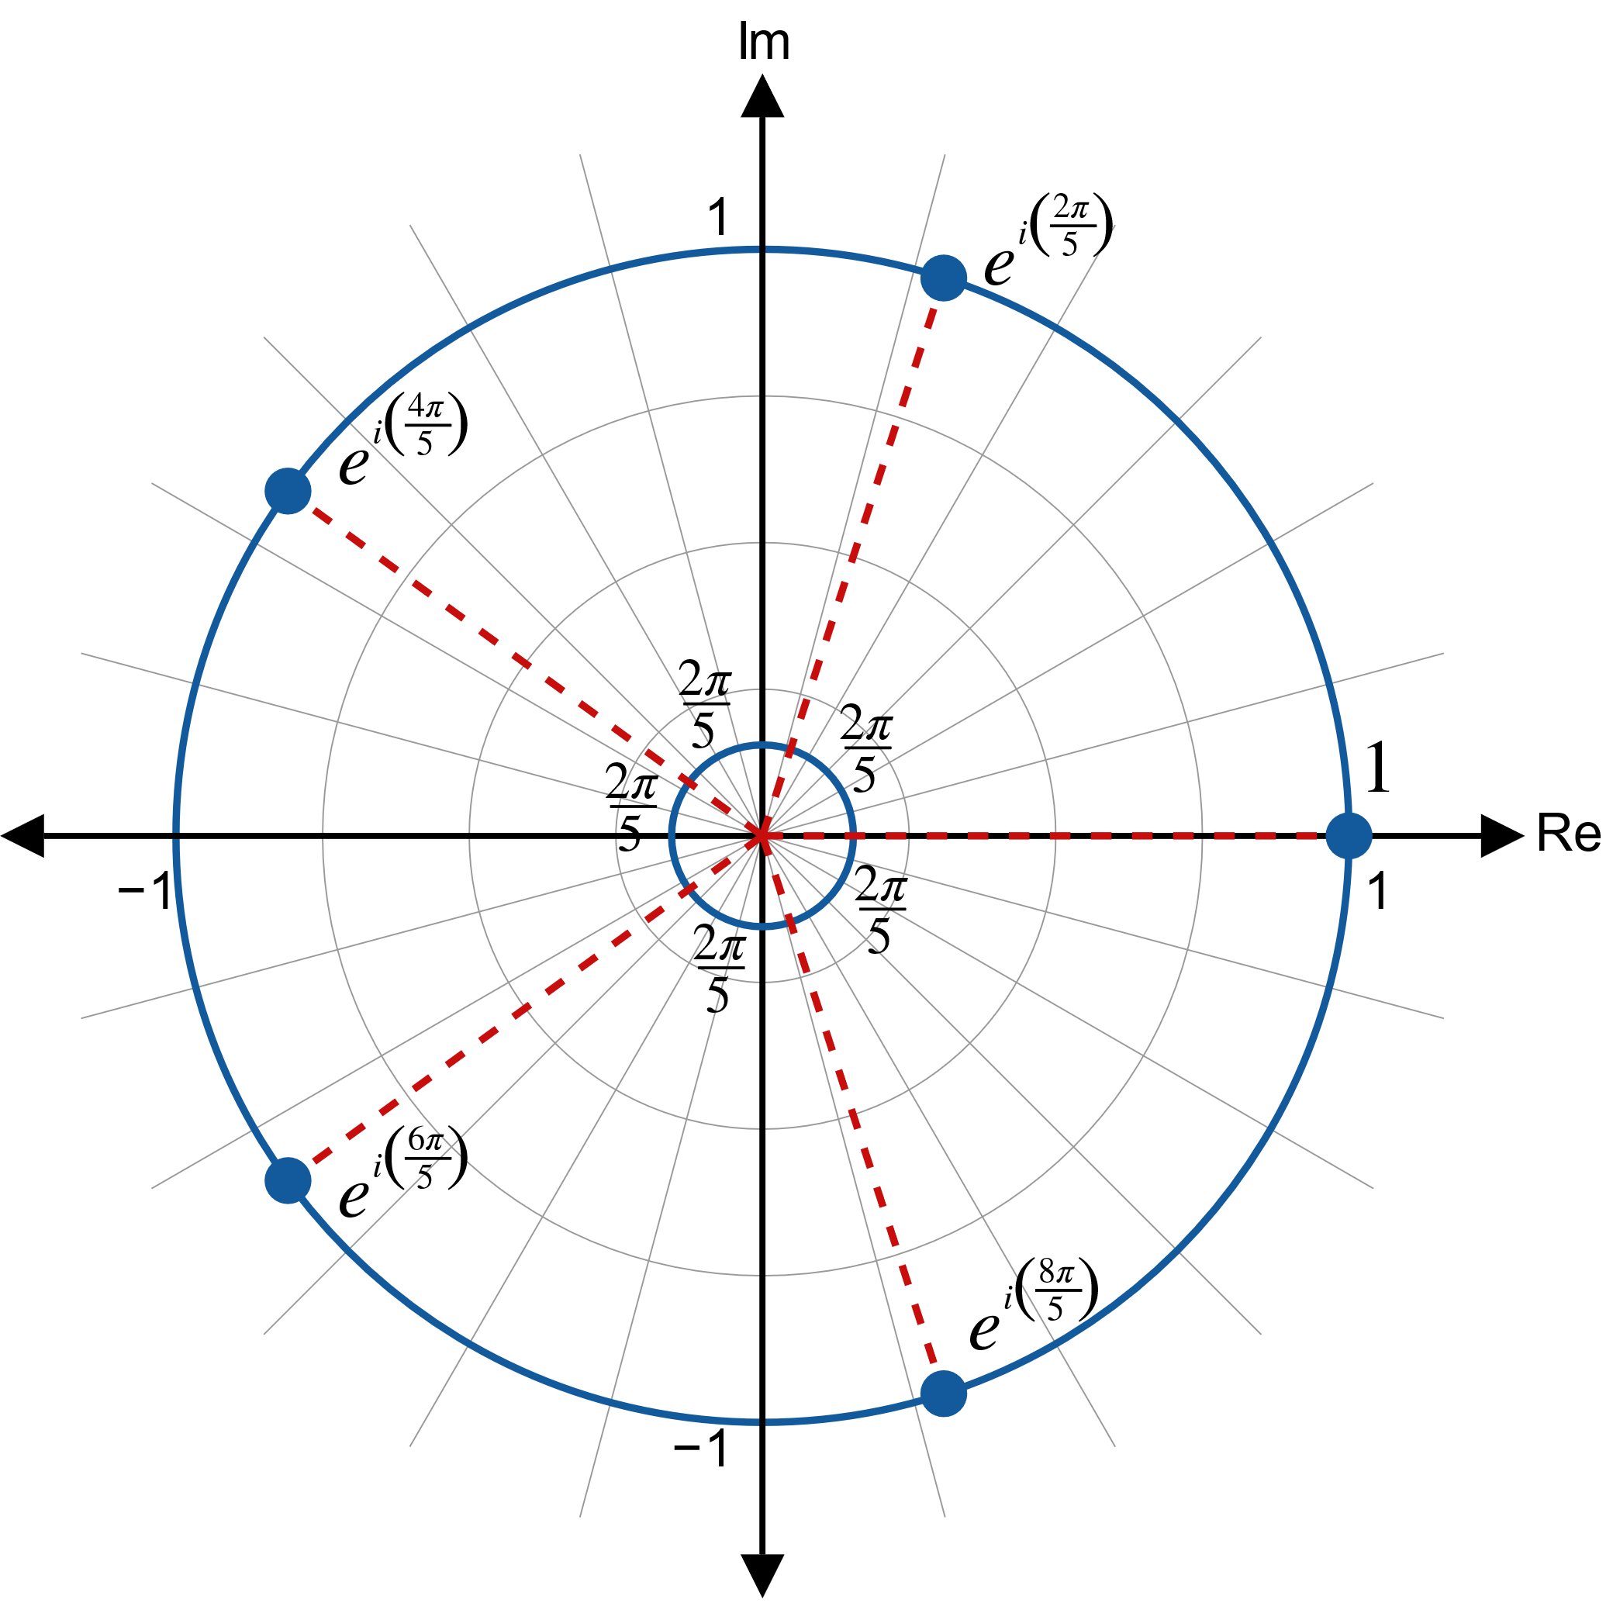

Example 9: Finding Roots of Complex Numbers (cont.)

Slide 35

Example 10: Finding Roots of Complex Numbers
Find all the fourth roots of $−1−i\sqrt{3}$.

Slide 36
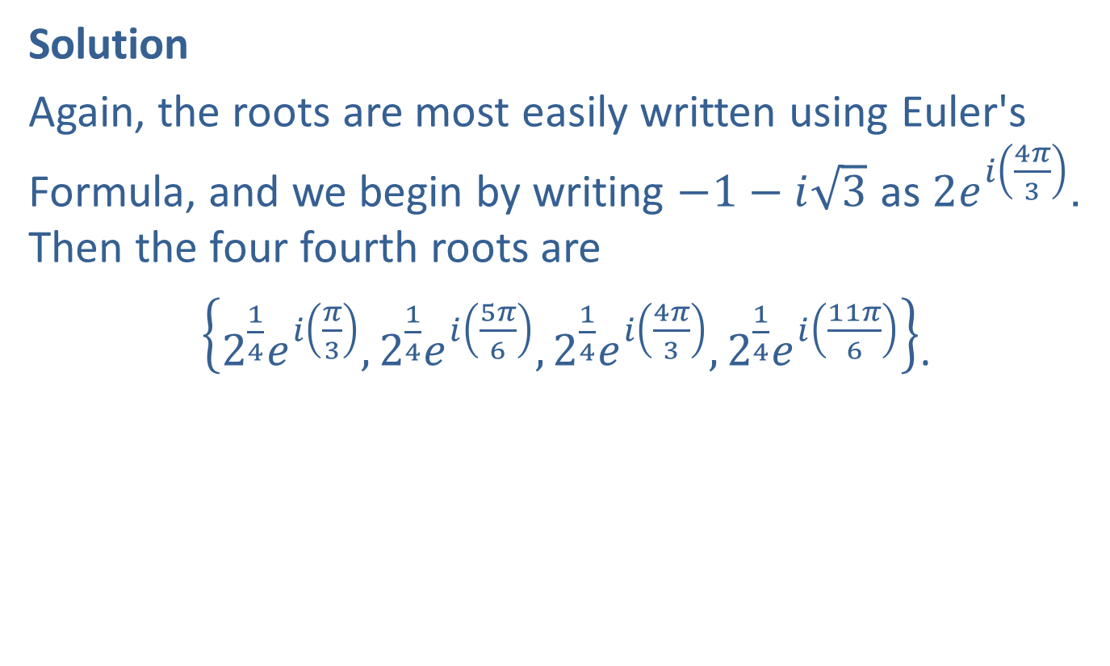
Example 10: Finding Roots of Complex Numbers (cont.)
Solution
Again, the roots are most easily written using Euler's Formula, and we begin by writing $−1−i\sqrt{3}$ as $2e^{i\left(\frac{4π}{3}\right)}$. Then the four fourth roots are
$\left\{2^{\frac{1}{4}}e^{i\left(\frac{π}{3}\right)},2^{\frac{1}{4}}e^{i\left(\frac{5π}{6}\right)},2^{\frac{1}{4}}e^{i\left(\frac{4π}{3}\right)},2^{\frac{1}{4}}e^{i\left(\frac{11π}{6}\right)}\right\}$.

