Slide 1
Section 10.6
Vectors in the Cartesian Plane

Slide 2

Example 1: Graphing the Sum of Two Vectors
Given the two vectors $u$ and $v$ depicted in Figure 3, construct a graphical representation of $u+v$.

Slide 3
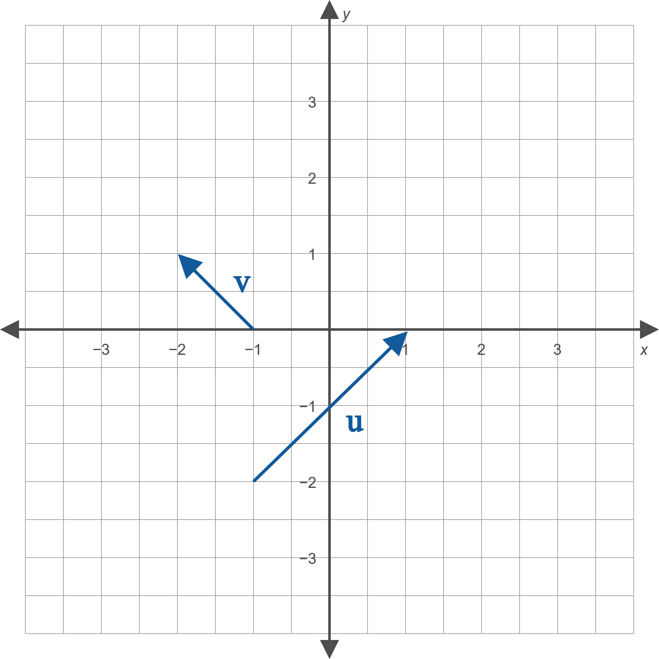
Example 1: Graphing the Sum of Two Vectors (cont.)
Figure 3

Slide 4
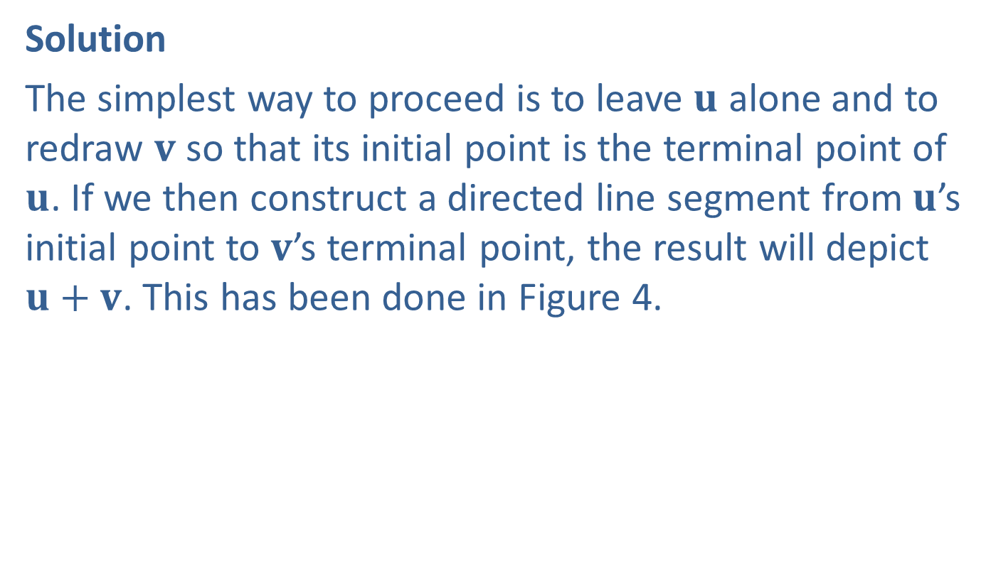
Example 1: Graphing the Sum of Two Vectors (cont.)
Solution
The simplest way to proceed is to leave $u$ alone and to redraw $v$ so that its initial point is the terminal point of $u$. If we then construct a directed line segment from $u$’s initial point to $v$’s terminal point, the result will depict $u+v$. This has been done in Figure 4.

Slide 5
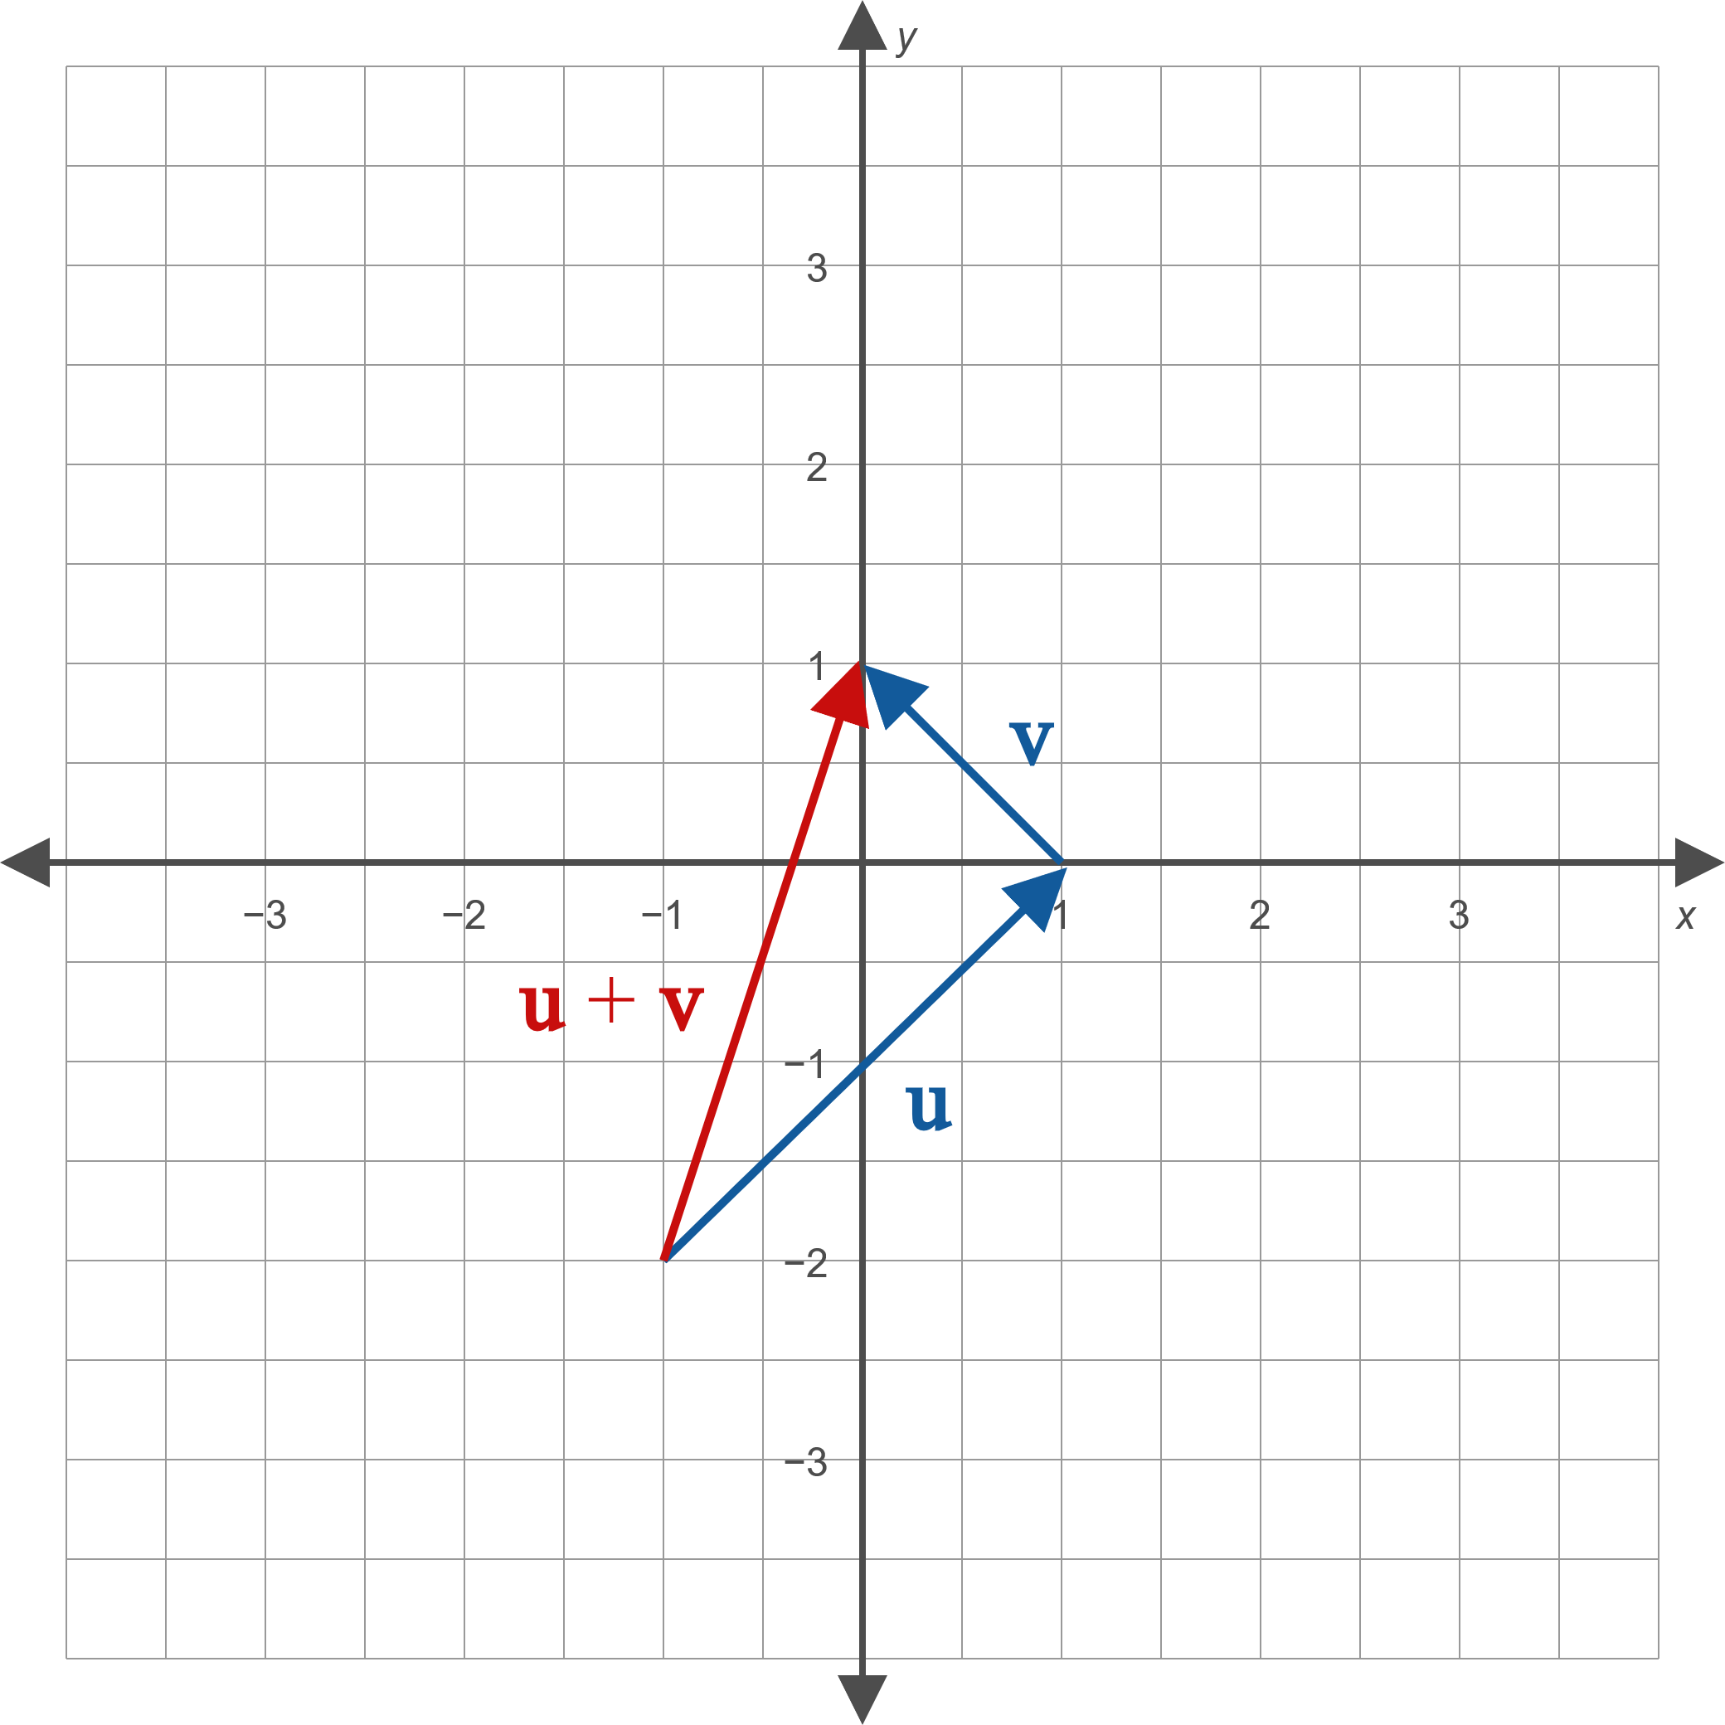
Example 1: Graphing the Sum of Two Vectors (cont.)
Figure 4

Slide 6
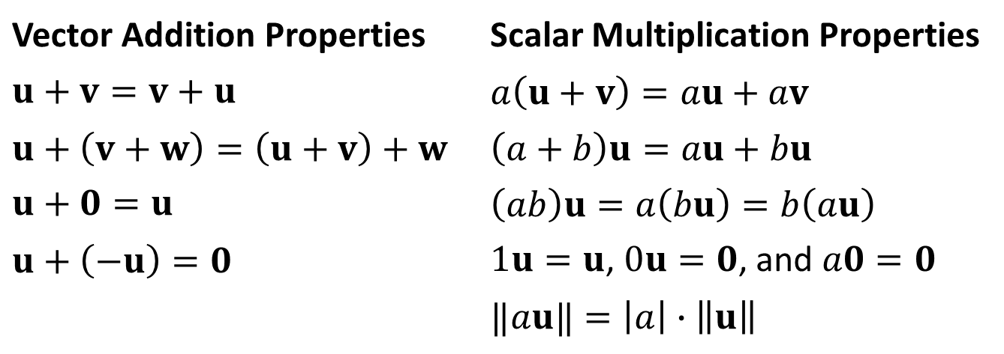

Properties of Vector Addition and Scalar Multiplication
Properties
Assume $u$, $v$, and $w$ represent vectors, while $a$ and $b$ represent scalars.
Vector Addition Properties | Scalar Multiplication Properties
$$u+v=v+u$$ | $$a\left(u+v\right)=au+av$$
$$u+\left(v+w\right)=\left(u+v\right)+w$$ | $$\left(a+b\right)u=au+bu$$
$$u+0=u$$ | $$\left(ab\right)u=a\left(bu\right)=b\left(au\right)$$
$$u+\left(−u\right)=0$$ | $1u=u$, $0u=0$, and $a0=0$
 | $$‖au‖=\left|a\right|∙\left\|u\right\|$$

Slide 7

Example 2: Graphing Vectors
Given the two vectors $u$ and $v$ depicted in Figure 5, construct graphical representations of $−2u$, $3u+v$, and $u−v$.

Slide 8
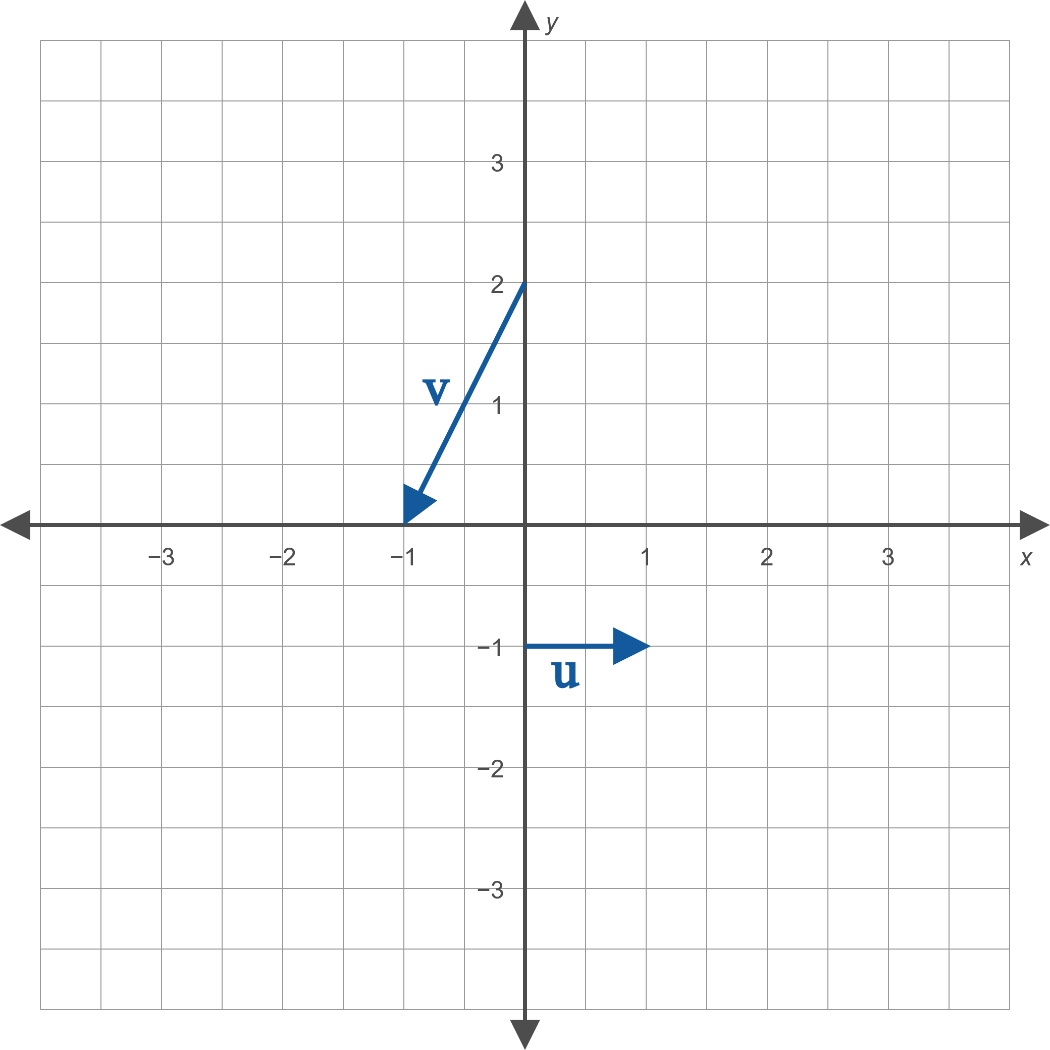
Example 2: Graphing Vectors (cont.)
Figure 5

Slide 9
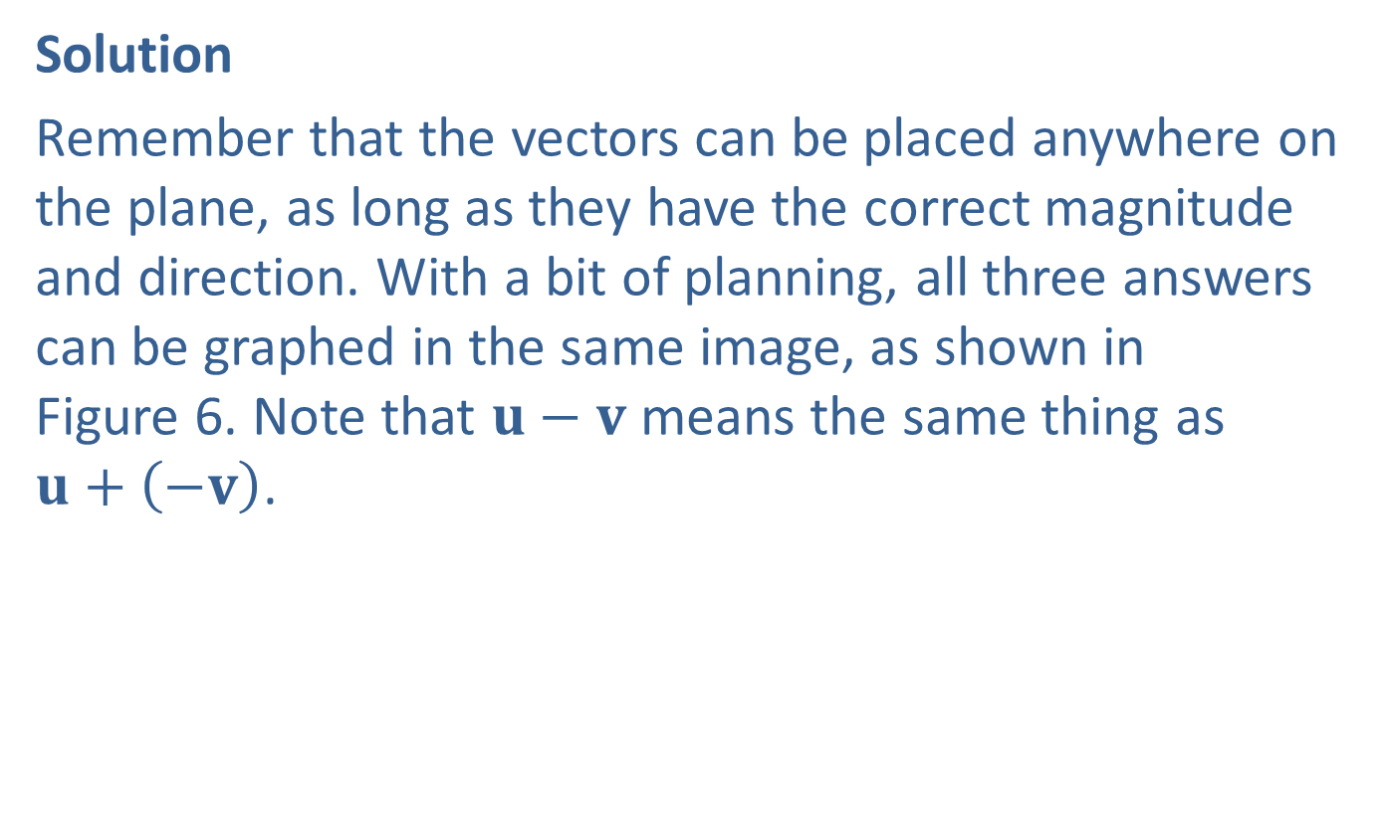
Example 2: Graphing Vectors (cont.)
Solution
Remember that the vectors can be placed anywhere on the plane, as long as they have the correct magnitude and direction. With a bit of planning, all three answers can be graphed in the same image, as shown in Figure 6. Note that $u−v$ means the same thing as
$u+\left(−v\right)$.

Slide 10
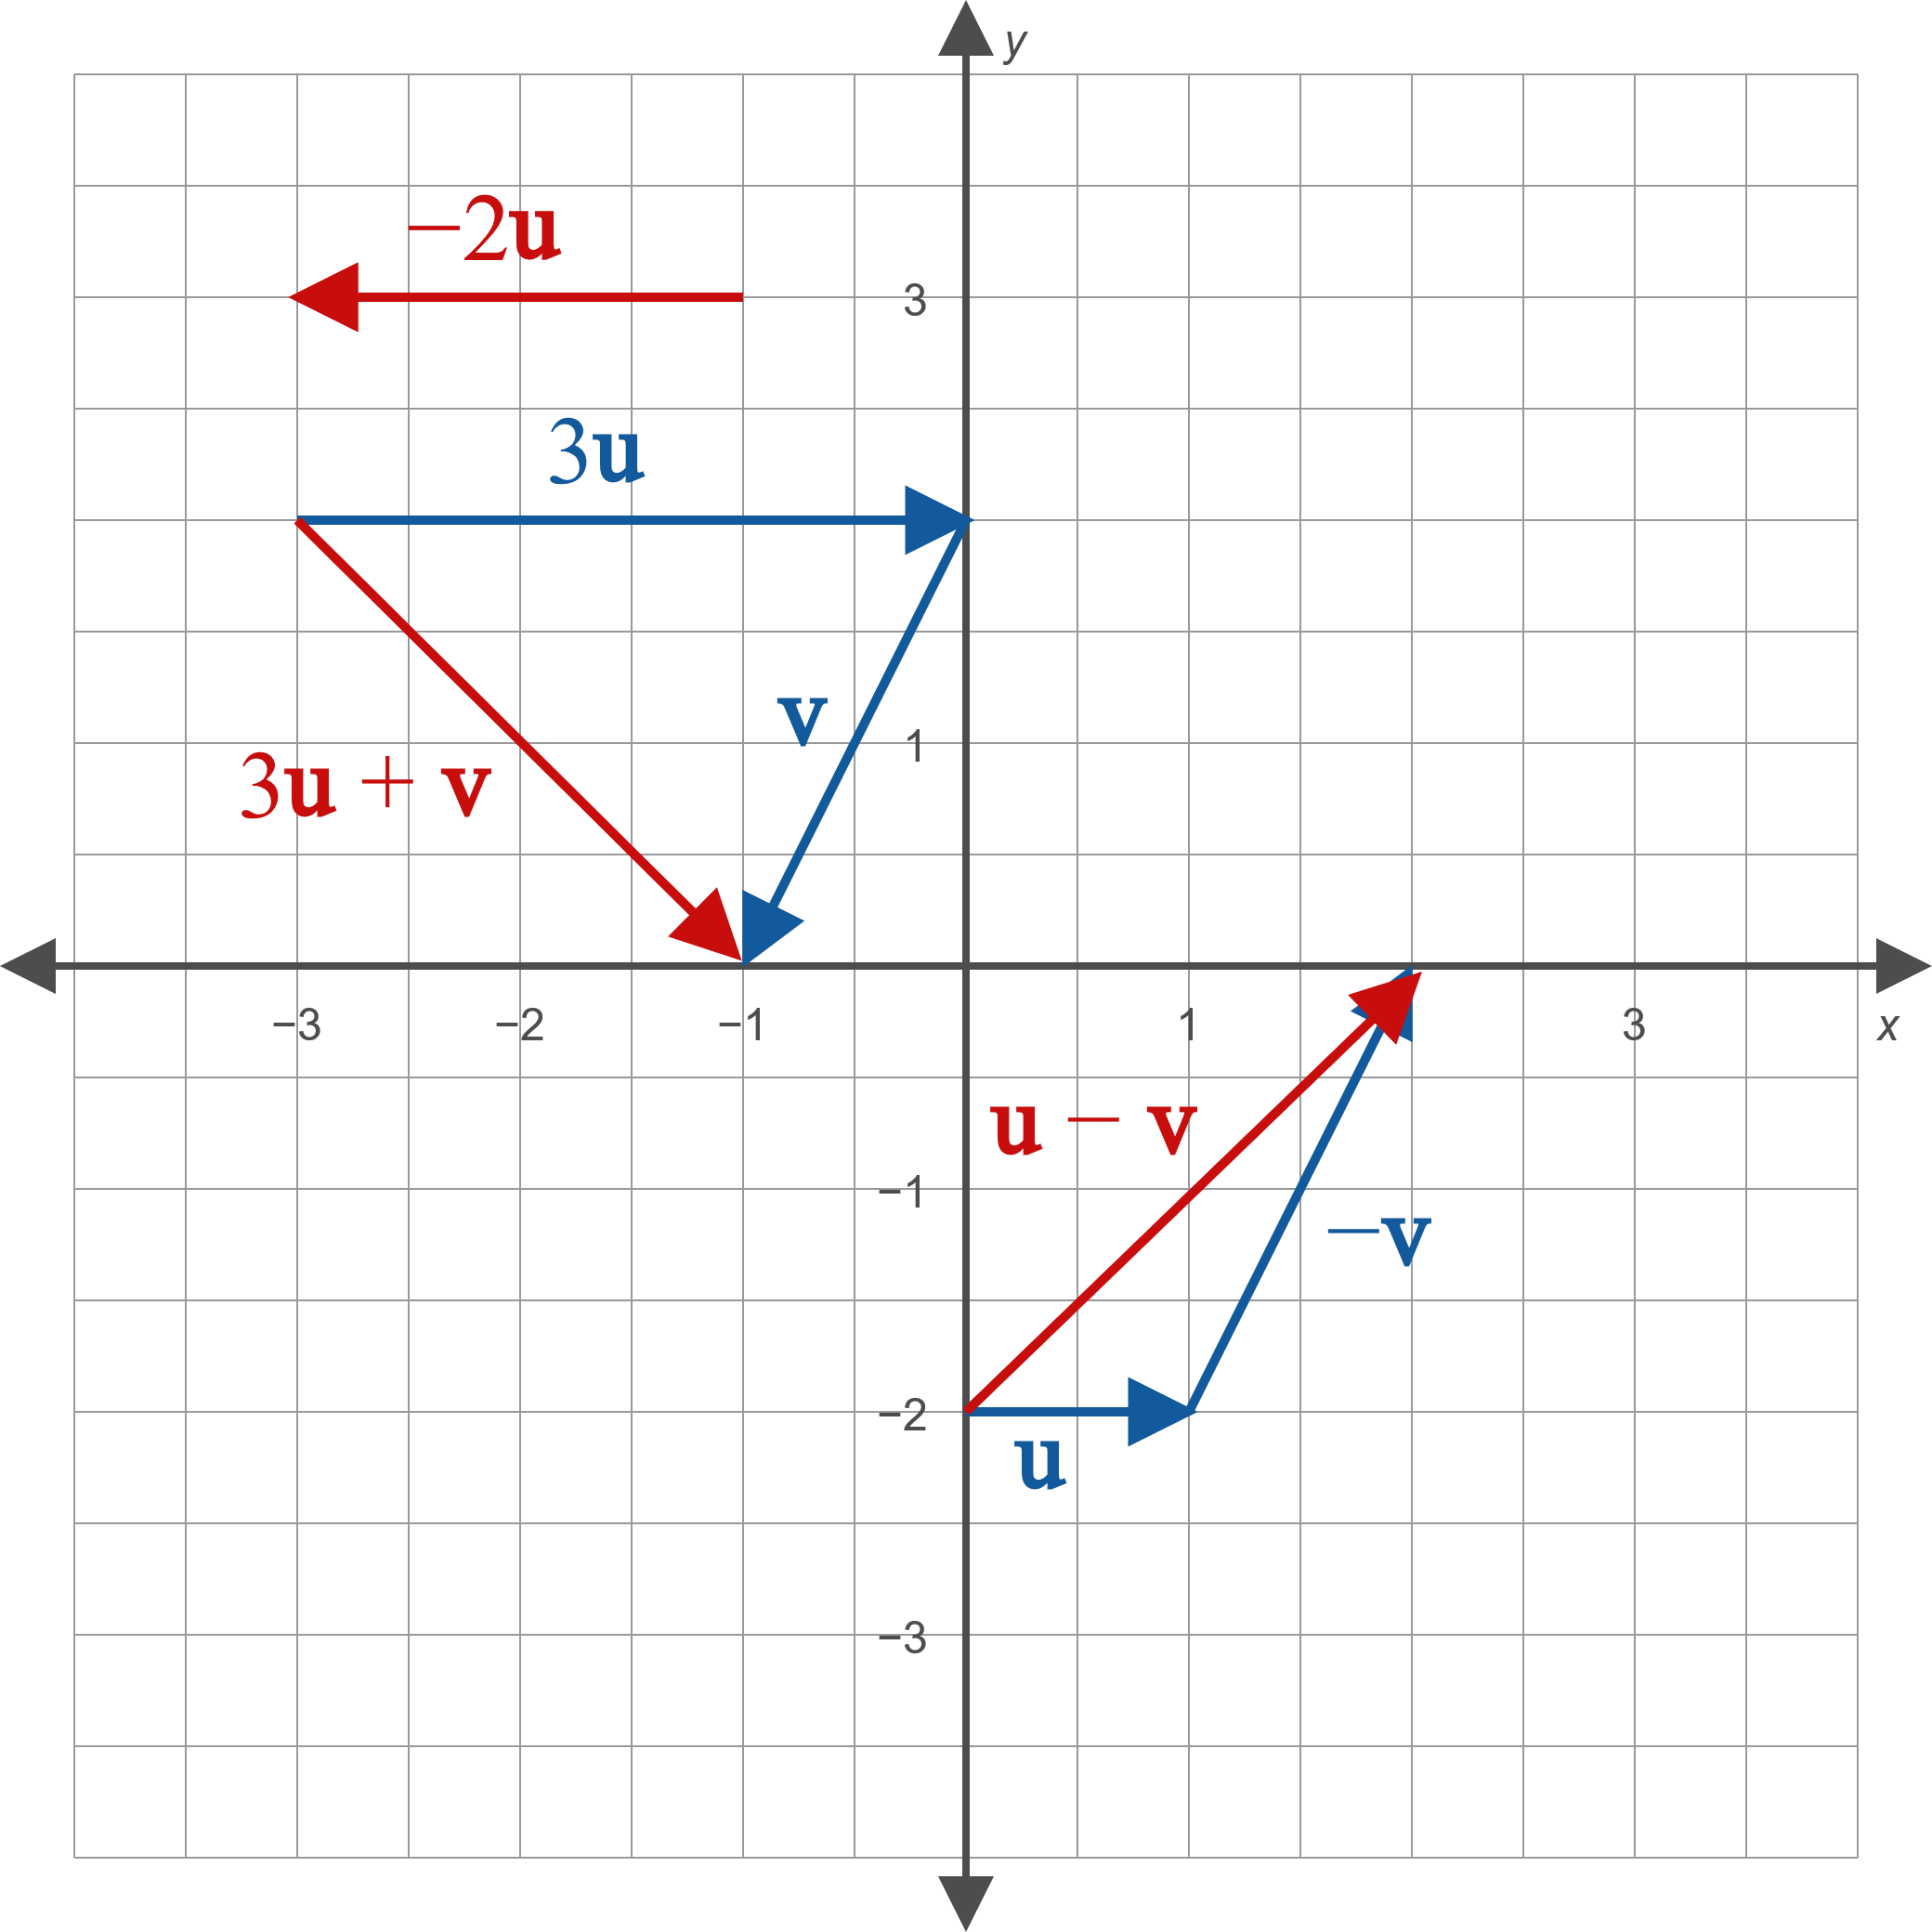
Example 2: Graphing Vectors (cont.)
Figure 6

Slide 11
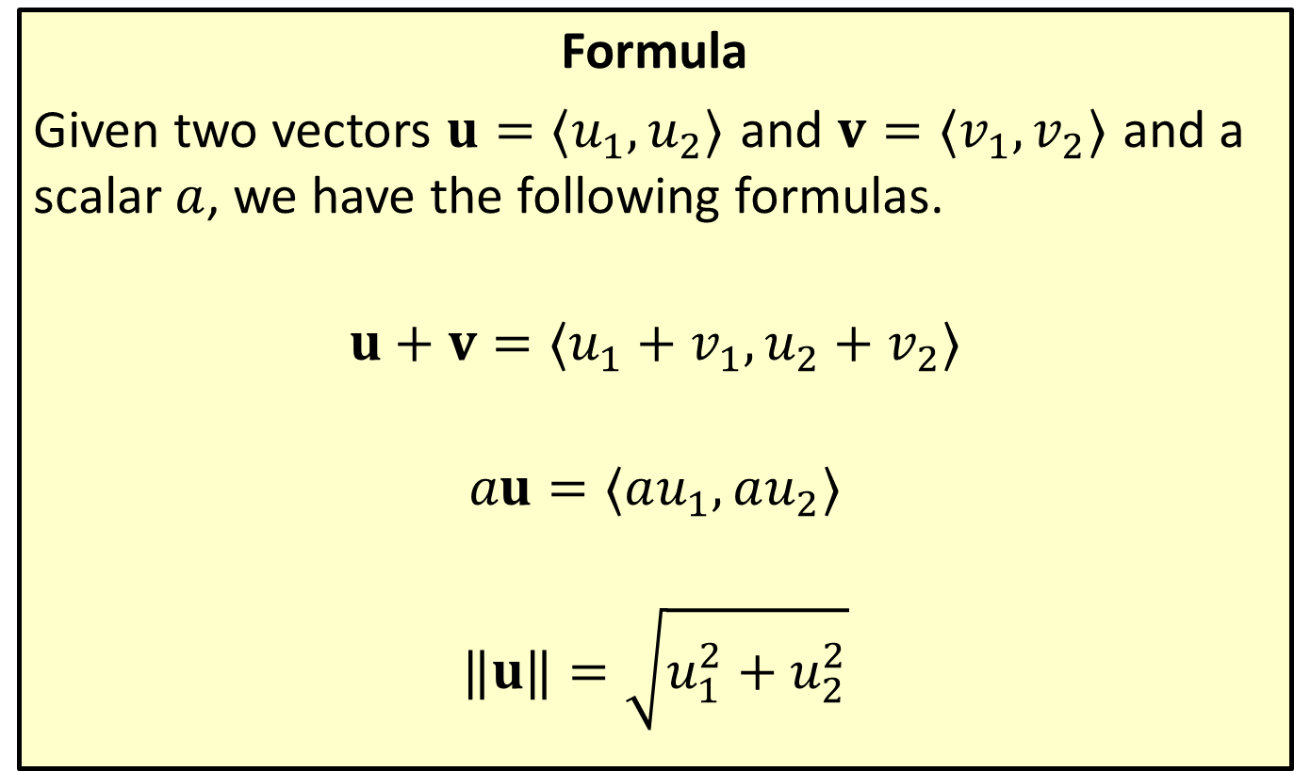
Vector Operations and Magnitude Using Components
Formula
Given two vectors $u=⟨u_{1},u_{2}⟩$ and $v=⟨v_{1},v_{2}⟩$ and a scalar $a$, we have the following formulas.
$$u+v=⟨u_{1}+v_{1},u_{2}+v_{2}⟩$$
$$au=⟨au_{1},au_{2}⟩$$
$$‖u‖=\sqrt{u_{1}^{2}+u_{2}^{2}}$$

Slide 12

Example 3: Using Vector Operations
Given the two vectors $u$ and $v$ depicted in Figure 8, determine the component forms of $−2u$, $3u+v$, and $u−v$, and then find the magnitudes of $u$ and $v$.

Slide 13
Example 3: Using Vector Operations (cont.)
Figure 8

Slide 14
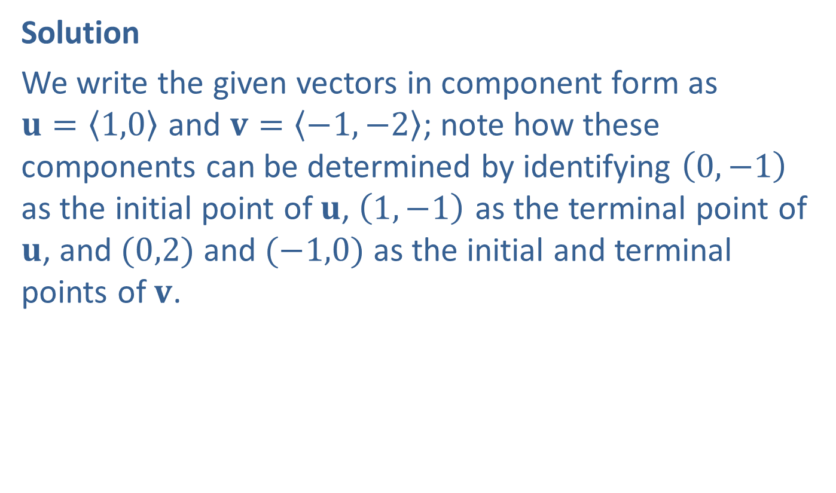
Example 3: Using Vector Operations (cont.)
Solution
We write the given vectors in component form as
$u=\left\langle 1,0\right\rangle$ and $v=\left\langle −1,−2\right\rangle$; note how these components can be determined by identifying $\left(0,−1\right)$ as the initial point of $u$, $\left(1,−1\right)$ as the terminal point of $u$, and $(0,2)$ and $(−1,0)$ as the initial and terminal points of $v$.
​

Slide 15
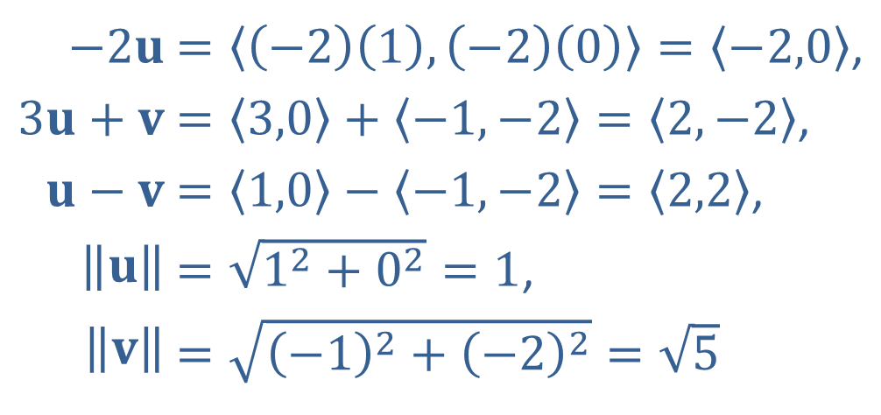
Example 3: Using Vector Operations (cont.)
The remainder of the work is straightforward.
​
​$−2u$ | ​$=\left\langle \left(−2\right)\left(1\right),\left(−2\right)\left(0\right)\right\rangle =\left\langle −2,0\right\rangle$,
​$3u+v$ | ​$=\left\langle 3,0\right\rangle +\left\langle −1,−2\right\rangle =\left\langle 2,−2\right\rangle$,
​$u−v$ | ​$=\left\langle 1,0\right\rangle −\left\langle −1,−2\right\rangle =\left\langle 2,2\right\rangle$,
​$\left\|u\right\|$ | ​$=\sqrt{1^{2}+0^{2}}=1$,
​$\left\|v\right\|$ | ​$=\sqrt{{\left(−1\right)}^{2}+{\left(−2\right)}^{2}}=\sqrt{5}$

Slide 16

Example 4: Finding the Unit Vector and Linear Combination of a Vector
Let $u=\left\langle −5,3\right\rangle$. Find
​a unit vector pointing in the same direction as $u$, and
​the linear combination of $i$ and $j$ that is equivalent to $u$.

Slide 17
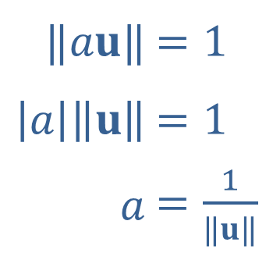

Example 4: Finding the Unit Vector and Linear Combination of a Vector (cont.)
Solution
​The key in constructing a unit vector with the same direction as $u$ is to multiply $u$ by an appropriate scalar $a$ such that $‖au‖=1$. We can solve this for $a$ as follows.
​$‖au‖$ | ​$=1$
​$\left|a\right|\left\|u\right\|$ | ​$=1$
​$a$ | ​$=\frac{1}{‖u‖}$

Slide 18
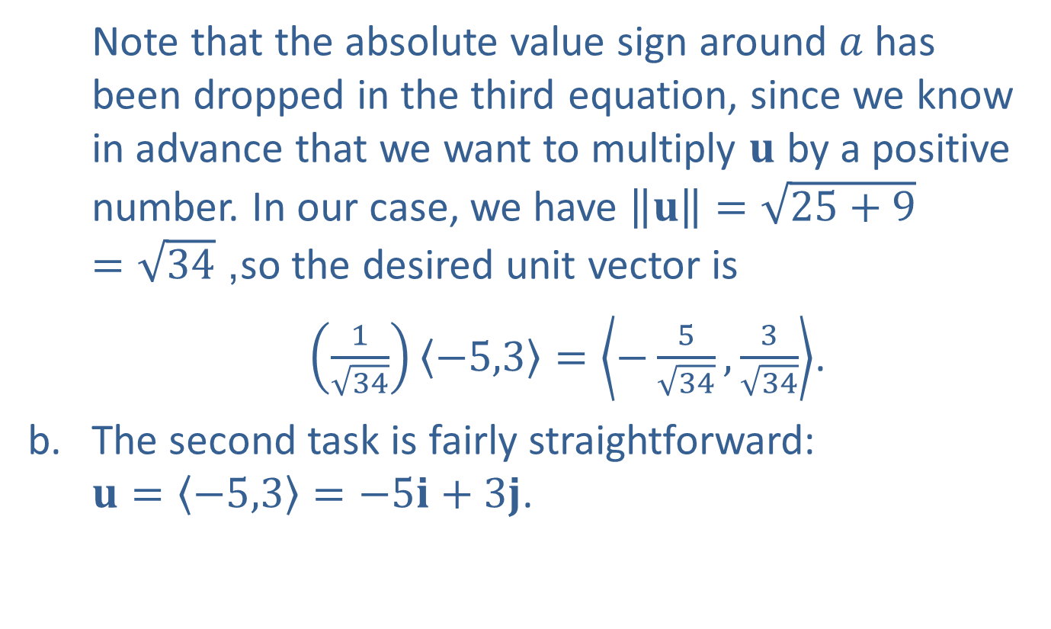
Example 4: Finding the Unit Vector and Linear Combination of a Vector (cont.)
​Note that the absolute value sign around $a$ has been dropped in the third equation, since we know in advance that we want to multiply $u$ by a positive number. In our case, we have $\left\|u\right\|=\sqrt{25+9}=\sqrt{34}$, so the desired unit vector is
​ $\left(\frac{1}{\sqrt{34}}\right)\left\langle −5,3\right\rangle =\left\langle −\frac{5}{\sqrt{34}},\frac{3}{\sqrt{34}}\right\rangle$.
​The second task is fairly straightforward:
$u=\left\langle −5,3\right\rangle =−5i+3j$.

Slide 19

Example 5: Finding the Vector Form of the Velocity
A baseball is hit and leaves the bat at a speed of $100 mph$ and at an angle of ${20}^{°}$ from the horizontal. Express this velocity in vector form.

Slide 20

Example 5: Finding the Vector Form of the Velocity (cont.)
Solution
The speed is the vector’s magnitude, and $θ={20}^{°}$. So the ball’s velocity as it leaves the bat is the vector
$100\left\langle \cos{{20}^{°}},\sin{{20}^{°}}\right\rangle ≈\left\langle 93.97,34.20\right\rangle$.

Slide 21

Example 6: Applying Vector Operations
An airplane is flying at a speed of 200 miles per hour at a bearing of $\text{N} {33}^{°} \text{E}$ when it encounters wind with a velocity of 35 miles per hour at a bearing of $\text{N} {47}^{°} \text{W}$. What is the resultant true velocity of the airplane?

Slide 22
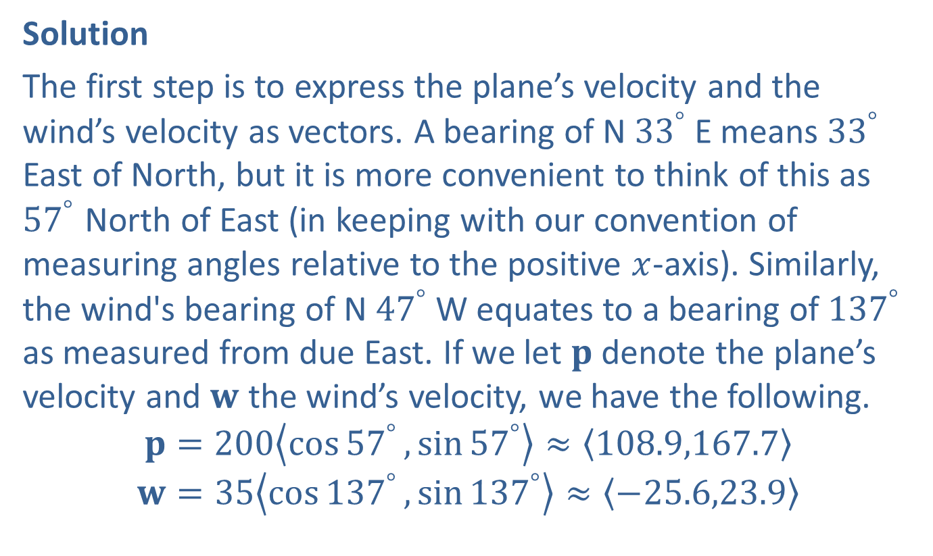
Example 6: Applying Vector Operations (cont.)
Solution
The first step is to express the plane’s velocity and the wind’s velocity as vectors. A bearing of $\text{N} {33}^{°} \text{E}$ means ${33}^{°}$ East of North, but it is more convenient to think of this as ${57}^{°}$ North of East (in keeping with our convention of measuring angles relative to the positive $x$-axis). Similarly, the wind's bearing of $\text{N} {47}^{°} \text{W}$ equates to a bearing of ${137}^{°}$ as measured from due East. If we let $p$ denote the plane’s velocity and $w$ the wind’s velocity, we have the following.
$$p=200\left\langle \cos{{57}^{°}},\sin{{57}^{°}}\right\rangle ≈\left\langle 108.9,167.7\right\rangle$$
$$w=35\left\langle \cos{{137}^{°}},\sin{{137}^{°}}\right\rangle ≈\left\langle −25.6,23.9\right\rangle$$

Slide 23
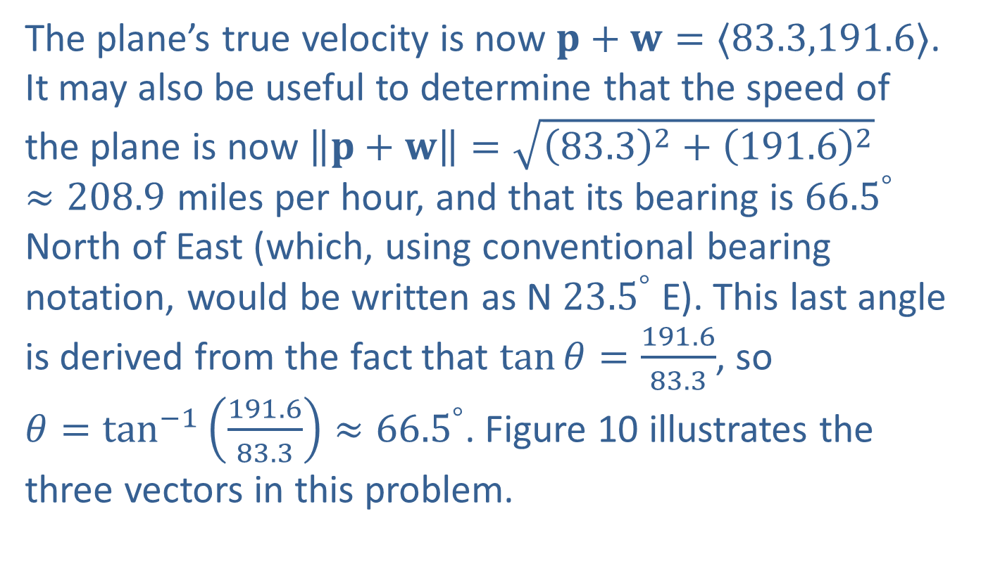
Example 6: Applying Vector Operations (cont.)
The plane’s true velocity is now $p+w=⟨83.3,191.6⟩$. It may also be useful to determine that the speed of the plane is now $\left\|p+w\right\|=\sqrt{{\left(83.3\right)}^{2}+{\left(191.6\right)}^{2}}≈208.9$ miles per hour, and that its bearing is ${66.5}^{°}$ North of East (which, using conventional bearing notation, would be written as $\text{N} {23.5}^{°} \text{E}$). This last angle is derived from the fact that $\tan{θ}=\frac{191.6}{83.3}$, so
$θ=\tan^{−1}\left(\frac{191.6}{83.3}\right)≈{66.5}^{°}$. Figure 10 illustrates the three vectors in this problem.

Slide 24
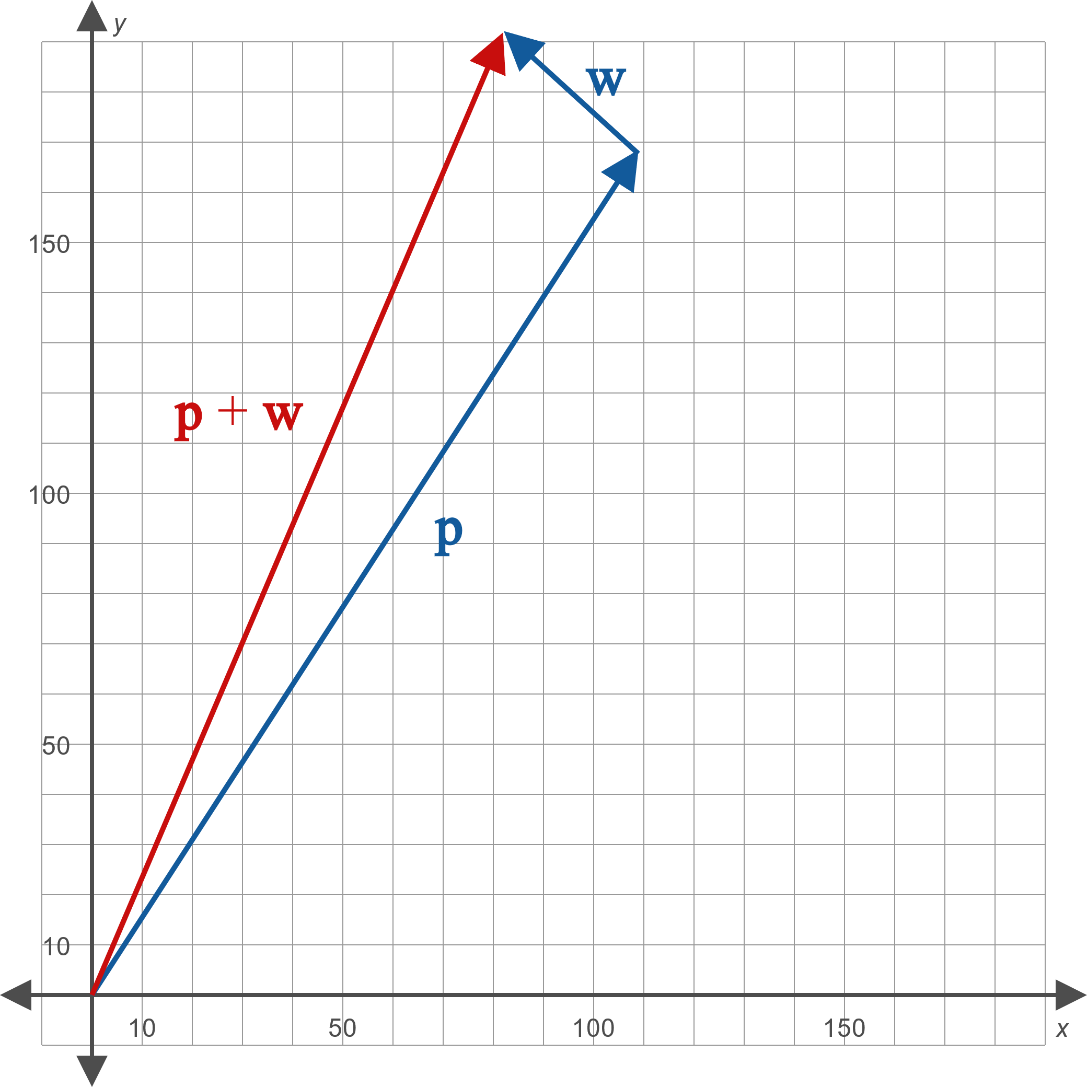
Example 6: Applying Vector Operations (cont.)
Figure 10

Slide 25
Example 7: Applying Vector Operations
A cat is slowly pushing a 5-pound plant across a table, with the intention of knocking it off the edge (determining why cats feel the need to do so is beyond the scope of this text). The cat is pushing with a force of 1 pound. What is the total force being applied to the plant?

Slide 26
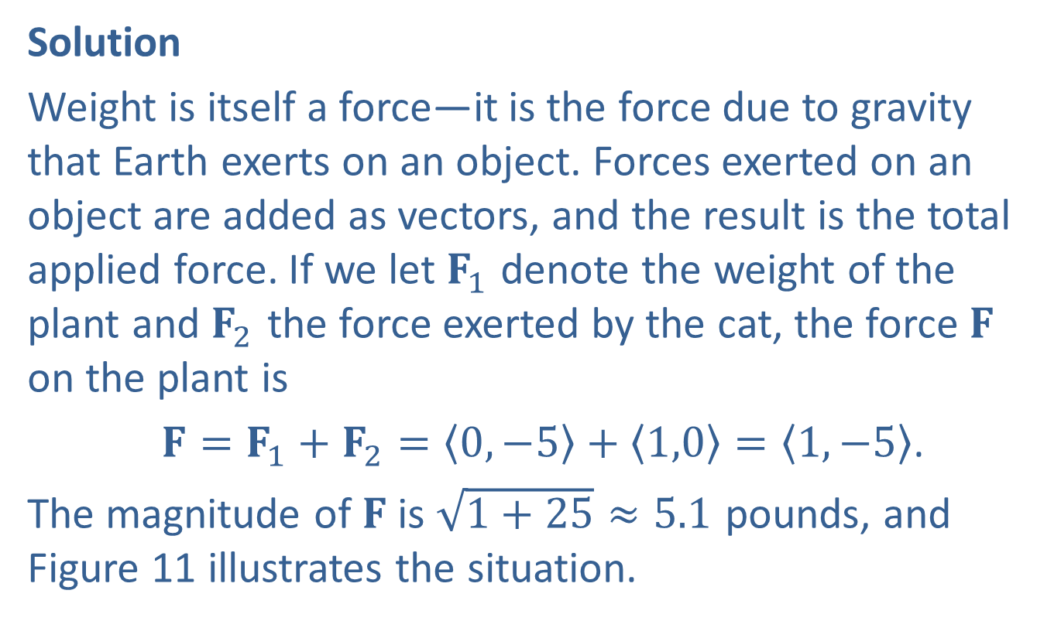
Example 7: Applying Vector Operations (cont.)
Solution
Weight is itself a force—it is the force due to gravity that Earth exerts on an object. Forces exerted on an object are added as vectors, and the result is the total applied force. If we let $F_{1}$ denote the weight of the plant and $F_{2}$ the force exerted by the cat, the force $F$ on the plant is
$F=F_{1}+F_{2}=\left\langle 0,−5\right\rangle +\left\langle 1,0\right\rangle =\left\langle 1,−5\right\rangle$.
The magnitude of $F$ is $\sqrt{1+25}≈5.1$ pounds, and Figure 11 illustrates the situation.

Slide 27
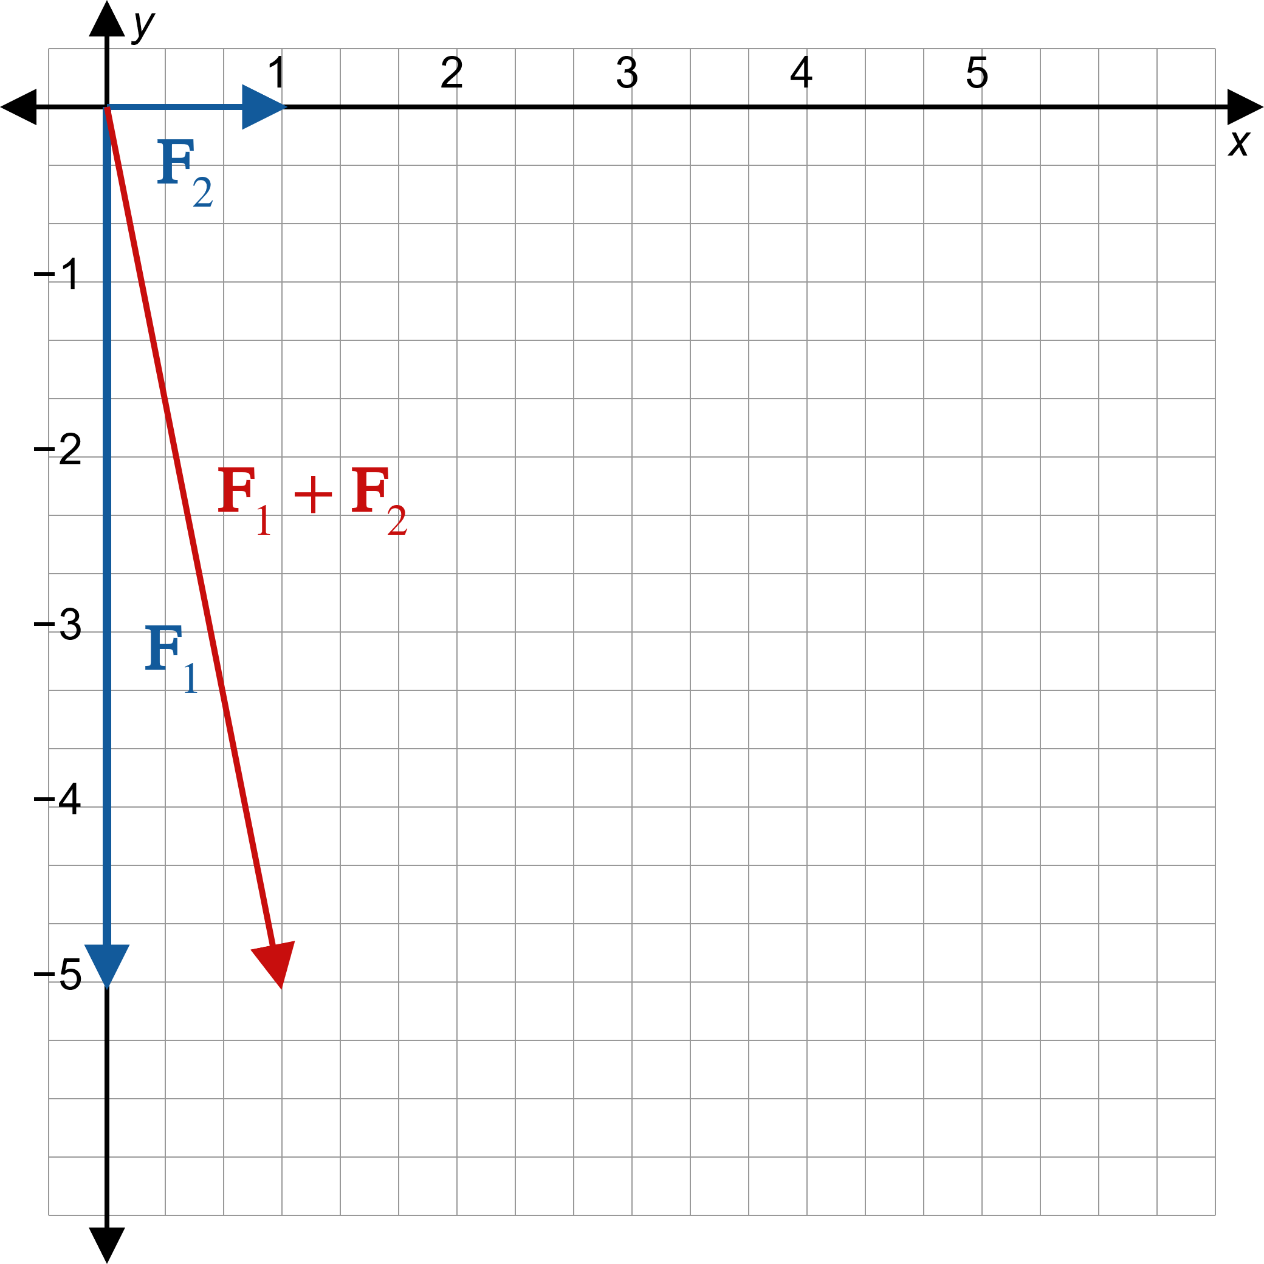
Example 7: Applying Vector Operations (cont.)
Figure 11

