Slide 1
Section 10.7
The Dot Product

Slide 2
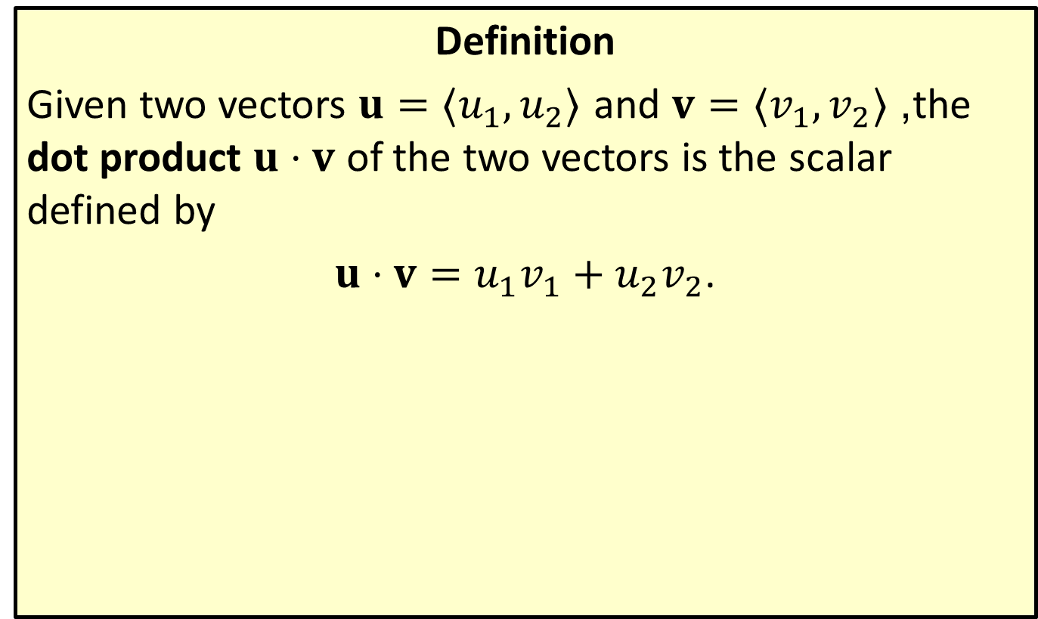
The Dot Product in the Plane
Definition
Given two vectors $u=⟨u_{1},u_{2}⟩$ and $v=⟨v_{1},v_{2}⟩$, the dot product $u⋅v$ of the two vectors is the scalar defined by
$u⋅v=u_{1}v_{1}+u_{2}v_{2}$.

Slide 3

Example 1: Calculating the Dot Product
Calculate each of the following dot products.
​$⟨−5,2⟩⋅\left\langle 3,−1\right\rangle$
​$⟨−5,2⟩⋅\left\langle 2,5\right\rangle$
​$⟨−5,2⟩⋅\left\langle −5,2\right\rangle$

Slide 4

Example 1: Calculating the Dot Product (cont.)
Solution
​$\left\langle −5,2\right\rangle ⋅\left\langle 3,−1\right\rangle =\left(−5\right)\left(3\right)+\left(2\right)\left(−1\right)=−15−2=−17$
​$\left\langle −5,2\right\rangle ⋅\left\langle 2,5\right\rangle =\left(−5\right)\left(2\right)+\left(2\right)\left(5\right)=−10+10=0$
​$⟨−5,2⟩⋅⟨−5,2⟩=\left(−5\right)\left(−5\right)+\left(2\right)\left(2\right)=25+4=29$

Slide 5
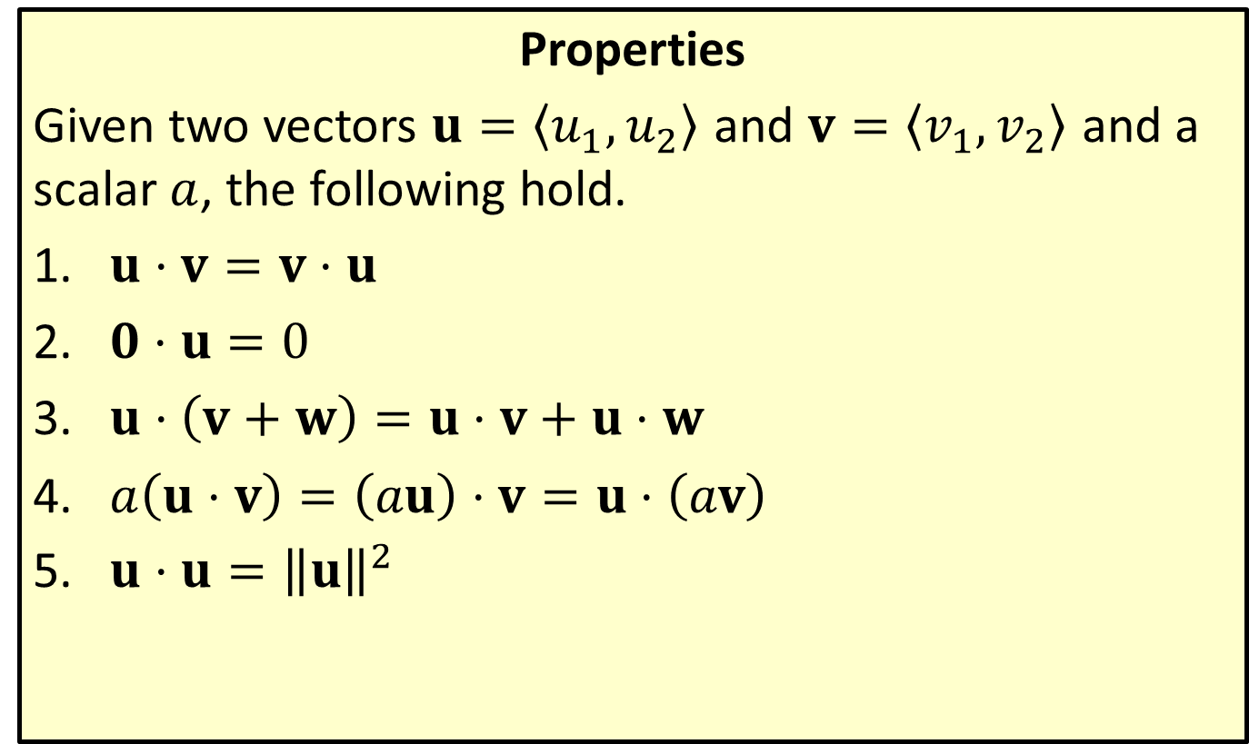
Elementary Properties of the Dot Product
Properties
Given two vectors $u=\left\langle u_{1},u_{2}\right\rangle$ and $v=\left\langle v_{1},v_{2}\right\rangle$ and a scalar $a$, the following hold.
​$u⋅v=v⋅u$
​$0⋅u=0$
​$u⋅\left(v+w\right)=u⋅v+u⋅w$
​$a\left(u⋅v\right)=\left(au\right)⋅v=u⋅\left(av\right)$
​$u⋅u={\left\|u\right\|}^{2}$

Slide 6

Example 2: Using the Properties of the Dot Product
Given that the dot product of a vector $u$ with itself is 8, determine the magnitude of $u$.

Slide 7

Example 2: Using the Properties of the Dot Product (cont.)
Solution
Since ${\left\|u\right\|}^{2}=u⋅u=8$, it follows that $\left\|u\right\|=2\sqrt{2}$.

Slide 8
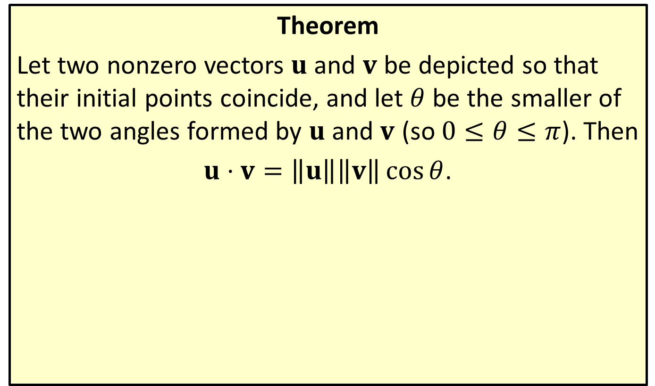
The Dot Product Theorem
Theorem
Let two nonzero vectors $u$ and $v$ be depicted so that their initial points coincide, and let $θ$ be the smaller of the two angles formed by $u$ and $v$ (so $0≤θ≤π$). Then
$u⋅v=\left\|u\right\|\left\|v\right\|\cos{θ}$.

Slide 9

Example 3: Applying the Dot Product Theorem
Find the angle between the vector $u=\left\langle −3,1\right\rangle$ and the vector $v=\left\langle 2,5\right\rangle$.

Slide 10
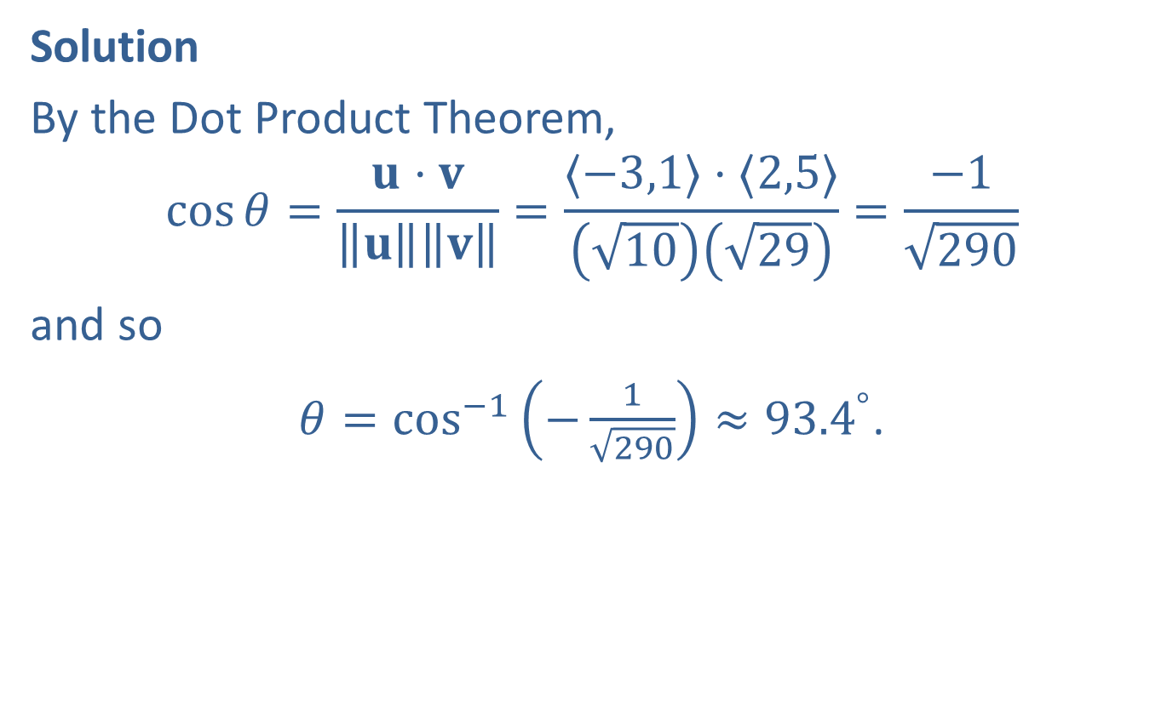
Example 3: Applying the Dot Product Theorem (cont.)
Solution
By the Dot Product Theorem,
$$\cos{θ}=\frac{u⋅v}{\left\|u\right\|\left\|v\right\|}=\frac{⟨−3,1⟩⋅⟨2,5⟩}{\left(\sqrt{10}\right)\left(\sqrt{29}\right)}=\frac{−1}{\sqrt{290}}$$
and so
$θ={cos⁡}^{−1}\left(−\frac{1}{\sqrt{290}}\right)≈{93.4}^{°}$.

Slide 11
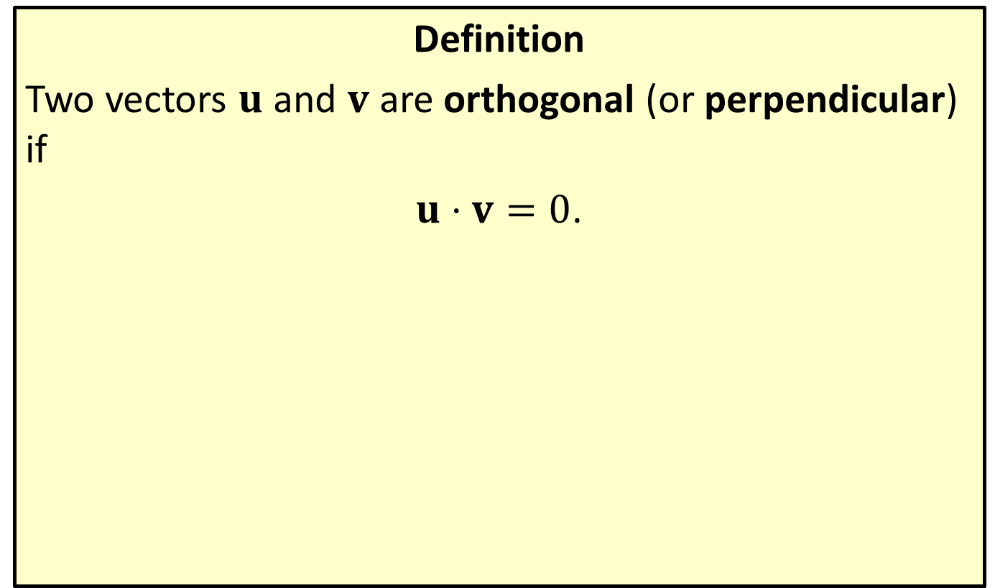
Orthogonal Vectors
Definition
Two vectors $u$ and $v$ are orthogonal (or perpendicular) if
$u⋅v=0$.

Slide 12
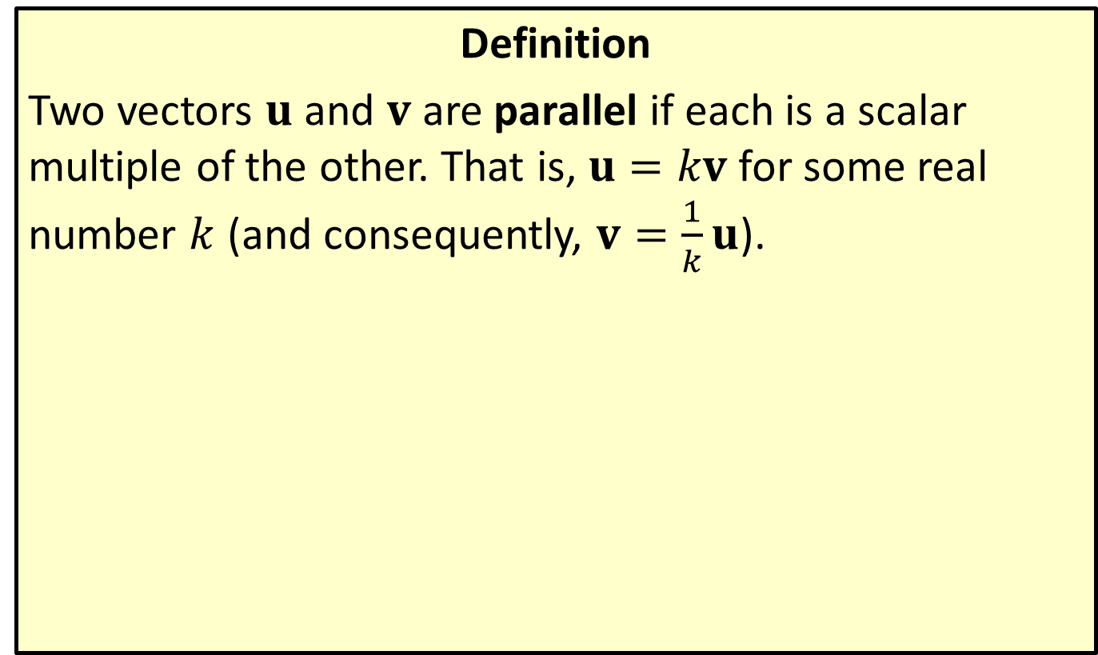
Parallel Vectors
Definition
Two vectors $u$ and $v$ are parallel if each is a scalar multiple of the other. That is, $u=kv$ for some real number $k$ (and consequently, $v=\frac{1}{k}u$).

Slide 13

Example 4: Finding an Orthogonal Vector
Find a vector orthogonal to the vector $u=\left\langle 7,−2\right\rangle$.

Slide 14
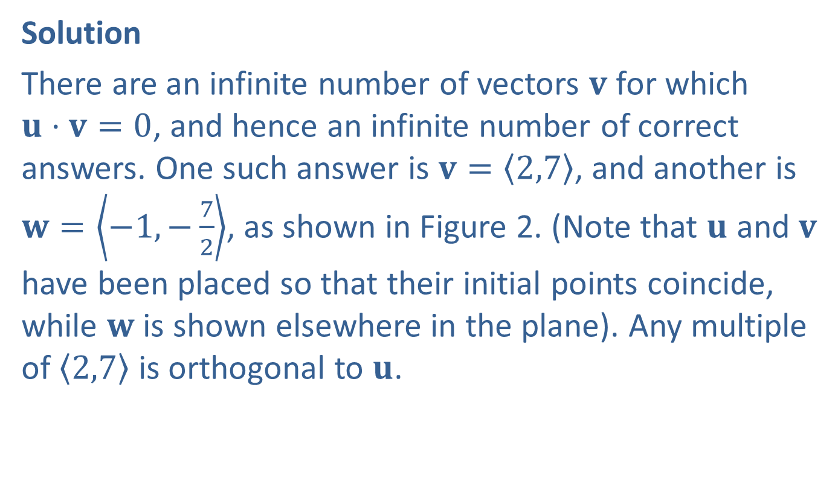
Example 4: Finding an Orthogonal Vector (cont.)
Solution
There are an infinite number of vectors $v$ for which
$u⋅v=0$, and hence an infinite number of correct answers. One such answer is $v=\left\langle 2,7\right\rangle$, and another is $w=\left\langle −1,−\frac{7}{2}\right\rangle$, as shown in Figure 2. (Note that $u$ and $v$ have been placed so that their initial points coincide, while $w$ is shown elsewhere in the plane). Any multiple of $\left\langle 2,7\right\rangle$ is orthogonal to $u$.

Slide 15
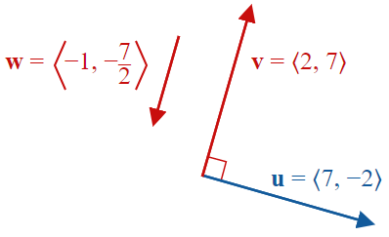
Example 4: Finding an Orthogonal Vector (cont.)
Figure 2

Slide 16
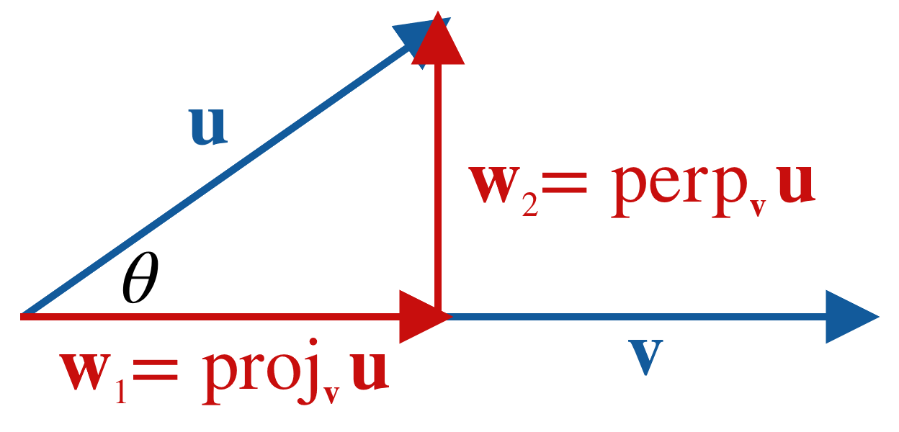
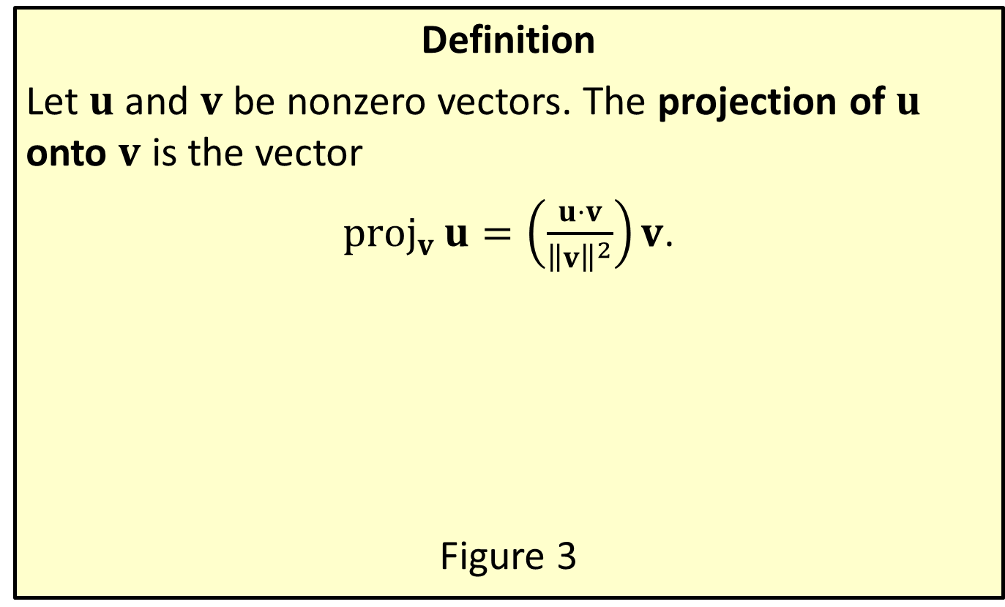
Projection of u onto v
Definition
Let $u$ and $v$ be nonzero vectors. The projection of $u$ onto $v$ is the vector
${proj}_{v}{u}=\left(\frac{u⋅v}{{\left\|v\right\|}^{2}}\right)v$.
Figure 3

Slide 17

Example 5: Finding the Projection of u onto v
Find the projection of $u=\left\langle 2,4\right\rangle$ onto $v=\left\langle 7,−1\right\rangle$, and then write $u$ as a sum of two orthogonal vectors, one of which is ${proj}_{v}⁡u$.

Slide 18
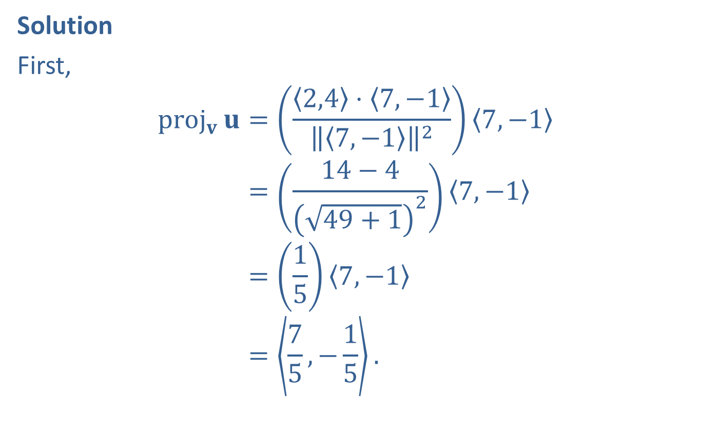
Example 5: Finding the Projection of u onto v (cont.)
Solution
First,
proj𝐯𝐮=2,4⋅7,−17,−127,−1proj𝐯⁡𝐮=14−449+127,−1proj𝐯⁡𝐮=157,−1proj𝐯⁡𝐮=75,−15.

Slide 19
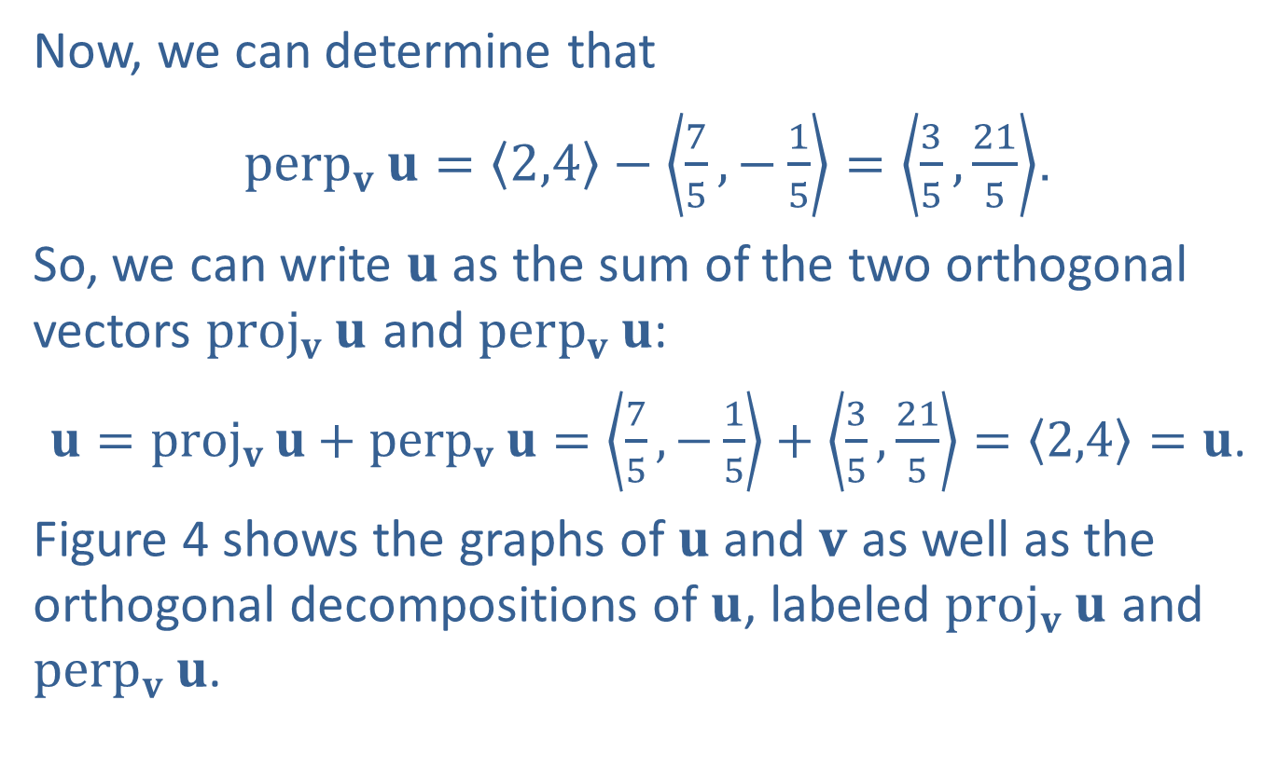
Example 5: Finding the Projection of u onto v (cont.)
Now, we can determine that
${perp}_{v}{u}=\left\langle 2,4\right\rangle −\left\langle \frac{7}{5},−\frac{1}{5}\right\rangle =\left\langle \frac{3}{5},\frac{21}{5}\right\rangle$.
So, we can write $u$ as the sum of the two orthogonal vectors ${proj}_{v}⁡u$ and ${perp}_{v}⁡u$:
$u={proj}_{v}{u}+{perp}_{v}{u}=\left\langle \frac{7}{5},−\frac{1}{5}\right\rangle +\left\langle \frac{3}{5},\frac{21}{5}\right\rangle =\left\langle 2,4\right\rangle =u$.
Figure 4 shows the graphs of $u$ and $v$ as well as the orthogonal decompositions of $u$, labeled ${proj}_{v}⁡u$ and ${perp}_{v}⁡u$.

Slide 20
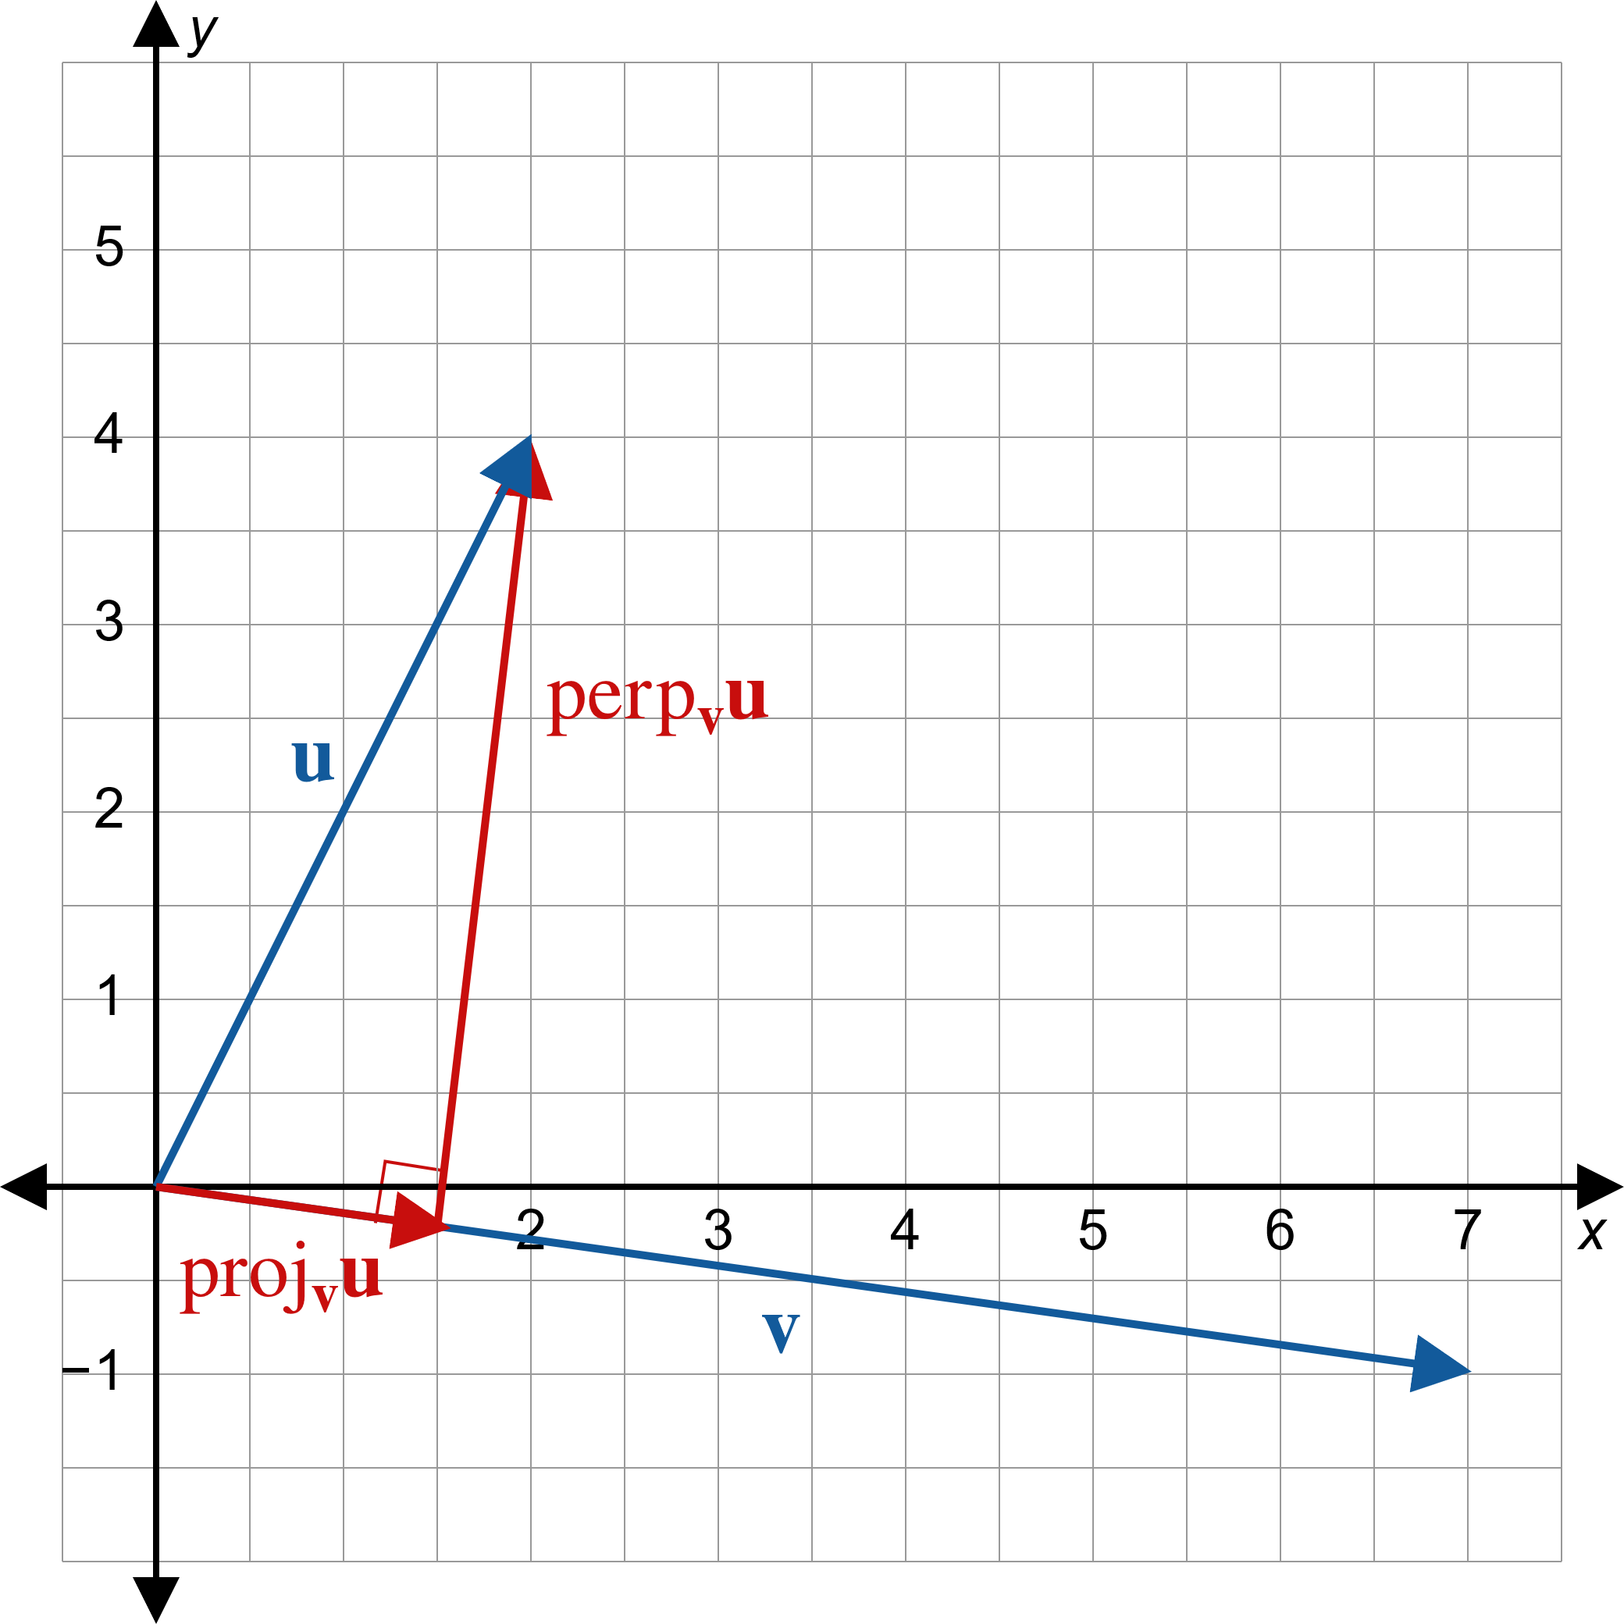
Example 5: Finding the Projection of u onto v (cont.)
Figure 4

Slide 21

Example 6: Applying the Dot Product
A boat and trailer, which together weigh 650 pounds, are to be pulled up a boat ramp that has an incline of ${30}^{°}$. What force is required to merely prevent the boat and trailer from rolling down the ramp?

Slide 22
Example 6: Applying the Dot Product (cont.)
Solution
As seen in an example in a previous section, weight is simply an example of force: it is the force that Earth exerts on an object through gravity. To gain some insight into this problem, suppose the question were “What is the force needed to lift the boat and trailer straight up?” The answer would be that 650 pounds of force is needed to counter the pull of gravity, so anything greater than 650 pounds of force would result in the boat and trailer being lifted.

Slide 23
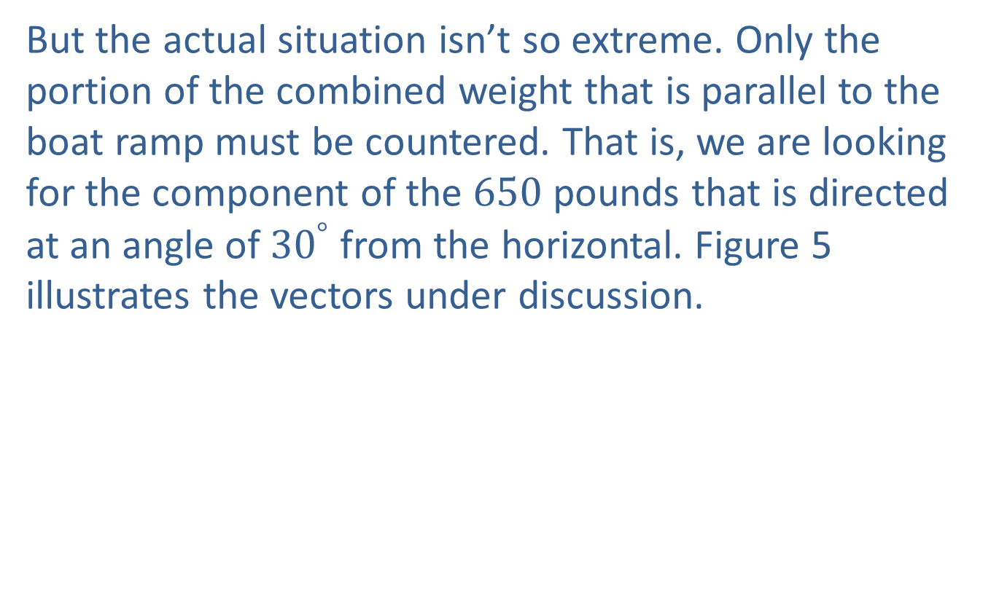
Example 6: Applying the Dot Product (cont.)
But the actual situation isn’t so extreme. Only the portion of the combined weight that is parallel to the boat ramp must be countered. That is, we are looking for the component of the 650 pounds that is directed at an angle of ${30}^{°}$ from the horizontal. Figure 5 illustrates the vectors under discussion.

Slide 24
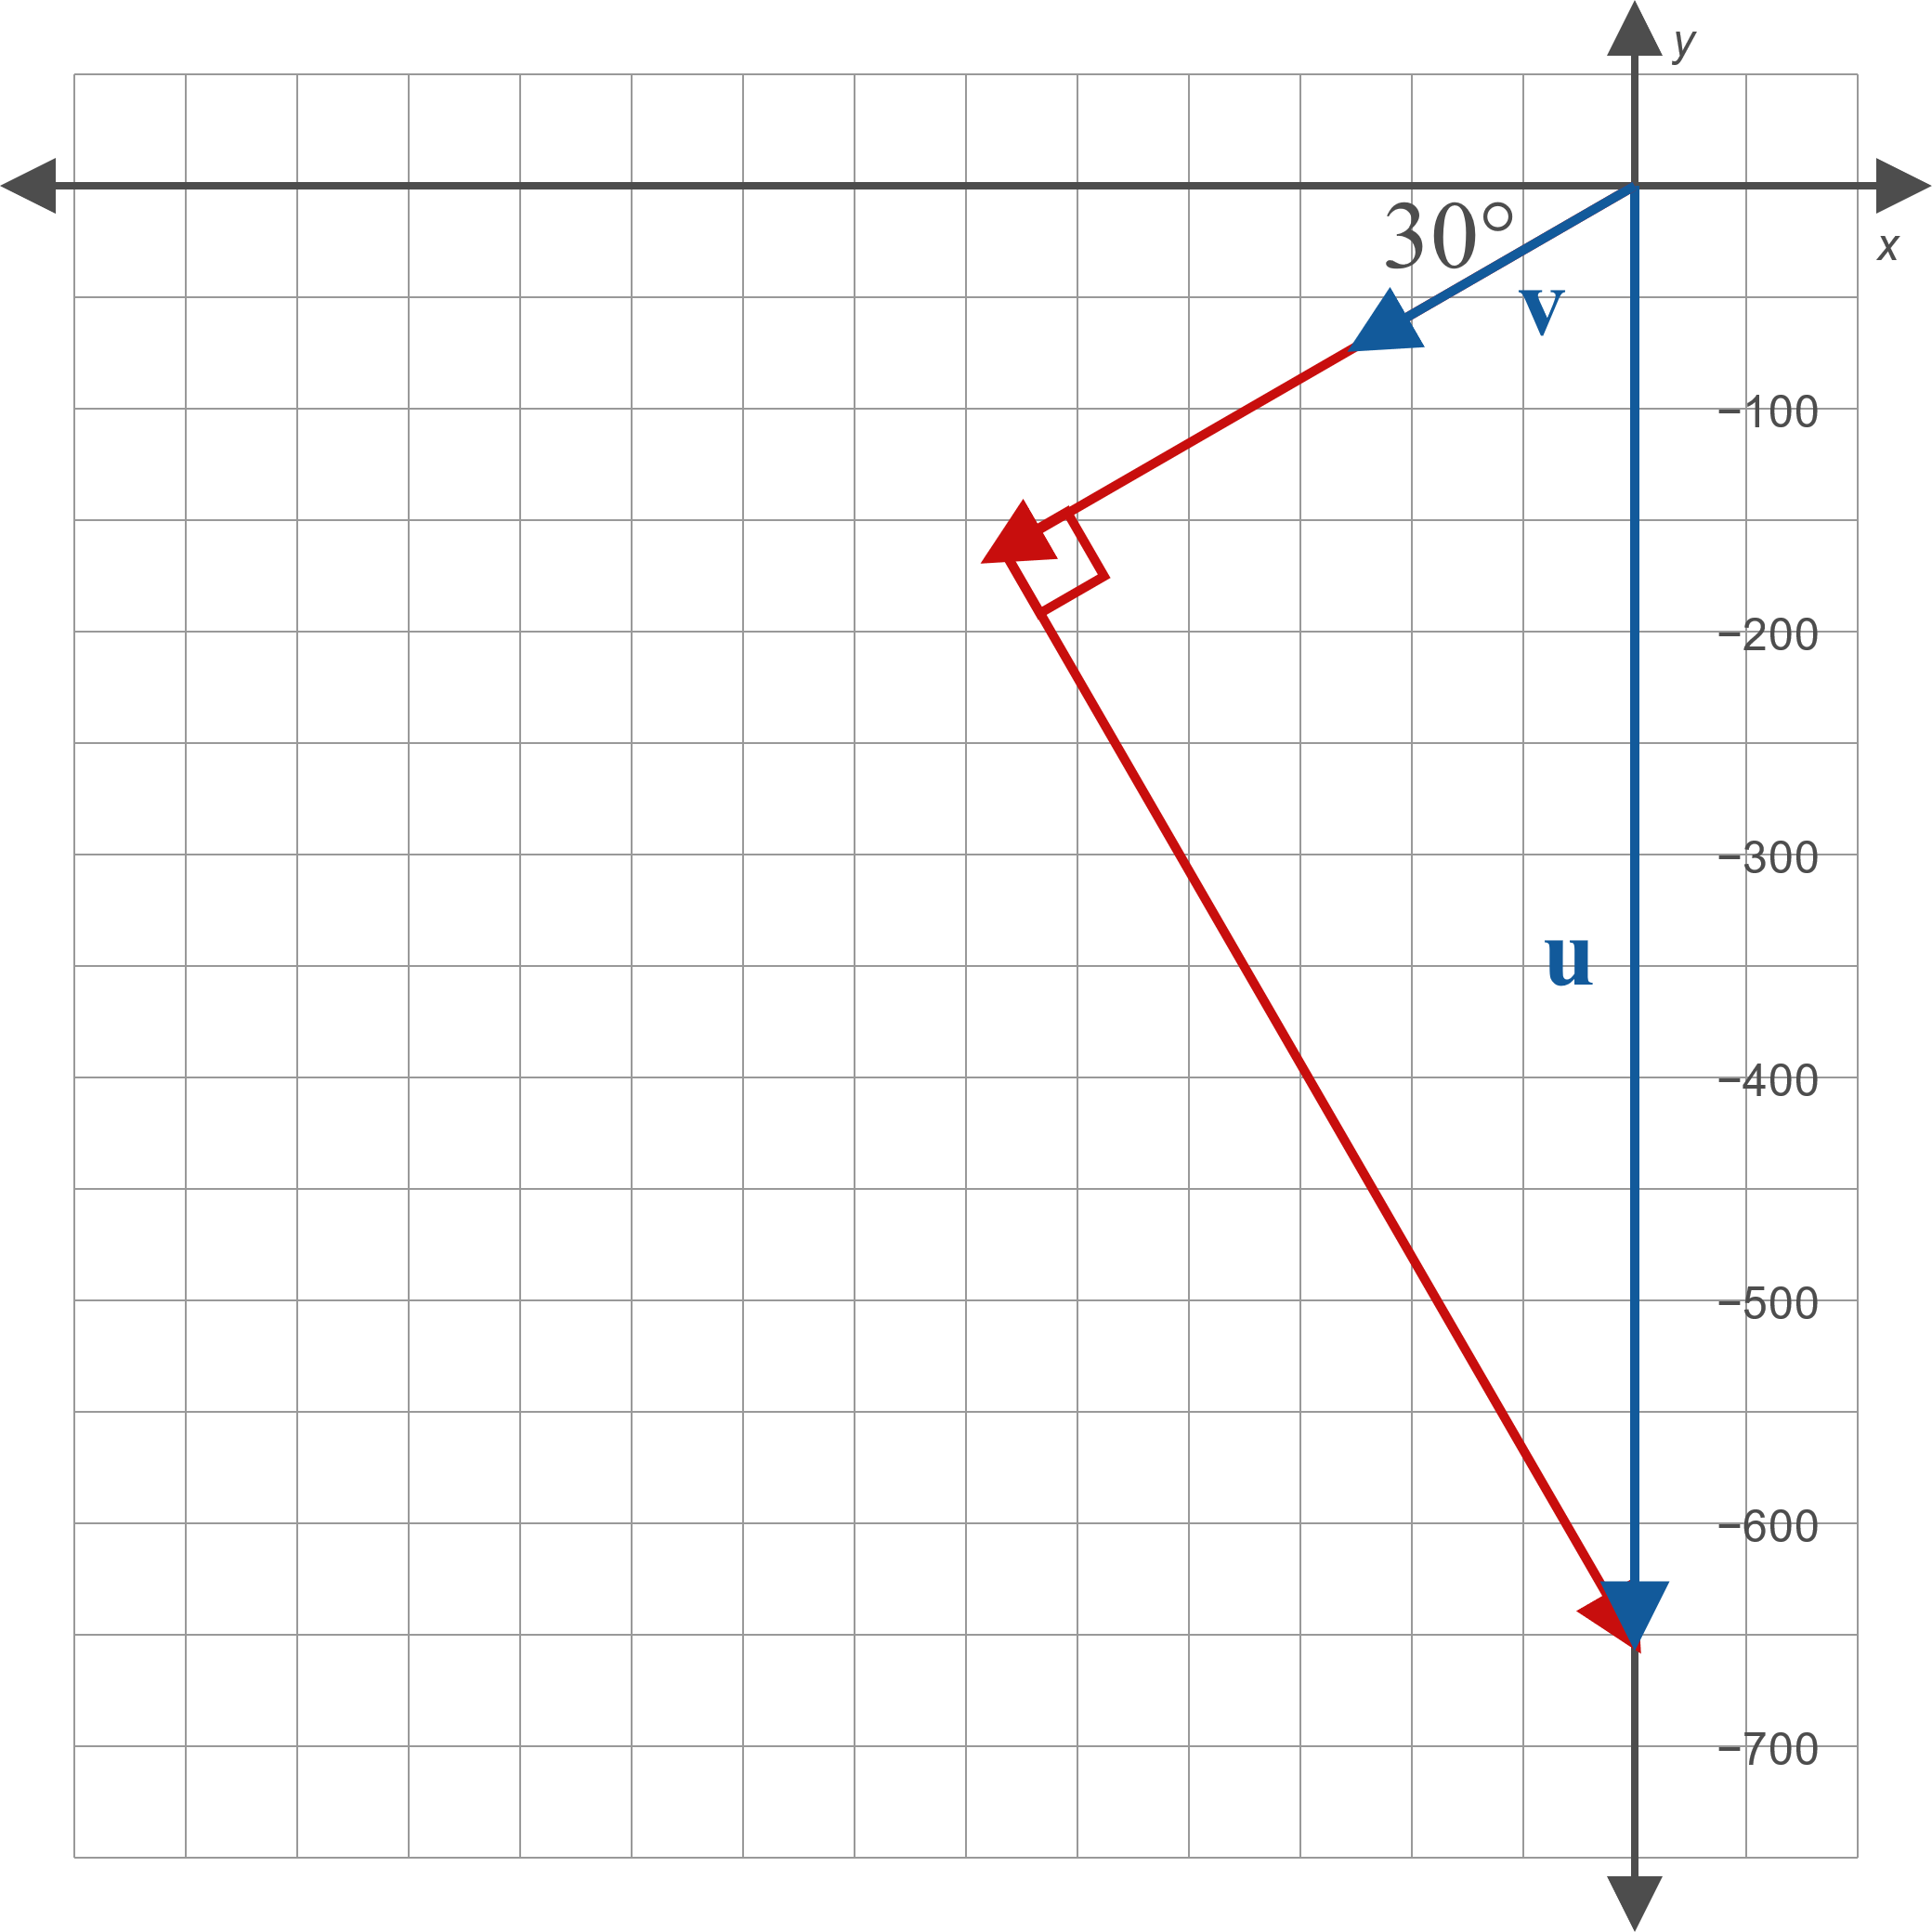
Example 6: Applying the Dot Product (cont.)
Figure 5

Slide 25
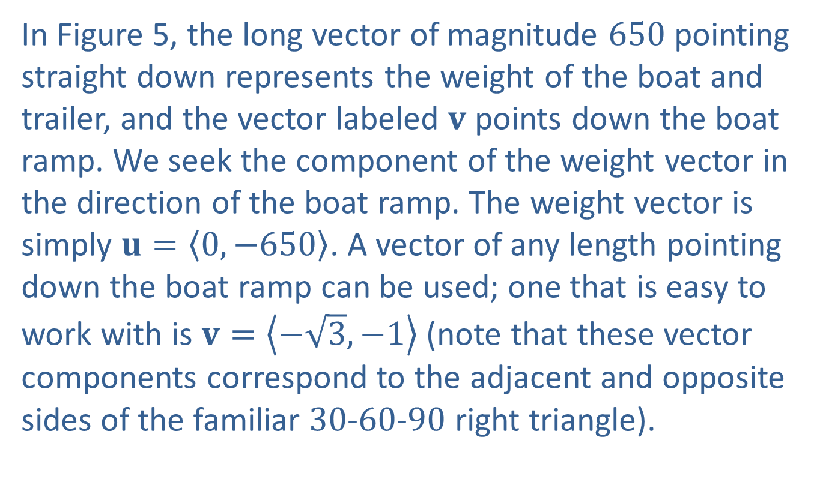
Example 6: Applying the Dot Product (cont.)
In Figure 5, the long vector of magnitude 650 pointing straight down represents the weight of the boat and trailer, and the vector labeled $v$ points down the boat ramp. We seek the component of the weight vector in the direction of the boat ramp. The weight vector is simply $u=\left\langle 0,−650\right\rangle$. A vector of any length pointing down the boat ramp can be used; one that is easy to work with is $v=\left\langle −\sqrt{3},−1\right\rangle$ (note that these vector components correspond to the adjacent and opposite sides of the familiar 30-60-90 right triangle).

Slide 26
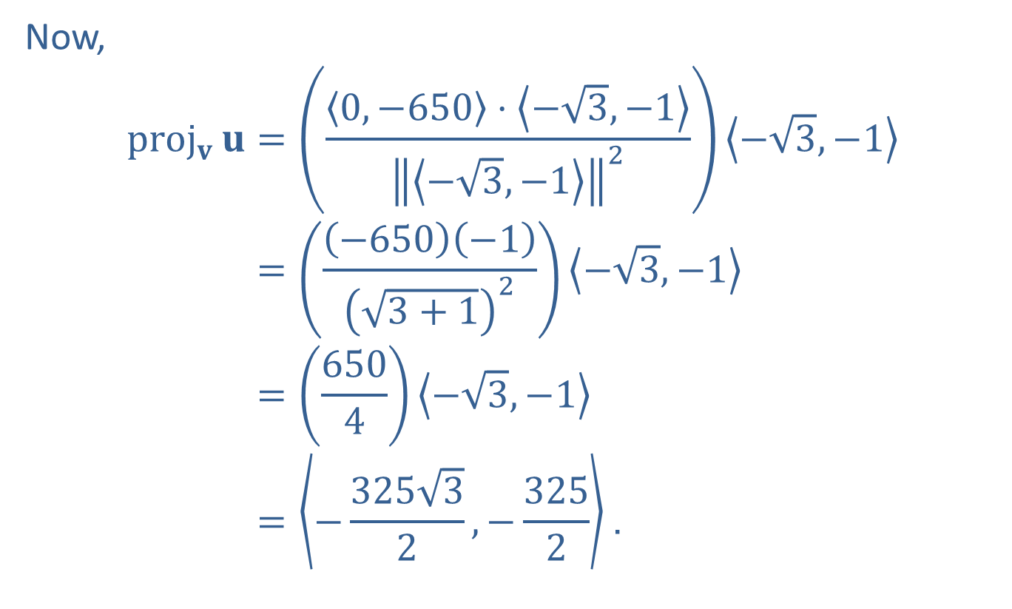
Example 6: Applying the Dot Product (cont.)
Now,
proj𝐯𝐮=0,−650⋅−3,−1−3,−12−3,−1proj𝐯⁡𝐮=−650−13+12−3,−1proj𝐯⁡𝐮=6504−3,−1proj𝐯⁡𝐮=−32532,−3252.

Slide 27
Example 6: Applying the Dot Product (cont.)
The magnitude of this projection, which is 325 pounds, is thus the force that must be exerted to keep the boat and trailer stationary. Anything more than this will allow the boat and trailer to be pulled up the ramp.

Slide 28
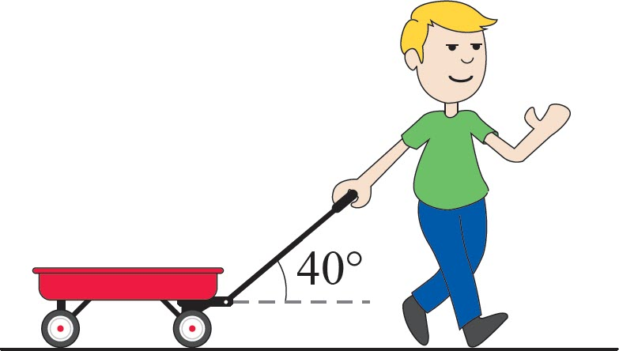

Example 7: Applying the Dot Product
A child pulls a wagon along a sidewalk, exerting a force of 15 pounds on the handle of the wagon. The handle is at an angle of ${40}^{°}$ to the horizontal. If the child pulls the wagon a distance of 50 feet, what work has been done?
Figure 7

Slide 29
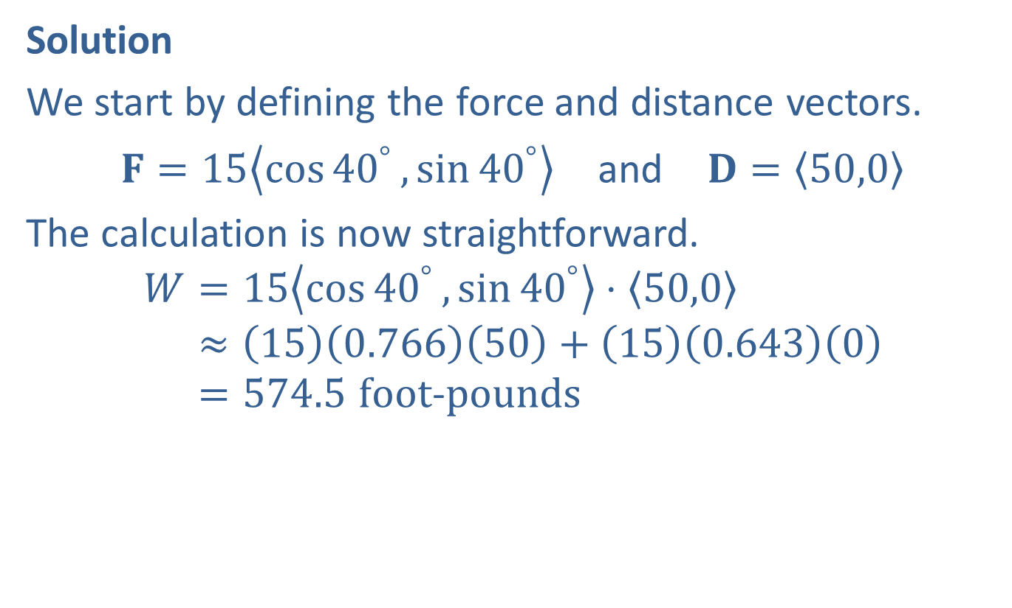
Example 7: Applying the Dot Product (cont.)
Solution
We start by defining the force and distance vectors.
$F=15\left\langle \cos{{40}^{°}},\sin{{40}^{°}}\right\rangle$ and $D=\left\langle 50,0\right\rangle$
The calculation is now straightforward.
𝑊=15cos40°,sin40°⋅50,0𝑊≈150.76650+150.6430𝑊=574.5 foot−pounds

