Slide 1
Section 11.3
Hyperbolas

Slide 2
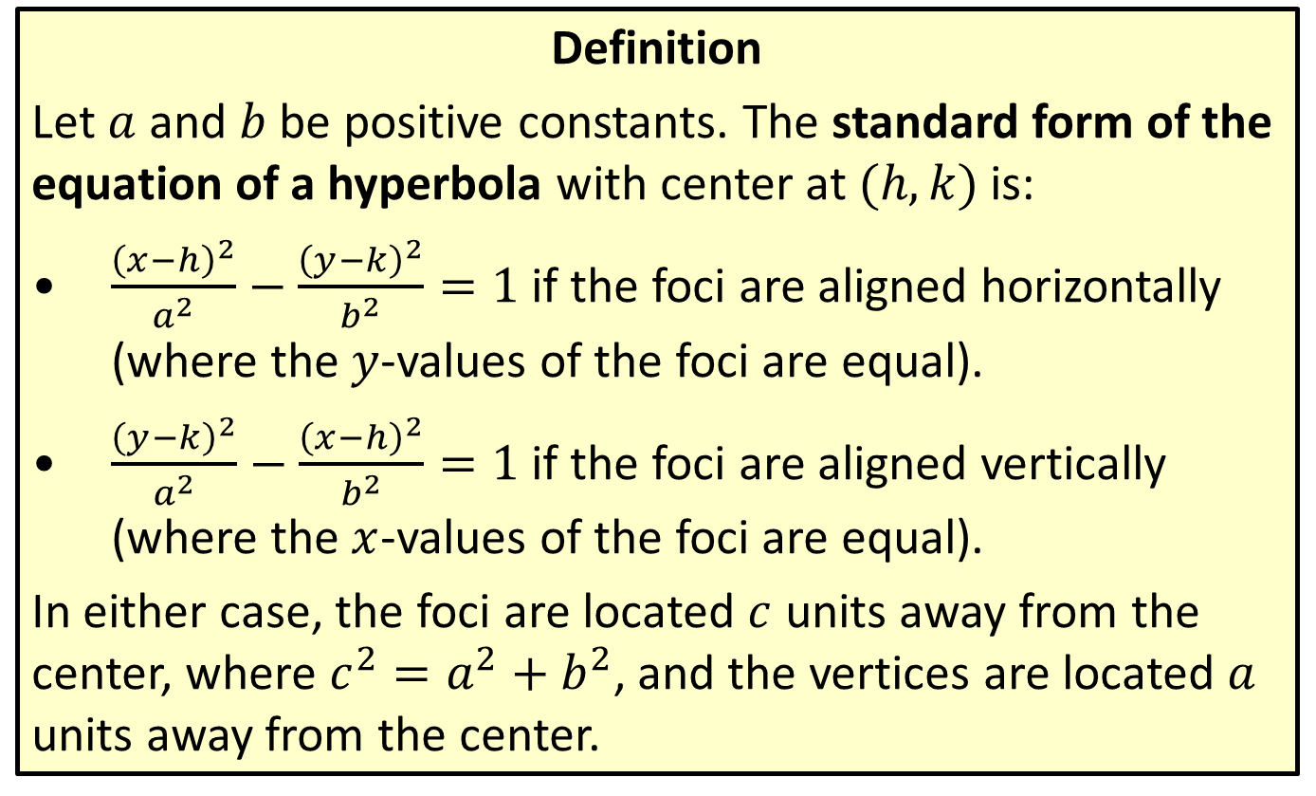
Standard Form the Equation of a Hyperbola
Definition
Let $a$ and $b$ be positive constants. The standard form of the equation of a hyperbola with center at $(h,k)$ is:
​$\frac{{\left(x−h\right)}^{2}}{a^{2}}−\frac{{\left(y−k\right)}^{2}}{b^{2}}=1$ if the foci are aligned horizontally (where the $y$-values of the foci are equal).
​$\frac{{\left(y−k\right)}^{2}}{a^{2}}−\frac{{\left(x−h\right)}^{2}}{b^{2}}=1$ if the foci are aligned vertically (where the $x$-values of the foci are equal).
In either case, the foci are located $c$ units away from the center, where $c^{2}=a^{2}+b^{2}$, and the vertices are located $a$ units away from the center.

Slide 3
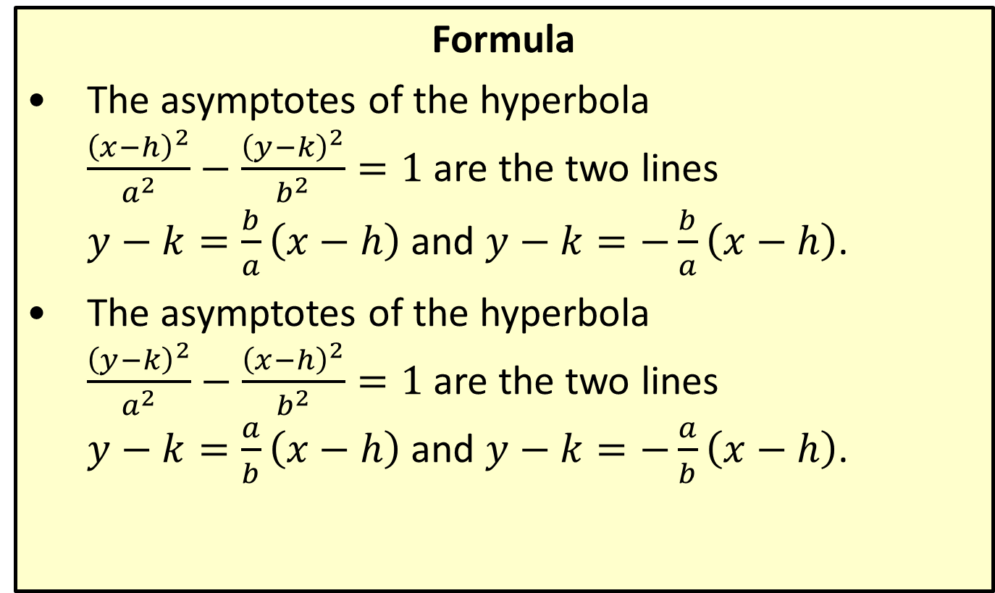
Asymptotes of Hyperbolas
Formula
​The asymptotes of the hyperbola $\frac{{\left(x−h\right)}^{2}}{a^{2}}−\frac{{\left(y−k\right)}^{2}}{b^{2}}=1$ are the two lines $y−k=\frac{b}{a}\left(x−h\right)$ and $y−k=−\frac{b}{a}\left(x−h\right)$.
​The asymptotes of the hyperbola $\frac{{\left(y−k\right)}^{2}}{a^{2}}−\frac{{\left(x−h\right)}^{2}}{b^{2}}=1$ are the two lines $y−k=\frac{a}{b}\left(x−h\right)$ and $y−k=−\frac{a}{b}\left(x−h\right)$.

Slide 4

Example 1: Graphing a Hyperbola with Equation in Standard Form
Graph the hyperbola $\frac{{\left(x−2\right)}^{2}}{25}−\frac{{\left(y−1\right)}^{2}}{4}=1$, indicating its asymptotes.

Slide 5
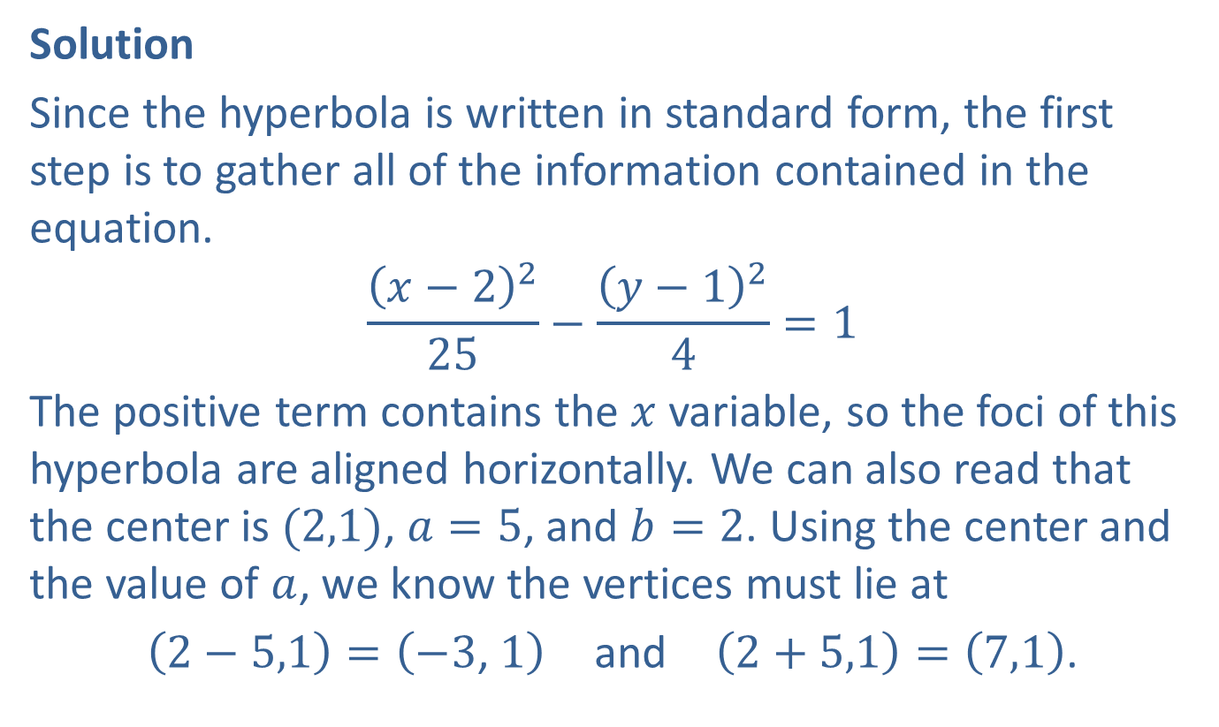
Example 1: Graphing a Hyperbola with Equation in Standard Form (cont.)
Solution
Since the hyperbola is written in standard form, the first step is to gather all of the information contained in the equation.
$$\frac{{\left(x−2\right)}^{2}}{25}−\frac{{\left(y−1\right)}^{2}}{4}=1$$
The positive term contains the $x$ variable, so the foci of this hyperbola are aligned horizontally. We can also read that the center is $(2,1)$, $a=5$, and $b=2$. Using the center and the value of $a$, we know the vertices must lie at
$\left(2−5,1\right)=\left(−3\text{, }1\right)$ and $\left(2+5,1\right)=\left(7,1\right)$.

Slide 6
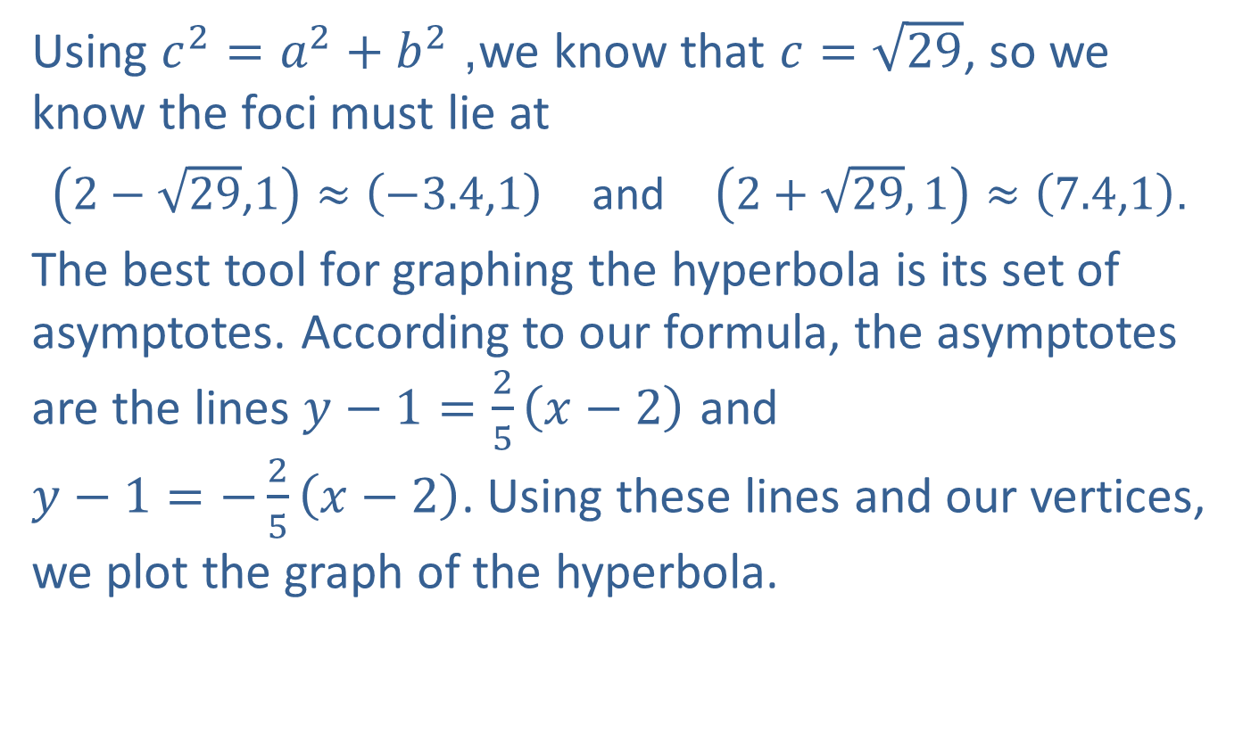
Example 1: Graphing a Hyperbola with Equation in Standard Form (cont.)
Using $c^{2}=a^{2}+b^{2}$, we know that $c=\sqrt{29}$, so we know the foci must lie at
$\left(2−\sqrt{29}\text{,}1\right)≈\left(−3.4\text{,}1\right)$ and $\left(2+\sqrt{29},1\right)≈\left(7.4\text{,}1\right)$.
The best tool for graphing the hyperbola is its set of asymptotes. According to our formula, the asymptotes are the lines $y−1=\frac{2}{5}\left(x−2\right)$ and $y−1=−\frac{2}{5}\left(x−2\right)$. Using these lines and our vertices, we plot the graph of the hyperbola.

Slide 7
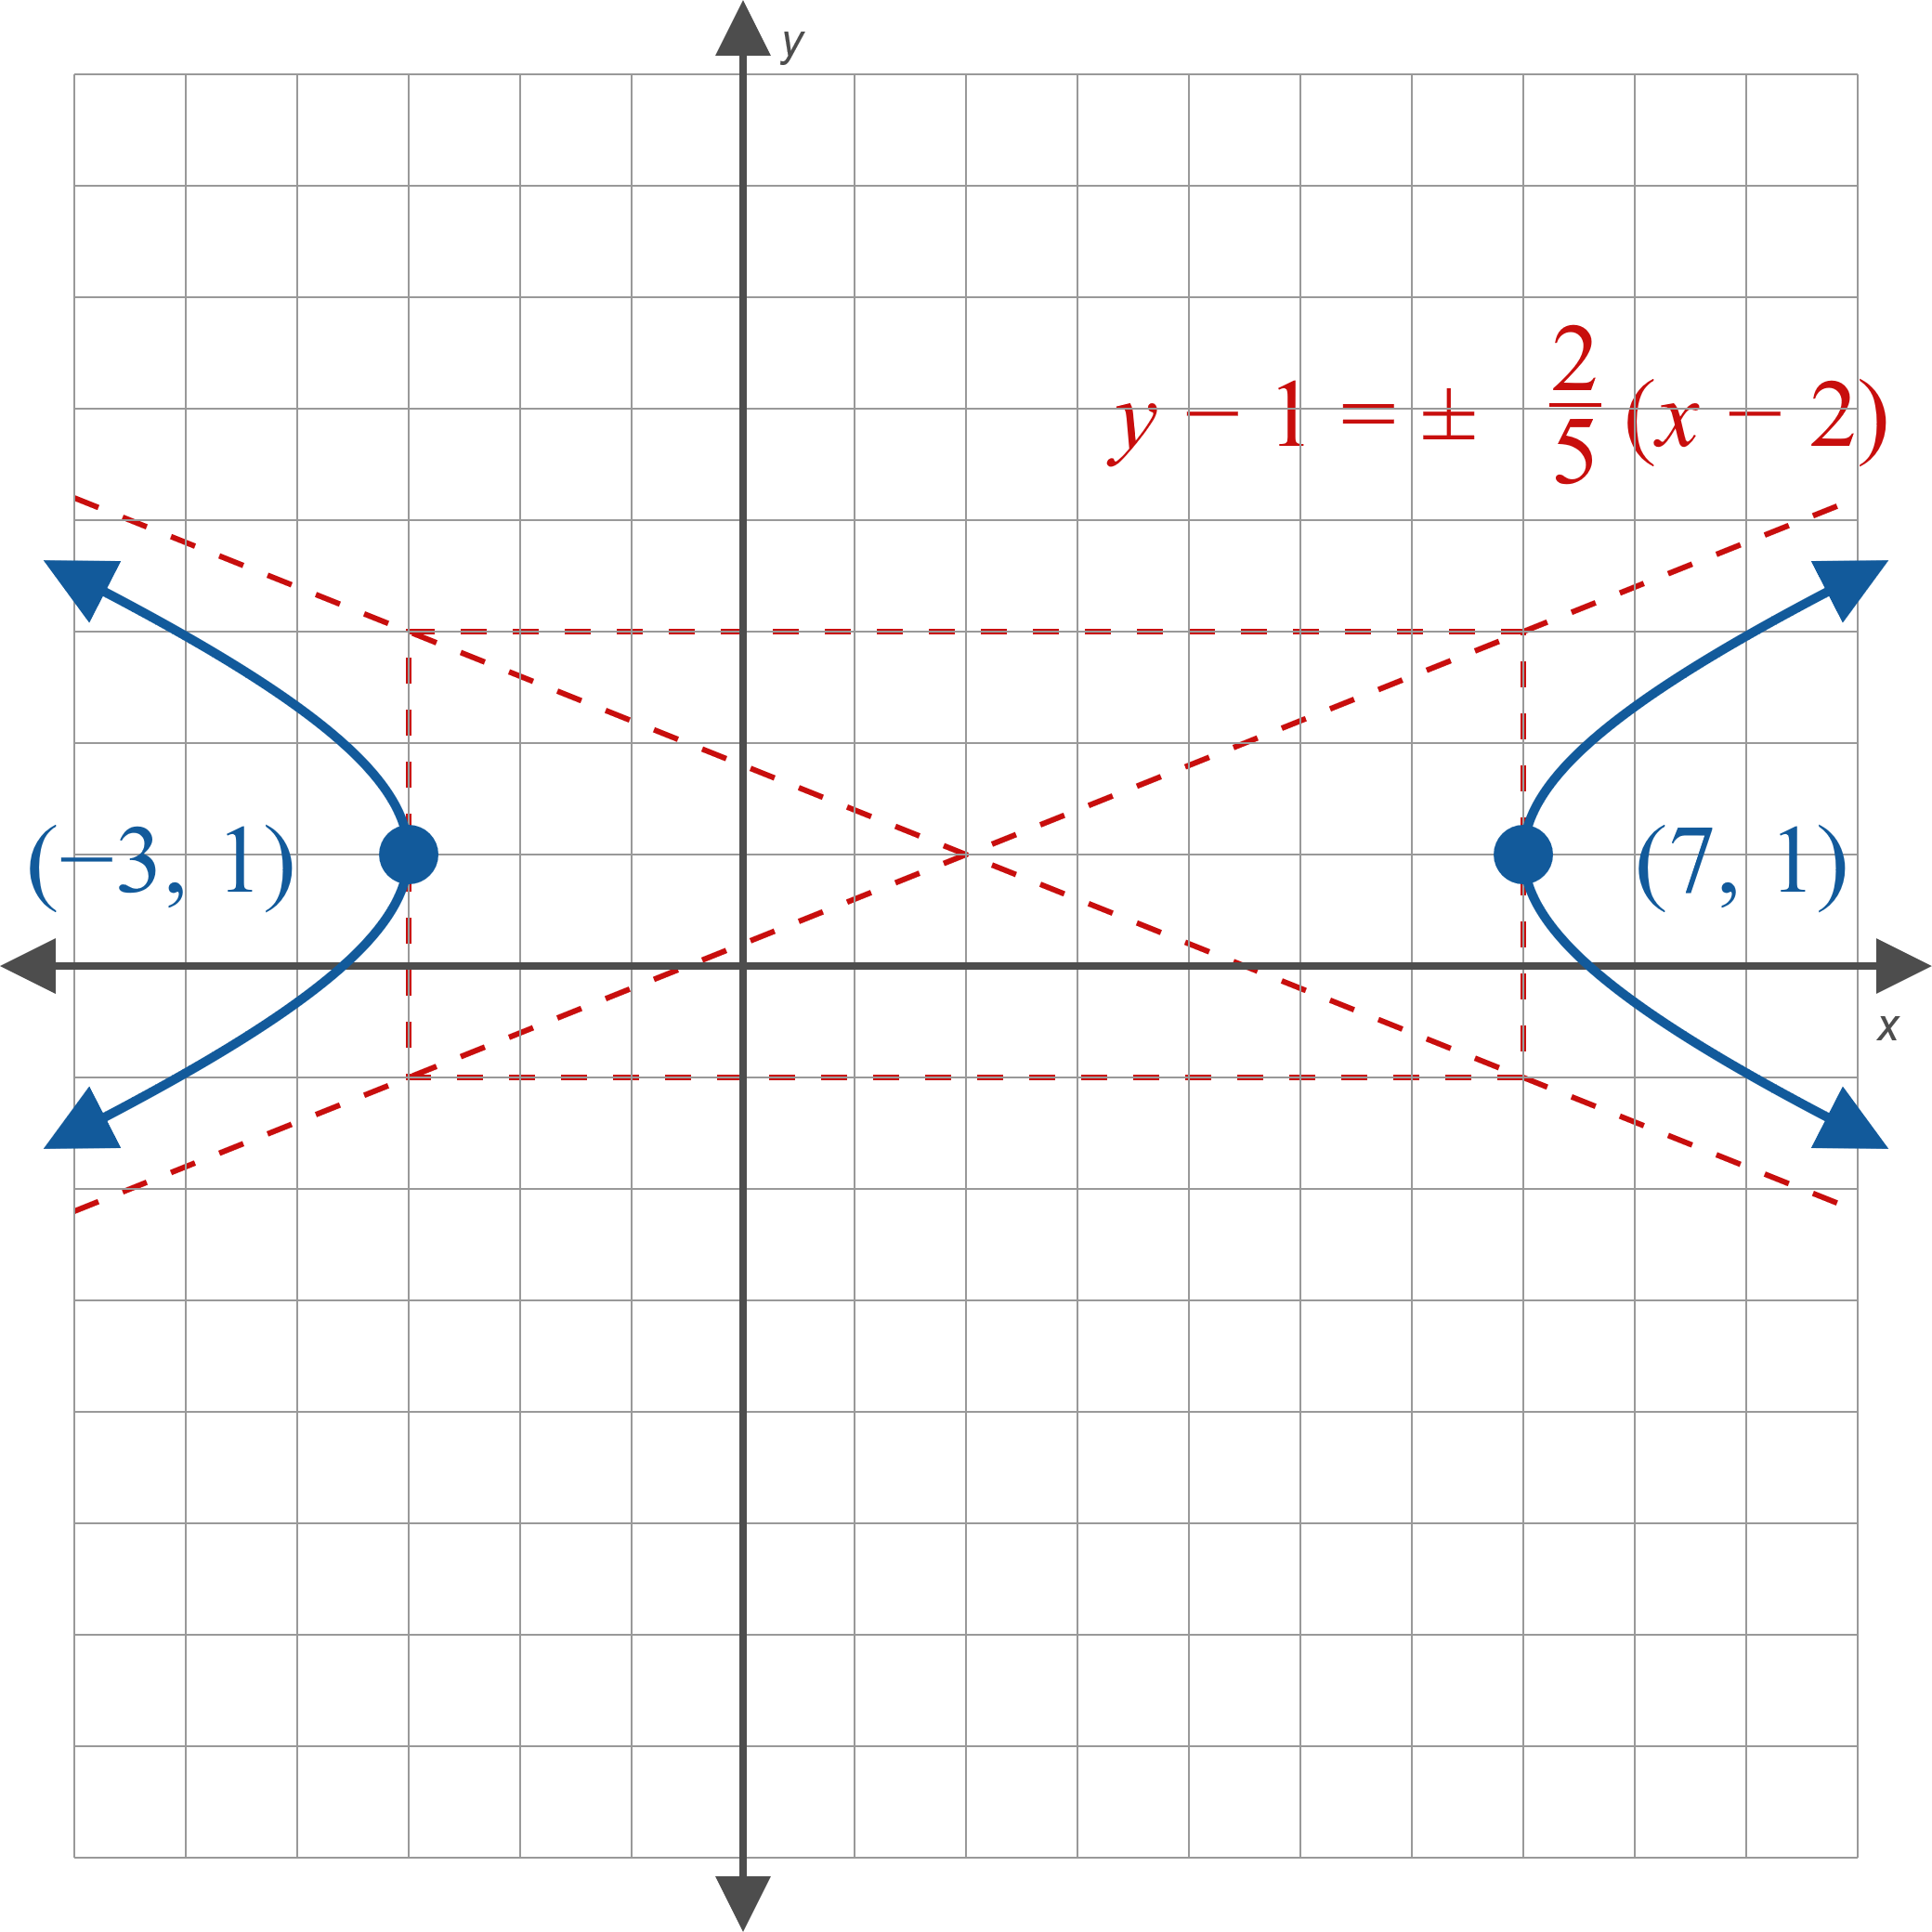
Example 1: Graphing a Hyperbola with Equation in Standard Form (cont.)
Figure 3

Slide 8

Example 2: Graphing a Hyperbola with Equation Not in Standard Form
Graph the hyperbola
$−16x^{2}+9y^{2}+96x+18y=279$,
indicating its asymptotes.

Slide 9
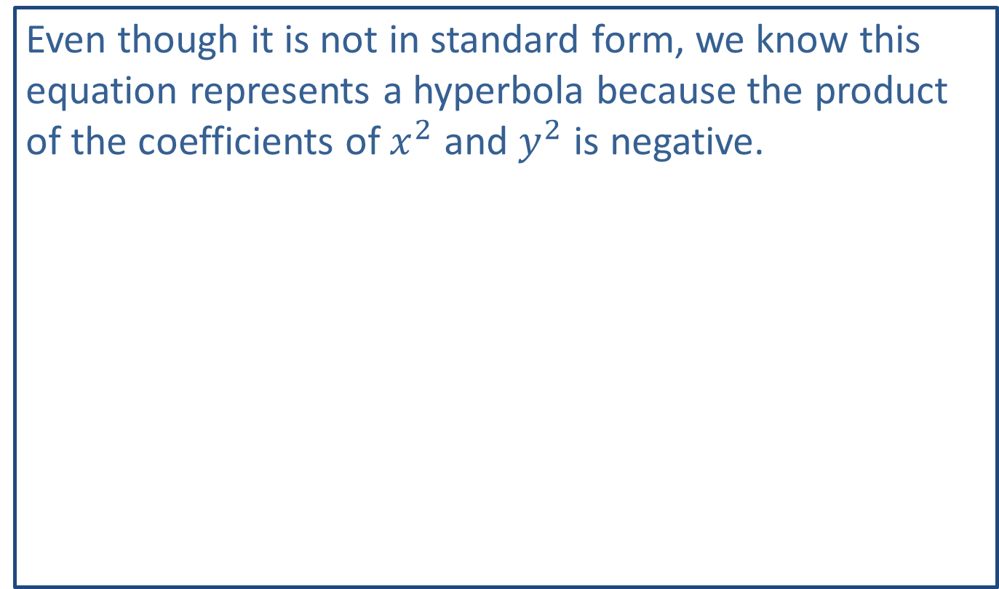
Note:
Even though it is not in standard form, we know this equation represents a hyperbola because the product of the coefficients of $x^{2}$ and $y^{2}$ is negative.

Slide 10
Example 2: Graphing a Hyperbola with Equation Not in Standard Form (cont.)
Solution
In its current form, the equation tells us nothing about the graph of the hyperbola it represents. We need to complete the square (twice) to find the standard form.

Slide 11
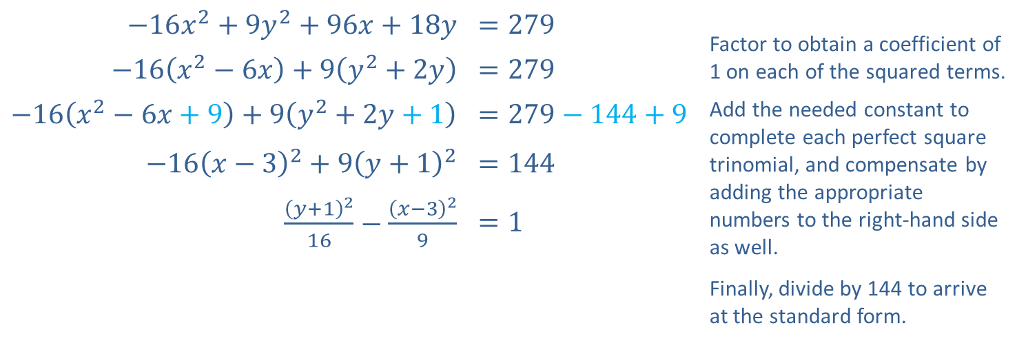
Example 2: Graphing a Hyperbola with Equation Not in Standard Form (cont.)
​$−16x^{2}+9y^{2}+96x+18y$ | $$=279$$ | Factor to obtain a coefficient of 1 on each of the squared terms.
​$−16\left(x^{2}−6x\right)+9\left(y^{2}+2y\right)$ | $$=279$$
​$−16\left(x^{2}−6x+9\right)+9\left(y^{2}+2y+1\right)$ | $$=279−144+9$$ | Add the needed constant to complete each perfect square trinomial, and compensate by adding the appropriate numbers to the right-hand side as well. Finally, divide by 144 to arrive at the standard form.
​$−16{\left(x−3\right)}^{2}+9{\left(y+1\right)}^{2}$ | $$=144$$
$\frac{{\left(y+1\right)}^{2}}{16}−\frac{{\left(x−3\right)}^{2}}{9}$ | $$=1$$

Slide 12
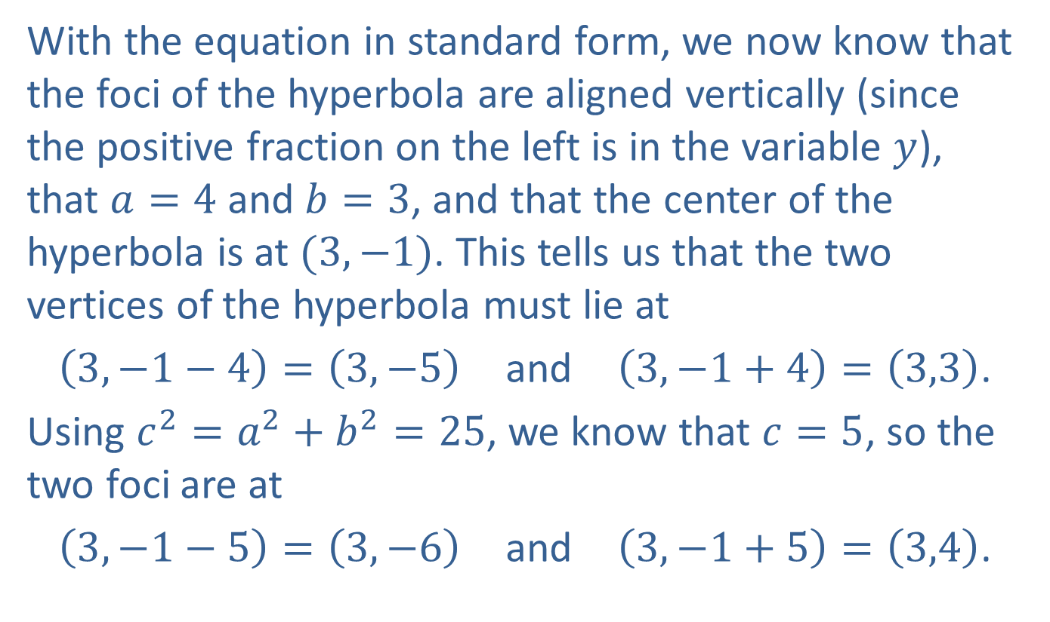
Example 2: Graphing a Hyperbola with Equation Not in Standard Form (cont.)
With the equation in standard form, we now know that the foci of the hyperbola are aligned vertically (since the positive fraction on the left is in the variable $y$), that $a=4$ and $b=3$, and that the center of the hyperbola is at $(3,−1)$. This tells us that the two vertices of the hyperbola must lie at
$\left(3,−1−4\right)=\left(3,−5\right)$ and $\left(3,−1+4\right)=\left(3,3\right)$.
Using $c^{2}=a^{2}+b^{2}=25$, we know that $c=5$, so the two foci are at
$\left(3,−1−5\right)=\left(3,−6\right)$ and $\left(3,−1+5\right)=\left(3,4\right)$.

Slide 13
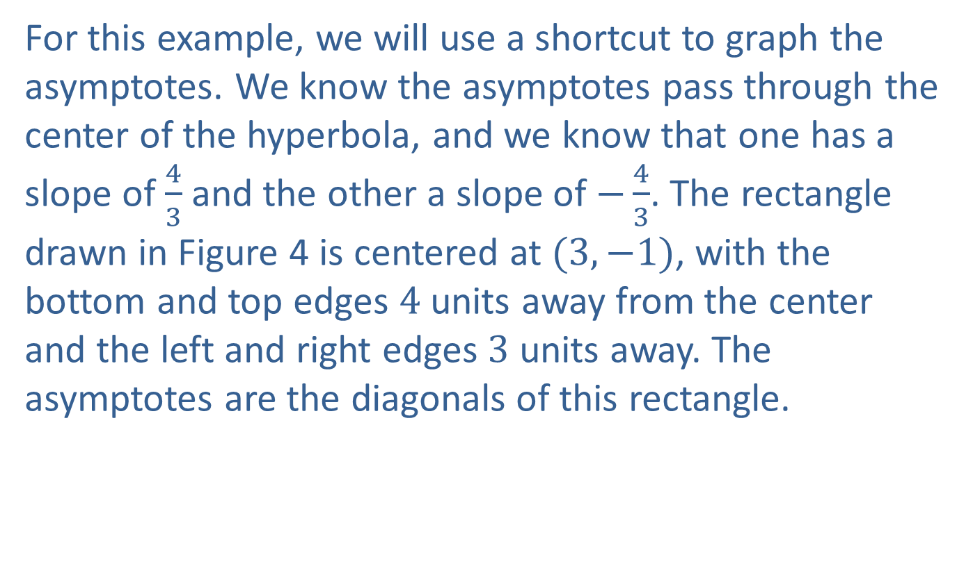
Example 2: Graphing a Hyperbola with Equation Not in Standard Form (cont.)
For this example, we will use a shortcut to graph the asymptotes. We know the asymptotes pass through the center of the hyperbola, and we know that one has a slope of $\frac{4}{3}$ and the other a slope of $−\frac{4}{3}$. The rectangle drawn in Figure 4 is centered at $(3,−1)$, with the bottom and top edges 4 units away from the center and the left and right edges 3 units away. The asymptotes are the diagonals of this rectangle.

Slide 14
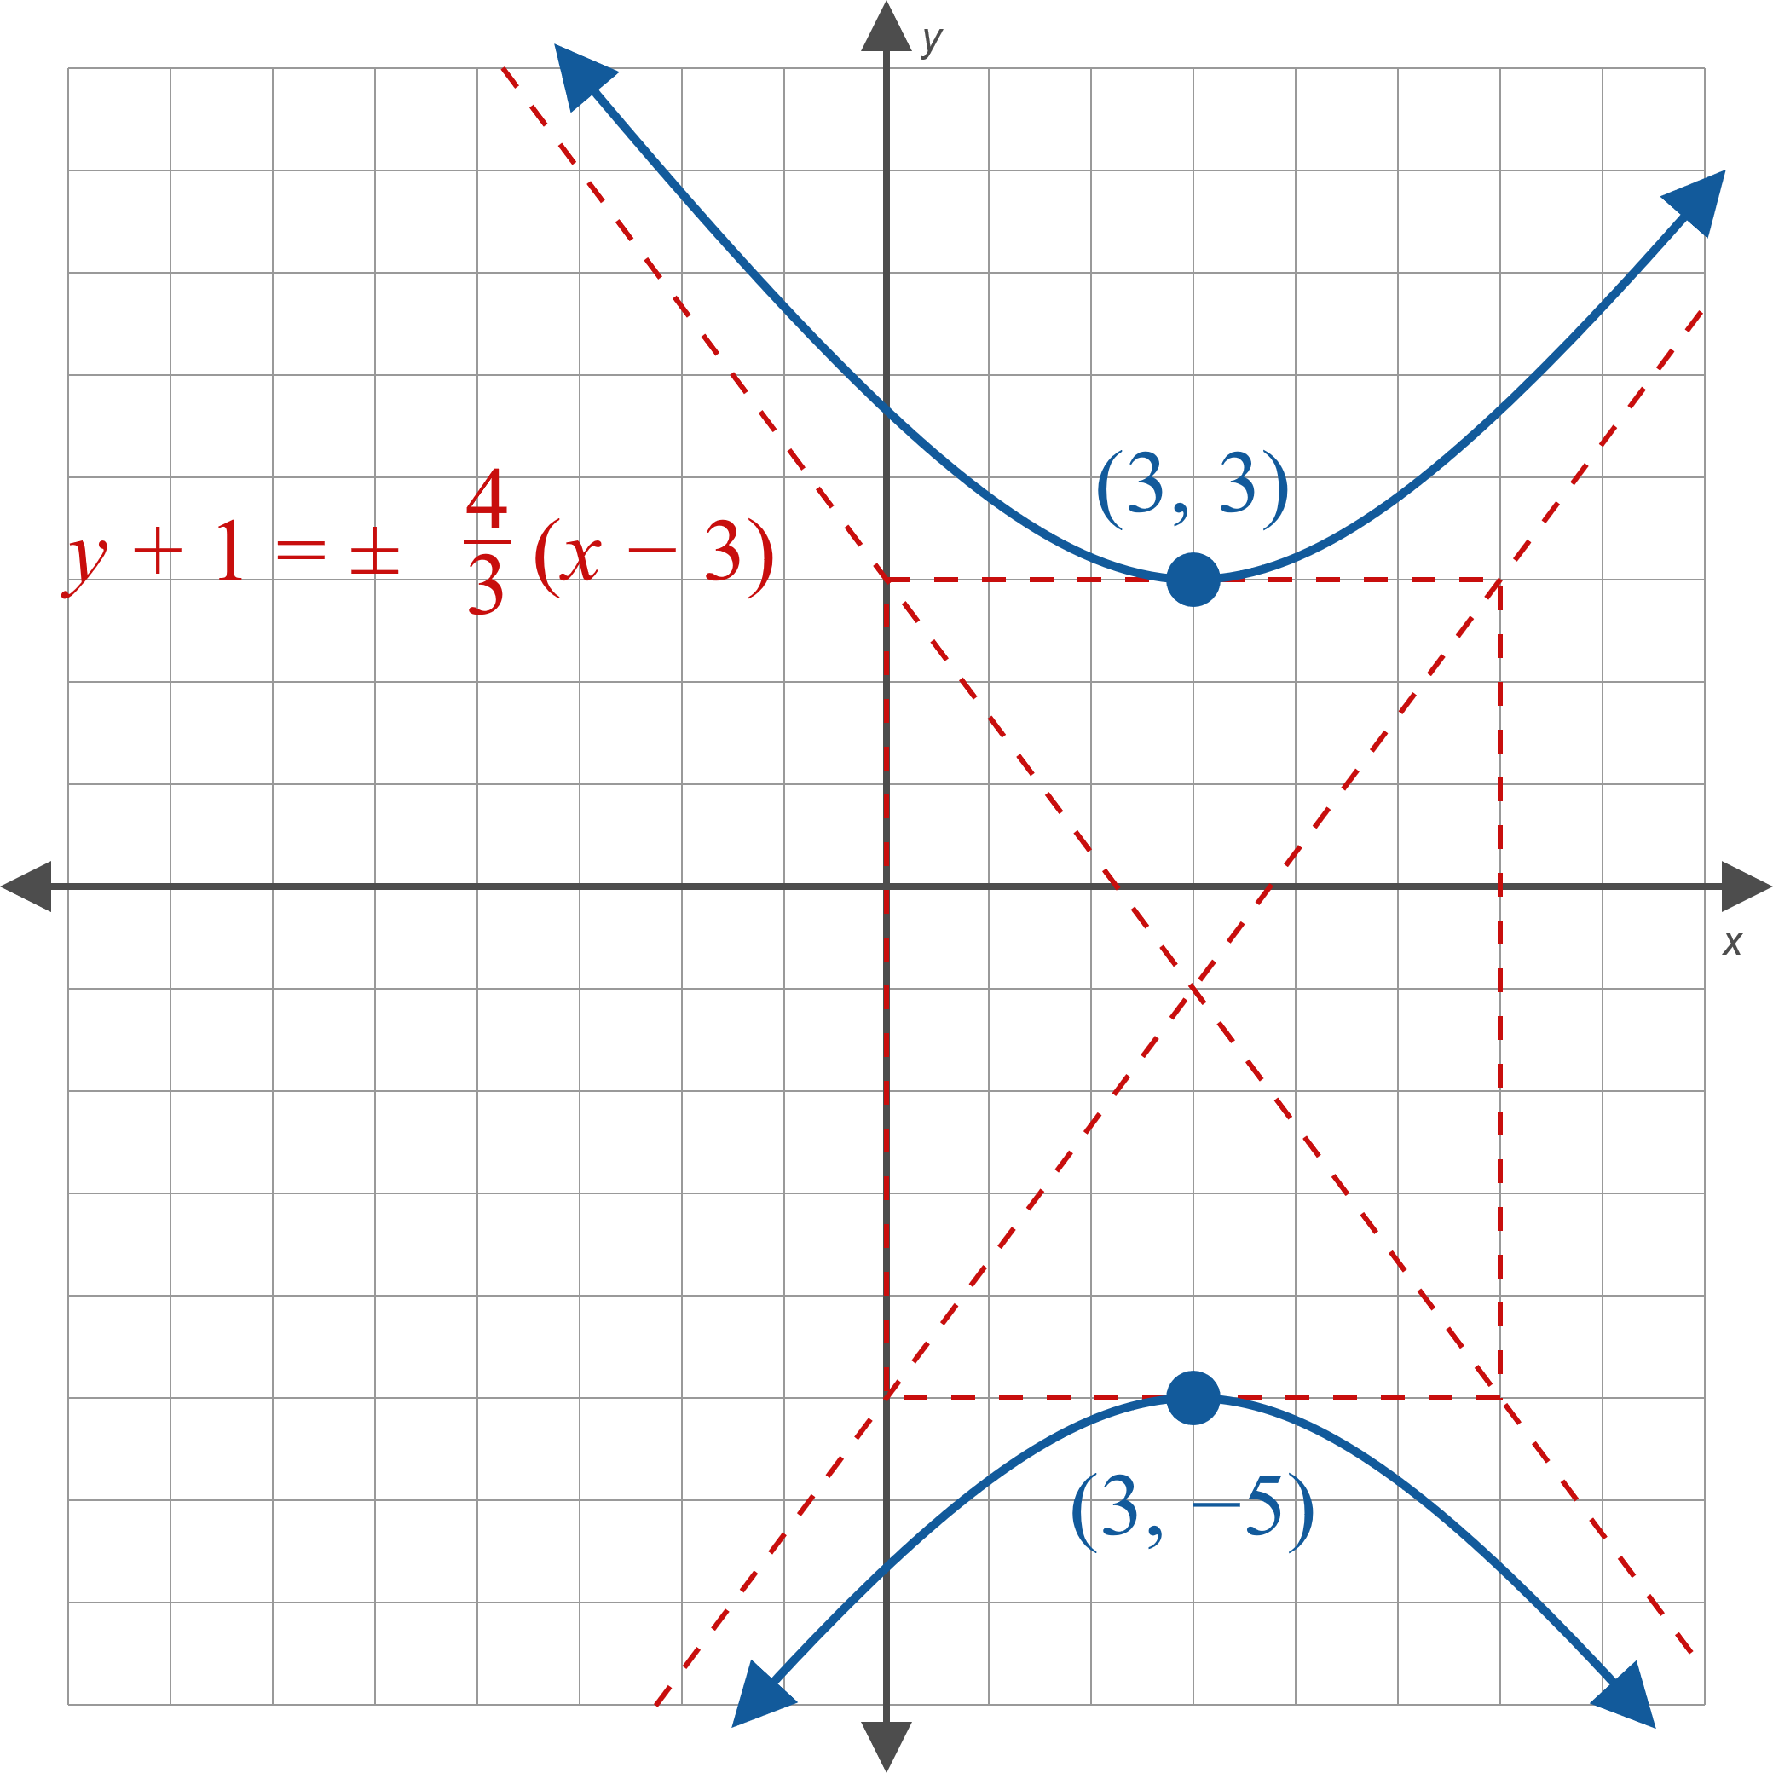
Example 2: Graphing a Hyperbola with Equation Not in Standard Form (cont.)
Figure 4

Slide 15

Example 3: Standard Form of the Equation of a Hyperbola
Given that the asymptotes of a hyperbola have slopes of $\frac{1}{2}$ and $−\frac{1}{2}$ and that the vertices of the hyperbola are at $(−1,0)$ and $(7,0)$, find its standard form equation.

Slide 16
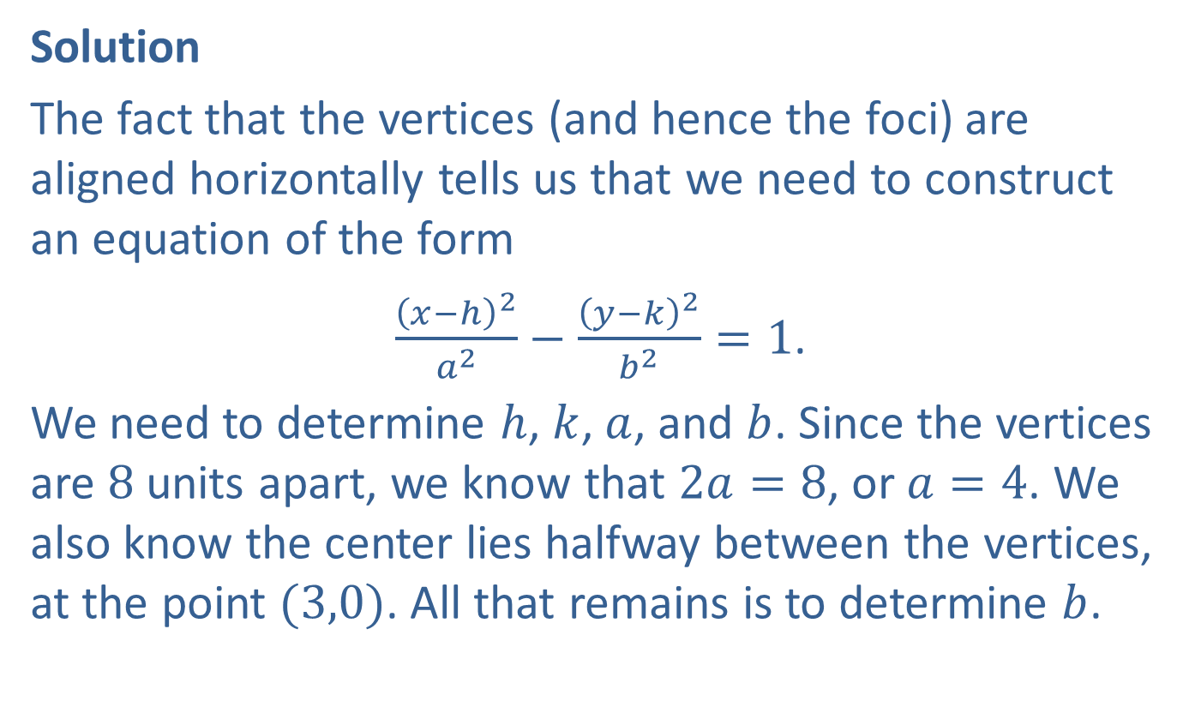
Example 3: Standard Form of the Equation of a Hyperbola (cont.)
Solution
The fact that the vertices (and hence the foci) are aligned horizontally tells us that we need to construct an equation of the form
$\frac{{\left(x−h\right)}^{2}}{a^{2}}−\frac{{\left(y−k\right)}^{2}}{b^{2}}=1$.
We need to determine $h$, $k$, $a$, and $b$. Since the vertices are 8 units apart, we know that $2a=8$, or $a=4$. We also know the center lies halfway between the vertices, at the point $(3,0)$. All that remains is to determine $b$.

Slide 17
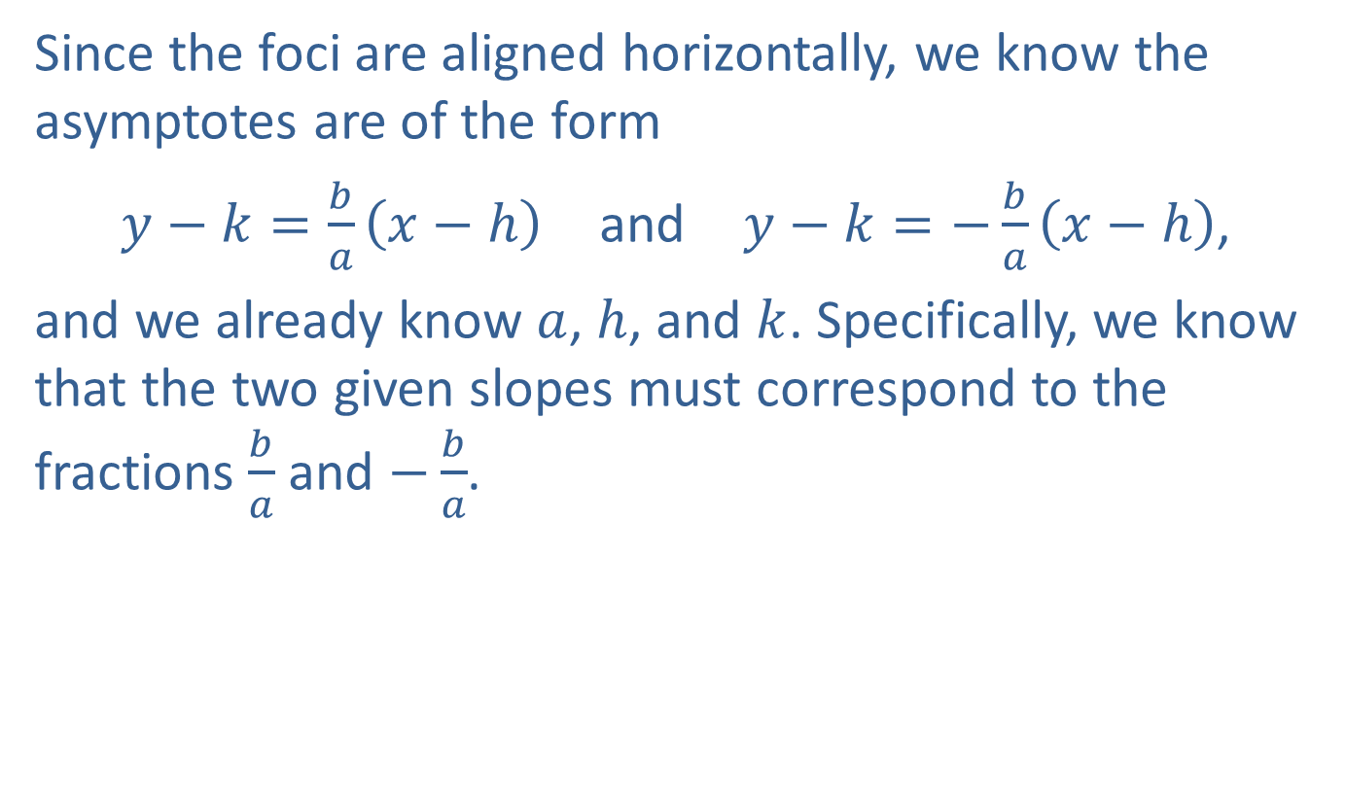
Example 3: Standard Form of the Equation of a Hyperbola (cont.)
Since the foci are aligned horizontally, we know the asymptotes are of the form
$y−k=\frac{b}{a}\left(x−h\right)$ and $y−k=−\frac{b}{a}\left(x−h\right)$,
and we already know $a$, $h$, and $k$. Specifically, we know that the two given slopes must correspond to the fractions $\frac{b}{a}$ and $−\frac{b}{a}$.

Slide 18
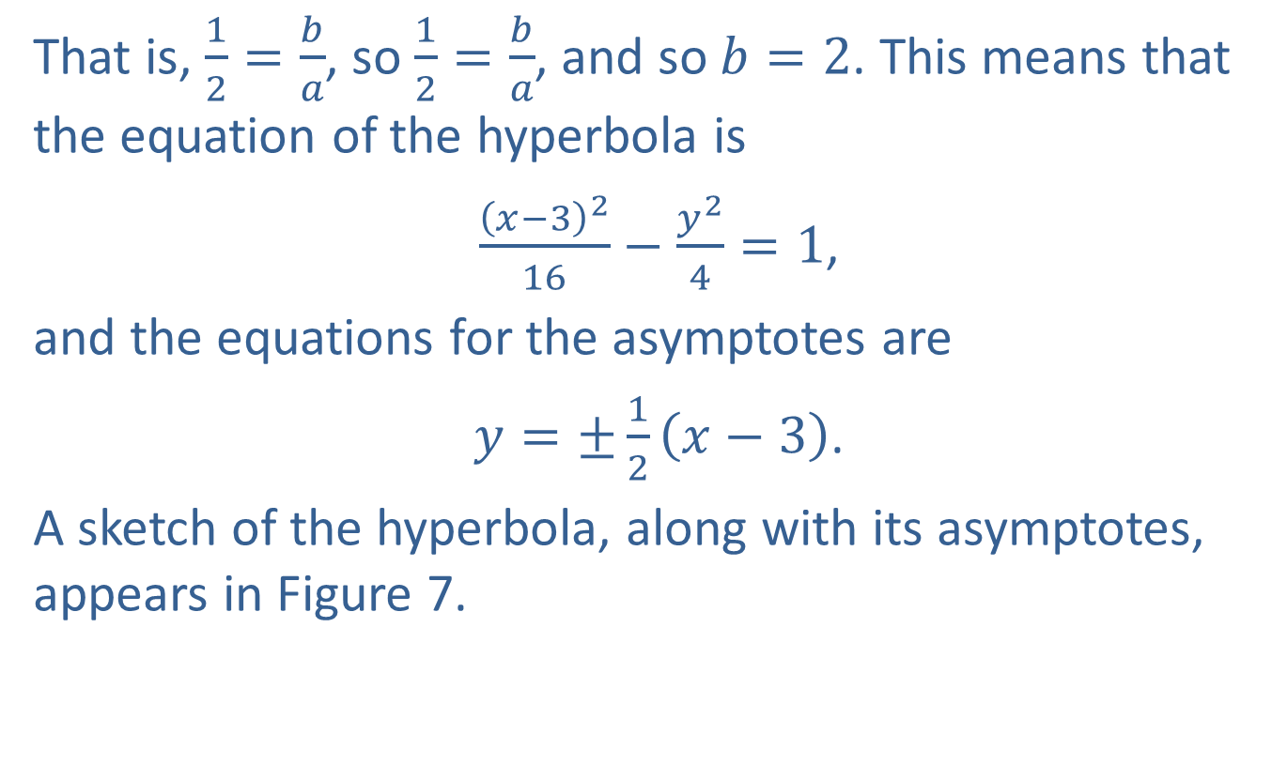
Example 3: Standard Form of the Equation of a Hyperbola (cont.)
That is, $\frac{1}{2}=\frac{b}{a}$, so $\frac{1}{2}=\frac{b}{a}$, and so $b=2$. This means that the equation of the hyperbola is
$\frac{{\left(x−3\right)}^{2}}{16}−\frac{y^{2}}{4}=1$,
and the equations for the asymptotes are
$y=±\frac{1}{2}\left(x−3\right)$.
A sketch of the hyperbola, along with its asymptotes, appears in Figure 7.

Slide 19
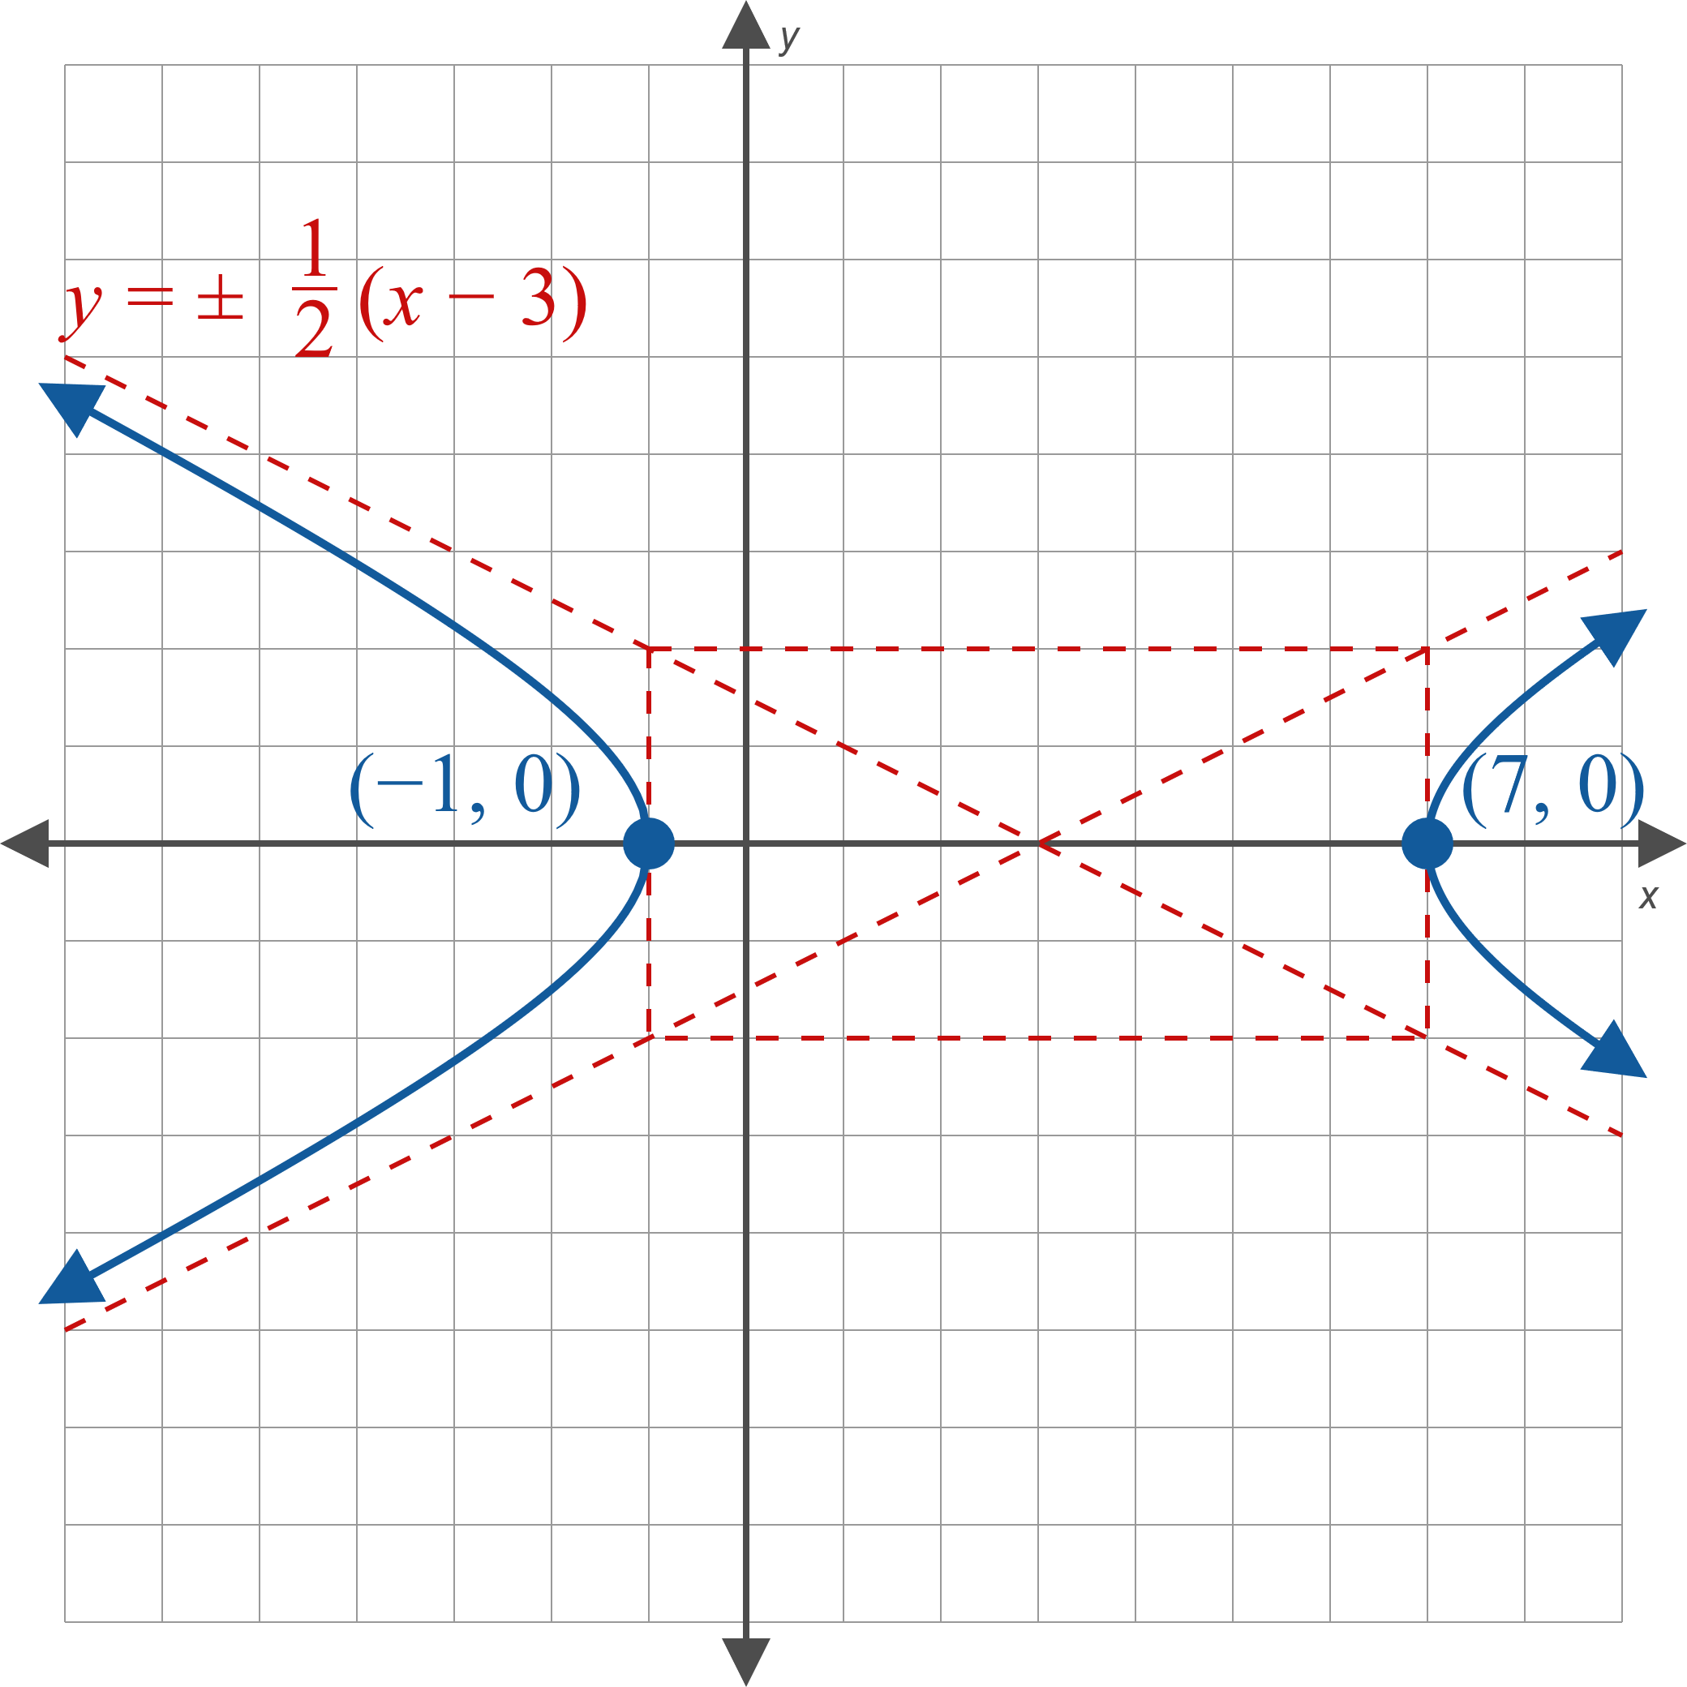
Example 3: Standard Form of the Equation of a Hyperbola (cont.)
Figure 7

Slide 20
Example 4: LORAN
A ship measures a time difference of 0.000108 seconds between the signals of two LORAN signals sent from stations 100 miles apart along a coastline. If the ship maintains this time difference, where will it land on the coastline? Assume that the signal moves at the speed of light (186,000 miles per second).

Slide 21
Note:
As usual, setting up a convenient system of coordinates can make the resulting equations simpler.

Slide 22

Example 4: LORAN (cont.)
Solution
Begin by graphing the situation in the Cartesian plane. We place the two stations (which are the foci of the hyperbola) at $(−50,0)$ and $(50,0)$. The ship must lie on the hyperbola (and hopefully is in the water).

Slide 23
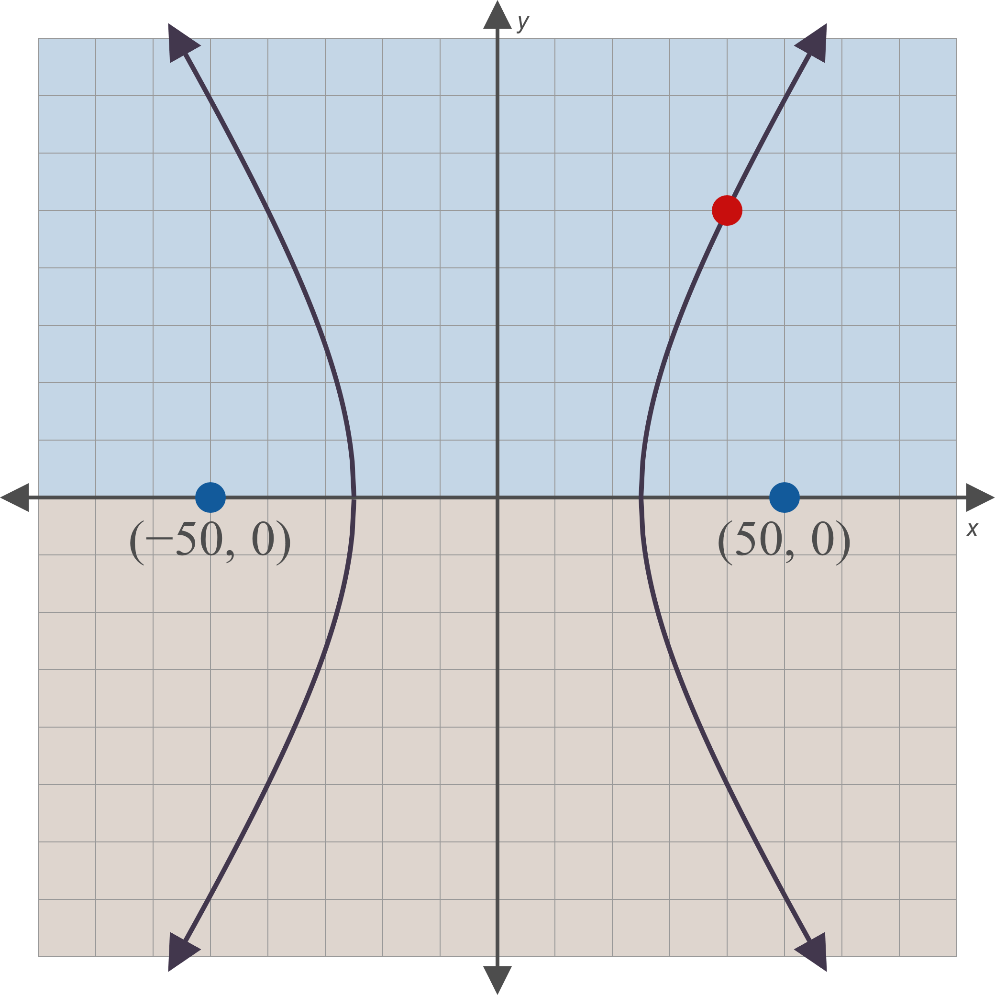
Example 4: LORAN (cont.)
Figure 9

Slide 24
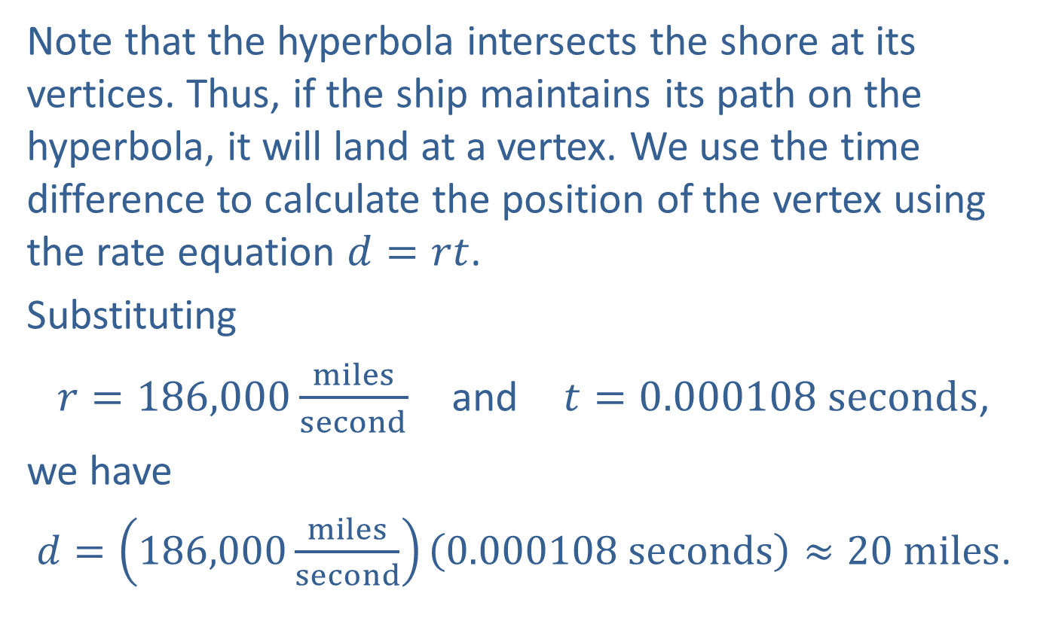
Example 4: LORAN (cont.)
Note that the hyperbola intersects the shore at its vertices. Thus, if the ship maintains its path on the hyperbola, it will land at a vertex. We use the time difference to calculate the position of the vertex using the rate equation $d=rt$.
Substituting
$r=186,000\frac{miles}{second}$ and $t=0.000108 seconds$,
we have
$d=\left(186,000\frac{miles}{second}\right)\left(0.000108 seconds\right)≈20 miles$.

Slide 25
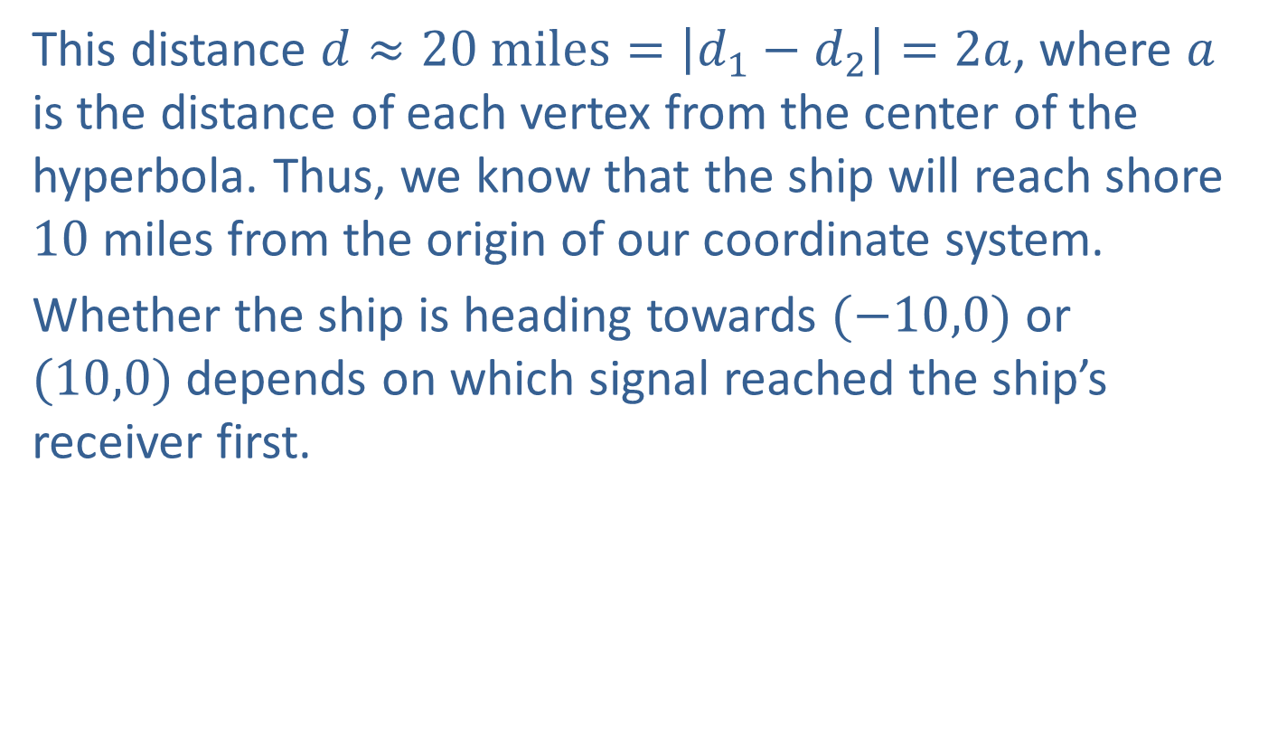
Example 4: LORAN (cont.)
This distance $d≈20 \text{miles}=\left|d_{1}−d_{2}\right|=2a$, where $a$ is the distance of each vertex from the center of the hyperbola. Thus, we know that the ship will reach shore 10 miles from the origin of our coordinate system.
Whether the ship is heading towards $(−10,0)$ or $(10,0)$ depends on which signal reached the ship’s receiver first.

