Slide 1
Section 12.1
Solving Systems of Linear Equations by Substitution and Elimination

Slide 2
Solutions to Systems of Linear Equations
Definition
​A system of linear equations with no solution is called inconsistent.
​A system of linear equations that has at least one solution is called consistent.
​A consistent system with exactly one solution is called independent.
​A consistent system with more than one solution must have an infinite number of solutions and is called dependent.

Slide 3

Example 1: Solving an Independent System by Substitution
Use the method of substitution to solve the system
$\left\{\begin{aligned}2x−y=1 \\ x+y=5\end{aligned}\right..$

Slide 4
Note:
Solving for a variable with a coefficient of 1 will make the process of substitution a bit easier.

Slide 5
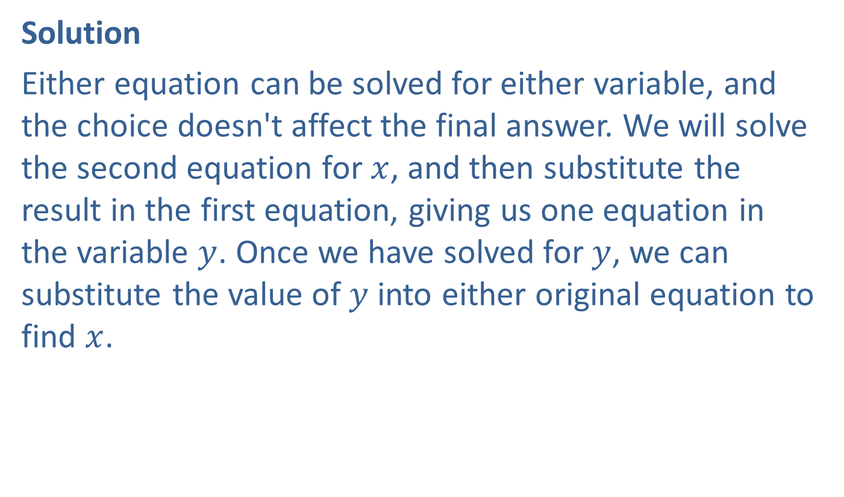
Example 1: Solving an Independent System by Substitution (cont.)
Solution
Either equation can be solved for either variable, and the choice doesn't affect the final answer. We will solve the second equation for $x$, and then substitute the result in the first equation, giving us one equation in the variable $y$. Once we have solved for $y$, we can substitute the value of $y$ into either original equation to find $x$.

Slide 6
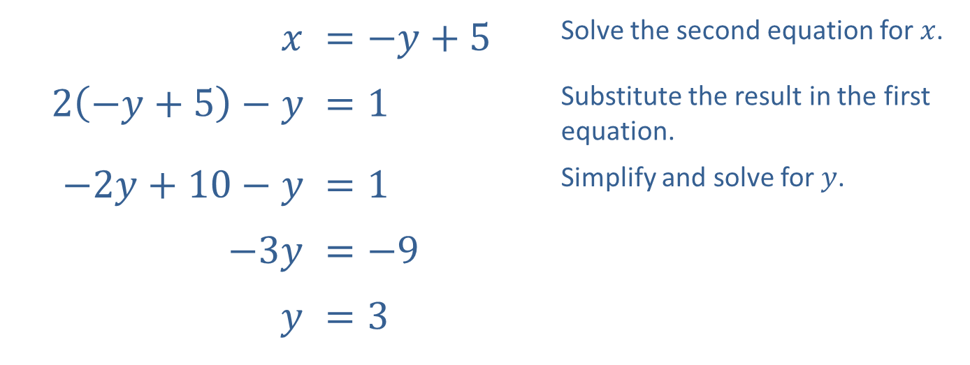
Example 1: Solving an Independent System by Substitution (cont.)
$$x$$ | ​$=−y+5$ | Solve the second equation for $x$.
​$2\left(−y+5\right)−y$ | ​$=1$ | Substitute the result in the first equation.
​$−2y+10−y$ | ​$=1$ | Simplify and solve for $y$.
​$−3y$ | ​$=−9$
$$y$$ | ​$=3$

Slide 7
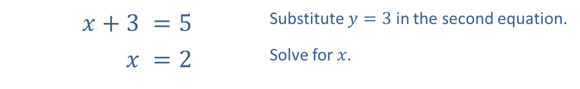

Example 1: Solving an Independent System by Substitution (cont.)
We then substitute our answer for $y$ into the original second equation.
​$x+3$ | ​$=5$ | Substitute $y=3$ in the second equation.
$$x$$ | ​$=2$ | Solve for $x$.

Slide 8

Example 1: Solving an Independent System by Substitution (cont.)
Thus, the solution to the system of equations is $\left(2\text{, }3\right)$.
Note how the graph in Figure 2 corresponds to the system and the ordered pair solution that we have found.

Slide 9
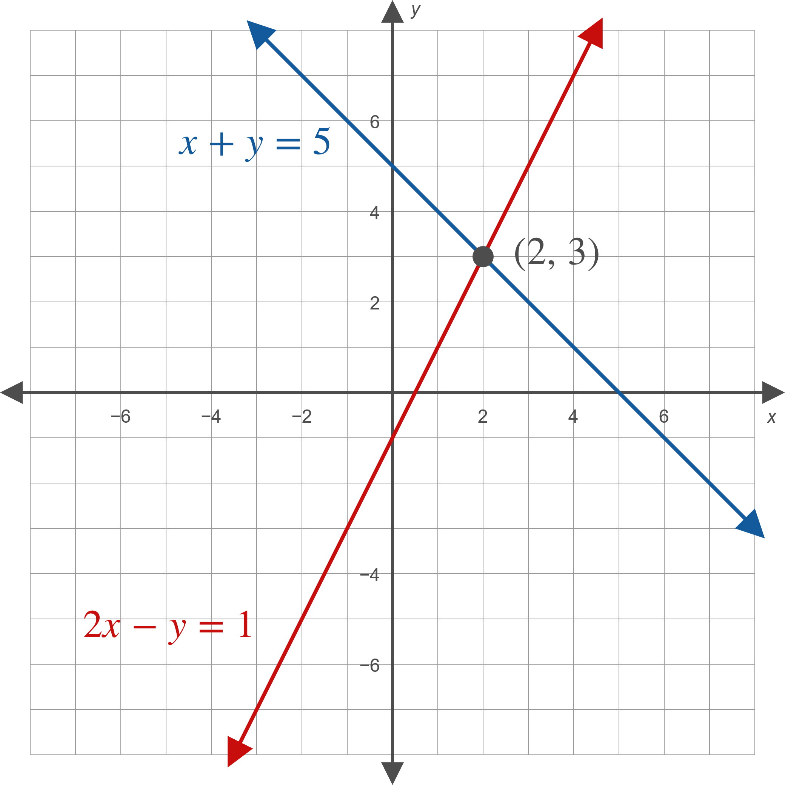
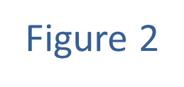
Example 1: Solving an Independent System by Substitution (cont.)

Slide 10

Example 2: Solving a Dependent System by Substitution
Use the method of substitution to solve the system
$\left\{\begin{matrix}−2x+6y & =6 \\ x+3 & =3y\end{matrix}\right.$.

Slide 11
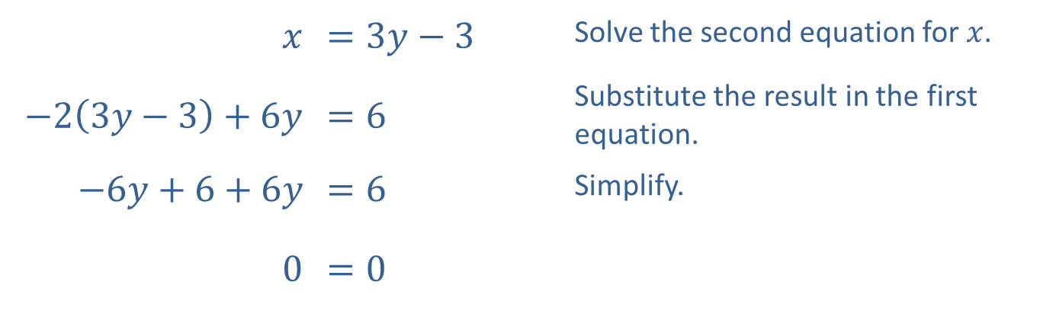
Example 2: Solving a Dependent System by Substitution (cont.)
Solution
$$x$$ | ​$=3y−3$ | Solve the second equation for $x$.
​$−2\left(3y−3\right)+6y$ | ​$=6$ | Substitute the result in the first equation.
​$−6y+6+6y$ | ​$=6$ | Simplify.
​0 | ​$=0$

Slide 12
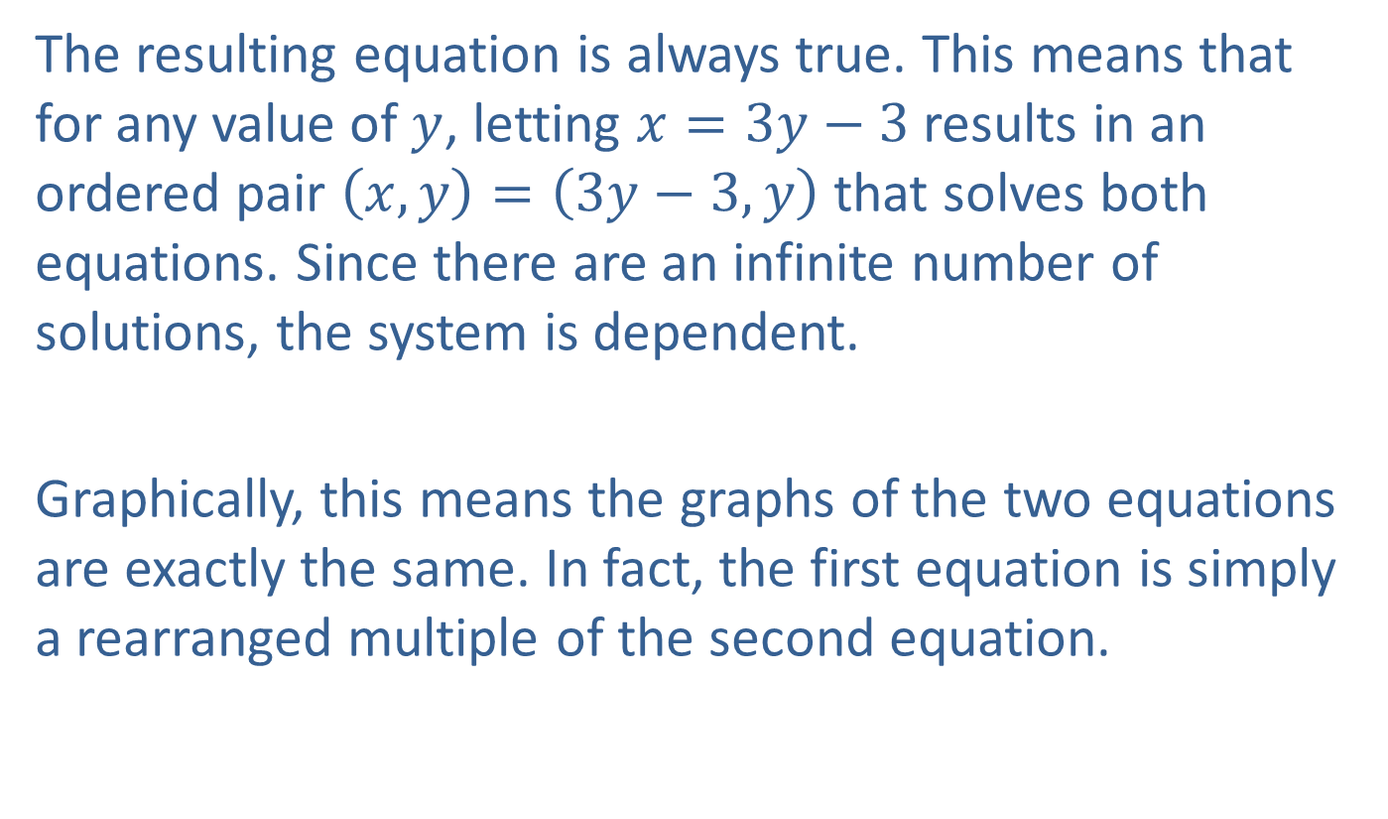
Example 2: Solving a Dependent System by Substitution (cont.)
The resulting equation is always true. This means that for any value of $y$, letting $x=3y−3$ results in an ordered pair $\left(x,y\right)=\left(3y−3,y\right)$ that solves both equations. Since there are an infinite number of solutions, the system is dependent.
Graphically, this means the graphs of the two equations are exactly the same. In fact, the first equation is simply a rearranged multiple of the second equation.

Slide 13

Example 2: Solving a Dependent System by Substitution (cont.)
Algebraically, we can describe the solution set as
$\{\left(3y−3,y\right)|y∈ℝ\}$. If we had solved either equation for $y$ instead of $x$, we would have obtained the alternative but equivalent solution $\left\{\left(x,\frac{x+3}{3}\right)|x∈ℝ\right\}$.

Slide 14

Example 3: Solving an Independent System by Elimination
Use the method of elimination to solve the system
$\left\{\begin{aligned}5x+3y=−7 \\ 7x−6y=−20\end{aligned}\right.$.

Slide 15
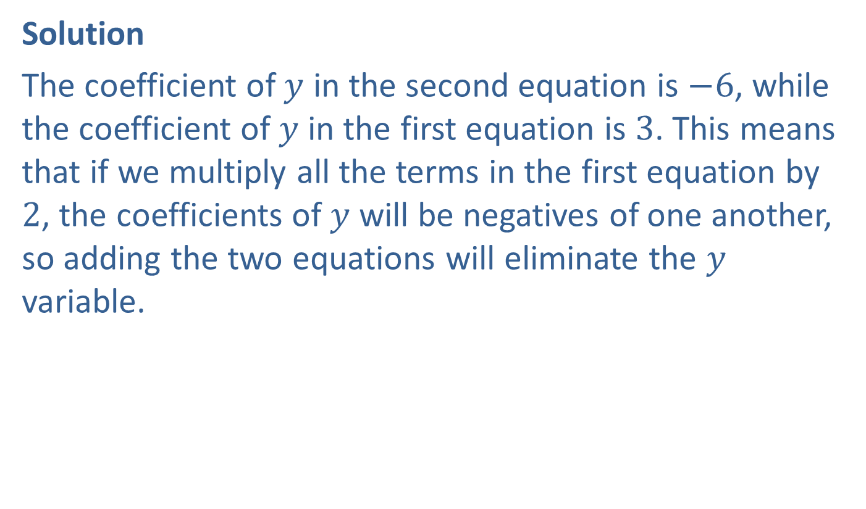
Example 3: Solving an Independent System by Elimination (cont.)
Solution
The coefficient of $y$ in the second equation is $−6$, while the coefficient of $y$ in the first equation is 3. This means that if we multiply all the terms in the first equation by 2, the coefficients of $y$ will be negatives of one another, so adding the two equations will eliminate the $y$ variable.

Slide 16
Example 3: Solving an Independent System by Elimination (cont.)
In order to keep track of these steps, we annotate our work with labeled arrows. When we modify the system, we are not changing the solutions, we are just writing an equivalent system that is easier to solve. The ultimate goal is to rewrite the system so that we can "read off" the answer.

Slide 17
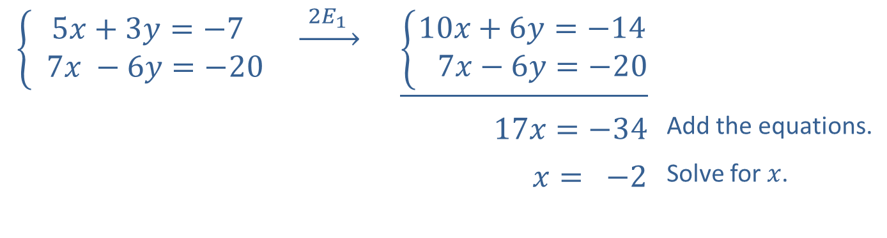
Example 3: Solving an Independent System by Elimination (cont.)
The notation above the arrow indicates that we have modified the system by multiplying each term in equation 1 by the constant 2.
$$\left\{\begin{aligned}5x+3y=−7 \\ 7x −6y=−20\end{aligned}\right.$$ | $$\underset{→}{ 2E_{1 } }$$ | $$\underline{\left\{\begin{aligned}10x+6y=−14 \\ 7x−6y=−20\end{aligned}\right.}$$
 |  | $$17x=−34$$ | Add the equations.
 |  | $$x= −2$$ | Solve for $x$.

Slide 18
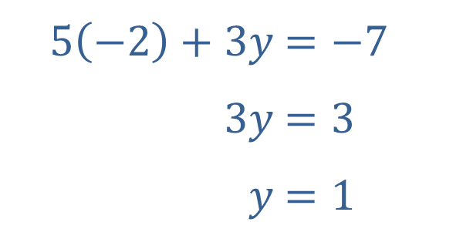

Example 3: Solving an Independent System by Elimination (cont.)
We can then substitute $x=−2$ into either of the original equations to determine $y$. Here, we substitute into the first equation of the original system.
​
​$5\left(−2\right)+3y$ | ​$=−7$
​$3y$ | ​$=3$
​$y$ | ​$=1$

Slide 19

Example 3: Solving an Independent System by Elimination (cont.)
The ordered pair $(−2,1)$ is thus the solution of the system. Note that using the second equation gives the same $y$-value and is a good way to check our work.

Slide 20

Example 4: Solving an Inconsistent System by Elimination
Use the method of elimination to solve the system
$\left\{\begin{matrix}2x−3y & =3 \\ 3x−\frac{9}{2}y & =5\end{matrix}\right.$.

Slide 21
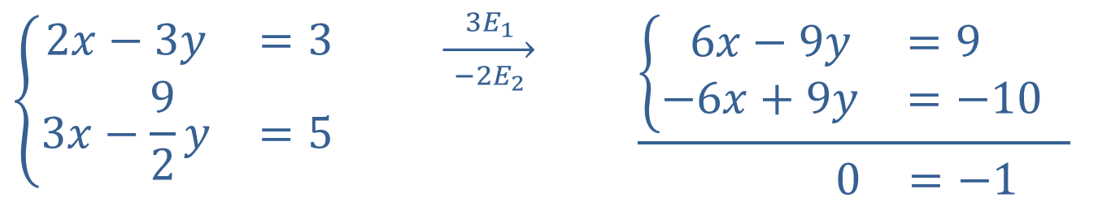

Example 4: Solving an Inconsistent System by Elimination (cont.)
Solution
Eliminate the variable $x$ by multiplying both equations by a constant.
$$\left\{\begin{matrix}2x−3y & =3 \\ 3x−\frac{9}{2}y & =5\end{matrix}\right.$$ | $$\overset{ 3E_{1 }}{\overset{→}{ −2E_{2 }}}$$ | 6𝑥−9𝑦=9 1−6𝑥+9𝑦=−101 0=−1

Slide 22
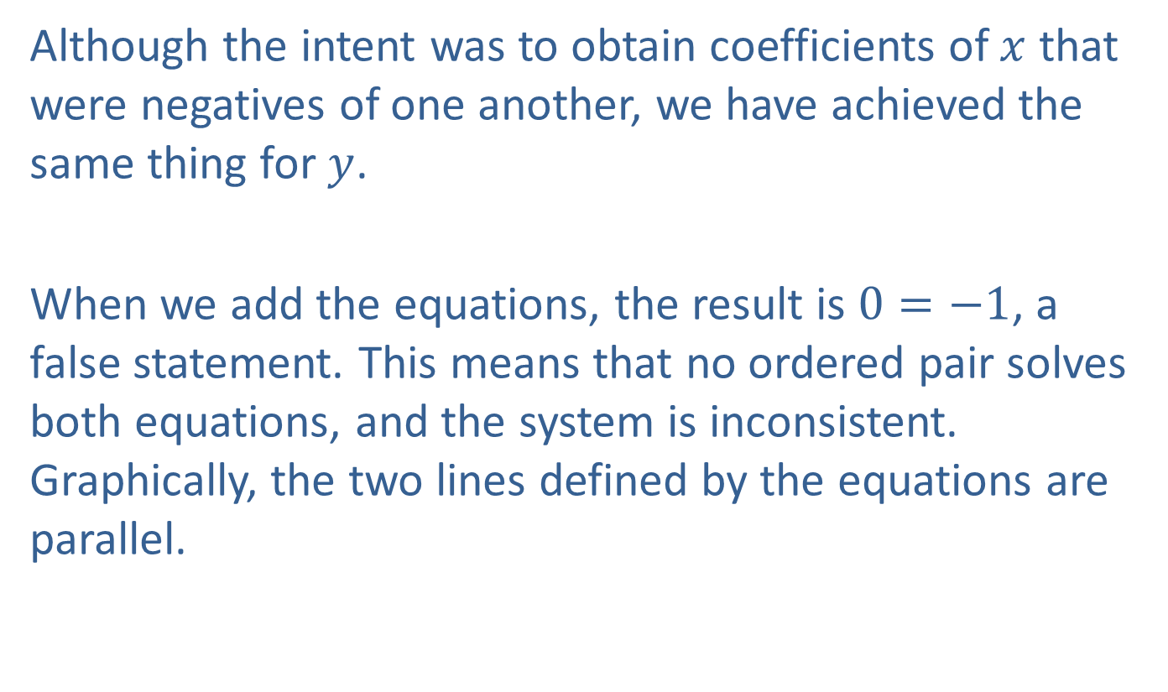
Example 4: Solving an Inconsistent System by Elimination (cont.)
Although the intent was to obtain coefficients of $x$ that were negatives of one another, we have achieved the same thing for $y$.
When we add the equations, the result is $0=−1$, a false statement. This means that no ordered pair solves both equations, and the system is inconsistent. Graphically, the two lines defined by the equations are parallel.

Slide 23

Example 5: Solving an Independent System by Elimination
Solve the system $\left\{\begin{matrix}2x+ y+z & =6 \\ 2x+3y−z & =−2 \\ −3x+2y−z & =5\end{matrix}\right.$.

Slide 24
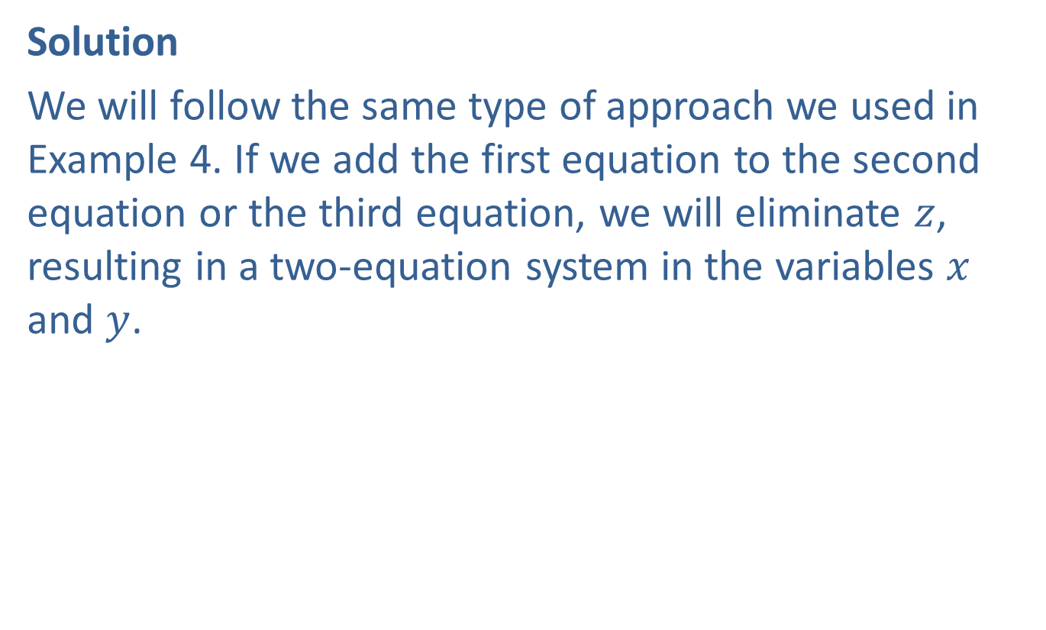
Example 5: Solving an Independent System by Elimination (cont.)
Solution
We will follow the same type of approach we used in Example 4. If we add the first equation to the second equation or the third equation, we will eliminate $z$, resulting in a two-equation system in the variables $x$ and $y$.

Slide 25
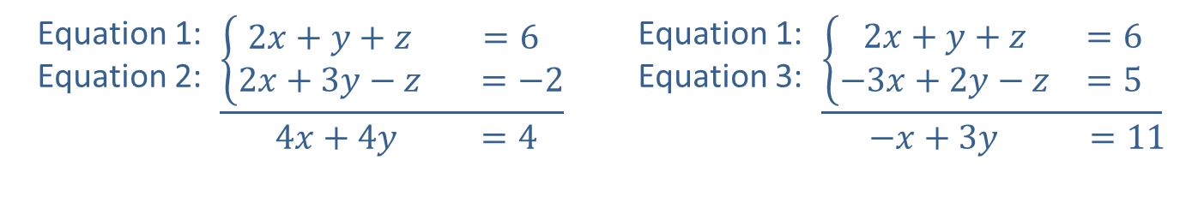
Example 5: Solving an Independent System by Elimination (cont.)
Equation 1: Equation 2: | $$\underline{\left\{\begin{matrix}2x+y+z & =6 \\ 2x+3y−z & =−2\end{matrix}\right.} \\ \begin{matrix} 4x+4y & =4\end{matrix}$$ | Equation 1: Equation 3: | 2𝑥+𝑦+𝑧=61−3𝑥+2𝑦−𝑧=51 −𝑥+3𝑦 =11

Slide 26
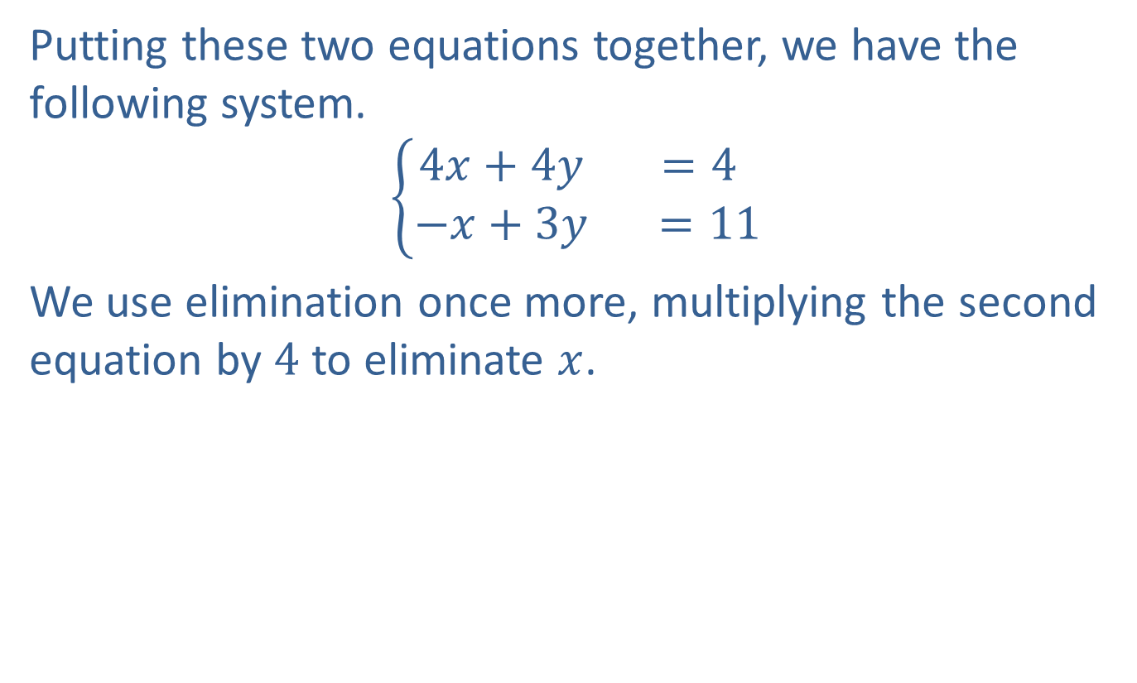
Example 5: Solving an Independent System by Elimination (cont.)
Putting these two equations together, we have the following system.
$$\left\{\begin{matrix}4x+4y & =4 \\ −x+3y & =11\end{matrix}\right.$$
We use elimination once more, multiplying the second equation by 4 to eliminate $x$.

Slide 27
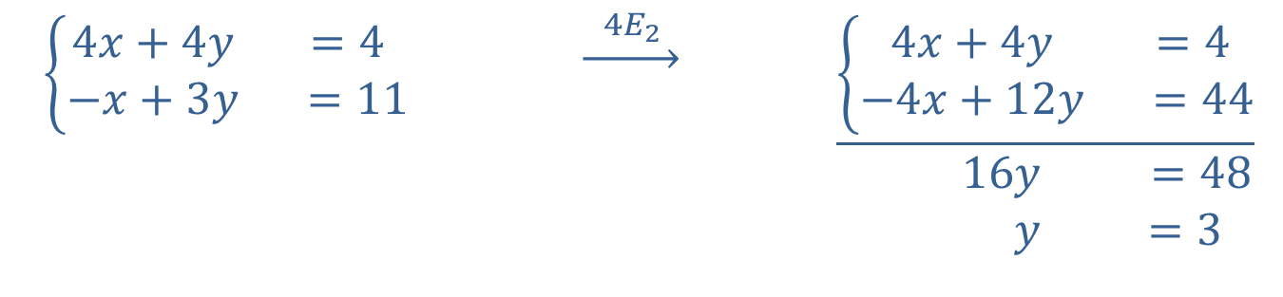
Example 5: Solving an Independent System by Elimination (cont.)
$\left\{\begin{matrix}4x+4y & =4 \\ −x+3y & =11\end{matrix}\right.$ | $$\underset{→}{ 4E_{2 }}$$ | $$\underline{\left\{\begin{matrix}4x+4y & =4 \\ −4x+12y & =44\end{matrix}\right.} \\ \begin{matrix} 16y & =48 \\ y & =3\end{matrix}$$

Slide 28
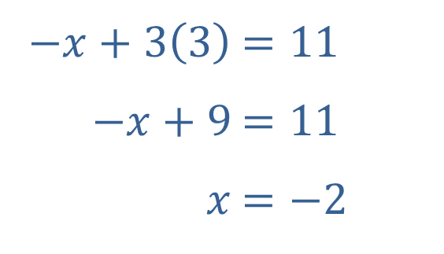

Example 5: Solving an Independent System by Elimination (cont.)
Now that we have solved for $y$, we can plug this back into one of the equations from the two variable system to solve for $x$.
​
​$−x+3\left(3\right)$ | ​$=11$
​$−x+9$ | ​$=11$
​$x$ | ​$=−2$

Slide 29
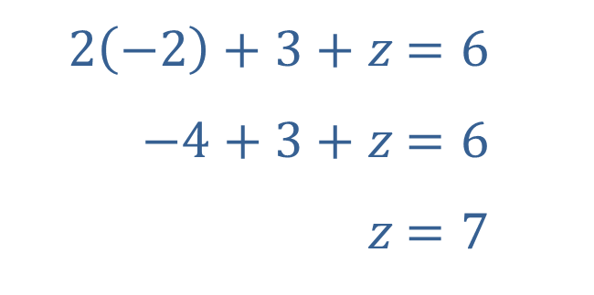
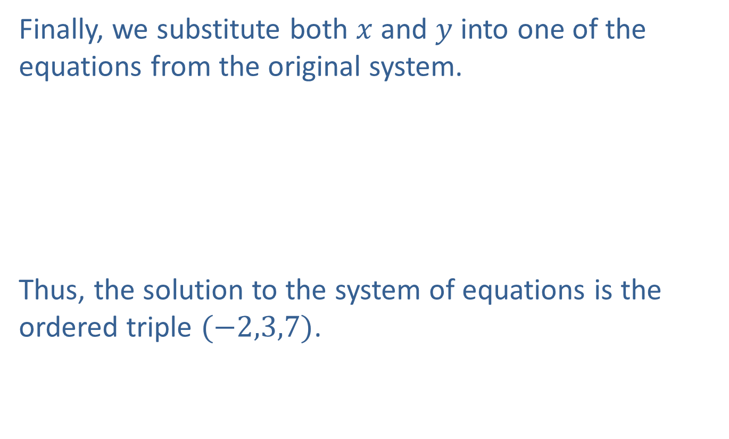
Example 5: Solving an Independent System by Elimination (cont.)
Finally, we substitute both $x$ and $y$ into one of the equations from the original system.
​
Thus, the solution to the system of equations is the ordered triple $(−2,3,7)$.
​$2\left(−2\right)+3+z$ | ​$=6$
​$−4+3+z$ | ​$=6$
​$z$ | ​$=7$

Slide 30

Example 6: Solving a Dependent System by Elimination
Solve the system $\left\{\begin{matrix}3x−5y+z & = & −10 \\ −x+2y−3z & = & −7 \\ x−y−5z & = & −24\end{matrix}\right.$.

Slide 31
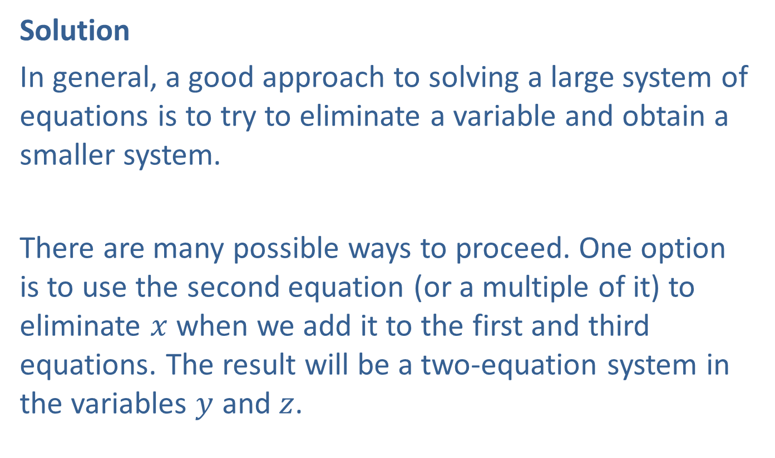
Example 6: Solving a Dependent System by Elimination (cont.)
Solution
In general, a good approach to solving a large system of equations is to try to eliminate a variable and obtain a smaller system.
There are many possible ways to proceed. One option is to use the second equation (or a multiple of it) to eliminate $x$ when we add it to the first and third equations. The result will be a two-equation system in the variables $y$ and $z$.

Slide 32
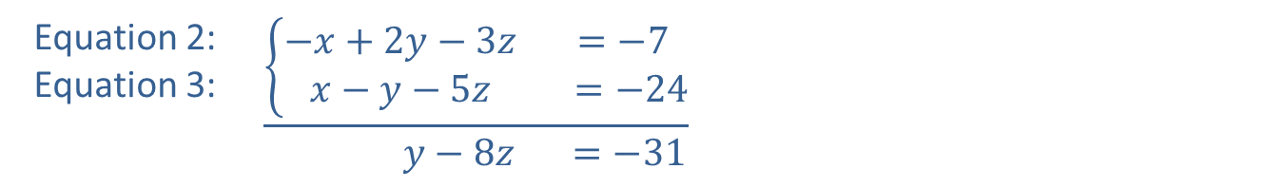
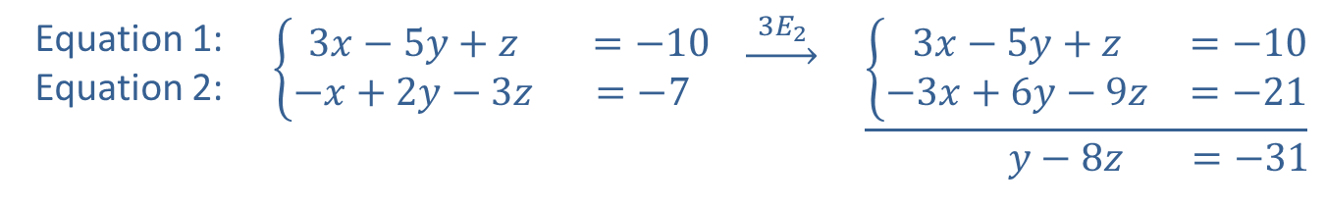
Example 6: Solving a Dependent System by Elimination (cont.)
Equation 1: Equation 2: | $$\left\{\begin{matrix}3x−5y+z & =−10 \\ −x+2y−3z & =−7\end{matrix}\right.$$ | $$\underset{→}{ 3E_{2 }}$$ | $$\underline{\left\{\begin{matrix}3x−5y+z & =−10 \\ −3x+6y−9z & =−21\end{matrix}\right.} \\ \begin{matrix}y−8z & =−31\end{matrix}$$
Equation 2: Equation 3: | $$\underline{\left\{\begin{matrix}−x+2y−3z & =−7 \\ x−y−5z & =−24\end{matrix}\right.} \\ \begin{matrix} y−8z & =−31\end{matrix}$$

Slide 33
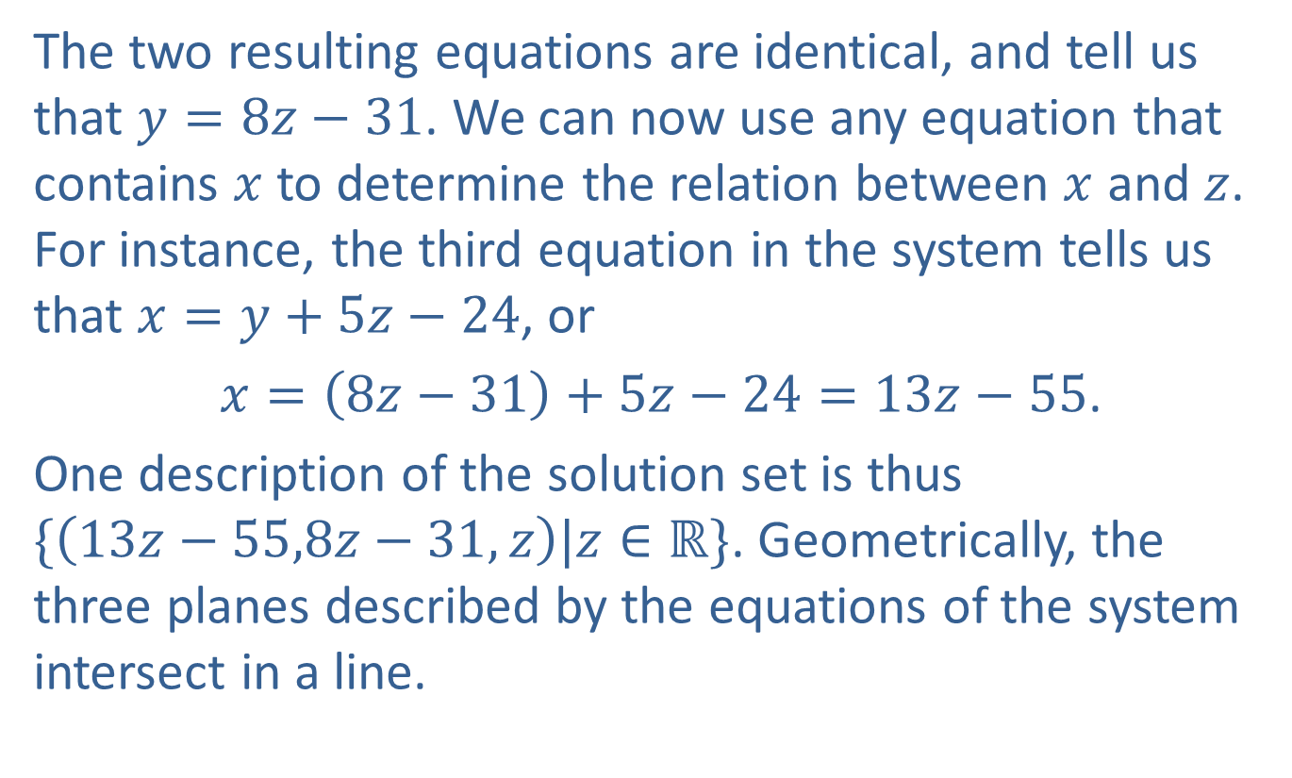
Example 6: Solving a Dependent System by Elimination (cont.)
The two resulting equations are identical, and tell us that $y=8z−31$. We can now use any equation that contains $x$ to determine the relation between $x$ and $z$. For instance, the third equation in the system tells us that $x=y+5z−24$, or
$x=\left(8z−31\right)+5z−24=13z−55$.
One description of the solution set is thus
$\{\left(13z−55,8z−31,z\right)|z∈ℝ\}$. Geometrically, the three planes described by the equations of the system intersect in a line.

Slide 34

Example 7: Mixing Alloys
A foundry needs to produce 75 tons of an alloy that is $34\%$ copper. It has supplies of $9\%$ copper alloy and $84\%$ copper alloy. How many tons of each alloy must be mixed to obtain the desired result?

Slide 35
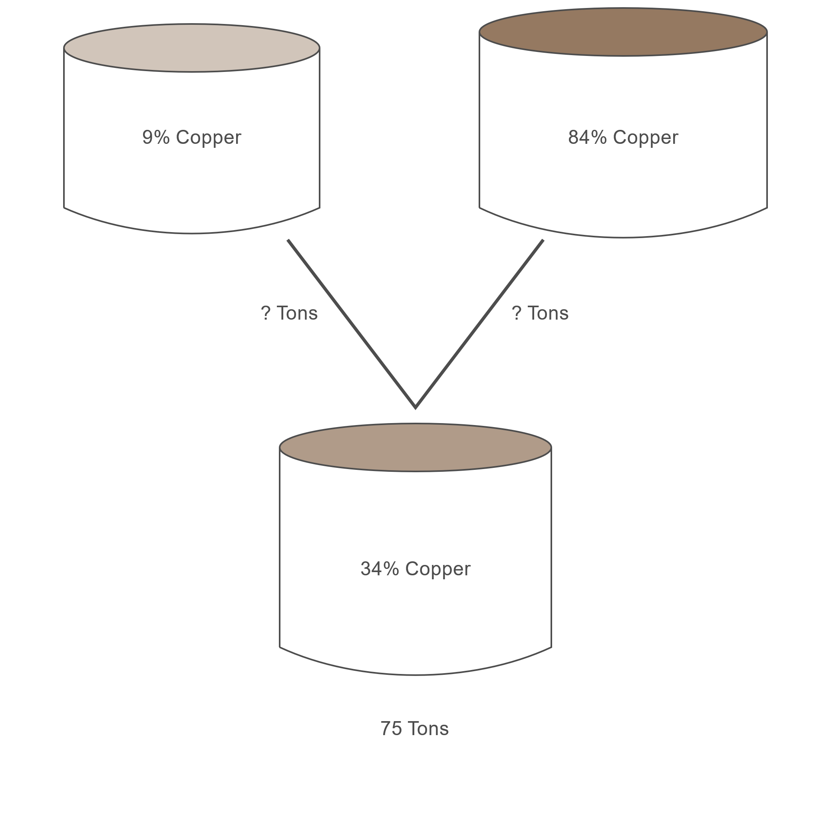
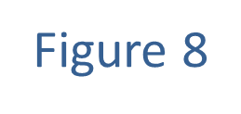
Example 7: Mixing Alloys (cont.)

Slide 36

Example 7: Mixing Alloys (cont.)
Solution
Let $x$ represent the number of tons of $9\%$ copper alloy needed, and $y$ the number of tons of $84\%$ copper alloy needed. We have two variables, so we will need two equations to find the solution.

Slide 37
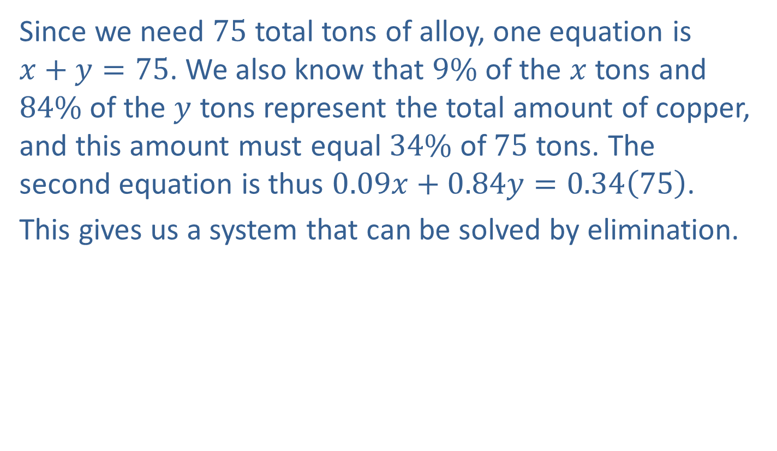
Example 7: Mixing Alloys (cont.)
Since we need 75 total tons of alloy, one equation is
$x+y=75$. We also know that $9\%$ of the $x$ tons and $84\%$ of the $y$ tons represent the total amount of copper, and this amount must equal $34\%$ of 75 tons. The second equation is thus $0.09x+0.84y=0.34\left(75\right)$.
This gives us a system that can be solved by elimination.

Slide 38
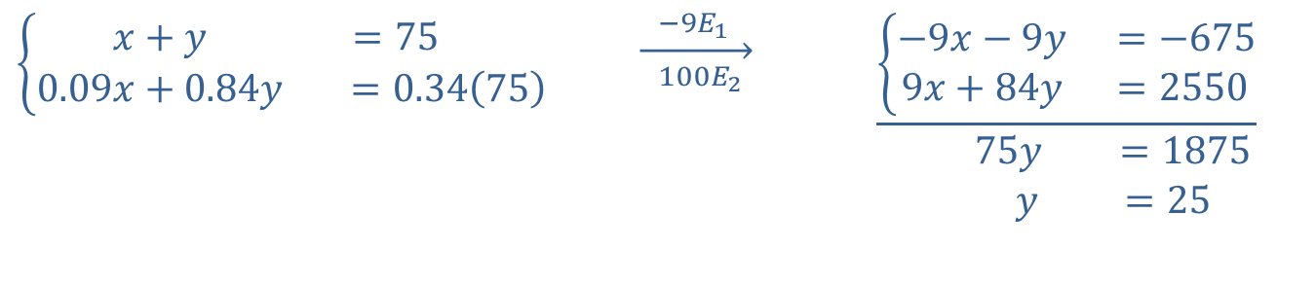
Example 7: Mixing Alloys (cont.)
$$\left\{\begin{matrix}x+y & =75 \\ 0.09x+0.84y & =0.34\left(75\right)\end{matrix}\right.$$ | $$\overset{ −9E_{1 } }{\overset{→}{ 100E_{2 } }}$$ | $$\underline{\left\{\begin{matrix}−9x−9y & =−675 \\ 9x+84y & =2550\end{matrix}\right.} \\ \begin{matrix} 75y & =1875 \\ y & =25\end{matrix}$$

Slide 39

Example 7: Mixing Alloys (cont.)
Substituting back, we have $x+25=75$, so $x=50$. Thus, 50 tons of $9\%$ alloy and 25 tons of $84\%$ alloy are needed.

Slide 40
Example 8: Determining Ages
If the ages of three girls, Xenia, Yolanda, and Zsa Zsa, are added, the result is 30. The sum of Xenia's and Yolanda's ages is Zsa Zsa's age, while Xenia's age subtracted from Yolanda's is half of Zsa Zsa's age a year ago. How old is each girl?

Slide 41
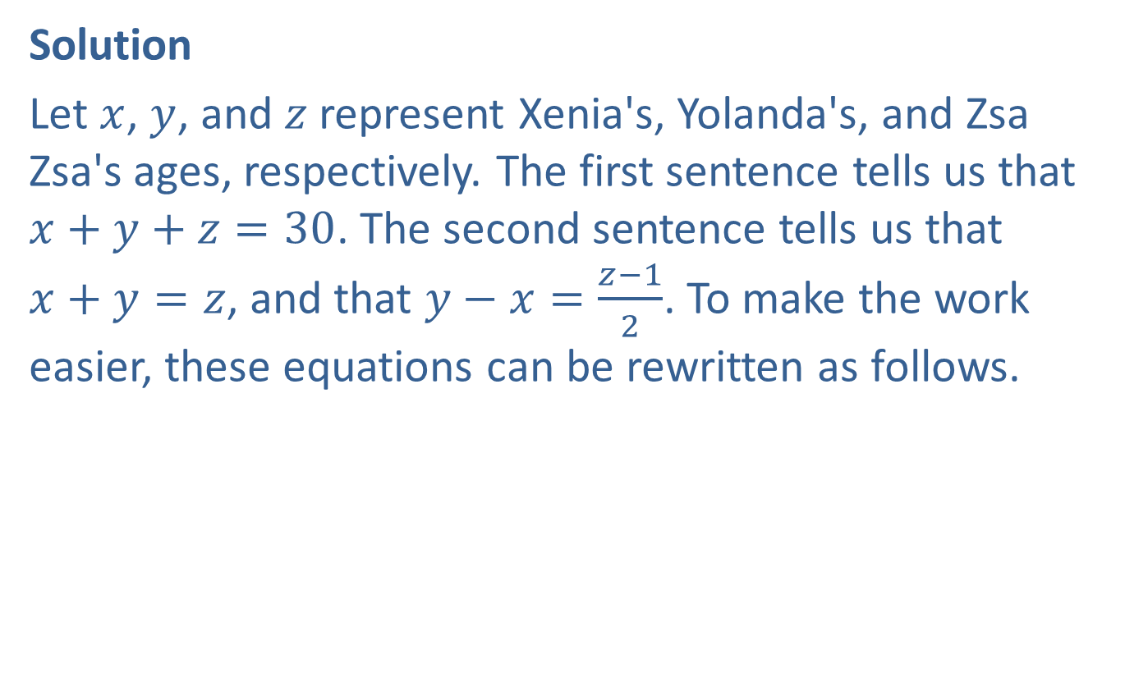
Example 8: Determining Ages (cont.)
Solution
Let $x$, $y$, and $z$ represent Xenia's, Yolanda's, and Zsa Zsa's ages, respectively. The first sentence tells us that $x+y+z=30$. The second sentence tells us that
$x+y=z$, and that $y−x=\frac{z−1}{2}$. To make the work easier, these equations can be rewritten as follows.

Slide 42
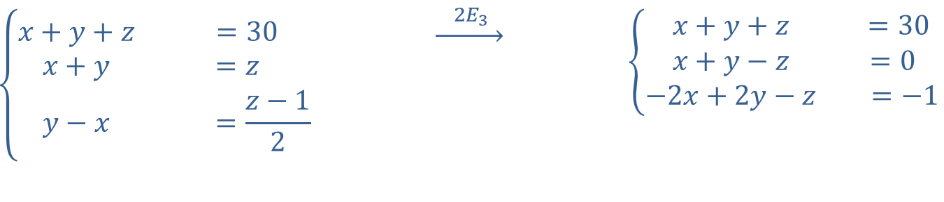
Example 8: Determining Ages (cont.)
$$\left\{\begin{matrix}x+y+z & =30 \\ x+y & =z \\ y−x & =\frac{z−1}{2}\end{matrix}\right.$$ | $$\underset{→}{ 2E_{3 }}$$ | $$\left\{\begin{matrix}x+y+z & =30 \\ x+y−z & =0 \\ −2x+2y−z & =−1\end{matrix}\right.$$

Slide 43
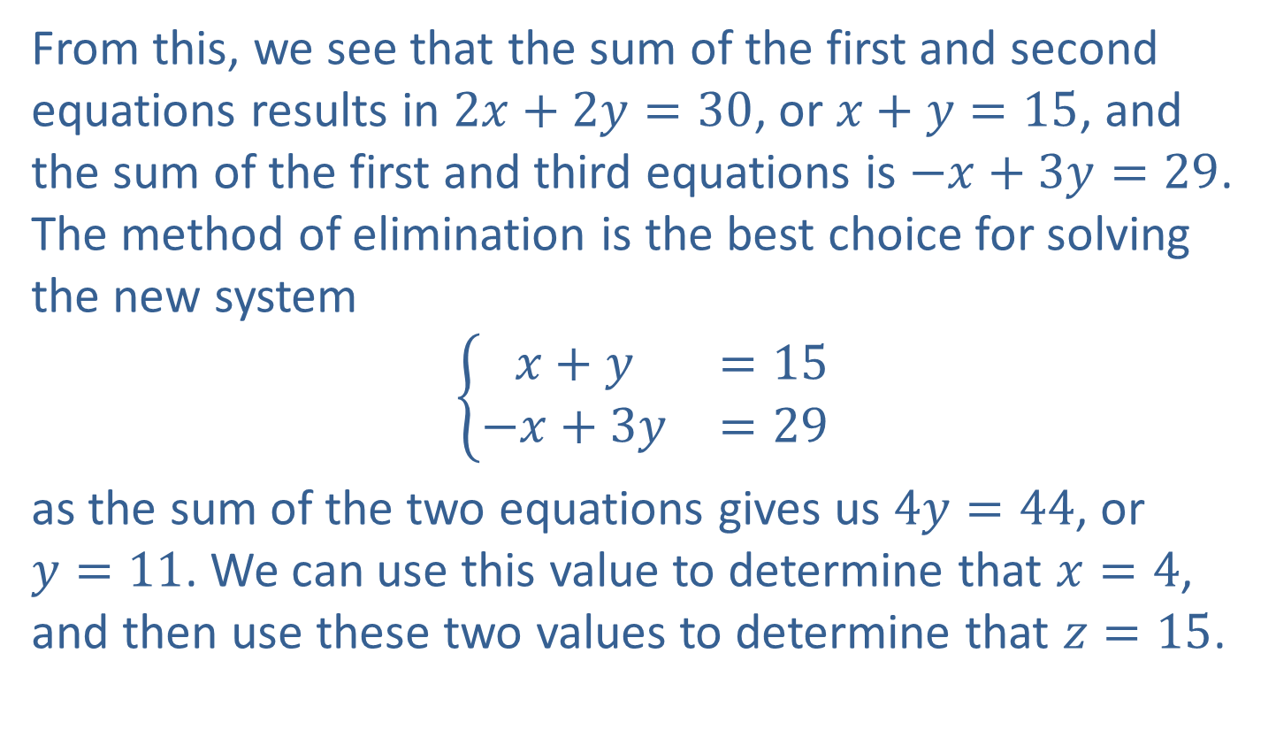
Example 8: Determining Ages (cont.)
From this, we see that the sum of the first and second equations results in $2x+2y=30$, or $x+y=15$, and the sum of the first and third equations is $−x+3y=29$. The method of elimination is the best choice for solving the new system
$$\left\{\begin{matrix}x+y & =15 \\ −x+3y & =29\end{matrix}\right.$$
as the sum of the two equations gives us $4y=44$, or
$y=11$. We can use this value to determine that $x=4$, and then use these two values to determine that $z=15$.

Slide 44

Example 8: Determining Ages (cont.)
Geometrically, it means that the ordered triple $(4,11,15)$ is the point of intersection of the three planes described by these equations. In context, it means that Xenia is 4, Yolanda is 11, and Zsa Zsa is 15.

