Slide 1
Section 12.2
Matrix Notation and Gauss-Jordan Elimination

Slide 2
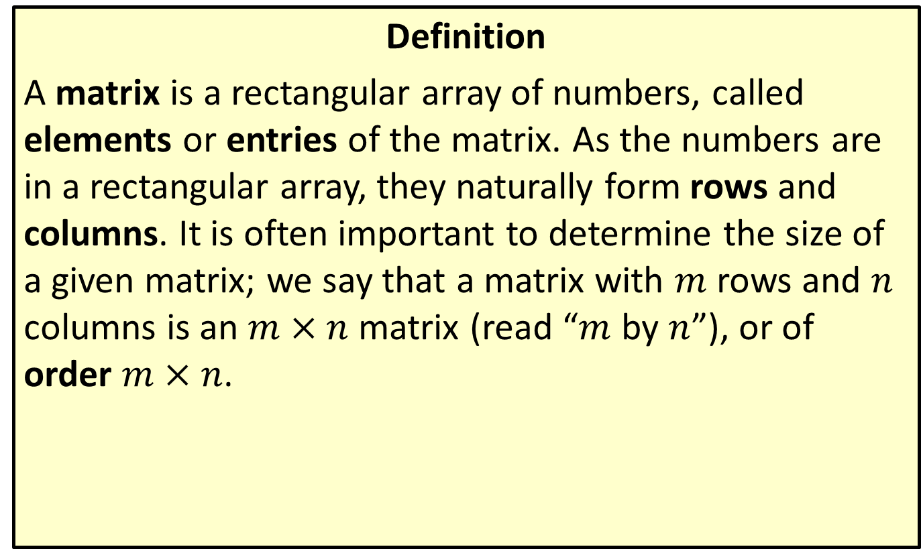
Matrices and Matrix Notation
Definition
A matrix is a rectangular array of numbers, called elements or entries of the matrix. As the numbers are in a rectangular array, they naturally form rows and columns. It is often important to determine the size of a given matrix; we say that a matrix with $m$ rows and $n$ columns is an $m×n$ matrix (read “$m$ by $n$”), or of order $m×n$.

Slide 3
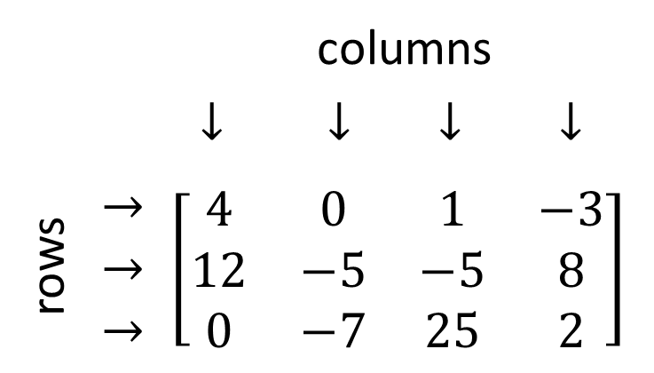
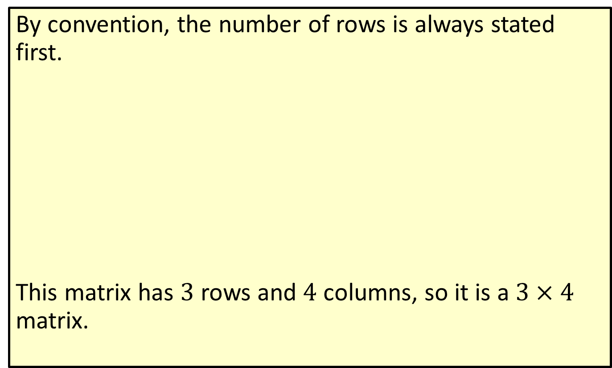
Matrices and Matrix Notation (cont.)
By convention, the number of rows is always stated first.
This matrix has 3 rows and 4 columns, so it is a $3×4$ matrix.
 |  | columns
 |  | $$↓$$ | $$↓$$ | $$↓$$ | $$↓$$
rows | $$→$$ $$→$$ $$→$$ | $$\left[\begin{matrix}4 & 0 & 1 & −3 \\ 12 & −5 & −5 & 8 \\ 0 & −7 & 25 & 2\end{matrix}\right]$$

Slide 4
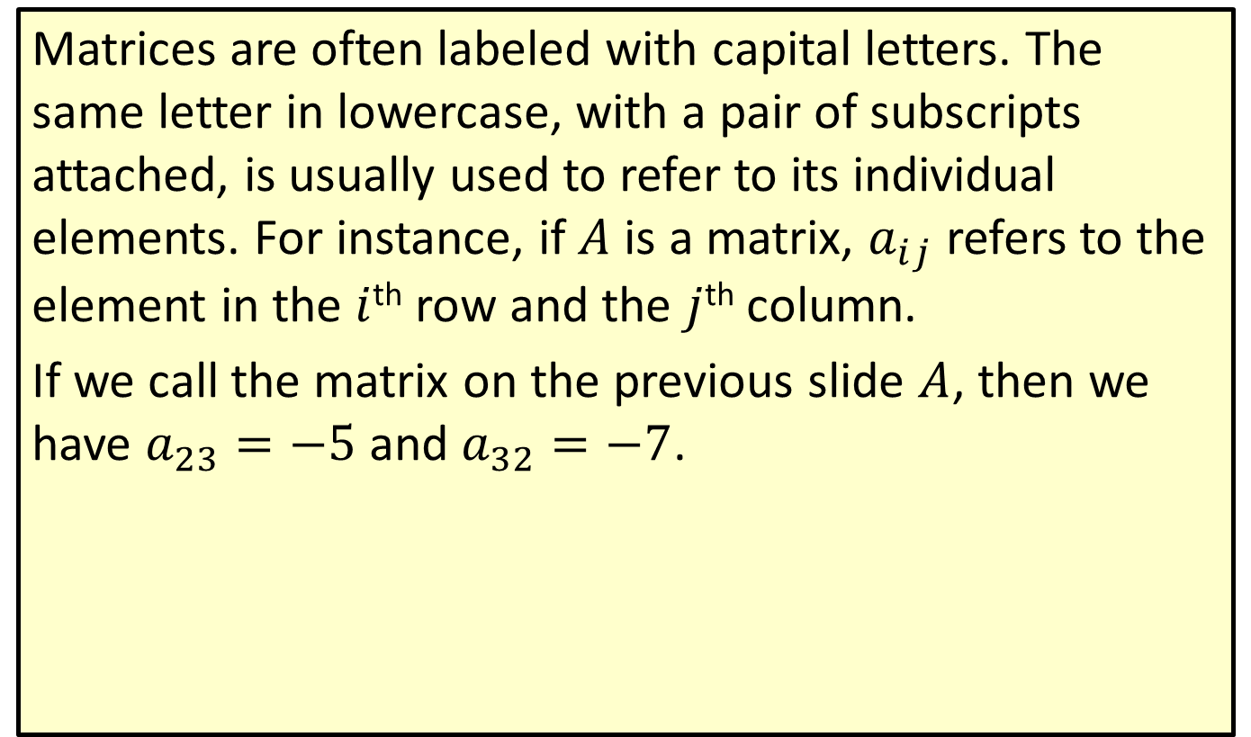
Matrices and Matrix Notation (cont.)
Matrices are often labeled with capital letters. The same letter in lowercase, with a pair of subscripts attached, is usually used to refer to its individual elements. For instance, if $A$ is a matrix, $a_{i⁣j}$ refers to the element in the $i$^{th} row and the $j$^{th} column.
If we call the matrix on the previous slide $A$, then we have $a_{2⁣3}=−5$ and $a_{3⁣2}=−7$.

Slide 5

Example 1: Matrices and Matrix Notation
Given the matrix $A=\left[\begin{matrix}−27 & 0 & 1 \\ 5 & −π & 13\end{matrix}\right]$, determine
​the order of $A$,
the value of $a_{1⁣3}$,
the value of $a_{2⁣1}$.

Slide 6
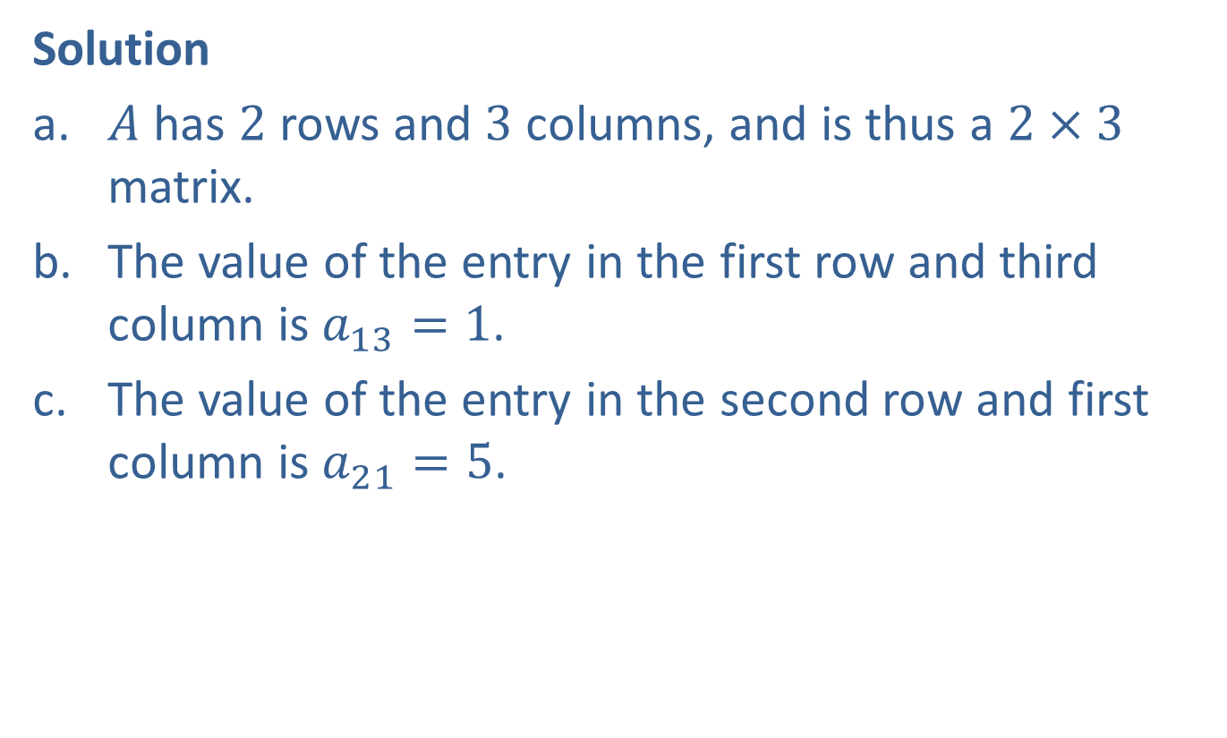
Example 1: Matrices and Matrix Notation (cont.)
Solution
​$A$ has 2 rows and 3 columns, and is thus a $2×3$ matrix.
​The value of the entry in the first row and third column is $a_{1⁣3}=1$.
​The value of the entry in the second row and first column is $a_{2⁣1}=5$.

Slide 7
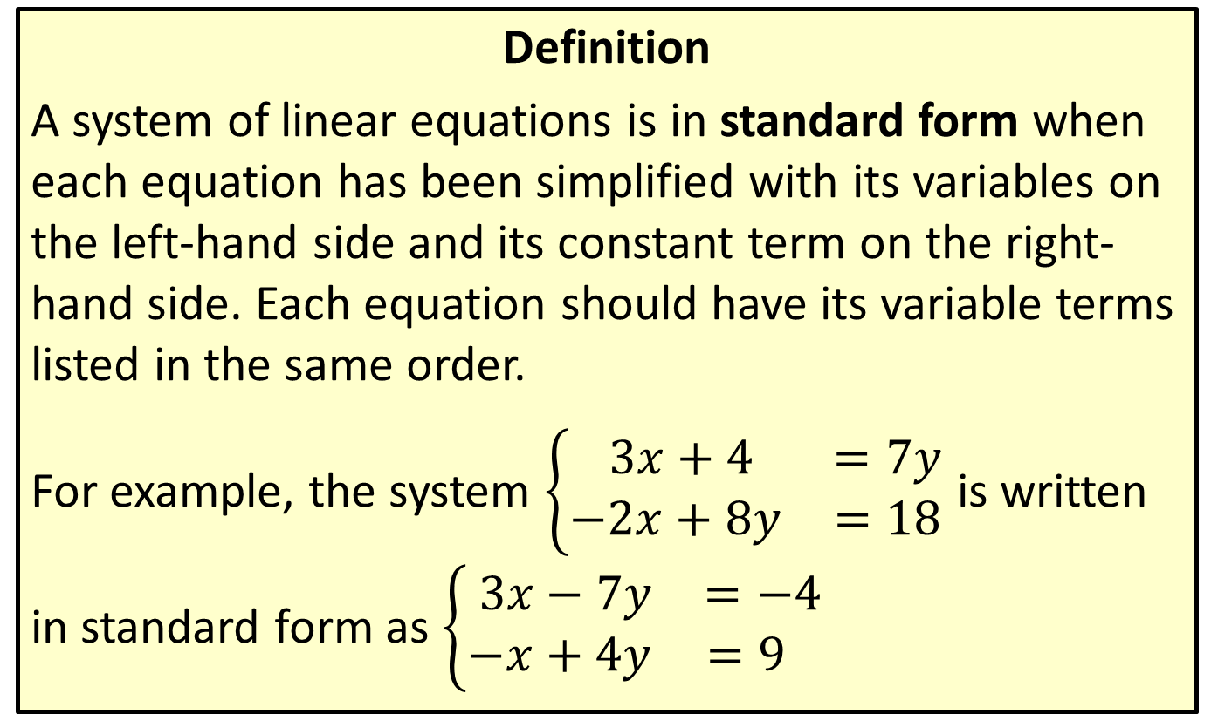
Standard Form of a System of Linear Equations
Definition
A system of linear equations is in standard form when each equation has been simplified with its variables on the left-hand side and its constant term on the right-hand side. Each equation should have its variable terms listed in the same order.
For example, the system $\left\{\begin{matrix} 3x+4 & =7y \\ −2x+8y & =18\end{matrix}\right.$ is written in standard form as $\left\{\begin{matrix} 3x−7y & =−4 \\ −x+4y & =9 \end{matrix}\right.$

Slide 8
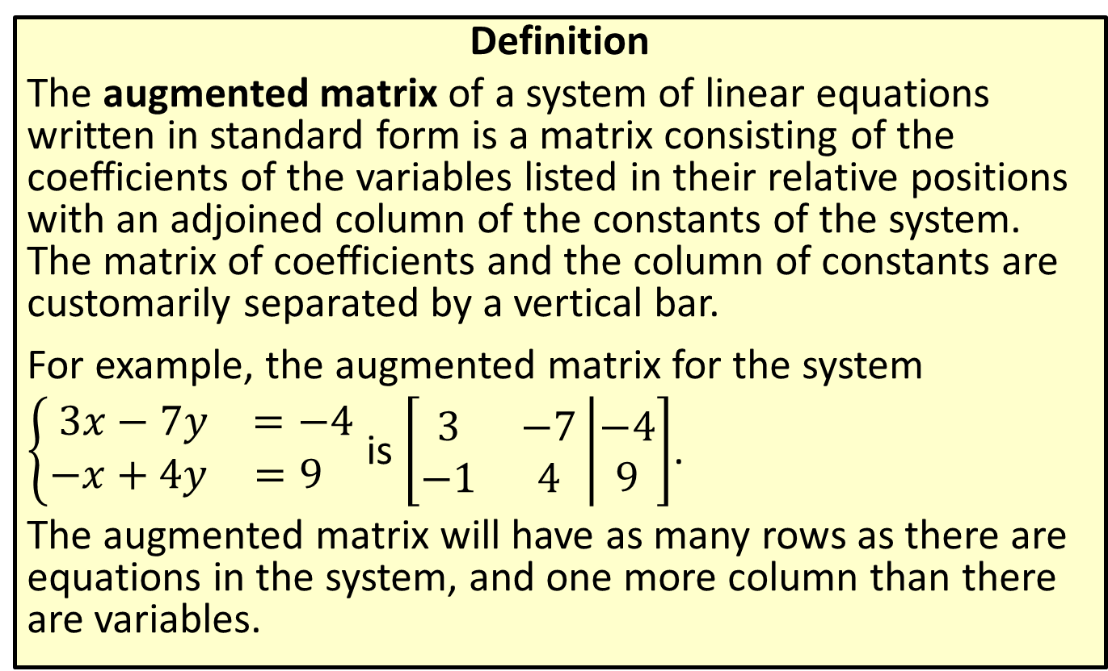
Augmented Matrices
Definition
The augmented matrix of a system of linear equations written in standard form is a matrix consisting of the coefficients of the variables listed in their relative positions with an adjoined column of the constants of the system. The matrix of coefficients and the column of constants are customarily separated by a vertical bar.
For example, the augmented matrix for the system $\left\{\begin{matrix} 3x−7y & =−4 \\ −x+4y & =9 \end{matrix}\right.$ is $\left[\begin{matrix}3 & −7 \\ −1 & 4\end{matrix}\left|\begin{matrix}−4 \\ 9\end{matrix}\right.\right]$.
The augmented matrix will have as many rows as there are equations in the system, and one more column than there are variables.

Slide 9

Example 2: Augmented Matrices
Construct the augmented matrix for the following linear system.
$$\left\{\begin{matrix}\frac{2x−6y}{2} & =3−z \\ z−x+5y & =12 \\ x+3y−2 & =2z \end{matrix}\right.$$

Slide 10
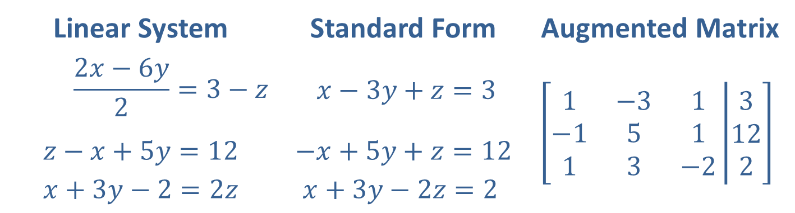
Example 2: Augmented Matrices (cont.)
Solution
Write each equation in standard form, then read off the coefficients and constants to construct the augmented matrix.
Linear System | Standard Form | Augmented Matrix
$$\frac{2x−6y}{2}=3−z$$ | $$x−3y+z=3$$ | $$\left[\begin{matrix}1 & −3 & 1 \\ −1 & 5 & 1 \\ 1 & 3 & −2\end{matrix}\left|\begin{matrix}3 \\ 12 \\ 2\end{matrix}\right.\right]$$
$$z−x+5y=12$$ $$x+3y−2=2z$$ | $$−x+5y+z=12$$ $$x+3y−2z=2$$

Slide 11
Row Echelon Form
Definition
A matrix is in row echelon form if each of the following is true.
​The first nonzero entry in each row is 1. We call this a leading 1.
​Every entry below a leading 1 is 0, and each leading 1 appears farther to the right than the leading 1s in the rows above it.
​All rows consisting entirely of 0s (if there are any) appear at the bottom.

Slide 12
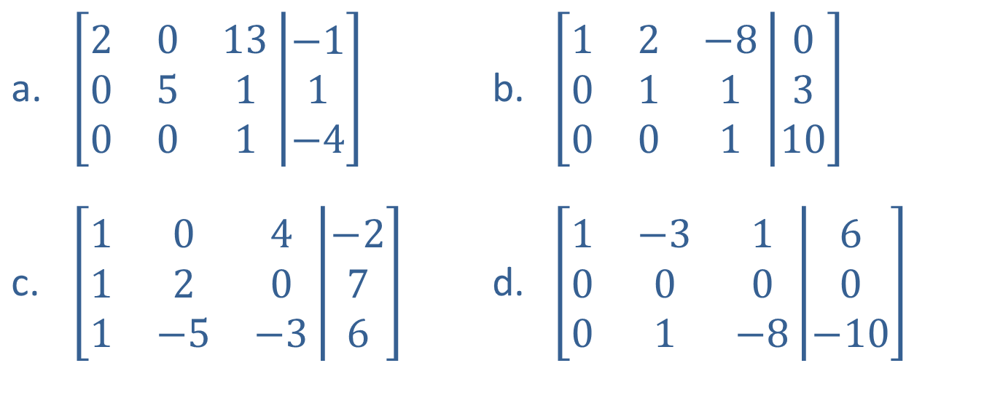
Example 3: Row Echelon Form
Determine if the following matrices are in row echelon form. If not, explain why not.
$\left[\begin{matrix}2 & 0 & 13 \\ 0 & 5 & 1 \\ 0 & 0 & 1\end{matrix}\left|\begin{matrix}−1 \\ 1 \\ −4\end{matrix}\right.\right]$
$\left[\begin{matrix}1 & 0 & 4 \\ 1 & 2 & 0 \\ 1 & −5 & −3\end{matrix}\left|\begin{matrix}−2 \\ 7 \\ 6\end{matrix}\right.\right]$
$\left[\begin{matrix}1 & 2 & −8 \\ 0 & 1 & 1 \\ 0 & 0 & 1\end{matrix}\left|\begin{matrix}0 \\ 3 \\ 10\end{matrix}\right.\right]$
​$\left[\begin{matrix}1 & −3 & 1 \\ 0 & 0 & 0 \\ 0 & 1 & −8\end{matrix}\left|\begin{matrix}6 \\ 0 \\ −10\end{matrix}\right.\right]$

Slide 13
Example 3: Row Echelon Form (cont.)
Solution
​This matrix fails the first condition, as the first nonzero entry is not always 1.
​
​This matrix meets each of the three conditions and is in row echelon form.
​This matrix fails the second condition, as nonzero values are present beneath a leading 1.
​
​This matrix fails the third condition, since there is a row of all zeros that lies above a row with nonzero entries.

Slide 14
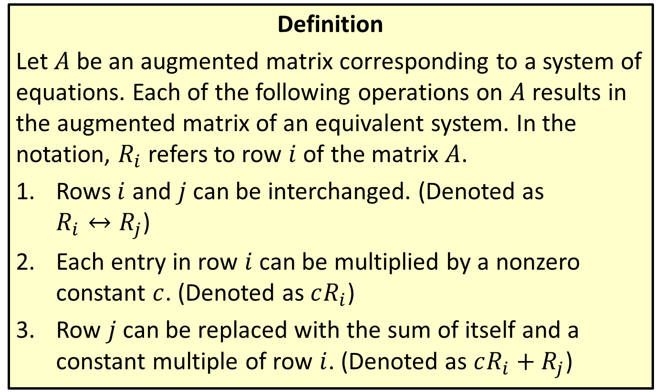
Elementary Row Operations
Definition
Let $A$ be an augmented matrix corresponding to a system of equations. Each of the following operations on $A$ results in the augmented matrix of an equivalent system. In the notation, $R_{i}$ refers to row $i$ of the matrix $A$.
​Rows $i$ and $j$ can be interchanged. (Denoted as
$R_{i}↔R_{j}$)
​Each entry in row $i$ can be multiplied by a nonzero constant $c$. (Denoted as $cR_{i}$)
​Row $j$ can be replaced with the sum of itself and a constant multiple of row $i$. (Denoted as $cR_{i}+R_{j}$)

Slide 15
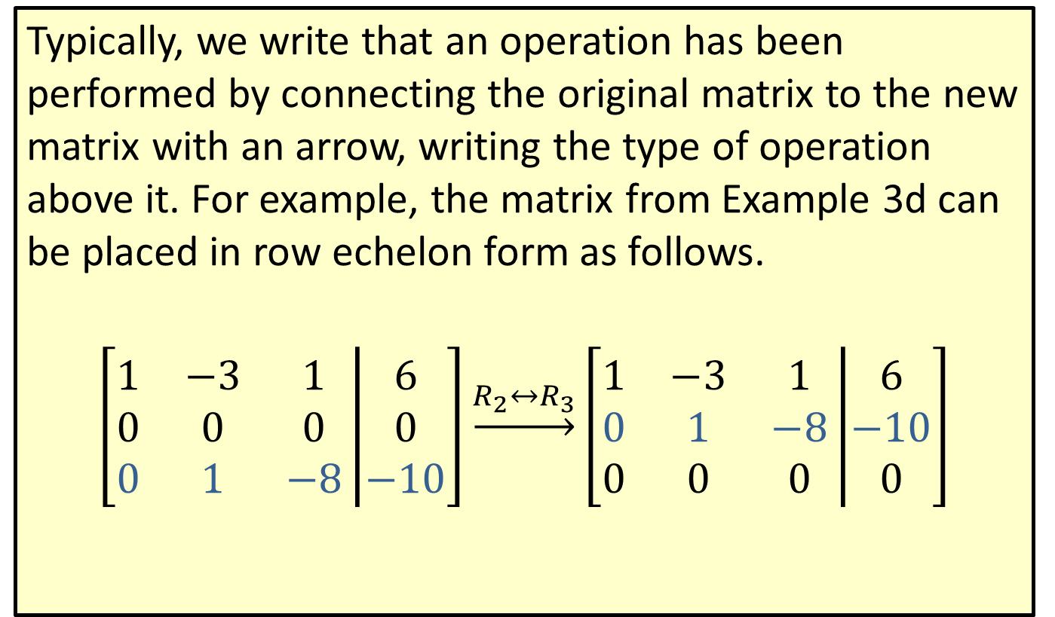
Elementary Row Operations (cont.)
Typically, we write that an operation has been performed by connecting the original matrix to the new matrix with an arrow, writing the type of operation above it. For example, the matrix from Example 3d can be placed in row echelon form as follows.
$$\left[\begin{matrix}1 & −3 & 1 \\ 0 & 0 & 0 \\ 0 & 1 & −8\end{matrix}\left|\begin{matrix}6 \\ 0 \\ −10\end{matrix}\right.\right]\underset{→}{R_{2}↔R_{3}}\left[\begin{matrix}1 & −3 & 1 \\ 0 & 1 & −8 \\ 0 & 0 & 0\end{matrix}\left|\begin{matrix}6 \\ −10 \\ 0\end{matrix}\right.\right]$$

Slide 16

Example 4: Elementary Row Operations
Perform the indicated elementary row operation.
$$\left[\begin{matrix}1 & 2 & 3 \\ 5 & 4 & 1 \\ 6 & 1 & 8\end{matrix}\left|\begin{matrix}0 \\ −7 \\ −9\end{matrix}\right.\right] \underset{→}{{−5R}_{1}+R_{2}} ?$$

Slide 17
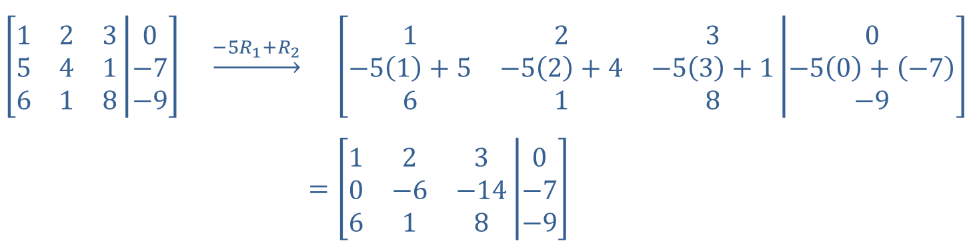

Example 4: Elementary Row Operations (cont.)
Solution
The row operation indicates that we should add $−5$ times Row 1 to Row 2.
Note that the first row now begins with 1 and the second row now begins with 0. The row operation has begun to change this matrix towards row echelon form.
$$\left[\begin{matrix}1 & 2 & 3 \\ 5 & 4 & 1 \\ 6 & 1 & 8\end{matrix}\left|\begin{matrix}0 \\ −7 \\ −9\end{matrix}\right.\right] \underset{→}{{−5R}_{1}+R_{2}}$$ | $$\left[\begin{matrix}1 & 2 & 3 \\ −5\left(1\right)+5 & −5\left(2\right)+4 & −5\left(3\right)+1 \\ 6 & 1 & 8\end{matrix}\left|\begin{matrix}0 \\ −5\left(0\right)+\left(−7\right) \\ −9\end{matrix}\right.\right]$$
​$=$ | ​$\left[\begin{matrix}1 & 2 & 3 \\ 0 & −6 & −14 \\ 6 & 1 & 8\end{matrix}\left|\begin{matrix}0 \\ −7 \\ −9\end{matrix}\right.\right]$

Slide 18

Example 5: Gaussian Elimination
Use Gaussian elimination to solve the system $\left\{\begin{matrix}−2x+y−5z & =−6 \\ x+2y−z & =−8 \\ 3x−y+2z & =2 \end{matrix}\right.$.

Slide 19
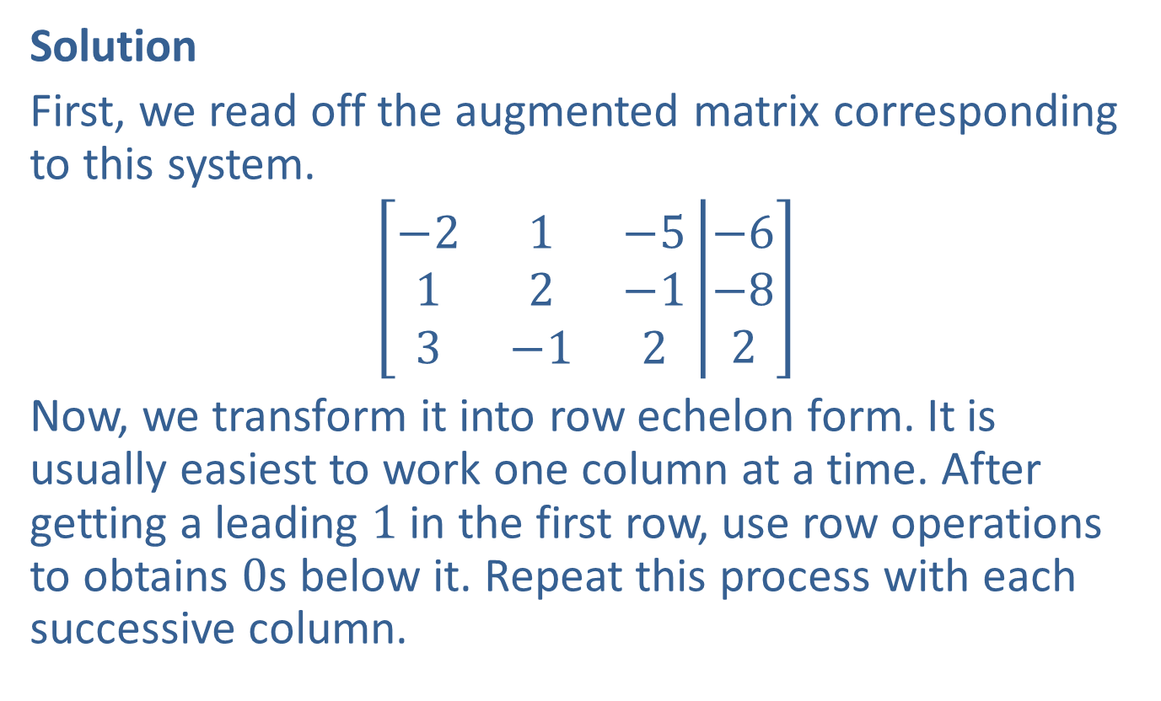
Example 5: Gaussian Elimination (cont.)
Solution
First, we read off the augmented matrix corresponding to this system.
$$\left[\begin{matrix}−2 & 1 & −5 \\ 1 & 2 & −1 \\ 3 & −1 & 2\end{matrix}\left|\begin{matrix}−6 \\ −8 \\ 2\end{matrix}\right.\right]$$
Now, we transform it into row echelon form. It is usually easiest to work one column at a time. After getting a leading 1 in the first row, use row operations to obtains 0s below it. Repeat this process with each successive column.

Slide 20
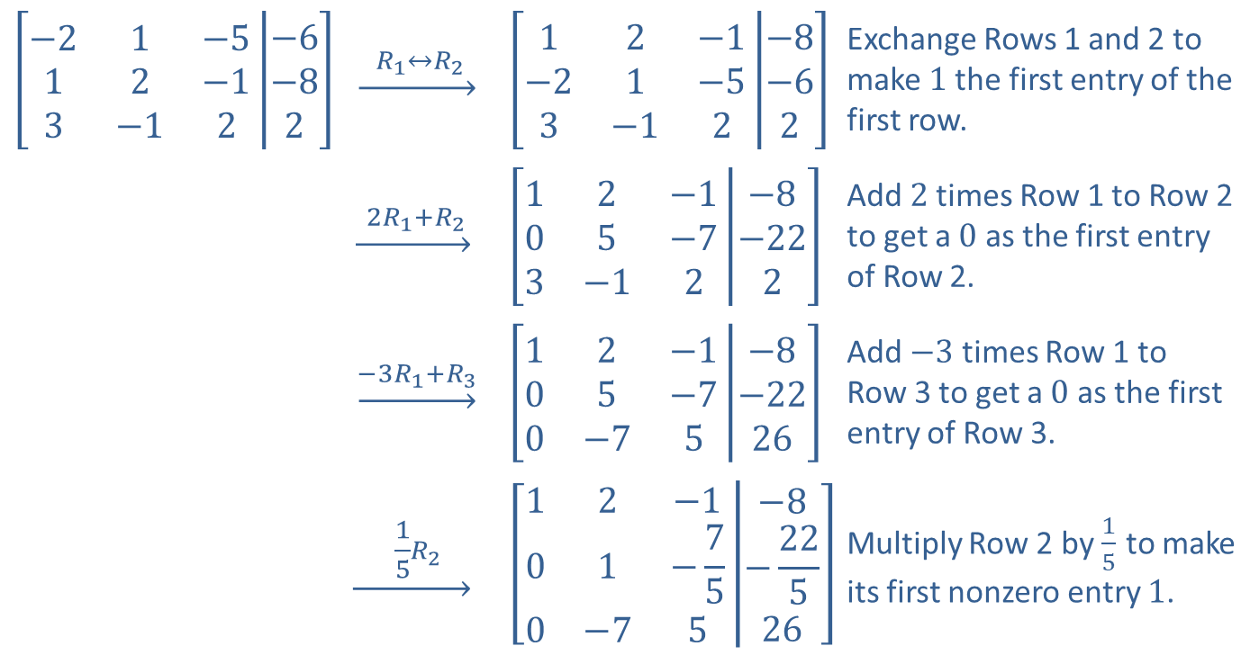
Example 5: Gaussian Elimination (cont.)
$$\left[\begin{matrix}−2 & 1 & −5 \\ 1 & 2 & −1 \\ 3 & −1 & 2\end{matrix}\left|\begin{matrix}−6 \\ −8 \\ 2\end{matrix}\right.\right]$$ | ​$\underset{→}{ R_{1}↔R_{2} }$ | $$\left[\begin{matrix}1 & 2 & −1 \\ −2 & 1 & −5 \\ 3 & −1 & 2\end{matrix}\left|\begin{matrix}−8 \\ −6 \\ 2\end{matrix}\right.\right]$$ | Exchange Rows 1 and 2 to make 1 the first entry of the first row.
 | $$\underset{→}{ {2R}_{1}+R_{2} }$$ | $$\left[\begin{matrix}1 & 2 & −1 \\ 0 & 5 & −7 \\ 3 & −1 & 2\end{matrix}\left|\begin{matrix}−8 \\ −22 \\ 2\end{matrix}\right.\right]$$ | Add 2 times Row 1 to Row 2 to get a 0 as the first entry of Row 2.
 | ​$\underset{→}{{−3R}_{1}+R_{3}}$ | $$\left[\begin{matrix}1 & 2 & −1 \\ 0 & 5 & −7 \\ 0 & −7 & 5\end{matrix}\left|\begin{matrix}−8 \\ −22 \\ 26\end{matrix}\right.\right]$$ | Add $−3$ times Row 1 to Row 3 to get a 0 as the first entry of Row 3.
 | $$\underset{→}{ \frac{1}{5}R_{2} }$$ | $$\left[\begin{matrix}1 & 2 & −1 \\ 0 & 1 & −\frac{7}{5} \\ 0 & −7 & 5\end{matrix}\left|\begin{matrix}−8 \\ −\frac{22}{5} \\ 26\end{matrix}\right.\right]$$ | Multiply Row 2 by $\frac{1}{5}$ to make its first nonzero entry 1.

Slide 21
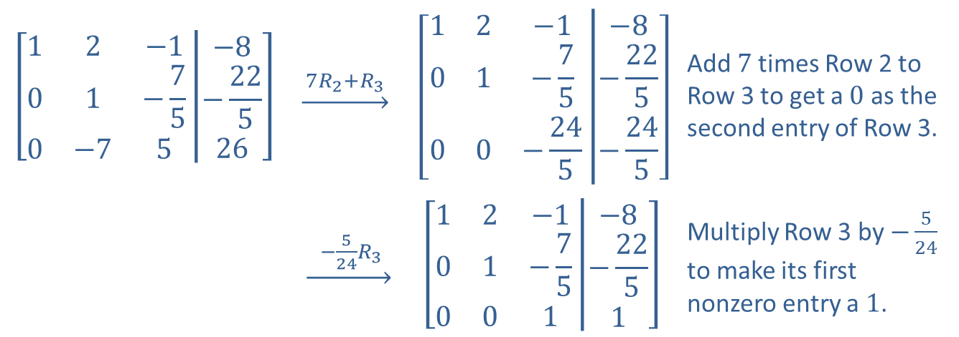
Example 5: Gaussian Elimination (cont.)
$$\left[\begin{matrix}1 & 2 & −1 \\ 0 & 1 & −\frac{7}{5} \\ 0 & −7 & 5\end{matrix}\left|\begin{matrix}−8 \\ −\frac{22}{5} \\ 26\end{matrix}\right.\right]$$ | $$\underset{→}{ {7R}_{2}+R_{3} }$$ | $$\left[\begin{matrix}1 & 2 & −1 \\ 0 & 1 & −\frac{7}{5} \\ 0 & 0 & −\frac{24}{5}\end{matrix}\left|\begin{matrix}−8 \\ −\frac{22}{5} \\ −\frac{24}{5}\end{matrix}\right.\right]$$ | Add 7 times Row 2 to Row 3 to get a 0 as the second entry of Row 3.
 | ​$\underset{→}{ −\frac{5}{24}R_{3} }$ | $$\left[\begin{matrix}1 & 2 & −1 \\ 0 & 1 & −\frac{7}{5} \\ 0 & 0 & 1\end{matrix}\left|\begin{matrix}−8 \\ −\frac{22}{5} \\ 1\end{matrix}\right.\right]$$ | Multiply Row 3 by $−\frac{5}{24}$ to make its first nonzero entry a 1.

Slide 22
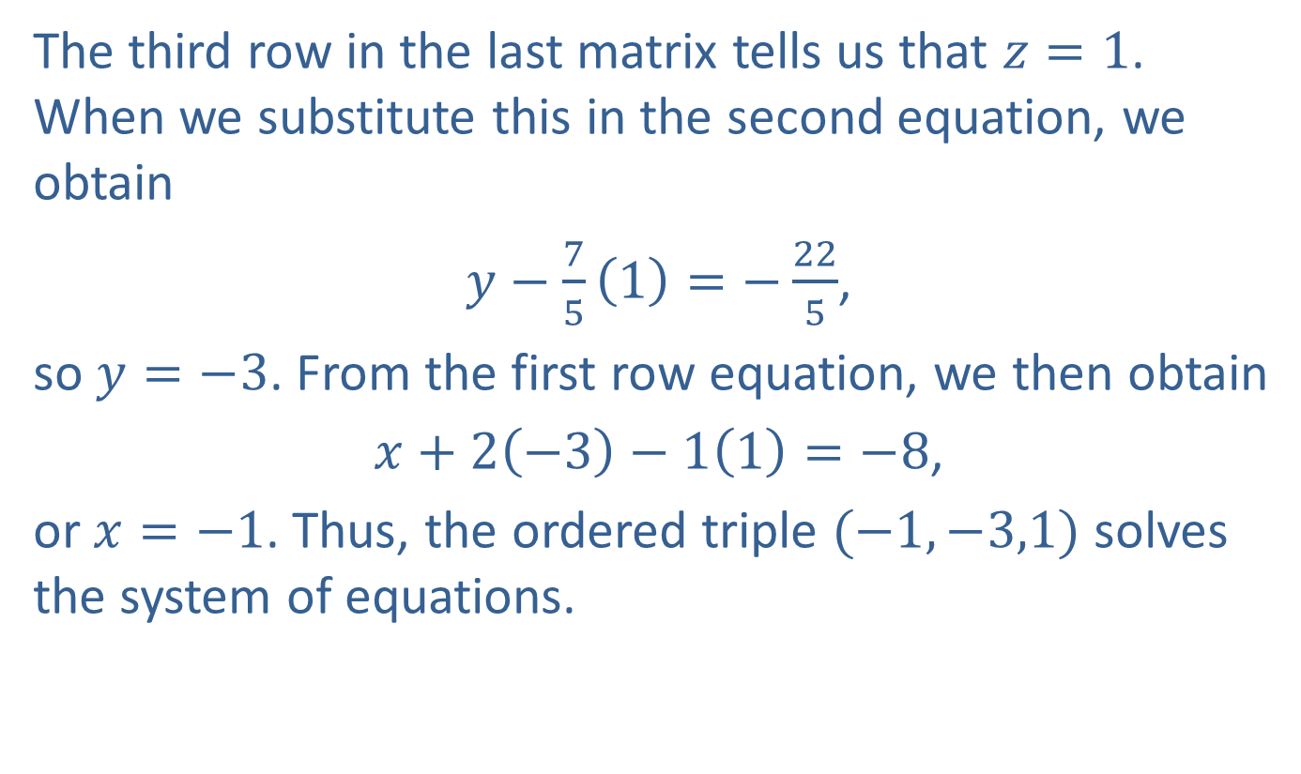
Example 5: Gaussian Elimination (cont.)
The third row in the last matrix tells us that $z=1$. When we substitute this in the second equation, we obtain
$y−\frac{7}{5}\left(1\right)=−\frac{22}{5}$,
so $y=−3$. From the first row equation, we then obtain
$x+2\left(−3\right)−1\left(1\right)=−8$,
or $x=−1$. Thus, the ordered triple $(−1,−3,1)$ solves the system of equations.

Slide 23
Reduced Row Echelon Form
Definition
A matrix is said to be in reduced row echelon form if
it is in row echelon form and
​each entry above a leading 1 is also 0.

Slide 24

Example 6: Reduced Row Echelon Form
Use Gauss-Jordan elimination to solve the system $\left\{\begin{matrix} x−2y+3z & =−5 \\ 2x+3y−z & =1 \\ −x−5y+4z & =−6\end{matrix}\right.$.

Slide 25

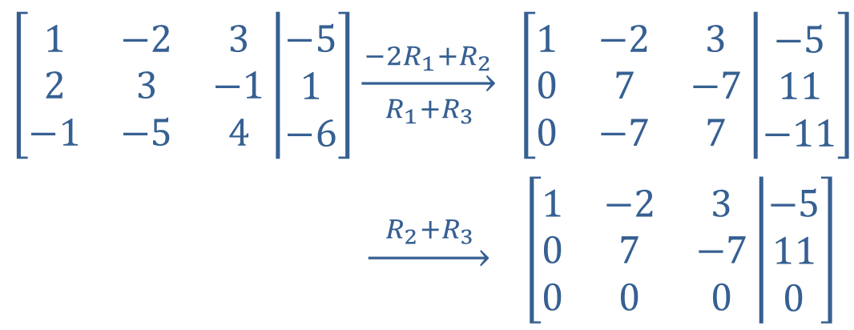
Example 6: Reduced Row Echelon Form (cont.)
Solution
Note that the row of 0s at the bottom corresponds to the true statement $0=0$, indicating that this system has an infinite number of solutions. In order to describe the solution set algebraically, we continue the row operations until the matrix is in reduced row echelon form.
$$\left[\begin{matrix}1 & −2 & 3 \\ 2 & 3 & −1 \\ −1 & −5 & 4\end{matrix}\left|\begin{matrix}−5 \\ 1 \\ −6\end{matrix}\right.\right]$$ | $$\overset{−2R_{1}+R_{2}}{\overset{→}{ { R}_{1}+R_{3 } }}$$ | $$\left[\begin{matrix}1 & −2 & 3 \\ 0 & 7 & −7 \\ 0 & −7 & 7\end{matrix}\left|\begin{matrix}−5 \\ 11 \\ −11\end{matrix}\right.\right]$$
 | $$\underset{→}{{ R}_{2}+R_{3 }}$$ | $$\left[\begin{matrix}1 & −2 & 3 \\ 0 & 7 & −7 \\ 0 & 0 & 0\end{matrix}\left|\begin{matrix}−5 \\ 11 \\ 0\end{matrix}\right.\right]$$

Slide 26
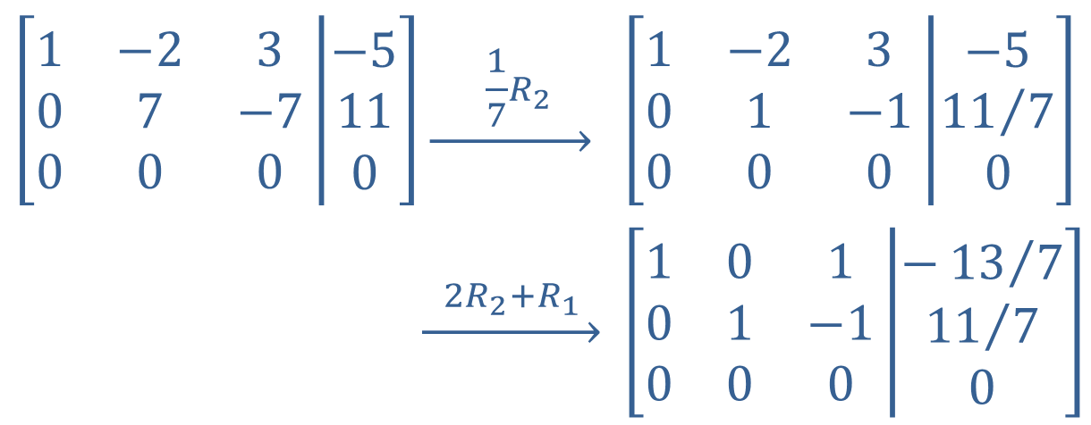

Example 6: Reduced Row Echelon Form (cont.)
The last matrix is in reduced row echelon form, as every leading $1$ has 0s both below and above it.
$$\left[\begin{matrix}1 & −2 & 3 \\ 0 & 7 & −7 \\ 0 & 0 & 0\end{matrix}\left|\begin{matrix}−5 \\ 11 \\ 0\end{matrix}\right.\right]$$ | $$\underset{→}{ \frac{1}{7}R_{2} }$$ | $$\left[\begin{matrix}1 & −2 & 3 \\ 0 & 1 & −1 \\ 0 & 0 & 0\end{matrix}\left|\begin{matrix}−5 \\ {11}/7 \\ 0\end{matrix}\right.\right]$$
 | $$\underset{→}{{ 2R}_{2}+R_{1 }}$$ | $$\left[\begin{matrix}1 & 0 & 1 \\ 0 & 1 & −1 \\ 0 & 0 & 0\end{matrix}\left|\begin{matrix}−{13}/7 \\ {11}/7 \\ 0\end{matrix}\right.\right]$$

Slide 27
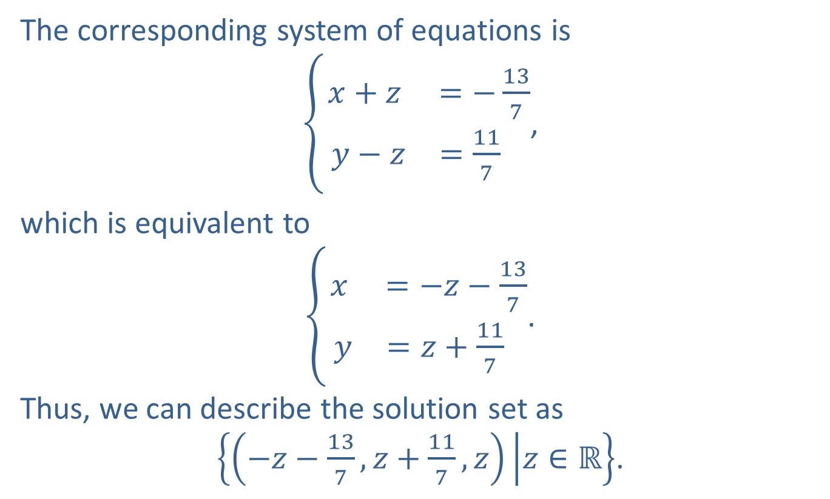
Example 6: Reduced Row Echelon Form (cont.)
The corresponding system of equations is
$\left\{\begin{matrix}x+z & =−\frac{13}{7} \\ y−z & =\frac{11}{7} \end{matrix}\right.$,
which is equivalent to
$\left\{\begin{matrix}x & =−z−\frac{13}{7} \\ y & =z+\frac{11}{7} \end{matrix}\right.$.
Thus, we can describe the solution set as
$\left\{\left(−z−\frac{13}{7},z+\frac{11}{7},z\right) | z∈ℝ\right\}$.

