Slide 1
Section 12.4
Basic Matrix Operations

Slide 2
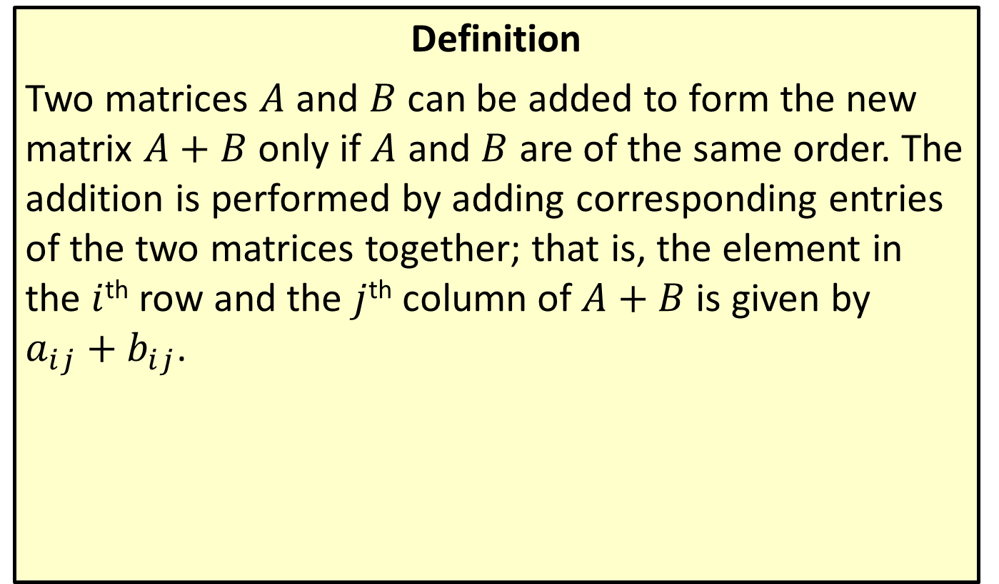
Matrix Addition
Definition
Two matrices $A$ and $B$ can be added to form the new matrix $A+B$ only if $A$ and $B$ are of the same order. The addition is performed by adding corresponding entries of the two matrices together; that is, the element in the $i$^{th} row and the $j$^{th} column of $A+B$ is given by $a_{i⁣j}+b_{i⁣j}$.

Slide 3
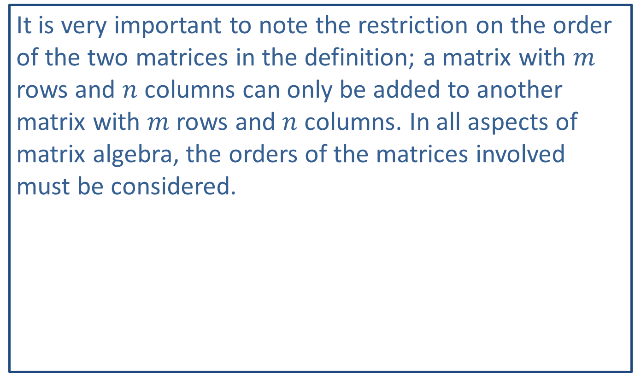
CAUTION!
It is very important to note the restriction on the order of the two matrices in the definition; a matrix with $m$ rows and $n$ columns can only be added to another matrix with $m$ rows and $n$ columns. In all aspects of matrix algebra, the orders of the matrices involved must be considered.

Slide 4
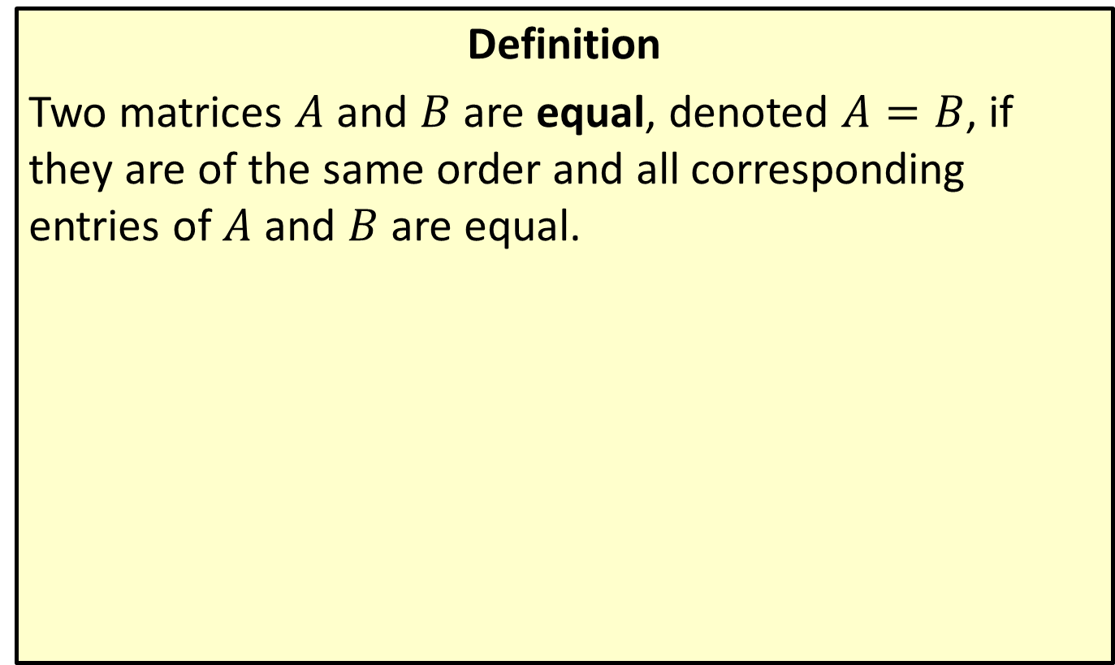
Matrix Equality
Definition
Two matrices $A$ and $B$ are equal, denoted $A=B$, if they are of the same order and all corresponding entries of $A$ and $B$ are equal.

Slide 5
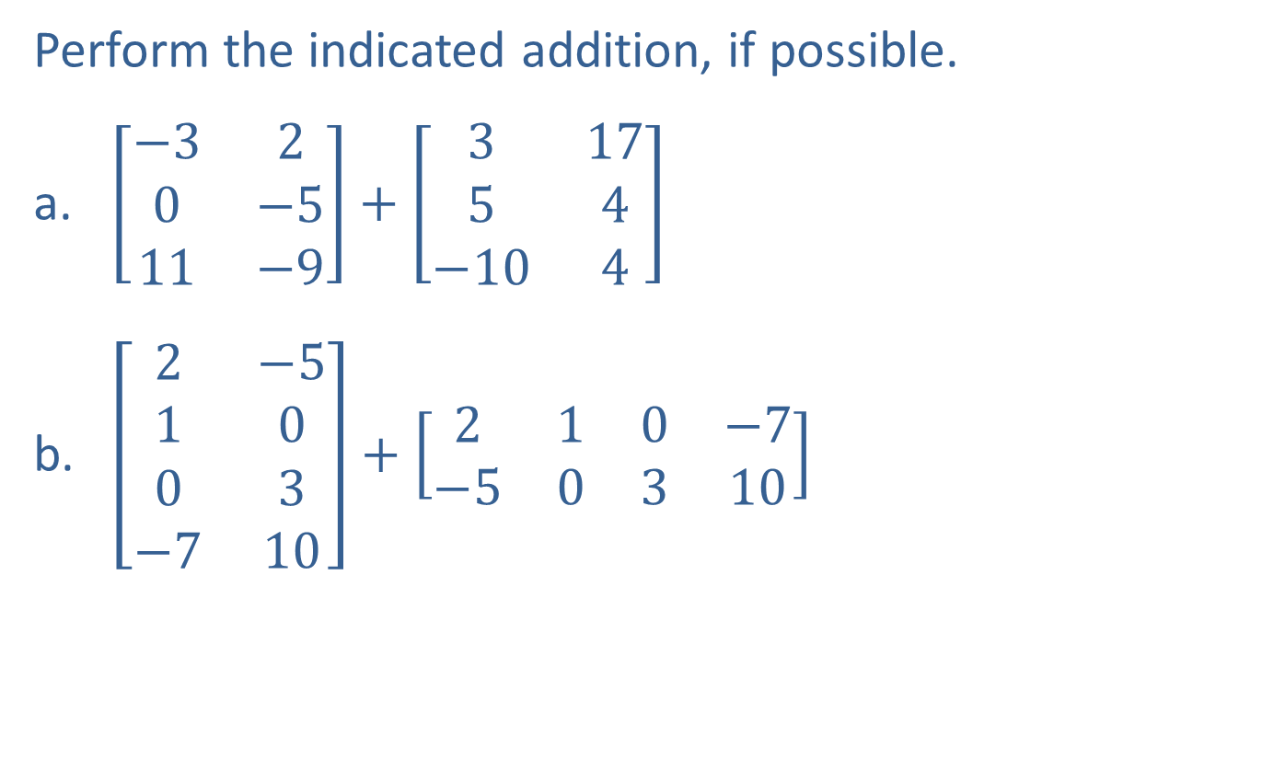
Example 1: Matrix Addition
Perform the indicated addition, if possible.
​$\left[\begin{matrix}−3 & 2 \\ 0 & −5 \\ 11 & −9\end{matrix}\right]+\left[\begin{matrix}3 & 17 \\ 5 & 4 \\ −10 & 4\end{matrix}\right]$
​$\left[\begin{matrix}2 & −5 \\ 1 & 0 \\ 0 & 3 \\ −7 & 10\end{matrix}\right]+\left[\begin{matrix}2 & 1 & 0 & −7 \\ −5 & 0 & 3 & 10\end{matrix}\right]$

Slide 6
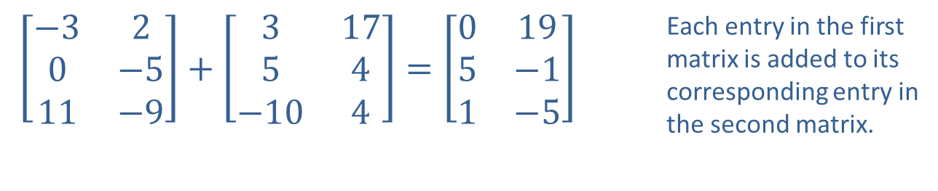

Example 1: Matrix Addition (cont.)
Solution
​Both matrices are $3×2$, so the sum is defined.
​
$\left[\begin{matrix}−3 & 2 \\ 0 & −5 \\ 11 & −9\end{matrix}\right]+\left[\begin{matrix}3 & 17 \\ 5 & 4 \\ −10 & 4\end{matrix}\right]=\left[\begin{matrix}0 & 19 \\ 5 & −1 \\ 1 & −5\end{matrix}\right]$ | Each entry in the first matrix is added to its corresponding entry in the second matrix.

Slide 7

Example 1: Matrix Addition (cont.)
​The first matrix is $4×2$ and the second is $2×4$, so the addition cannot be performed.

Slide 8
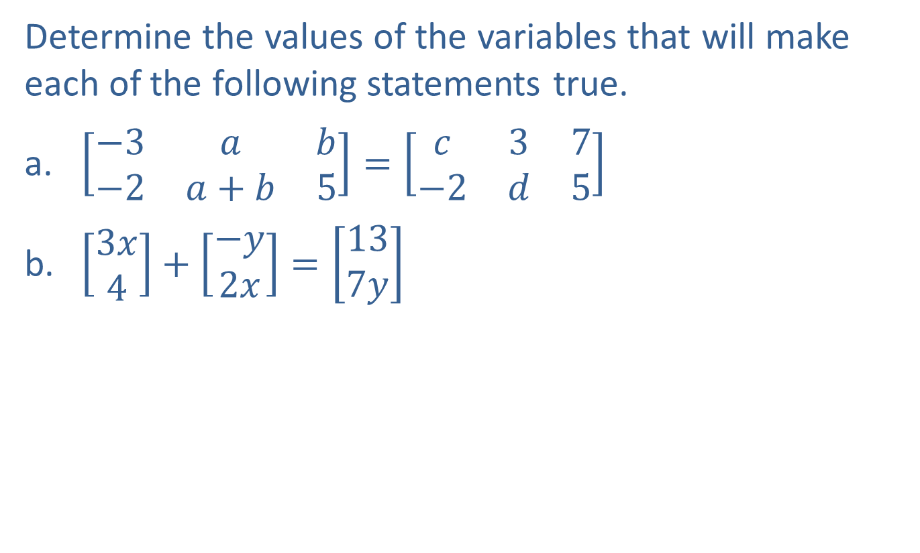
Example 2: Matrix Equations
Determine the values of the variables that will make each of the following statements true.
​$\left[\begin{matrix}−3 & a & b \\ −2 & a+b & 5\end{matrix}\right]=\left[\begin{matrix}c & 3 & 7 \\ −2 & d & 5\end{matrix}\right]$
​$\left[\begin{aligned}3x \\ 4\end{aligned}\right]+\left[\begin{aligned}−y \\ 2x\end{aligned}\right]=\left[\begin{aligned}13 \\ 7y\end{aligned}\right]$

Slide 9
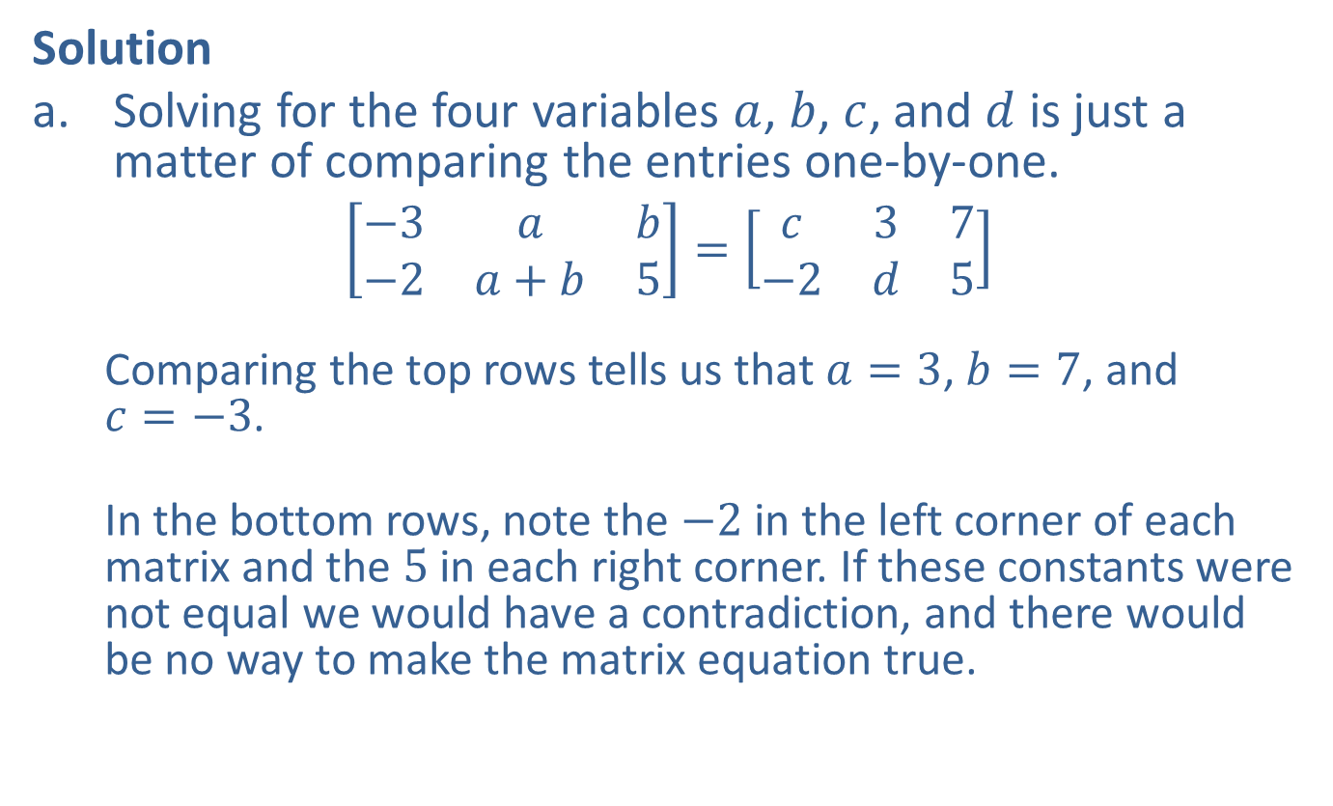
Example 2: Matrix Equations (cont.)
Solution
​Solving for the four variables $a$, $b$, $c$, and $d$ is just a matter of comparing the entries one-by-one.
​$\left[\begin{matrix}−3 & a & b \\ −2 & a+b & 5\end{matrix}\right]=\left[\begin{matrix}c & 3 & 7 \\ −2 & d & 5\end{matrix}\right]$
Comparing the top rows tells us that $a=3$, $b=7$, and $c=−3$.
In the bottom rows, note the $−2$ in the left corner of each matrix and the 5 in each right corner. If these constants were not equal we would have a contradiction, and there would be no way to make the matrix equation true.
​

Slide 10

Example 2: Matrix Equations (cont.)
​The only variable left to solve for is $d$, which we see is equal to $a+b$. So, $d=3+7=10$.

Slide 11
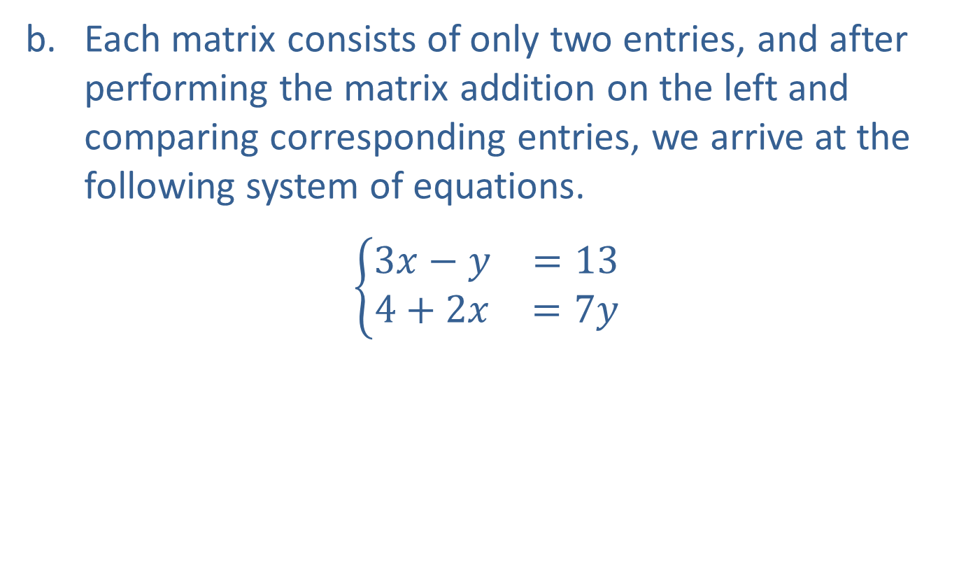
Example 2: Matrix Equations (cont.)
​Each matrix consists of only two entries, and after performing the matrix addition on the left and comparing corresponding entries, we arrive at the following system of equations.
​$\left\{\begin{matrix}3x−y & =13 \\ 4+2x & =7y\end{matrix}\right.$
​​

Slide 12
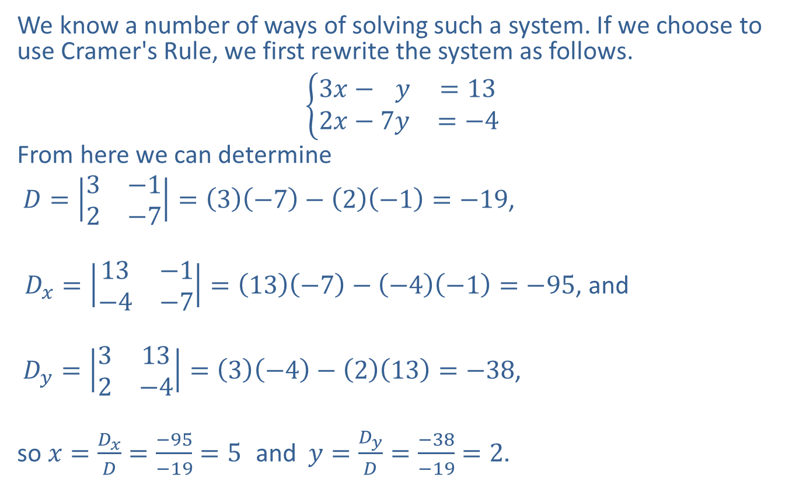
Example 2: Matrix Equations (cont.)
​We know a number of ways of solving such a system. If we choose to use Cramer's Rule, we first rewrite the system as follows.
​3𝑥−7𝑦=132𝑥−7𝑦=−4
​From here we can determine
​ $D=\left|\begin{matrix}3 & −1 \\ 2 & −7\end{matrix}\right|=\left(3\right)\left(−7\right)−\left(2\right)\left(−1\right)=−19$,
​ $D_{x}=\left|\begin{matrix}13 & −1 \\ −4 & −7\end{matrix}\right|=\left(13\right)\left(−7\right)−\left(−4\right)\left(−1\right)=−95$, and
​ $D_{y}=\left|\begin{matrix}3 & 13 \\ 2 & −4\end{matrix}\right|=\left(3\right)\left(−4\right)−\left(2\right)\left(13\right)=−38$,
​so $x=\frac{D_{x}}{D}=\frac{−95}{−19}=5$ and $y=\frac{D_{y}}{D}=\frac{−38}{−19}=2$.

Slide 13
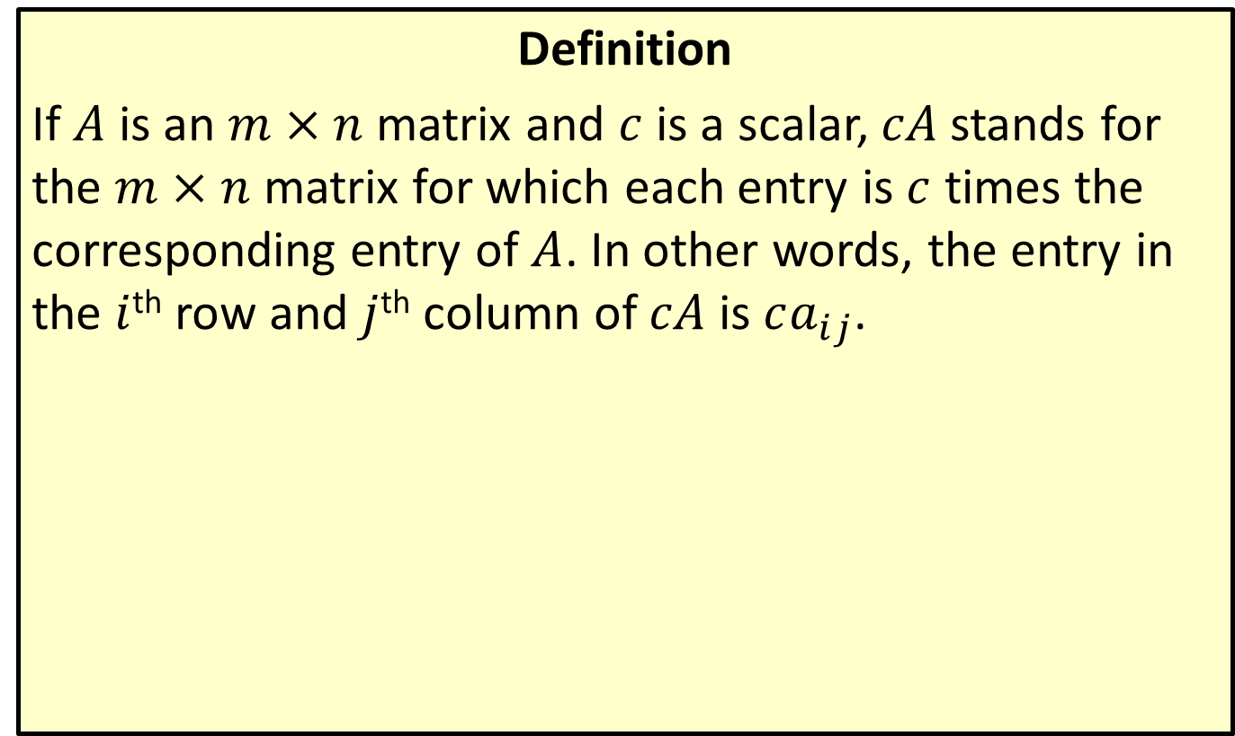
Scalar Multiplication
Definition
If $A$ is an $m×n$ matrix and $c$ is a scalar, $cA$ stands for the $m×n$ matrix for which each entry is $c$ times the corresponding entry of $A$. In other words, the entry in the $i$^{th} row and $j$^{th} column of $cA$ is $ca_{i⁣j}$.

Slide 14

Example 3: Scalar Multiplication
Given the matrices $A=\left[\begin{matrix}−1 & 6 & 2 \\ −8 & 0 & 1\end{matrix}\right]$ and $B=\left[\begin{matrix}0 & −3 & 4 \\ 1 & −2 & 6\end{matrix}\right]$, write $−3A+2B$ as a single matrix.

Slide 15
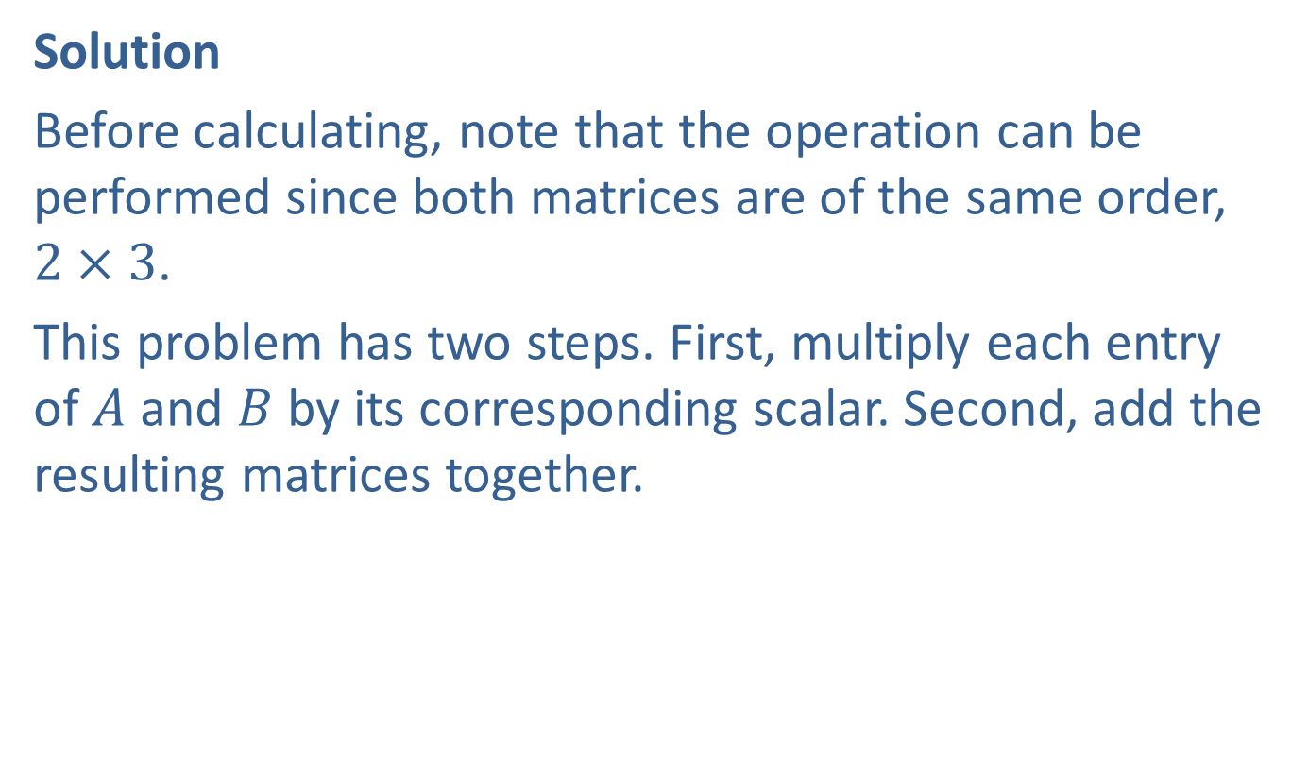
Example 3: Scalar Multiplication (cont.)
Solution
Before calculating, note that the operation can be performed since both matrices are of the same order, $2×3$.
This problem has two steps. First, multiply each entry of $A$ and $B$ by its corresponding scalar. Second, add the resulting matrices together.

Slide 16
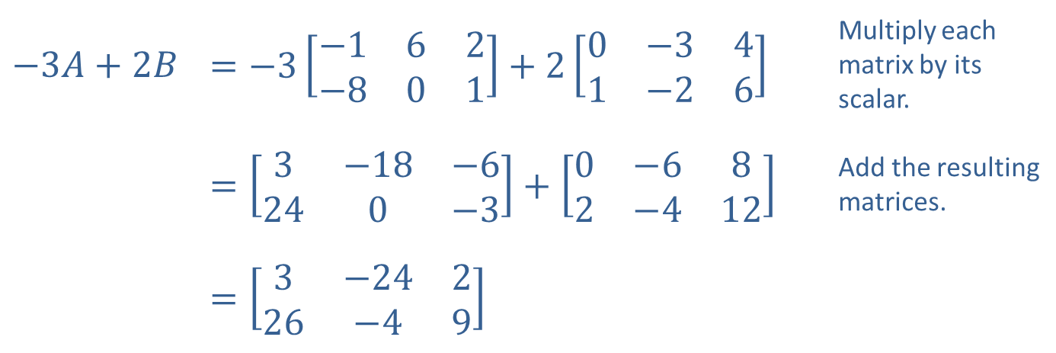
Example 3: Scalar Multiplication (cont.)
​$−3A+2B$ | ​$=−3\left[\begin{matrix}−1 & 6 & 2 \\ −8 & 0 & 1\end{matrix}\right]+2\left[\begin{matrix}0 & −3 & 4 \\ 1 & −2 & 6\end{matrix}\right]$ | Multiply each matrix by its scalar.
 | ​$=\left[\begin{matrix}3 & −18 & −6 \\ 24 & 0 & −3\end{matrix}\right]+\left[\begin{matrix}0 & −6 & 8 \\ 2 & −4 & 12\end{matrix}\right]$ | Add the resulting matrices.
 | ​$=\left[\begin{matrix}3 & −24 & 2 \\ 26 & −4 & 9\end{matrix}\right]$

Slide 17
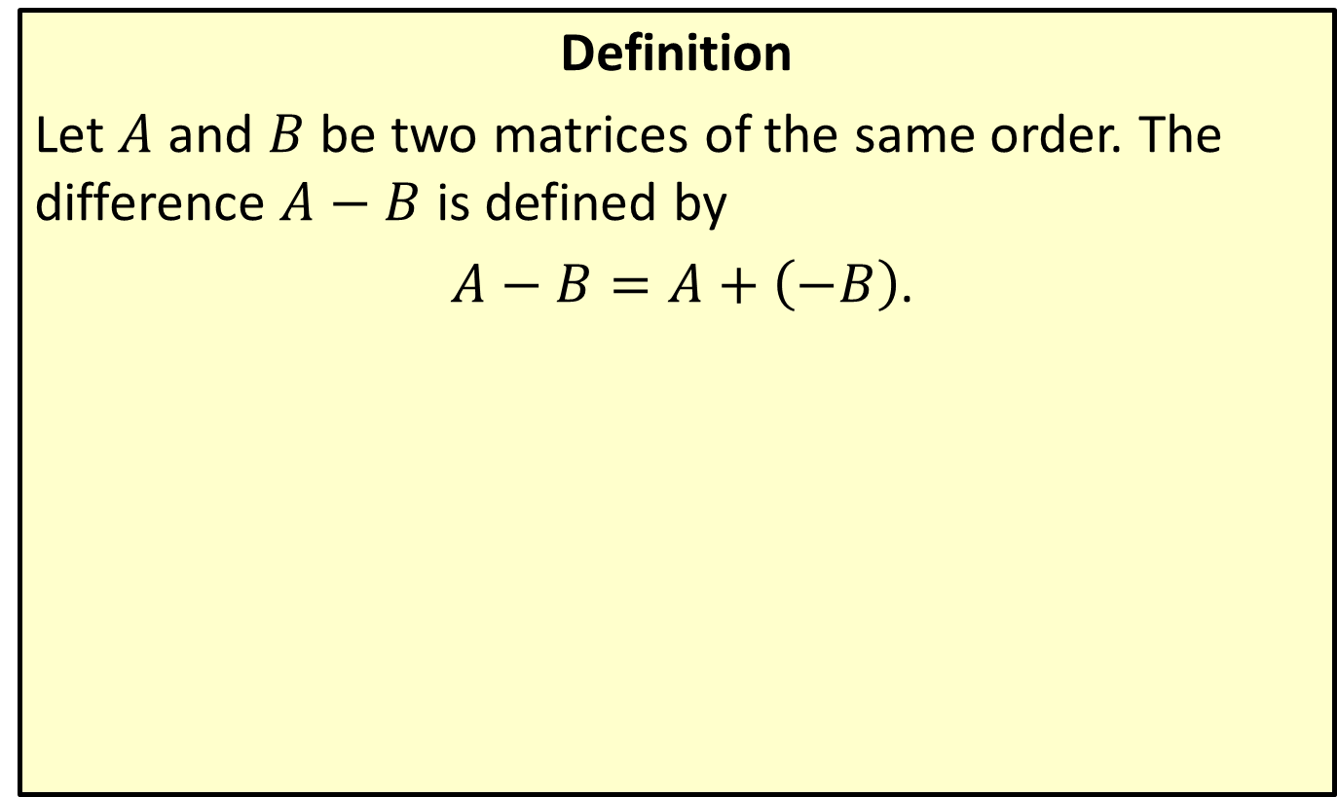
Matrix Subtraction
Definition
Let $A$ and $B$ be two matrices of the same order. The difference $A−B$ is defined by
$A−B=A+\left(−B\right)$.

Slide 18

Example 4: Matrix Subtraction
Perform the indicated subtraction:
$\left[\begin{matrix}3 & −5 & 2\end{matrix}\right]−\left[\begin{matrix}−2 & −5 & 3\end{matrix}\right]$.

Slide 19
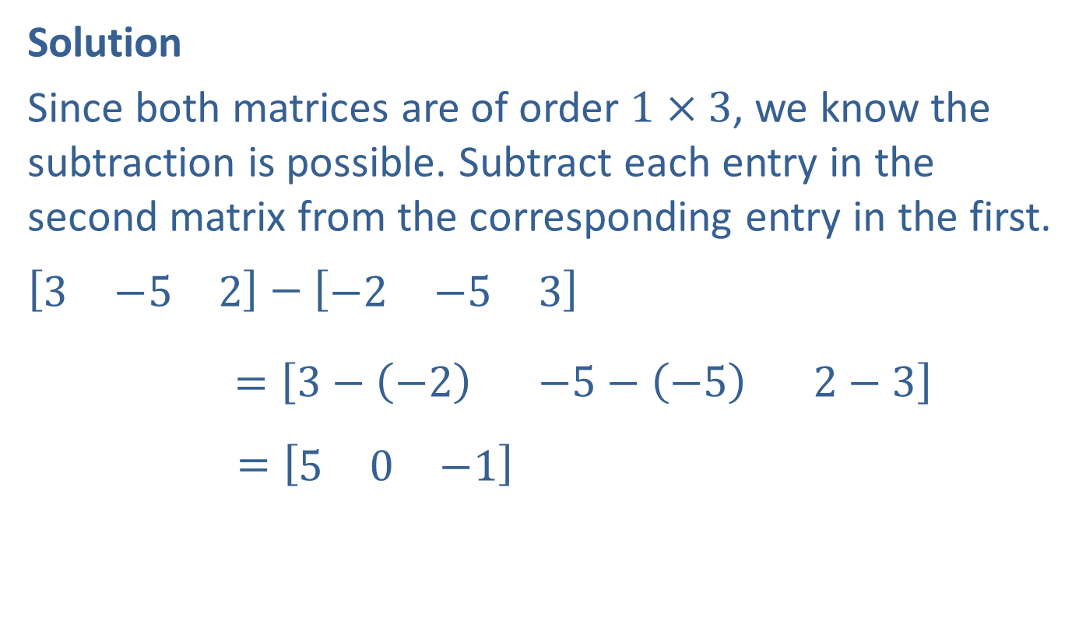
Example 4: Matrix Subtraction (cont.)
Solution
Since both matrices are of order $1×3$, we know the subtraction is possible. Subtract each entry in the second matrix from the corresponding entry in the first.
$$\left[\begin{matrix}3 & −5 & 2\end{matrix}\right]−\left[\begin{matrix}−2 & −5 & 3\end{matrix}\right]$$
$=$ $\left[\begin{matrix}3−\left(−2\right) & −5−\left(−5\right) & 2−3\end{matrix}\right]$
$$=\left[\begin{matrix}5 & 0 & −1\end{matrix}\right]$$

Slide 20
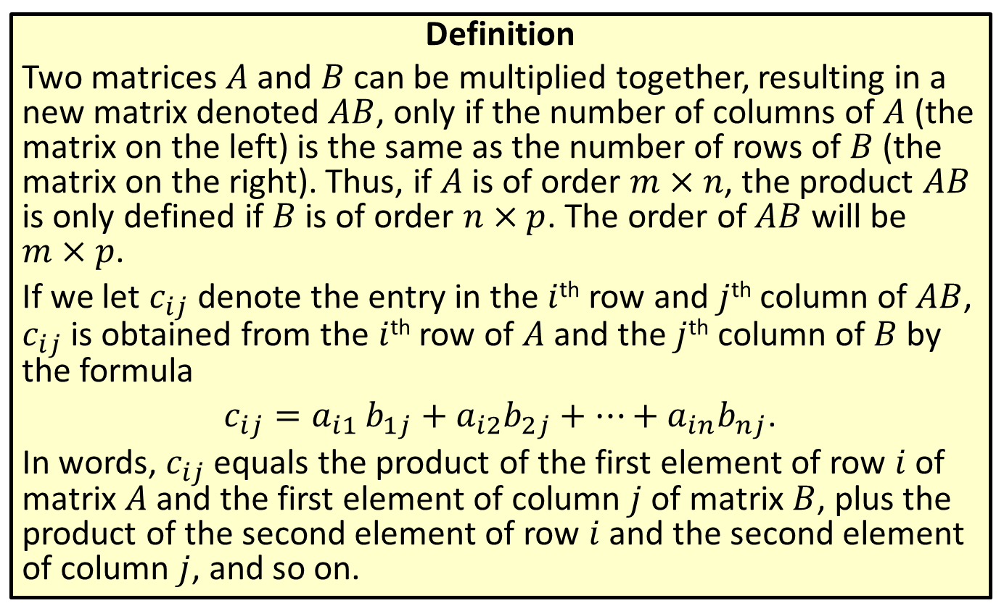
Matrix Multiplication
Definition
Two matrices $A$ and $B$ can be multiplied together, resulting in a new matrix denoted $AB$, only if the number of columns of $A$ (the matrix on the left) is the same as the number of rows of $B$ (the matrix on the right). Thus, if $A$ is of order $m×n$, the product $AB$ is only defined if $B$ is of order $n×p$. The order of $AB$ will be $m×p$.
If we let $c_{i⁣j}$ denote the entry in the $i$^{th} row and $j$^{th} column of $AB$, $c_{i⁣j}$ is obtained from the $i$^{th} row of $A$ and the $j$^{th} column of $B$ by the formula
$c_{i⁣j}=a_{i⁣1}⁣b_{1⁣j}+a_{i⁣2}b_{2⁣j}+…+a_{i⁣n}b_{n⁣j}$.
In words, $c_{ij}$ equals the product of the first element of row $i$ of matrix $A$ and the first element of column $j$ of matrix $B$, plus the product of the second element of row $i$ and the second element of column $j$, and so on.

Slide 21
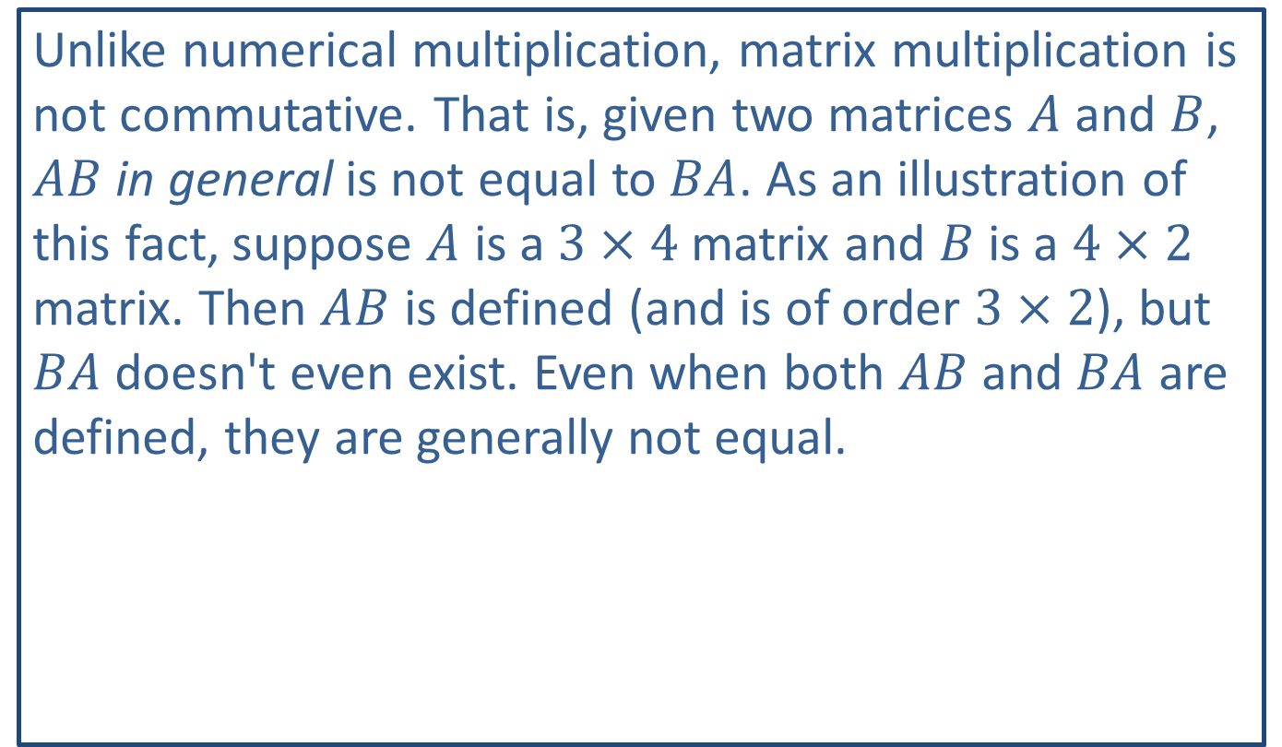
CAUTION!
Unlike numerical multiplication, matrix multiplication is not commutative. That is, given two matrices $A$ and $B$, $AB$ in general is not equal to $BA$. As an illustration of this fact, suppose $A$ is a $3×4$ matrix and $B$ is a $4×2$ matrix. Then $AB$ is defined (and is of order $3×2$), but $BA$ doesn't even exist. Even when both $AB$ and $BA$ are defined, they are generally not equal.

Slide 22

Example 5: Matrix Multiplication
Given the matrices $A=\left[\begin{matrix}2 & 0 \\ −5 & 1\end{matrix}\right]$ and $B=\left[\begin{matrix}7 & −2 \\ 3 & 1\end{matrix}\right]$, find $AB$.

Slide 23

Example 5: Matrix Multiplication (cont.)
Solution
Since both matrices are $2×2$, they can be multiplied, and the result will also be a $2×2$ matrix. For this example, we will follow the procedure one entry at a time.

Slide 24
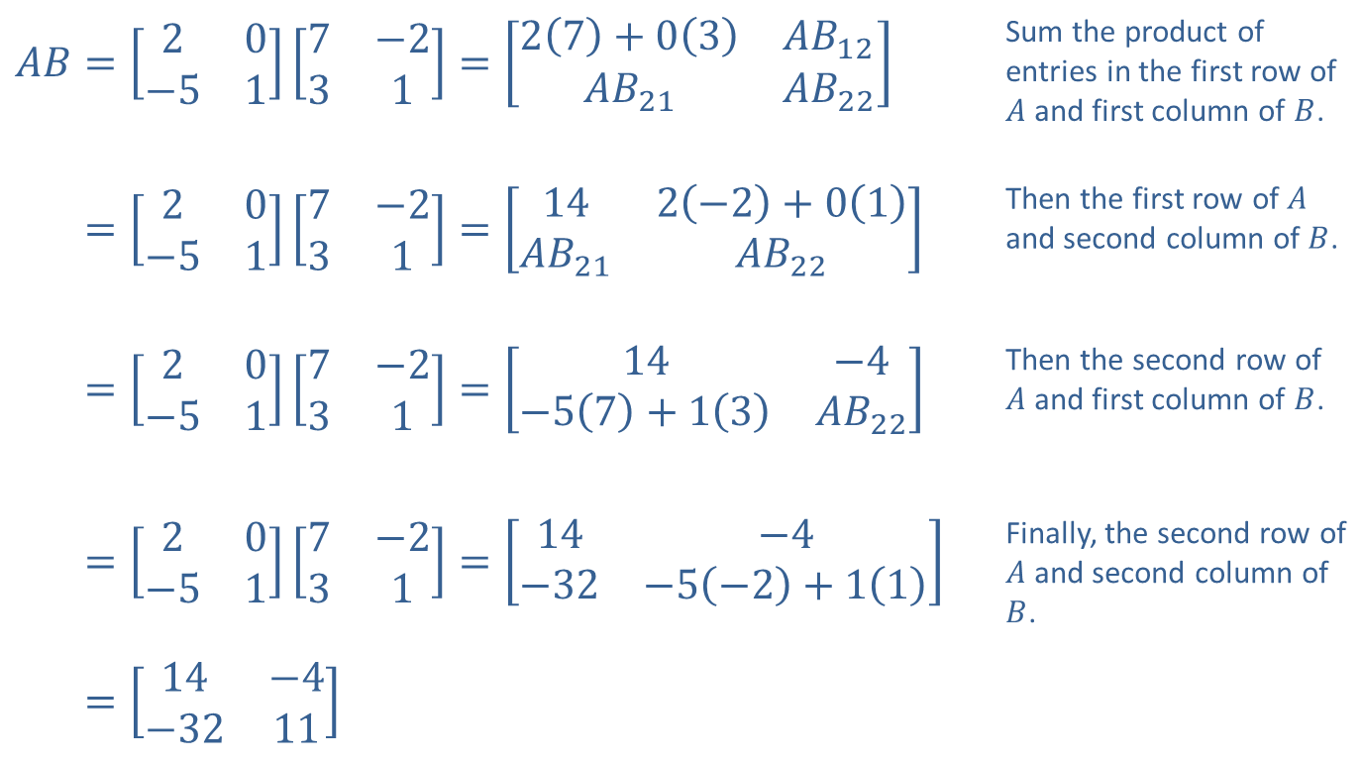
Example 5: Matrix Multiplication (cont.)
​$AB=\left[\begin{matrix}2 & 0 \\ −5 & 1\end{matrix}\right]\left[\begin{matrix}7 & −2 \\ 3 & 1\end{matrix}\right]=\left[\begin{matrix}2\left(7\right)+0\left(3\right) & AB_{1⁣2} \\ AB_{2⁣1} & AB_{2⁣2}\end{matrix}\right]$ | Sum the product of entries in the first row of $A$ and first column of $B$.
​𝐴𝐵=20−517−231=142−2+01𝐴𝐵2⁣1𝐴𝐵2⁣2 | Then the first row of $A$ and second column of $B$.
​𝐴𝐵=20−517−231=14−4−57+13𝐴𝐵2⁣2 | Then the second row of $A$ and first column of $B$.
​𝐴𝐵=20−517−231=14−4−32−5−2+11 | Finally, the second row of $A$ and second column of $B$.
​𝐴𝐵=14−4−3211

Slide 25

Example 6: Matrix Multiplication
Given the matrices $A=\left[\begin{matrix}2 & −3 \\ 4 & −1 \\ 1 & 0\end{matrix}\right]$ and $B=\left[\begin{matrix}5 & 0 & −2 \\ −4 & 1 & 3\end{matrix}\right]$, find the following products.
​$AB$
​$BA$

Slide 26

Example 6: Matrix Multiplication (cont.)
Solution
​$A$ is of order $3×2$ and $B$ is of order $2×3$, so $AB$ is defined and is of order $3×3$. Each entry of $AB$ is formed from a row of $A$ and a column of $B$.

Slide 27
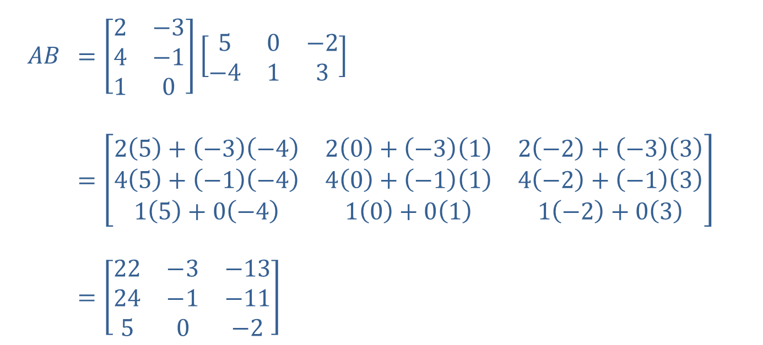
Example 6: Matrix Multiplication (cont.)
$$AB$$ | ​$=\left[\begin{matrix}2 & −3 \\ 4 & −1 \\ 1 & 0\end{matrix}\right]\left[\begin{matrix}5 & 0 & −2 \\ −4 & 1 & 3\end{matrix}\right]$
 | ​$=\left[\begin{matrix}2\left(5\right)+\left(−3\right)\left(−4\right) & 2\left(0\right)+\left(−3\right)\left(1\right) & 2\left(−2\right)+\left(−3\right)\left(3\right) \\ 4\left(5\right)+\left(−1\right)\left(−4\right) & 4\left(0\right)+\left(−1\right)\left(1\right) & 4\left(−2\right)+\left(−1\right)\left(3\right) \\ 1\left(5\right)+0\left(−4\right) & 1\left(0\right)+0\left(1\right) & 1\left(−2\right)+0\left(3\right)\end{matrix}\right]$
 | ​$=\left[\begin{matrix}22 & −3 & −13 \\ 24 & −1 & −11 \\ 5 & 0 & −2\end{matrix}\right]$

Slide 28

Example 6: Matrix Multiplication (cont.)
​From the orders of the two matrices, we know $BA$ exists and will be a $2×2$ matrix. Note that each entry of $BA$ is a sum of three products.

Slide 29
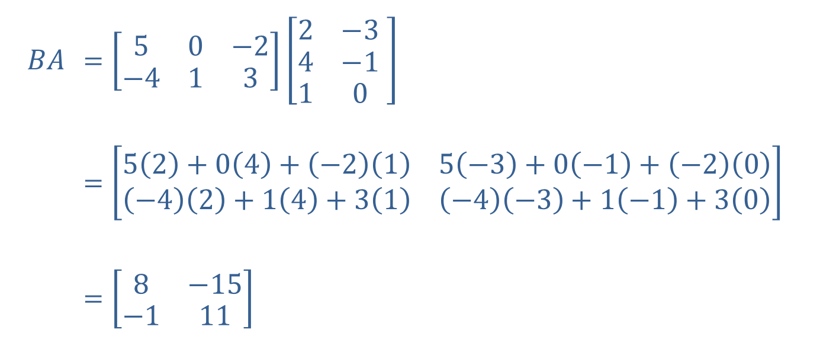
Example 6: Matrix Multiplication (cont.)
$$BA$$ | ​$=\left[\begin{matrix}5 & 0 & −2 \\ −4 & 1 & 3\end{matrix}\right]\left[\begin{matrix}2 & −3 \\ 4 & −1 \\ 1 & 0\end{matrix} \right]$
 | ​$=\left[\begin{matrix}5\left(2\right)+0\left(4\right)+\left(−2\right)\left(1\right) & 5\left(−3\right)+0\left(−1\right)+\left(−2\right)\left(0\right) \\ \left(−4\right)\left(2\right)+1\left(4\right)+3\left(1\right) & \left(−4\right)\left(−3\right)+1\left(−1\right)+3\left(0\right)\end{matrix}\right]$
 | ​$=\left[\begin{matrix}8 & −15 \\ −1 & 11\end{matrix}\right]$

