Slide 1
Section 12.5
Inverses of Matrices

Slide 2

Example 1: Matrix Equation
Write each linear system as a matrix equation.
​$\left\{\begin{matrix}\begin{matrix}−3x+5y=2 \\ x−4y=−1\end{matrix} & \\ & \end{matrix}\right.$
​$\left\{\begin{matrix}3y−x=−2 \\ 4−z+y=5 \\ z−3x+3=y−x\end{matrix}\right.$

Slide 3
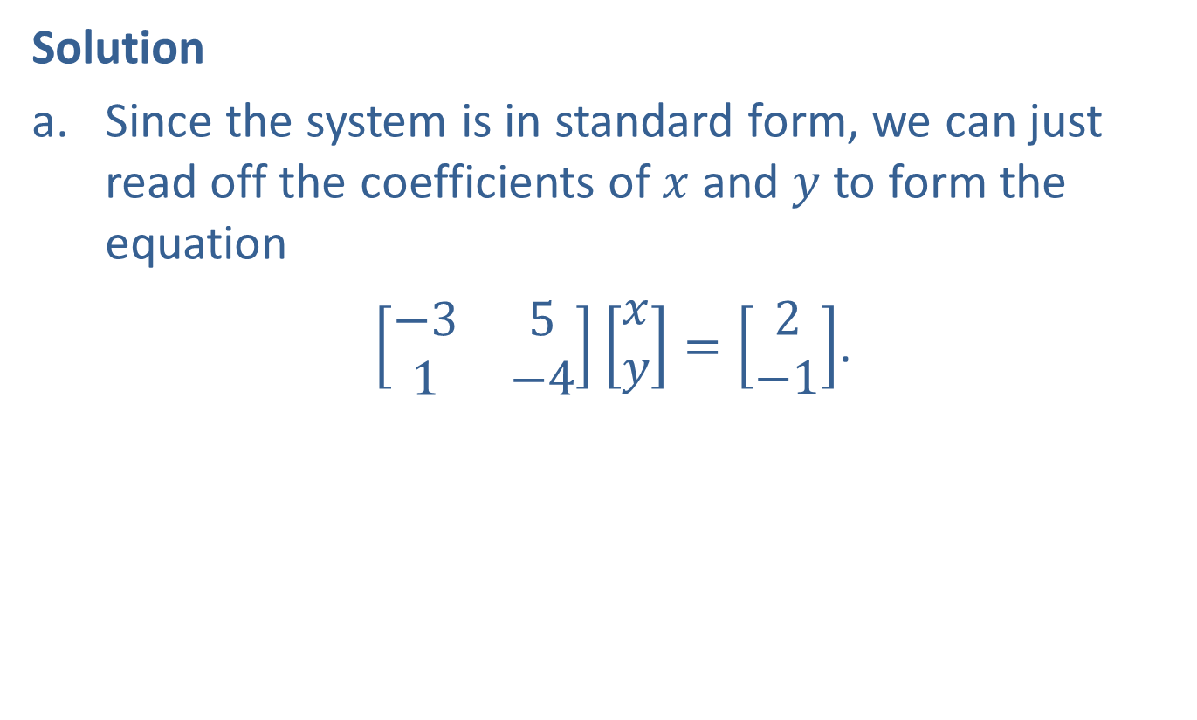
Example 1: Matrix Equation (cont.)
Solution
​Since the system is in standard form, we can just read off the coefficients of $x$ and $y$ to form the equation
​ $\left[\begin{matrix}−3 & 5 \\ 1 & −4\end{matrix}\right]\left[\begin{aligned}x \\ y\end{aligned}\right]=\left[\begin{aligned}2 \\ −1\end{aligned}\right]$.

Slide 4
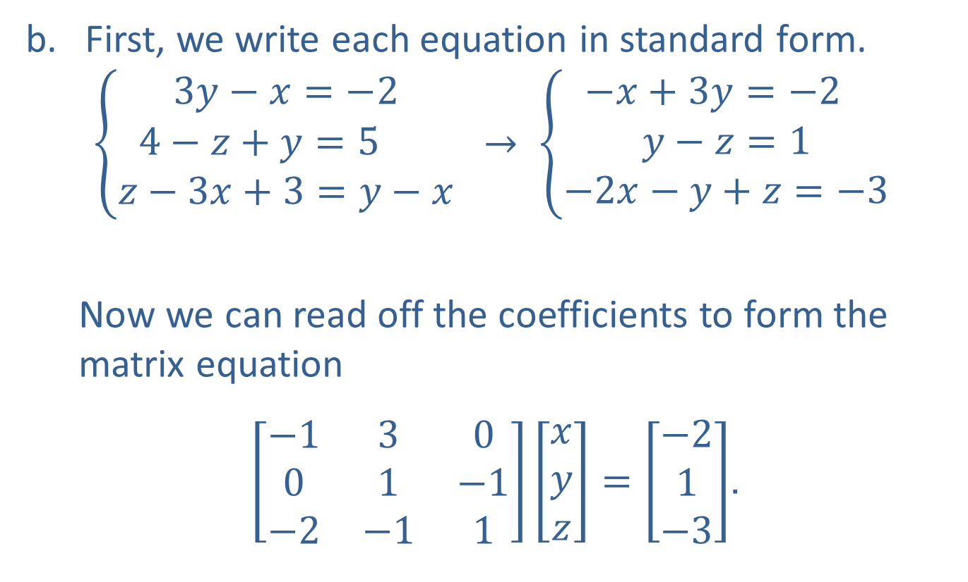
Example 1: Matrix Equation (cont.)
​First, we write each equation in standard form.
$$\left\{\begin{matrix}3y−x=−2 \\ 4−z+y=5 \\ z−3x+3=y−x\end{matrix}\right. → \left\{\begin{matrix}−x+3y=−2 \\ y−z=1 \\ −2x−y+z=−3\end{matrix}\right.$$
​
  Now we can read off the coefficients to form the matrix equation
​ $\left[\begin{matrix}−1 & 3 & 0 \\ 0 & 1 & −1 \\ −2 & −1 & 1\end{matrix}\right]\left[\begin{aligned}x \\ y \\ z\end{aligned}\right]=\left[\begin{aligned}−2 \\ 1 \\ −3\end{aligned}\right]$.

Slide 5
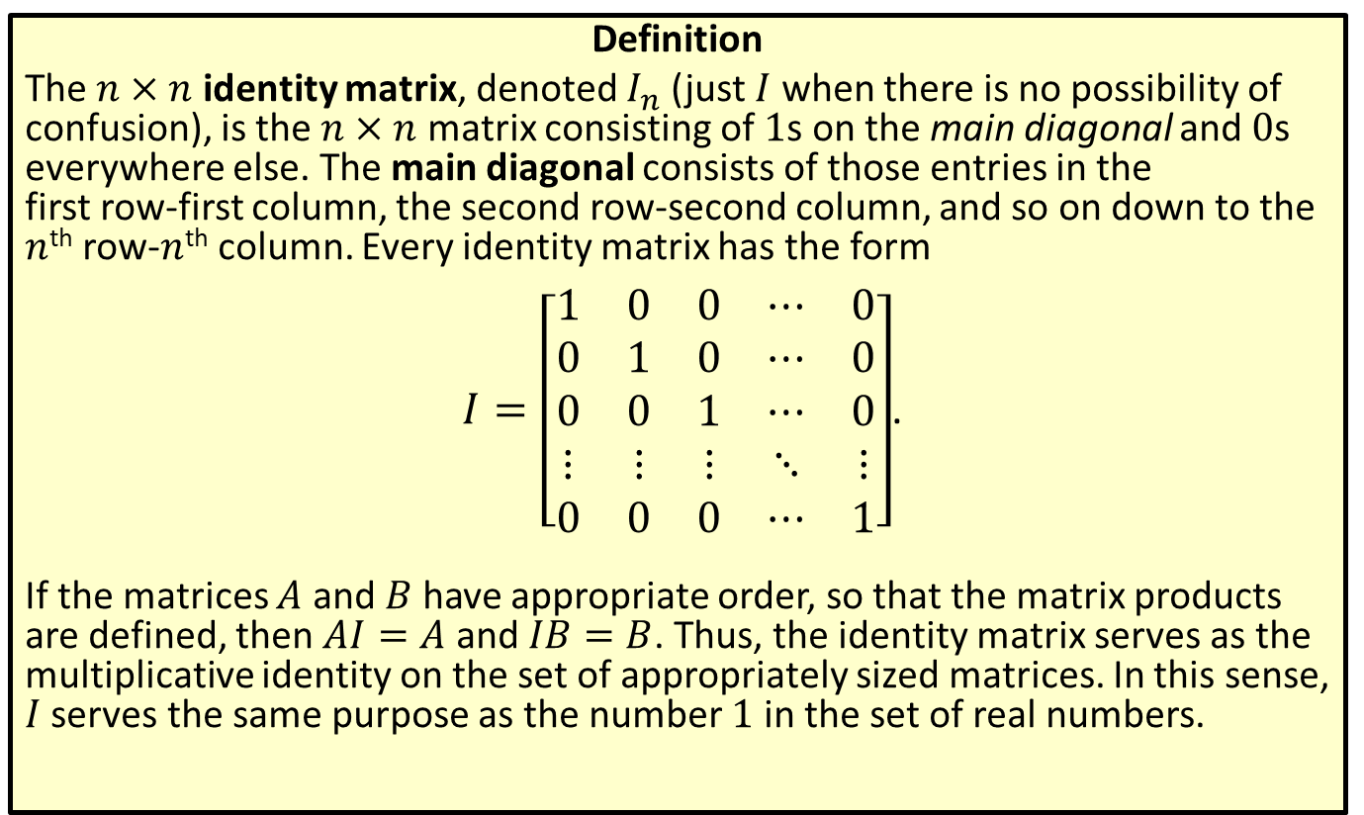
Identity Matrices
Definition
The $n×n$ identity matrix, denoted $I_{n}$ (just $I$ when there is no possibility of confusion), is the $n×n$ matrix consisting of 1s on the main diagonal and 0s everywhere else. The main diagonal consists of those entries in the
first row-first column, the second row-second column, and so on down to the $n$^{th} row-$n$^{th} column. Every identity matrix has the form
$I=\left[\begin{matrix}1 & 0 & 0 & ⋯ & 0 \\ 0 & 1 & 0 & ⋯ & 0 \\ 0 & 0 & 1 & ⋯ & 0 \\ ⋮ & ⋮ & ⋮ & ⋱ & ⋮ \\ 0 & 0 & 0 & ⋯ & 1\end{matrix}\right]$.
If the matrices $A$ and $B$ have appropriate order, so that the matrix products are defined, then $AI=A$ and $IB=B$. Thus, the identity matrix serves as the multiplicative identity on the set of appropriately sized matrices. In this sense, $I$ serves the same purpose as the number 1 in the set of real numbers.

Slide 6
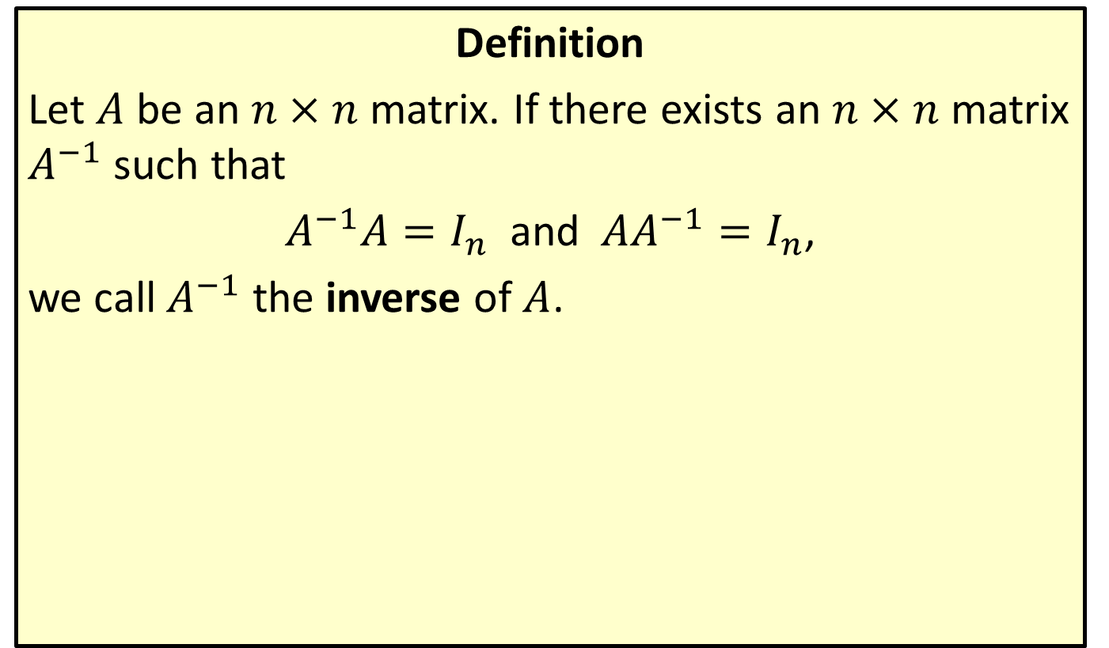
The Inverse of a Matrix
Definition
Let $A$ be an $n×n$ matrix. If there exists an $n×n$ matrix $A^{−1}$ such that
$A^{−1}A=I_{n}$ and $AA^{−1}=I_{n}$,
we call $A^{−1}$ the inverse of $A$.

Slide 7

Example 2: Finding the Inverse of a Matrix
Find the inverse of the matrix $A=\left[\begin{matrix}2 & −3 \\ −1 & 2\end{matrix}\right]$.

Slide 8
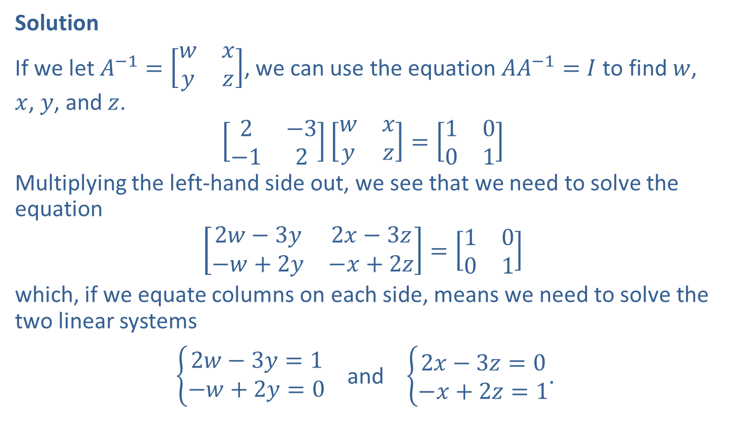
Example 2: Finding the Inverse of a Matrix (cont.)
Solution
If we let $A^{−1}=\left[\begin{matrix}w & x \\ y & z\end{matrix}\right]$, we can use the equation $AA^{−1}=I$ to find $w$, $x$, $y$, and $z$.
$$\left[\begin{matrix}2 & −3 \\ −1 & 2\end{matrix}\right]\left[\begin{matrix}w & x \\ y & z\end{matrix}\right]=\left[\begin{matrix}1 & 0 \\ 0 & 1\end{matrix}\right]$$
Multiplying the left-hand side out, we see that we need to solve the equation
$$\left[\begin{matrix}2w−3y & 2x−3z \\ −w+2y & −x+2z\end{matrix}\right]=\left[\begin{matrix}1 & 0 \\ 0 & 1\end{matrix}\right]$$
which, if we equate columns on each side, means we need to solve the two linear systems
$\left\{\begin{aligned}2w−3y=1 \\ −w+2y=0\end{aligned}\right.$ and $\left\{\begin{aligned}2x−3z=0 \\ −x+2z=1\end{aligned}\right.$.

Slide 9
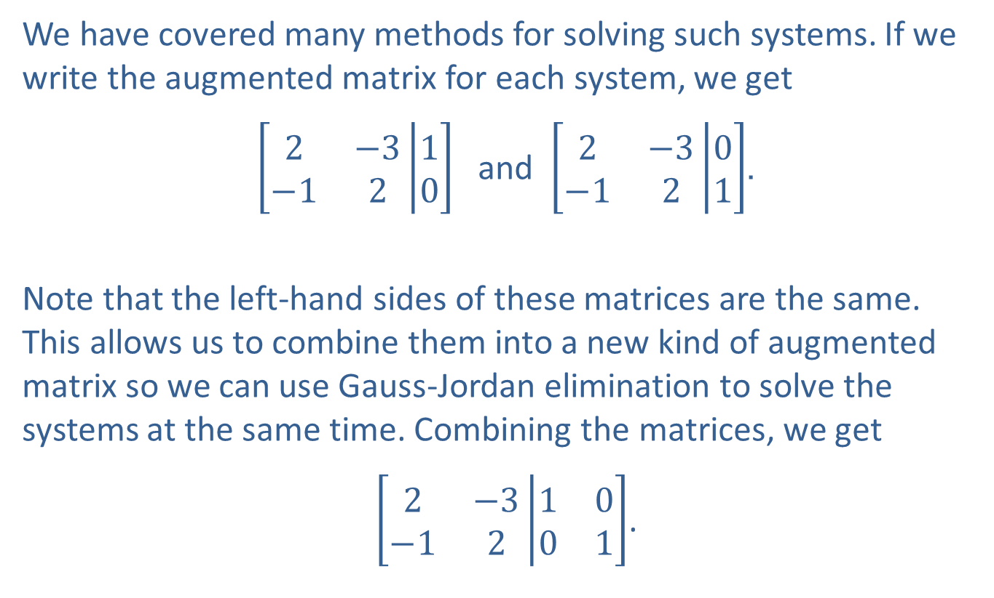
Example 2: Finding the Inverse of a Matrix (cont.)
We have covered many methods for solving such systems. If we write the augmented matrix for each system, we get
$\left[\begin{matrix}2 & −3 \\ −1 & 2\end{matrix}\left|\begin{matrix}1 \\ 0\end{matrix}\right.\right]$ and $\left[\begin{matrix}2 & −3 \\ −1 & 2\end{matrix}\left|\begin{matrix}0 \\ 1\end{matrix}\right.\right]$.
Note that the left-hand sides of these matrices are the same. This allows us to combine them into a new kind of augmented matrix so we can use Gauss-Jordan elimination to solve the systems at the same time. Combining the matrices, we get
$\left[\begin{matrix}2 & −3 \\ −1 & 2\end{matrix}\left|\begin{matrix}1 & 0 \\ 0 & 1\end{matrix}\right.\right]$.

Slide 10
Example 2: Finding the Inverse of a Matrix (cont.)
When we change this new matrix into reduced row echelon form, we will have solved the first system with the numbers in the third column and the second system with the numbers in the fourth column.

Slide 11
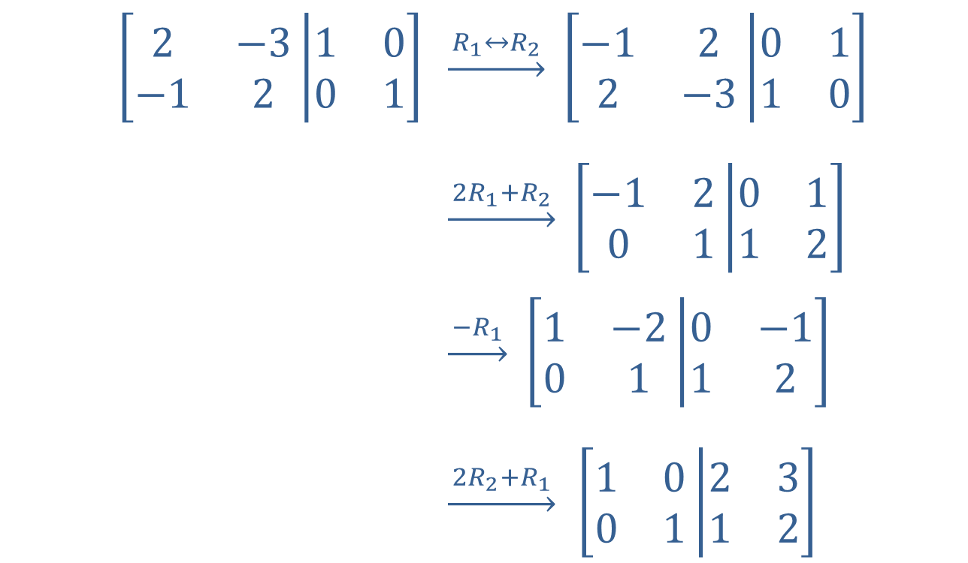
Example 2: Finding the Inverse of a Matrix (cont.)
$$\left[\begin{matrix}2 & −3 \\ −1 & 2\end{matrix}\left|\begin{matrix}1 & 0 \\ 0 & 1\end{matrix}\right.\right]$$ | $\underset{→}{{ R}_{1}↔R_{2 }}$ $\left[\begin{matrix}−1 & 2 \\ 2 & −3\end{matrix}\left|\begin{matrix}0 & 1 \\ 1 & 0\end{matrix}\right.\right]$
 | $\underset{→}{ 2R_{1}+R_{2 }}$ $\left[\begin{matrix}−1 & 2 \\ 0 & 1\end{matrix}\left|\begin{matrix}0 & 1 \\ 1 & 2\end{matrix}\right.\right]$
 | $\underset{→}{ −R_{1 }}$ $\left[\begin{matrix}1 & −2 \\ 0 & 1\end{matrix}\left|\begin{matrix}0 & −1 \\ 1 & 2\end{matrix}\right.\right]$
 | $\underset{→}{ 2R_{2}+R_{1 }}$ $\left[\begin{matrix}1 & 0 \\ 0 & 1\end{matrix}\left|\begin{matrix}2 & 3 \\ 1 & 2\end{matrix}\right.\right]$

Slide 12

Example 2: Finding the Inverse of a Matrix (cont.)
This tells us that $w=2$ and $y=1$ (from the third column) and $x=3$ and $z=2$ (from the fourth column). So
$A^{−1}=\left[\begin{matrix}2 & 3 \\ 1 & 2\end{matrix}\right]$.

Slide 13
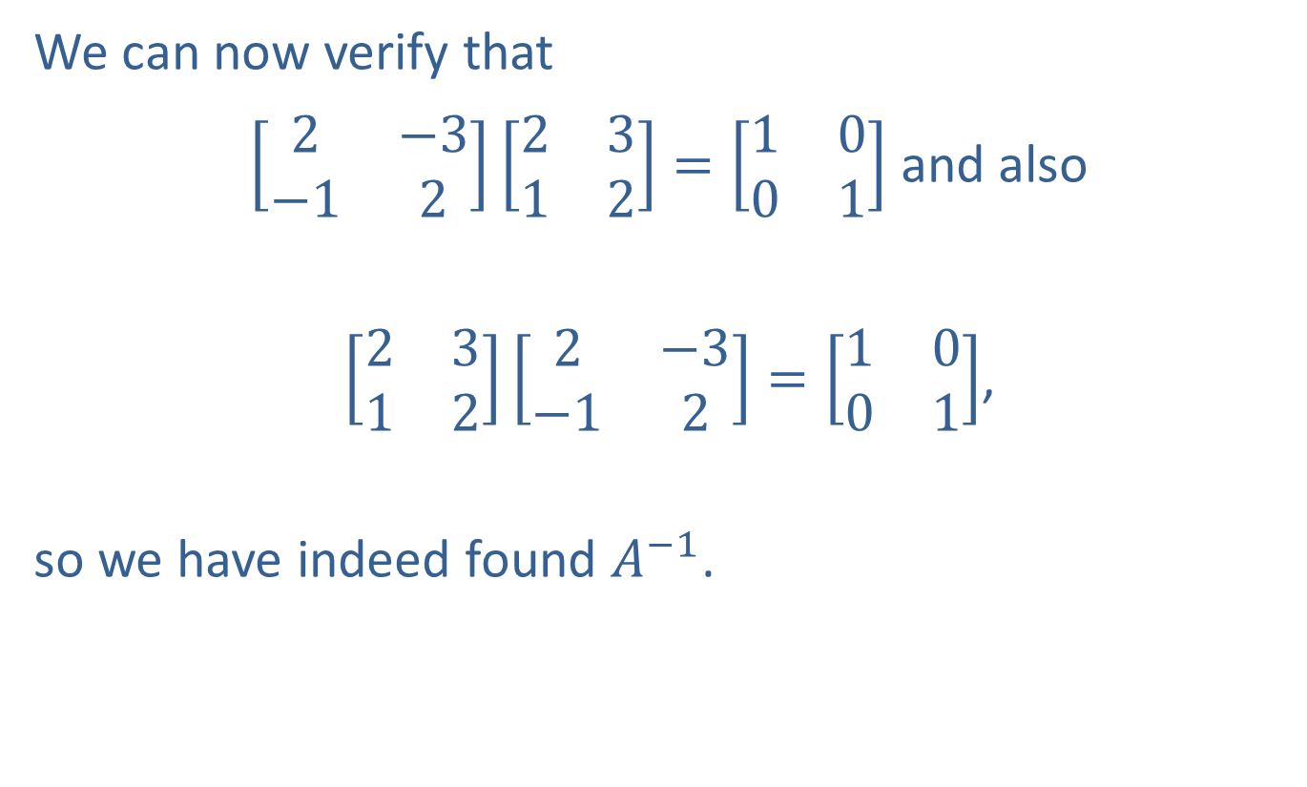
Example 2: Finding the Inverse of a Matrix (cont.)
We can now verify that
$\left[\begin{matrix}2 & −3 \\ −1 & 2\end{matrix}\right]\left[\begin{matrix}2 & 3 \\ 1 & 2\end{matrix}\right]=\left[\begin{matrix}1 & 0 \\ 0 & 1\end{matrix}\right]$ and also
$\left[\begin{matrix}2 & 3 \\ 1 & 2\end{matrix}\right]\left[\begin{matrix}2 & −3 \\ −1 & 2\end{matrix}\right]=\left[\begin{matrix}1 & 0 \\ 0 & 1\end{matrix}\right]$,
so we have indeed found $A^{−1}$.

Slide 14
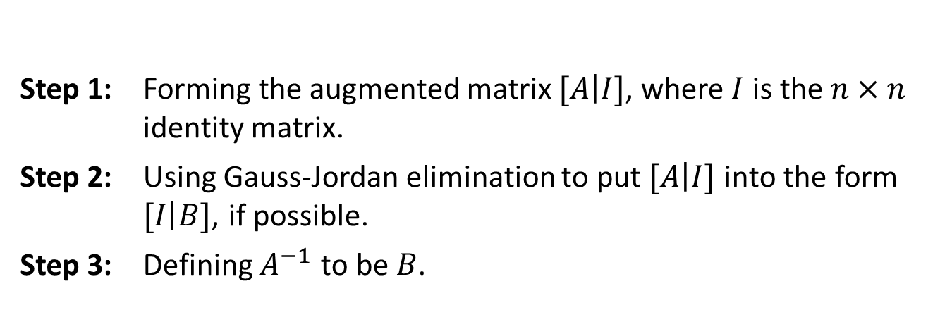

Finding the Inverse of a Matrix
Procedure
Let $A$ be an $n×n$ matrix. The inverse of $A$ can be found by
If it is not possible to put $[\left.A\right|I]$ into reduced row echelon form, then $A$ doesn't have an inverse, and we say $A$ is not invertible.
If the coefficient matrix of a system of equations is not invertible, it means that the system either has an infinite number of solutions or has no solution.
Step 1: | Forming the augmented matrix $[\left.A\right|I]$, where $I$ is the $n×n$ identity matrix.
Step 2: | Using Gauss-Jordan elimination to put $[\left.A\right|I]$ into the form $[\left.I\right|B]$, if possible.
Step 3: | Defining $A^{−1}$ to be $B$.

Slide 15
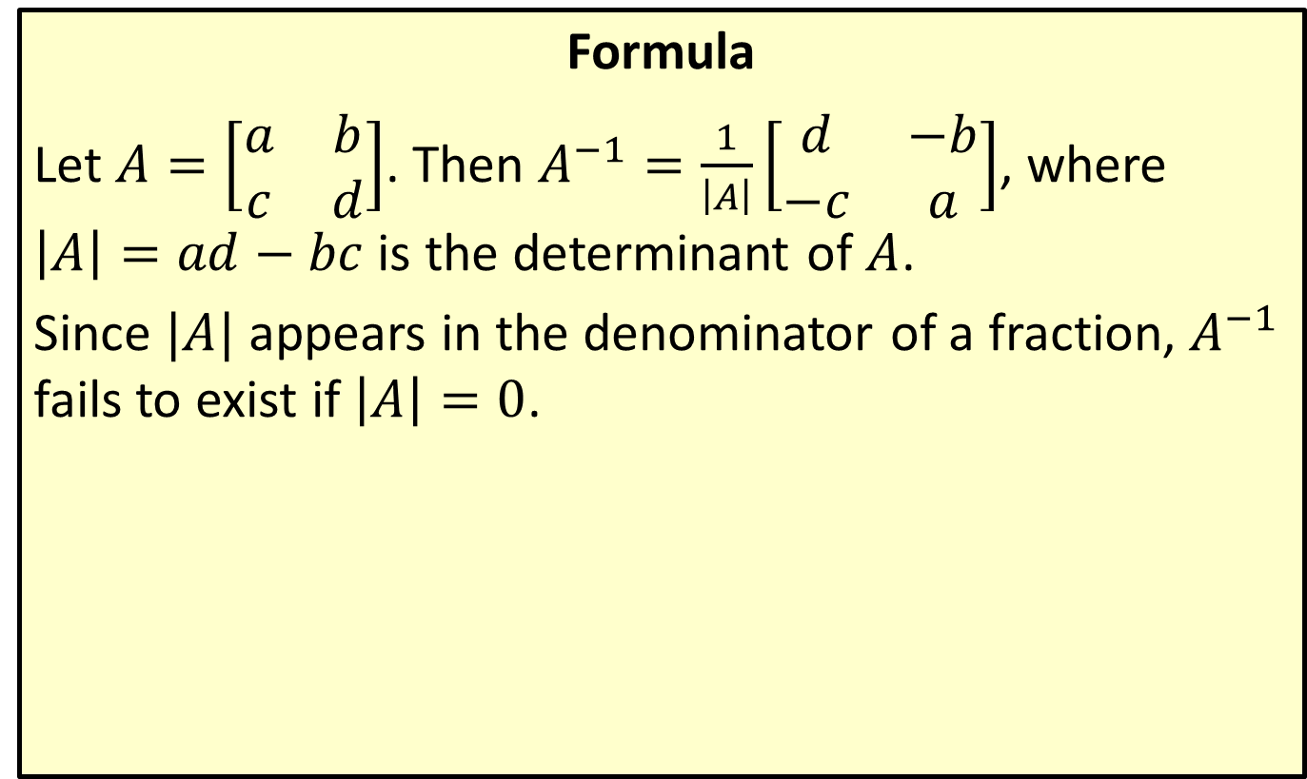
Inverse of a 2 × 2 Matrix
Formula
Let $A=\left[\begin{matrix}a & b \\ c & d\end{matrix}\right]$. Then $A^{−1}=\frac{1}{\left|A\right|}\left[\begin{matrix}d & −b \\ −c & a\end{matrix}\right]$, where
$\left|A\right|=ad−bc$ is the determinant of $A$.
Since $|A|$ appears in the denominator of a fraction, $A^{−1}$ fails to exist if $\left|A\right|=0$.

Slide 16
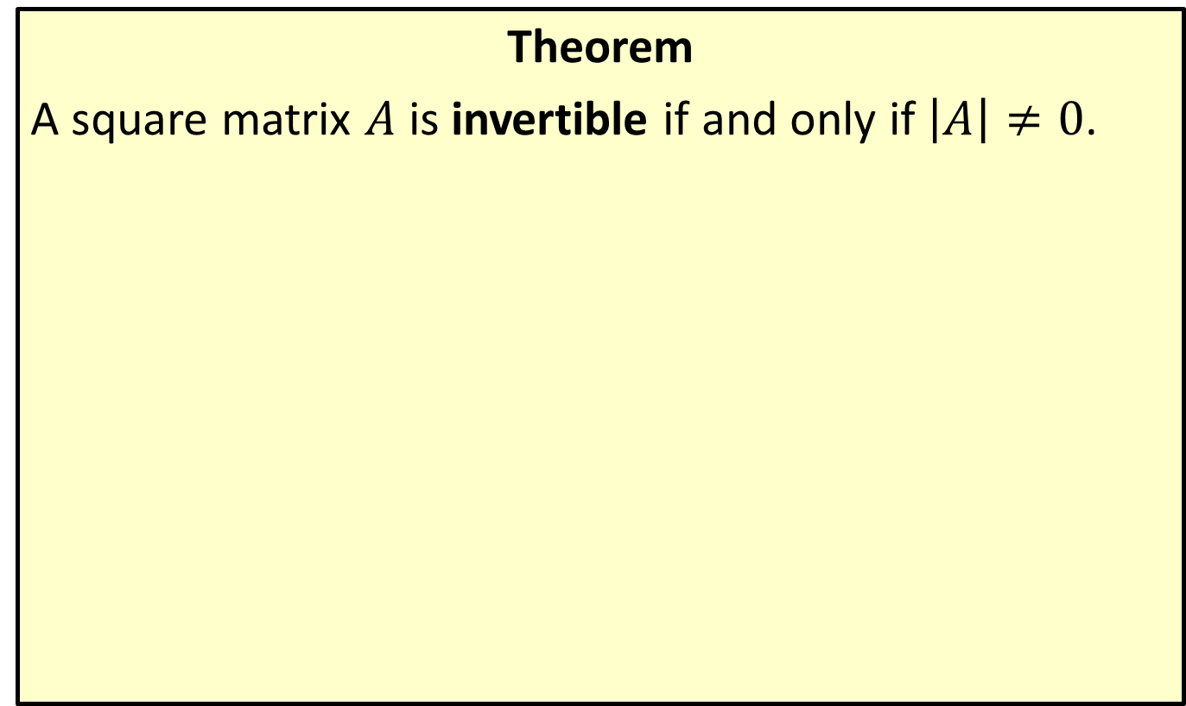
Invertible Matrices
Theorem
A square matrix $A$ is invertible if and only if $\left|A\right|≠0$.

Slide 17

Example 3: Finding the Inverse of a Matrix
Find the inverses of the following matrices, if possible.
​$A=\left[\begin{matrix}3 & −5 \\ 2 & 1\end{matrix}\right]$
​$B=\left[\begin{matrix}2 & 4 & 2 \\ −1 & 5 & −1 \\ 3 & 1 & 3\end{matrix}\right]$

Slide 18
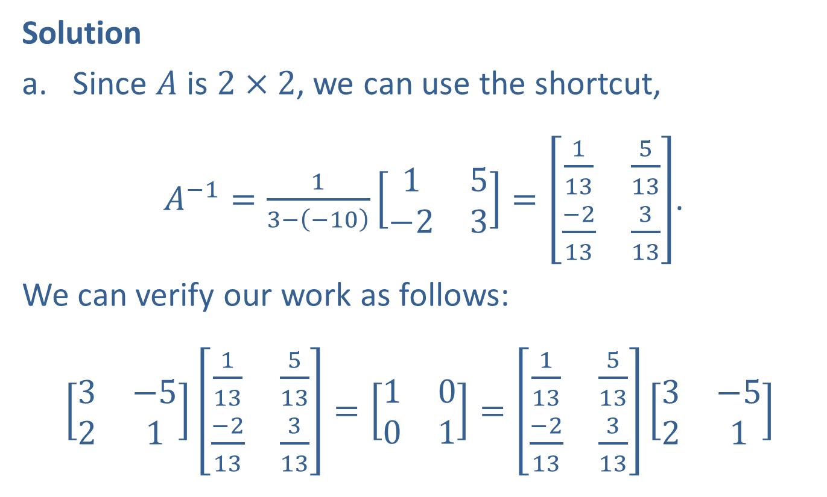
Example 3: Finding the Inverse of a Matrix (cont.)
Solution
​Since $A$ is $2×2$, we can use the shortcut,
​ $A^{−1}=\frac{1}{3−\left(−10\right)}\left[\begin{matrix}1 & 5 \\ −2 & 3\end{matrix}\right]=\left[\begin{matrix}\frac{1}{13} & \frac{5}{13} \\ \frac{−2}{13} & \frac{3}{13}\end{matrix}\right]$.
​We can verify our work as follows:
​$\left[\begin{matrix}3 & −5 \\ 2 & 1\end{matrix}\right]\left[\begin{matrix}\frac{1}{13} & \frac{5}{13} \\ \frac{−2}{13} & \frac{3}{13}\end{matrix}\right]=\left[\begin{matrix}1 & 0 \\ 0 & 1\end{matrix}\right]=\left[\begin{matrix}\frac{1}{13} & \frac{5}{13} \\ \frac{−2}{13} & \frac{3}{13}\end{matrix}\right]\left[\begin{matrix}3 & −5 \\ 2 & 1\end{matrix}\right]$

Slide 19
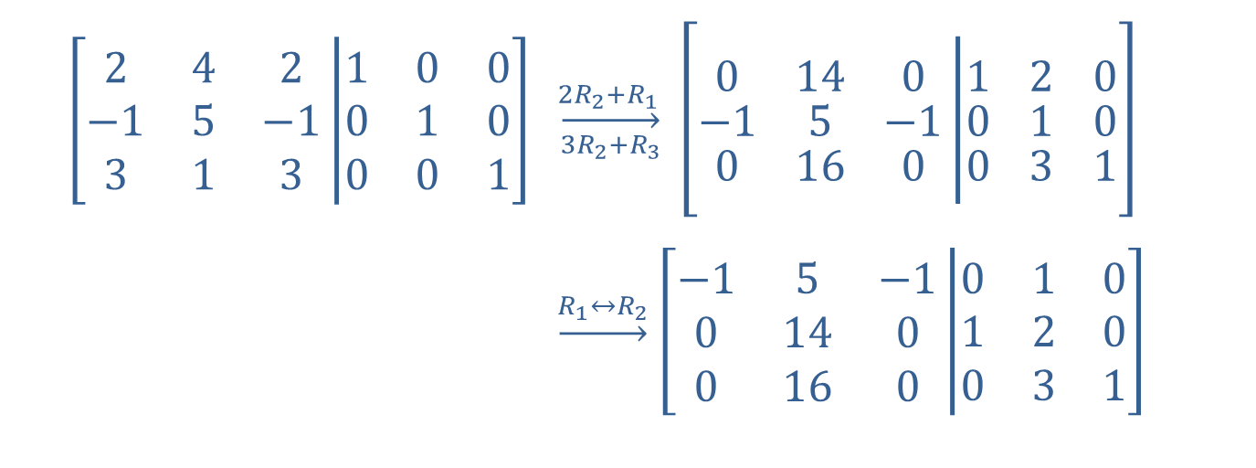

Example 3: Finding the Inverse of a Matrix (cont.)
​Since $B$ is a $3×3$ matrix, we use the augmented identity matrix process.
$$\left[\begin{matrix}2 & 4 & 2 \\ −1 & 5 & −1 \\ 3 & 1 & 3\end{matrix}\left|\begin{matrix}1 & 0 & 0 \\ 0 & 1 & 0 \\ 0 & 0 & 1\end{matrix}\right.\right]$$ | $$\overset{2R_{2}+R_{1 }}{\overset{→}{3R_{2}+R_{3}}} \left[\begin{matrix}0 & 14 & 0 \\ −1 & 5 & −1 \\ 0 & 16 & 0\end{matrix}\left|\begin{matrix}1 & 2 & 0 \\ 0 & 1 & 0 \\ 0 & 3 & 1\end{matrix}\right.\right]$$
 | $\underset{→}{R_{1}↔R_{2}}$ $\left[\begin{matrix}−1 & 5 & −1 \\ 0 & 14 & 0 \\ 0 & 16 & 0\end{matrix}\left|\begin{matrix}0 & 1 & 0 \\ 1 & 2 & 0 \\ 0 & 3 & 1\end{matrix}\right.\right]$

Slide 20
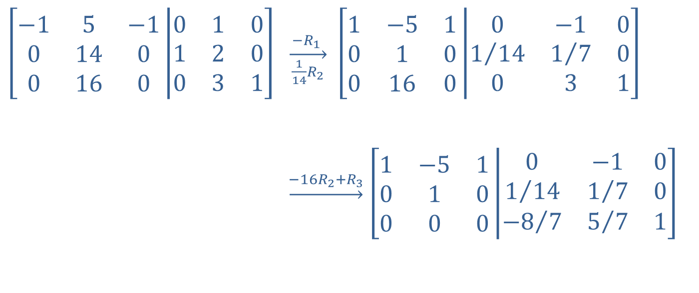
Example 3: Finding the Inverse of a Matrix (cont.)
$$\left[\begin{matrix}−1 & 5 & −1 \\ 0 & 14 & 0 \\ 0 & 16 & 0\end{matrix}\left|\begin{matrix}0 & 1 & 0 \\ 1 & 2 & 0 \\ 0 & 3 & 1\end{matrix}\right.\right]$$ | $\overset{−R_{1} }{\overset{→}{ \frac{1}{14}R_{2} }}$ $\left[\begin{matrix}1 & −5 & 1 \\ 0 & 1 & 0 \\ 0 & 16 & 0\end{matrix}\left|\begin{matrix}0 & −1 & 0 \\ 1/{14} & 1/7 & 0 \\ 0 & 3 & 1\end{matrix}\right.\right]$
 | $\underset{→}{−16R_{2}+R_{3}}$ $\left[\begin{matrix}1 & −5 & 1 \\ 0 & 1 & 0 \\ 0 & 0 & 0\end{matrix}\left|\begin{matrix}0 & −1 & 0 \\ 1/{14} & 1/7 & 0 \\ {−8}/7 & 5/7 & 1\end{matrix}\right.\right]$

Slide 21

Example 3: Finding the Inverse of a Matrix (cont.)
At this point, we can stop. Once the first three entries of any row are 0 in the $3×3$ matrix, there is no way to put the matrix into reduced row echelon form. Thus, $B$ has no inverse.
​

Slide 22
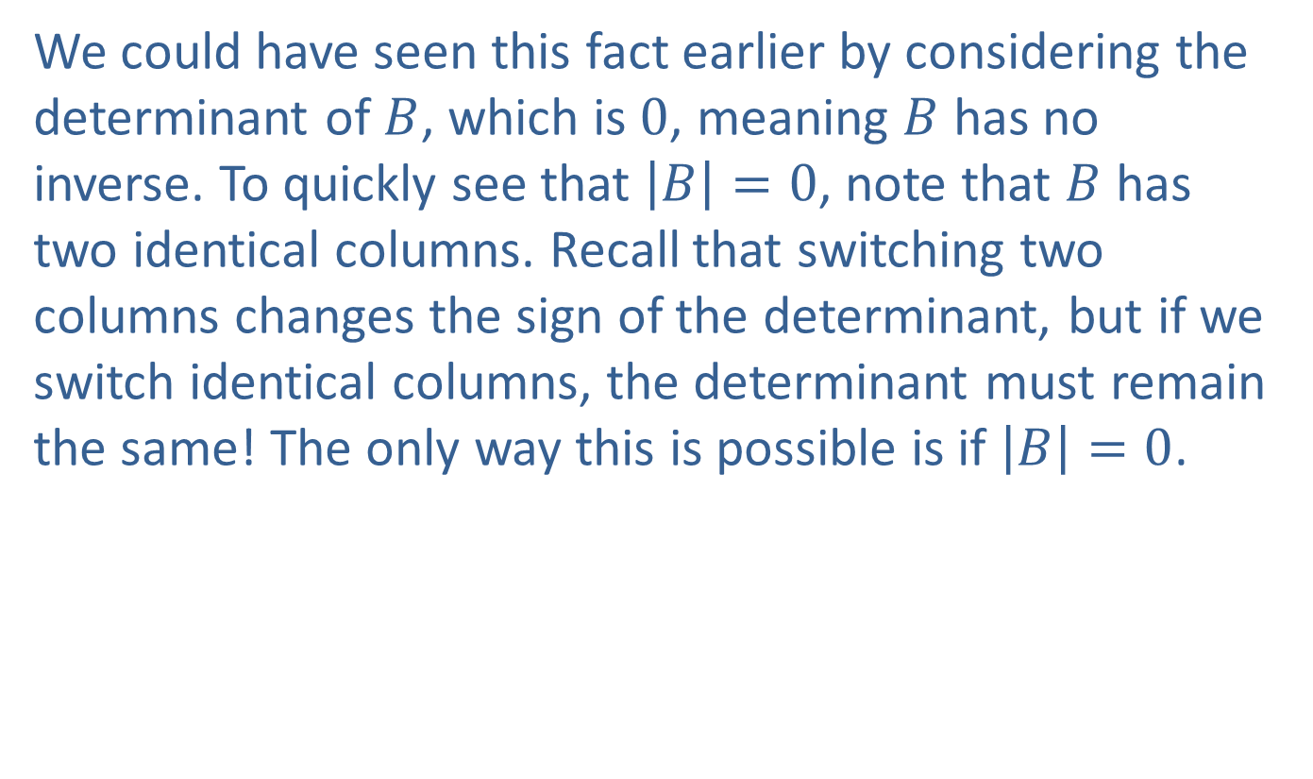
Example 3: Finding the Inverse of a Matrix (cont.)
​We could have seen this fact earlier by considering the determinant of $B$, which is 0, meaning $B$ has no inverse. To quickly see that $\left|B\right|=0$, note that $B$ has two identical columns. Recall that switching two columns changes the sign of the determinant, but if we switch identical columns, the determinant must remain the same! The only way this is possible is if $\left|B\right|=0$.

Slide 23
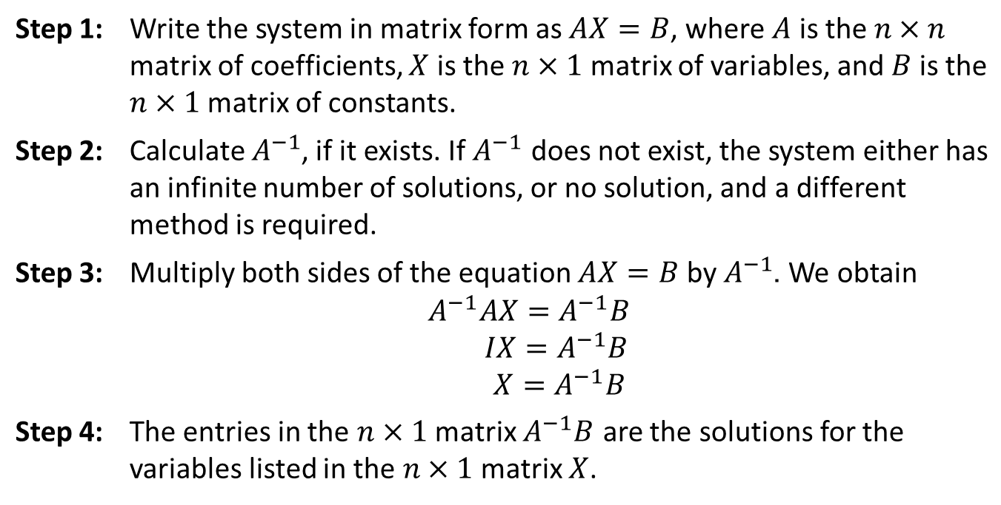

The Inverse Matrix Method
Procedure
To solve a linear system of $n$ equations in $n$ variables
Step 1: | Write the system in matrix form as $AX=B$, where $A$ is the $n×n$ matrix of coefficients, $X$ is the $n×1$ matrix of variables, and $B$ is the $n×1$ matrix of constants.
Step 2: | Calculate $A^{−1}$, if it exists. If $A^{−1}$ does not exist, the system either has an infinite number of solutions, or no solution, and a different method is required.
Step 3: | Multiply both sides of the equation $AX=B$ by $A^{−1}$. We obtain $$A^{−1}AX=A^{−1}B \\ IX=A^{−1}B \\ X=A^{−1}B$$
Step 4: | The entries in the $n×1$ matrix $A^{−1}B$ are the solutions for the variables listed in the $n×1$ matrix $X$.

Slide 24
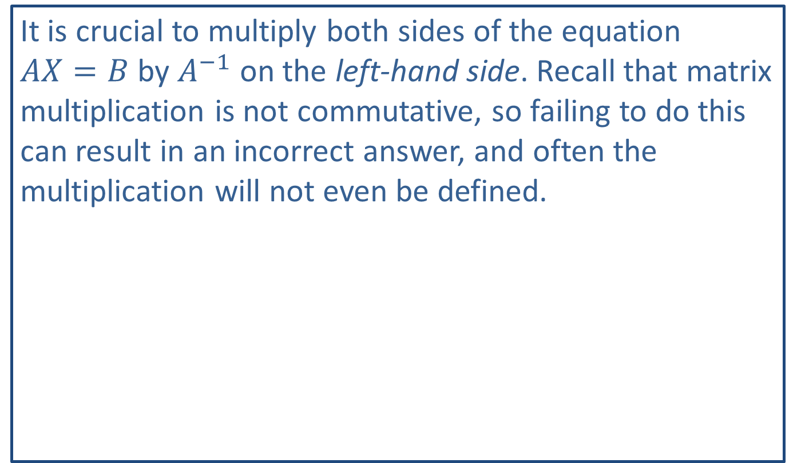
CAUTION!
It is crucial to multiply both sides of the equation
$AX=B$ by $A^{−1}$ on the left-hand side. Recall that matrix multiplication is not commutative, so failing to do this can result in an incorrect answer, and often the multiplication will not even be defined.

Slide 25

Example 4: Inverse Matrix Method
Solve the following systems by the inverse matrix method.
​$\left\{\begin{aligned} 4x−5y=3 \\ −3x+7y=1\end{aligned}\right.$
​ $\left\{\begin{aligned}−x+2y=3 \\ 3x−6y=−5\end{aligned}\right.$

Slide 26

Example 4: Inverse Matrix Method (cont.)
Solution
​$\left\{\begin{aligned} 4x−5y=3 \\ −3x+7y=1\end{aligned}\right.$
  $\left[\begin{matrix}4 & −5 \\ −3 & 7\end{matrix}\right]\left[\begin{aligned}x \\ y\end{aligned}\right]=\left[\begin{aligned}3 \\ 1\end{aligned}\right]$ Write the system in matrix form.
​

Slide 27
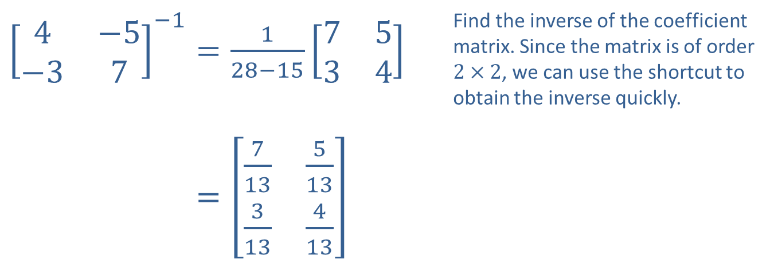
Example 4: Inverse Matrix Method (cont.)
​${\left[\begin{matrix}4 & −5 \\ −3 & 7\end{matrix}\right]}^{−1}=\frac{1}{28−15}\left[\begin{matrix}7 & 5 \\ 3 & 4\end{matrix}\right]$ | Find the inverse of the coefficient matrix. Since the matrix is of order $2×2$, we can use the shortcut to obtain the inverse quickly.
​4−5−37−1=713513313413

Slide 28
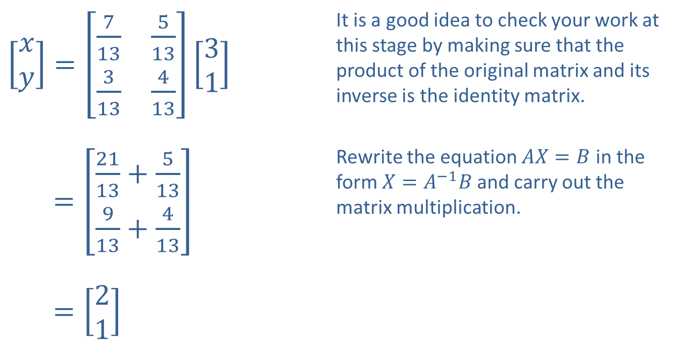
Example 4: Inverse Matrix Method (cont.)
​$\left[\begin{aligned}x \\ y\end{aligned}\right]=\left[\begin{matrix}\frac{7}{13} & \frac{5}{13} \\ \frac{3}{13} & \frac{4}{13}\end{matrix}\right]\left[\begin{aligned}3 \\ 1\end{aligned}\right]$ | It is a good idea to check your work at this stage by making sure that the product of the original matrix and its inverse is the identity matrix.
​[𝑥𝑦]=2113+513913+413 | Rewrite the equation $AX=B$ in the form $X=A^{−1}B$ and carry out the matrix multiplication.
​[𝑥𝑦]=21

Slide 29

Example 4: Inverse Matrix Method (cont.)
​Thus, the solution to the system is $(2,1)$.

Slide 30
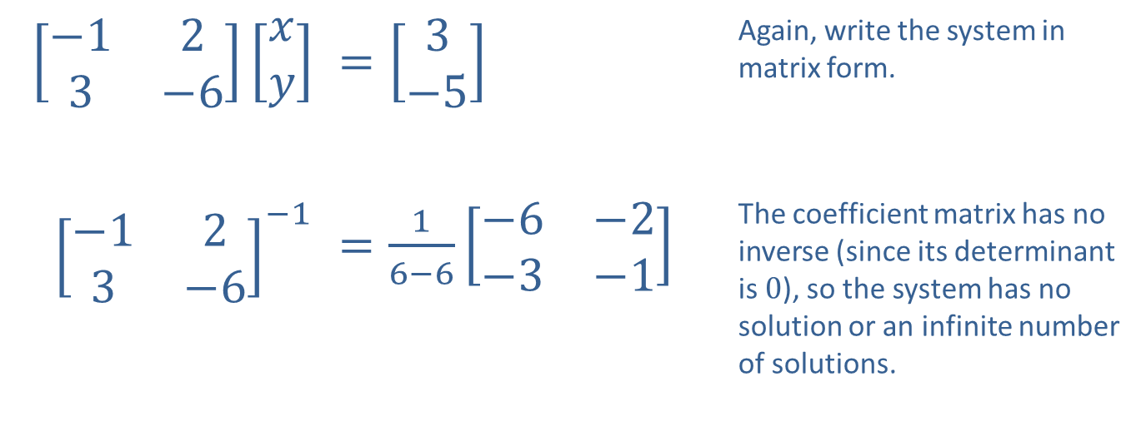

Example 4: Inverse Matrix Method (cont.)
​$\left\{\begin{aligned}−x+2y=3 \\ 3x−6y=−5\end{aligned}\right.$
​
​$\left[\begin{matrix}−1 & 2 \\ 3 & −6\end{matrix}\right]\left[\begin{aligned}x \\ y\end{aligned}\right]$ | ​$=\left[\begin{aligned}3 \\ −5\end{aligned}\right]$ | Again, write the system in matrix form.
​${\left[\begin{matrix}−1 & 2 \\ 3 & −6\end{matrix}\right]}^{−1}$ | ​$=\frac{1}{6−6}\left[\begin{matrix}−6 & −2 \\ −3 & −1\end{matrix}\right]$ | The coefficient matrix has no inverse (since its determinant is 0), so the system has no solution or an infinite number of solutions.

Slide 31
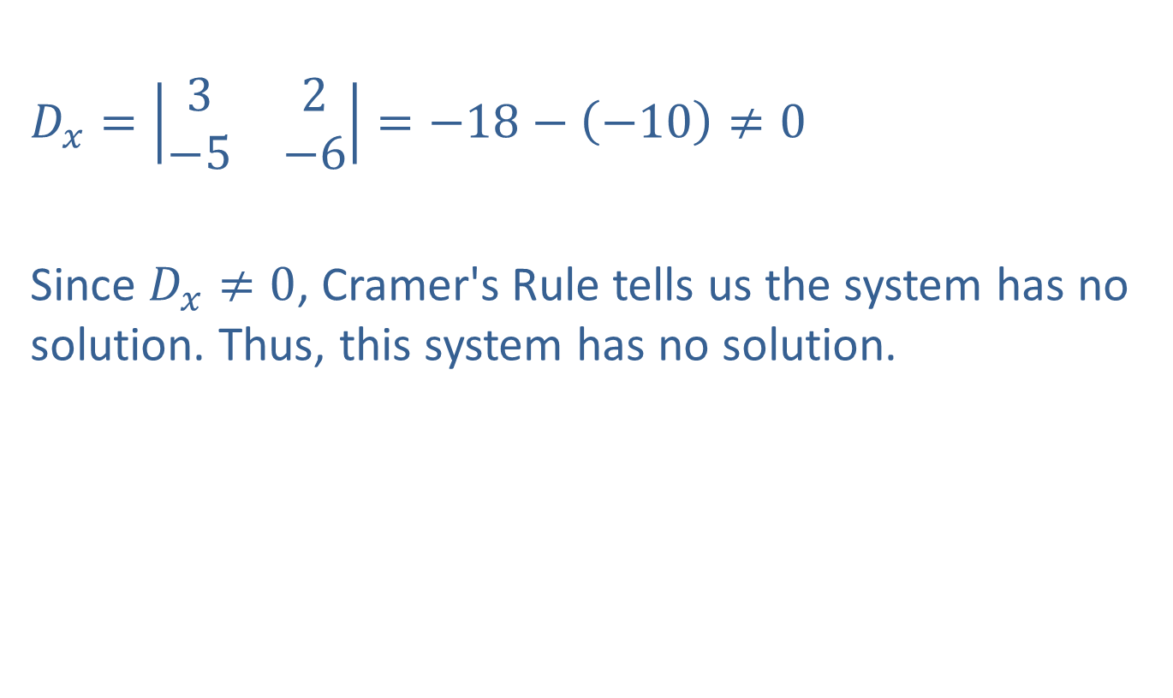
Example 4: Inverse Matrix Method (cont.)
​
$D_{x}=\left|\begin{matrix}3 & 2 \\ −5 & −6\end{matrix}\right|=−18−\left(−10\right)≠0$
Since $D_{x}≠0$, Cramer's Rule tells us the system has no solution. Thus, this system has no solution.

Slide 32
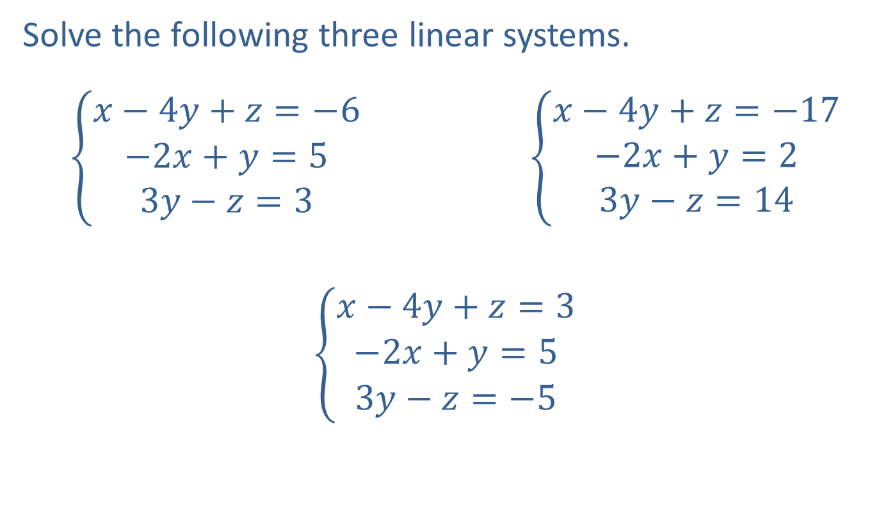
Example 5: Using the Inverse Matrix Method
Solve the following three linear systems.
  $\left\{\begin{aligned}x−4y+z=−6 \\ −2x+y=5 \\ 3y−z=3\end{aligned}\right. \left\{\begin{aligned}x−4y+z=−17 \\ −2x+y=2 \\ 3y−z=14\end{aligned}\right.$
$$\left\{\begin{aligned}x−4y+z=3 \\ −2x+y=5 \\ 3y−z=−5\end{aligned}\right.$$

Slide 33
Example 5: Using the Inverse Matrix Method (cont.)
Solution
The coefficient matrix is the same for the three systems, and this means we can avoid unnecessary computation if we use the inverse matrix method. We begin by finding the inverse of the coefficient matrix.

Slide 34
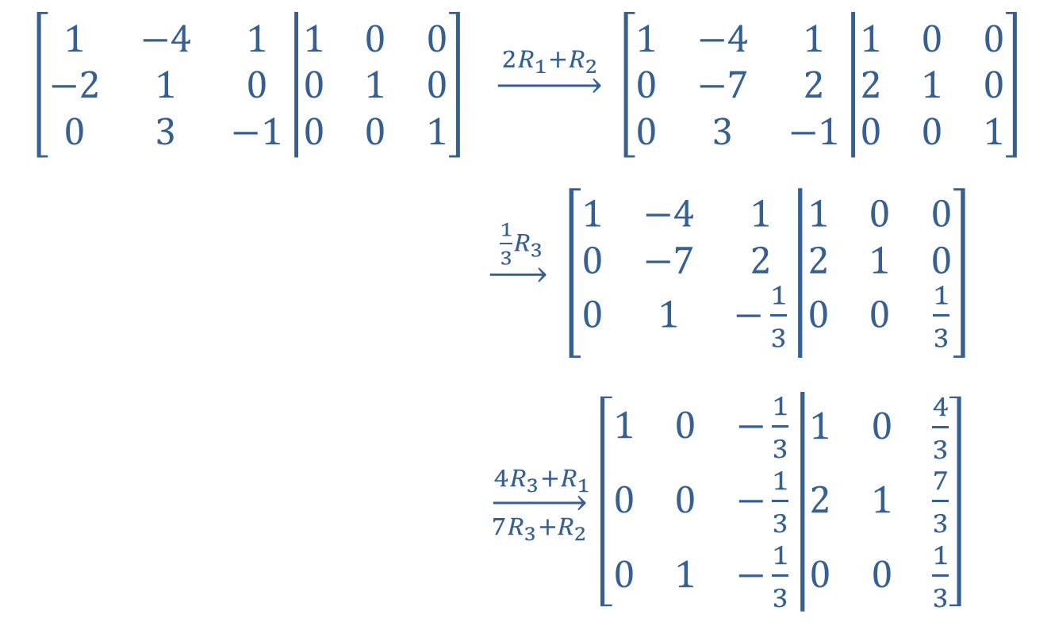
Example 5: Using the Inverse Matrix Method (cont.)
$$\left[\begin{matrix}1 & −4 & 1 \\ −2 & 1 & 0 \\ 0 & 3 & −1\end{matrix}\left|\begin{matrix}1 & 0 & 0 \\ 0 & 1 & 0 \\ 0 & 0 & 1\end{matrix}\right.\right]$$ | $\underset{→}{ 2R_{1}+R_{2 }}$ $\left[\begin{matrix}1 & −4 & 1 \\ 0 & −7 & 2 \\ 0 & 3 & −1\end{matrix}\left|\begin{matrix}1 & 0 & 0 \\ 2 & 1 & 0 \\ 0 & 0 & 1\end{matrix}\right.\right]$
 | $\underset{→}{ \frac{1}{3}R_{3 }}$ $\left[\begin{matrix}1 & −4 & 1 \\ 0 & −7 & 2 \\ 0 & 1 & −\frac{1}{3}\end{matrix}\left|\begin{matrix}1 & 0 & 0 \\ 2 & 1 & 0 \\ 0 & 0 & \frac{1}{3}\end{matrix}\right.\right]$
 | $\overset{ 4R_{3}+R_{1}}{\overset{→}{7R_{3}+R_{2}}}$ $\left[\begin{matrix}1 & 0 & −\frac{1}{3} \\ 0 & 0 & −\frac{1}{3} \\ 0 & 1 & −\frac{1}{3}\end{matrix}\left|\begin{matrix}1 & 0 & \frac{4}{3} \\ 2 & 1 & \frac{7}{3} \\ 0 & 0 & \frac{1}{3}\end{matrix}\right.\right]$

Slide 35
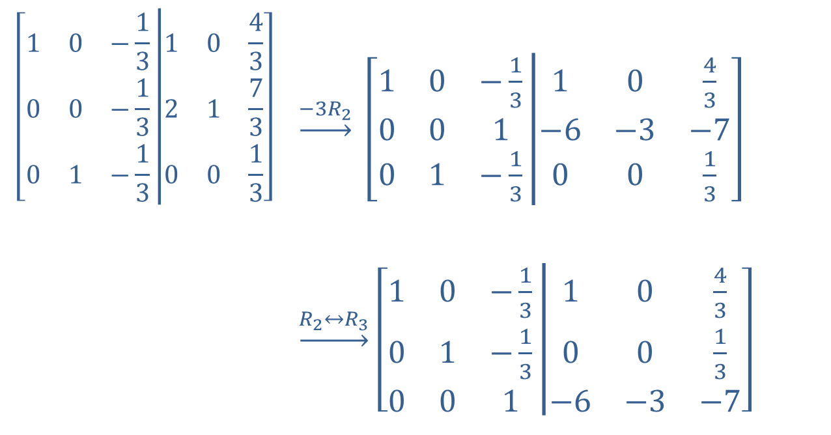
Example 5: Using the Inverse Matrix Method (cont.)
$$\left[\begin{matrix}1 & 0 & −\frac{1}{3} \\ 0 & 0 & −\frac{1}{3} \\ 0 & 1 & −\frac{1}{3}\end{matrix}\left|\begin{matrix}1 & 0 & \frac{4}{3} \\ 2 & 1 & \frac{7}{3} \\ 0 & 0 & \frac{1}{3}\end{matrix}\right.\right]$$ | $\underset{→}{−3R_{2}}$ $\left[\begin{matrix}1 & 0 & −\frac{1}{3} \\ 0 & 0 & 1 \\ 0 & 1 & −\frac{1}{3}\end{matrix}\left|\begin{matrix}1 & 0 & \frac{4}{3} \\ −6 & −3 & −7 \\ 0 & 0 & \frac{1}{3}\end{matrix}\right.\right]$
 | $\underset{→}{R_{2}↔R_{3}}$ $\left[\begin{matrix}1 & 0 & −\frac{1}{3} \\ 0 & 1 & −\frac{1}{3} \\ 0 & 0 & 1\end{matrix}\left|\begin{matrix}1 & 0 & \frac{4}{3} \\ 0 & 0 & \frac{1}{3} \\ −6 & −3 & −7\end{matrix}\right.\right]$

Slide 36
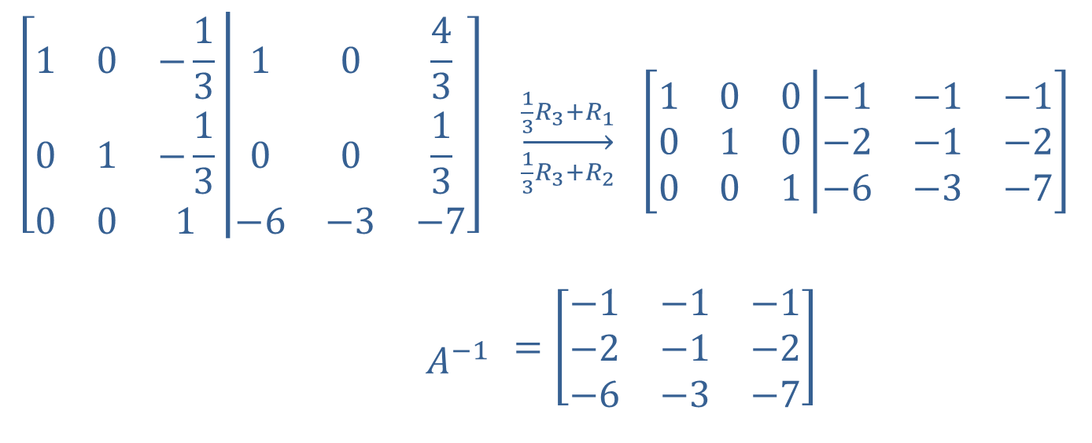
Example 5: Using the Inverse Matrix Method (cont.)
$$\left[\begin{matrix}1 & 0 & −\frac{1}{3} \\ 0 & 1 & −\frac{1}{3} \\ 0 & 0 & 1\end{matrix}\left|\begin{matrix}1 & 0 & \frac{4}{3} \\ 0 & 0 & \frac{1}{3} \\ −6 & −3 & −7\end{matrix}\right.\right]$$ | $\overset{\frac{1}{3}R_{3}+R_{1}}{\overset{→}{\frac{1}{3}R_{3}+R_{2}}}$ $\left[\begin{matrix}1 & 0 & 0 \\ 0 & 1 & 0 \\ 0 & 0 & 1\end{matrix}\left|\begin{matrix}−1 & −1 & −1 \\ −2 & −1 & −2 \\ −6 & −3 & −7\end{matrix}\right.\right]$
$$A^{−1}$$ | $$=\left[\begin{matrix}−1 & −1 & −1 \\ −2 & −1 & −2 \\ −6 & −3 & −7\end{matrix}\right]$$

Slide 37
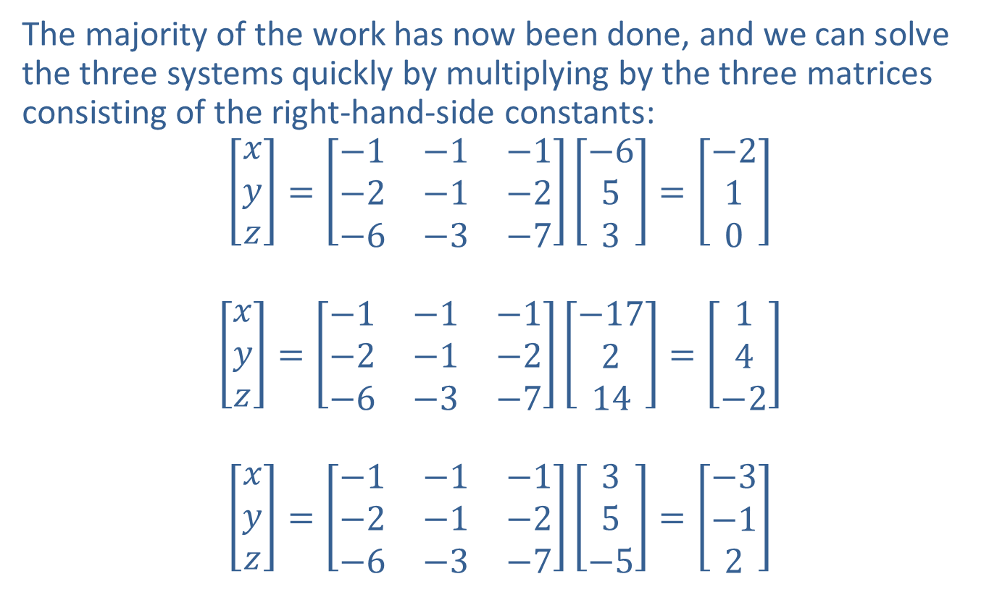
Example 5: Using the Inverse Matrix Method (cont.)
The majority of the work has now been done, and we can solve the three systems quickly by multiplying by the three matrices consisting of the right-hand-side constants:
$$\left[\begin{aligned}x \\ y \\ z\end{aligned}\right]=\left[\begin{matrix}−1 & −1 & −1 \\ −2 & −1 & −2 \\ −6 & −3 & −7\end{matrix}\right]\left[\begin{aligned}−6 \\ 5 \\ 3\end{aligned}\right]=\left[\begin{aligned}−2 \\ 1 \\ 0\end{aligned}\right]$$
$$\left[\begin{aligned}x \\ y \\ z\end{aligned}\right]=\left[\begin{matrix}−1 & −1 & −1 \\ −2 & −1 & −2 \\ −6 & −3 & −7\end{matrix}\right]\left[\begin{aligned}−17 \\ 2 \\ 14\end{aligned}\right]=\left[\begin{aligned}1 \\ 4 \\ −2\end{aligned}\right]$$
$$\left[\begin{aligned}x \\ y \\ z\end{aligned}\right]=\left[\begin{matrix}−1 & −1 & −1 \\ −2 & −1 & −2 \\ −6 & −3 & −7\end{matrix}\right]\left[\begin{aligned}3 \\ 5 \\ −5\end{aligned}\right]=\left[\begin{aligned}−3 \\ −1 \\ 2\end{aligned}\right]$$

