Slide 1
Section 12.6
Partial Fraction Decomposition

Slide 2
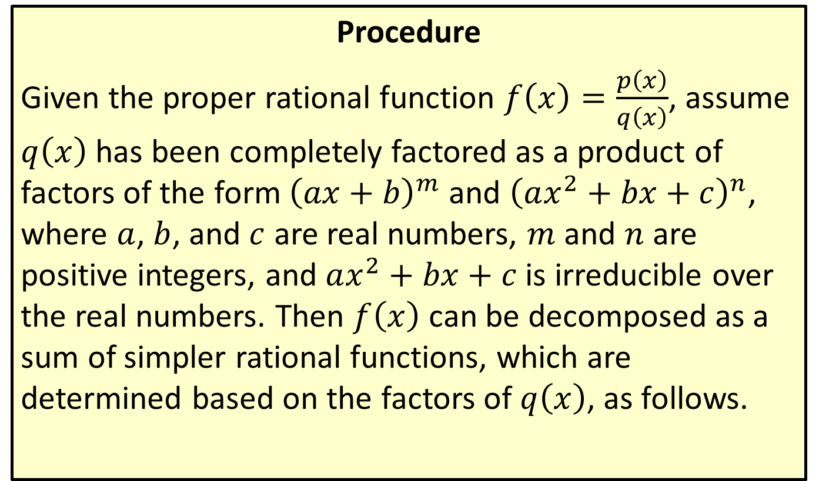
Decomposition Pattern
Procedure
Given the proper rational function $f\left(x\right)=\frac{p\left(x\right)}{q\left(x\right)}$, assume $q⁡\left(x\right)$ has been completely factored as a product of factors of the form ${\left(ax+b\right)}^{m}$ and ${\left(ax^{2}+bx+c\right)}^{n}$, where $a$, $b$, and $c$ are real numbers, $m$ and $n$ are positive integers, and $ax^{2}+bx+c$ is irreducible over the real numbers. Then $f⁡\left(x\right)$ can be decomposed as a sum of simpler rational functions, which are determined based on the factors of $q⁡\left(x\right)$, as follows.

Slide 3
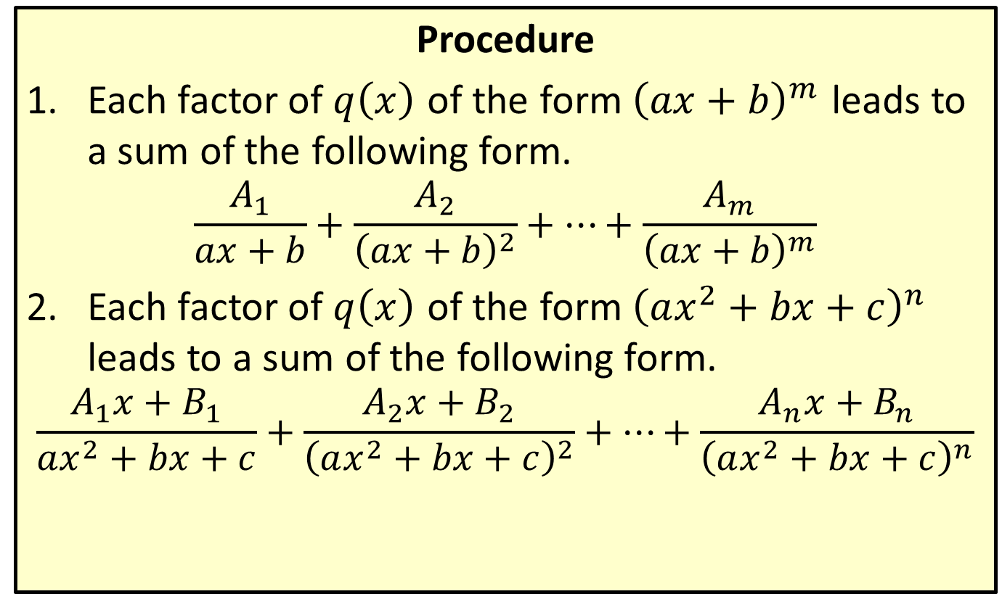
Decomposition Pattern
Procedure
​Each factor of $q⁡\left(x\right)$ of the form ${\left(ax+b\right)}^{m}$ leads to a sum of the following form.
$$\frac{A_{1}}{ax+b}+\frac{A_{2}}{{\left(ax+b\right)}^{2}}+…+\frac{A_{m}}{{\left(ax+b\right)}^{m}}$$
​Each factor of $q⁡\left(x\right)$ of the form ${\left(ax^{2}+bx+c\right)}^{n}$ leads to a sum of the following form.
$$\frac{A_{1}x+B_{1}}{ax^{2}+bx+c}+\frac{A_{2}x+B_{2}}{{\left(ax^{2}+bx+c\right)}^{2}}+…+\frac{A_{n}x+B_{n}}{{\left(ax^{2}+bx+c\right)}^{n}}$$

Slide 4

Example 1: Finding the Partial Fraction Decomposition of a Function
Write the form of the partial fraction decomposition of the rational function.
$$f\left(x\right)=\frac{p\left(x\right)}{x^{3}+6x^{2}+12x+8}$$
Assume that the degree of $p$ is 2 or smaller.

Slide 5
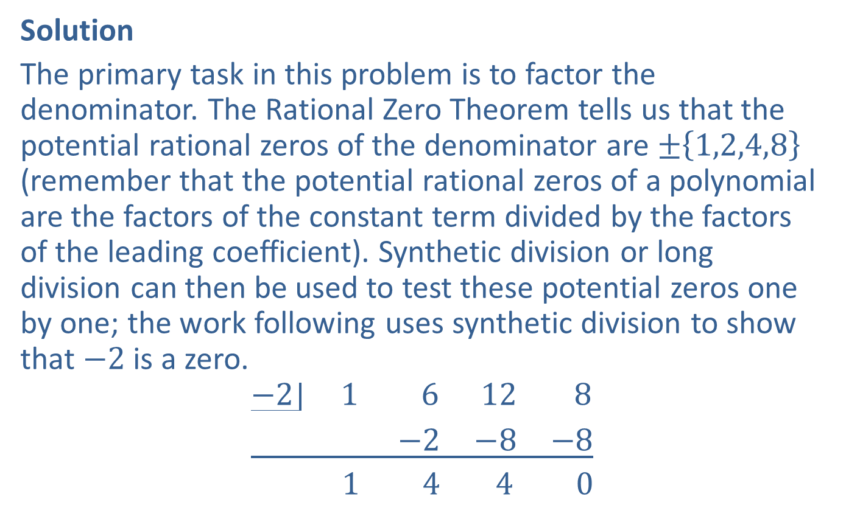
Example 1: Finding the Partial Fraction Decomposition of a Function (cont.)
Solution
The primary task in this problem is to factor the denominator. The Rational Zero Theorem tells us that the potential rational zeros of the denominator are $±\left\{1,2,4,8\right\}$ (remember that the potential rational zeros of a polynomial are the factors of the constant term divided by the factors of the leading coefficient). Synthetic division or long division can then be used to test these potential zeros one by one; the work following uses synthetic division to show that $−2$ is a zero.
$$\underline{\begin{matrix}−2 & 1 & 6 & 12 & 8 \\ & & −2 & −8 & −8\end{matrix}}$$
$$\begin{matrix} & 1 & 4 & 4 & 0\end{matrix}$$

Slide 6
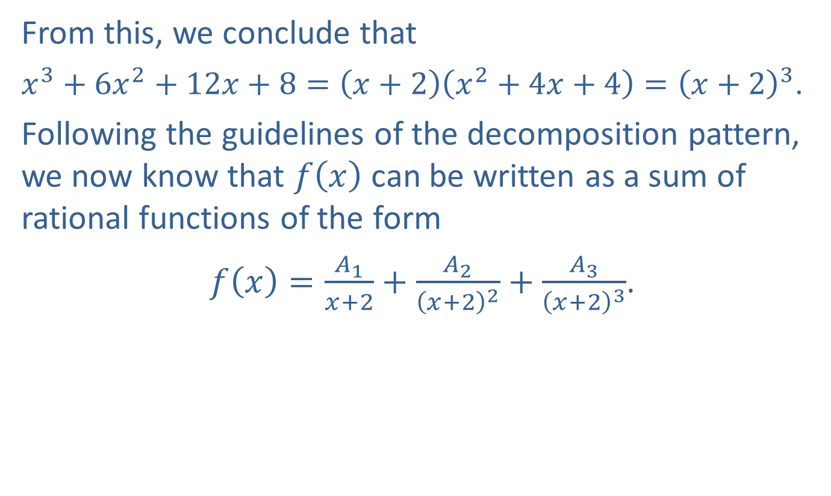
Example 1: Finding the Partial Fraction Decomposition of a Function (cont.)
From this, we conclude that
$x^{3}+6x^{2}+12x+8=\left(x+2\right)\left(x^{2}+4x+4\right)={\left(x+2\right)}^{3}$.
Following the guidelines of the decomposition pattern, we now know that $f⁡\left(x\right)$ can be written as a sum of rational functions of the form
$f\left(x\right)=\frac{A_{1}}{x+2}+\frac{A_{2}}{{\left(x+2\right)}^{2}}+\frac{A_{3}}{{\left(x+2\right)}^{3}}$.

Slide 7

Example 2: Finding the Partial Fraction Decomposition of a Function
Write the form of the partial fraction decomposition of the rational function.
$$f\left(x\right)=\frac{p\left(x\right)}{{\left(x−5\right)}^{2}{\left(x^{2}+4\right)}^{2}}$$
Assume that the degree of $p$ is 5 or smaller.

Slide 8
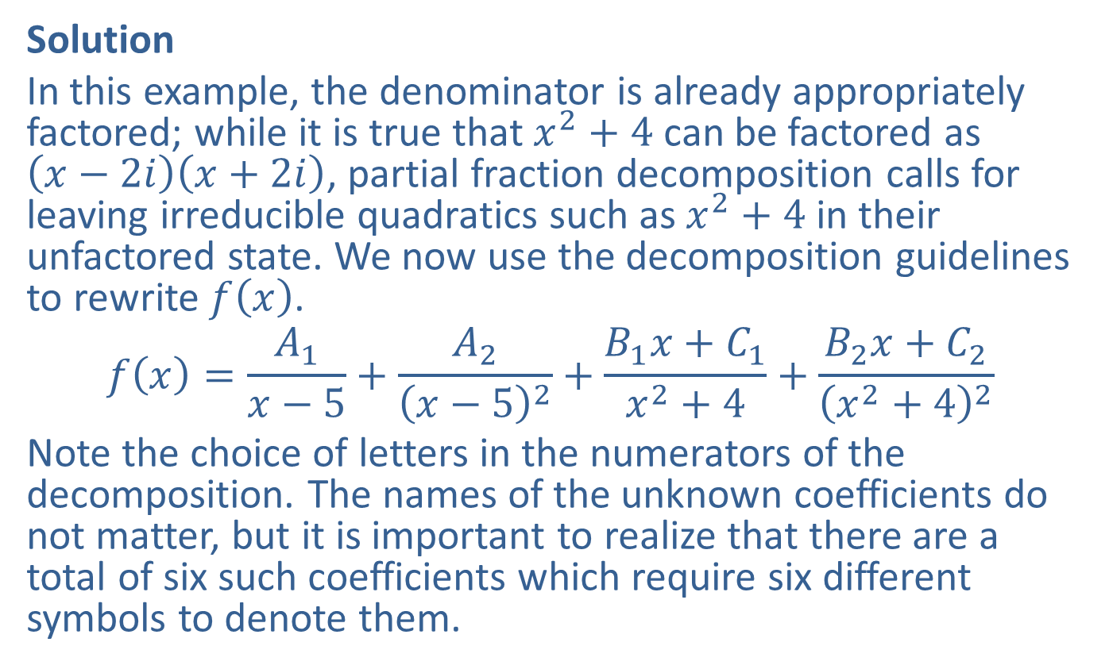
Example 2: Finding the Partial Fraction Decomposition of a Function (cont.)
Solution
In this example, the denominator is already appropriately factored; while it is true that $x^{2}+4$ can be factored as $\left(x−2i\right)\left(x+2i\right)$, partial fraction decomposition calls for leaving irreducible quadratics such as $x^{2}+4$ in their unfactored state. We now use the decomposition guidelines to rewrite $f⁡\left(x\right)$.
$$f\left(x\right)=\frac{A_{1}}{x−5}+\frac{A_{2}}{{\left(x−5\right)}^{2}}+\frac{B_{1}x+C_{1}}{x^{2}+4}+\frac{B_{2}x+C_{2}}{{\left(x^{2}+4\right)}^{2}}$$
Note the choice of letters in the numerators of the decomposition. The names of the unknown coefficients do not matter, but it is important to realize that there are a total of six such coefficients which require six different symbols to denote them.

Slide 9
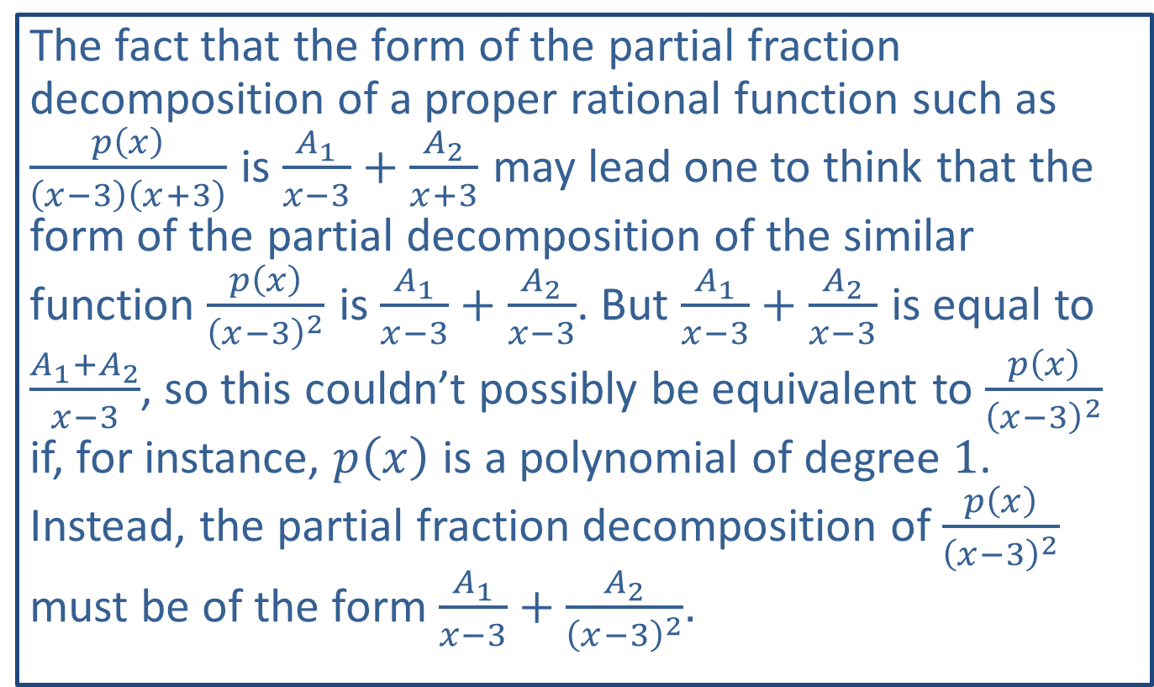
CAUTION!
The fact that the form of the partial fraction decomposition of a proper rational function such as $\frac{p\left(x\right)}{\left(x−3\right)\left(x+3\right)}$ is $\frac{A_{1}}{x−3}+\frac{A_{2}}{x+3}$ may lead one to think that the form of the partial decomposition of the similar function $\frac{p\left(x\right)}{{\left(x−3\right)}^{2}}$ is $\frac{A_{1}}{x−3}+\frac{A_{2}}{x−3}$. But $\frac{A_{1}}{x−3}+\frac{A_{2}}{x−3}$ is equal to $\frac{A_{1}+A_{2}}{x−3}$, so this couldn’t possibly be equivalent to $\frac{p\left(x\right)}{{\left(x−3\right)}^{2}}$ if, for instance, $p⁡\left(x\right)$ is a polynomial of degree 1. Instead, the partial fraction decomposition of $\frac{p\left(x\right)}{{\left(x−3\right)}^{2}}$ must be of the form $\frac{A_{1}}{x−3}+\frac{A_{2}}{{\left(x−3\right)}^{2}}$.

Slide 10

Example 3: Finding the Partial Fraction Decomposition of a Function
Find the partial fraction decomposition of the rational function.
$$f\left(x\right)=\frac{−2x+14}{x^{2}+2x−3}$$

Slide 11
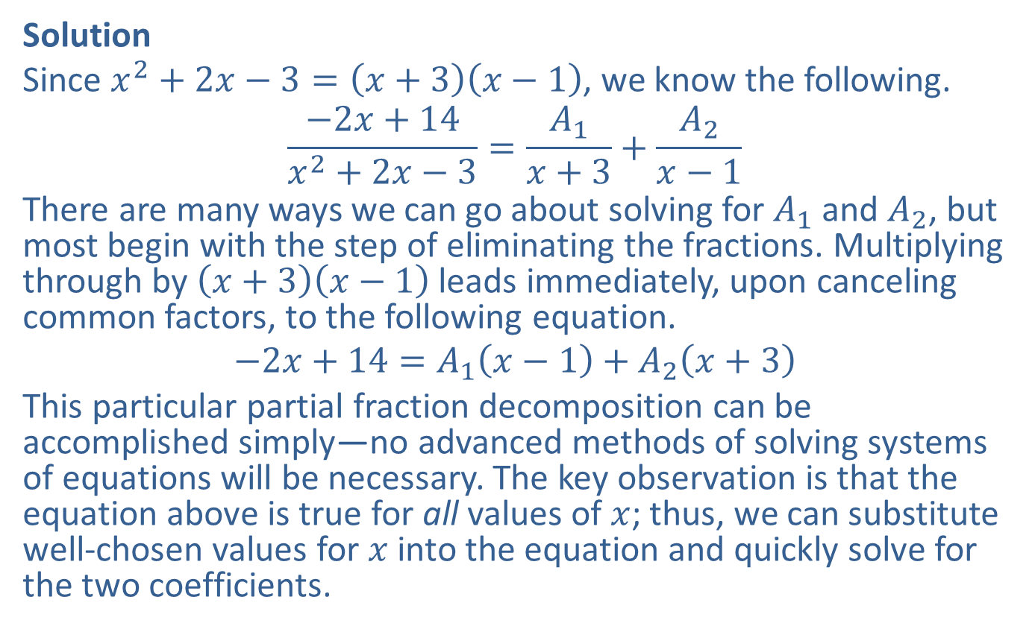
Example 3: Finding the Partial Fraction Decomposition of a Function (cont.)
Solution
Since $x^{2}+2x−3=\left(x+3\right)\left(x−1\right)$, we know the following.
$$\frac{−2x+14}{x^{2}+2x−3}=\frac{A_{1}}{x+3}+\frac{A_{2}}{x−1}$$
There are many ways we can go about solving for $A_{1}$ and $A_{2}$, but most begin with the step of eliminating the fractions. Multiplying through by $\left(x+3\right)\left(x−1\right)$ leads immediately, upon canceling common factors, to the following equation.
$$−2x+14=A_{1}\left(x−1\right)+A_{2}\left(x+3\right)$$
This particular partial fraction decomposition can be accomplished simply—no advanced methods of solving systems of equations will be necessary. The key observation is that the equation above is true for all values of $x$; thus, we can substitute well-chosen values for $x$ into the equation and quickly solve for the two coefficients.

Slide 12
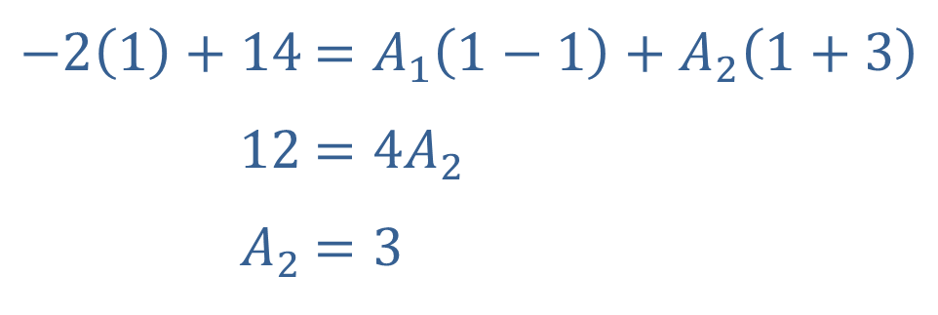

Example 3: Finding the Partial Fraction Decomposition of a Function (cont.)
The values of $x$ that are useful are those that make either $x−1$ or $x+3$ zero.
Let $x=1$ and solve for $A_{2}$.
​$−2\left(1\right)+14$ | ​$=A_{1}\left(1−1\right)+A_{2}\left(1+3\right)$
​$12$ | ​$=4A_{2}$
​$A_{2}$ | ​$=3$

Slide 13
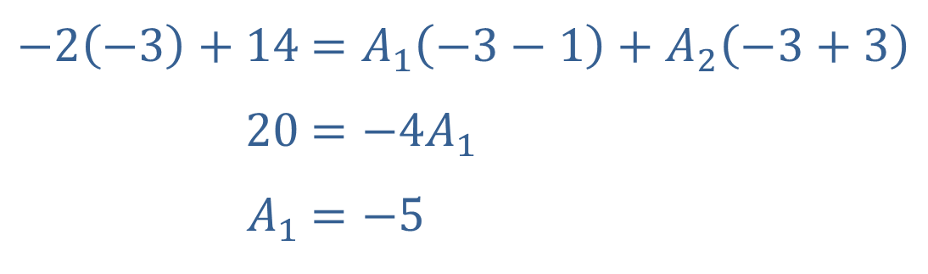

Example 3: Finding the Partial Fraction Decomposition of a Function (cont.)
Let $x=−3$ and solve for $A_{1}$.
​
Thus, $\frac{−2x+14}{x^{2}+2x−3}=\frac{−5}{x+3}+\frac{3}{x−1}$. Our answer can be checked by combining these two fractions.
​$−2\left(−3\right)+14$ | ​$=A_{1}\left(−3−1\right)+A_{2}\left(−3+3\right)$
​$20$ | ​$=−4A_{1}$
​$A_{1}$ | ​$=−5$

Slide 14

Example 4: Finding the Partial Fraction Decomposition of a Function
Find the partial fraction decomposition of the rational function.
$$f\left(x\right)=\frac{3x+1}{{\left(x+2\right)}^{3}}$$

Slide 15
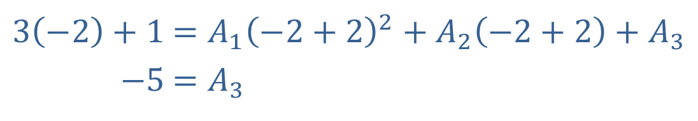
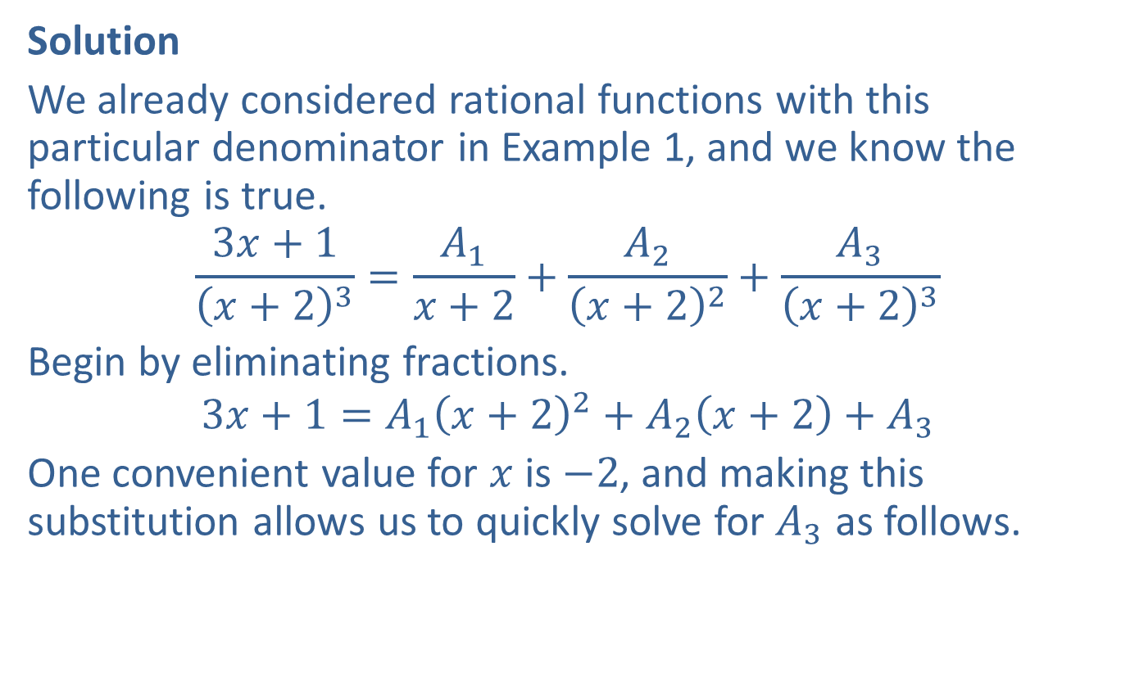
Example 4: Finding the Partial Fraction Decomposition of a Function (cont.)
Solution
We already considered rational functions with this particular denominator in Example 1, and we know the following is true.
$$\frac{3x+1}{{\left(x+2\right)}^{3}}=\frac{A_{1}}{x+2}+\frac{A_{2}}{{\left(x+2\right)}^{2}}+\frac{A_{3}}{{\left(x+2\right)}^{3}}$$
Begin by eliminating fractions.
$$3x+1=A_{1}{\left(x+2\right)}^{2}+A_{2}\left(x+2\right)+A_{3}$$
One convenient value for $x$ is $−2$, and making this substitution allows us to quickly solve for $A_{3}$ as follows.
​
​$3\left(−2\right)+1$ | ​$=A_{1}{\left(−2+2\right)}^{2}+A_{2}\left(−2+2\right)+A_{3}$
​$−5$ | ​$=A_{3}$

Slide 16
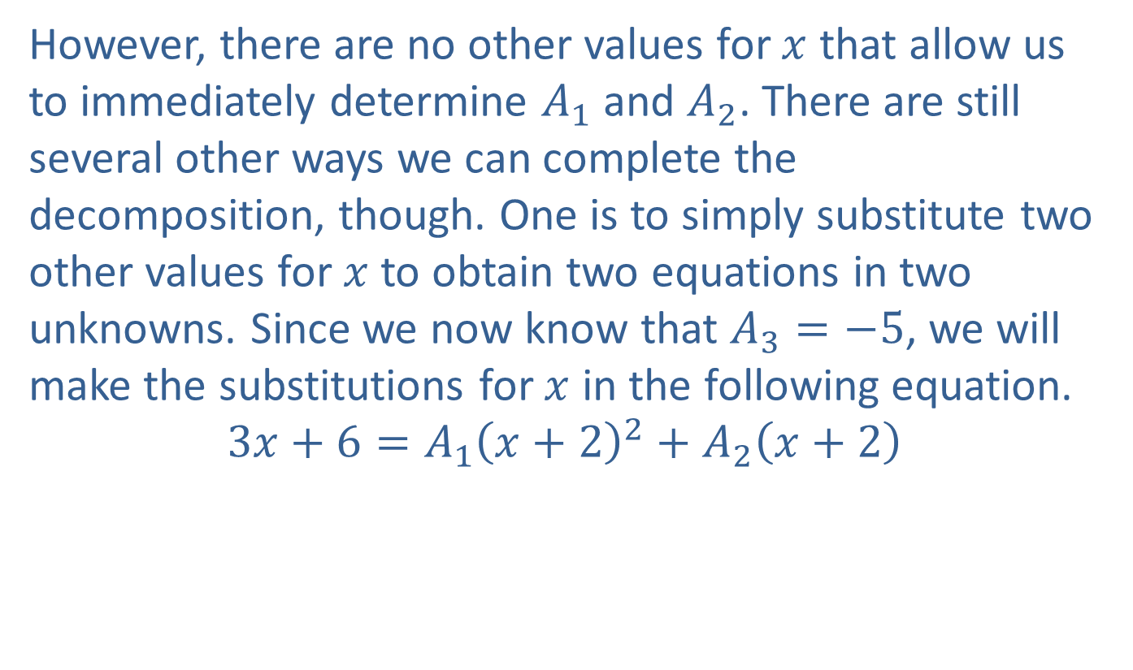
Example 4: Finding the Partial Fraction Decomposition of a Function (cont.)
However, there are no other values for $x$ that allow us to immediately determine $A_{1}$ and $A_{2}$. There are still several other ways we can complete the decomposition, though. One is to simply substitute two other values for $x$ to obtain two equations in two unknowns. Since we now know that $A_{3}=−5$, we will make the substitutions for $x$ in the following equation.
$$3x+6=A_{1}{\left(x+2\right)}^{2}+A_{2}\left(x+2\right)$$

Slide 17


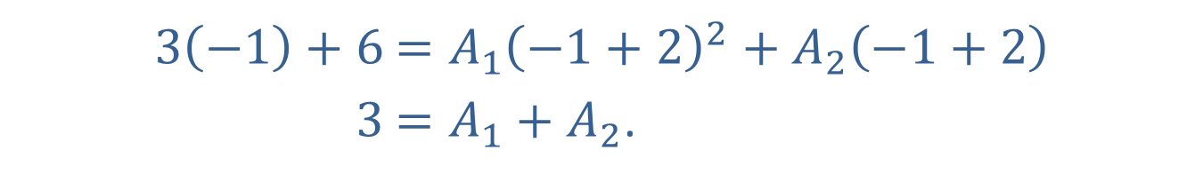
Example 4: Finding the Partial Fraction Decomposition of a Function (cont.)
In the work below, we chose to use $x=0$ and $x=−1$ because they make the calculations easy:
and
​$3\left(0\right)+6$ | ​$=A_{1}{\left(0+2\right)}^{2}+A_{2}\left(0+2\right)$
​$6$ | ​$=4A_{1}+2A_{2}$
​$3\left(−1\right)+6$ | ​$=A_{1}{\left(−1+2\right)}^{2}+A_{2}\left(−1+2\right)$
​$3$ | ​$=A_{1}+A_{2}\text{.}$

Slide 18
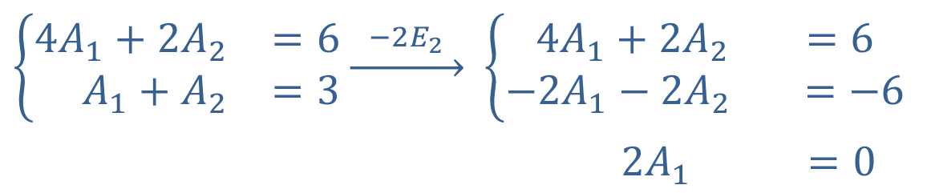
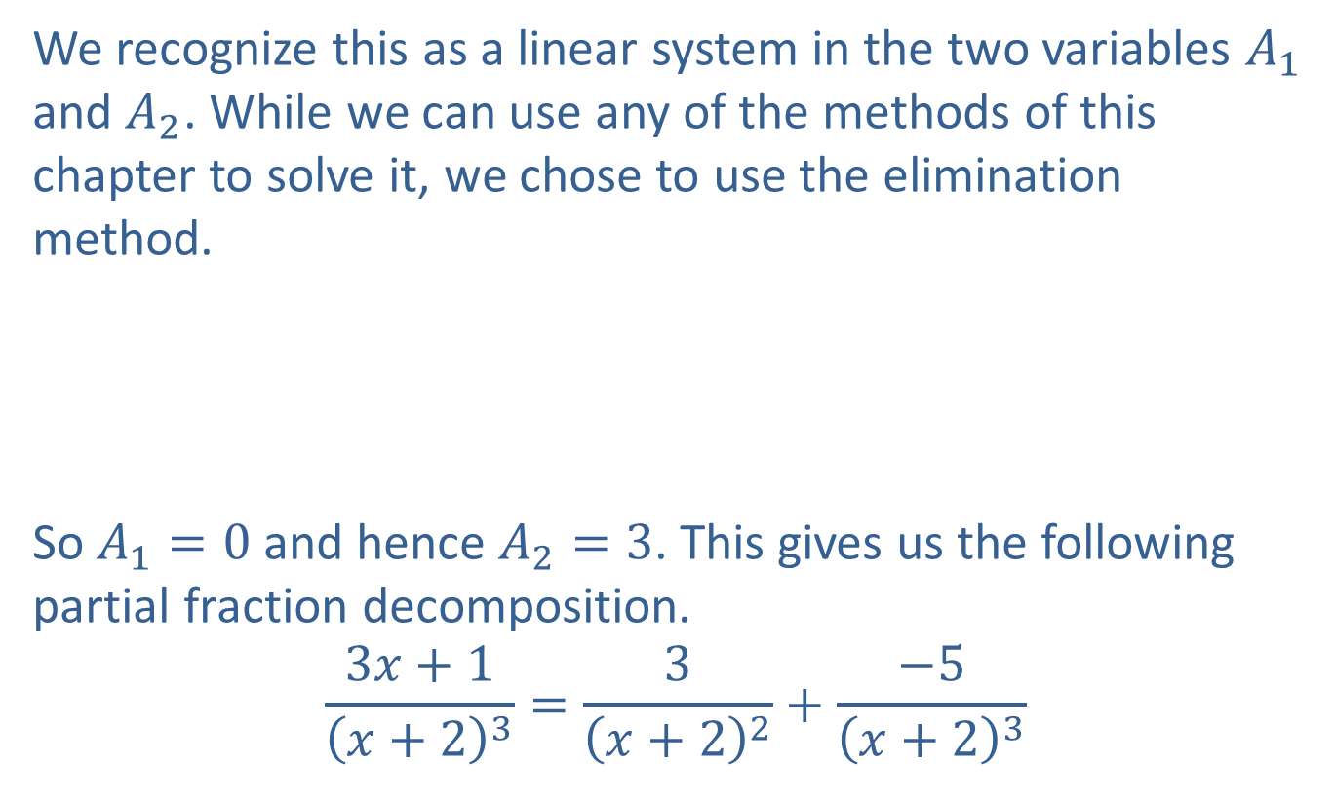
Example 4: Finding the Partial Fraction Decomposition of a Function (cont.)
We recognize this as a linear system in the two variables $A_{1}$ and $A_{2}$. While we can use any of the methods of this chapter to solve it, we chose to use the elimination method.
So $A_{1}=0$ and hence $A_{2}=3$. This gives us the following partial fraction decomposition.
$$\frac{3x+1}{{\left(x+2\right)}^{3}}=\frac{3}{{\left(x+2\right)}^{2}}+\frac{−5}{{\left(x+2\right)}^{3}}$$
$$\left\{\begin{matrix}4A_{1}+2A_{2} & =6 \\ A_{1}+A_{2} & =3\end{matrix}\right.\underset{→}{ −2E_{2} }$$ | $$\left\{\begin{matrix} 4A_{1}+2A_{2} & =6 \\ −2A_{1}−2A_{2} & =−6\end{matrix}\right.$$
 | 2𝐴1−2𝐴2=0

Slide 19

Example 5: Finding the Partial Fraction Decomposition of a Function
Find the partial fraction decomposition of the rational function.
$$f\left(x\right)=\frac{3x^{5}+6x^{4}+9x^{3}+7x^{2}+4x−1}{{\left(x^{2}+x+1\right)}^{2}}$$

Slide 20
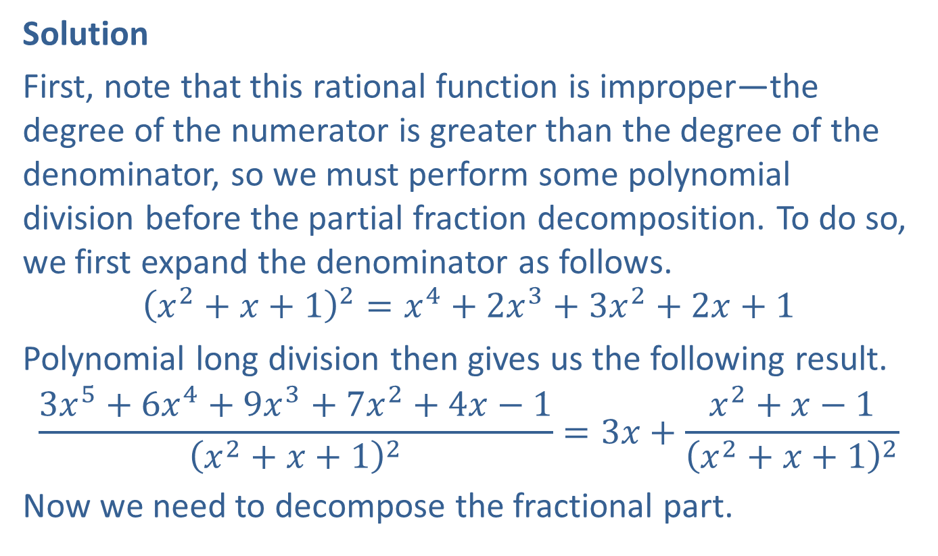
Example 5: Finding the Partial Fraction Decomposition of a Function (cont.)
Solution
First, note that this rational function is improper—the degree of the numerator is greater than the degree of the denominator, so we must perform some polynomial division before the partial fraction decomposition. To do so, we first expand the denominator as follows.
$${\left(x^{2}+x+1\right)}^{2}=x^{4}+2x^{3}+3x^{2}+2x+1$$
Polynomial long division then gives us the following result.
$$\frac{3x^{5}+6x^{4}+9x^{3}+7x^{2}+4x−1}{{\left(x^{2}+x+1\right)}^{2}}=3x+\frac{x^{2}+x−1}{{\left(x^{2}+x+1\right)}^{2}}$$
Now we need to decompose the fractional part.

Slide 21
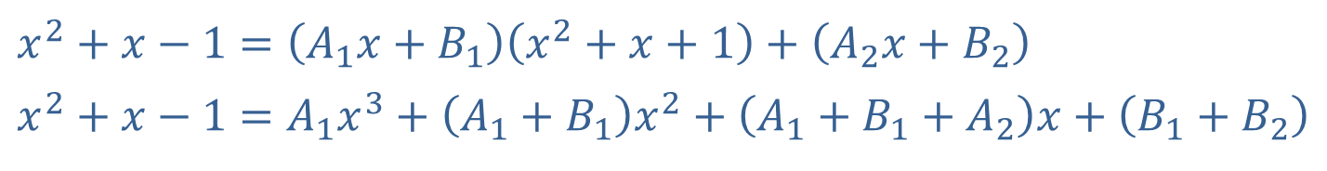
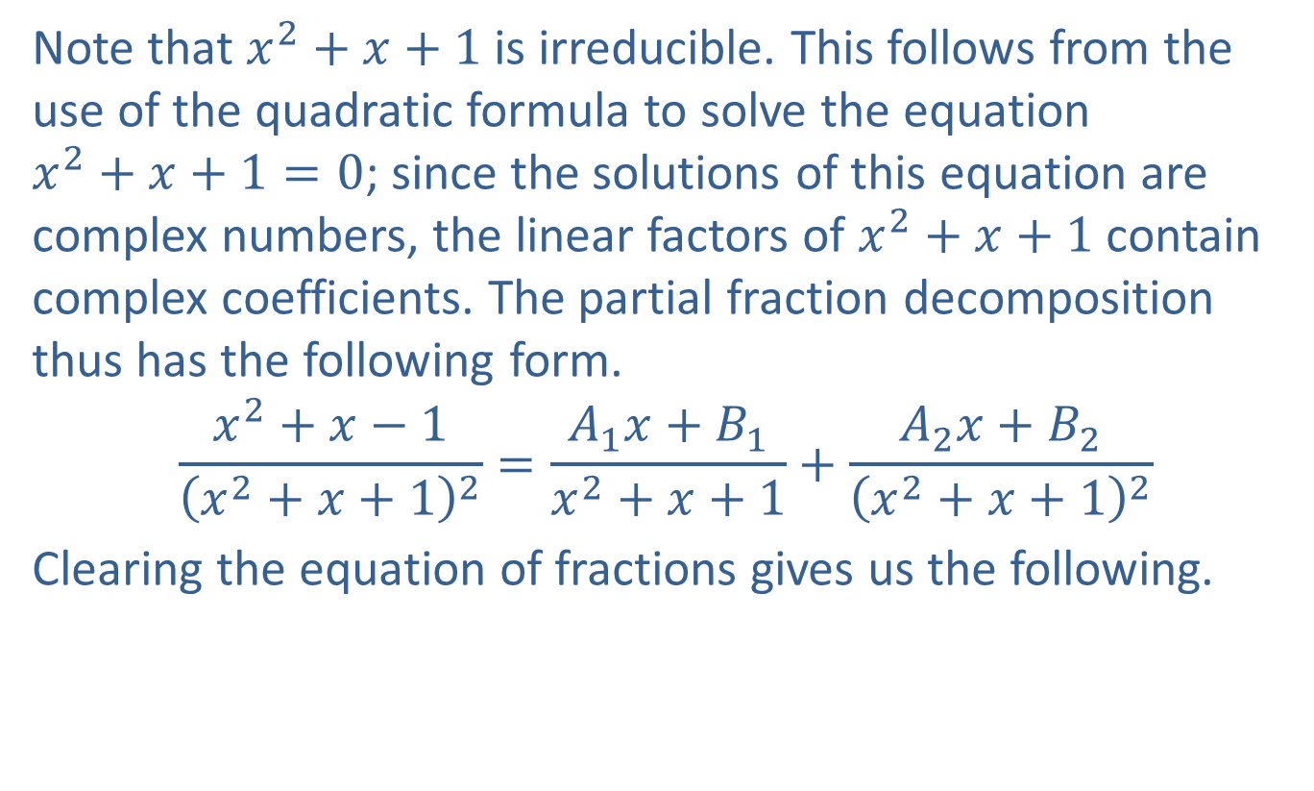
Example 5: Finding the Partial Fraction Decomposition of a Function (cont.)
Note that $x^{2}+x+1$ is irreducible. This follows from the use of the quadratic formula to solve the equation
$x^{2}+x+1=0$; since the solutions of this equation are complex numbers, the linear factors of $x^{2}+x+1$ contain complex coefficients. The partial fraction decomposition thus has the following form.
$$\frac{x^{2}+x−1}{{\left(x^{2}+x+1\right)}^{2}}=\frac{A_{1}x+B_{1}}{x^{2}+x+1}+\frac{A_{2}x+B_{2}}{{\left(x^{2}+x+1\right)}^{2}}$$
Clearing the equation of fractions gives us the following.
​
​$x^{2}+x−1$ | ​$=\left(A_{1}x+B_{1}\right)\left(x^{2}+x+1\right)+\left(A_{2}x+B_{2}\right)$
​$x^{2}+x−1$ | ​$=A_{1}x^{3}+\left(A_{1}+B_{1}\right)x^{2}+\left(A_{1}+B_{1}+A_{2}\right)x+\left(B_{1}+B_{2}\right)$

Slide 22
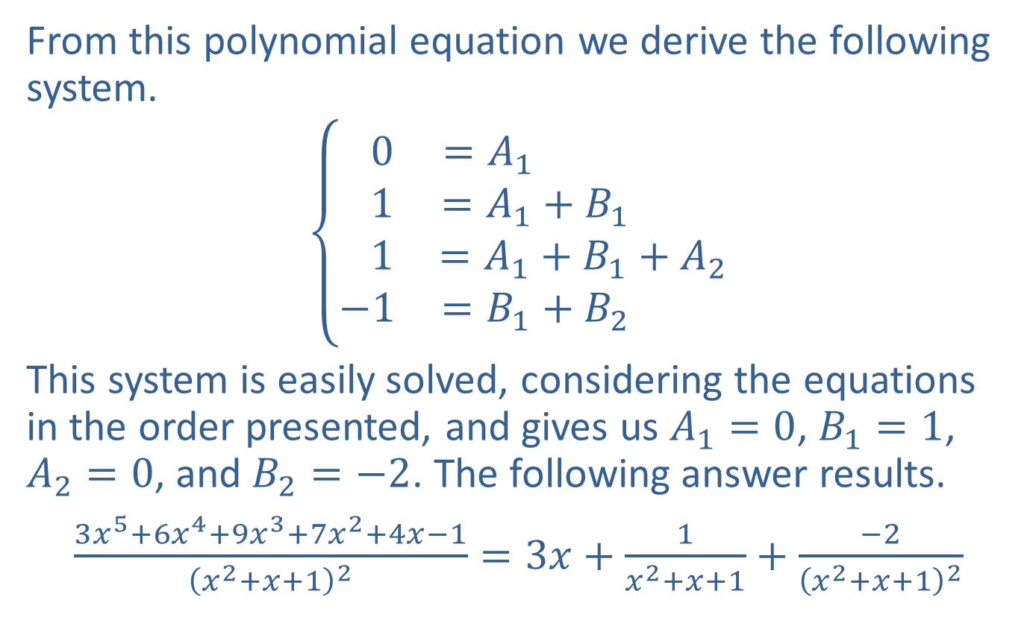
Example 5: Finding the Partial Fraction Decomposition of a Function (cont.)
From this polynomial equation we derive the following system.
$$\left\{\begin{matrix} 0 & =A_{1} \\ 1 & =A_{1}+B_{1} \\ 1 & =A_{1}+B_{1}+A_{2} \\ −1 & =B_{1}+B_{2} \end{matrix}\right.$$
This system is easily solved, considering the equations in the order presented, and gives us $A_{1}=0$, $B_{1}=1$, $A_{2}=0$, and $B_{2}=−2$. The following answer results.
$\frac{3x^{5}+6x^{4}+9x^{3}+7x^{2}+4x−1}{{\left(x^{2}+x+1\right)}^{2}}=3x+\frac{1}{x^{2}+x+1}+\frac{−2}{{\left(x^{2}+x+1\right)}^{2}}$

