Slide 1
Section 12.8
Systems of Nonlinear Equations and Inequalities

Slide 2

Example 1: Solving Systems of Nonlinear Equations by Graphing
Use graphing to approximate the real solution(s) of the following system, and then verify that your answer is correct.
$$\left\{\begin{matrix}x+y & =2 \\ x^{2}+y^{2} & =4\end{matrix}\right.$$

Slide 3
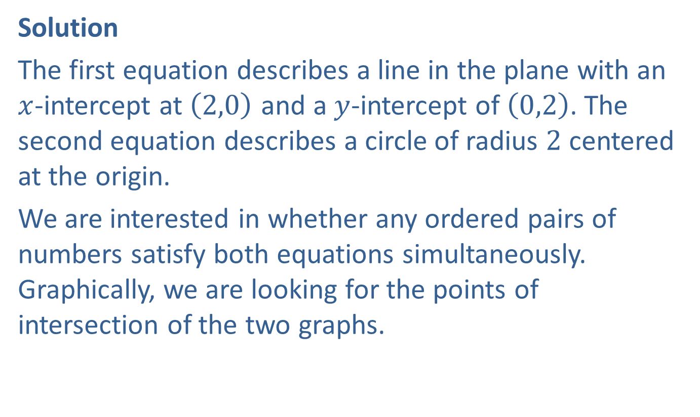
Example 1: Solving Systems of Nonlinear Equations by Graphing (cont.)
Solution
The first equation describes a line in the plane with an $x$-intercept at $\left(2,0\right)$ and a $y$-intercept of $\left(0,2\right)$. The second equation describes a circle of radius 2 centered at the origin.
We are interested in whether any ordered pairs of numbers satisfy both equations simultaneously. Graphically, we are looking for the points of intersection of the two graphs.

Slide 4
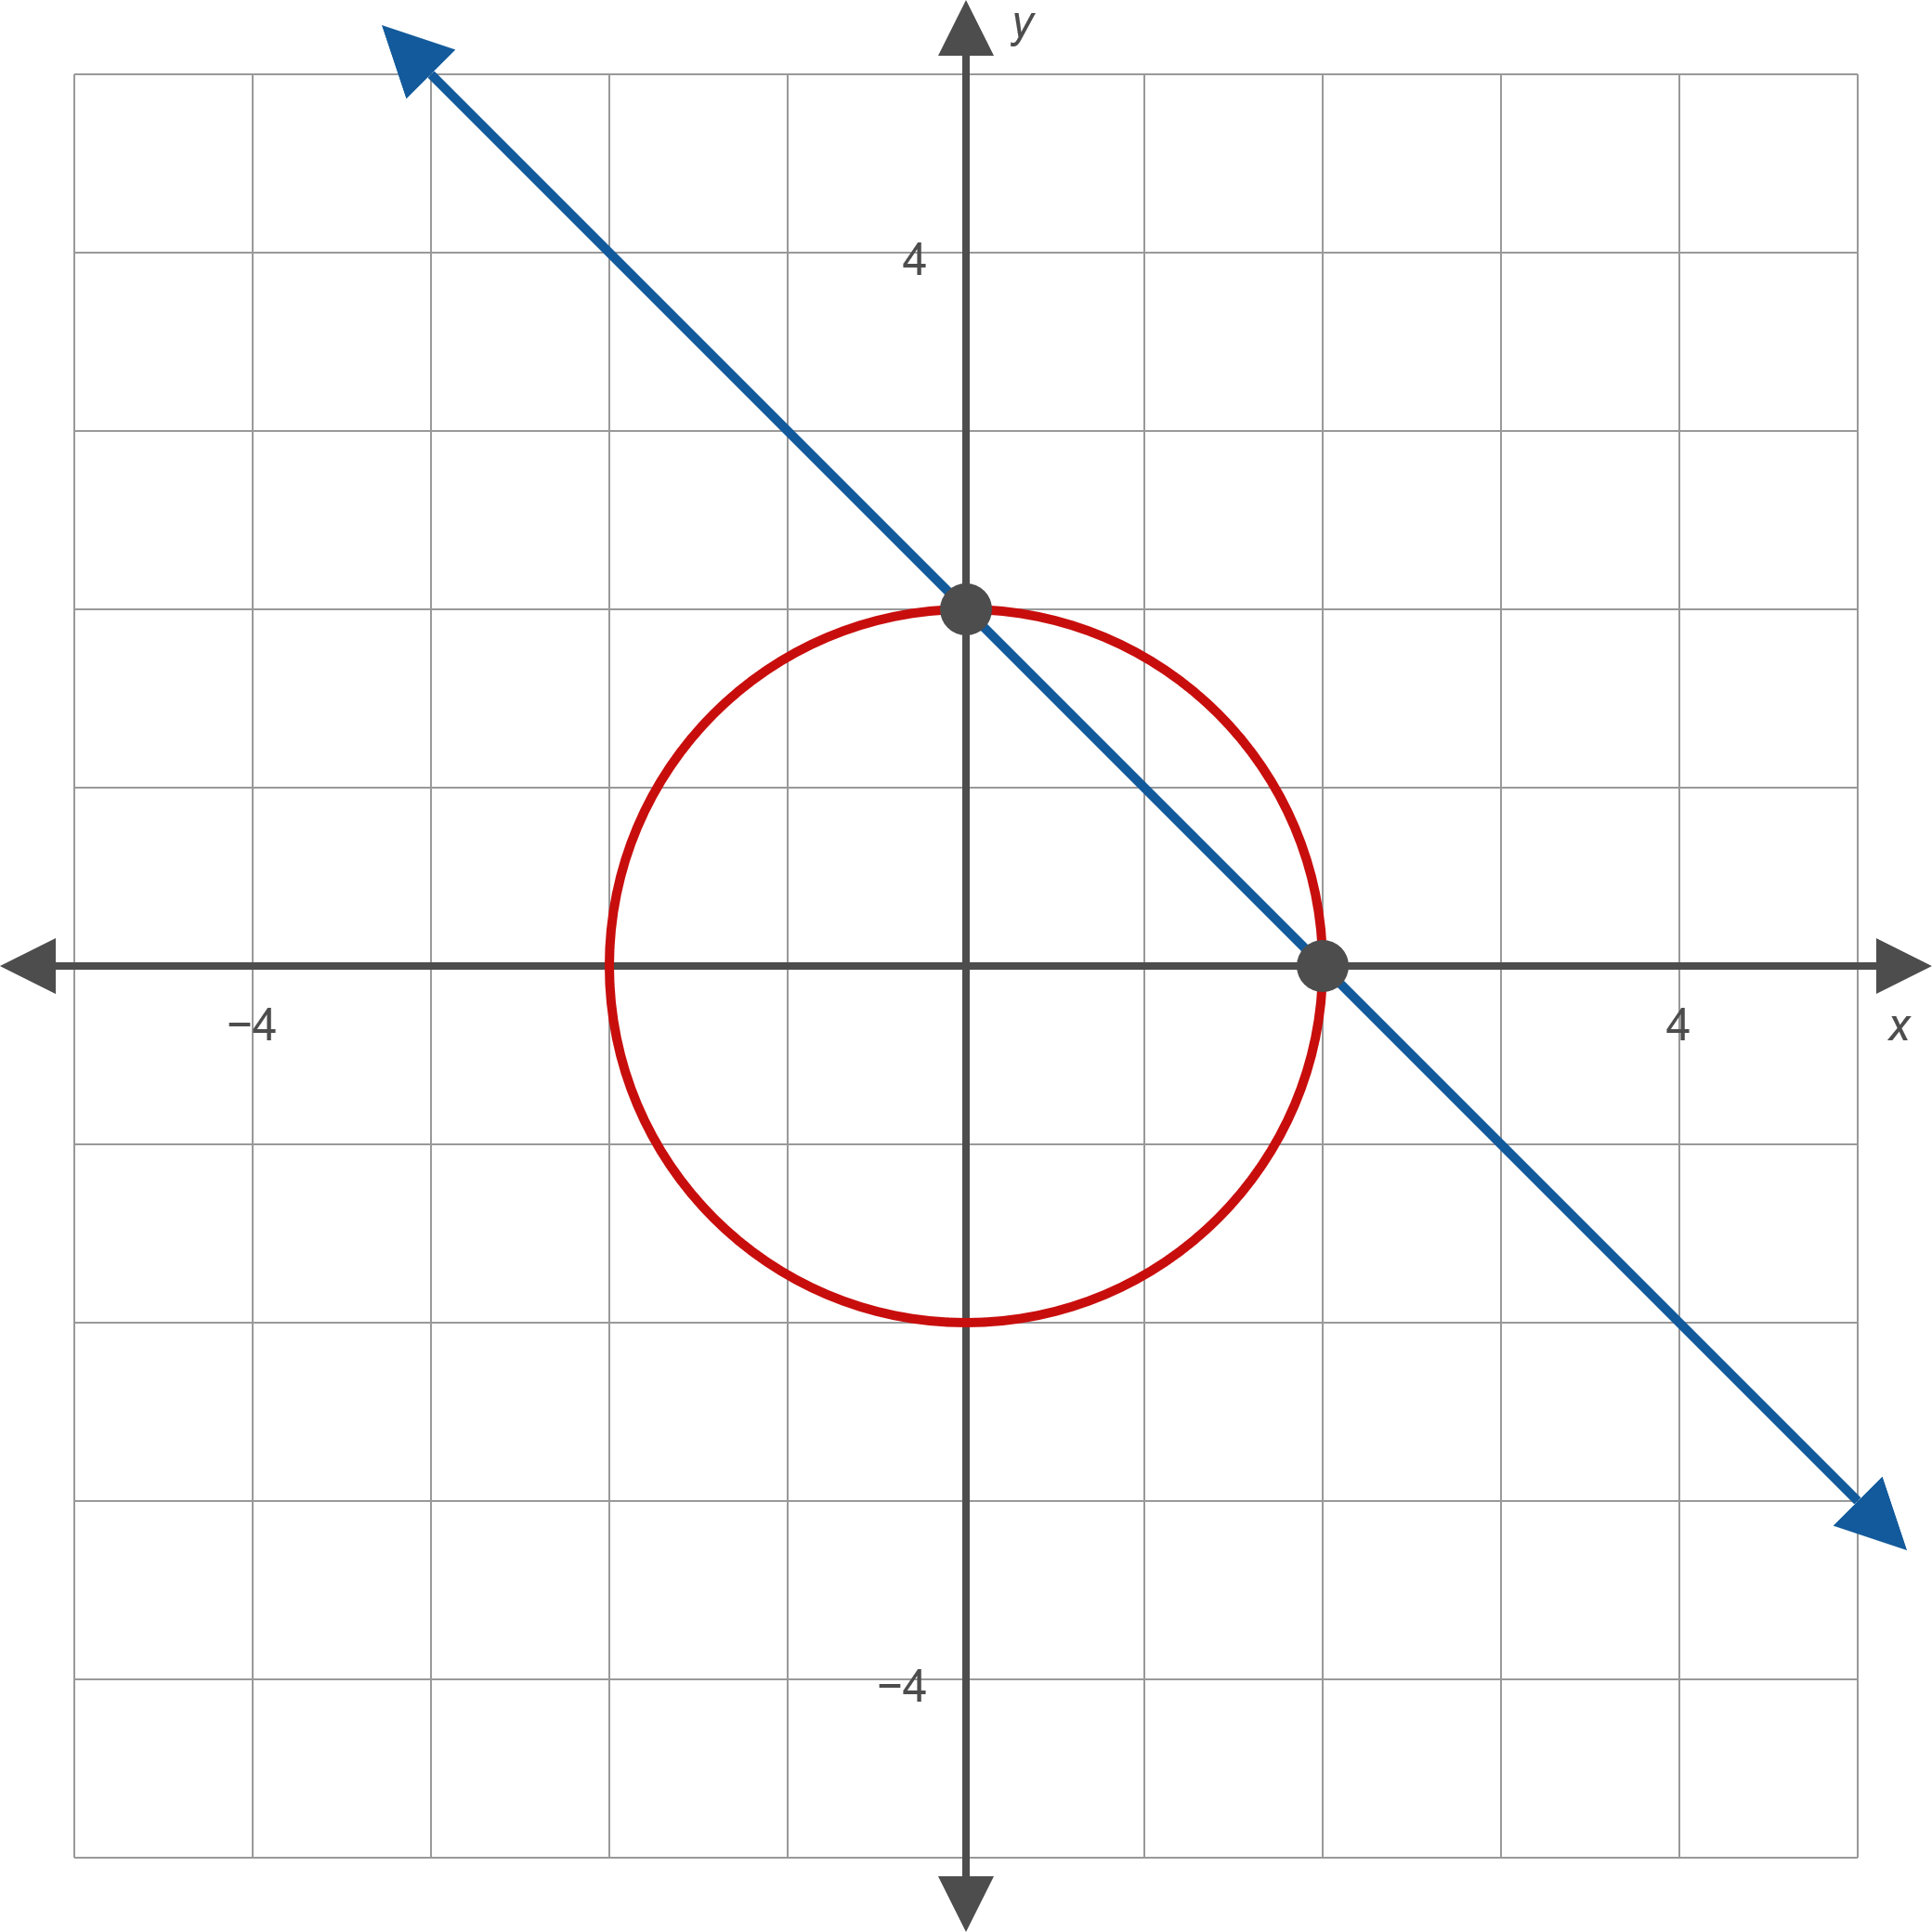
Example 1: Solving Systems of Nonlinear Equations by Graphing (cont.)
Figure 1

Slide 5

Example 1: Solving Systems of Nonlinear Equations by Graphing (cont.)
The graph in Figure 1 suggests that $\left(2,0\right)$ and $\left(0,2\right)$ make up the real solutions of the system. We already know these two points lie on the line, and it can be verified that they also solve the second equation.
$2^{2}+0^{2}=4$ and $0^{2}+2^{2}=4$

Slide 6

Example 2: Solving Systems of Nonlinear Equations by Graphing
Use graphing to approximate the real solution(s) of the following system, and then verify that your answer is correct.
$$\left\{\begin{matrix}x+2 & =y^{2} \\ x^{2}+y^{2} & =4 \end{matrix}\right.$$

Slide 7

Example 2: Solving Systems of Nonlinear Equations by Graphing (cont.)
Solution
The first equation represents a horizontally oriented parabola opening to the right, with vertex at $\left(−2,0\right)$. The second equation is again a circle of radius 2 centered at the origin.

Slide 8
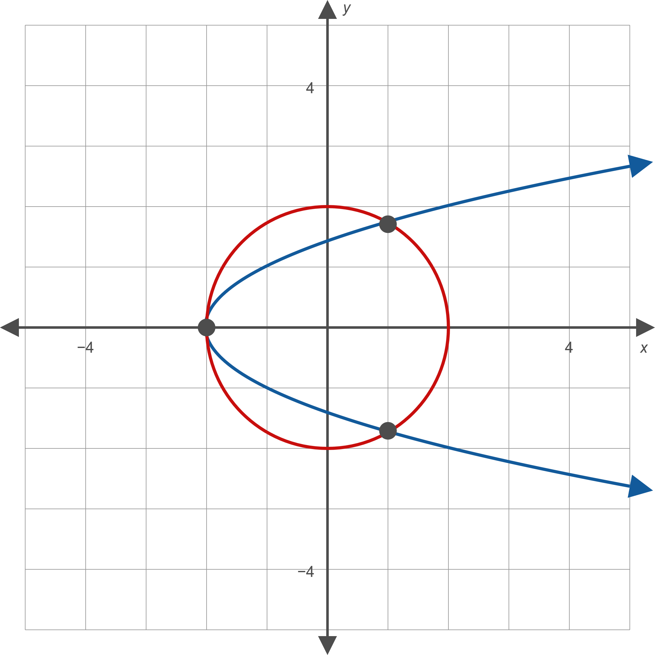
Example 2: Solving Systems of Nonlinear Equations by Graphing (cont.)
Figure 2

Slide 9
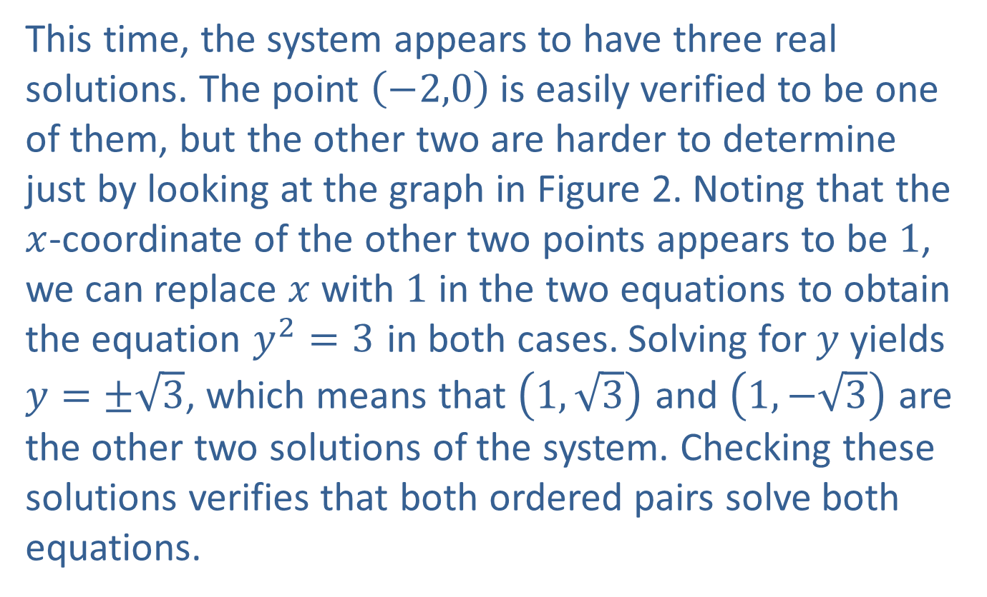
Example 2: Solving Systems of Nonlinear Equations by Graphing (cont.)
This time, the system appears to have three real solutions. The point $\left(−2,0\right)$ is easily verified to be one of them, but the other two are harder to determine just by looking at the graph in Figure 2. Noting that the $x$-coordinate of the other two points appears to be 1, we can replace $x$ with 1 in the two equations to obtain the equation $y^{2}=3$ in both cases. Solving for $y$ yields $y=±\sqrt{3}$, which means that $\left(1,\sqrt{3}\right)$ and $\left(1,−\sqrt{3}\right)$ are the other two solutions of the system. Checking these solutions verifies that both ordered pairs solve both equations.

Slide 10

Example 3: Solving Systems of Nonlinear Equations Algebraically
Solve the following system of nonlinear equations.
$$\left\{\begin{matrix}x+4 & =y^{2} \\ x^{2}+y^{2} & =4 \end{matrix}\right.$$

Slide 11

Example 3: Solving Systems of Nonlinear Equations Algebraically (cont.)
Solution
The only difference between this system and the one in Example 2 is that the vertex of the parabola is at $\left(−4,0\right)$. The graph of the system is shown in Figure 3.

Slide 12
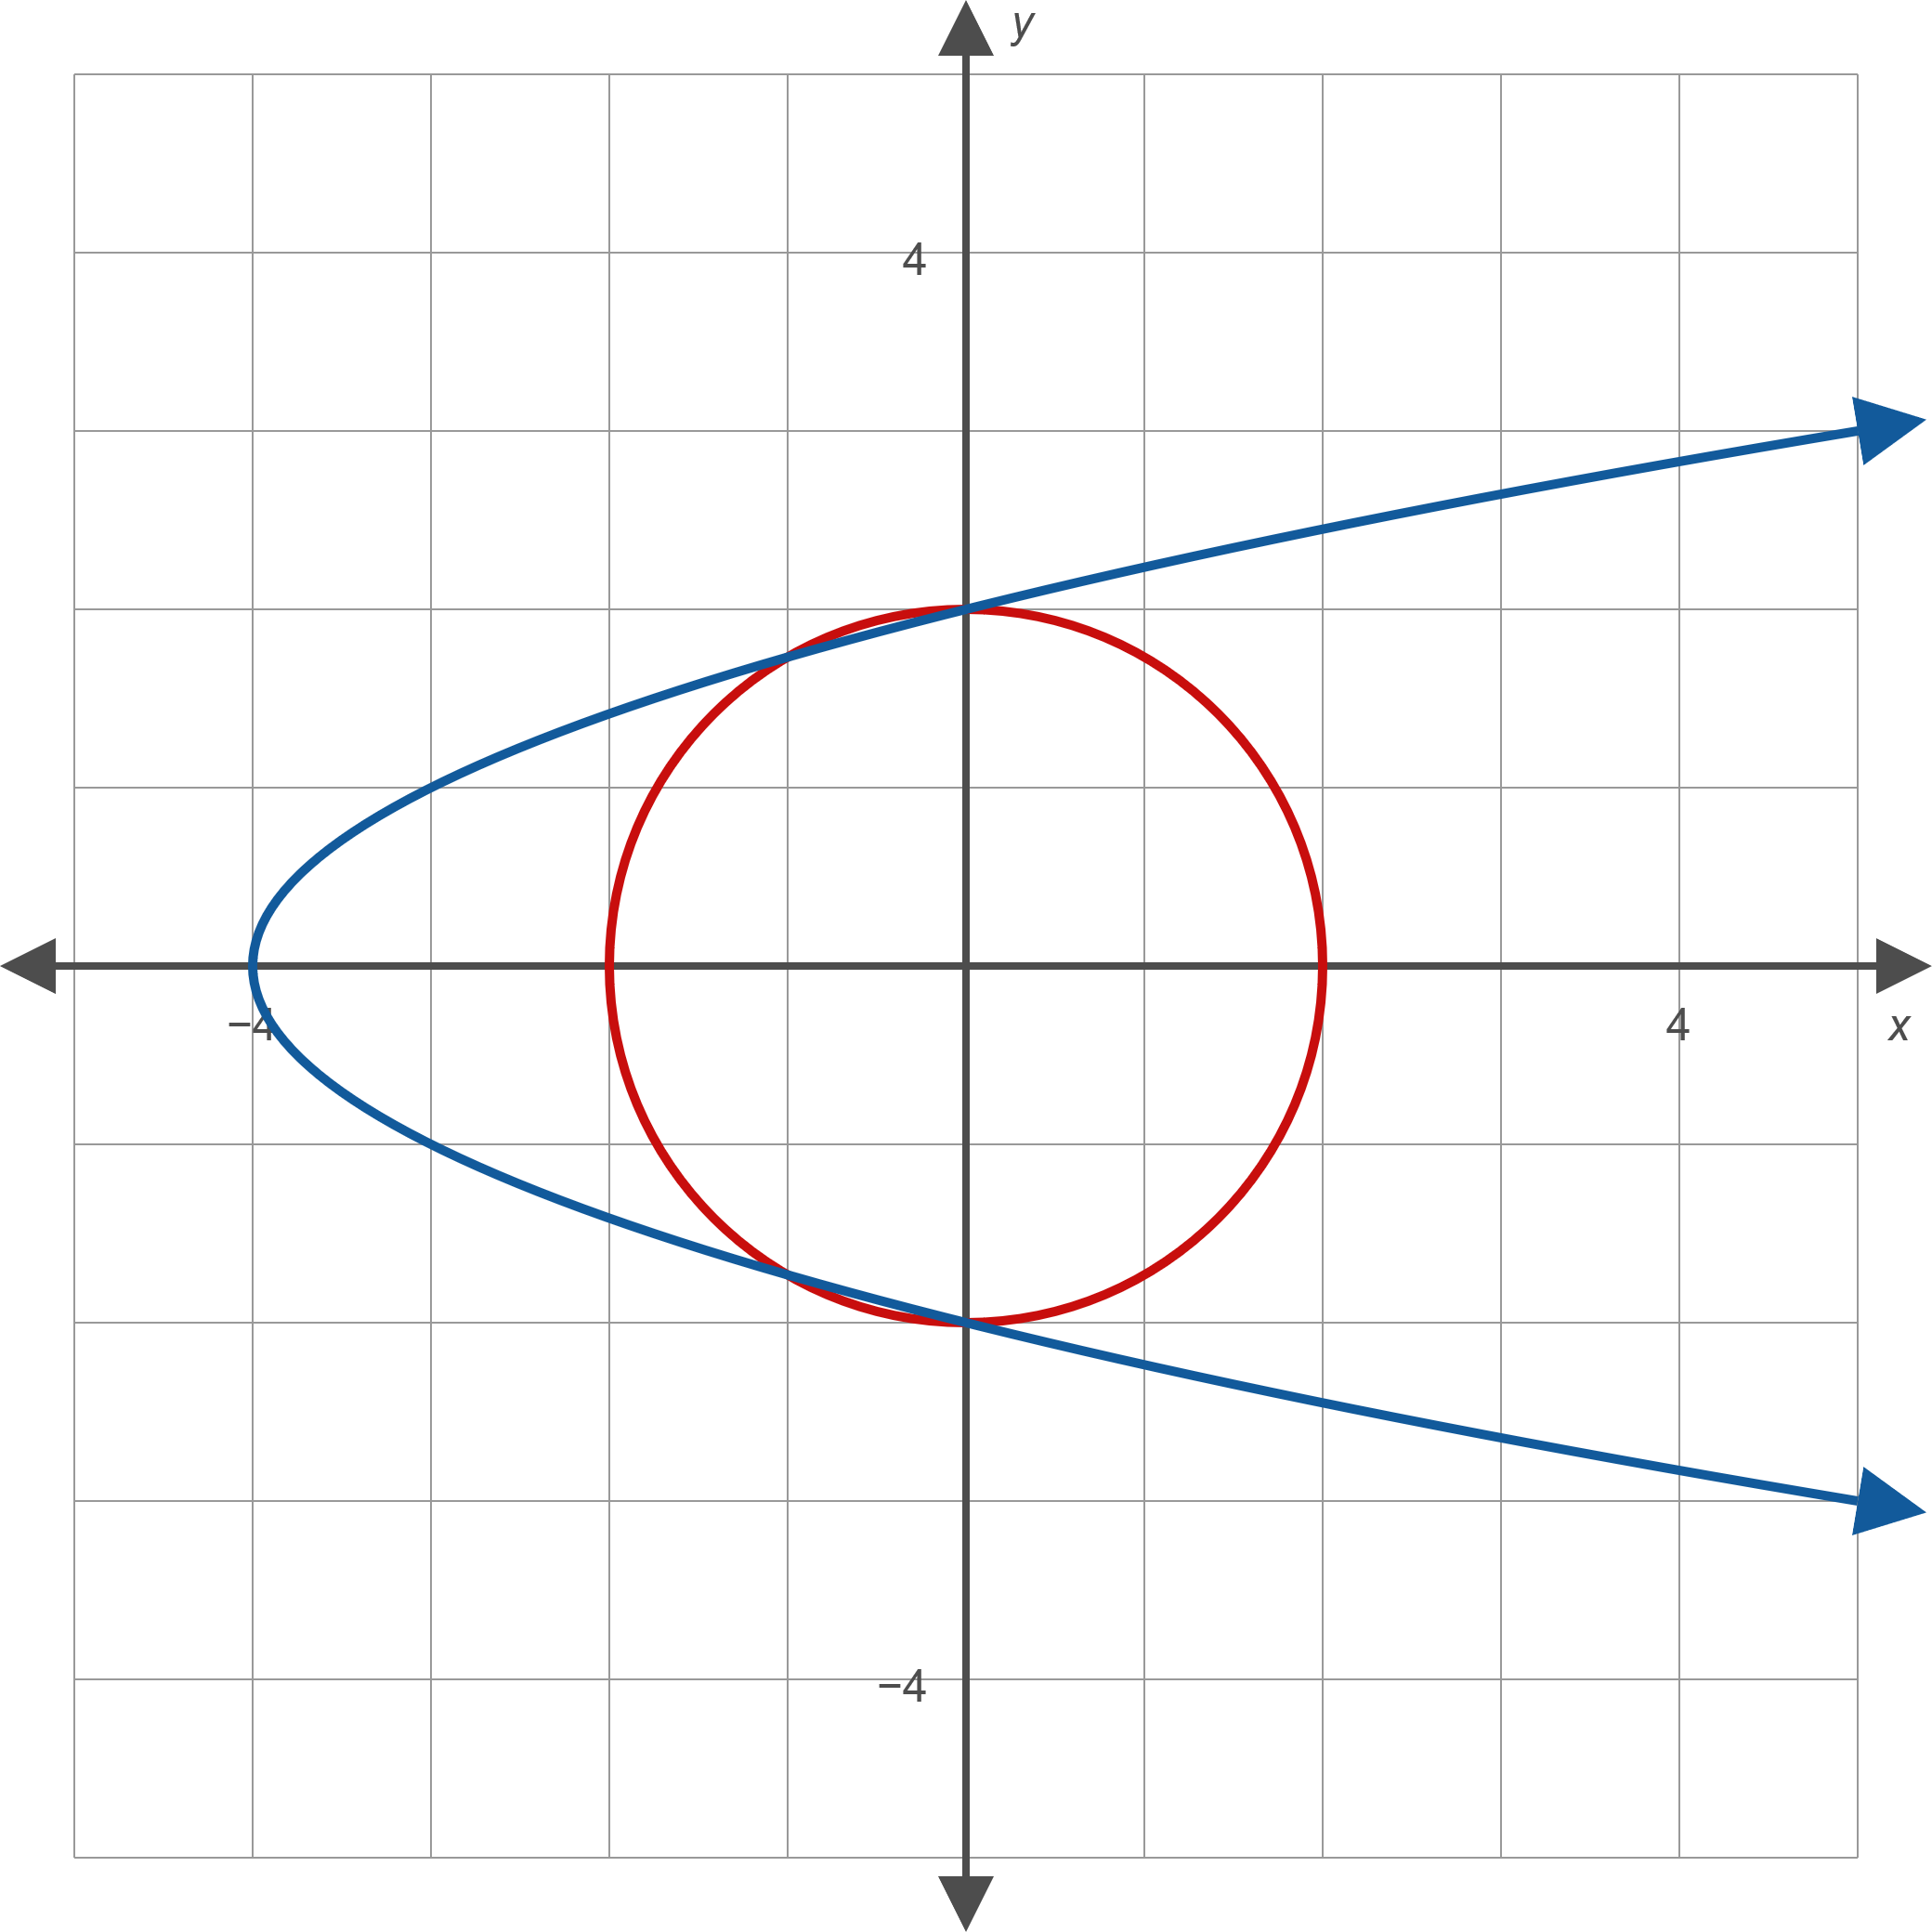
Example 3: Solving Systems of Nonlinear Equations Algebraically (cont.)
Figure 3

Slide 13
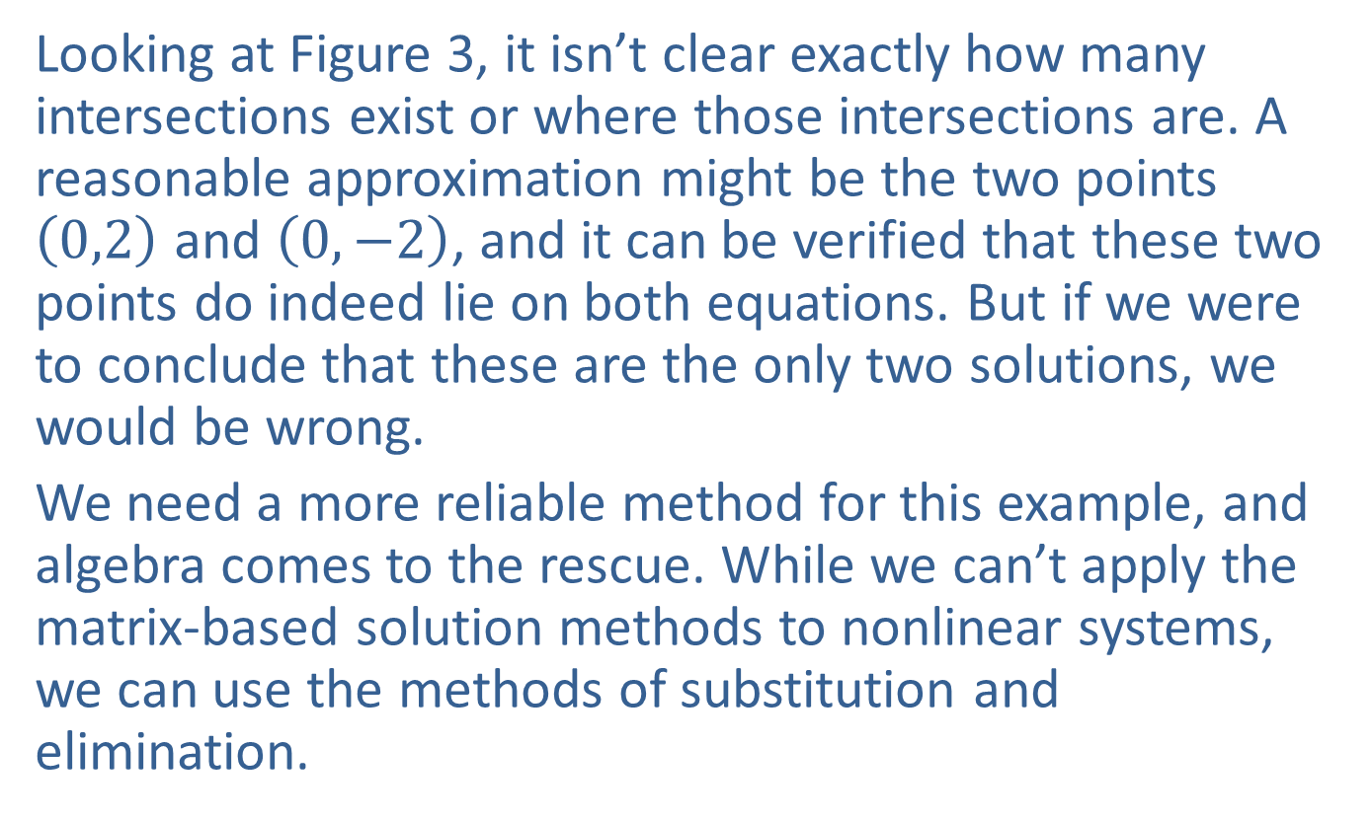
Example 3: Solving Systems of Nonlinear Equations Algebraically (cont.)
Looking at Figure 3, it isn’t clear exactly how many intersections exist or where those intersections are. A reasonable approximation might be the two points $\left(0,2\right)$ and $\left(0,−2\right)$, and it can be verified that these two points do indeed lie on both equations. But if we were to conclude that these are the only two solutions, we would be wrong.
We need a more reliable method for this example, and algebra comes to the rescue. While we can’t apply the matrix-based solution methods to nonlinear systems, we can use the methods of substitution and elimination.

Slide 14
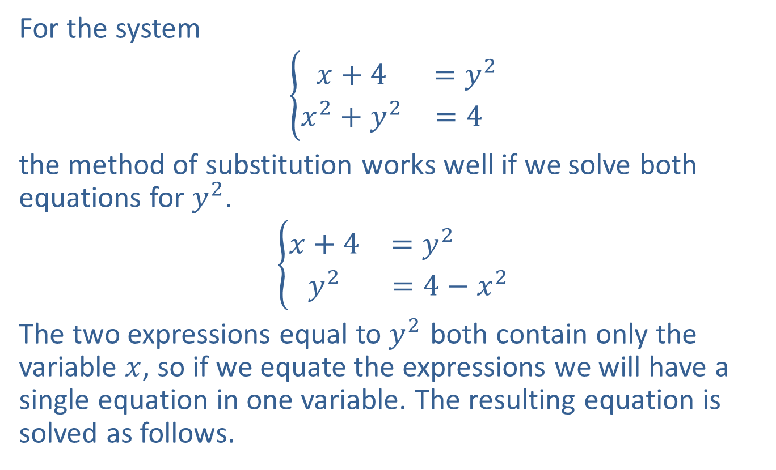
Example 3: Solving Systems of Nonlinear Equations Algebraically (cont.)
For the system
$$\left\{\begin{matrix}x+4 & =y^{2} \\ x^{2}+y^{2} & =4 \end{matrix}\right.$$
the method of substitution works well if we solve both equations for $y^{2}$.
$$\left\{\begin{matrix}x+4 & =y^{2} \\ y^{2} & =4−x^{2}\end{matrix}\right.$$
The two expressions equal to $y^{2}$ both contain only the variable $x$, so if we equate the expressions we will have a single equation in one variable. The resulting equation is solved as follows.

Slide 15
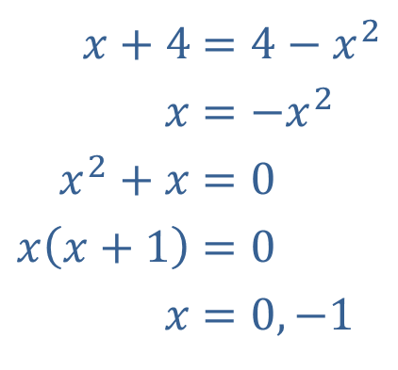

Example 3: Solving Systems of Nonlinear Equations Algebraically (cont.)
We already know that 0 is one possible value for $x$, as we have verified that $\left(0,2\right)$ and $\left(0,−2\right)$ are solutions of the system. But the value of $−1$ is new, and if we substitute
$x=−1$ into either equation, we find that $\left(−1,\sqrt{3}\right)$ and $\left(−1,−\sqrt{3}\right)$ are also solutions. So the system has a total of four solutions, which we now indicate on the graph in Figure 4.
​$x+4$ | ​$=4−x^{2}$
​$x$ | ​$=−x^{2}$
​$x^{2}+x$ | ​$=0$
​$x\left(x+1\right)$ | ​$=0$
​$x$ | ​$=0,−1$

Slide 16
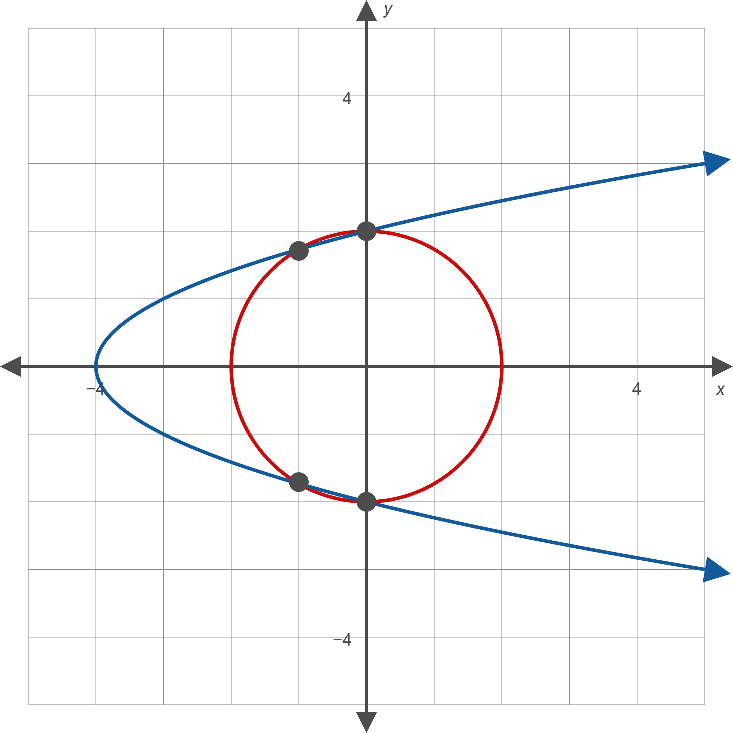
Example 3: Solving Systems of Nonlinear Equations Algebraically (cont.)
Figure 4

Slide 17

Example 4: Solving Systems of Nonlinear Equations Algebraically
Solve the following system of nonlinear equations.
$$\left\{\begin{aligned}y+1={\left(x−2\right)}^{2} \\ 3−y={\left(x−1\right)}^{2}\end{aligned}\right.$$

Slide 18
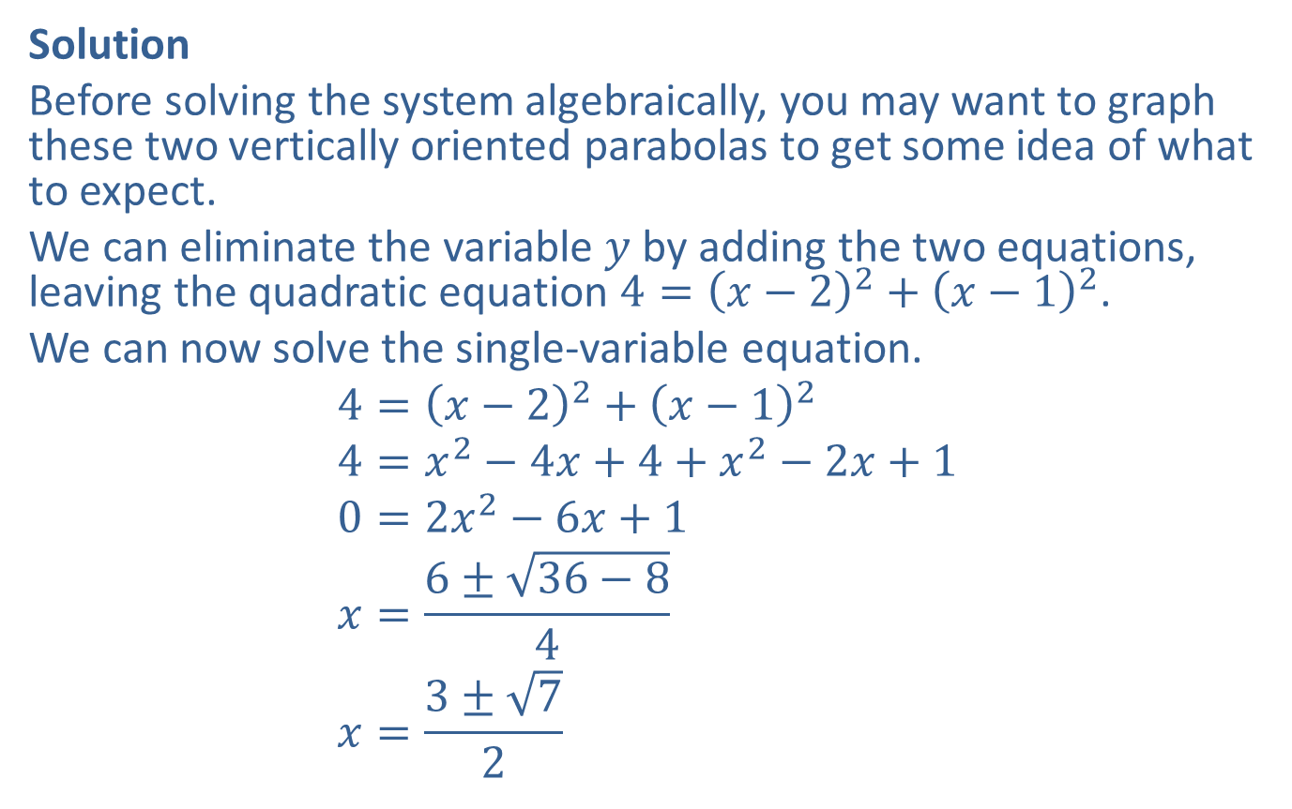
Example 4: Solving Systems of Nonlinear Equations Algebraically (cont.)
Solution
Before solving the system algebraically, you may want to graph these two vertically oriented parabolas to get some idea of what to expect.
We can eliminate the variable $y$ by adding the two equations, leaving the quadratic equation $4={\left(x−2\right)}^{2}+{\left(x−1\right)}^{2}$.
We can now solve the single-variable equation.
$$4={\left(x−2\right)}^{2}+{\left(x−1\right)}^{2} \\ 4=x^{2}−4x+4+x^{2}−2x+1 \\ 0=2x^{2}−6x+1 \\ x=\frac{6±\sqrt{36−8}}{4} \\ x=\frac{3±\sqrt{7}}{2}$$

Slide 19
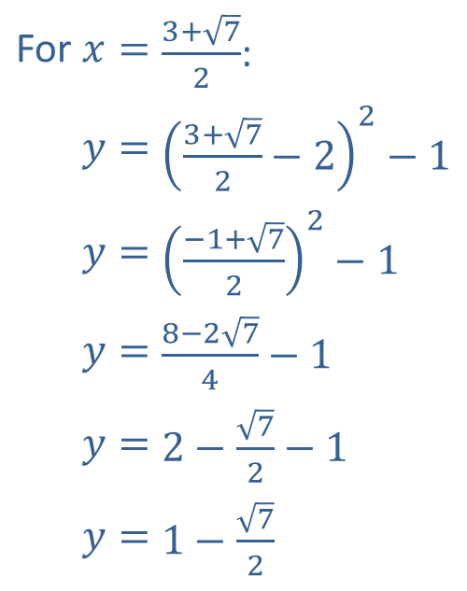

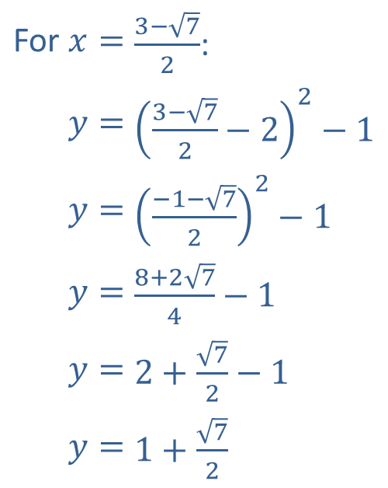
Example 4: Solving Systems of Nonlinear Equations Algebraically (cont.)
For each of the two values of $x$, we need to determine the corresponding values of $y$, and we can use either equation to do so. For this example, we will use the first equation.
For $x=$ | $\frac{3+\sqrt{7}}{2}$:
​$y=$ | ​${\left(\frac{3+\sqrt{7}}{2}−2\right)}^{2}−1$
​$y=$ | ​${\left(\frac{−1+\sqrt{7}}{2}\right)}^{2}−1$
​$y=$ | ​$\frac{8−2\sqrt{7}}{4}−1$
$$y=$$ | ​$2−\frac{\sqrt{7}}{2}−1$
​$y=$ | ​$1−\frac{\sqrt{7}}{2}$
For $x=$ | $\frac{3−\sqrt{7}}{2}$:
​$y=$ | ​${\left(\frac{3−\sqrt{7}}{2}−2\right)}^{2}−1$
​$y=$ | ​${\left(\frac{−1−\sqrt{7}}{2}\right)}^{2}−1$
​$y=$ | ​$\frac{8+2\sqrt{7}}{4}−1$
$$y=$$ | ​$2+\frac{\sqrt{7}}{2}−1$
​$y=$ | ​$1+\frac{\sqrt{7}}{2}$

Slide 20

Example 4: Solving Systems of Nonlinear Equations Algebraically (cont.)
Thus, the two solutions of the system are as follows.
$\left(\frac{3+\sqrt{7}}{2},1−\frac{\sqrt{7}}{2}\right)$ and $\left(\frac{3−\sqrt{7}}{2},1+\frac{\sqrt{7}}{2}\right)$

Slide 21

Example 5: Solving Systems of Nonlinear Equations Algebraically
Solve the following system of nonlinear equations.
$$\left\{\begin{matrix}\frac{{\left(x+1\right)}^{2}}{9}+y^{2} & =1 \\ y^{2} & =x+2\end{matrix}\right.$$

Slide 22
Example 5: Solving Systems of Nonlinear Equations Algebraically (cont.)
Solution
The first equation describes an ellipse, and the second describes a parabola opening to the right. The graph of the system in Figure 5 indicates that we should expect two real solutions.

Slide 23
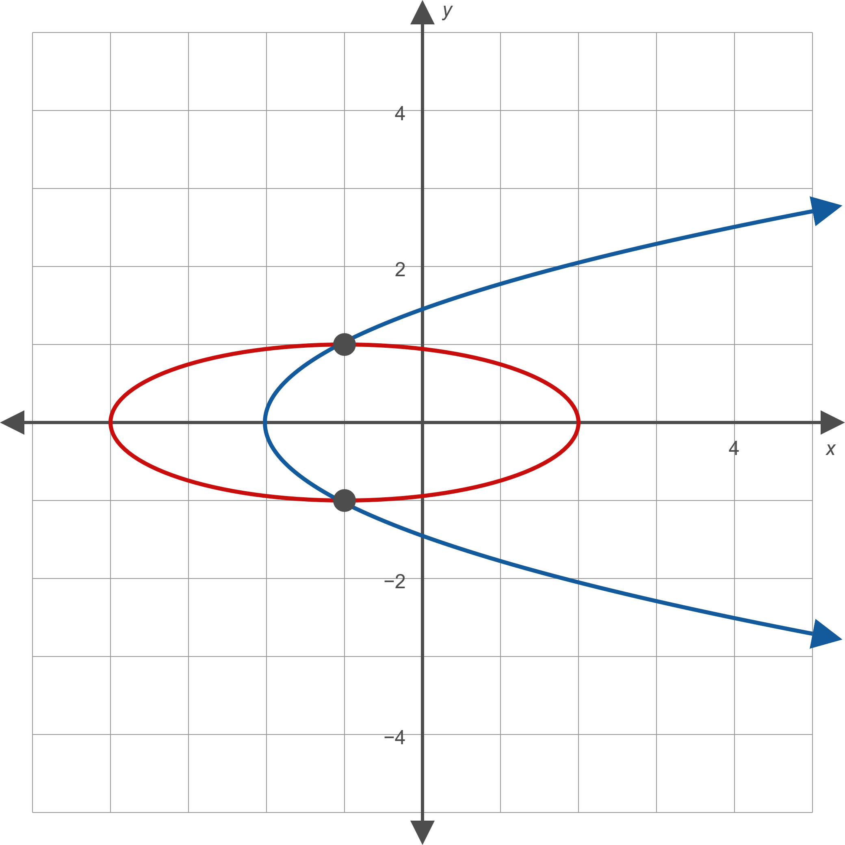
Example 5: Solving Systems of Nonlinear Equations Algebraically (cont.)
Figure 5

Slide 24
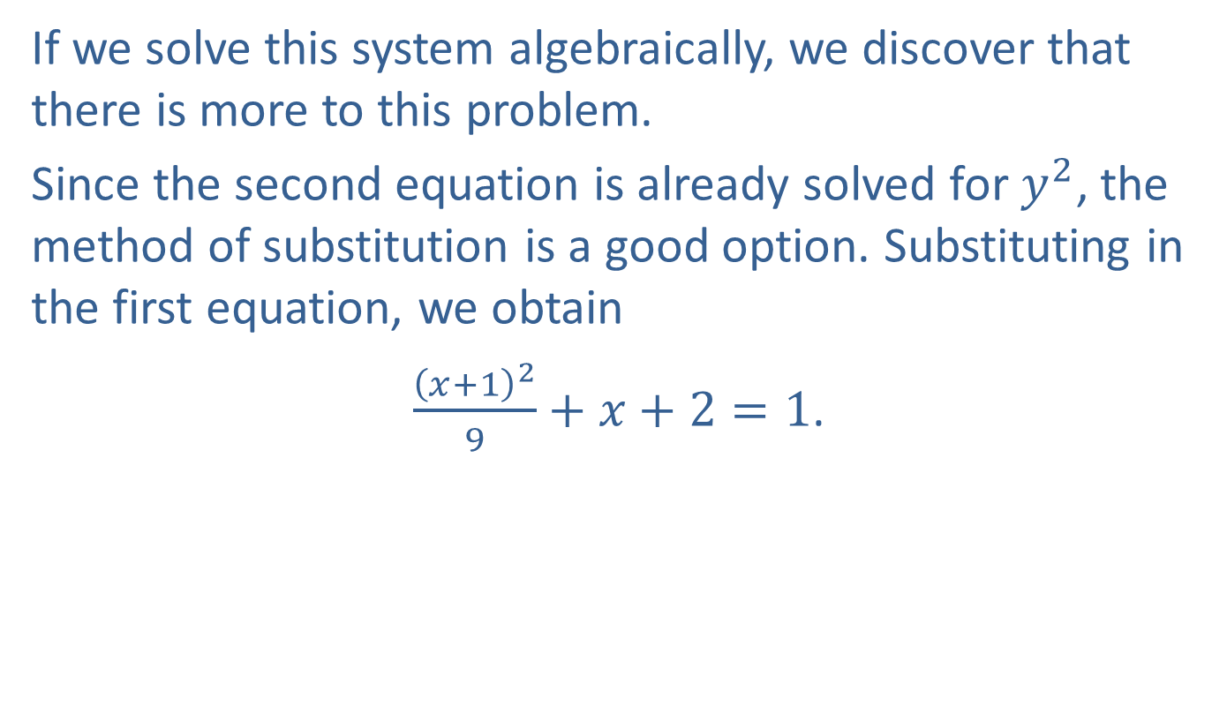
Example 5: Solving Systems of Nonlinear Equations Algebraically (cont.)
If we solve this system algebraically, we discover that there is more to this problem.
Since the second equation is already solved for $y^{2}$, the method of substitution is a good option. Substituting in the first equation, we obtain
$\frac{{\left(x+1\right)}^{2}}{9}+x+2=1$.

Slide 25
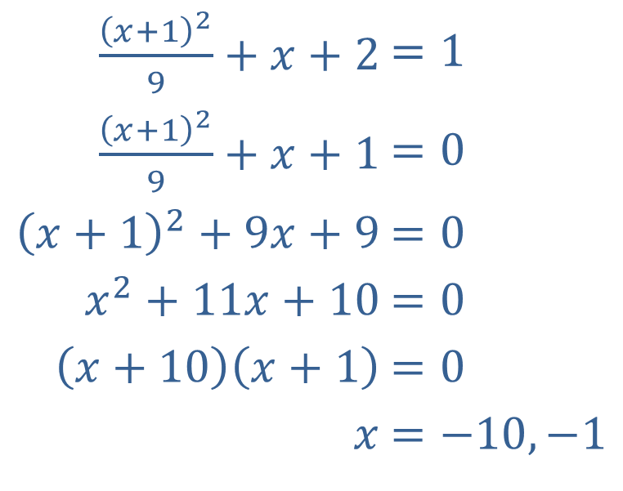

Example 5: Solving Systems of Nonlinear Equations Algebraically (cont.)
We solve this second-degree equation in $x$ the usual way.
​$\frac{{\left(x+1\right)}^{2}}{9}+x+2$ | ​$=1$
​$\frac{{\left(x+1\right)}^{2}}{9}+x+1$ | ​$=0$
​${\left(x+1\right)}^{2}+9x+9$ | ​$=0$
​$x^{2}+11x+10$ | ​$=0$
​$\left(x+10\right)\left(x+1\right)$ | ​$=0$
​$x$ | ​$=−10,−1$

Slide 26
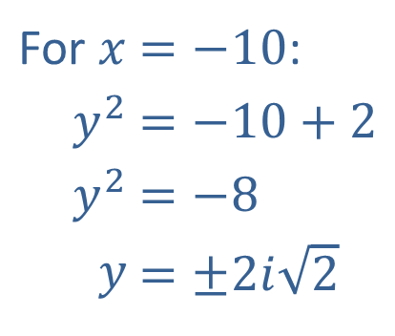
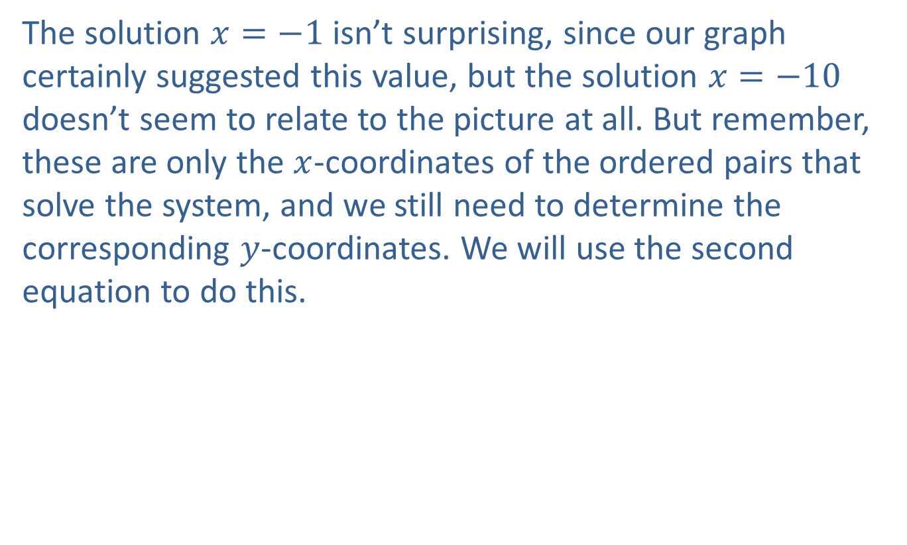
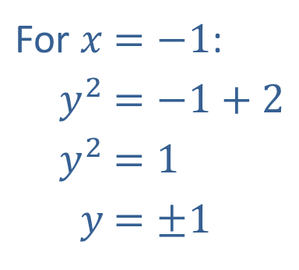
Example 5: Solving Systems of Nonlinear Equations Algebraically (cont.)
The solution $x=−1$ isn’t surprising, since our graph certainly suggested this value, but the solution $x=−10$ doesn’t seem to relate to the picture at all. But remember, these are only the $x$-coordinates of the ordered pairs that solve the system, and we still need to determine the corresponding $y$-coordinates. We will use the second equation to do this.
For ​$x$ | ​$=−10$:
​$y^{2}$ | ​$=−10+2$
​$y^{2}$ | ​$=−8$
​$y$ | ​$=±2i\sqrt{2}$
For ​$x$ | ​$=−1$:
​$y^{2}$ | ​$=−1+2$
​$y^{2}$ | ​$=1$
​$y$ | ​$=±1$

Slide 27
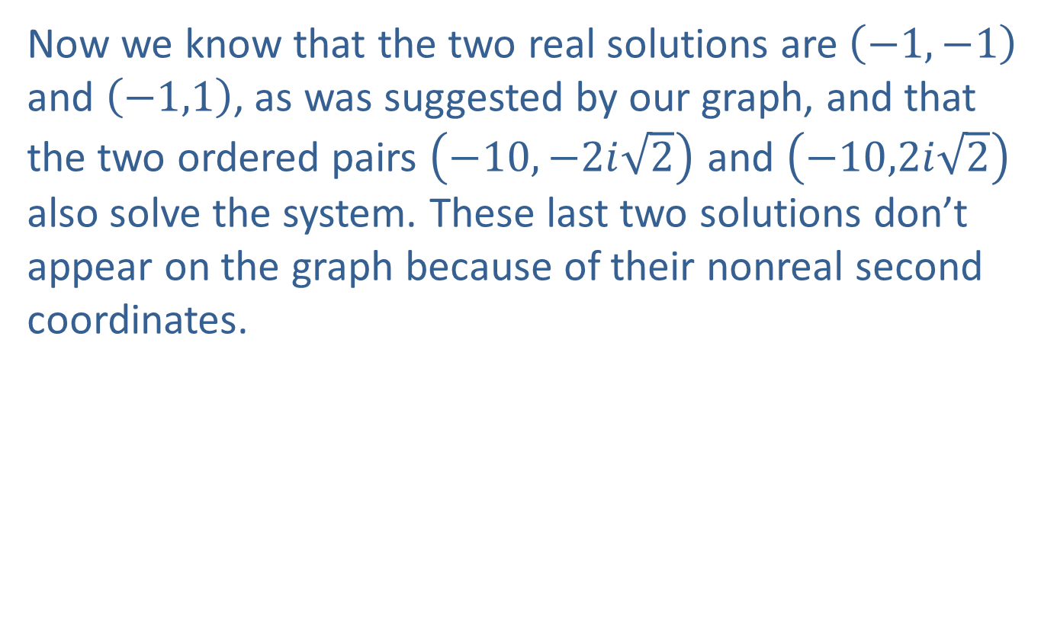
Example 5: Solving Systems of Nonlinear Equations Algebraically (cont.)
Now we know that the two real solutions are $\left(−1,−1\right)$ and $\left(−1,1\right)$, as was suggested by our graph, and that the two ordered pairs $\left(−10,−2i\sqrt{2}\right)$ and $\left(−10,2i\sqrt{2}\right)$ also solve the system. These last two solutions don’t appear on the graph because of their nonreal second coordinates.

Slide 28
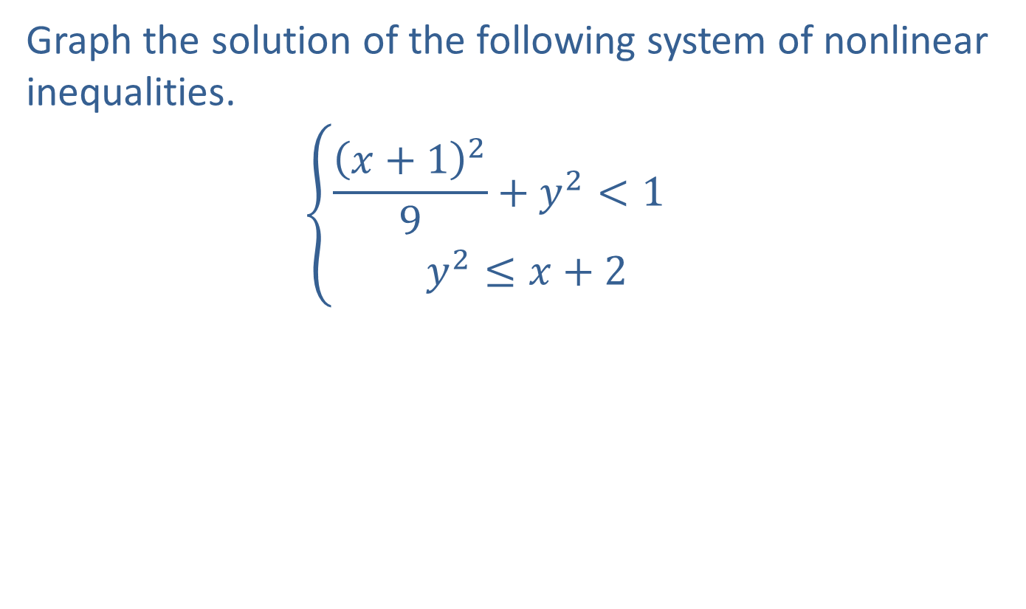
Example 6: Solving Systems of Nonlinear Inequalities by Graphing
Graph the solution of the following system of nonlinear inequalities.
𝑥+129+𝑦2<1+2𝑦2≤𝑥+2

Slide 29
Example 6: Solving Systems of Nonlinear Inequalities by Graphing (cont.)
Solution
The region solving the first inequality is the interior of an ellipse (with the boundary excluded), while the region solving the second inequality consists of those points on and to the right of a rightward-opening parabola. Thus, the solution of the system consists of all those points in the plane lying in both regions; that is, the intersection of the regions. The graph of this intersection appears shaded in Figure 7 (note the dashed line for the portion of the boundary defined by the ellipse and the solid line for the portion defined by the parabola).

Slide 30
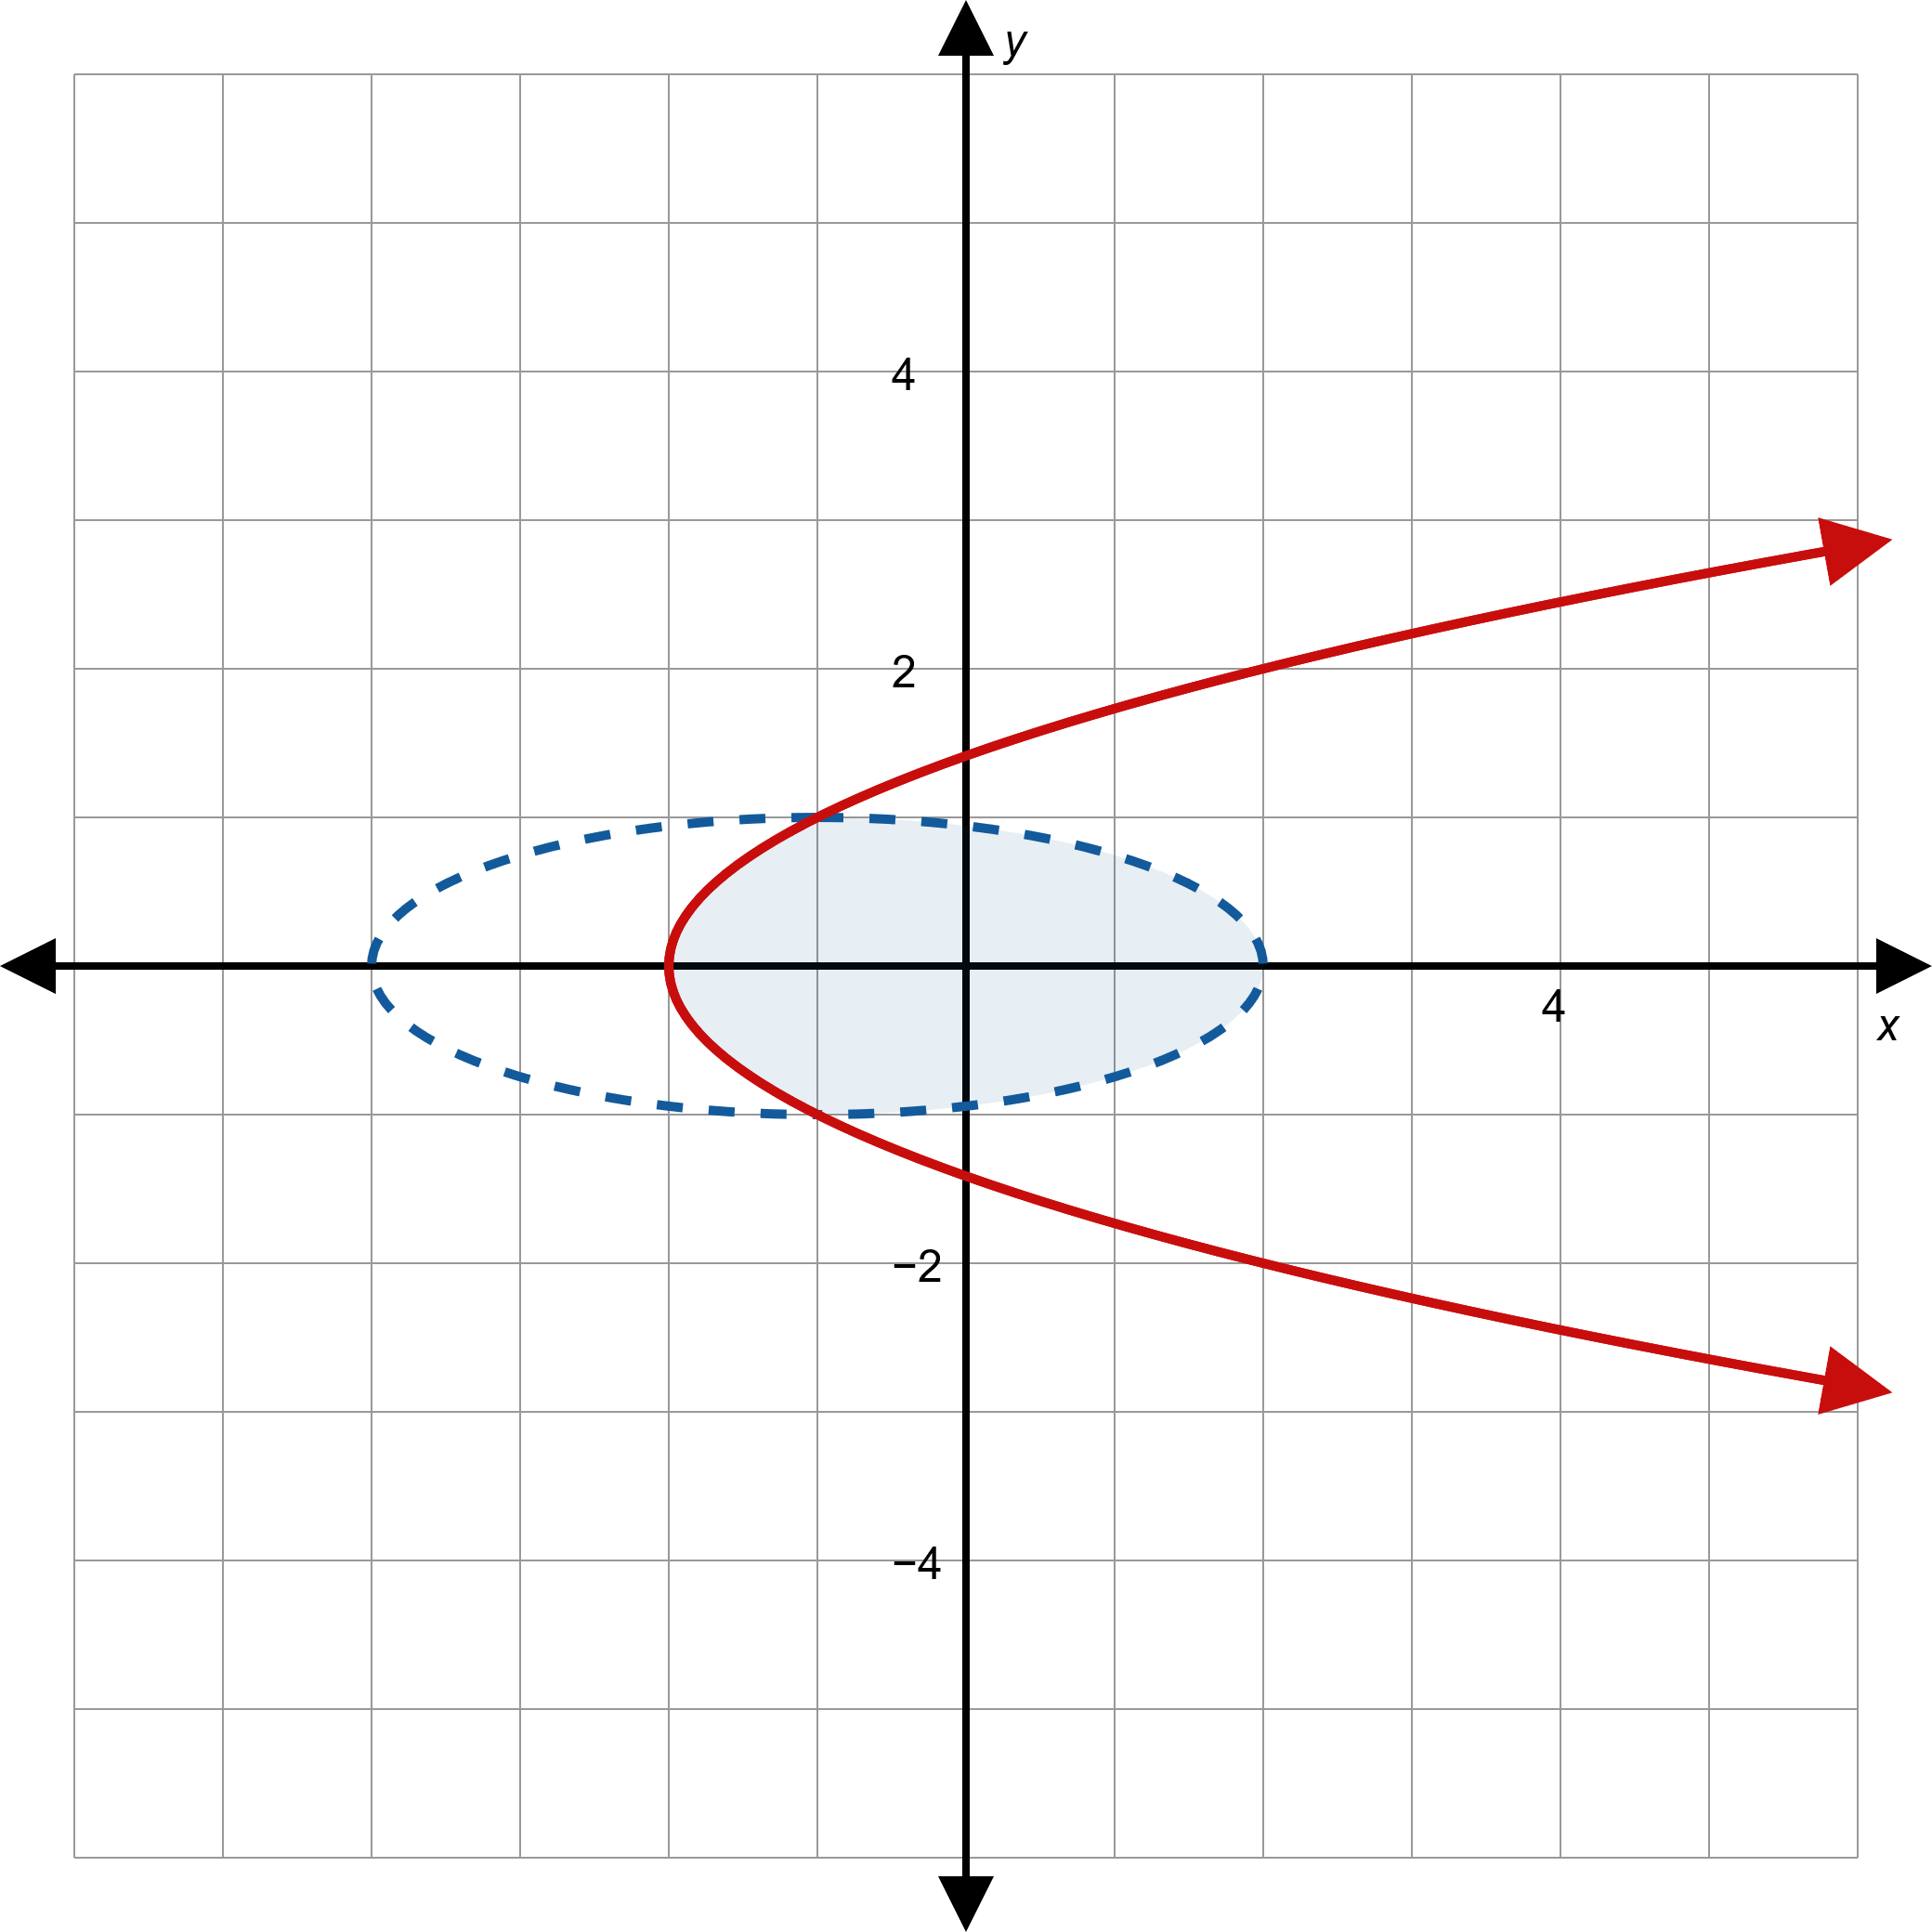
Example 6: Solving Systems of Nonlinear Inequalities by Graphing (cont.)
Figure 7

