Slide 1
Section 13.1
Sequences and Series

Slide 2
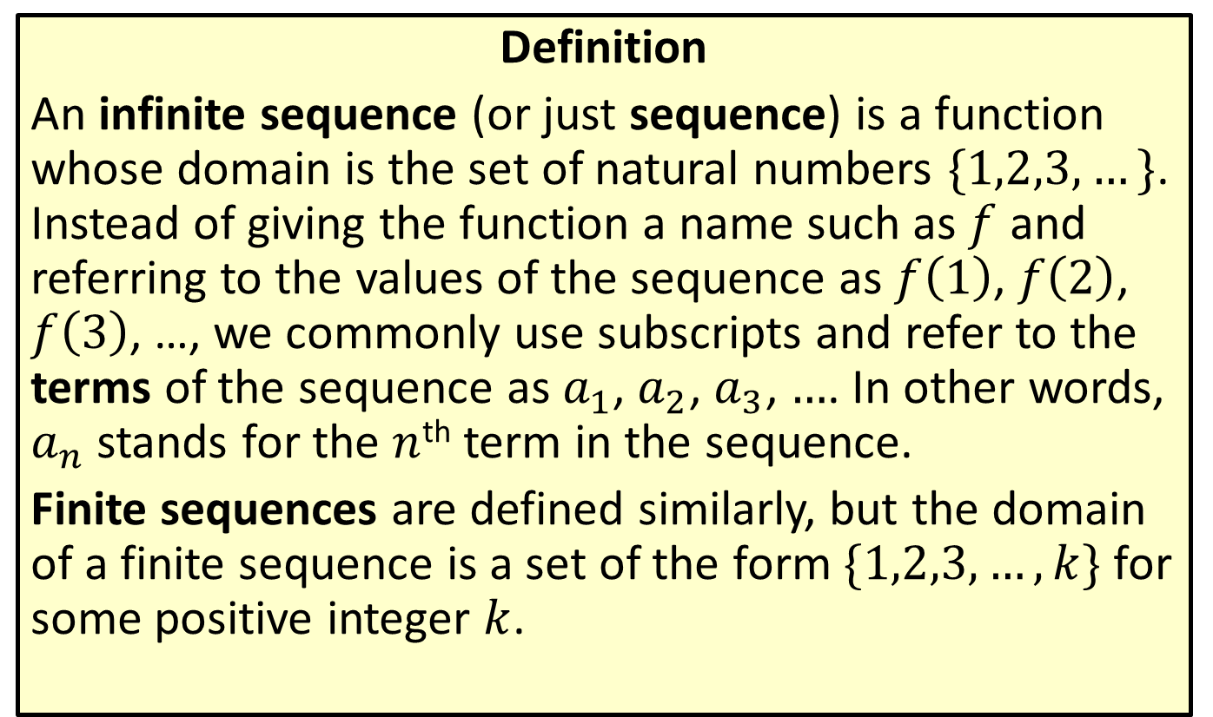
Sequences
Definition
An infinite sequence (or just sequence) is a function whose domain is the set of natural numbers $\{1,2,3,…\}$. Instead of giving the function a name such as $f$ and referring to the values of the sequence as $f⁡\left(1\right)$, $f⁡\left(2\right)$, $f⁡\left(3\right)$, …, we commonly use subscripts and refer to the terms of the sequence as $a_{1}$, $a_{2}$, $a_{3}$, $…$. In other words, $a_{n}$ stands for the $n$^{th} term in the sequence.
Finite sequences are defined similarly, but the domain of a finite sequence is a set of the form $\{1,2,3,…,k\}$ for some positive integer $k$.

Slide 3

Example 1: Sequences
Determine the first five terms of the following sequences.
​$a_{n}=5n−2$
​$b_{n}=\frac{{\left(−1\right)}^{n}+1}{2}$
​$c_{n}=\frac{n}{n+1}$

Slide 4
Note:
Sequences often have distinct patterns. As you write out the terms for each sequence, see if you can predict the next term before calculating it.

Slide 5
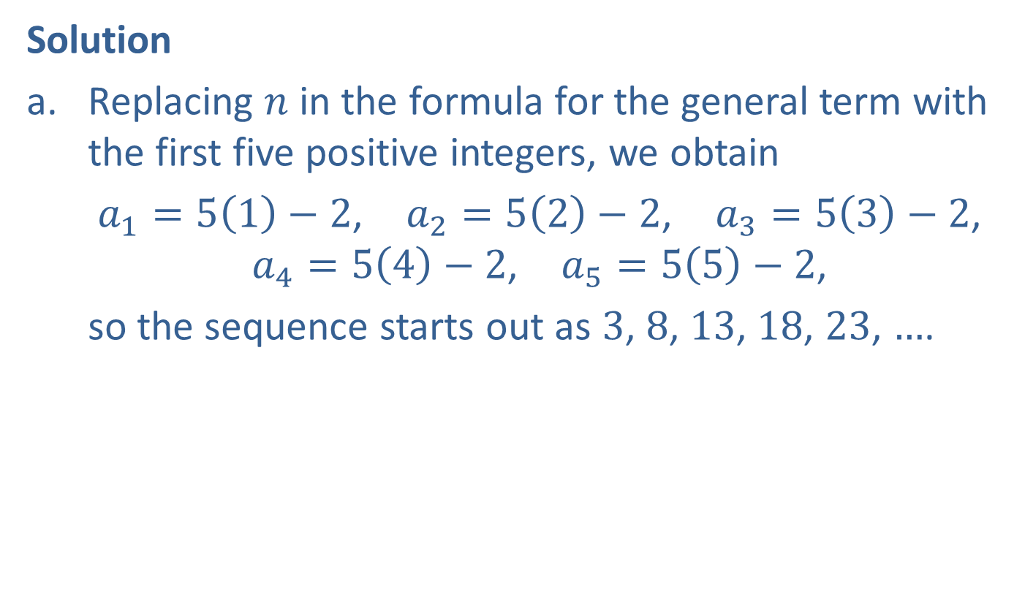
Example 1: Sequences (cont.)
Solution
​Replacing $n$ in the formula for the general term with the first five positive integers, we obtain
$a_{1}=5\left(1\right)−2$, $a_{2}=5\left(2\right)−2$, $a_{3}=5\left(3\right)−2$,
$a_{4}=5\left(4\right)−2$, $a_{5}=5\left(5\right)−2$,
​so the sequence starts out as 3, 8, 13, 18, 23, $…$.

Slide 6
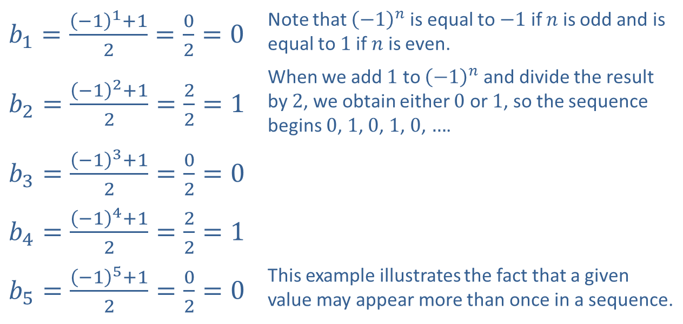

Example 1: Sequences (cont.)
​Again, we replace $n$ with the first five positive integers to determine the first five terms of the sequence.
​
​$b_{1}=\frac{{\left(−1\right)}^{1}+1}{2}=\frac{0}{2}=0$ | Note that ${\left(−1\right)}^{n}$ is equal to $−1$ if $n$ is odd and is equal to 1 if $n$ is even.
​$b_{2}=\frac{{\left(−1\right)}^{2}+1}{2}=\frac{2}{2}=1$ | When we add 1 to ${\left(−1\right)}^{n}$ and divide the result by 2, we obtain either 0 or 1, so the sequence begins 0, 1, 0, 1, 0, $…$.
​$b_{3}=\frac{{\left(−1\right)}^{3}+1}{2}=\frac{0}{2}=0$
​$b_{4}=\frac{{\left(−1\right)}^{4}+1}{2}=\frac{2}{2}=1$
​$b_{5}=\frac{{\left(−1\right)}^{5}+1}{2}=\frac{0}{2}=0$ | This example illustrates the fact that a given value may appear more than once in a sequence.

Slide 7
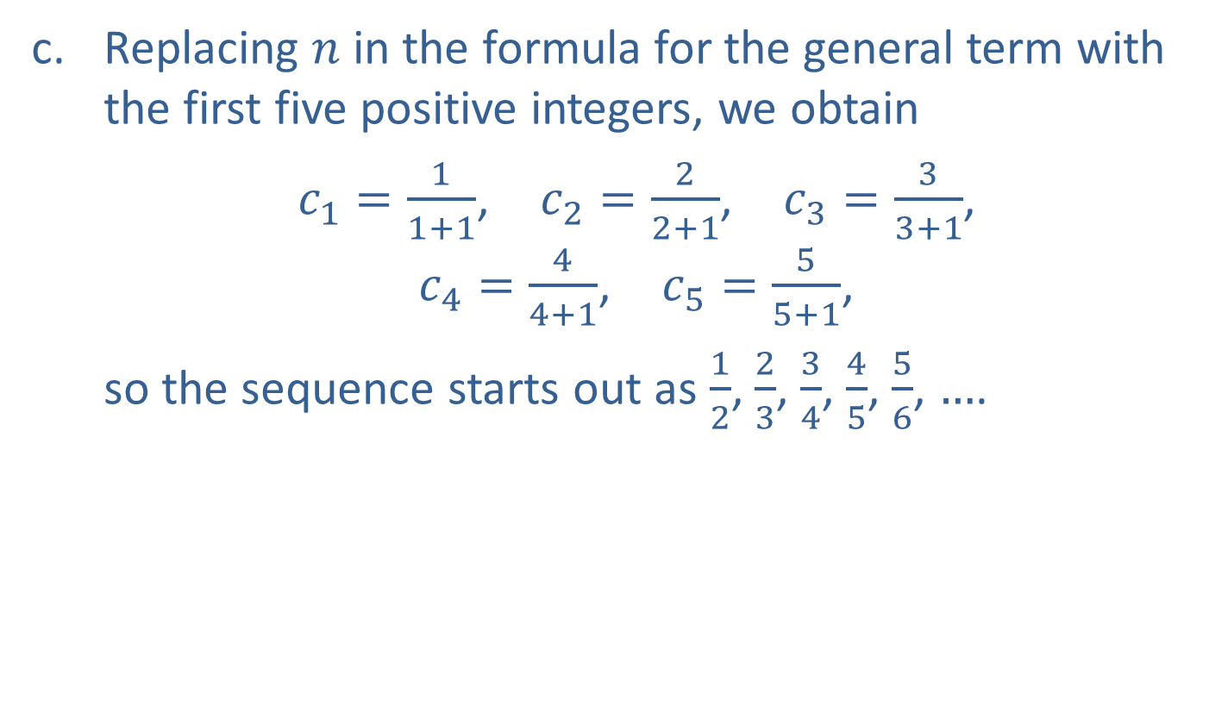
Example 1: Sequences (cont.)
​Replacing $n$ in the formula for the general term with the first five positive integers, we obtain
$c_{1}=\frac{1}{1+1}$, $c_{2}=\frac{2}{2+1}$, $c_{3}=\frac{3}{3+1}$,
$c_{4}=\frac{4}{4+1}$, $c_{5}=\frac{5}{5+1}$,
​so the sequence starts out as $\frac{1}{2}$, $\frac{2}{3}$, $\frac{3}{4}$, $\frac{4}{5}$, $\frac{5}{6}$, $…$.

Slide 8

Example 2: Recursively Defined Sequences
Determine the first five terms of the following recursively defined sequences.
​$a_{1}=3$ and $a_{n}=a_{n−1}+5$ for $n≥2$
​$a_{1}=2$ and $a_{n}=3a_{n−1}+1$ for $n≥2$

Slide 9
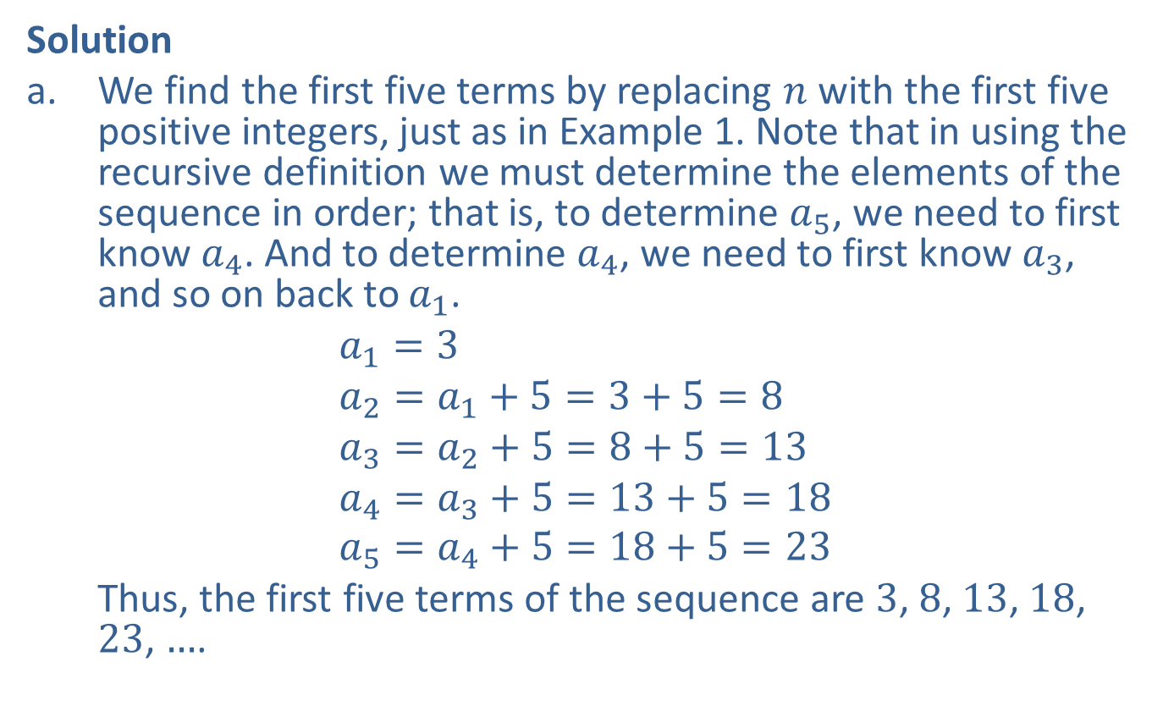
Example 2: Recursively Defined Sequences (cont.)
Solution
​We find the first five terms by replacing $n$ with the first five positive integers, just as in Example 1. Note that in using the recursive definition we must determine the elements of the sequence in order; that is, to determine $a_{5}$, we need to first know $a_{4}$. And to determine $a_{4}$, we need to first know $a_{3}$, and so on back to $a_{1}$.
$$a_{1}=3 \\ a_{2}=a_{1}+5=3+5=8 \\ a_{3}=a_{2}+5=8+5=13 \\ a_{4}=a_{3}+5=13+5=18 \\ a_{5}=a_{4}+5=18+5=23$$
​Thus, the first five terms of the sequence are 3, 8, 13, 18, 23, $…$.

Slide 10

Example 2: Recursively Defined Sequences (cont.)
​The sequence defined by this recursive definition appears to be the same as the first sequence in Example 1, defined explicitly by $a_{n}=5n−2$. This illustrates the fact that a given sequence can often be defined several different ways.

Slide 11
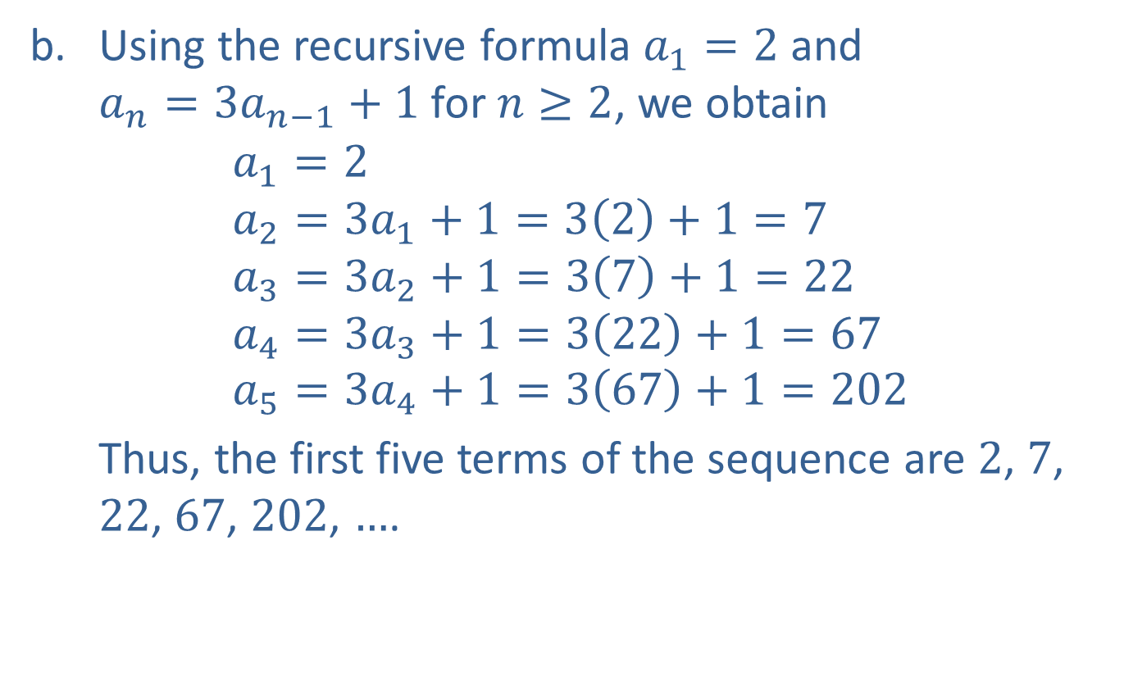
Example 2: Recursively Defined Sequences (cont.)
​Using the recursive formula $a_{1}=2$ and
$a_{n}=3a_{n−1}+1$ for $n≥2$, we obtain
$$a_{1}=2 \\ a_{2}=3a_{1}+1=3\left(2\right)+1=7 \\ a_{3}=3a_{2}+1=3\left(7\right)+1=22 \\ a_{4}=3a_{3}+1=3\left(22\right)+1=67 \\ a_{5}=3a_{4}+1=3\left(67\right)+1=202$$
​Thus, the first five terms of the sequence are 2, 7, 22, 67, 202, $…$.

Slide 12

Example 3: Finding the Formula for a Sequence
Find a possible formula for the general $n$^{th} term of the sequences that begin as follows.
​ $−3$, 9, $−27$, 81, $−243$, $…$
​ 1, 3, 6, 10, 15, $…$

Slide 13
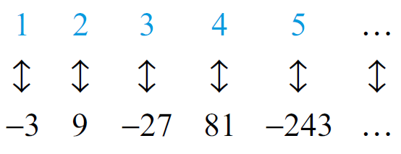
Example 3: Finding the Formula for a Sequence (cont.)
Solution
​There is no general method to find a formula for the terms of a sequence. Observation is usually the best tool. If a formula for a given sequence does not come to mind quickly, it may help to associate each term of the sequence with its place in the sequence, as shown below.
​

Slide 14
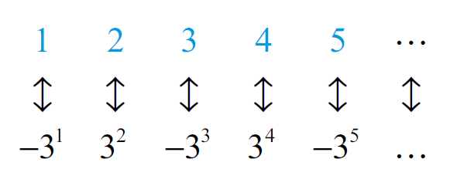
Example 3: Finding the Formula for a Sequence (cont.)
​If a pattern is still not apparent, try rewriting the terms of the sequence in different ways. In this case, factoring the terms leads to the following.
​

Slide 15
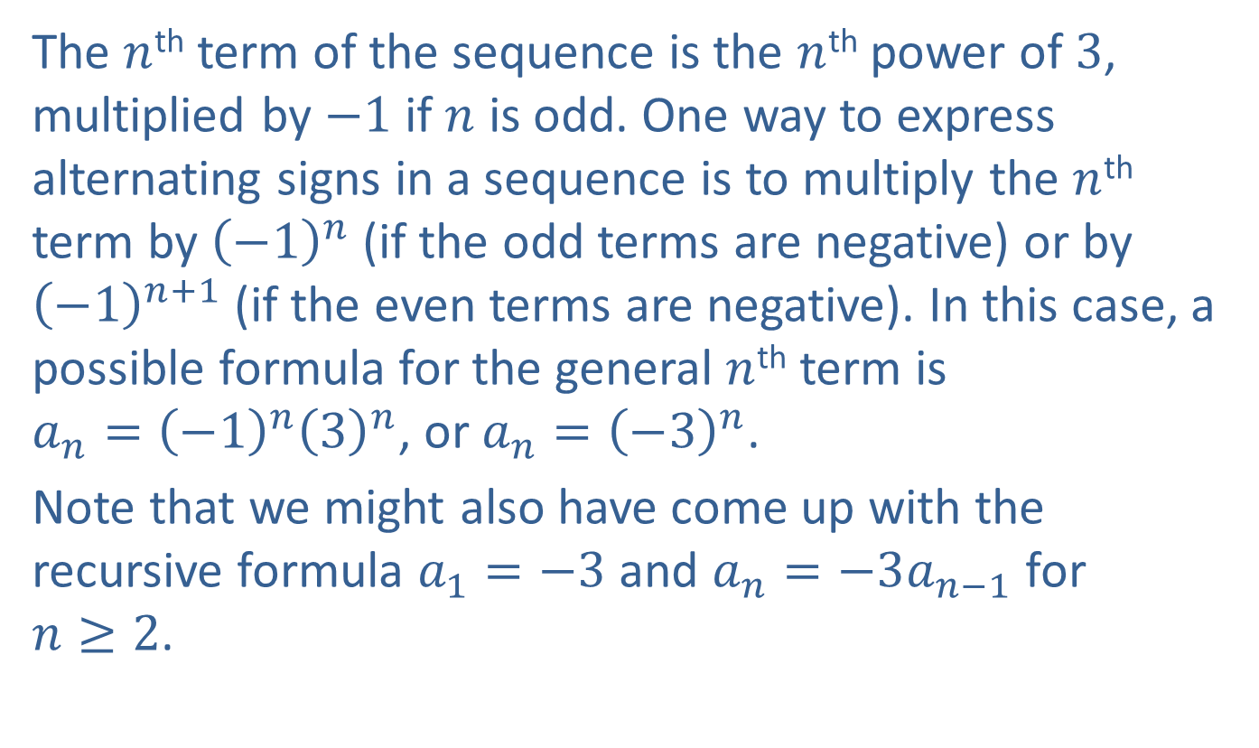
Example 3: Finding the Formula for a Sequence (cont.)
​The $n$^{th} term of the sequence is the $n$^{th} power of 3, multiplied by $−1$ if $n$ is odd. One way to express alternating signs in a sequence is to multiply the $n$^{th} term by ${\left(−1\right)}^{n}$ (if the odd terms are negative) or by ${\left(−1\right)}^{n+1}$ (if the even terms are negative). In this case, a possible formula for the general $n$^{th} term is
$a_{n}={\left(−1\right)}^{n}{\left(3\right)}^{n}$, or $a_{n}={\left(−3\right)}^{n}$.
​Note that we might also have come up with the recursive formula $a_{1}=−3$ and $a_{n}=−3a_{n−1}$ for
$n≥2$.

Slide 16
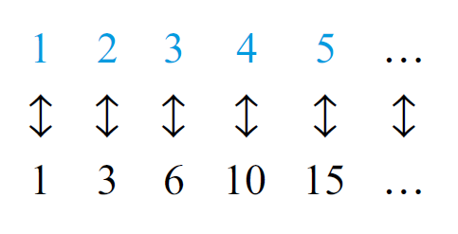
Example 3: Finding the Formula for a Sequence (cont.)
​Associate each term with its place in the sequence, as follows.
​

Slide 17
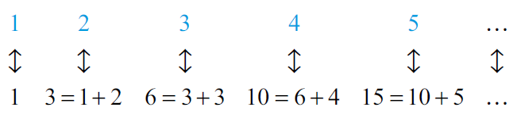
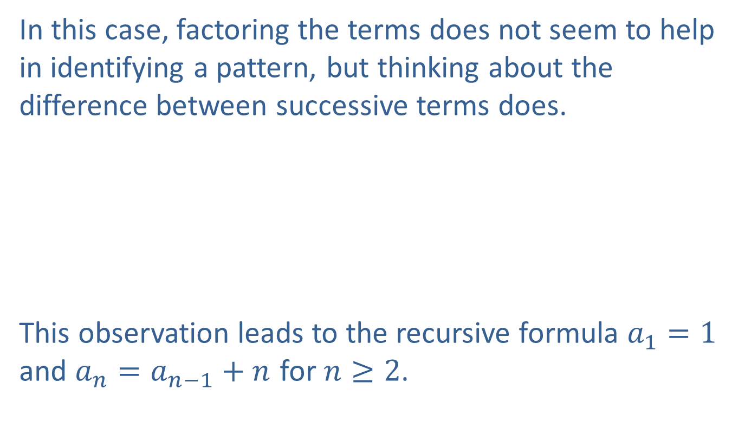
Example 3: Finding the Formula for a Sequence (cont.)
​In this case, factoring the terms does not seem to help in identifying a pattern, but thinking about the difference between successive terms does.
​
This observation leads to the recursive formula $a_{1}=1$ and $a_{n}=a_{n−1}+n$ for $n≥2$.

Slide 18
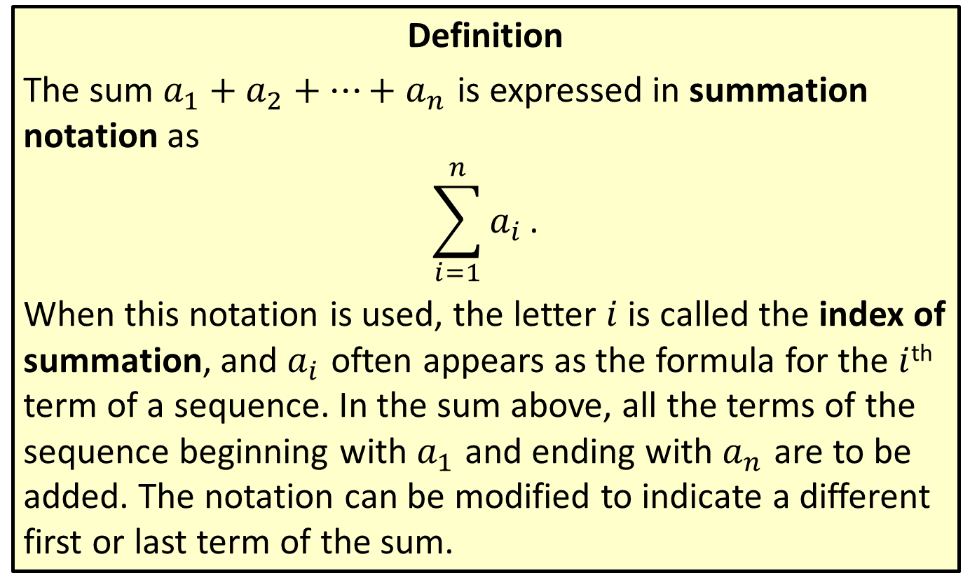
Summation Notation
Definition
The sum $a_{1}+a_{2}+…+a_{n}$ is expressed in summation notation as
$$\sum_{i=1}^{n}{a_{i}}\text{.}$$
When this notation is used, the letter $i$ is called the index of summation, and $a_{i}$ often appears as the formula for the $i$^{th} term of a sequence. In the sum above, all the terms of the sequence beginning with $a_{1}$ and ending with $a_{n}$ are to be added. The notation can be modified to indicate a different first or last term of the sum.

Slide 19

Example 4: Evaluating Sums
Rewrite the following sums in expanded form, then evaluate them.
​
​
$$\sum_{i=1}^{4}{\left(3i−2\right)}$$
$$\sum_{i=3}^{5}{i^{2}}$$

Slide 20

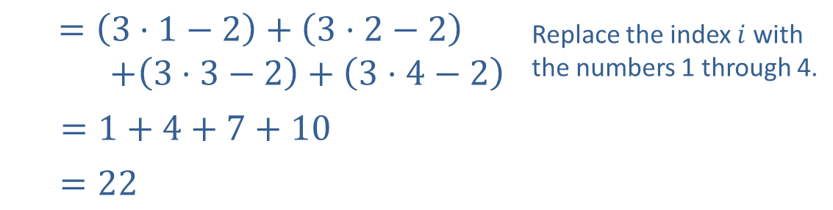
Example 4: Evaluating Sums (cont.)
Solution
​
$$\sum_{i=1}^{4}{\left(3i−2\right)}$$
$$=\left(3⋅1−2\right)+\left(3⋅2−2\right)$$ $+\left(3⋅3−2\right)+\left(3⋅4−2\right)$ | Replace the index $i$ with the numbers 1 through 4.
$=1+4+7+10$
$=22$

Slide 21

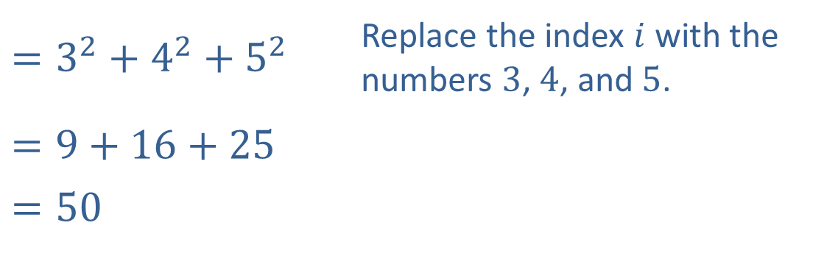
Example 4: Evaluating Sums (cont.)
$$\sum_{i=3}^{5}{i^{2}}$$
​$=3^{2}+4^{2}+5^{2}$ | Replace the index $i$ with the numbers 3, 4, and 5.
$$=9+16+25$$
​$=50$
​

Slide 22
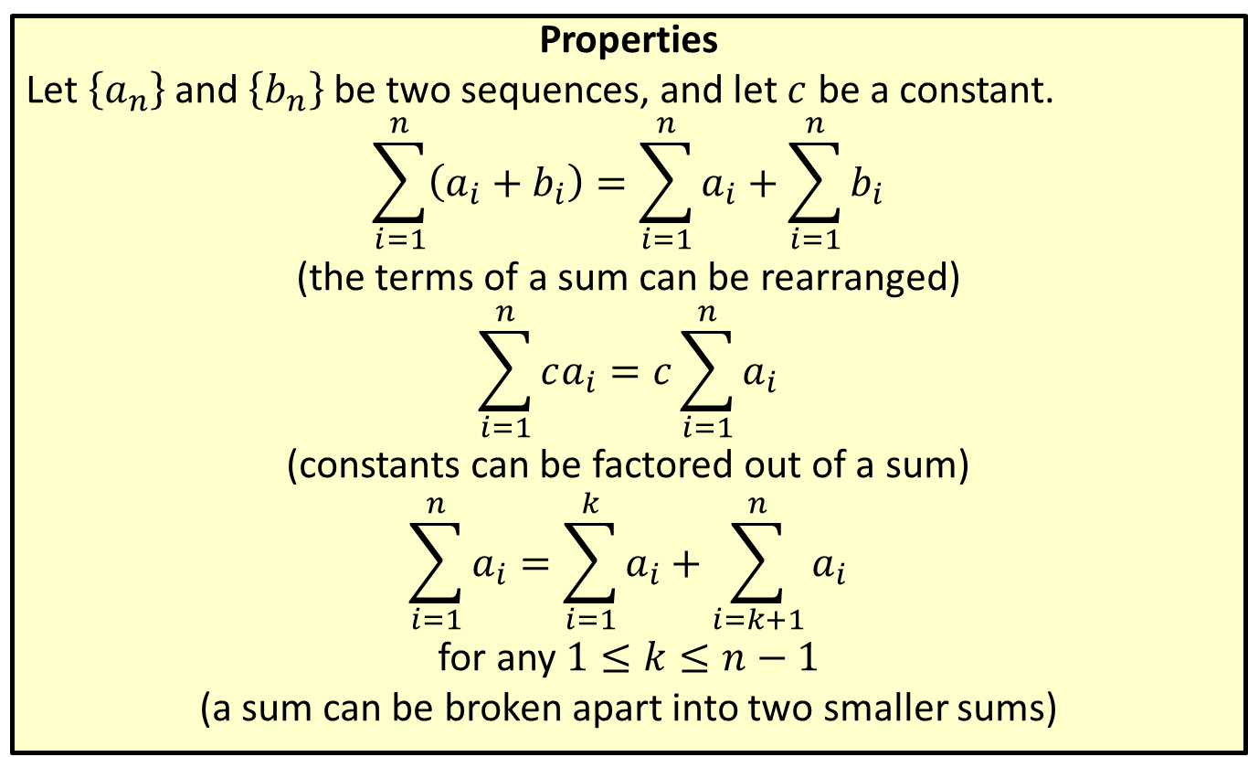
Properties of Sigma Notation
Properties
Let $\left\{a_{n}\right\}$ and $\left\{b_{n}\right\}$ be two sequences, and let $c$ be a constant.
$$\sum_{i=1}^{n}{\left(a_{i}+b_{i}\right)}=\sum_{i=1}^{n}{a_{i}}+\sum_{i=1}^{n}{b_{i}}$$
(the terms of a sum can be rearranged)
$$\sum_{i=1}^{n}{ca_{i}}=c\sum_{i=1}^{n}{a_{i}}$$
(constants can be factored out of a sum)
$$\sum_{i=1}^{n}{a_{i}}=\sum_{i=1}^{k}{a_{i}}+\sum_{i=k+1}^{n}{a_{i}}$$
for any $1≤k≤n−1$
(a sum can be broken apart into two smaller sums)
​
​

Slide 23
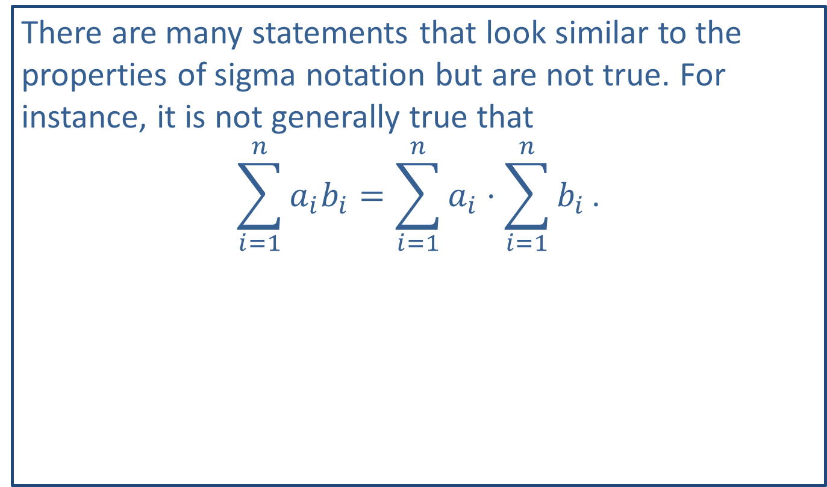
CAUTION!
There are many statements that look similar to the properties of sigma notation but are not true. For instance, it is not generally true that
$$\sum_{i=1}^{n}{a_{i}b_{i}}=\sum_{i=1}^{n}{a_{i}}⋅\sum_{i=1}^{n}{b_{i}}\text{.}$$

Slide 24
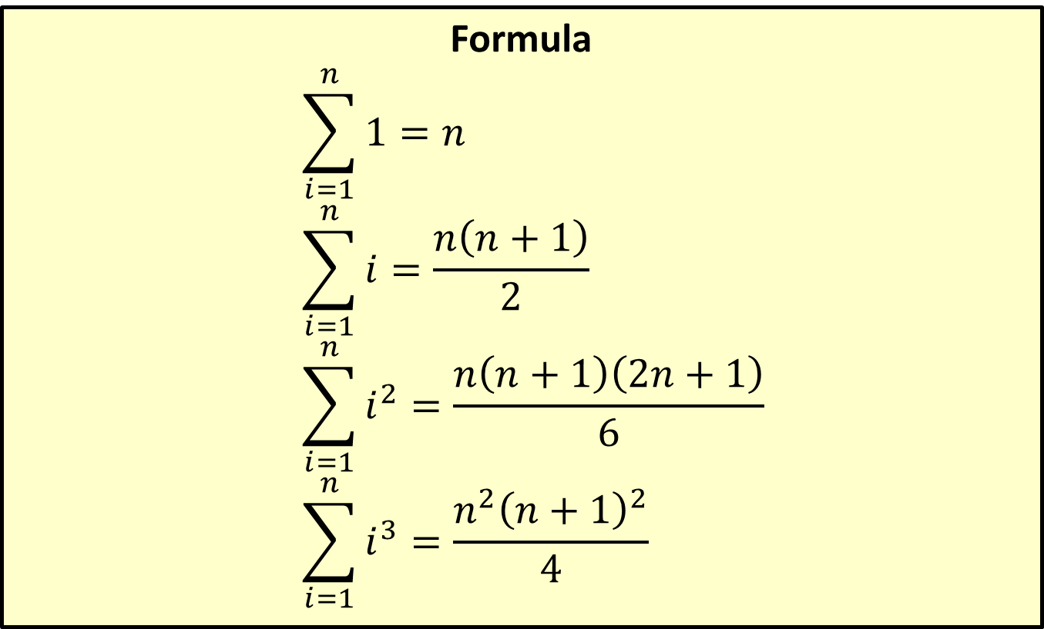
Four Summation Formulas
Formula
$$\sum_{i=1}^{n}{1}=n$$
$$\sum_{i=1}^{n}{i}=\frac{n\left(n+1\right)}{2}$$
$$\sum_{i=1}^{n}{i^{2}}=\frac{n\left(n+1\right)\left(2n+1\right)}{6}$$
$$\sum_{i=1}^{n}{i^{3}}=\frac{n^{2}{\left(n+1\right)}^{2}}{4}$$
​

Slide 25

Example 5: Evaluating Sums
Use the above properties and formulas to evaluate the following sums.
​
​
$$\sum_{i=1}^{9}{\left(7i−3\right)}$$
$$\sum_{i=4}^{6}{3i^{2}}$$

Slide 26
Note:
A good strategy is to break the sum into the simplest parts possible using the properties of sigma notation, then apply the known formulas.

Slide 27
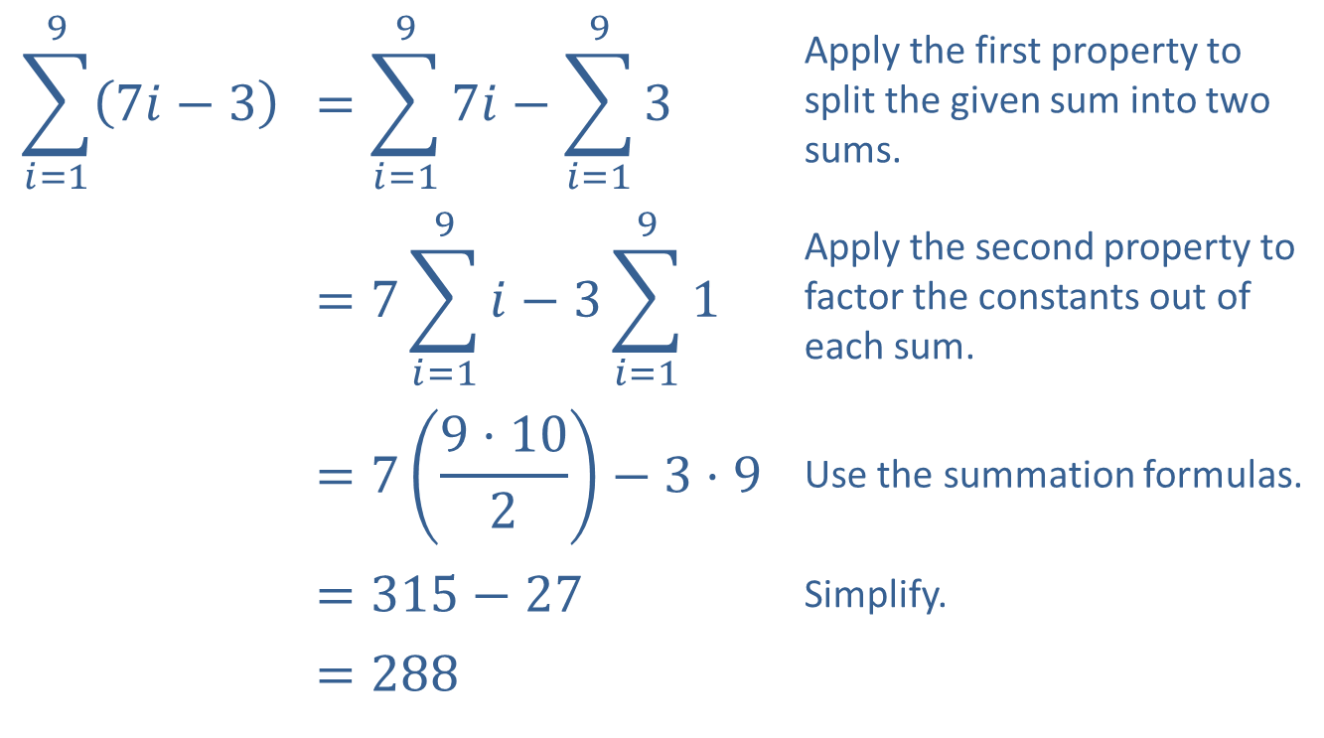
Example 5: Evaluating Sums (cont.)
Solution
​
$$\sum_{i=1}^{9}{\left(7i−3\right)}$$ | $$=\sum_{i=1}^{9}{7i}−\sum_{i=1}^{9}{3}$$ | Apply the first property to split the given sum into two sums.
 | $$=7\sum_{i=1}^{9}{i}−3\sum_{i=1}^{9}{1}$$ | Apply the second property to factor the constants out of each sum.
 | $$=7\left(\frac{9⋅10}{2}\right)−3⋅9$$ | Use the summation formulas.
 | ​$=315−27$ | Simplify.
 | ​$=288$

Slide 28
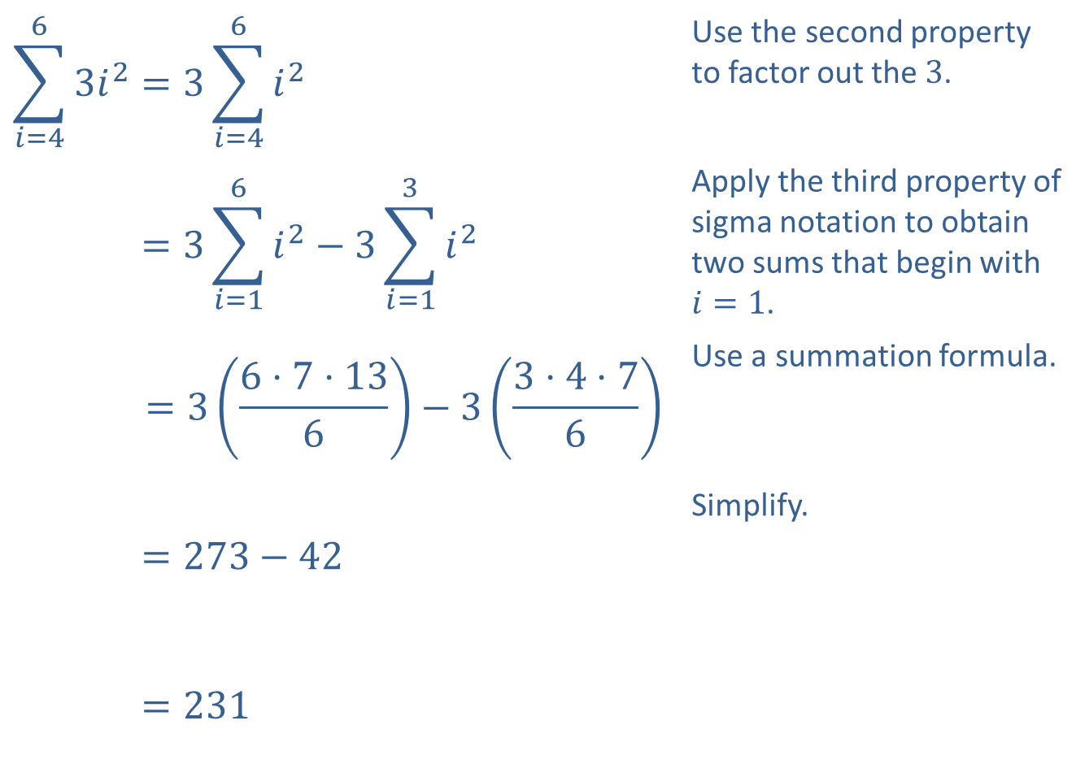
Example 5: Evaluating Sums (cont.)
​
$$\sum_{i=4}^{6}{3i^{2}}=3\sum_{i=4}^{6}{i^{2}}$$ | Use the second property to factor out the 3.
𝑖=463𝑖2=3𝑖=16𝑖2−3𝑖=13𝑖2 | Apply the third property of sigma notation to obtain two sums that begin with $i=1$.
𝑖=463𝑖2=36⋅7⋅136−33⋅4⋅76 | Use a summation formula.
𝑖=463𝑖2=273−42 | Simplify.
𝑖=463𝑖2=231

Slide 29
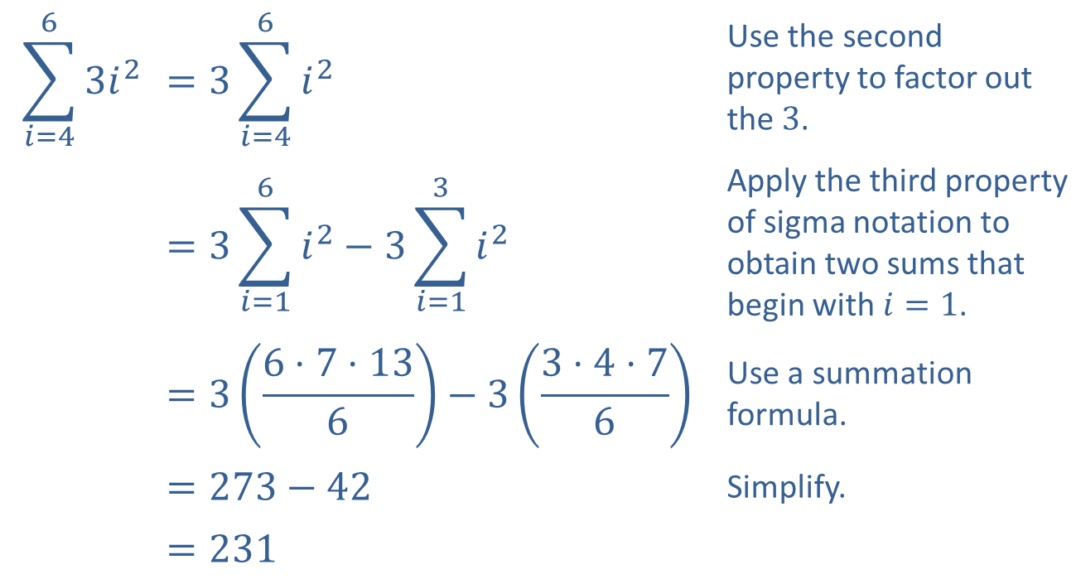
Example 5: Evaluating Sums (cont.)
$$\sum_{i=4}^{6}{3i^{2}}$$ | $$=3\sum_{i=4}^{6}{i^{2}}$$ | Use the second property to factor out the 3.
 | $$=3\sum_{i=1}^{6}{i^{2}}−3\sum_{i=1}^{3}{i^{2}}$$ | Apply the third property of sigma notation to obtain two sums that begin with $i=1$.
 | $$=3\left(\frac{6⋅7⋅13}{6}\right)−3\left(\frac{3⋅4⋅7}{6}\right)$$ | Use a summation formula.
 | $$=273−42$$ | Simplify.
 | $$=231$$
​

Slide 30
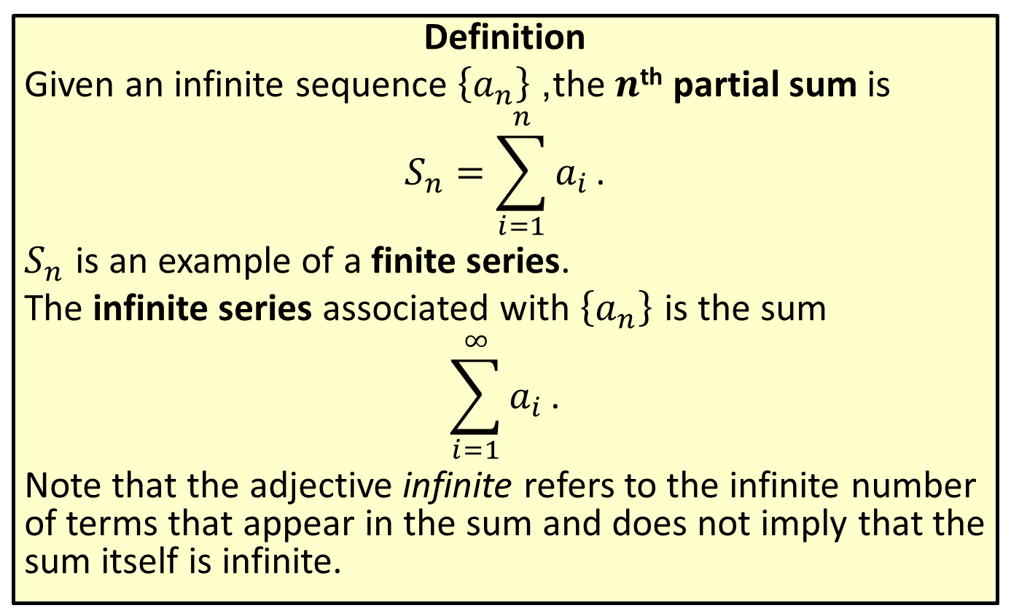
Partial Sums and Series
Definition
Given an infinite sequence $\left\{a_{n}\right\}$, the $n$^{th} partial sum is
$$S_{n}=\sum_{i=1}^{n}{a_{i}}\text{.}$$
$S_{n}$ is an example of a finite series.
The infinite series associated with $\left\{a_{n}\right\}$ is the sum
$$\sum_{i=1}^{∞}{a_{i}}\text{.}$$
Note that the adjective infinite refers to the infinite number of terms that appear in the sum and does not imply that the sum itself is infinite.

Slide 31

Example 6: Evaluating Partial Sums and Series
Examine the partial sums associated with each infinite series to determine if the series converges or diverges.
​
​
$$\sum_{i=1}^{∞}{⁡}⁡\left(\frac{1}{i}−\frac{1}{i+1}\right)$$
$$\sum_{i=1}^{∞}{{\left(−1\right)}^{i}}$$

Slide 32
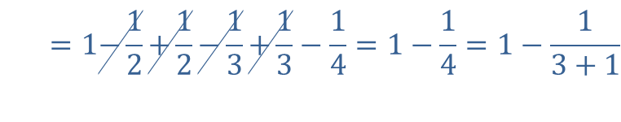
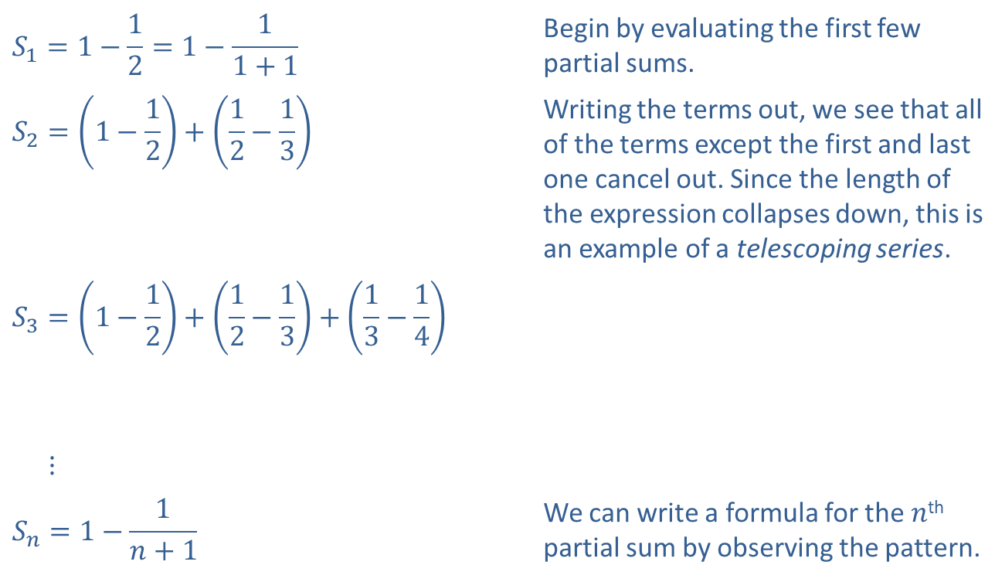
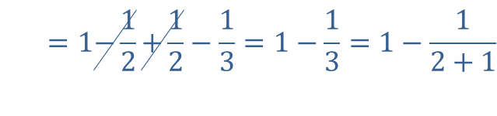
Example 6: Evaluating Partial Sums and Series (cont.)
Solution
​
$$S_{1}=1−\frac{1}{2}=1−\frac{1}{1+1}$$ | Begin by evaluating the first few partial sums.
$$S_{2}=\left(1−\frac{1}{2}\right)+\left(\frac{1}{2}−\frac{1}{3}\right)$$ | Writing the terms out, we see that all of the terms except the first and last one cancel out. Since the length of the expression collapses down, this is an example of a telescoping series.
​
$$S_{3}=\left(1−\frac{1}{2}\right)+\left(\frac{1}{2}−\frac{1}{3}\right)+\left(\frac{1}{3}−\frac{1}{4}\right)$$
​
​𝑆3⋮
$$S_{n}=1−\frac{1}{n+1}$$ | We can write a formula for the $n$^{th} partial sum by observing the pattern.
𝑆2=1−12+12−13=1−13=1−12+1
𝑆3=1−12+12−13+13−14=1−14=1−13+1

Slide 33

Example 6: Evaluating Partial Sums and Series (cont.)
​The partial sums approach 1 as $n$ gets larger and larger, therefore the series converges. In fact,
$$\sum_{i=1}^{∞}{\left(\frac{1}{i}−\frac{1}{i+1}\right)}=1\text{.}$$

Slide 34
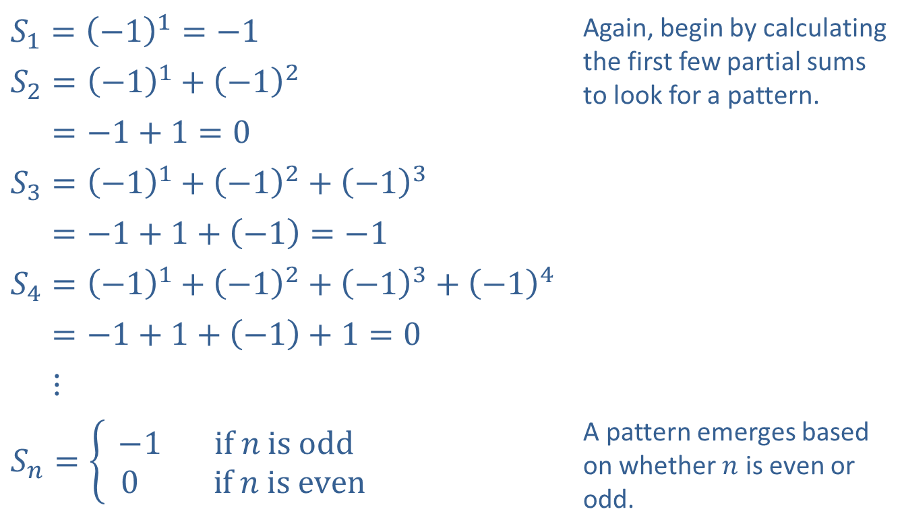
Example 6: Evaluating Partial Sums and Series (cont.)
​
​$S_{1}={\left(−1\right)}^{1}=−1$ | Again, begin by calculating the first few partial sums to look for a pattern.
​$S_{2}={\left(−1\right)}^{1}+{\left(−1\right)}^{2}$
​𝑆2=−1+1=0
​$S_{3}={\left(−1\right)}^{1}+{\left(−1\right)}^{2}+{\left(−1\right)}^{3}$
​𝑆3=−1+1+−1=−1
​$S_{4}={\left(−1\right)}^{1}+{\left(−1\right)}^{2}+{\left(−1\right)}^{3}+{\left(−1\right)}^{4}$
​𝑆4=−1+1+−1+1=0
​𝑆4⋮
​$S_{n}=\left\{\begin{aligned}−1 if n is odd \\ 0 if n is even\end{aligned}\right.$ | A pattern emerges based on whether $n$ is even or odd.

Slide 35

Example 6: Evaluating Partial Sums and Series (cont.)
​The partial sums of this series oscillate between $−1$ and 0 and do not approach a fixed number as $n$ gets large. Therefore, this series diverges.

