Slide 1
Section 13.4
Mathematical Induction

Slide 2
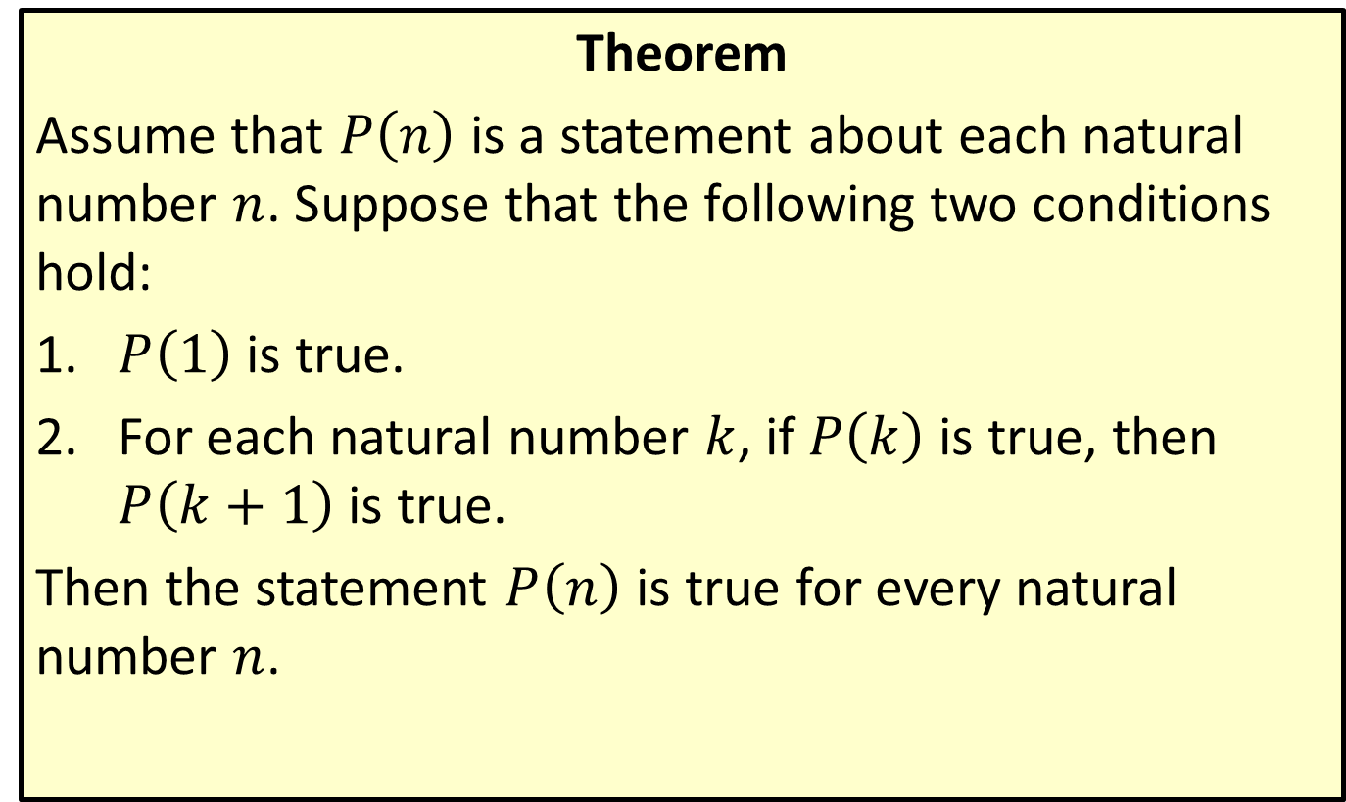
Principle of Mathematical Induction
Theorem
Assume that $P⁡\left(n\right)$ is a statement about each natural number $n$. Suppose that the following two conditions hold:
​$P⁡\left(1\right)$ is true.
​For each natural number $k$, if $P⁡\left(k\right)$ is true, then $P⁡\left(k+1\right)$ is true.
Then the statement $P⁡\left(n\right)$ is true for every natural number $n$.

Slide 3

Example 1: Proof by Mathematical Induction
Prove that for each natural number $n$,
$1+3+5+…+\left(2n−1\right)=n^{2}$.

Slide 4
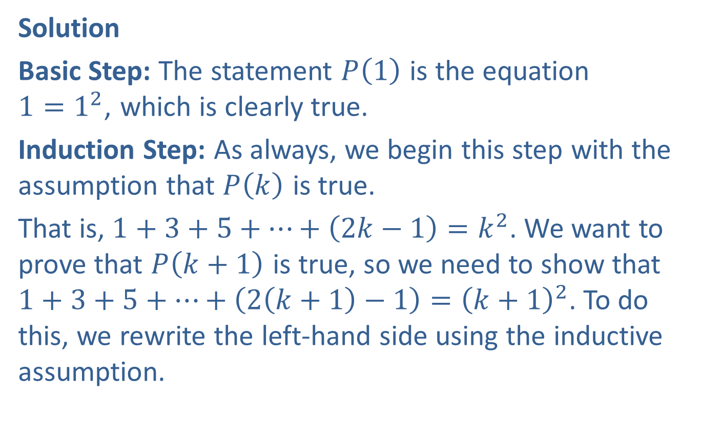
Example 1: Proof by Mathematical Induction (cont.)
Solution
Basic Step: The statement $P⁡\left(1\right)$ is the equation
$1=1^{2}$, which is clearly true.
Induction Step: As always, we begin this step with the assumption that $P⁡\left(k\right)$ is true.
That is, $1+3+5+…+\left(2k−1\right)=k^{2}$. We want to prove that $P⁡\left(k+1\right)$ is true, so we need to show that
$1+3+5+…+\left(2\left(k+1\right)−1\right)={\left(k+1\right)}^{2}$. To do this, we rewrite the left-hand side using the inductive assumption.

Slide 5
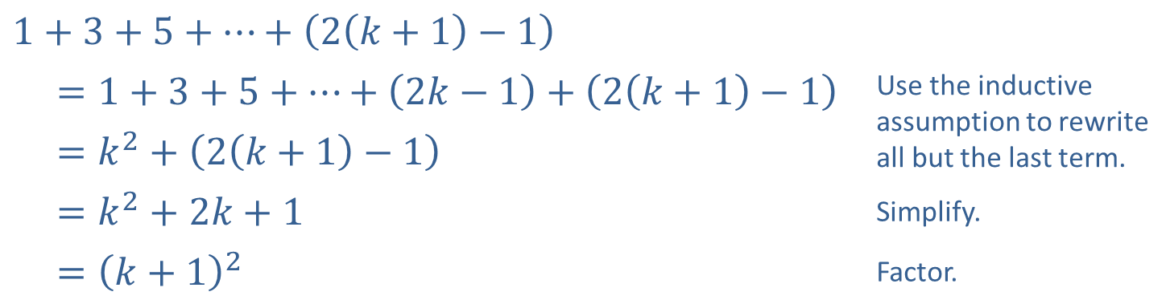
Example 1: Proof by Mathematical Induction (cont.)
Since we’ve completed the basic step and the induction step, the proof is complete.
$$1+3+5+…+\left(2\left(k+1\right)−1\right)$$ | Use the inductive assumption to rewrite all but the last term.
$=1+3+5+…+\left(2k−1\right)+\left(2\left(k+1\right)−1\right)$
$=k^{2}+\left(2\left(k+1\right)−1\right)$
$=k^{2}+2k+1$ | Simplify.
$={\left(k+1\right)}^{2}$ | Factor.

Slide 6

Example 2: Proof by Mathematical Induction
Prove that for each natural number $n$, $2n≤2^{n}$.

Slide 7
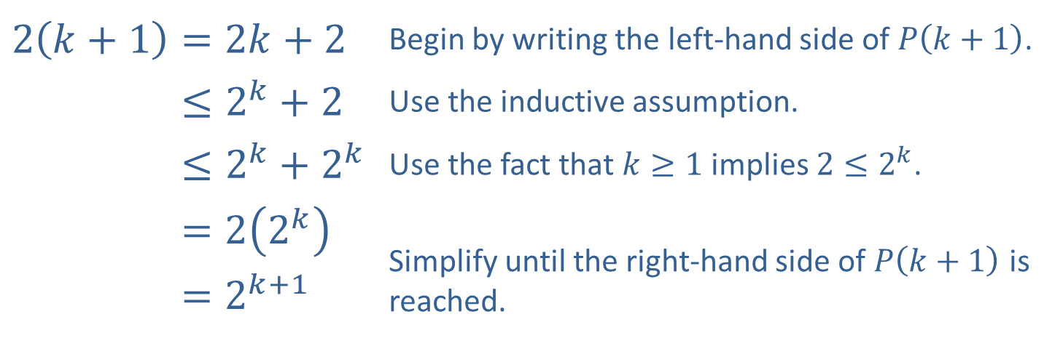

Example 2: Proof by Mathematical Induction (cont.)
Solution
Basic Step: The statement $P⁡\left(1\right)$ is the inequality $2\left(1\right)≤2^{1}$, or $2≤2$. This is true.
Induction Step: Assume that $2k≤2^{k}$. Then we have the following.
​$2\left(k+1\right)=2k+2$ | Begin by writing the left-hand side of $P⁡\left(k+1\right)$.
​2𝑘+1≤2𝑘+2 | Use the inductive assumption.
​2𝑘+1≤2𝑘+2𝑘 | Use the fact that $k≥1$ implies $2≤2^{k}$.
​2𝑘+1=22𝑘 | Simplify until the right-hand side of $P⁡\left(k+1\right)$ is reached.
​2𝑘+1=2𝑘+1

Slide 8

Example 3: Proof by Mathematical Induction
Prove that for each natural number $n$, $8^{n}−3^{n}$ is divisible by 5.

Slide 9

Example 3: Proof by Mathematical Induction (cont.)
Solution
Basic Step: Since $8^{1}−3^{1}=5$ is divisible by 5, $P⁡\left(1\right)$ is true.
Induction Step: Assume that $8^{k}−3^{k}$ is divisible by 5. Then there is some integer $p$ for which $8^{k}−3^{k}=5p$.

Slide 10
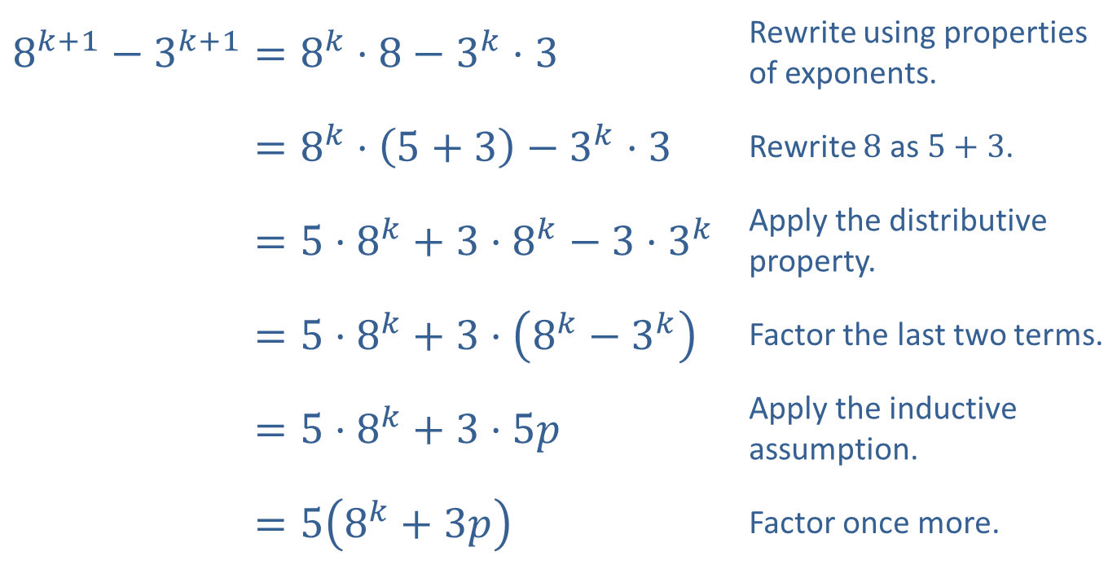
Example 3: Proof by Mathematical Induction (cont.)
​$8^{k+1}−3^{k+1}=8^{k}⋅8−3^{k}⋅3$ | Rewrite using properties of exponents.
​8𝑘+1−3𝑘+1=8𝑘⋅5+3−3𝑘⋅3 | Rewrite 8 as $5+3$.
​8𝑘+1−3𝑘+1=5⋅8𝑘+3⋅8𝑘−3⋅3𝑘 | Apply the distributive property.
​8𝑘+1−3𝑘+1=5⋅8𝑘+3⋅8𝑘−3𝑘 | Factor the last two terms.
​8𝑘+1−3𝑘+1=5⋅8𝑘+3⋅5𝑝 | Apply the inductive assumption.
8𝑘+1−3𝑘+1=58𝑘+3𝑝 | Factor once more.

Slide 11

Example 3: Proof by Mathematical Induction (cont.)
This shows that $8^{k+1}−3^{k+1}$ is a product of 5 and the integer $8^{k}+3p$, so we have shown that $8^{k+1}−3^{k+1}$ is divisible by 5, completing the inductive step, and thus the proof.

Slide 12

Example 4: Proof by Mathematical Induction
Prove that for each natural number $n$,
$$\sum_{i=1}^{n}{i^{2}}=\frac{n\left(n+1\right)\left(2n+1\right)}{6}\text{.}$$

Slide 13
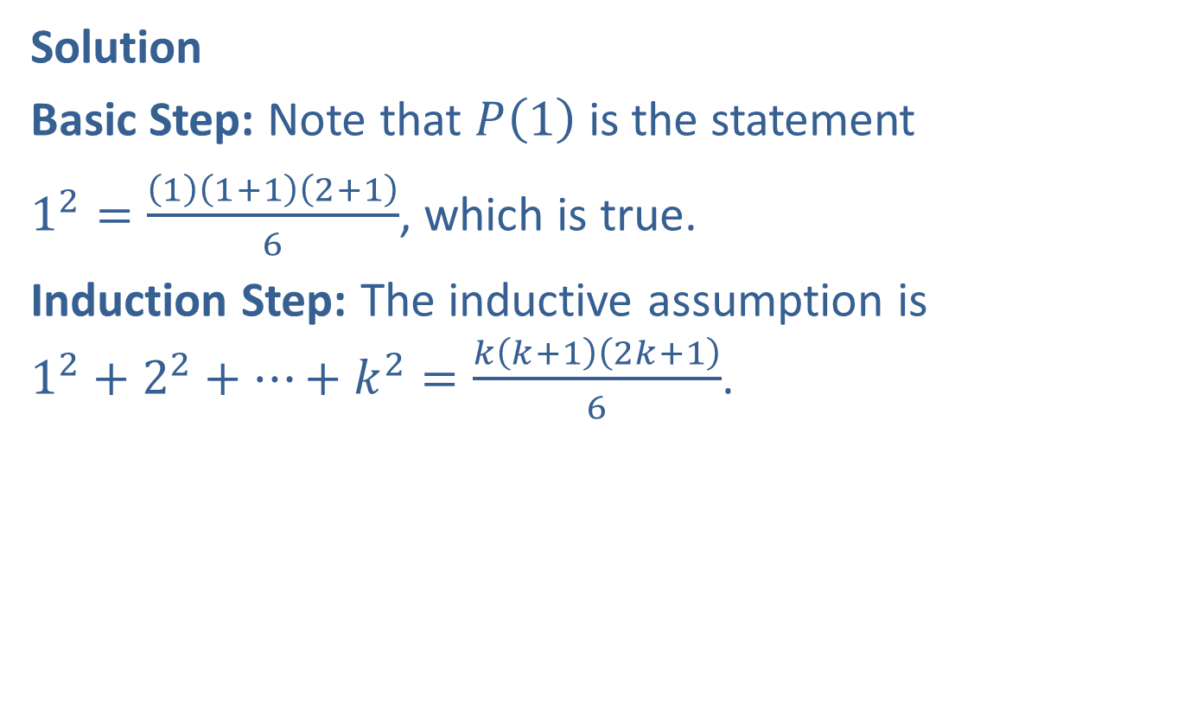
Example 4: Proof by Mathematical Induction (cont.)
Solution
Basic Step: Note that $P⁡\left(1\right)$ is the statement
$1^{2}=\frac{\left(1\right)\left(1+1\right)\left(2+1\right)}{6}$, which is true.
Induction Step: The inductive assumption is
$1^{2}+2^{2}+…+k^{2}=\frac{k\left(k+1\right)\left(2k+1\right)}{6}$.

Slide 14
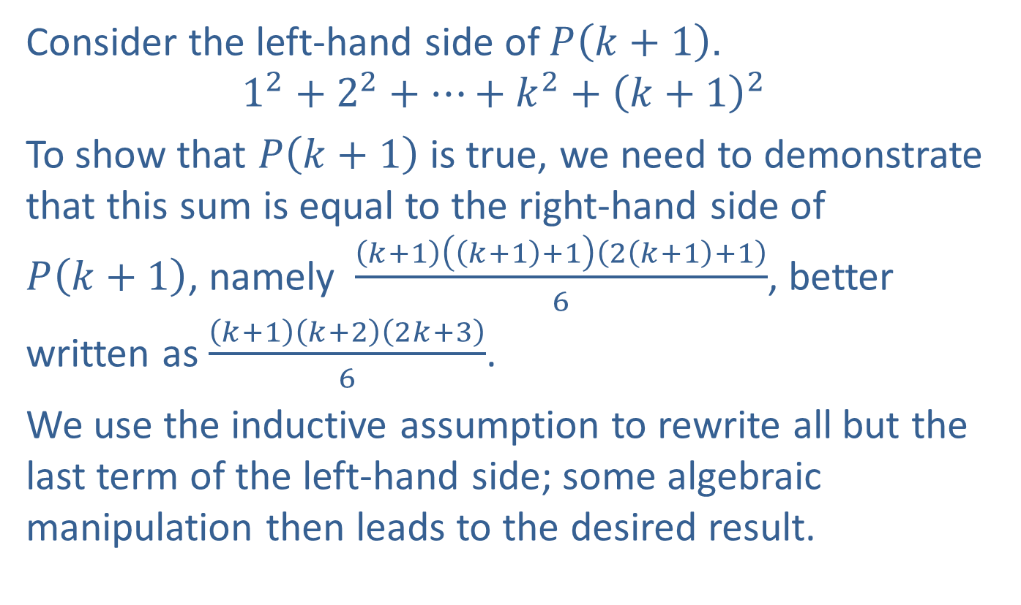
Example 4: Proof by Mathematical Induction (cont.)
Consider the left-hand side of $P⁡\left(k+1\right)$.
$$1^{2}+2^{2}+…+k^{2}+{\left(k+1\right)}^{2}$$
To show that $P⁡\left(k+1\right)$ is true, we need to demonstrate that this sum is equal to the right-hand side of
$P⁡\left(k+1\right)$, namely $\frac{\left(k+1\right)\left(\left(k+1\right)+1\right)\left(2\left(k+1\right)+1\right)}{6}$, better written as $\frac{\left(k+1\right)\left(k+2\right)\left(2k+3\right)}{6}$.
We use the inductive assumption to rewrite all but the last term of the left-hand side; some algebraic manipulation then leads to the desired result.

Slide 15
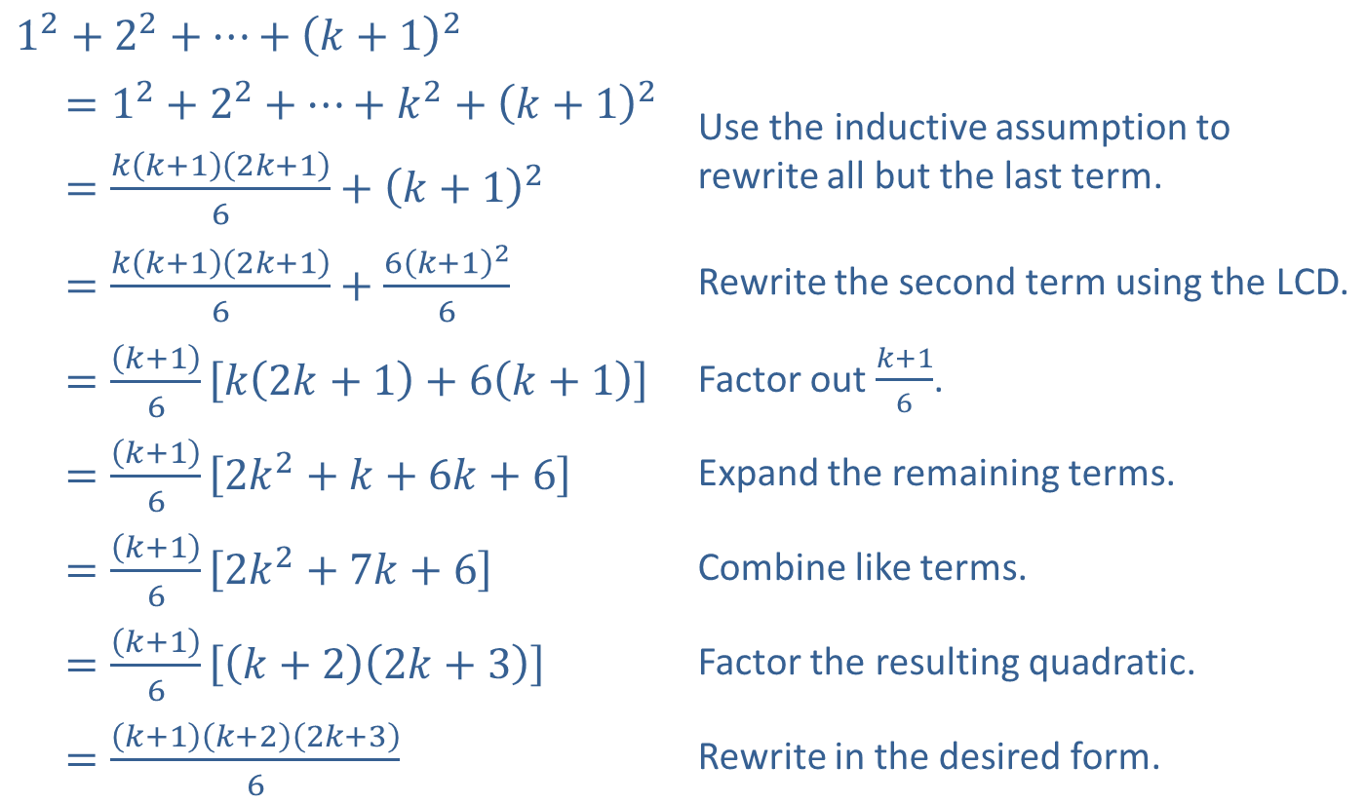
Example 4: Proof by Mathematical Induction (cont.)
$$1^{2}+2^{2}+…+{\left(k+1\right)}^{2}$$
$$=1^{2}+2^{2}+…+k^{2}+{\left(k+1\right)}^{2}$$ | Use the inductive assumption to rewrite all but the last term.
​$=\frac{k\left(k+1\right)\left(2k+1\right)}{6}+{\left(k+1\right)}^{2}$
​$=\frac{k\left(k+1\right)\left(2k+1\right)}{6}+\frac{6{\left(k+1\right)}^{2}}{6}$ | Rewrite the second term using the LCD.
​$=\frac{\left(k+1\right)}{6}\left[k\left(2k+1\right)+6\left(k+1\right)\right]$ | Factor out $\frac{k+1}{6}$.
​$=\frac{\left(k+1\right)}{6}\left[2k^{2}+k+6k+6\right]$ | Expand the remaining terms.
​$=\frac{\left(k+1\right)}{6}\left[2k^{2}+7k+6\right]$ | Combine like terms.
​$=\frac{\left(k+1\right)}{6}\left[\left(k+2\right)\left(2k+3\right)\right]$ | Factor the resulting quadratic.
​$=\frac{\left(k+1\right)\left(k+2\right)\left(2k+3\right)}{6}$ | Rewrite in the desired form.

Slide 16
Example 4: Proof by Mathematical Induction (cont.)
This completes the induction step, and thus the entire proof.

