Slide 1
Section 13.5
Combinatorics

Slide 2
Example 1: Counting Phone Numbers
In the United States, telephone numbers consist of a 3-digit area code followed by a 7-digit local number. Neither the first digit of the area code nor the first digit of the local number can be 0 or 1. How many such phone numbers are there if
​there is a further restriction that the middle digit of the area code must be 0 or 1?
​there are no further restrictions?

Slide 3
Example 1: Counting Phone Numbers (cont.)
Solution
​Notice that this problem, in mathematical terms, concerns finding the cardinality of the set of all phone numbers of a certain form, but the words “set” and “cardinality” don't appear in the statement of the problem. This is very typical. Most of the combinatorics problems we will see use informal language to define a set, and then ask us, with equally informal language, to determine its size.

Slide 4
Example 1: Counting Phone Numbers (cont.)
​The method we will use to solve this problem is also very typical. We will count all the possible phone numbers by considering how we could go about constructing them. Every such phone number consists of a string of ten digits, with the restrictions that the first and fourth digits (reading from left to right) can't be either 0 or 1, but the second digit must be either 0 or 1. ​

Slide 5
Example 1: Counting Phone Numbers (cont.)
​Since there are ten digits in all (0 through 9), this means there are eight possible ways to choose a digit for the first and fourth “slots”, only two possible ways to choose a digit for the second slot, and ten possible ways to choose digits for all the remaining slots. This is illustrated in Figure 1.
​

Slide 6
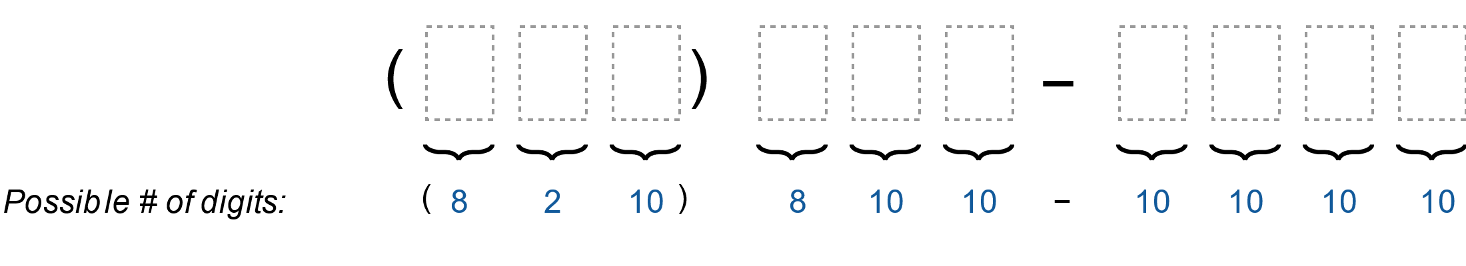
Example 1: Counting Phone Numbers (cont.)
Figure 1: Constructing Allowable Phone Numbers

Slide 7
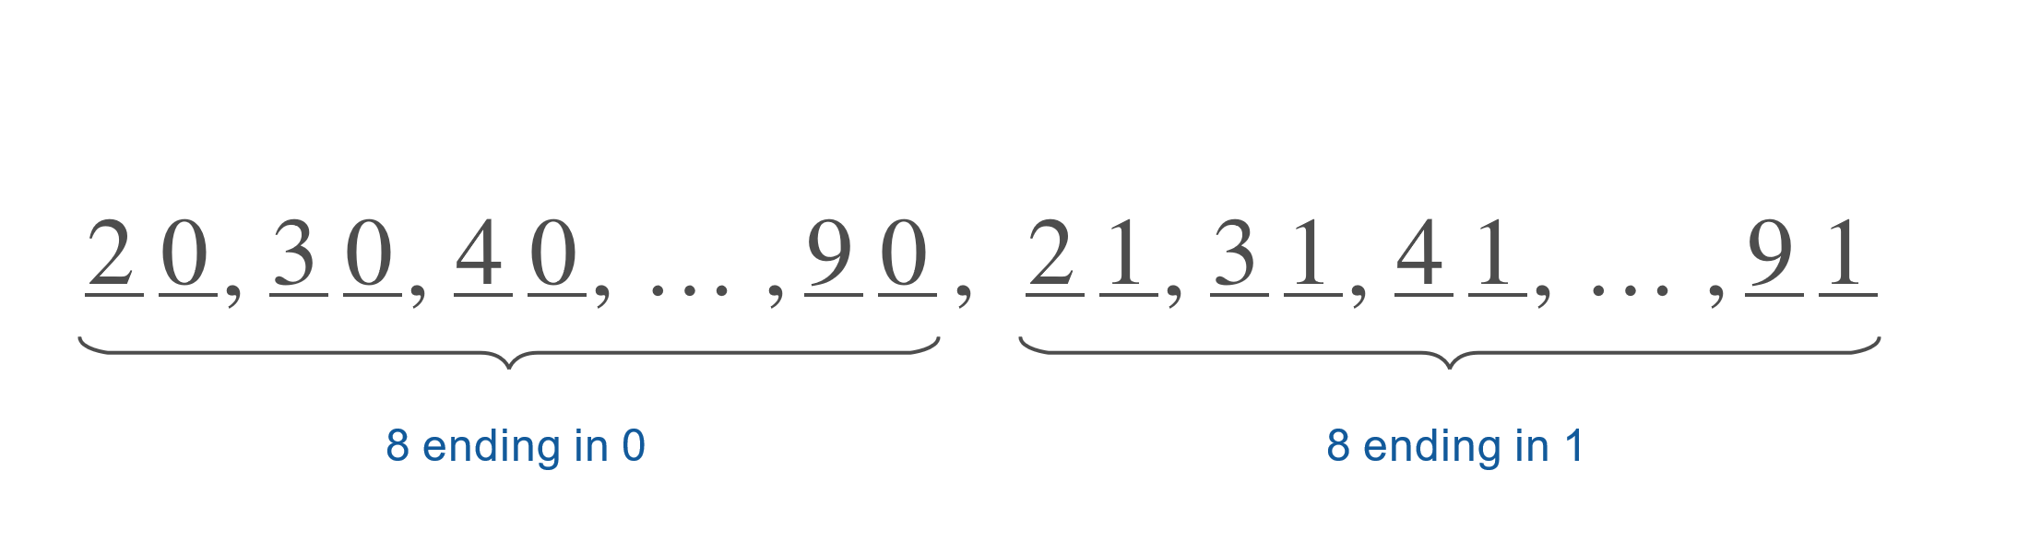
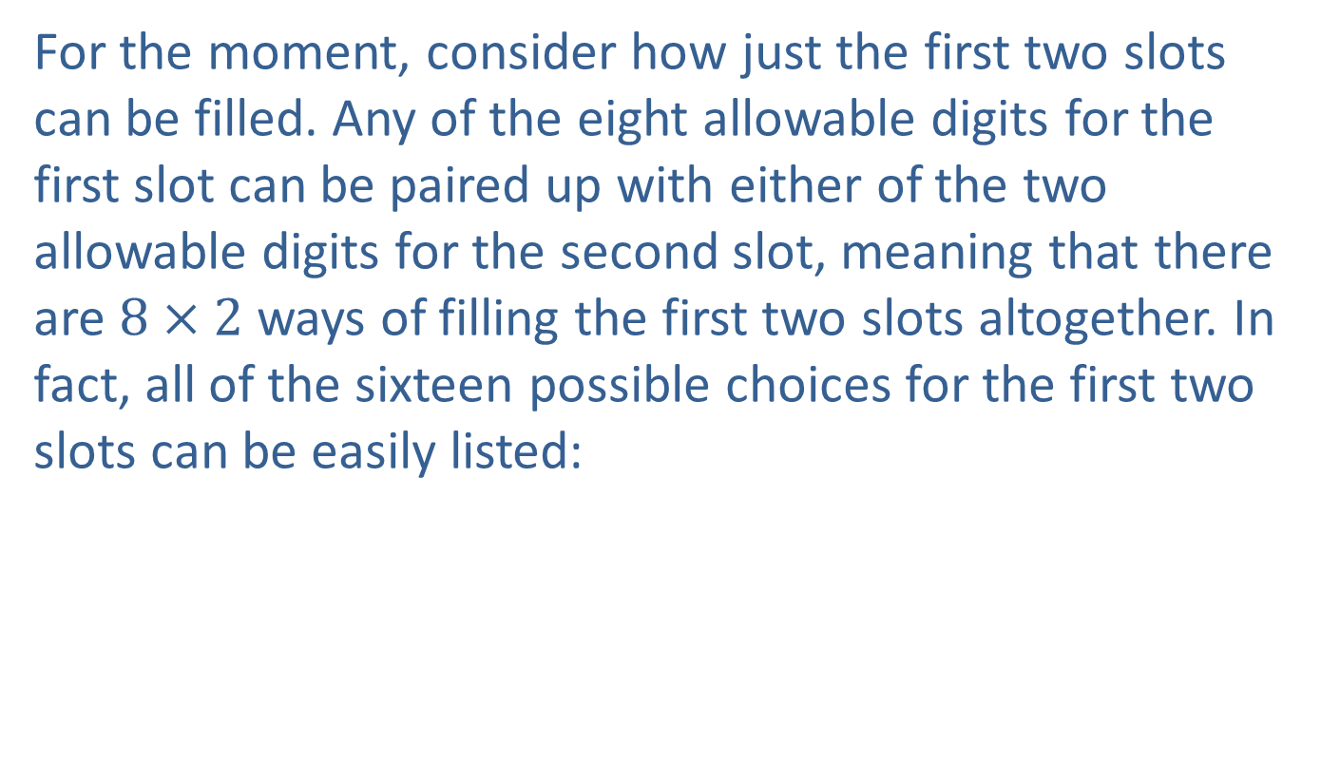
Example 1: Counting Phone Numbers (cont.)
​For the moment, consider how just the first two slots can be filled. Any of the eight allowable digits for the first slot can be paired up with either of the two allowable digits for the second slot, meaning that there are $8×2$ ways of filling the first two slots altogether. In fact, all of the sixteen possible choices for the first two slots can be easily listed:
​

Slide 8
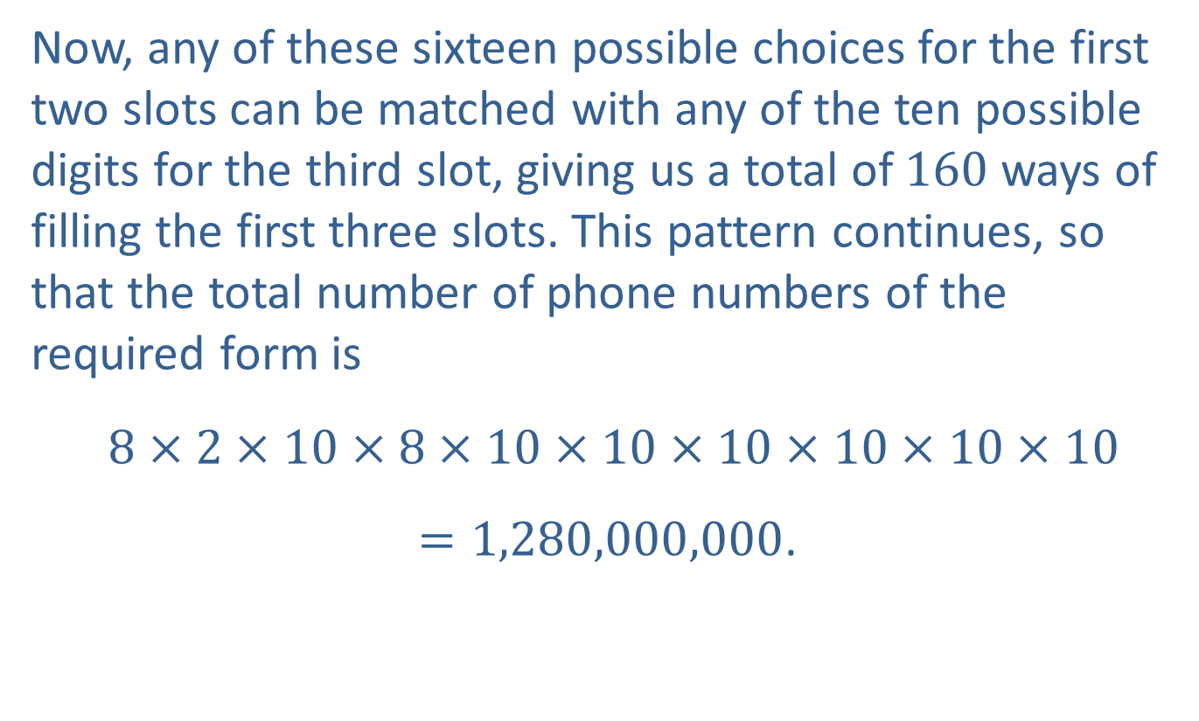
Example 1: Counting Phone Numbers (cont.)
​Now, any of these sixteen possible choices for the first two slots can be matched with any of the ten possible digits for the third slot, giving us a total of 160 ways of filling the first three slots. This pattern continues, so that the total number of phone numbers of the required form is
​ $8×2×10×8×10×10×10×10×10×10=1,280,000,000$.

Slide 9
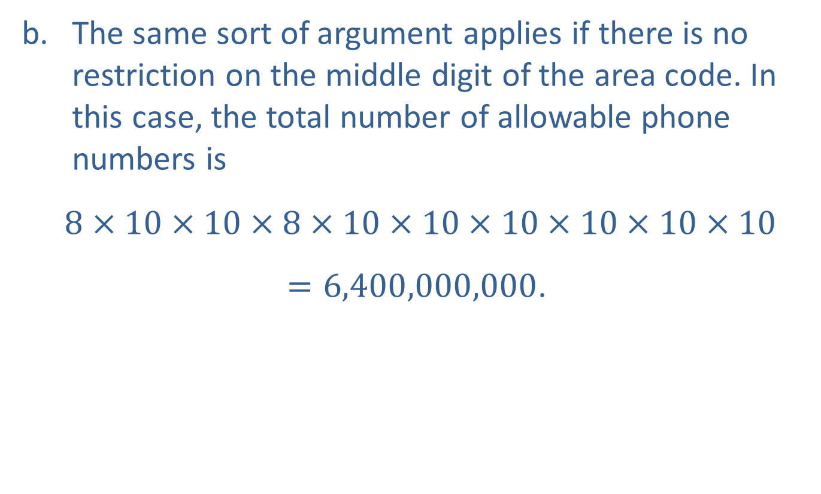
Example 1: Counting Phone Numbers (cont.)
​The same sort of argument applies if there is no restriction on the middle digit of the area code. In this case, the total number of allowable phone numbers is
​ $8×10×10×8×10×10×10×10×10×10$ $=6,400,000,000$.

Slide 10
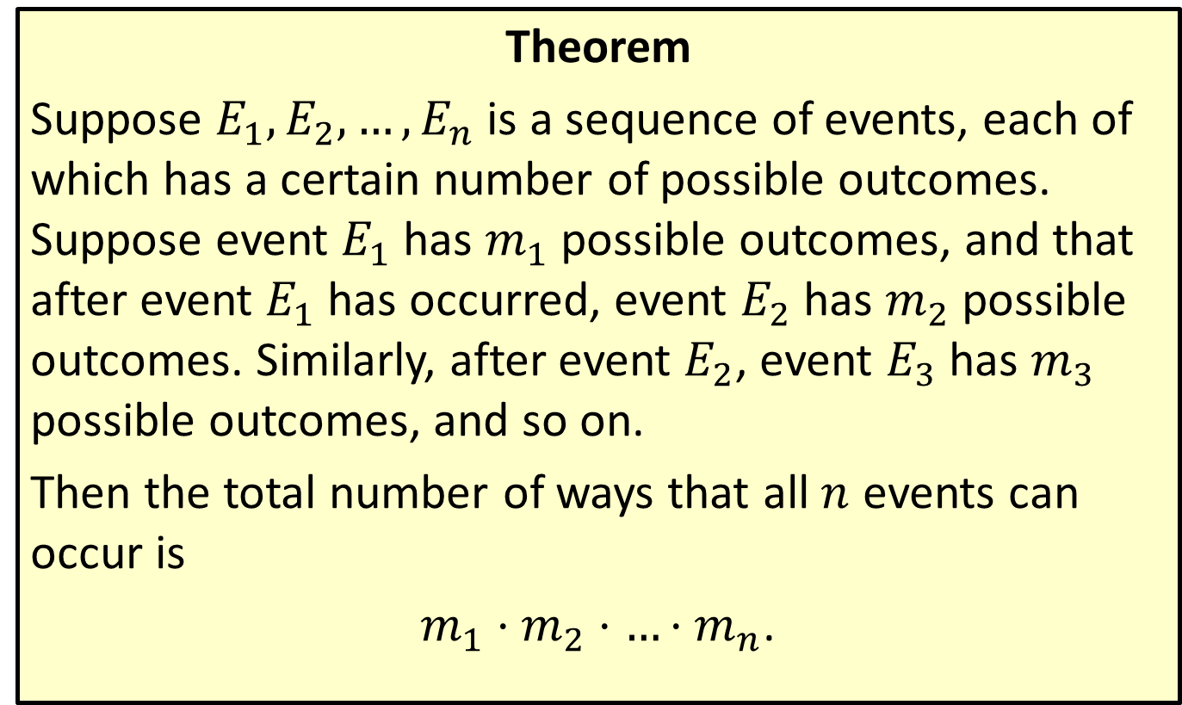
The Multiplication Principle of Counting
Theorem
Suppose $E_{1},E_{2},…,E_{n}$ is a sequence of events, each of which has a certain number of possible outcomes. Suppose event $E_{1}$ has $m_{1}$ possible outcomes, and that after event $E_{1}$ has occurred, event $E_{2}$ has $m_{2}$ possible outcomes. Similarly, after event $E_{2}$, event $E_{3}$ has $m_{3}$ possible outcomes, and so on.
Then the total number of ways that all $n$ events can occur is
$m_{1}⋅m_{2}⋅…⋅m_{n}$.

Slide 11
Example 2: Using the Multiplication Principle of Counting
A certain state specifies that all non-personalized license plates consist of two letters followed by four digits, and that the letter O (which could be mistaken for the digit 0) cannot be used. How many such license plates are there?

Slide 12
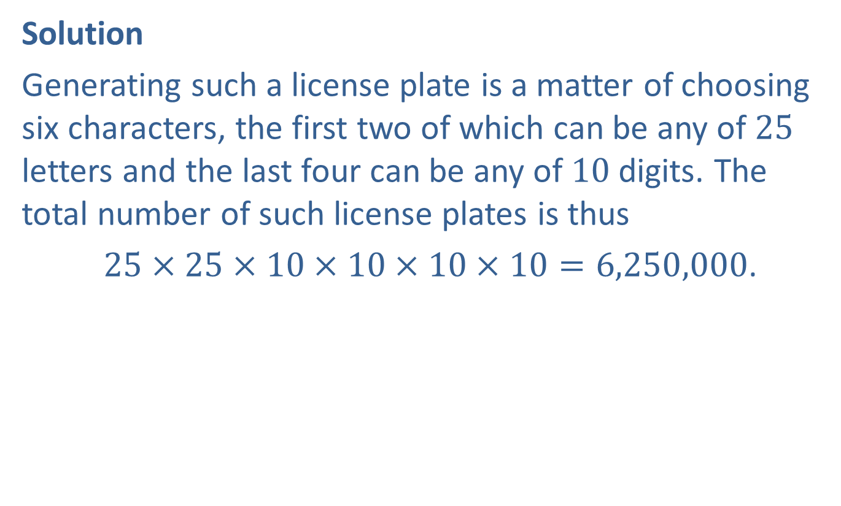
Example 2: Using the Multiplication Principle of Counting (cont.)
Solution
Generating such a license plate is a matter of choosing six characters, the first two of which can be any of 25 letters and the last four can be any of 10 digits. The total number of such license plates is thus
$25×25×10×10×10×10=6,250,000$.

Slide 13
Example 3: Calculating Permutations
One brand of combination lock for a door consists of five buttons labeled A, B, C, D, and E. To unlock the door, each button is pressed once and only once. Given that the installer of the lock can set the combination to be any permutation of the five letters, how many such permutations are there?

Slide 14
Example 3: Calculating Permutations (cont.)
Solution
The difference between this problem and Examples 1 and 2 is that once a letter has been chosen for a given slot, it can't be reused. So in constructing a combination code, there are five choices for the first letter but only four choices for the second letter, since whatever letter was used first cannot be used again.

Slide 15
Example 3: Calculating Permutations (cont.)
Similarly, there are only three choices for the third slot and only two choices for the fourth slot. Finally, whichever of the five letters is left must be used for the fifth slot, so there is only one choice. Figure 2 illustrates the slot-filling process.

Slide 16
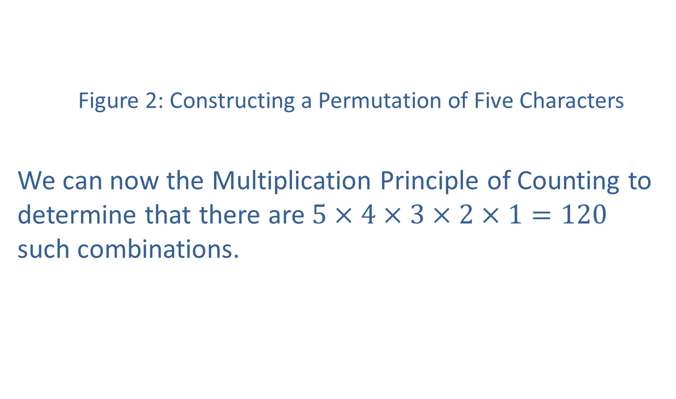
Example 3: Calculating Permutations (cont.)
Figure 2: Constructing a Permutation of Five Characters
We can now the Multiplication Principle of Counting to determine that there are $5×4×3×2×1=120$ such combinations.

Slide 17
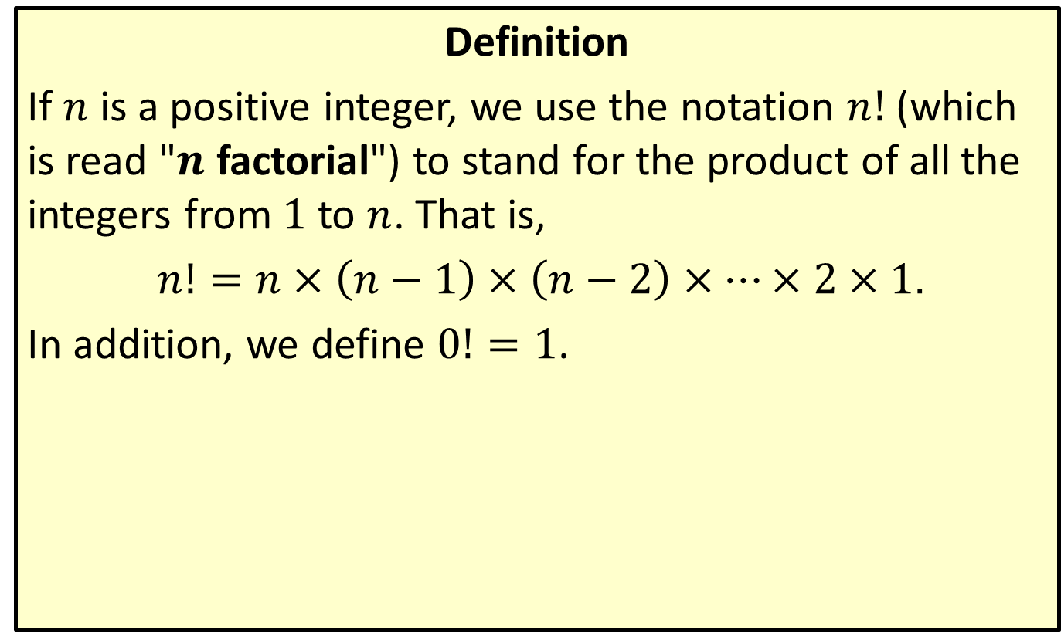
Factorial Notation
Definition
If $n$ is a positive integer, we use the notation $n!$ (which is read "$n$ factorial") to stand for the product of all the integers from 1 to $n$. That is,
$n!=n×\left(n−1\right)×\left(n−2\right)×…×2×1$.
In addition, we define $0!=1$.

Slide 18
CAUTION!
Note that the factorial operation is defined only for positive integers and, as a special case, 0. You may encounter, in a later math class, a related function called the gamma function that extends the factorial idea to all positive real numbers.

Slide 19
Example 4: Calculating Permutations
How many different five-letter combination codes are possible if every letter of the alphabet can be used, but no letter may be repeated?

Slide 20
Example 4: Calculating Permutations (cont.)
Solution
The difference between this problem and the one in Example 3 is that there are now 26 choices for the first letter, 25 choices for the second, and so on. The corresponding "slot diagram" describing the number of ways each slot can be filled appears in Figure 3.

Slide 21
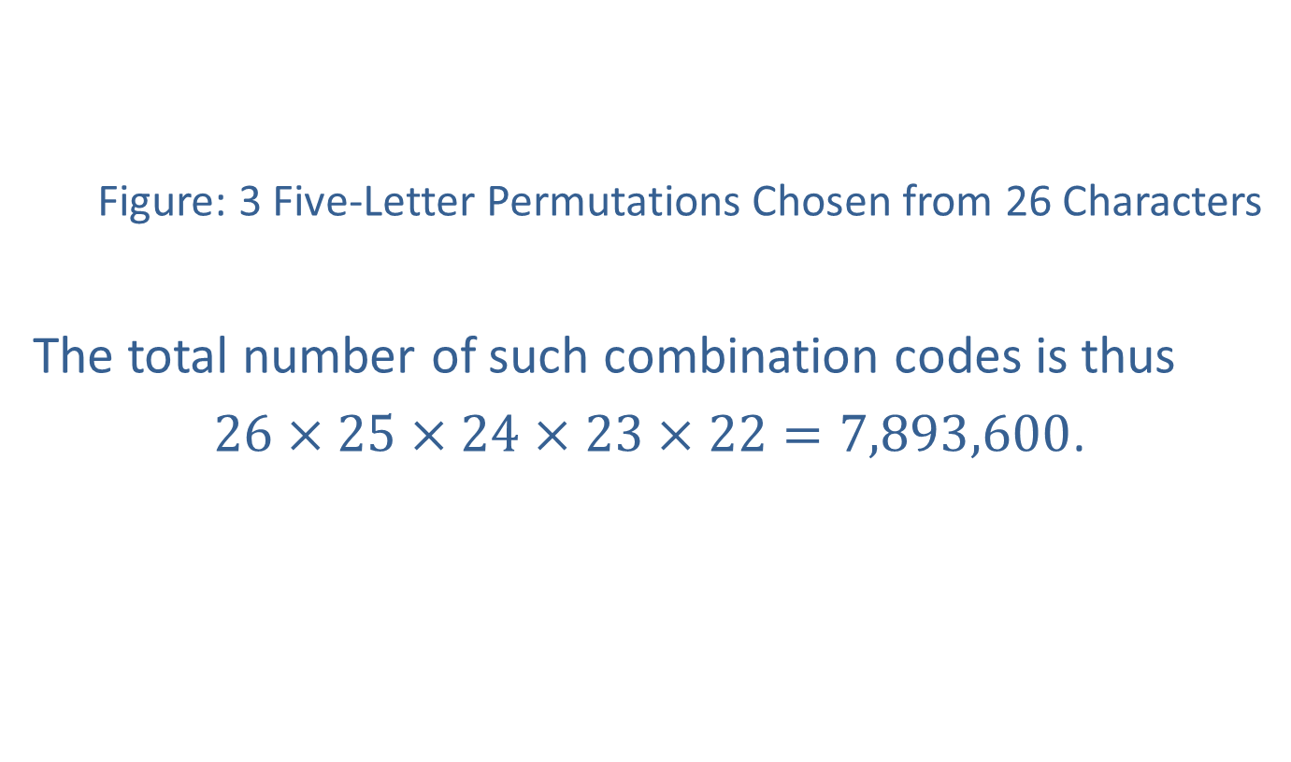
Example 4: Calculating Permutations (cont.)
Figure: 3 Five-Letter Permutations Chosen from 26 Characters
The total number of such combination codes is thus
$26×25×24×23×22=7,893,600$.
$$\begin{matrix}\underbrace{____________} \\ 26 choices\end{matrix}$$ | $$\begin{matrix}\underbrace{____________} \\ 25 choices\end{matrix}$$ | $$\begin{matrix}\underbrace{____________} \\ 24 choices\end{matrix}$$ | $$\begin{matrix}\underbrace{____________} \\ 23 choices\end{matrix}$$ | $$\begin{matrix}\underbrace{____________} \\ 22 choices\end{matrix}$$

Slide 22
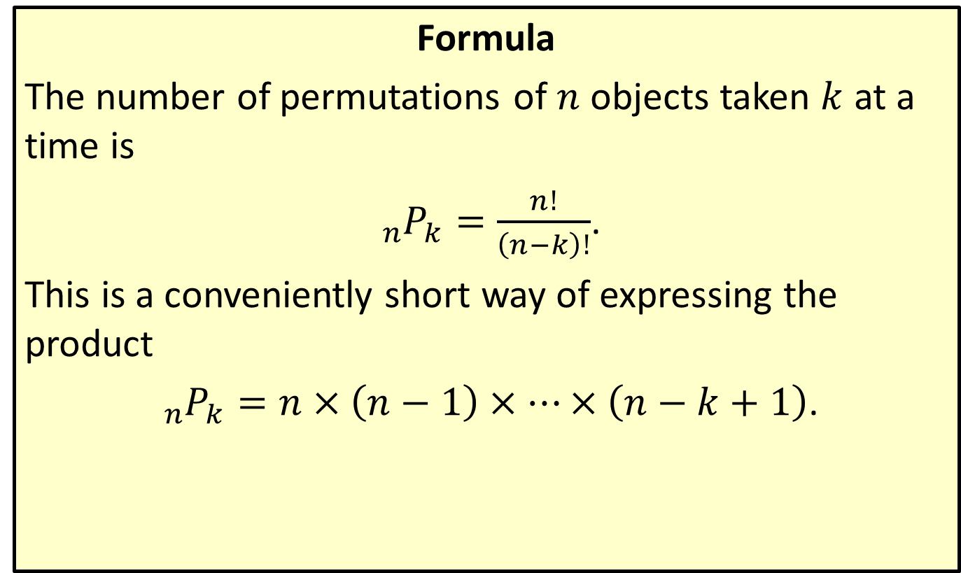
Permutation Formula
Formula
The number of permutations of $n$ objects taken $k$ at a time is
${}_{n}^{ }{P_{k}}=\frac{n!}{\left(n−k\right)!}$.
This is a conveniently short way of expressing the product
${}_{n}^{ }{P_{k}}=n×\left(n−1\right)×…×\left(n−k+1\right)$.

Slide 23
Example 5: Using the Permutation Formula
A magician is preparing to demonstrate a card trick that involves 20 cards chosen at random from a standard deck of cards. Once chosen, the 20 cards are arranged in a row, and the order of the cards plays a role in the trick. How many such orderings are possible?

Slide 24
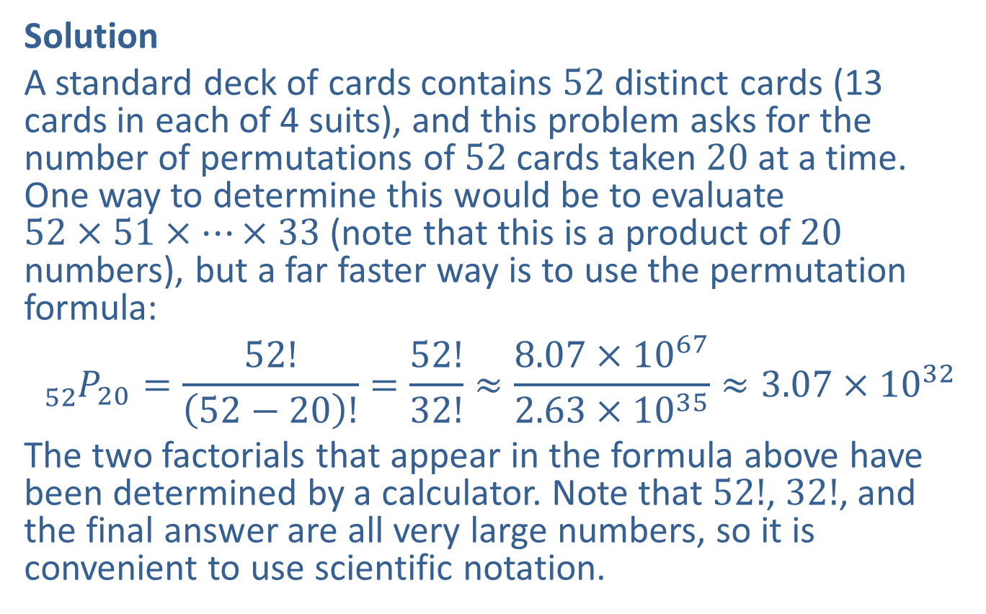
Example 5: Using the Permutation Formula (cont.)
Solution
A standard deck of cards contains 52 distinct cards (13 cards in each of 4 suits), and this problem asks for the number of permutations of 52 cards taken 20 at a time. One way to determine this would be to evaluate $52×51×…×33$ (note that this is a product of 20 numbers), but a far faster way is to use the permutation formula:
$${}_{52}^{ }{P_{20}}=\frac{52!}{\left(52−20\right)!}=\frac{52!}{32!}≈\frac{8.07×{10}^{67}}{2.63×{10}^{35}}≈3.07×{10}^{32}$$
The two factorials that appear in the formula above have been determined by a calculator. Note that $52!$, $32!$, and the final answer are all very large numbers, so it is convenient to use scientific notation.

Slide 25

Example 6: Calculating Permutations and Combinations
Let $S=\left\{a,b,c,d\right\}$.
​How many permutations of size 3 can be formed from the set $S$?
​How many combinations of size 3 can be formed from the set $S$?

Slide 26

Example 6: Calculating Permutations and Combinations (cont.)
Solution
​The number of permutations of 4 objects taken 3 at a time is
${}_{4}^{ }{P_{3}}=\frac{4!}{\left(4−3\right)!}=\frac{4!}{1!}=24$.

Slide 27
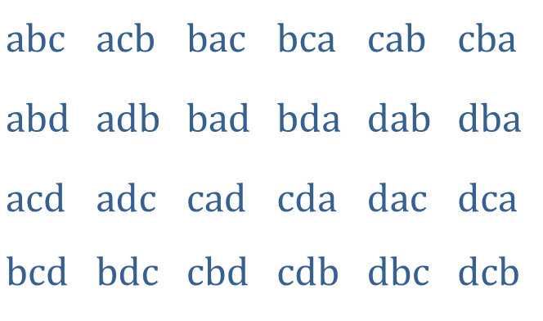
Example 6: Calculating Permutations and Combinations (cont.)
​We have already determined there are 24 permutations of size 3 that can be formed. For the purpose of determining the corresponding number of combinations, it might be useful to actually list out the permutations:
​
​
​$abc$ | ​$acb$ | ​$bac$ | ​$bca$ | ​$cab$ | ​$cba$
​$abd$ | ​$adb$ | ​$bad$ | ​$bda$ | ​$dab$ | ​$dba$
​$acd$ | ​$adc$ | ​$cad$ | ​$cda$ | ​$dac$ | ​$dca$
​$bcd$ | ​$bdc$ | ​$cbd$ | ​$cdb$ | ​$dbc$ | ​$dcb$

Slide 28
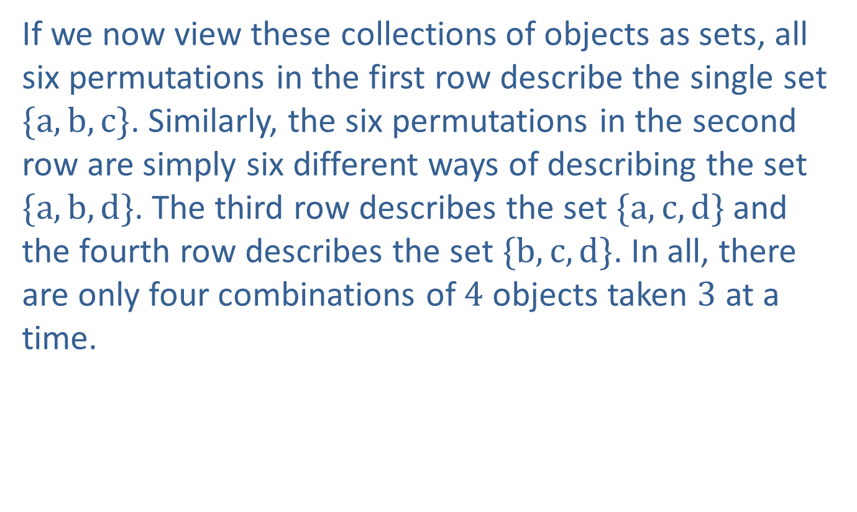
Example 6: Calculating Permutations and Combinations (cont.)
​If we now view these collections of objects as sets, all six permutations in the first row describe the single set $\{a,b,c\}$. Similarly, the six permutations in the second row are simply six different ways of describing the set $\{a,b,d\}$. The third row describes the set $\{a,c,d\}$ and the fourth row describes the set $\{b,c,d\}$. In all, there are only four combinations of 4 objects taken 3 at a time.

Slide 29
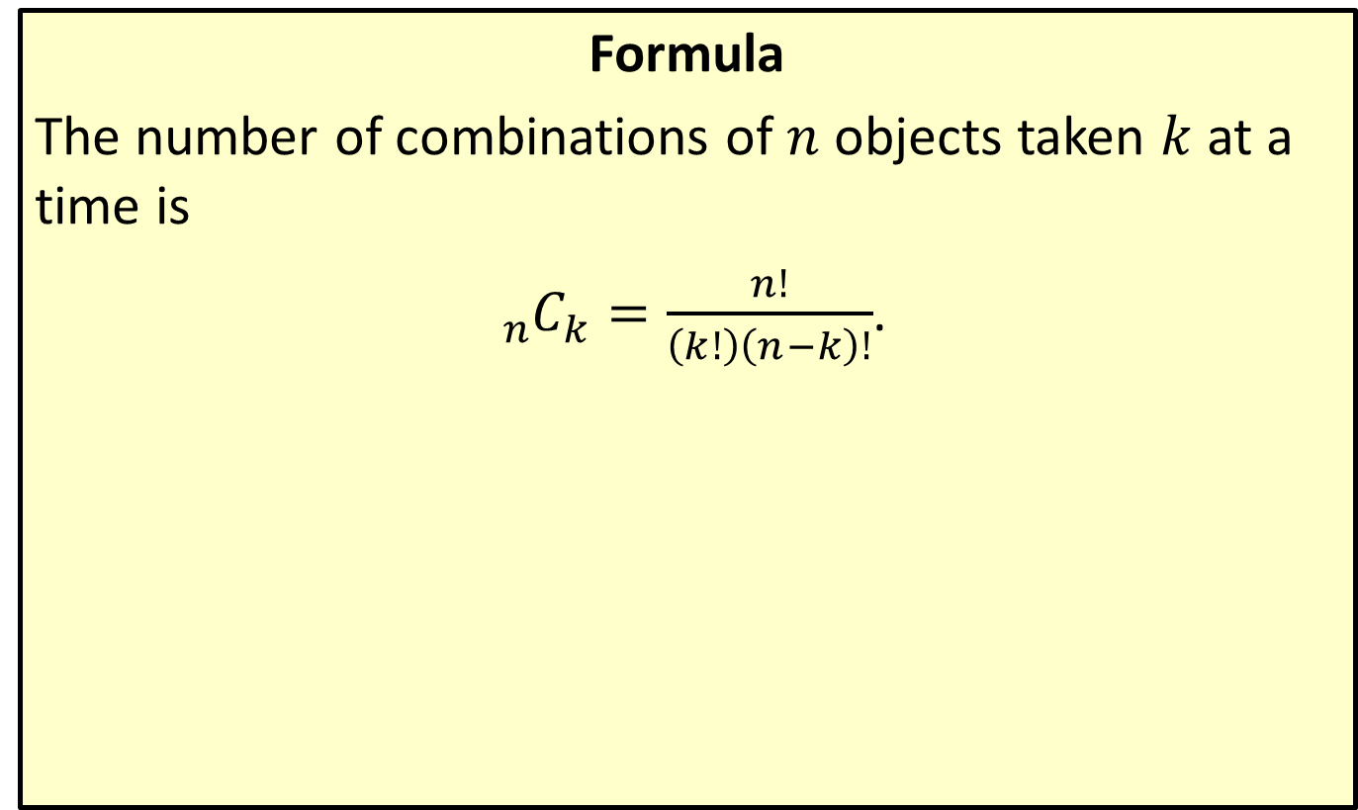
Combination Formula
Formula
The number of combinations of $n$ objects taken $k$ at a time is
${}_{n}^{ }{C_{k}}=\frac{n!}{\left(k!\right)\left(n−k\right)!}$.

Slide 30
Example 7: The Combination Formula and Forming Committees
Suppose a Senate committee consists of 11 Democrats, 10 Republicans, and 1 Independent. The chair of the committee wants to form a subcommittee to be charged with researching a particular issue, and decides to appoint 3 Democrats, 2 Republicans, and the 1 Independent to the subcommittee. How many different subcommittees are possible?

Slide 31
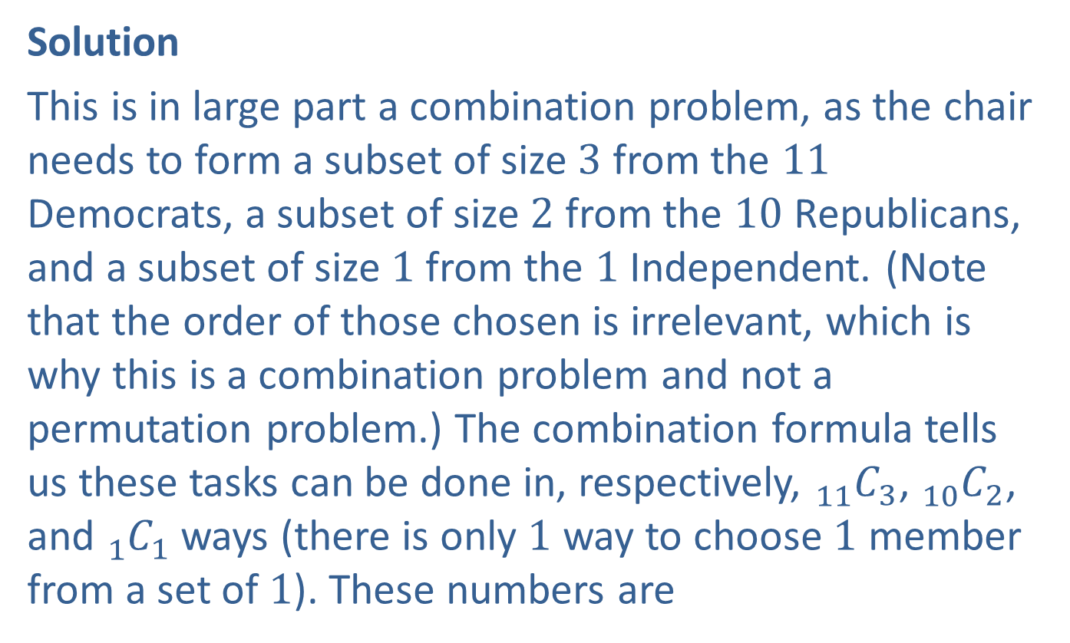
Example 7: The Combination Formula and Forming Committees (cont.)
Solution
This is in large part a combination problem, as the chair needs to form a subset of size 3 from the 11 Democrats, a subset of size 2 from the 10 Republicans, and a subset of size 1 from the 1 Independent. (Note that the order of those chosen is irrelevant, which is why this is a combination problem and not a permutation problem.) The combination formula tells us these tasks can be done in, respectively, ${}_{11}^{ }{C_{3}}$, ${}_{10}^{ }{C_{2}}$, and ${}_{1}^{ }{C_{1}}$ ways (there is only 1 way to choose 1 member from a set of 1). These numbers are

Slide 32
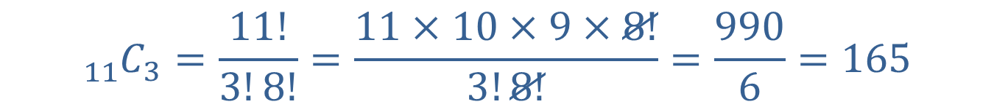


Example 7: The Combination Formula and Forming Committees (cont.)
$${}_{1}^{ }{C_{1}}=\frac{1!}{1!0!}=\frac{1}{1}=1 \text{(}\text{remember} \text{that} 0!=1\text{)}$$
$${}_{11}^{ }{C_{3}}=\frac{11!}{3!8!}=\frac{11×10×9×8!}{3!8!}=\frac{990}{6}=165$$
$${}_{10}^{ }{C_{2}}=\frac{10!}{2!8!}=\frac{10×9×8!}{2!8!}=\frac{90}{2}=45$$

Slide 33
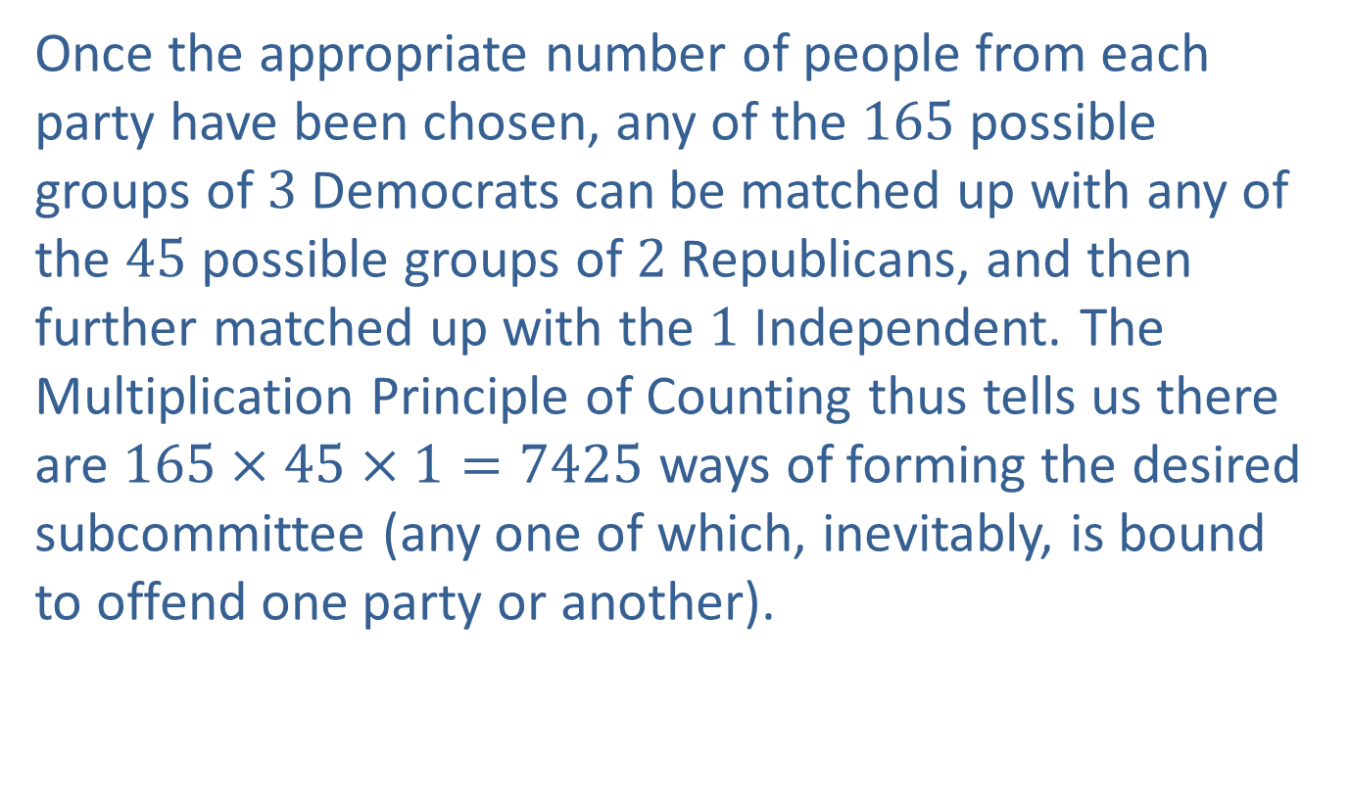
Example 7: The Combination Formula and Forming Committees (cont.)
Once the appropriate number of people from each party have been chosen, any of the 165 possible groups of 3 Democrats can be matched up with any of the 45 possible groups of 2 Republicans, and then further matched up with the 1 Independent. The Multiplication Principle of Counting thus tells us there are $165×45×1=7425$ ways of forming the desired subcommittee (any one of which, inevitably, is bound to offend one party or another).

Slide 34
Example 8: Counting Rules and Forming "Words"
How many different arrangements are there of the letters in the following words?
​STIPEND
​SALAAM
​MISSISSIPPI

Slide 35
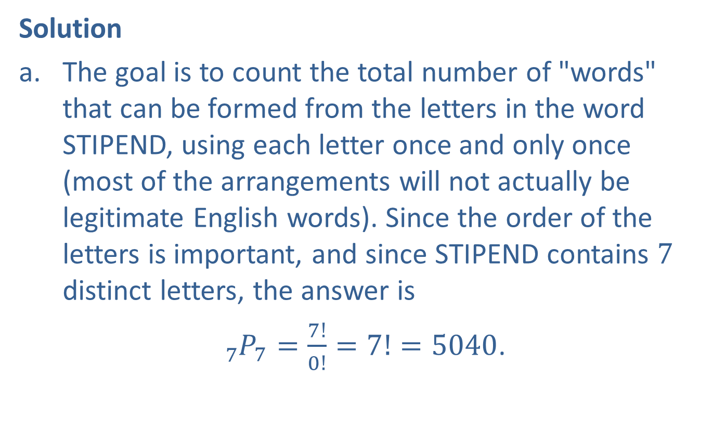
Example 8: Counting Rules and Forming "Words" (cont.)
Solution
​The goal is to count the total number of "words" that can be formed from the letters in the word STIPEND, using each letter once and only once (most of the arrangements will not actually be legitimate English words). Since the order of the letters is important, and since STIPEND contains 7 distinct letters, the answer is
​ ${}_{7}^{ }{P_{7}}=\frac{7!}{0!}=7!=5040$.

Slide 36
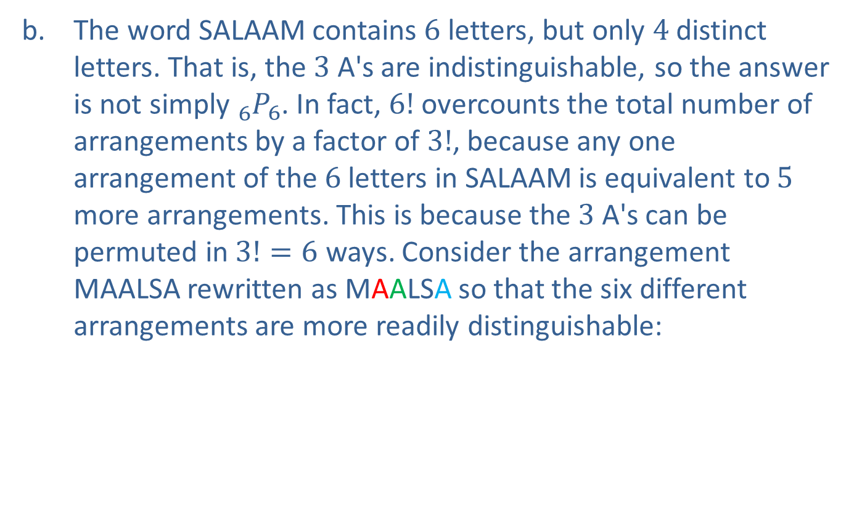
Example 8: Counting Rules and Forming "Words" (cont.)
​The word SALAAM contains 6 letters, but only 4 distinct letters. That is, the 3 A's are indistinguishable, so the answer is not simply ${}_{6}^{ }{P_{6}}$. In fact, $6!$ overcounts the total number of arrangements by a factor of $3!$, because any one arrangement of the 6 letters in SALAAM is equivalent to 5 more arrangements. This is because the 3 A's can be permuted in $3!=6$ ways. Consider the arrangement MAALSA rewritten as MAALSA so that the six different arrangements are more readily distinguishable:
​

Slide 37

Example 8: Counting Rules and Forming "Words" (cont.)
​This means the total number of arrangements is actually
​ $\frac{6!}{3!}=\frac{720}{6}=120$.

Slide 38
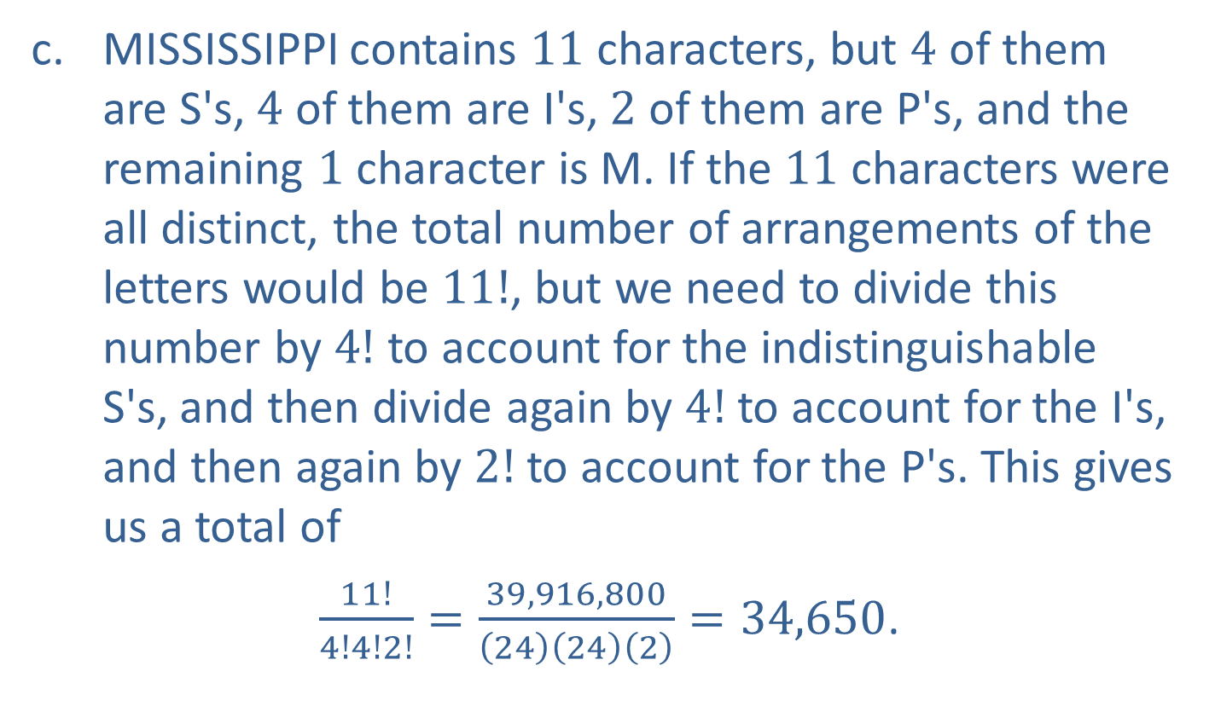
Example 8: Counting Rules and Forming "Words" (cont.)
​MISSISSIPPI contains 11 characters, but 4 of them are S's, 4 of them are I's, 2 of them are P's, and the remaining 1 character is M. If the 11 characters were all distinct, the total number of arrangements of the letters would be $11!$, but we need to divide this number by $4!$ to account for the indistinguishable S's, and then divide again by $4!$ to account for the I's, and then again by $2!$ to account for the P's. This gives us a total of
​ $\frac{11!}{4!4!2!}=\frac{39,916,800}{\left(24\right)\left(24\right)\left(2\right)}=34,650$.

Slide 39
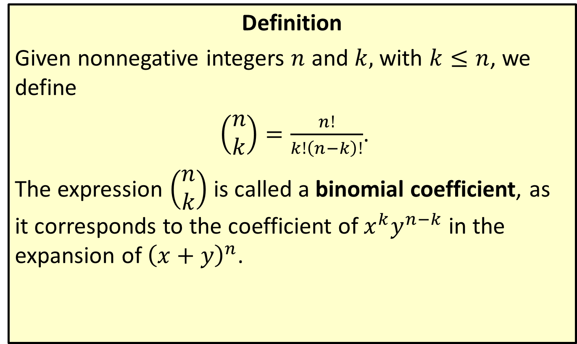
Binomial Coefficients
Definition
Given nonnegative integers $n$ and $k,$ with $k≤n$, we define
$\left(\begin{aligned}n \\ k\end{aligned}\right)=\frac{n!}{k!\left(n−k\right)!}$.
The expression $\left(\begin{aligned}n \\ k\end{aligned}\right)$ is called a binomial coefficient, as it corresponds to the coefficient of $x^{k}y^{n−k}$ in the expansion of ${\left(x+y\right)}^{n}$.

Slide 40

Example 9: Constructing a Binomial Expansion
Expand the expression ${\left(x+y\right)}^{7}$.

Slide 41
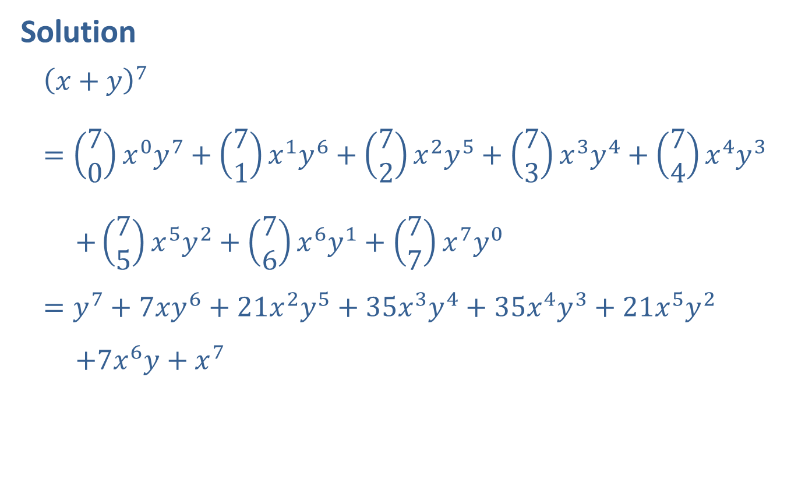
Example 9: Constructing a Binomial Expansion (cont.)
Solution
$${\left(x+y\right)}^{7}=\left(\begin{aligned}7 \\ 0\end{aligned}\right)x^{0}y^{7}+\left(\begin{aligned}7 \\ 1\end{aligned}\right)x^{1}y^{6}+\left(\begin{aligned}7 \\ 2\end{aligned}\right)x^{2}y^{5}+{\left(\begin{aligned}7 \\ 3\end{aligned}\right)x}^{3}y^{4}+\left(\begin{aligned}7 \\ 4\end{aligned}\right)x^{4}y^{3} \\ +\left(\begin{aligned}7 \\ 5\end{aligned}\right)x^{5}y^{2}+\left(\begin{aligned}7 \\ 6\end{aligned}\right)x^{6}y^{1}+\left(\begin{aligned}7 \\ 7\end{aligned}\right)x^{7}y^{0} \\ =y^{7}+7xy^{6}+21x^{2}y^{5}+35x^{3}y^{4}+35x^{4}y^{3}+21x^{5}y^{2} \\ +7x^{6}y+x^{7}$$

Slide 42
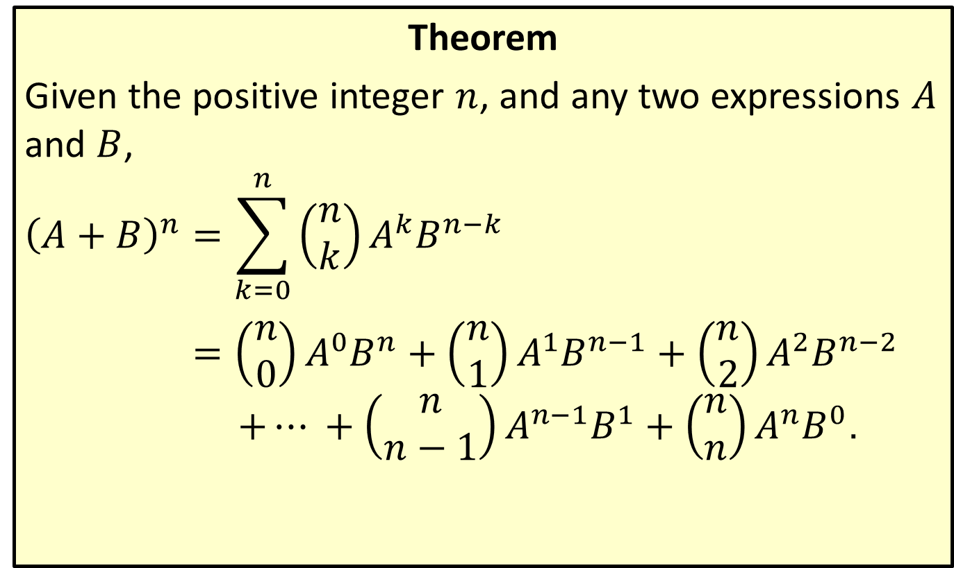
The Binomial Theorem
Theorem
Given the positive integer $n$, and any two expressions $A$ and $B$,
$${\left(A+B\right)}^{n}=\sum_{k=0}^{n}{\left(\begin{aligned}n \\ k\end{aligned}\right)A^{k}B^{n−k}}$$ $=\left(\begin{aligned}n \\ 0\end{aligned}\right)A^{0}B^{n}+\left(\begin{aligned}n \\ 1\end{aligned}\right)A^{1}B^{n−1}+\left(\begin{aligned}n \\ 2\end{aligned}\right)A^{2}B^{n−2}$ $$+… +\left(\begin{aligned}n \\ n−1\end{aligned}\right)A^{n−1}B^{1}+\left(\begin{aligned}n \\ n\end{aligned}\right)A^{n}B^{0}\text{.}$$

Slide 43

Example 10: Using the Binomial Theorem
Expand the expression ${\left(2x−y\right)}^{4}$.

Slide 44
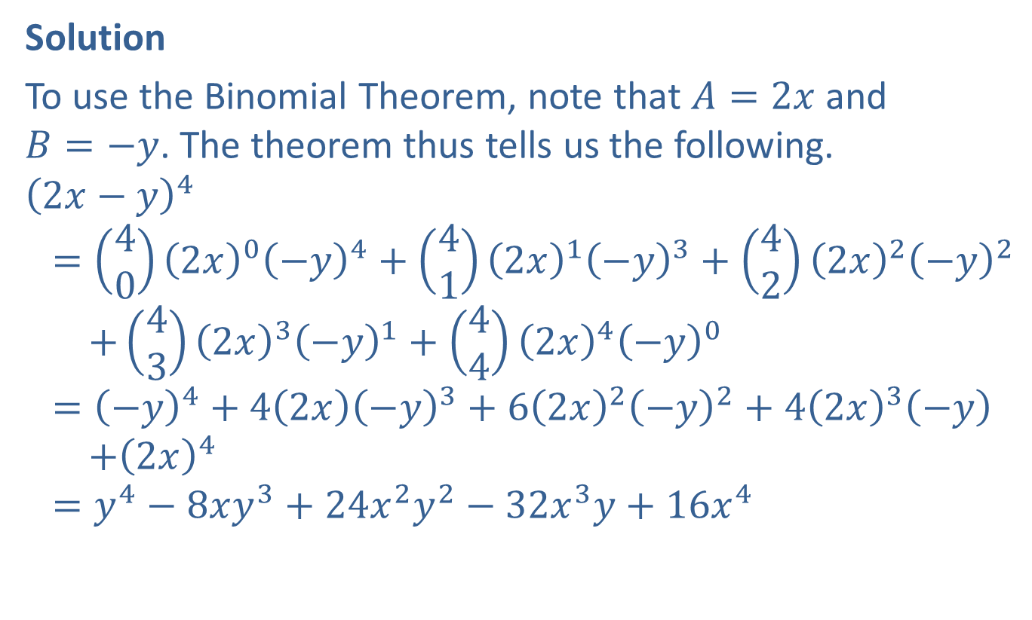
Example 10: Using the Binomial Theorem (cont.)
Solution
To use the Binomial Theorem, note that $A=2x$ and $B=−y$. The theorem thus tells us the following.
$${\left(2x−y\right)}^{4} \\ =\left(\begin{aligned}4 \\ 0\end{aligned}\right){\left(2x\right)}^{0}{\left(−y\right)}^{4}+\left(\begin{aligned}4 \\ 1\end{aligned}\right){\left(2x\right)}^{1}{\left(−y\right)}^{3}+\left(\begin{aligned}4 \\ 2\end{aligned}\right){\left(2x\right)}^{2}{\left(−y\right)}^{2} \\ +\left(\begin{aligned}4 \\ 3\end{aligned}\right){\left(2x\right)}^{3}{\left(−y\right)}^{1}+\left(\begin{aligned}4 \\ 4\end{aligned}\right){\left(2x\right)}^{4}{\left(−y\right)}^{0} \\ ={\left(−y\right)}^{4}+4\left(2x\right){\left(−y\right)}^{3}+6{\left(2x\right)}^{2}{\left(−y\right)}^{2}+4{\left(2x\right)}^{3}\left(−y\right) \\ +{\left(2x\right)}^{4} \\ =y^{4}−8xy^{3}+24x^{2}y^{2}−32x^{3}y+16x^{4}$$

Slide 45
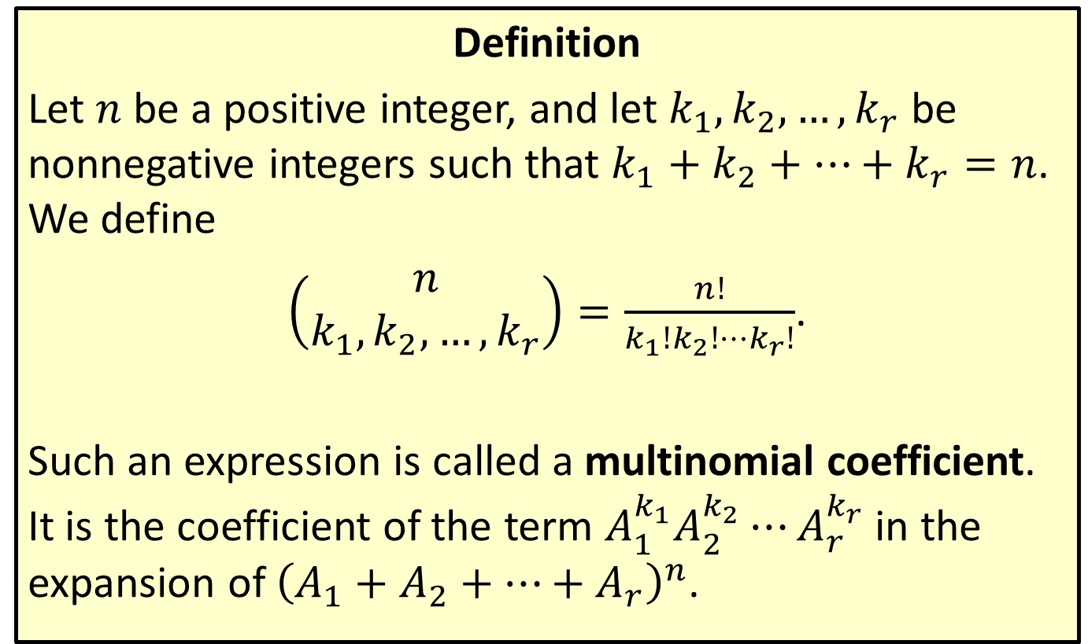
Multinomial Coefficients
Definition
Let $n$ be a positive integer, and let $k_{1},k_{2},…,k_{r}$ be nonnegative integers such that $k_{1}+k_{2}+…+k_{r}=n$. We define
$\left(\begin{aligned}n \\ k_{1},k_{2},…,k_{r}\end{aligned}\right)=\frac{n!}{k_{1}!k_{2}!⋯k_{r}!}$.
Such an expression is called a multinomial coefficient. It is the coefficient of the term $A_{1}^{k_{1}}A_{2}^{k_{2}}⋯A_{r}^{k_{r}}$ in the expansion of ${\left(A_{1}+A_{2}+…+A_{r}\right)}^{n}$.

Slide 46
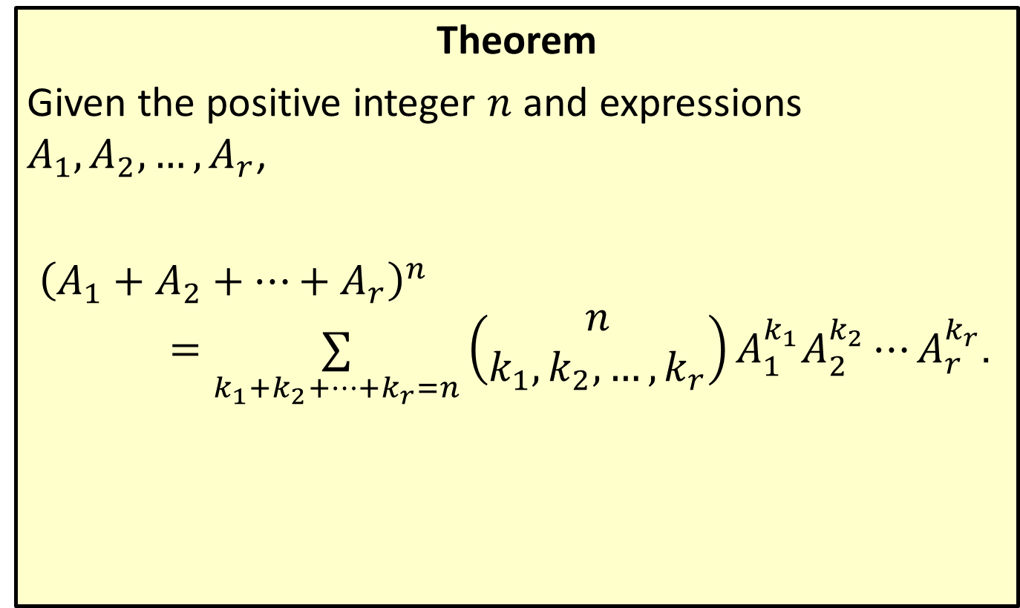
The Multinomial Theorem
Theorem
Given the positive integer $n$ and expressions $A_{1},A_{2},…,A_{r}$,
${\left(A_{1}+A_{2}+…+A_{r}\right)}^{n}$ $=\underset{k_{1}+k_{2}+…+k_{r}=n}{∑}\left(\begin{aligned}n \\ k_{1},k_{2},…,k_{r}\end{aligned}\right)A_{1}^{k_{1}}A_{2}^{k_{2}}⋯A_{r}^{k_{r}}$.

Slide 47

Example 11: Using the Multinomial Theorem
Expand the expression ${\left(a+b+c\right)}^{3}$.

Slide 48
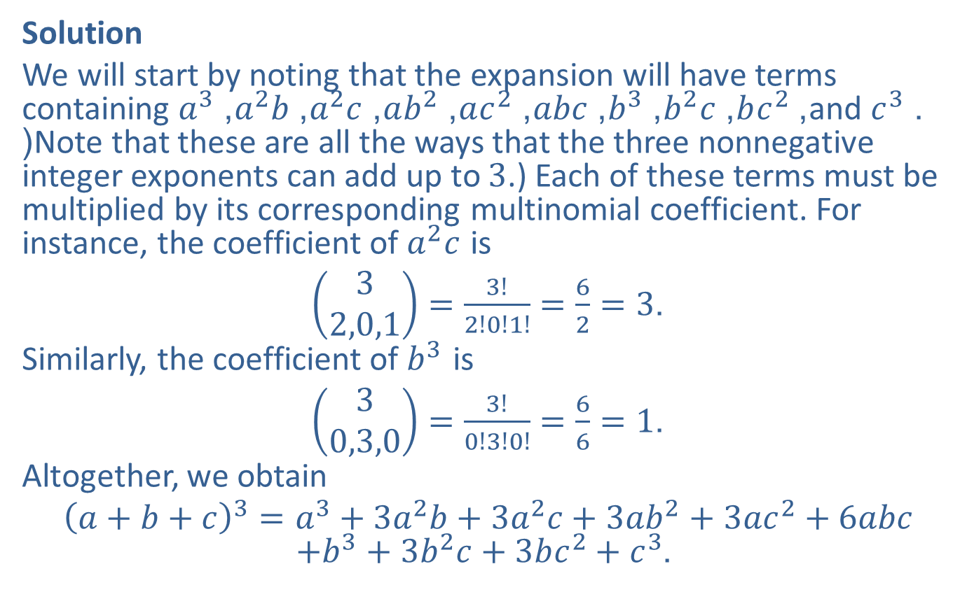
Example 11: Using the Multinomial Theorem (cont.)
Solution
We will start by noting that the expansion will have terms containing $a^{3}$, $a^{2}b$, $a^{2}c$, $ab^{2}$, $ac^{2}$, $abc$, $b^{3}$, $b^{2}c$, $bc^{2}$, and $c^{3}$. (Note that these are all the ways that the three nonnegative integer exponents can add up to 3.) Each of these terms must be multiplied by its corresponding multinomial coefficient. For instance, the coefficient of $a^{2}c$ is
$\left(\begin{aligned}3 \\ 2,0,1\end{aligned}\right)=\frac{3!}{2!0!1!}=\frac{6}{2}=3$.
Similarly, the coefficient of $b^{3}$ is
$\left(\begin{aligned}3 \\ 0,3,0\end{aligned}\right)=\frac{3!}{0!3!0!}=\frac{6}{6}=1$.
Altogether, we obtain
${\left(a+b+c\right)}^{3}=a^{3}+3a^{2}b+3a^{2}c+3ab^{2}+3ac^{2}+6abc$ $+b^{3}+3b^{2}c+3bc^{2}+c^{3}$.

