Slide 1
Section 2.1
Linear Equations in One Variable

Slide 2
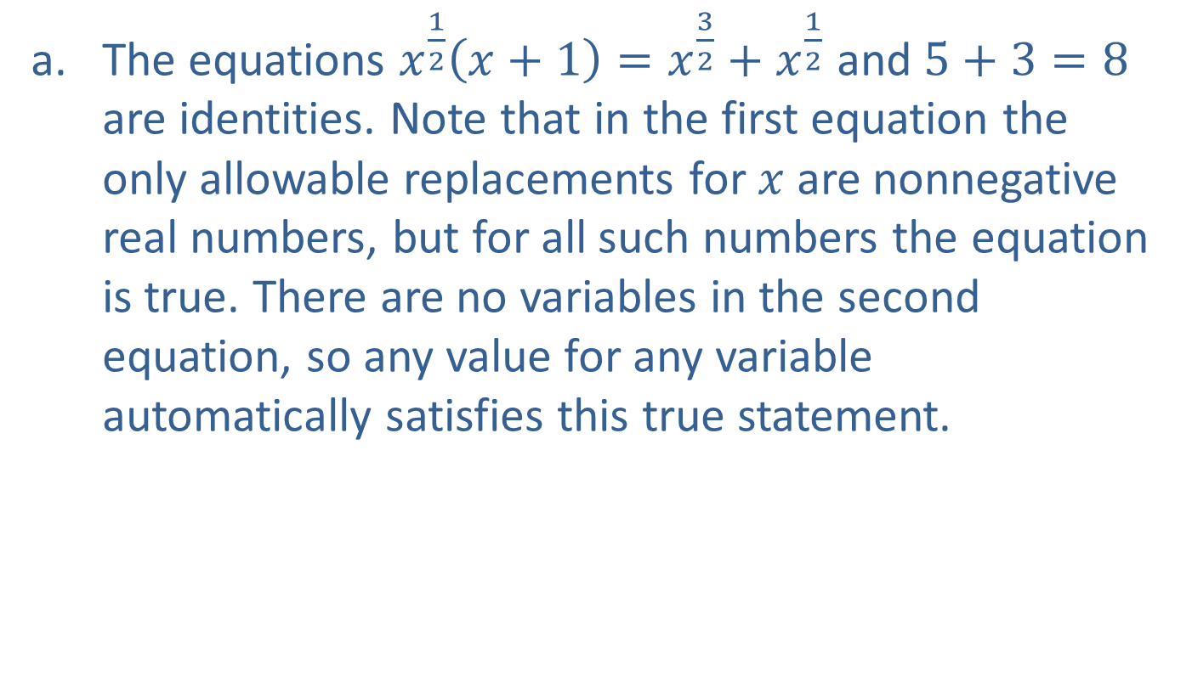
Example 1: Identifying Types of Equations
​The equations $x^{\frac{1}{2}}\left(x+1\right)=x^{\frac{3}{2}}+x^{\frac{1}{2}}$ and $5+3=8$ are identities. Note that in the first equation the only allowable replacements for $x$ are nonnegative real numbers, but for all such numbers the equation is true. There are no variables in the second equation, so any value for any variable automatically satisfies this true statement.

Slide 3
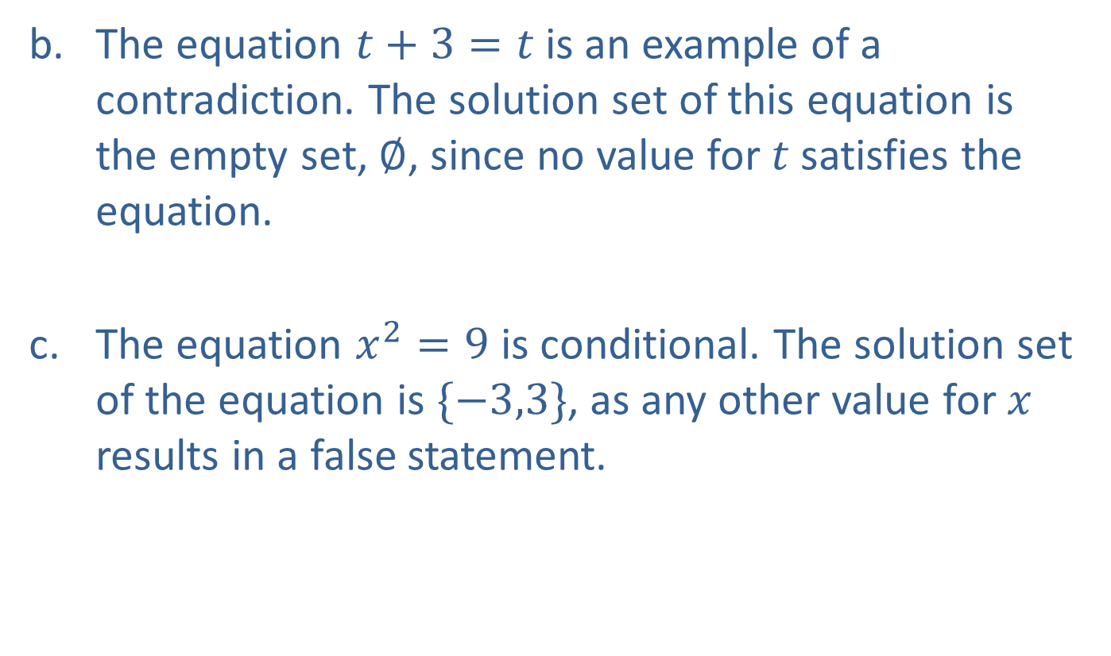
Example 1: Identifying Types of Equations (cont.)
​The equation $t+3=t$ is an example of a contradiction. The solution set of this equation is the empty set, $∅$, since no value for $t$ satisfies the equation.
The equation $x^{2}=9$ is conditional. The solution set of the equation is $\{−3,3\}$, as any other value for $x$ results in a false statement.

Slide 4
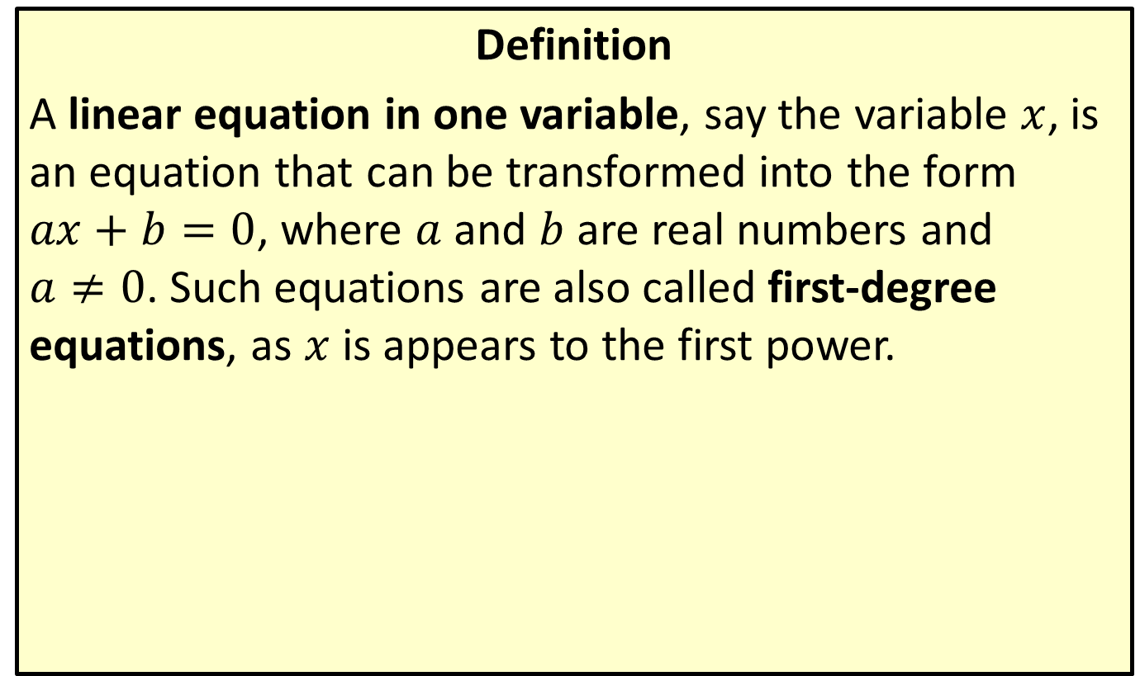
Linear Equations in One Variable
Definition
A linear equation in one variable, say the variable $x$, is an equation that can be transformed into the form $ax+b=0$, where $a$ and $b$ are real numbers and
$a≠0$. Such equations are also called first-degree equations, as $x$ is appears to the first power.

Slide 5
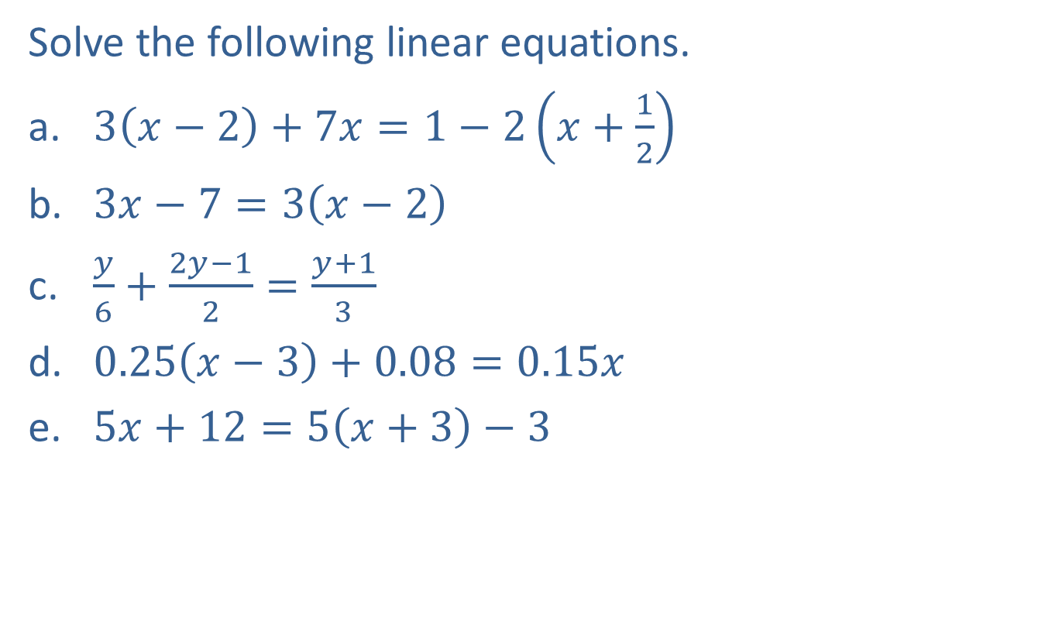
Example 2: Solving Linear Equations in One Variable
Solve the following linear equations.
​$3\left(x−2\right)+7x=1−2\left(x+\frac{1}{2}\right)$
​$3x−7=3\left(x−2\right)$
​$\frac{y}{6}+\frac{2y−1}{2}=\frac{y+1}{3}$
​$0.25\left(x−3\right)+0.08=0.15x$
​$5x+12=5\left(x+3\right)−3$

Slide 6
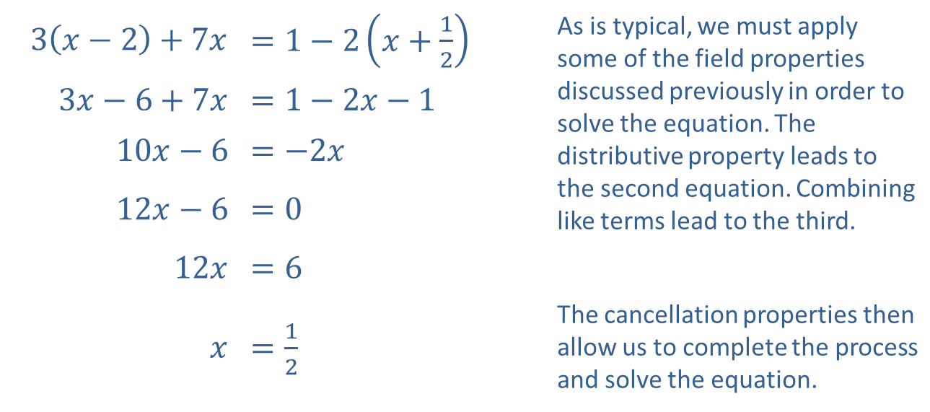
Example 2: Solving Linear Equations in One Variable (cont.)
Solution
​
​$3\left(x−2\right)+7x$ | ​$=1−2\left(x+\frac{1}{2}\right)$ | As is typical, we must apply some of the field properties discussed previously in order to solve the equation. The distributive property leads to the second equation. Combining like terms lead to the third.
​$3x−6+7x$ | ​$=1−2x−1$
​$10x−6$ | ​$=−2x$
​$12x−6$ | ​$=0$
​$12x$ | ​$=6$
$x$ | ​$=\frac{1}{2}$ | The cancellation properties then allow us to complete the process and solve the equation.

Slide 7

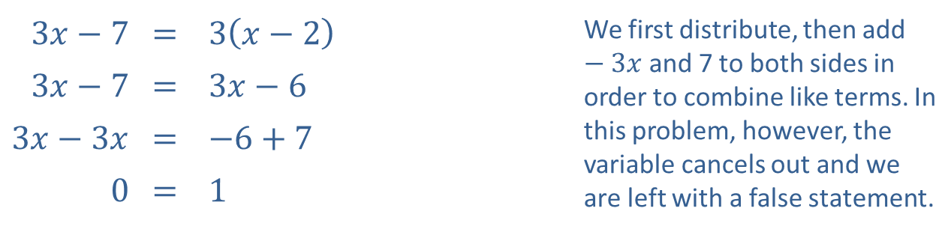
Example 2: Solving Linear Equations in One Variable (cont.)
​
​$3x−7$ | ​= | ​$3\left(x−2\right)$ | We first distribute, then add $−3x$ and 7 to both sides in order to combine like terms. In this problem, however, the variable cancels out and we are left with a false statement.
​$3x−7$ | ​= | ​$3x−6$
​$3x−3x$ | ​= | ​$−6+7$
​0 | ​= | ​1
​Thus, the equation is a contradiction and has no solutions. The solution set is the empty set, $∅$.

Slide 8
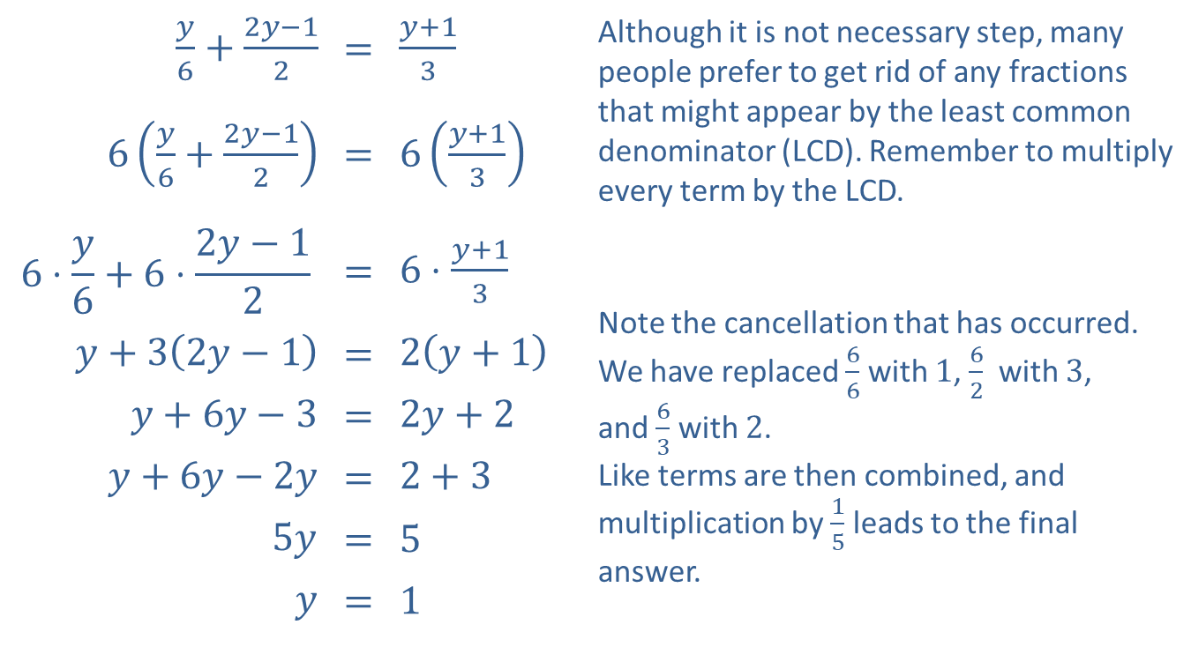
Example 2: Solving Linear Equations in One Variable (cont.)
​
$\frac{y}{6}+\frac{2y−1}{2}$ | = | $\frac{y+1}{3}$ | Although it is not necessary step, many people prefer to get rid of any fractions that might appear by the least common denominator (LCD). Remember to multiply every term by the LCD.
$6\left(\frac{y}{6}+\frac{2y−1}{2}\right)$ | = | $6\left(\frac{y+1}{3}\right)$
$$6⋅\frac{y}{6}+6⋅\frac{2y−1}{2}$$ | = | $6⋅\frac{y+1}{3}$ | Note the cancellation that has occurred. We have replaced $\frac{6}{6}$ with 1, $\frac{6}{2}$ with 3, and $\frac{6}{3}$ with 2. Like terms are then combined, and multiplication by $\frac{1}{5}$ leads to the final answer.
$y+3\left(2y−1\right)$ | = | $2\left(y+1\right)$
$y+6y−3$ | = | $2y+2$
$y+6y−2y$ | = | $2+3$
$5y$ | = | 5
$y$ | = | 1

Slide 9
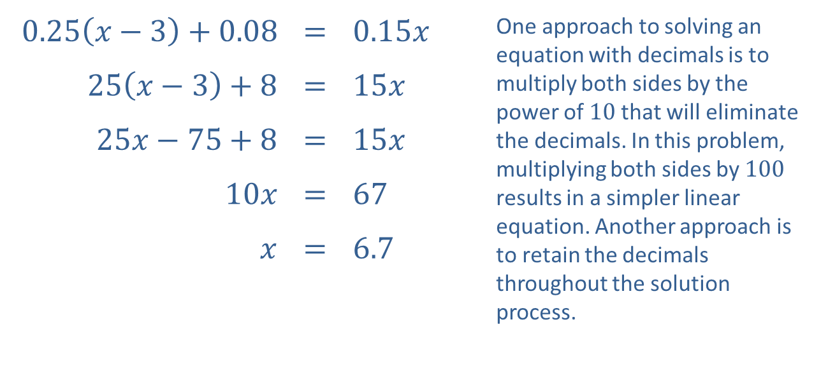
Example 2: Solving Linear Equations in One Variable (cont.)
​
​$0.25\left(x−3\right)+0.08$ | ​= | ​$0.15x$ | One approach to solving an equation with decimals is to multiply both sides by the power of 10 that will eliminate the decimals. In this problem, multiplying both sides by 100 results in a simpler linear equation. Another approach is to retain the decimals throughout the solution process.
​$25\left(x−3\right)+8$ | ​= | ​$15x$
​$25x−75+8$ | ​= | ​$15x$
​$10x$ | ​= | ​67
$x$ | ​= | ​6.7

Slide 10
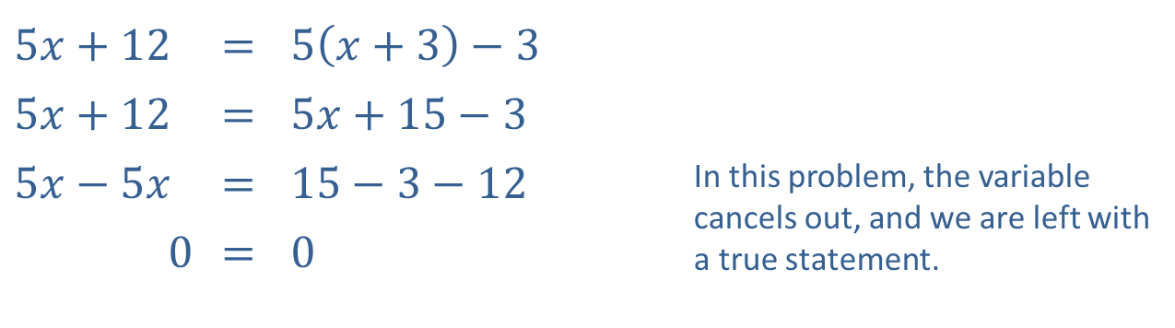
Example 2: Solving Linear Equations in One Variable (cont.)
​
​$5x+12$ | ​= | ​$5\left(x+3\right)−3$
​$5x+12$ | ​= | ​$5x+15−3$
​$5x−5x$ | ​= | ​$15−3−12$ | In this problem, the variable cancels out, and we are left with a true statement.
​0 | ​= | ​0
​Thus, the equation is an identity. The solution set is all real numbers, ℝ.

Slide 11

Linear Absolute Value Equations
In general, every occurrence of an absolute value term in an equation leads to two equations with the absolute value signs removed. As an example,
​$\left|ax+b\right|=c$ means $ax+b=c$ or $−\left(ax+b\right)=c$.

Slide 12
CAUTION!
A word of warning: the apparent solutions obtained by the previous method may not solve the original absolute value equation! Absolute value equations are one class of equations (there are others, as we shall see) in which it is very important to check your final answer in the original equation. An apparent solution that does not solve the original problem is called an extraneous solution.

Slide 13

Example 3: Solving Absolute Value Equations
Solve the absolute value equations.
​$\left|3x−2\right|=1$
​$\left|x−4\right|=\left|2x+1\right|$
​$\left|6x−7\right|+5=3$

Slide 14
Note:
Begin by rewriting each absolute value term as two new equations, one with a positive sign and one with a negative sign.

Slide 15
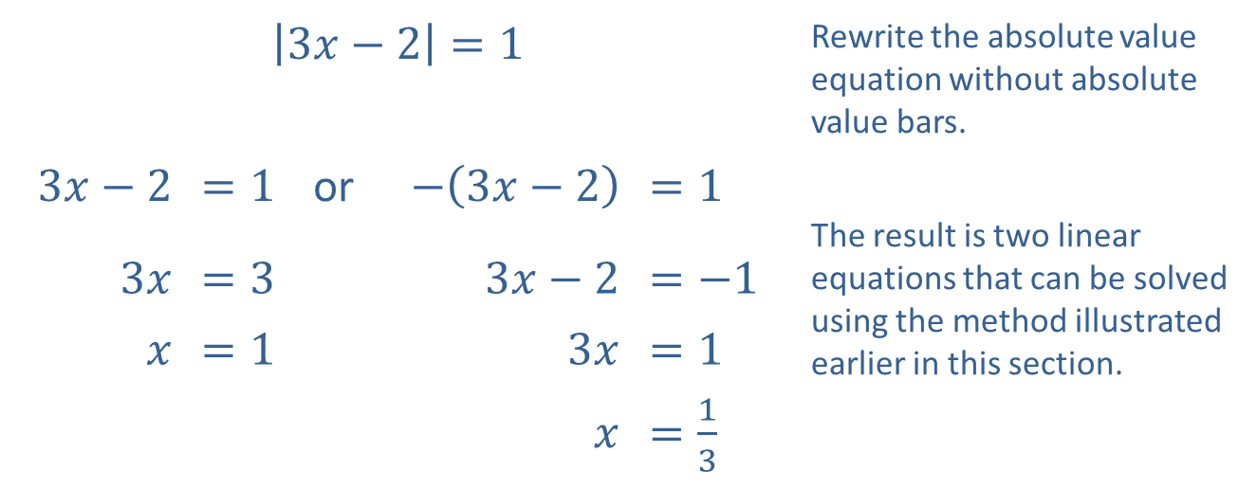
Example 3: Solving Absolute Value Equations (cont.)
Solution
​
​$\left|3x−2\right|=1$ |  |  |  |  | Rewrite the absolute value equation without absolute value bars.
​$3x−2$ | ​$=1$ | or | ​$−\left(3x−2\right)$ | ​$=1$
 |  |  |  |  | The result is two linear equations that can be solved using the method illustrated earlier in this section.
​$3x$ | ​$=3$ |  | ​$3x−2$ | ​$=−1$
$x$ | ​$=1$ |  | ​$3x$ | ​$=1$
 |  |  | $x$ | ​$=\frac{1}{3}$

Slide 16

Example 3: Solving Absolute Value Equations (cont.)
​Now check each solution in the original equation: $\left|3\left(1\right)−2\right|=\left|3−2\right|=\left|1\right|=1$, and
$\left|3\left(\frac{1}{3}\right)−2\right|=\left|1−2\right|=\left|−1\right|=1$, so the solution set is $x=\frac{1}{3}, 1$.

Slide 17
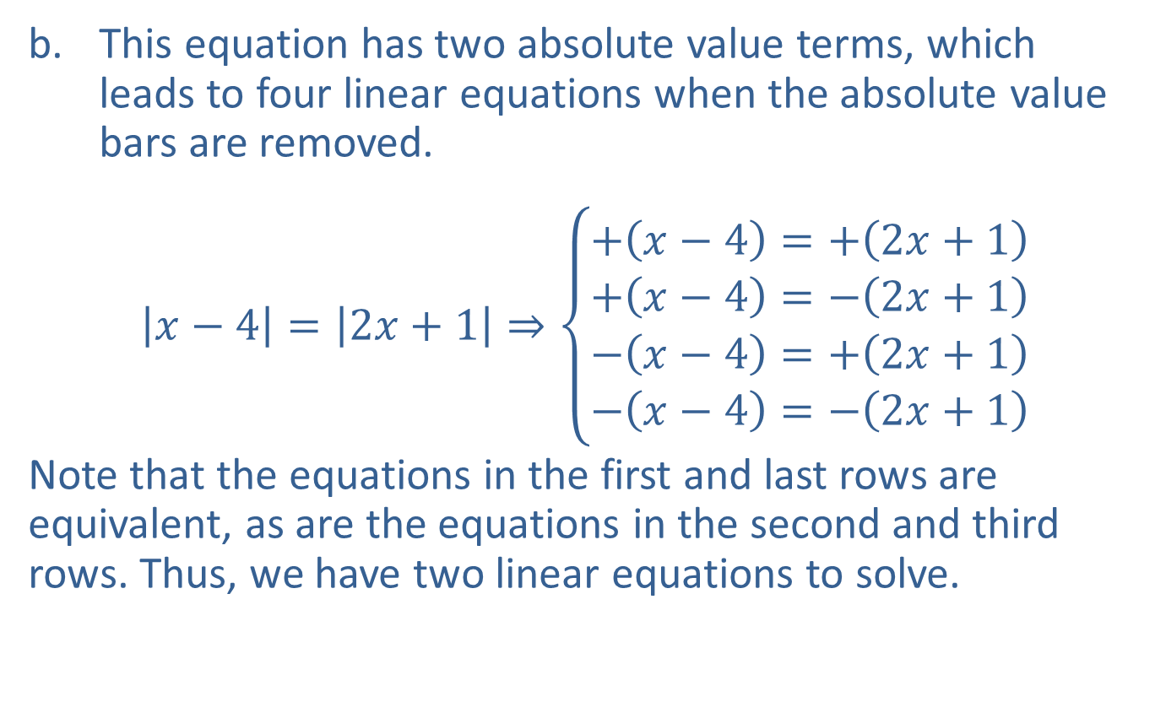
Example 3: Solving Absolute Value Equations (cont.)
​This equation has two absolute value terms, which leads to four linear equations when the absolute value bars are removed.
​$\left|x−4\right|=\left|2x+1\right|⇒\left\{\begin{aligned}+\left(x−4\right)=+\left(2x+1\right) \\ +\left(x−4\right)=−\left(2x+1\right) \\ −\left(x−4\right)=+\left(2x+1\right) \\ −\left(x−4\right)=−\left(2x+1\right)\end{aligned}\right.$
​Note that the equations in the first and last rows are equivalent, as are the equations in the second and third rows. Thus, we have two linear equations to solve.
​

Slide 18
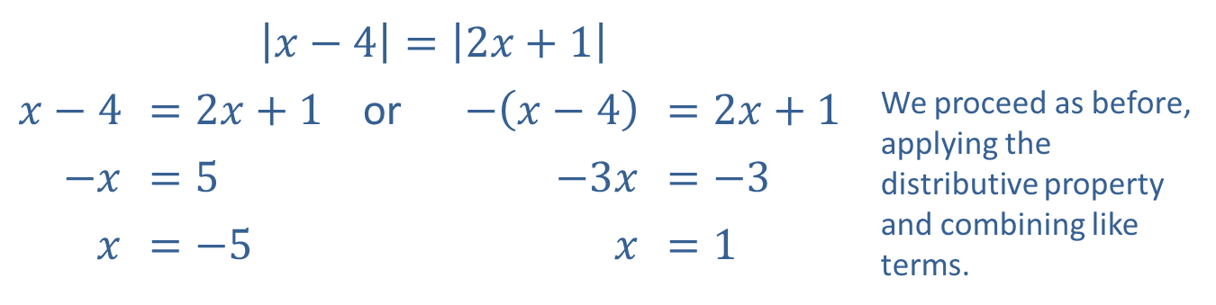
Example 3: Solving Absolute Value Equations (cont.)
​$\left|x−4\right|=\left|2x+1\right|$
​$x−4$ | ​$=2x+1$ | or | ​$−\left(x−4\right)$ | ​$=2x+1$ | We proceed as before, applying the distributive property and combining like terms.
​$−x$ | ​$=5$ |  | ​$−3x$ | ​$=−3$
$x$ | ​$=−5$ |  | $x$ | ​$=1$

Slide 19
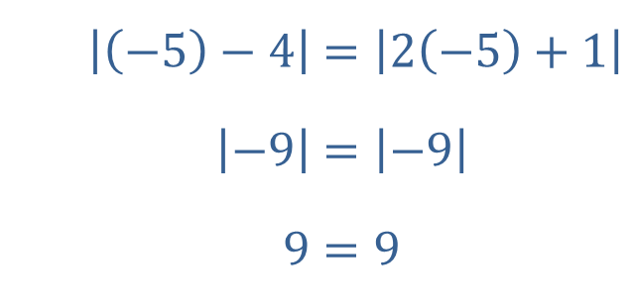
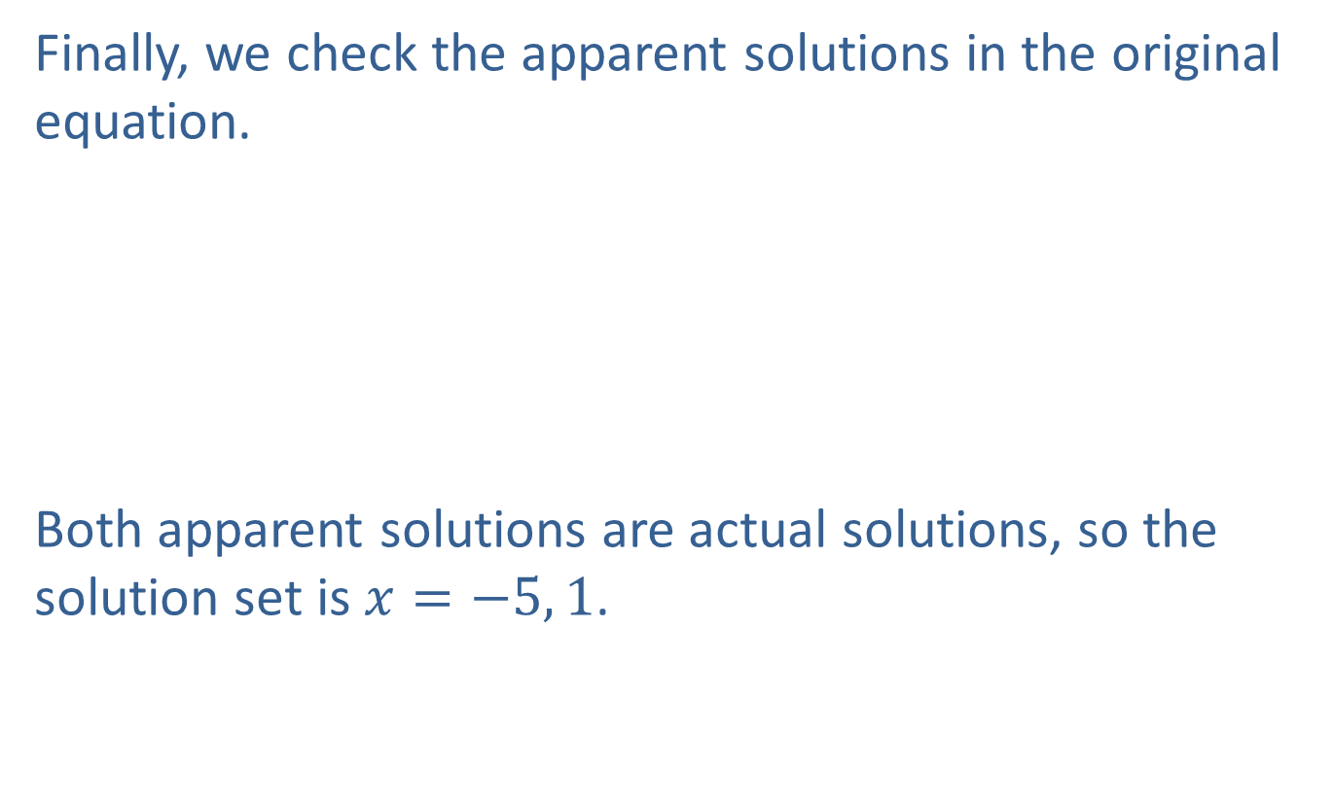
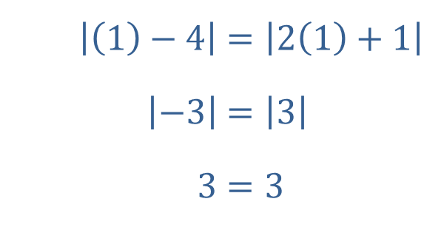
Example 3: Solving Absolute Value Equations (cont.)
​Finally, we check the apparent solutions in the original equation.
​
​Both apparent solutions are actual solutions, so the solution set is $x=−5, 1$.
​$\left|\left(−5\right)−4\right|$ | ​$=\left|2\left(−5\right)+1\right|$
​$\left|−9\right|$ | ​$=\left|−9\right|$
​$9$ | ​$=9$
​$\left|\left(1\right)−4\right|$ | ​$=\left|2\left(1\right)+1\right|$
​$\left|−3\right|$ | ​$=\left|3\right|$
​$3$ | ​$=3$

Slide 20
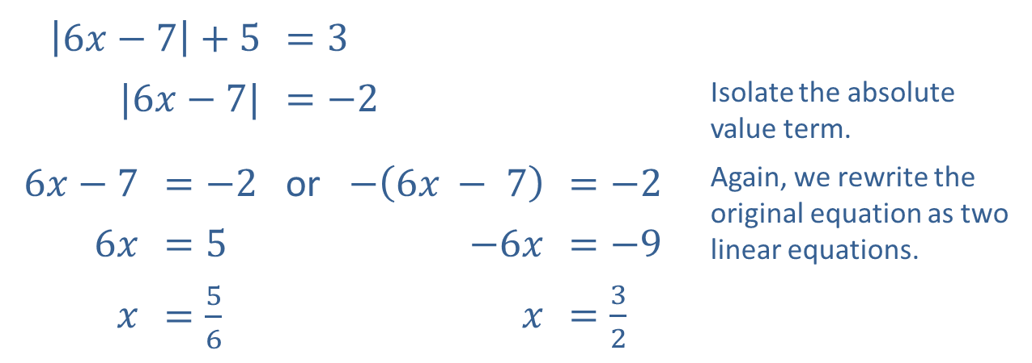
Example 3: Solving Absolute Value Equations (cont.)
​
​$\left|6x−7\right|+5$ |  | ​$=3$
​$|6x−7|$ |  | ​$=−2$ |  |  | Isolate the absolute value term.
​$6x−7$ | ​$=−2$ | or | ​$−\left(6x − 7\right)$ | ​$=−2$ | Again, we rewrite the original equation as two linear equations.
​$6x$ | ​$=5$ |  | ​$−6x$ | ​$=−9$
$x$ | ​$=\frac{5}{6}$ |  | $x$ | ​$=\frac{3}{2}$

Slide 21
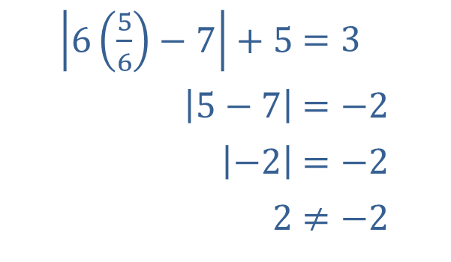

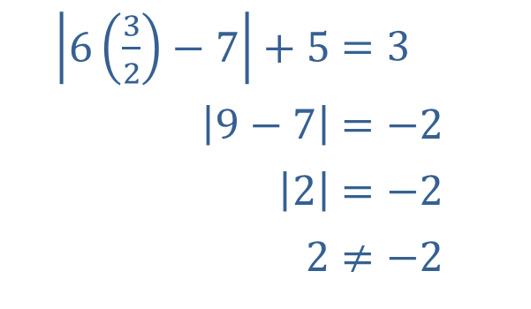
Example 3: Solving Absolute Value Equations (cont.)
​When we check the solutions this time, we find that neither apparent solution actually solves the equation!
​
​Thus, the equation is a contradiction, and the solution set is $∅$.
​$\left|6\left(\frac{5}{6}\right)−7\right|+5$ | ​$=3$
​$\left|5−7\right|$ | ​$=−2$
​$\left|−2\right|$ | ​$=−2$
​$2$ | ​$≠−2$
​$\left|6\left(\frac{3}{2}\right)−7\right|+5$ | ​$=3$
​$\left|9−7\right|$ | ​$=−2$
​$\left|2\right|$ | ​$=−2$
​$2$ | ​$≠−2$

Slide 22
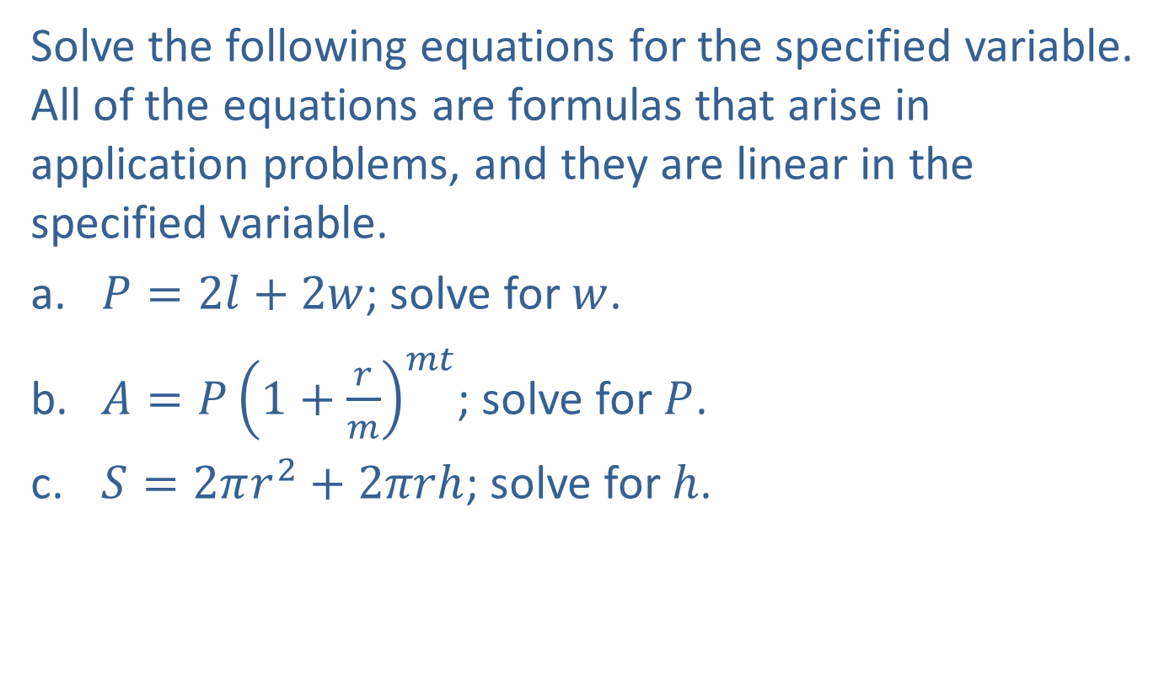
Example 4: Solving Linear Equations for One Variable
Solve the following equations for the specified variable. All of the equations are formulas that arise in application problems, and they are linear in the specified variable.
​$P=2l+2w$; solve for $w$.
​$A=P{\left(1+\frac{r}{m}\right)}^{mt}$; solve for $P$.
​$S=2πr^{2}+2πrh$; solve for $h$.

Slide 23
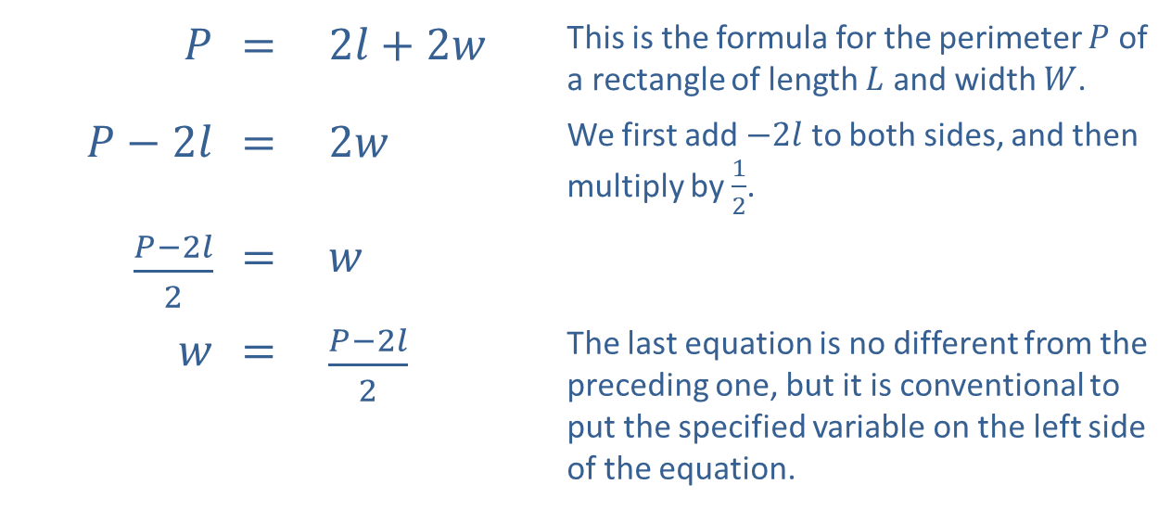
Example 4: Solving Linear Equations for One Variable (cont.)
Solution
​
$P$ | ​= | ​$2l+2w$ | This is the formula for the perimeter $P$ of a rectangle of length $L$ and width $W$.
​$P−2l$ | ​= | ​$2w$ | We first add $−2l$ to both sides, and then multiply by $\frac{1}{2}$.
​$\frac{P−2l}{2}$ | ​= | $w$
$w$ | ​= | ​$\frac{P−2l}{2}$ | The last equation is no different from the preceding one, but it is conventional to put the specified variable on the left side of the equation.

Slide 24
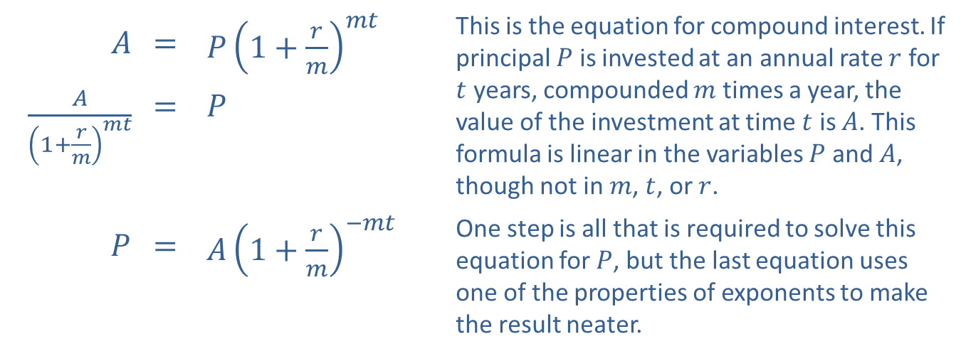
Example 4: Solving Linear Equations for One Variable (cont.)
$A$ | ​= | ​$P{\left(1+\frac{r}{m}\right)}^{mt}$ | This is the equation for compound interest. If principal $P$ is invested at an annual rate $r$ for $t$ years, compounded $m$ times a year, the value of the investment at time $t$ is $A$. This formula is linear in the variables $P$ and $A$, though not in $m$, $t$, or $r$.
​$\frac{A}{{\left(1+\frac{r}{m}\right)}^{mt}}$ | ​= | $P$
$P$ | ​= | ​$A{\left(1+\frac{r}{m}\right)}^{−mt}$ | One step is all that is required to solve this equation for $P$, but the last equation uses one of the properties of exponents to make the result neater.
​

Slide 25
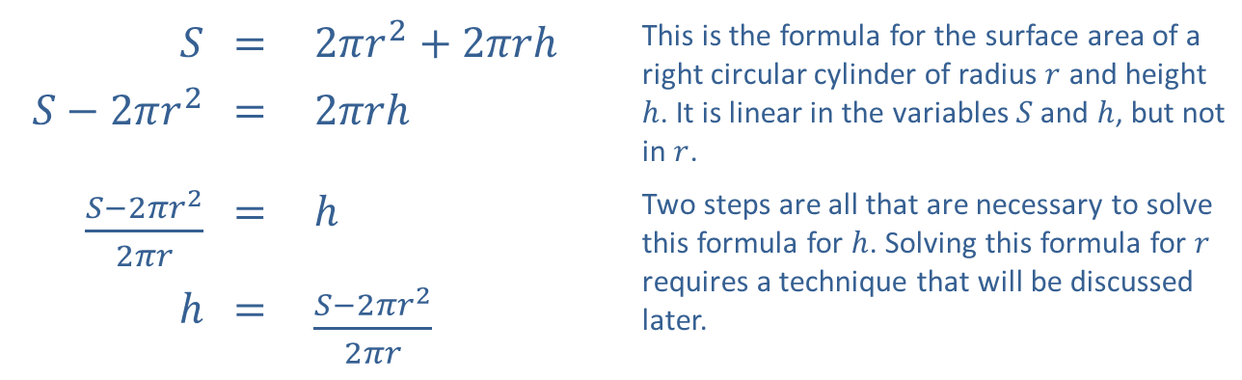
Example 4: Solving Linear Equations for One Variable (cont.)
​
$$S$$ | ​= | ​$2πr^{2}+2πrh$ | This is the formula for the surface area of a right circular cylinder of radius $r$ and height $h$. It is linear in the variables $S$ and $h$, but not in $r$.
​$S−2πr^{2}$ | ​= | ​$2πrh$
​$\frac{S−2πr^{2}}{2πr}$ | ​= | $h$ | Two steps are all that are necessary to solve this formula for $h$. Solving this formula for $r$ requires a technique that will be discussed later.
$$h$$ | ​= | ​$\frac{S−2πr^{2}}{2πr}$

Slide 26
Example 5: Calculating Average Speed
The distance from Shreveport, LA to Austin, TX by one route is 325 miles. If Kevin made the trip in five and a half hours, what was his average speed?

Slide 27
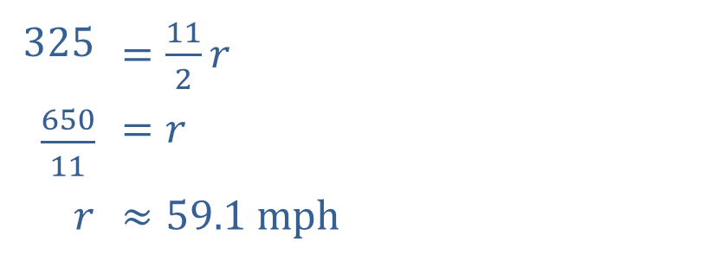
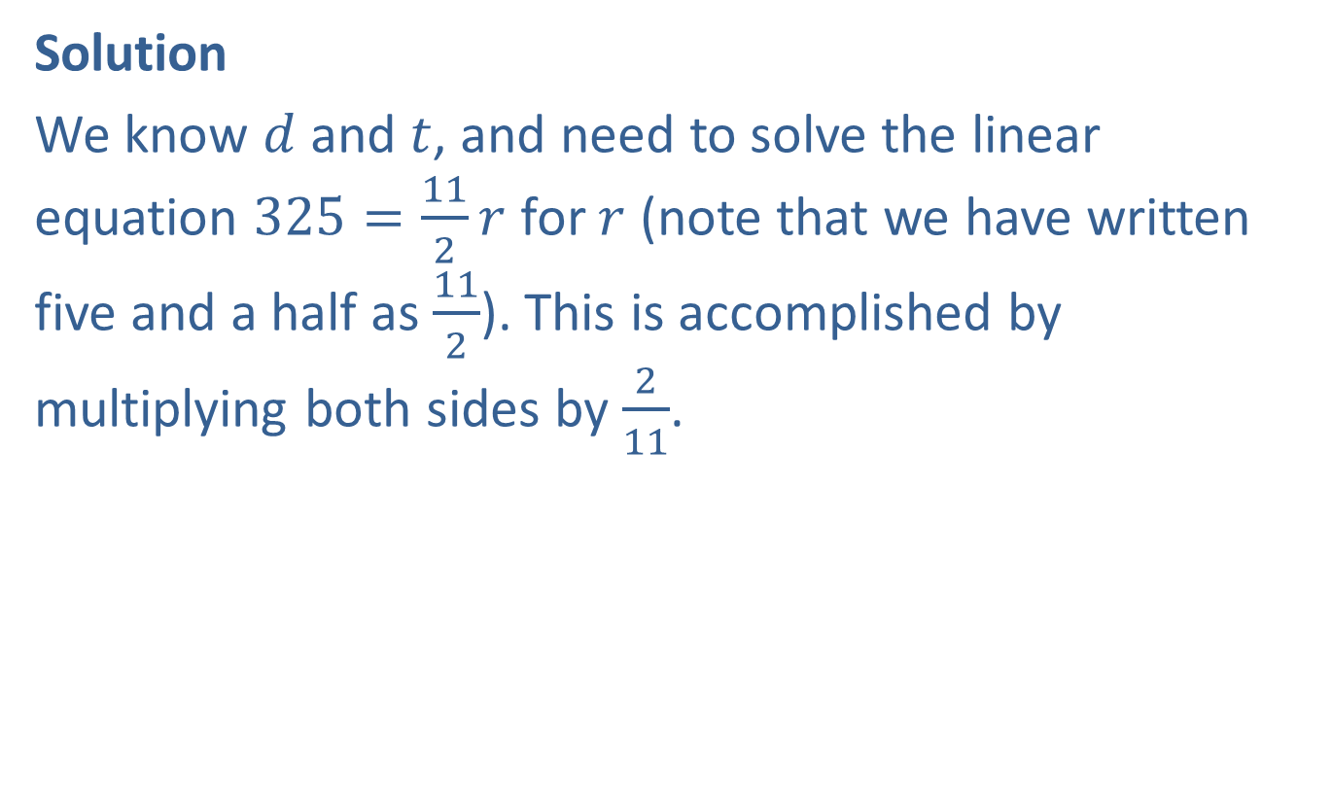
Example 5: Calculating Average Speed (cont.)
Solution
We know $d$ and $t$, and need to solve the linear equation $325=\frac{11}{2}r$ for $r$ (note that we have written five and a half as $\frac{11}{2}$). This is accomplished by multiplying both sides by $\frac{2}{11}$.
​325 | ​$=\frac{11}{2}r$
​$\frac{650}{11}$ | ​$=r$
$r$ | ​$≈59.1 \text{m}\text{ph}$

Slide 28

Example 5: Calculating Average Rate of Speed (cont.)
Alternatively, the time can be expressed in decimal form.
​325 | ​$=5.5r$
​$\frac{325}{5.5}$ | ​$=r$
$r$ | ​$≈59.1 mph$

Slide 29
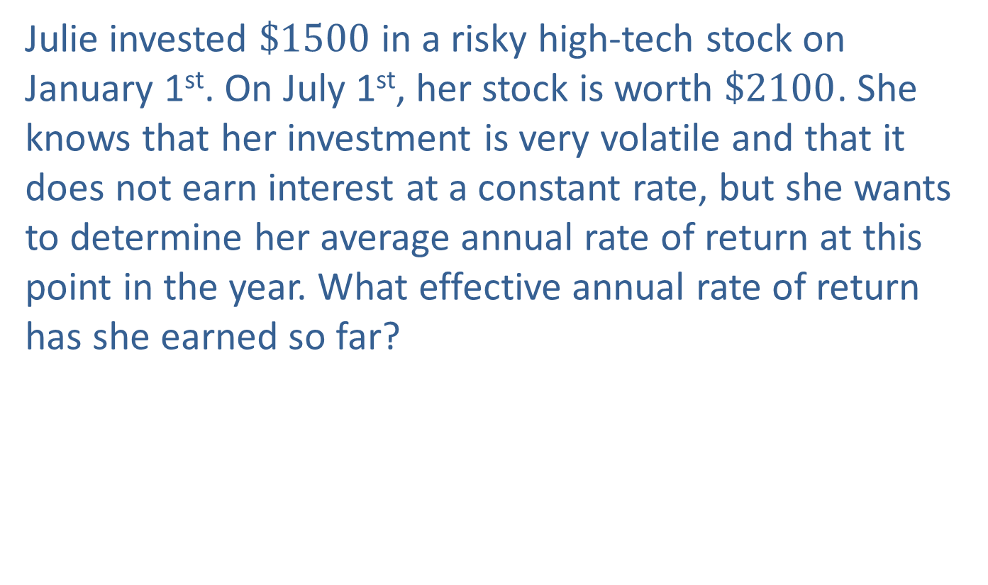
Example 6: Calculating Average Interest Rate
Julie invested $\$1500$ in a risky high-tech stock on January 1st. On July 1st, her stock is worth $\$2100$. She knows that her investment is very volatile and that it does not earn interest at a constant rate, but she wants to determine her average annual rate of return at this point in the year. What effective annual rate of return has she earned so far?

Slide 30
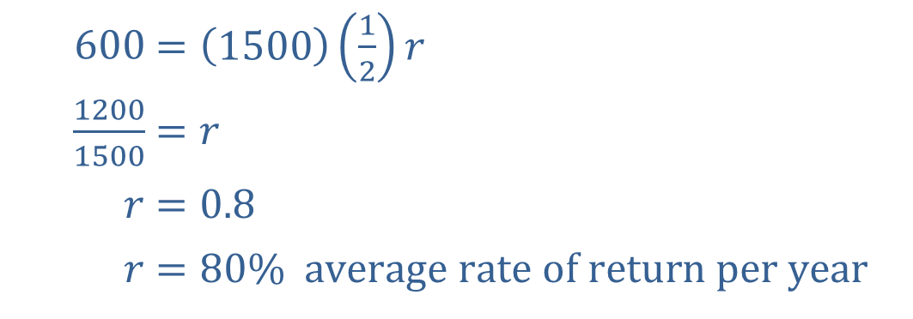

Example 6: Calculating Average Interest Rate (cont.)
Solution
The interest that Julie has earned in half a year is $\$600$ (or $\$2100−\$1500$). Replacing $P$ with 1500, $t$ with $\frac{1}{2}$, and $I$ with 600 in the formula $I=Prt$, we have the following equation.
​
​$600$ | ​$=\left(1500\right)\left(\frac{1}{2}\right)r$
​$\frac{1200}{1500}$ | ​$=r$
​$r$ | ​$=0.8$
​$r$ | ​$=80\% \text{average} \text{rate} \text{of} \text{return} \text{per} \text{year}$

Slide 31
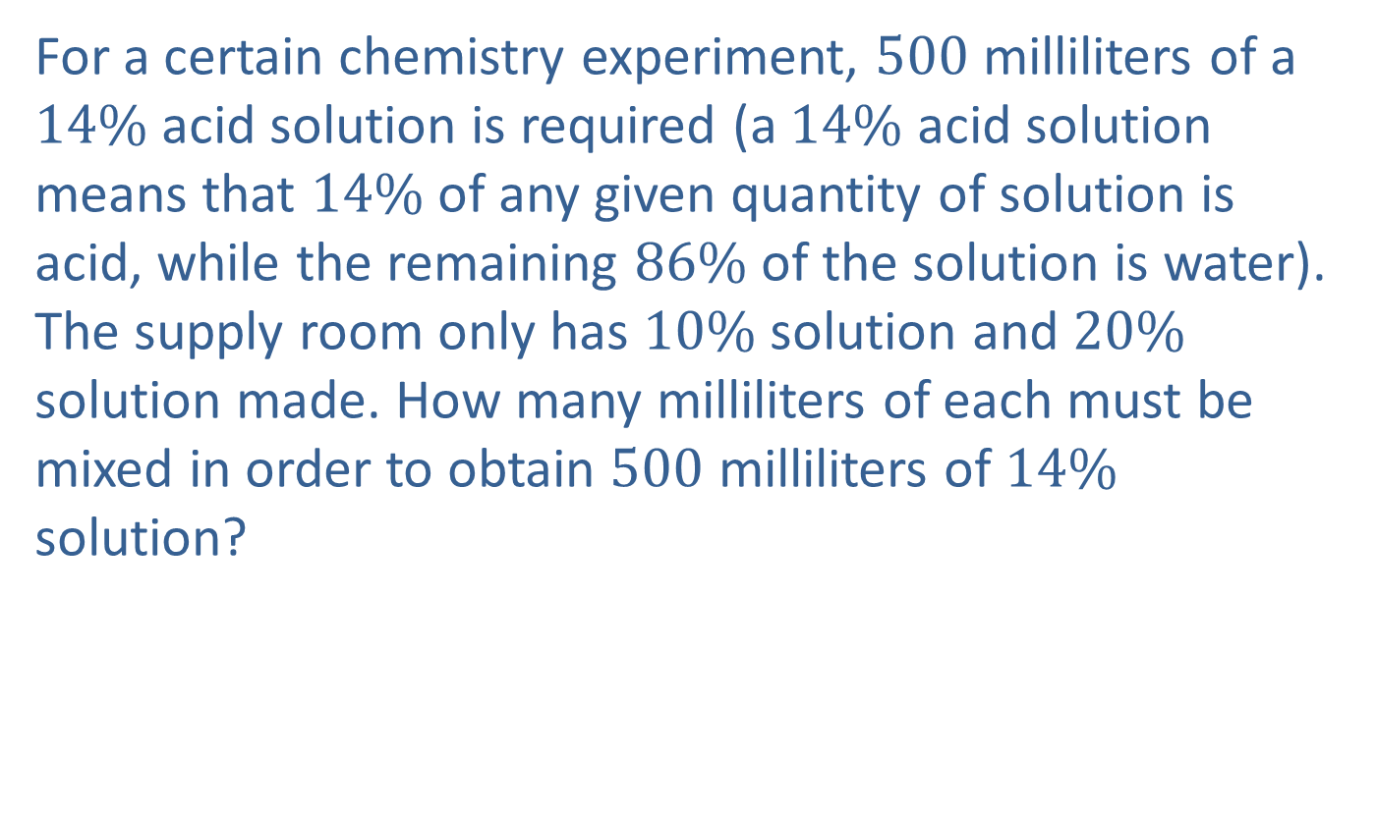
Example 7: Solving a Mixture Problem
For a certain chemistry experiment, 500 milliliters of a $14\%$ acid solution is required (a $14\%$ acid solution means that $14\%$ of any given quantity of solution is acid, while the remaining $86\%$ of the solution is water). The supply room only has $10\%$ solution and $20\%$ solution made. How many milliliters of each must be mixed in order to obtain 500 milliliters of $14\%$ solution?

Slide 32
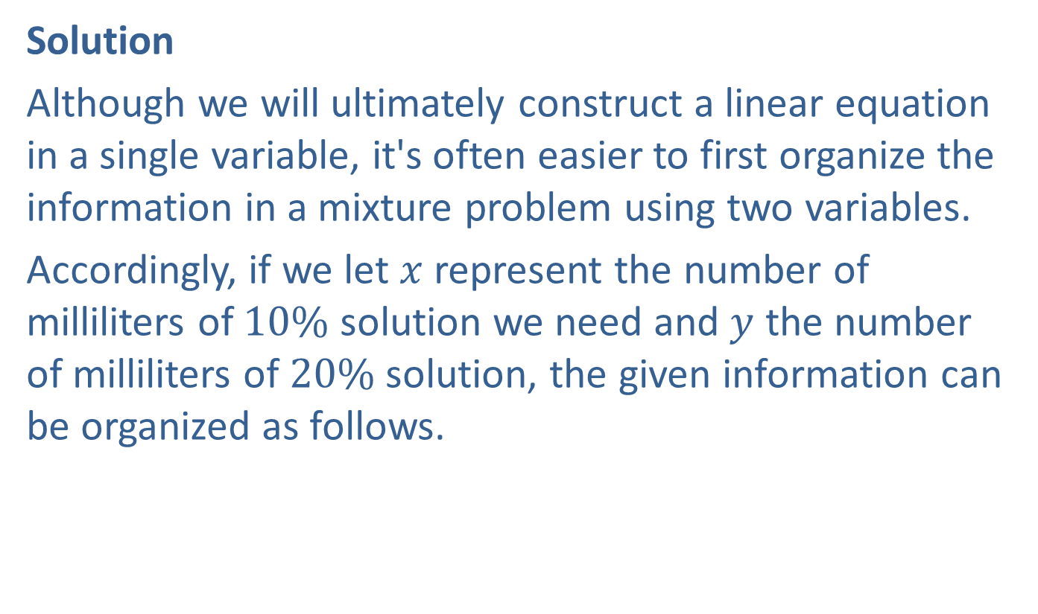
Example 7: Solving a Mixture Problem (cont.)
Solution
Although we will ultimately construct a linear equation in a single variable, it's often easier to first organize the information in a mixture problem using two variables.
Accordingly, if we let $x$ represent the number of milliliters of $10\%$ solution we need and $y$ the number of milliliters of $20\%$ solution, the given information can be organized as follows.

Slide 33
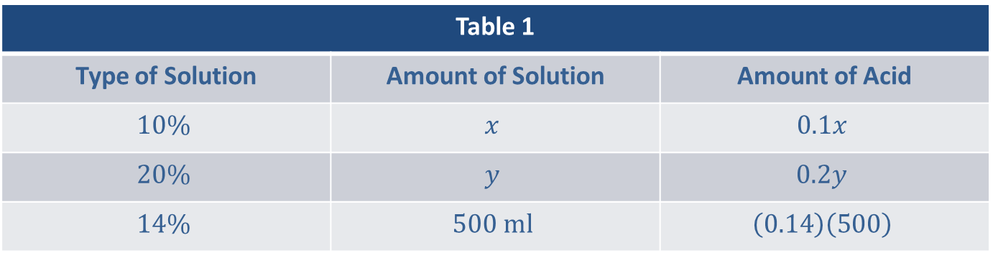
Example 7: Solving a Mixture Problem (cont.)
Table 1
Type of Solution | Amount of Solution | Amount of Acid
$$10\%$$ | $$x$$ | $$0.1x$$
$$20\%$$ | $$y$$ | $$0.2y$$
$$14\%$$ | $$500 ml$$ | $$\left(0.14\right)\left(500\right)$$

Slide 34
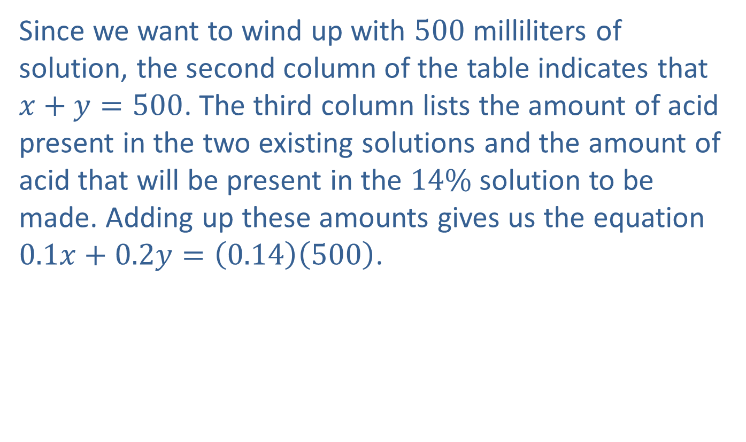
Example 7: Solving a Mixture Problem (cont.)
Since we want to wind up with 500 milliliters of solution, the second column of the table indicates that $x+y=500$. The third column lists the amount of acid present in the two existing solutions and the amount of acid that will be present in the $14\%$ solution to be made. Adding up these amounts gives us the equation $0.1x+0.2y=\left(0.14\right)\left(500\right)$.

Slide 35
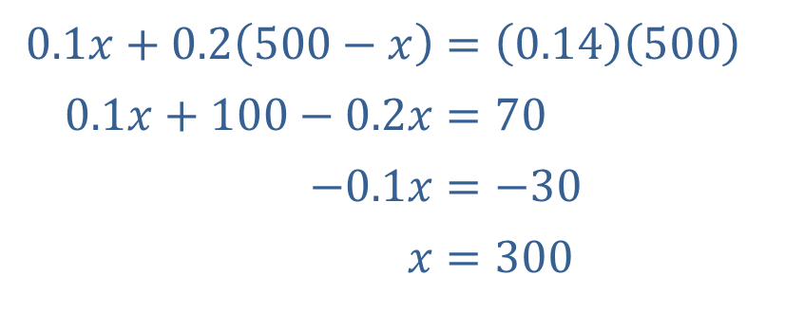
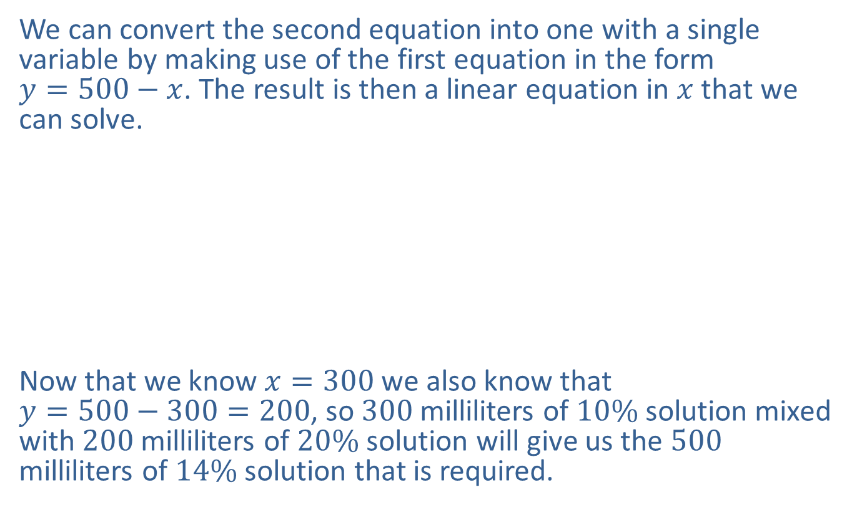
Example 7: Solving a Mixture Problem (cont.)
We can convert the second equation into one with a single variable by making use of the first equation in the form
$y=500−x$. The result is then a linear equation in $x$ that we can solve.
​
Now that we know $x=300$ we also know that
$y=500−300=200$, so 300 milliliters of $10\%$ solution mixed with 200 milliliters of $20\%$ solution will give us the 500 milliliters of $14\%$ solution that is required.
​$0.1x+0.2\left(500−x\right)$ | ​$=\left(0.14\right)\left(500\right)$
​$0.1x+100−0.2x$ | ​$=70$
​$−0.1x$ | ​$=−30$
​$x$ | ​$=300$

