Slide 1
Section 2.2
Linear Inequalities in One Variable

Slide 2
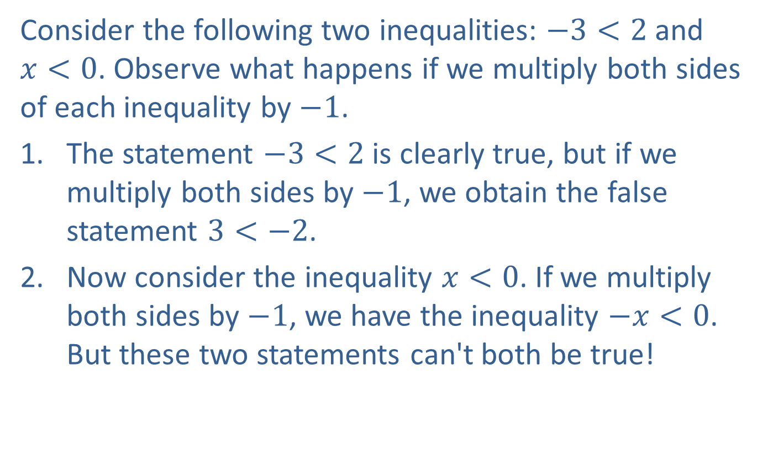
Example 1: Multiplying Inequalities by Negative Numbers
Consider the following two inequalities: $−3<2$ and $x<0$. Observe what happens if we multiply both sides of each inequality by $−1$.
​The statement $−3<2$ is clearly true, but if we multiply both sides by $−1$, we obtain the false statement $3<−2$.
​Now consider the inequality $x<0$. If we multiply both sides by $−1$, we have the inequality $−x<0$. But these two statements can't both be true!

Slide 3
Example 1: Multiplying Inequalities by Negative Numbers (cont.)
These examples show that multiplicative cancellation must behave a bit differently for linear inequalities. Note that if we reverse the inequality sign in our results, we actually get true statements. This provides a clue to how we approach multiplicative cancellation in the case of linear inequalities.

Slide 4
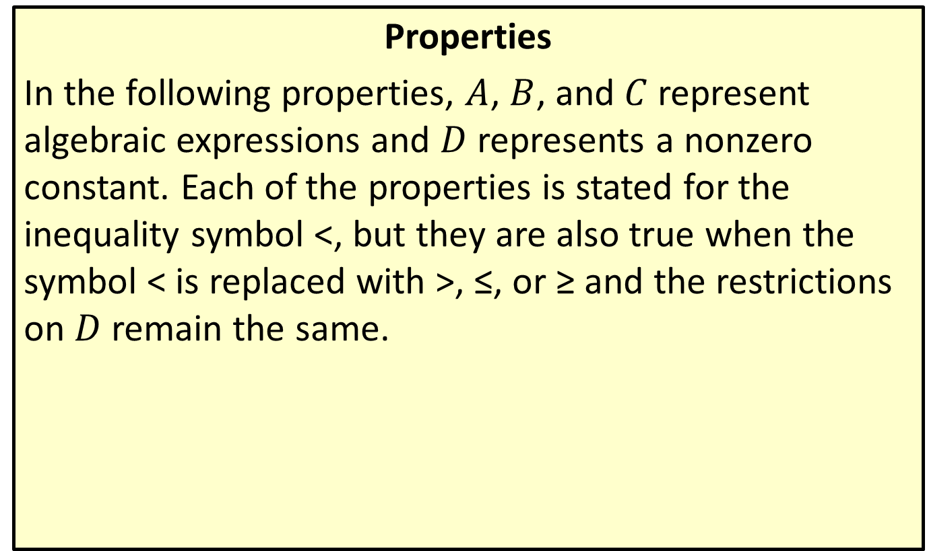
Cancellation Properties for Inequalities
Properties
In the following properties, $A$, $B$, and $C$ represent algebraic expressions and $D$ represents a nonzero constant. Each of the properties is stated for the inequality symbol <, but they are also true when the symbol < is replaced with >, ≤, or ≥ and the restrictions on $D$ remain the same.

Slide 5
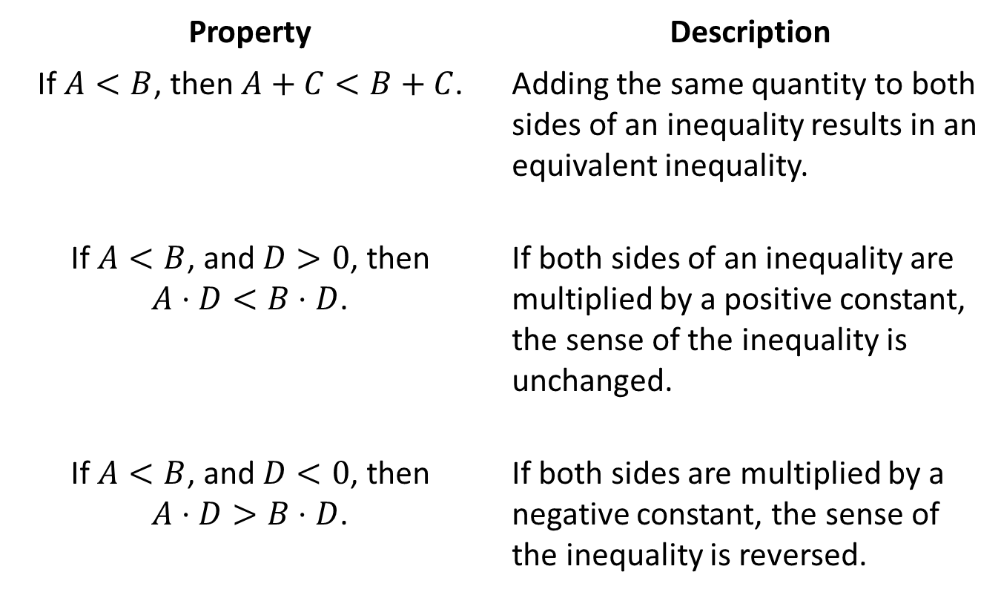
Cancellation Properties for Inequalities (cont.)
Property | Description
If $A<B$, then $A+C<B+C$. | Adding the same quantity to both sides of an inequality results in an equivalent inequality.
If $A<B$, and $D>0$, then $A⋅D<B⋅D$. | If both sides of an inequality are multiplied by a positive constant, the sense of the inequality is unchanged.
If $A<B$, and $D<0$, then $A⋅D>B⋅D$. | If both sides are multiplied by a negative constant, the sense of the inequality is reversed.

Slide 6

Example 2: Solving Linear Inequalities
Solve the following inequalities, using interval notation to describe the solution set.
​ $5−2\left(x−3\right)≤−\left(1−x\right)$
​ $\frac{3\left(a−2\right)}{2}<\frac{5a}{4}$

Slide 7
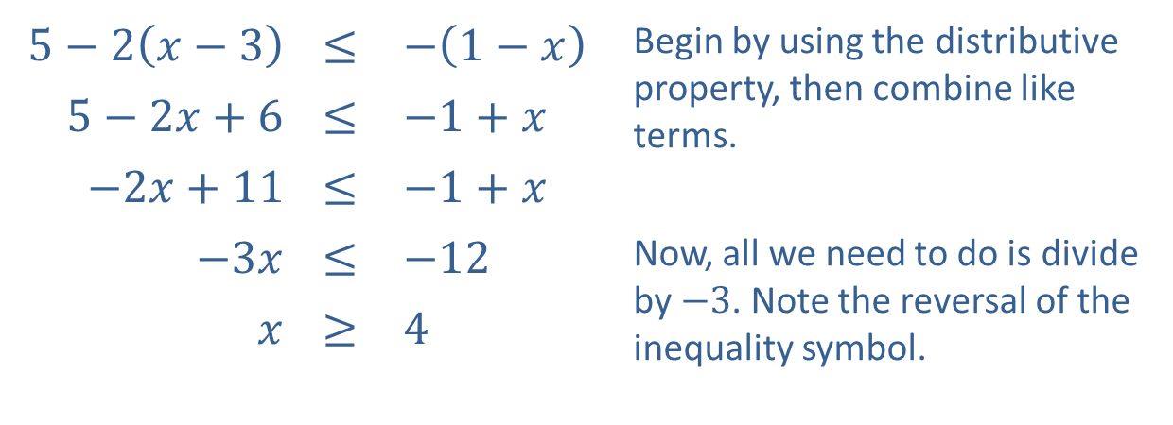
Example 2: Solving Linear Inequalities (cont.)
Solution
​
$5−2\left(x−3\right)$ | ≤ | $−\left(1−x\right)$ | Begin by using the distributive property, then combine like terms.
$5−2x+6$ | ≤ | $−1+x$
$−2x+11$ | ≤ | $−1+x$
$−3x$ | ≤ | $−12$ | Now, all we need to do is divide by $−3$. Note the reversal of the inequality symbol.
$x$ | ≥ | 4
​In interval notation, the solution is $\left[4\text{, }∞\right)$.

Slide 8
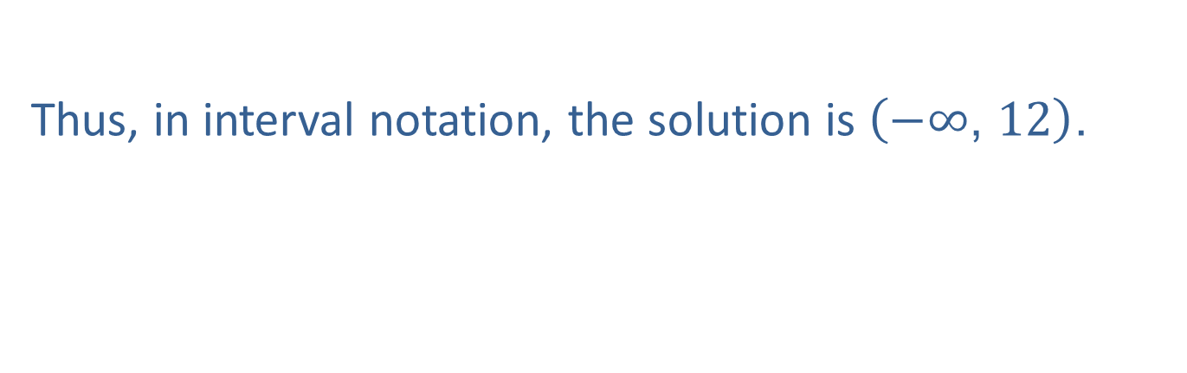
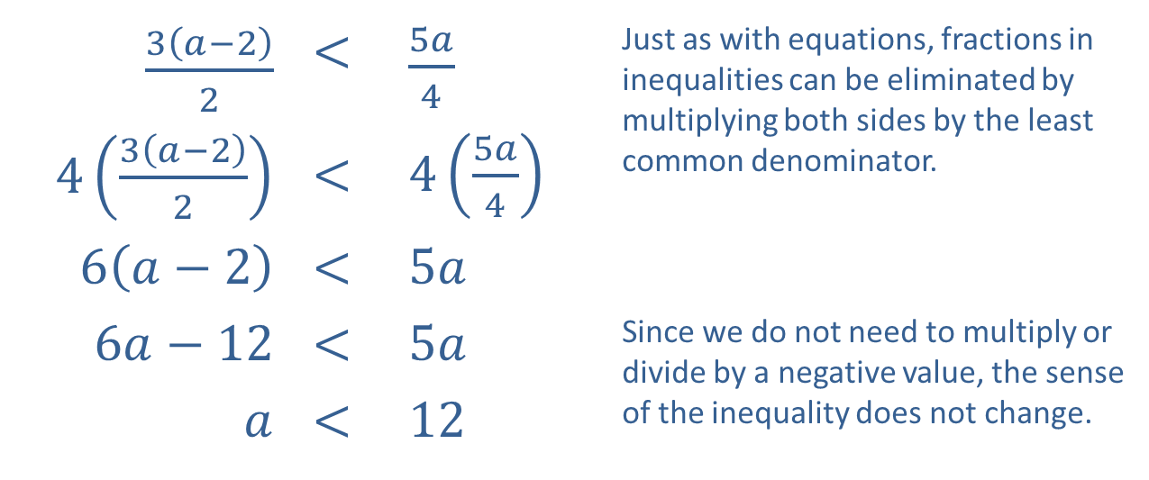
Example 2: Solving Linear Inequalities (cont.)
$\frac{3\left(a−2\right)}{2}$ | < | $\frac{5a}{4}$ | Just as with equations, fractions in inequalities can be eliminated by multiplying both sides by the least common denominator.
$4\left(\frac{3\left(a−2\right)}{2}\right)$ | < | $4\left(\frac{5a}{4}\right)$
$6\left(a−2\right)$ | < | $5a$
$6a−12$ | < | $5a$ | Since we do not need to multiply or divide by a negative value, the sense of the inequality does not change.
$a$ | < | 12
​
​
Thus, in interval notation, the solution is $\left(−∞\text{, }12\right)$.

Slide 9

Example 3: Graphing Intervals of Real Numbers
Graph the following intervals.
​$[−3,6]$
​$(−∞,5]$
​$[2,9)$

Slide 10
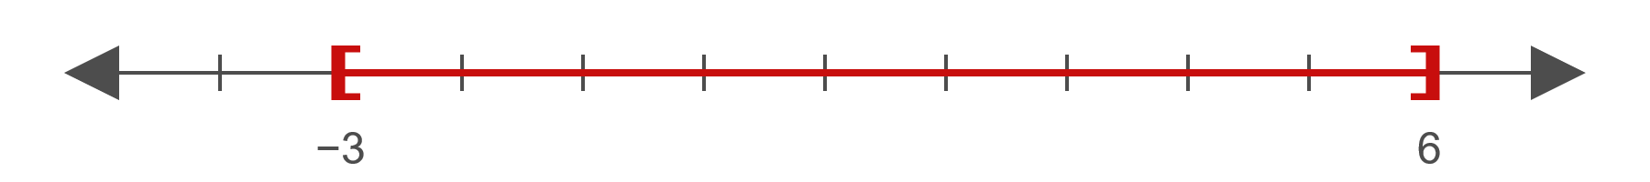
Example 3: Graphing Intervals of Real Numbers (cont.)
Solution
​
Both endpoints are included in the interval.

Slide 11

Example 3: Graphing Intervals of Real Numbers (cont.)
​
The left-hand side of the graph extends to negative infinity.

Slide 12
Example 3: Graphing Intervals of Real Numbers (cont.)
​
The left endpoint is included in the interval, while the right endpoint is excluded.

Slide 13
Example 4: Calculating Final Grades
The final grade in a class depends on the grades of 5 exams, each worth a maximum of 100 points. Suppose Janice's scores on the first four tests are 67, 82, 73, and 85. Assuming a grade of B corresponds to a numerical grade greater than or equal to 80 and less than 90, what scores can she make on the fifth test to get a B in the class?

Slide 14
Note:
We follow the same process in solving double inequalities as we do for standard ones. The only difference is that operations are applied to all three "sides" of the statements.

Slide 15
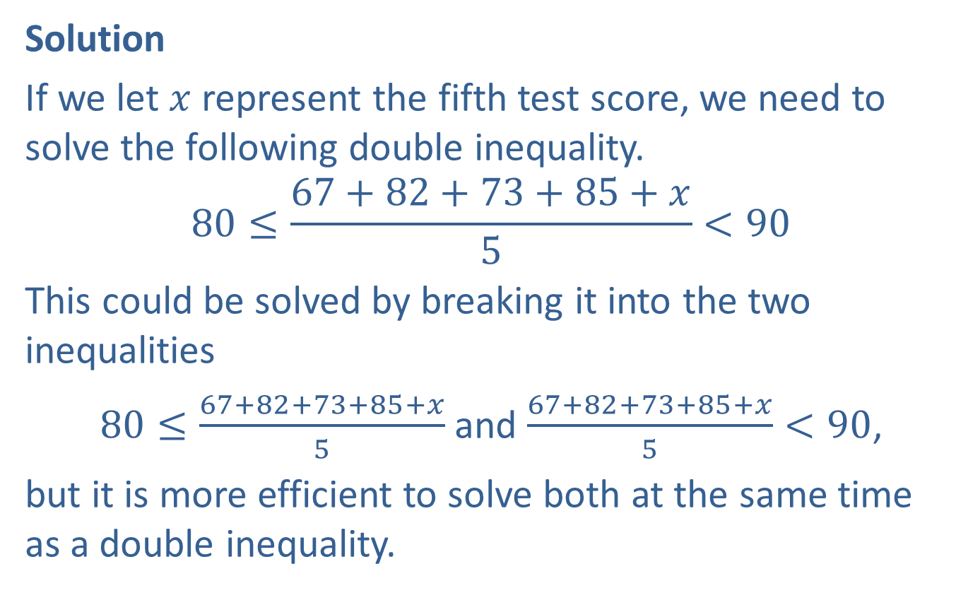
Example 4: Calculating Final Grades (cont.)
Solution
If we let $x$ represent the fifth test score, we need to solve the following double inequality.
$$80≤\frac{67+82+73+85+x}{5}<90$$
This could be solved by breaking it into the two inequalities
$80≤\frac{67+82+73+85+x}{5}$ and $\frac{67+82+73+85+x}{5}<90$,
but it is more efficient to solve both at the same time as a double inequality.

Slide 16
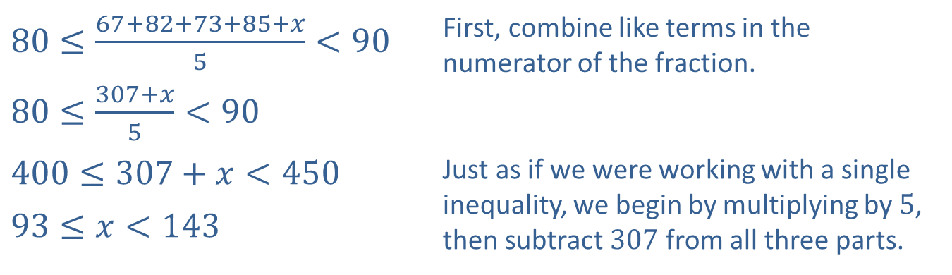
Example 4: Calculating Final Grades (cont.)
​$80≤\frac{67+82+73+85+x}{5}<90$ | First, combine like terms in the numerator of the fraction.
​$80≤\frac{307+x}{5}<90$
​$400≤307+x<450$ | Just as if we were working with a single inequality, we begin by multiplying by 5, then subtract 307 from all three parts.
​$93≤x<143$

Slide 17
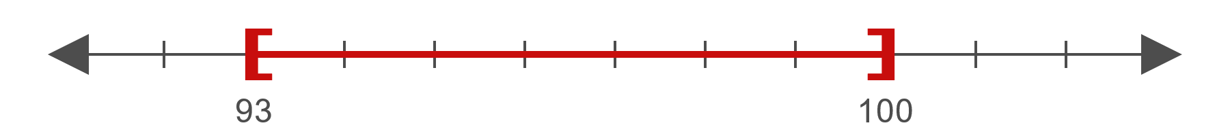
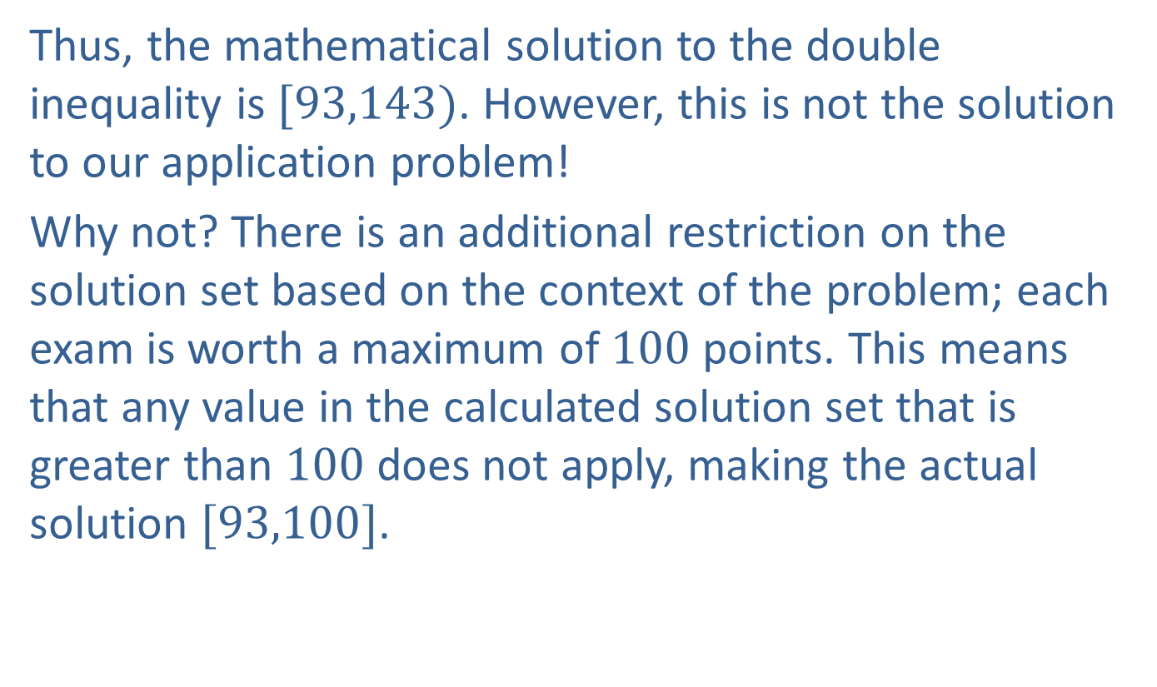
Example 4: Calculating Final Grades (cont.)
Thus, the mathematical solution to the double inequality is $[93,143)$. However, this is not the solution to our application problem!
Why not? There is an additional restriction on the solution set based on the context of the problem; each exam is worth a maximum of 100 points. This means that any value in the calculated solution set that is greater than 100 does not apply, making the actual solution $[93,100]$.

Slide 18

Example 5: Solving Double Linear Inequalities
Solve the following double inequalities.
​$−1<3−2x≤5$
​$2\left(2x−1\right)≤4x+2≤4\left(x+1\right)$

Slide 19

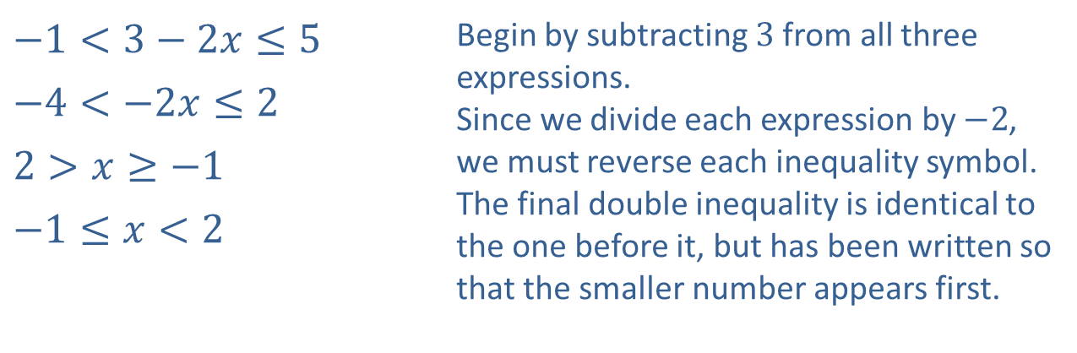
Example 5: Solving Double Linear Inequalities (cont.)
Solution
​
​$−1<3−2x≤5$ | Begin by subtracting 3 from all three expressions. Since we divide each expression by $−2$, we must reverse each inequality symbol. The final double inequality is identical to the one before it, but has been written so that the smaller number appears first.
​$−4<−2x≤2$
​$2>x≥−1$
​$−1≤x<2$
​In interval notation, the solution is $[−1,2)$.

Slide 20

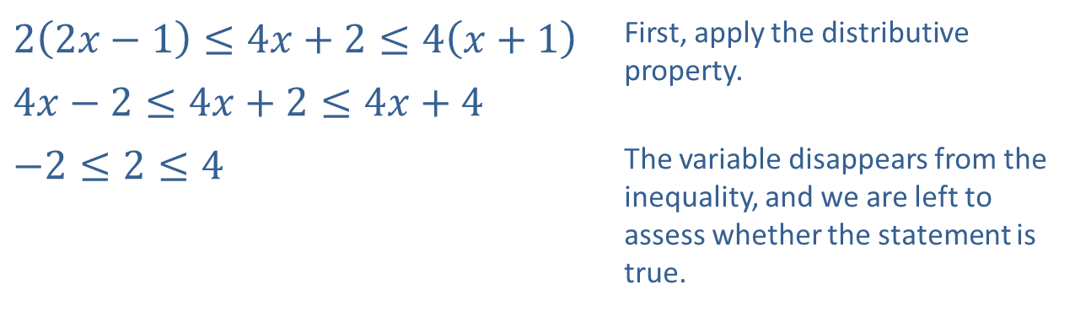
Example 5: Solving Double Linear Inequalities (cont.)
​
​$2\left(2x−1\right)≤4x+2≤4\left(x+1\right)$ | First, apply the distributive property.
​$4x−2≤4x+2≤4x+4$
​$−2≤2≤4$ | The variable disappears from the inequality, and we are left to assess whether the statement is true.
​Since we are left with a true statement, the double inequality is true for all values of the variable $x$, and the solution set is $(−∞,∞)$.

Slide 21

Example 6: Solving Linear Absolute Value Inequalities
Solve the following absolute value inequalities.
​$\left|4−2x\right|>6$
​$2\left|3y−2\right|+3≤11$
​$\left|5+2s\right|≤−3$
​$\left|5+2s\right|≥−3$

Slide 22


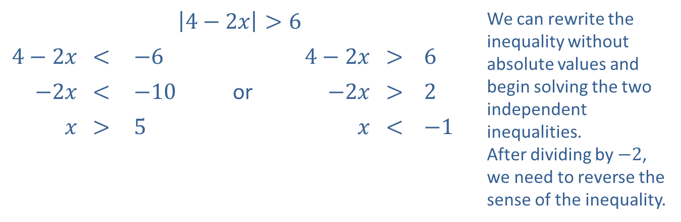
Example 6: Solving Linear Absolute Value Inequalities (cont.)
Solution
​
​$\left|4−2x\right|>6$ |  |  |  |  |  |  | We can rewrite the inequality without absolute values and begin solving the two independent inequalities. After dividing by $−2$, we need to reverse the sense of the inequality.
​$4−2x$ | ​< | ​$−6$ |  | ​$4−2x$ | ​> | ​6
​$−2x$ | ​< | ​$−10$ | or | ​$−2x$ | ​> | ​2
$x$ | ​> | ​5 |  | $x$ | ​< | ​$−1$
​The solution is $(−∞,−1)∪(5,∞)$.
​

Slide 23
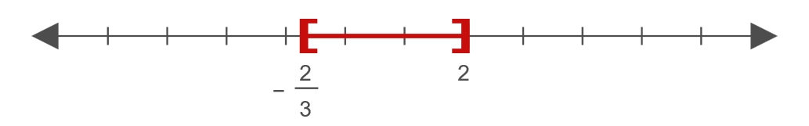

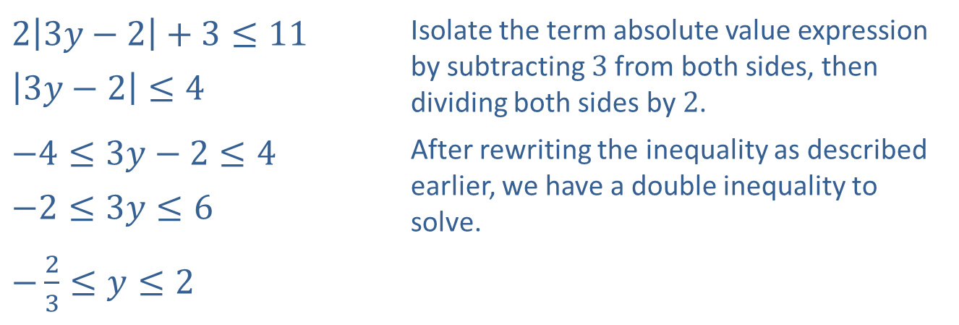
Example 6: Solving Linear Absolute Value Inequalities (cont.)
​
​$2\left|3y−2\right|+3≤11$ | Isolate the term absolute value expression by subtracting 3 from both sides, then dividing both sides by 2.
​$\left|3y−2\right|≤4$
​$−4≤3y−2≤4$ | After rewriting the inequality as described earlier, we have a double inequality to solve.
​$−2≤3y≤6$
​$−\frac{2}{3}≤y≤2$
​Thus, the solution is $[−\frac{2}{3},2]$.
​

Slide 24
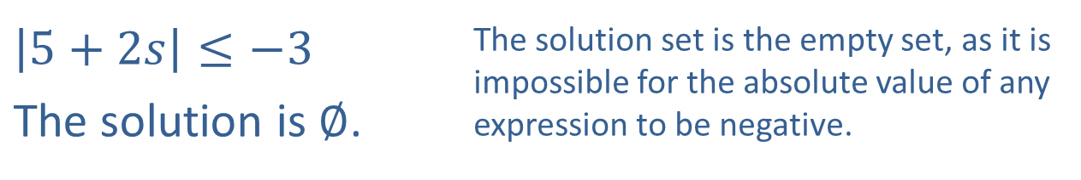
Example 6: Solving Linear Absolute Value Inequalities (cont.)
​
$\left|5+2s\right|≤−3$ | The solution set is the empty set, as it is impossible for the absolute value of any expression to be negative.
​The solution is $∅$.

Slide 25
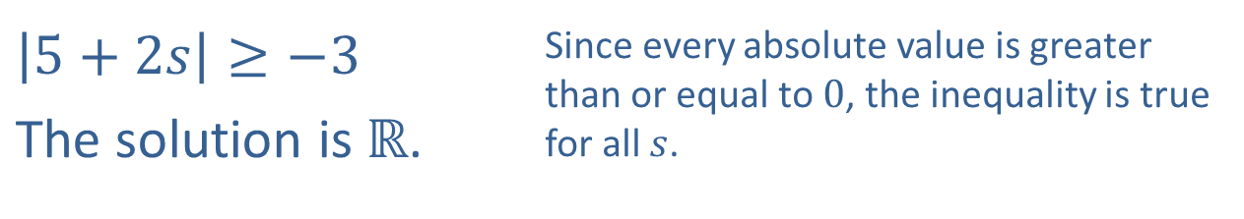
Example 6: Solving Linear Absolute Value Inequalities (cont.)
d.
​$\left|5+2s\right|≥−3$ | Since every absolute value is greater than or equal to 0, the inequality is true for all $s$.
The solution is $ℝ$.

Slide 26
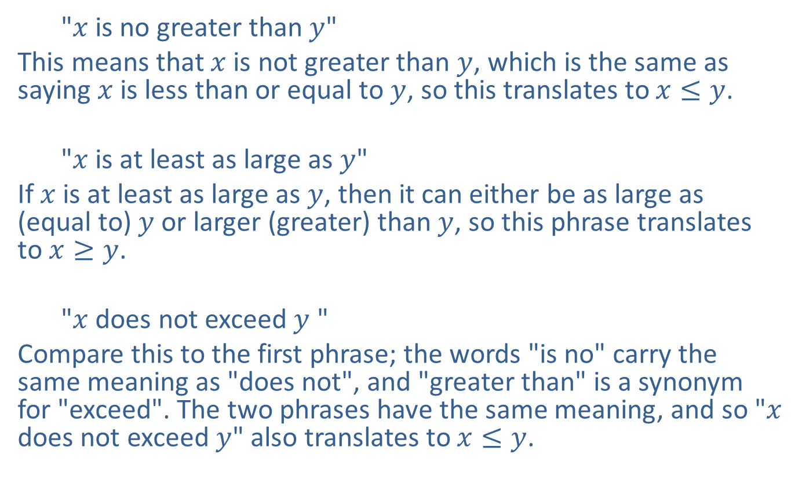
Example 7: Translating Inequality Phrases
  "$x$ is no greater than $y$"
This means that $x$ is not greater than $y$, which is the same as saying $x$ is less than or equal to $y$, so this translates to $x≤y$.
  "$x$ is at least as large as $y$"
If $x$ is at least as large as $y$, then it can either be as large as (equal to) $y$ or larger (greater) than $y$, so this phrase translates to $x≥y$.
  "$x$ does not exceed $y$ "
Compare this to the first phrase; the words "is no" carry the same meaning as "does not", and "greater than" is a synonym for "exceed". The two phrases have the same meaning, and so "$x$ does not exceed $y$" also translates to $x≤y$.

Slide 27
Example 8: Applications of Inequalities
Express each of the following problems as an inequality, and then solve the inequality.
​The average daily high temperature in Santa Fe, NM over the course of three days exceeded 75. Given that the high on the first day was 72 and the high on the third day was 77, what can we say about the high temperature on the second day?

Slide 28
Example 8: Applications of Inequalities (cont.)
​As a test for quality at a plant manufacturing silicon wafers for computer chips, a random sample of 10 batches of 1000 wafers each must not detect more than 5 defective wafers per batch on average. In the first 9 batches tested, the average number of defective wafers per batch is found to be 4.78 (to the nearest hundredth). What is the maximum number of defective wafers that can be found in the 10th batch for the plant to pass the quality test?

Slide 29
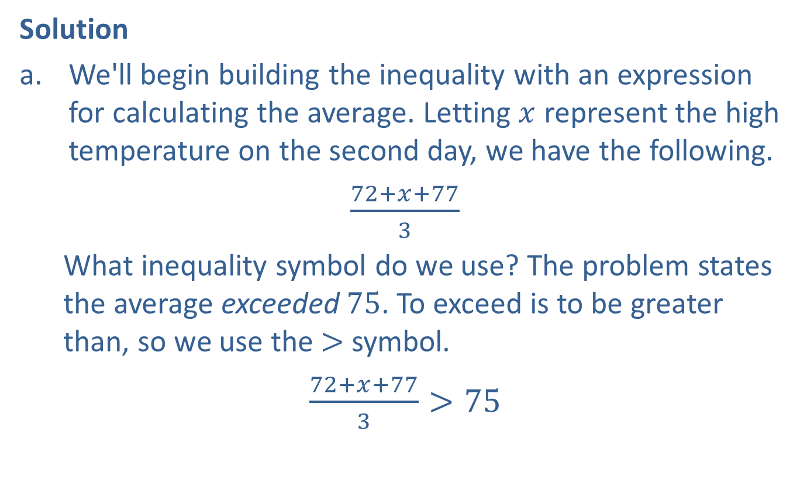
Example 8: Applications of Inequalities (cont.)
Solution
​We'll begin building the inequality with an expression for calculating the average. Letting $x$ represent the high temperature on the second day, we have the following.
​$\frac{72+x+77}{3}$
  What inequality symbol do we use? The problem states the average exceeded 75. To exceed is to be greater than, so we use the > symbol.
​$\frac{72+x+77}{3}>75$
​

Slide 30
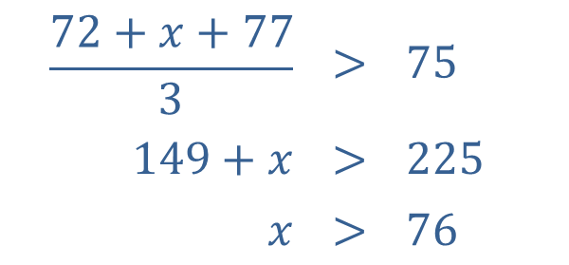
Example 8: Applications of Inequalities (cont.)
​We then proceed to solve the inequality.
​
​Thus, the high temperature on the second day exceeded 76 degrees.
$$\frac{72+x+77}{3}$$ | $$>$$ | $$75$$
$$149+x$$ | $$>$$ | $$225$$
$$x$$ | $$>$$ | $$76$$

Slide 31
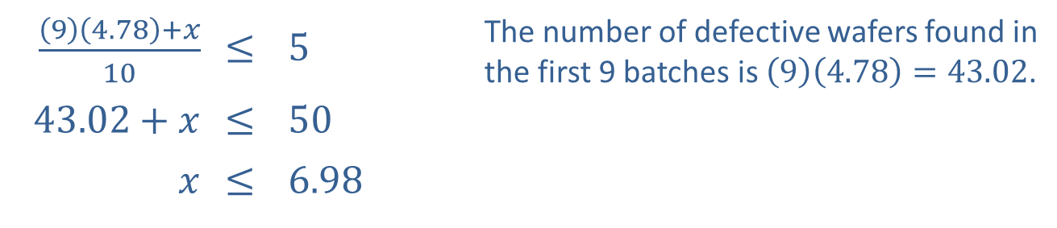

Example 8: Applications of Inequalities (cont.)
​The phrase "must not detect more than 5 defective wafers per batch on average" means the average number must be less than or equal to 5. Let $x$ denote the maximum number of defective wafers in the last batch.
​
​$\frac{\left(9\right)\left(4.78\right)+x}{10}$ | ​≤ | ​5 | The number of defective wafers found in the first 9 batches is $\left(9\right)\left(4.78\right)=43.02$.
​$43.02+x$ | ​≤ | ​50
$$x$$ | ​≤ | ​6.98

Slide 32
Example 8: Applications of Inequalities (cont.)
​Since it is not possible to have a fractional number of wafers, there must have been 43 defective wafers in the first 9 batches, so the maximum allowable number of defective wafers in the final batch is 7.

