Slide 1
Section 2.4
Polynomial and Polynomial-Like Equations in One Variable

Slide 2
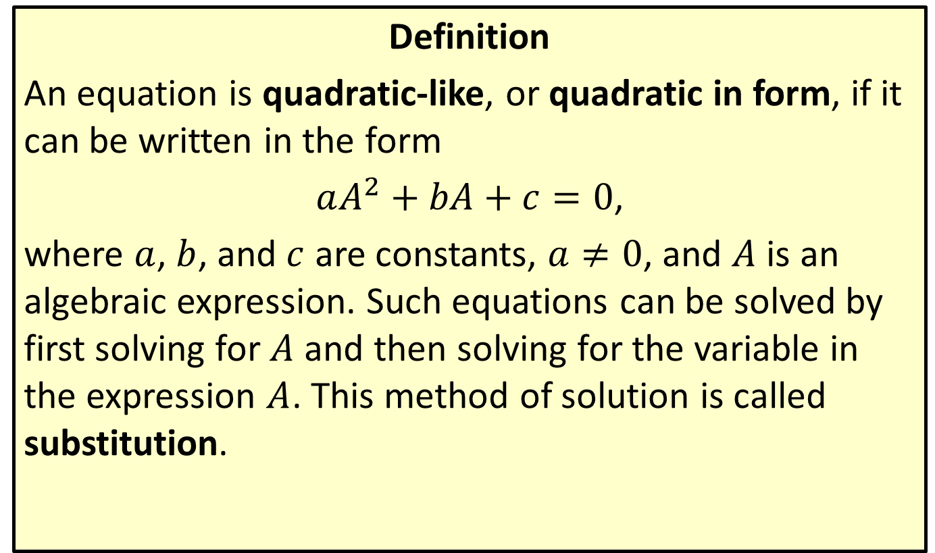
Quadratic-Like Equations
Definition
An equation is quadratic-like, or quadratic in form, if it can be written in the form
$aA^{2}+bA+c=0$,
where $a$, $b$, and $c$ are constants, $a≠0$, and $A$ is an algebraic expression. Such equations can be solved by first solving for $A$ and then solving for the variable in the expression $A$. This method of solution is called substitution.

Slide 3

Example 1: Quadratic-Like Equations
Solve the quadratic-like equations.
​${\left(x^{2}+2x\right)}^{2}−7\left(x^{2}+2x\right)−8=0$
​$y^{\frac{2}{3}}+4y^{\frac{1}{3}}−5=0$

Slide 4
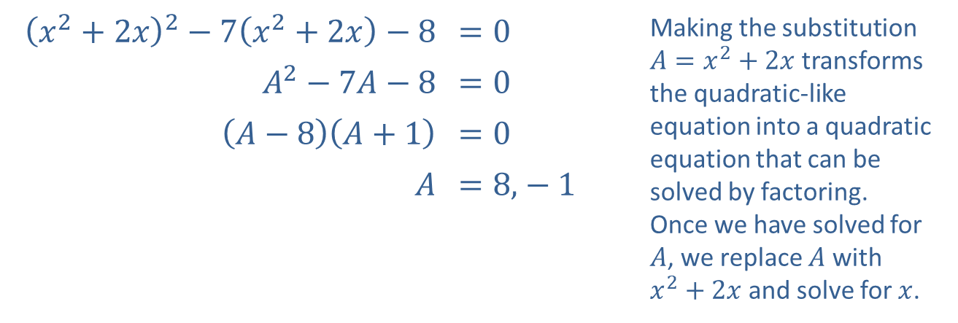
Example 1: Quadratic-Like Equations (cont.)
Solution
​
​${\left(x^{2}+2x\right)}^{2}−7\left(x^{2}+2x\right)−8$ | ​$=0$ | Making the substitution $A=x^{2}+2x$ transforms the quadratic-like equation into a quadratic equation that can be solved by factoring. Once we have solved for $A$, we replace $A$ with $x^{2}+2x$ and solve for $x$.
​$A^{2}−7A−8$ | ​$=0$
​$\left(A−8\right)\left(A+1\right)$ | ​$=0$
$A$ | ​$=8\text{,}−1$

Slide 5
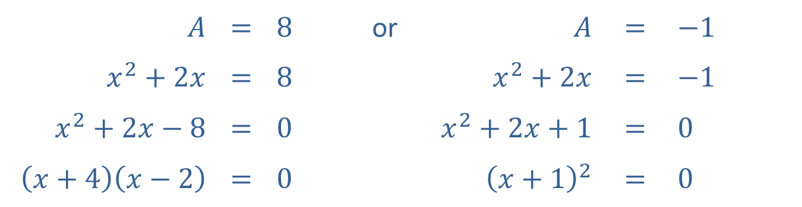

Example 1: Quadratic-Like Equations (cont.)
        $x=−4$ or $x=2$ or $x=−1$
​Note that $−1$ is a double root, while $−4$ and 2 are single roots.
While the substitution method does not necessarily introduce extraneous solutions, you should still check that each solution solves the original quadratic-like equation.
$A$ | $$=$$ | $8$ | or | $A$ | $$=$$ | $−1$
$x^{2}+2x$ | $$=$$ | $8$ |  | $x^{2}+2x$ | $$=$$ | $−1$
$x^{2}+2x−8$ | $$=$$ | $0$ |  | $x^{2}+2x+1$ | $$=$$ | $0$
$\left(x+4\right)\left(x−2\right)$ | $$=$$ | $0$ |  | ${\left(x+1\right)}^{2}$ | $$=$$ | $0$

Slide 6
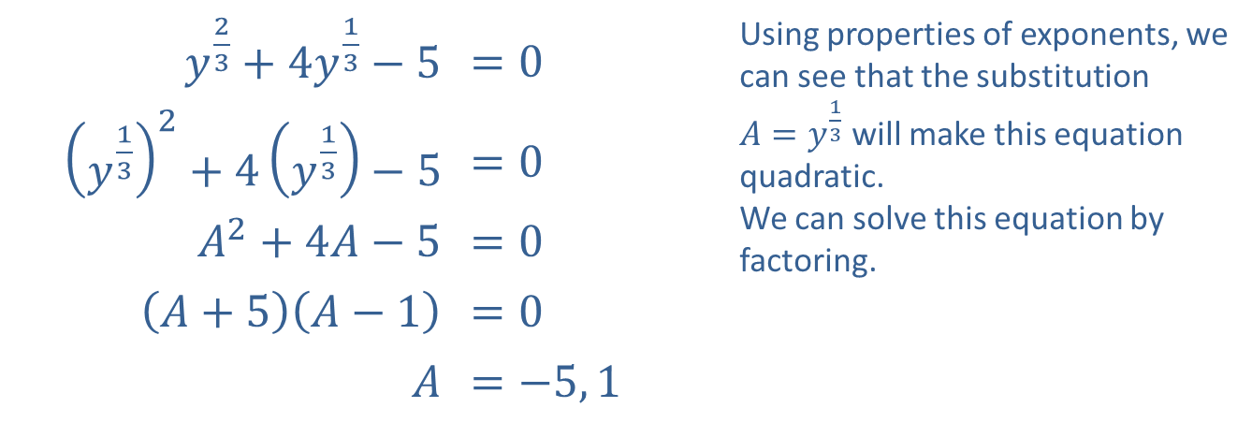
Example 1: Quadratic-Like Equations (cont.)
​$y^{\frac{2}{3}}+4y^{\frac{1}{3}}−5$ | ​$=0$ | Using properties of exponents, we can see that the substitution $A=y^{\frac{1}{3}}$ will make this equation quadratic. We can solve this equation by factoring.
​${\left(y^{\frac{1}{3}}\right)}^{2}+4\left(y^{\frac{1}{3}}\right)−5$ | ​$=0$
​$A^{2}+4A−5$ | ​$=0$
​$\left(A+5\right)\left(A−1\right)$ | ​$=0$
$A$ | ​$=−5, 1$
​

Slide 7
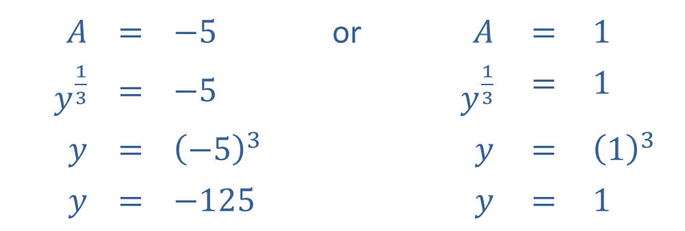

Example 1: Quadratic-Like Equations (cont.)
Now that we have solved for $A$, we reverse the substitution and solve for $y$ in each case.​
​Once again, you should confirm that both values do indeed solve the original equation $y^{\frac{2}{3}}+4y^{\frac{1}{3}}−5=0$.
$$A$$ | $$=$$ | $$−5$$ | or | $A$ | $$=$$ | $$1$$
$y^{\frac{1}{3}}$ | $$=$$ | $$−5$$ |  | $y^{\frac{1}{3}}$ | $$=$$ | $$1$$
$y$ | $$=$$ | $${\left(−5\right)}^{3}$$ |  | $y$ | $$=$$ | $${\left(1\right)}^{3}$$
$y$ | $$=$$ | $$−125$$ |  | $y$ | $$=$$ | $$1$$

Slide 8

Example 2: Solving Equations by Factoring
Solve the equations by factoring.
​$x^{4}=9$
​$y^{3}+y^{2}−4y−4=0$
​$8t^{3}−27=0$
​$3x^{4}+18x^{3}−21x^{2}=0$

Slide 9
Note:
While checking solutions is always a good practice, solving by factoring does not produce any extraneous solutions.

Slide 10
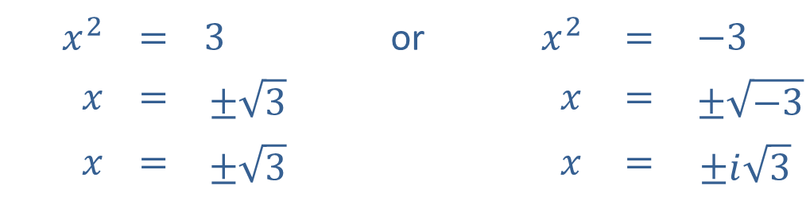
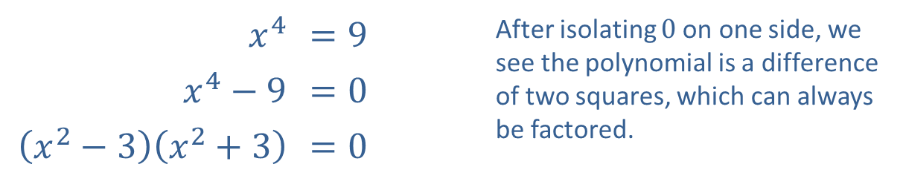
Example 2: Solving Equations by Factoring (cont.)
Solution
​
​$x^{4}$ | ​$=9$ | After isolating 0 on one side, we see the polynomial is a difference of two squares, which can always be factored.
​$x^{4}−9$ | ​$=0$
​$\left(x^{2}−3\right)\left(x^{2}+3\right)$ | ​$=0$
The Zero-Product Property gives us two equations, both of which can be solved by taking square roots.
$$x^{2}$$ | $$=$$ | $$3$$ | or | $x^{2}$ | $$=$$ | $$−3$$
$x$ | $$=$$ | $$±\sqrt{3}$$ |  | $x$ | $$=$$ | $$±\sqrt{−3}$$
$x$ | $$=$$ | $$±\sqrt{3}$$ |  | $x$ | $$=$$ | $$±i\sqrt{3}$$

Slide 11

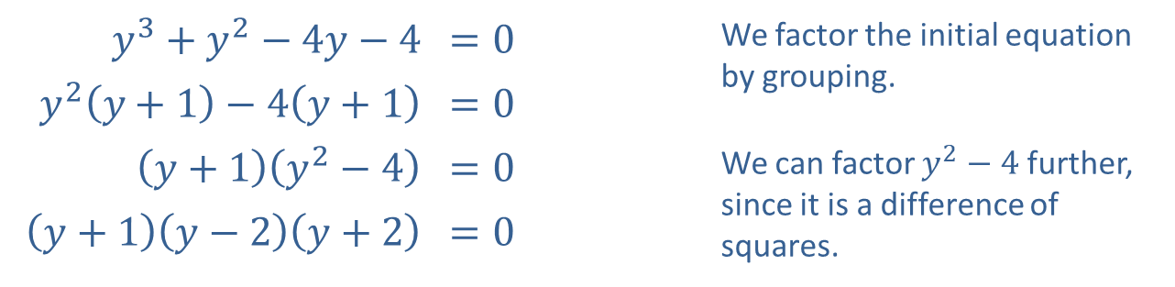
Example 2: Solving Equations by Factoring (cont.)
​
​$y^{3}+y^{2}−4y−4$ | ​$=0$ | We factor the initial equation by grouping.
​$y^{2}\left(y+1\right)−4\left(y+1\right)$ | ​$=0$
​$\left(y+1\right)\left(y^{2}−4\right)$ | ​$=0$ | We can factor $y^{2}−4$ further, since it is a difference of squares.
​$\left(y+1\right)\left(y−2\right)\left(y+2\right)$ | ​$=0$
​There are three solutions by the Zero-Factor Property.
​$y=−1$ or $y=2$ or $y=−2$
​

Slide 12
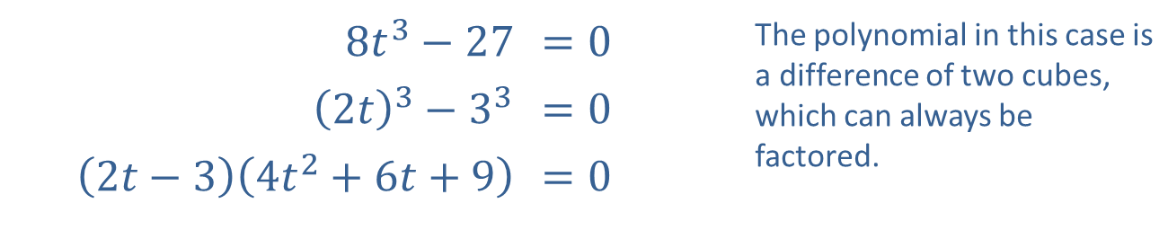
Example 2: Solving Equations by Factoring (cont.)
​
​$8t^{3}−27$ | ​$=0$ | The polynomial in this case is a difference of two cubes, which can always be factored.
​${\left(2t\right)}^{3}−3^{3}$ | ​$=0$
​$\left(2t−3\right)\left(4t^{2}+6t+9\right)$ | ​$=0$

Slide 13
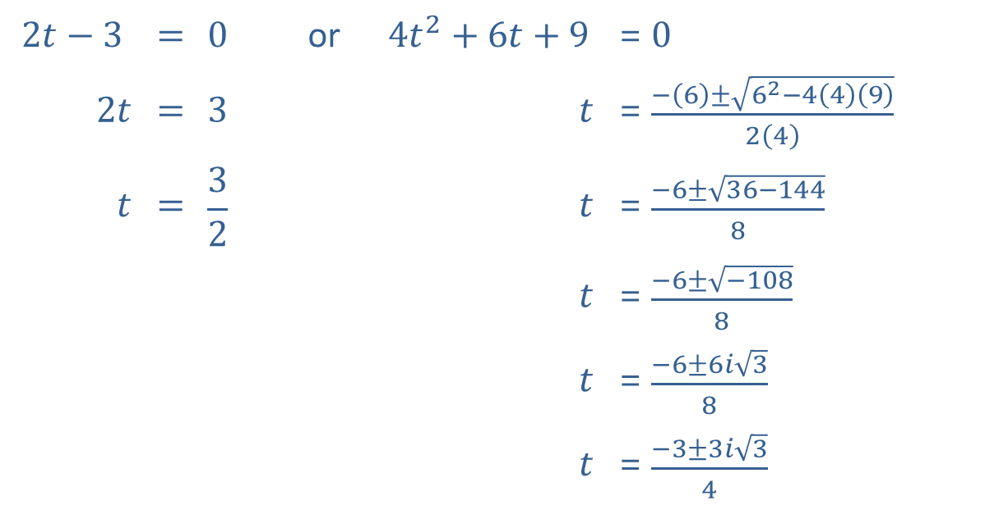
Example 2: Solving Equations by Factoring (cont.)
The Zero-Factor Property gives us two equations to solve. One of the equations is quadratic, and we can use the quadratic formula to solve it.
$$2t−3$$ | $$=$$ | $$0$$ | or | $$4t^{2}+6t+9$$ | $$=$$ | $0$
$2t$ | $$=$$ | $$3$$ |  | $t$ | $$=$$ | $\frac{−\left(6\right)±\sqrt{6^{2}−4\left(4\right)\left(9\right)}}{2\left(4\right)}$
$t$ | $$=$$ | $$\frac{3}{2}$$ |  | $t$ | $$=$$ | $\frac{−6±\sqrt{36−144}}{8}$
 |  |  |  | $t$ | $$=$$ | $\frac{−6±\sqrt{−108}}{8}$
 |  |  |  | $t$ | $$=$$ | $\frac{−6±6i\sqrt{3}}{8}$
 |  |  |  | $t$ | $$=$$ | $\frac{−3±3i\sqrt{3}}{4}$

Slide 14

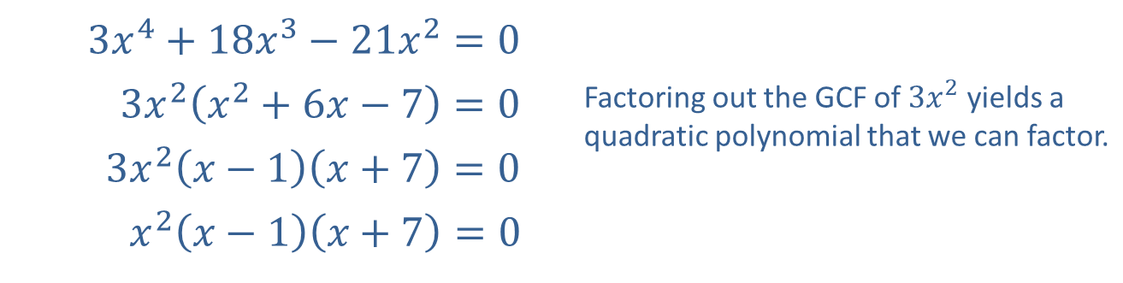
Example 2: Solving Equations by Factoring (cont.)
​
​$3x^{4}+18x^{3}−21x^{2}=0$
​$3x^{2}\left(x^{2}+6x−7\right)=0$ | Factoring out the GCF of $3x^{2}$ yields a quadratic polynomial that we can factor.
​$3x^{2}\left(x−1\right)\left(x+7\right)=0$
​$x^{2}\left(x−1\right)\left(x+7\right)=0$
​The Zero-Factor Property yields three solutions to the original equation.
​$x=0,1,$ or $−7$

Slide 15

Example 3: Solving Equations by Factoring
Solve the equations by factoring.
​$x^{\frac{7}{3}}+x^{\frac{4}{3}}−2x^{\frac{1}{3}}=0$
​${\left(x−1\right)}^{\frac{1}{2}}−{\left(x−1\right)}^{−\frac{1}{2}}=0$

Slide 16
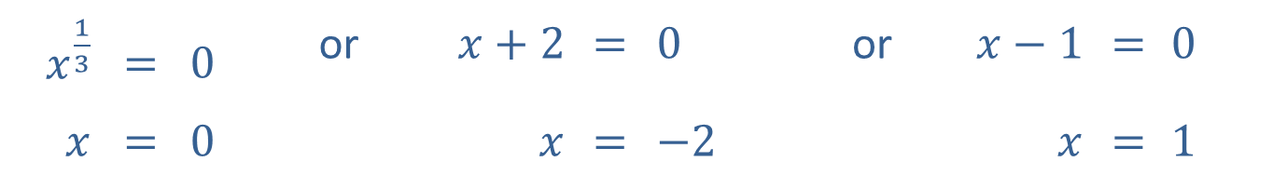
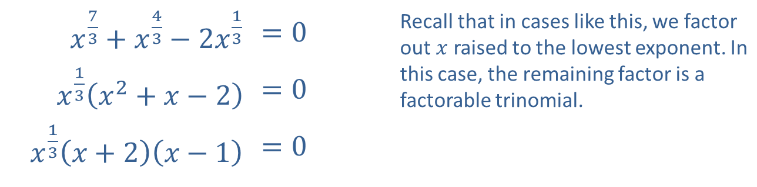
Example 3: Solving Equations by Factoring (cont.)
Solution
​
​$x^{\frac{7}{3}}+x^{\frac{4}{3}}−2x^{\frac{1}{3}}$ | ​$=0$ | Recall that in cases like this, we factor out $x$ raised to the lowest exponent. In this case, the remaining factor is a factorable trinomial.
​$x^{\frac{1}{3}}\left(x^{2}+x−2\right)$ | ​$=0$
​$x^{\frac{1}{3}}\left(x+2\right)\left(x−1\right)$ | ​$=0$
​The Zero-Factor Property leads to three simple equations.
$x^{\frac{1}{3}}$ | $$=$$ | $0$ | or | $x+2$ | $$=$$ | $0$ | or | $x−1$ | $$=$$ | $0$
$x$ | $$=$$ | $0$ |  | $x$ | $$=$$ | $−2$ |  | $x$ | $$=$$ | $1$

Slide 17
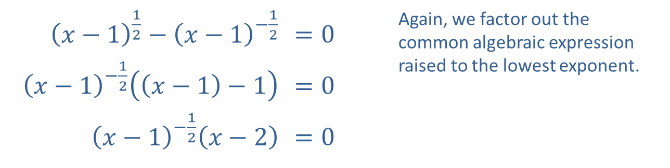
Example 3: Solving Equations by Factoring (cont.)
​${\left(x−1\right)}^{\frac{1}{2}}−{\left(x−1\right)}^{−\frac{1}{2}}$ | ​$=0$ | Again, we factor out the common algebraic expression raised to the lowest exponent.
​${\left(x−1\right)}^{−\frac{1}{2}}\left(\left(x−1\right)−1\right)$ | ​$=0$
​${\left(x−1\right)}^{−\frac{1}{2}}\left(x−2\right)$ | ​$=0$
​

Slide 18
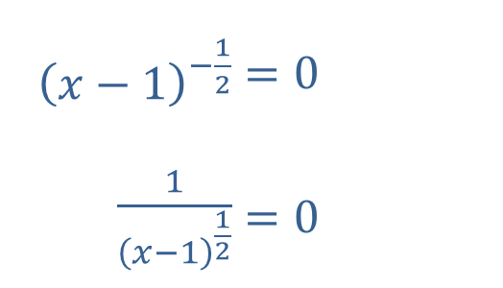
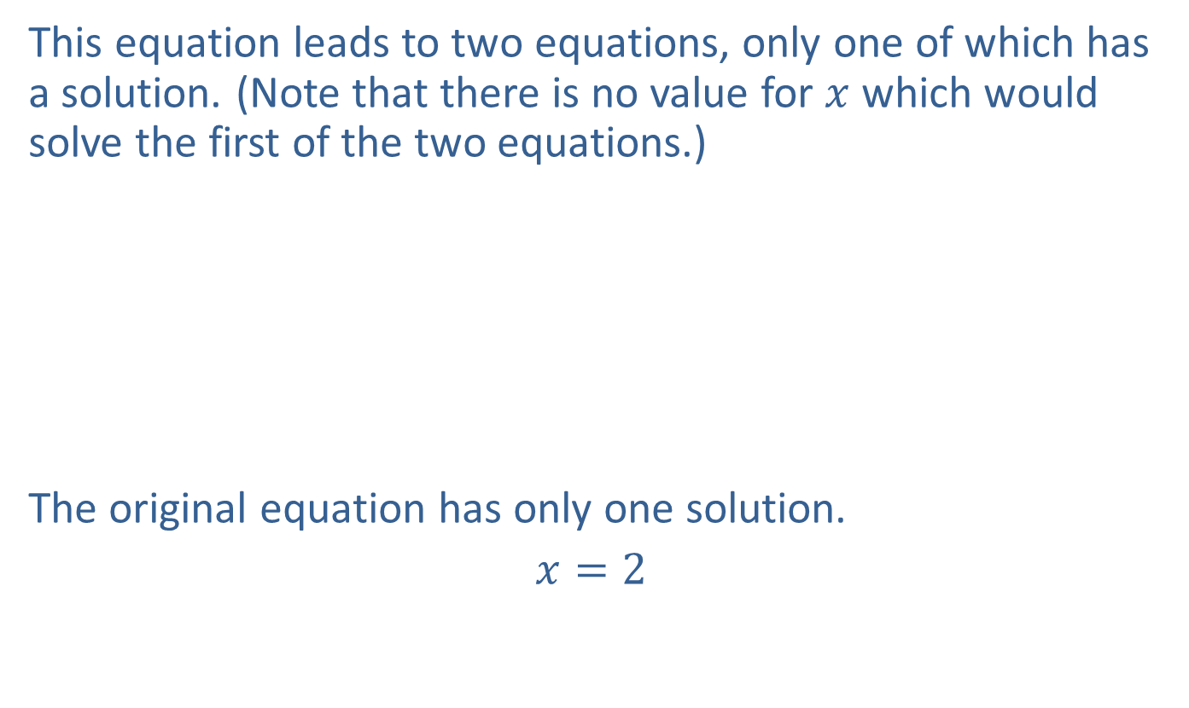

Example 3: Solving Equations by Factoring (cont.)
​This equation leads to two equations, only one of which has a solution. (Note that there is no value for $x$ which would solve the first of the two equations.)
​
​The original equation has only one solution.
​$x=2$
​
​${\left(x−1\right)}^{−\frac{1}{2}}$ | ​$=0$
​$\frac{1}{{\left(x−1\right)}^{\frac{1}{2}}}$ | ​$=0$
​$x−2$ | ​$=0$
​$x$ | ​$=2$
or

Slide 19

Example 4: Solving Equations by Factoring
Solve the equation $x^{−2}−7x^{−1}+12=0$ by factoring.

Slide 20
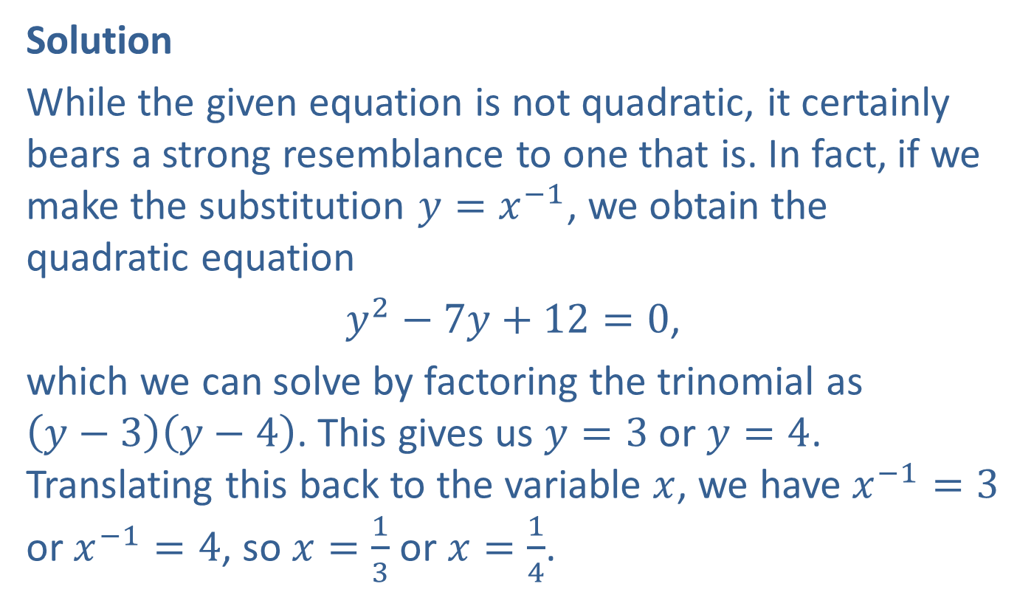
Example 4: Solving Equations by Factoring (cont.)
Solution
While the given equation is not quadratic, it certainly bears a strong resemblance to one that is. In fact, if we make the substitution $y=x^{−1}$, we obtain the quadratic equation
$y^{2}−7y+12=0$,
which we can solve by factoring the trinomial as
$\left(y−3\right)\left(y−4\right)$. This gives us $y=3$ or $y=4$. Translating this back to the variable $x$, we have $x^{−1}=3$ or $x^{−1}=4$, so $x=\frac{1}{3}$ or $x=\frac{1}{4}$.

