Slide 1
Section 2.5
Rational Equations in One Variable

Slide 2
Rational Equations
A rational equation is an equation that contains at least one rational expression, while any nonrational expressions are polynomials.

Slide 3

Example 1: Solving Rational Equations
Solve the following rational equations.
​ $\frac{x^{3}+3x^{2}}{x^{2}−2x−15}=\frac{4x+5}{x−5}$
​ $\frac{3x^{2}}{5x−1}−1=0$

Slide 4
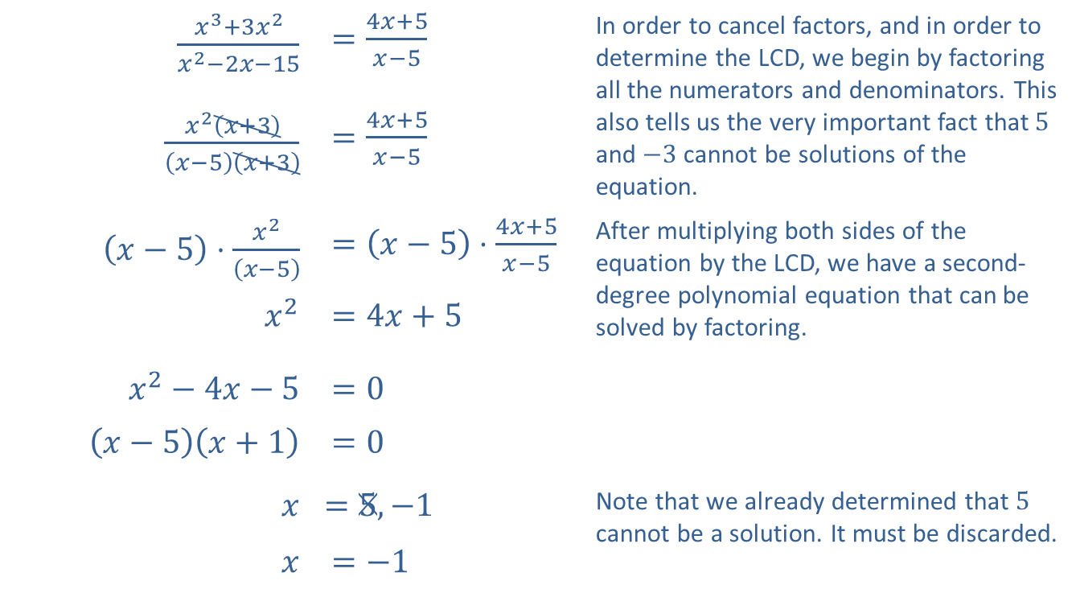
Example 1: Solving Rational Equations (cont.)
Solution
​
$\frac{x^{3}+3x^{2}}{x^{2}−2x−15}$ | $=\frac{4x+5}{x−5}$ | In order to cancel factors, and in order to determine the LCD, we begin by factoring all the numerators and denominators. This also tells us the very important fact that 5 and $−3$ cannot be solutions of the equation.
$\frac{x^{2}\left(x+3\right)}{\left(x−5\right)\left(x+3\right)}$ | $=\frac{4x+5}{x−5}$
$\left(x−5\right)⋅\frac{x^{2}}{\left(x−5\right)}$ | $=\left(x−5\right)⋅\frac{4x+5}{x−5}$ | After multiplying both sides of the equation by the LCD, we have a second-degree polynomial equation that can be solved by factoring.
$x^{2}$ | $=4x+5$
$x^{2}−4x−5$ | $=0$
$\left(x−5\right)\left(x+1\right)$ | $=0$
$$x$$ | ​$=5,−1$ | Note that we already determined that 5 cannot be a solution. It must be discarded.
$$x$$ | $=−1$

Slide 5
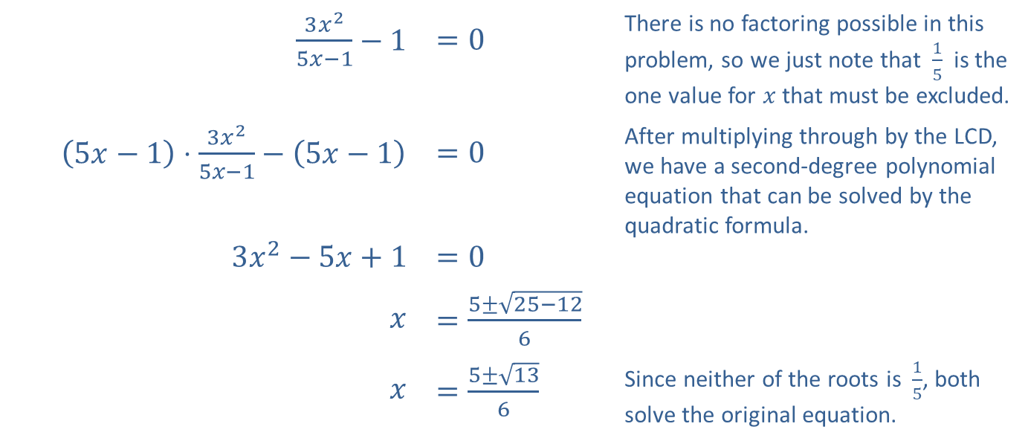
Example 1: Solving Rational Equations (cont.)
$\frac{3x^{2}}{5x−1}−1$ | $=0$ | There is no factoring possible in this problem, so we just note that $\frac{1}{5}$ is the one value for $x$ that must be excluded.
$\left(5x−1\right)⋅\frac{3x^{2}}{5x−1}−\left(5x−1\right)$ | $=0$ | After multiplying through by the LCD, we have a second-degree polynomial equation that can be solved by the quadratic formula.
$3x^{2}−5x+1$ | $=0$
$$x$$ | $=\frac{5±\sqrt{25−12}}{6}$
$$x$$ | $=\frac{5±\sqrt{13}}{6}$ | Since neither of the roots is $\frac{1}{5}$, both solve the original equation.
​

Slide 6

Example 2: Solving an Absolute Value Rational Equation
Solve the equation $\left|x−5\right|=\frac{7}{x+1}$.

Slide 7
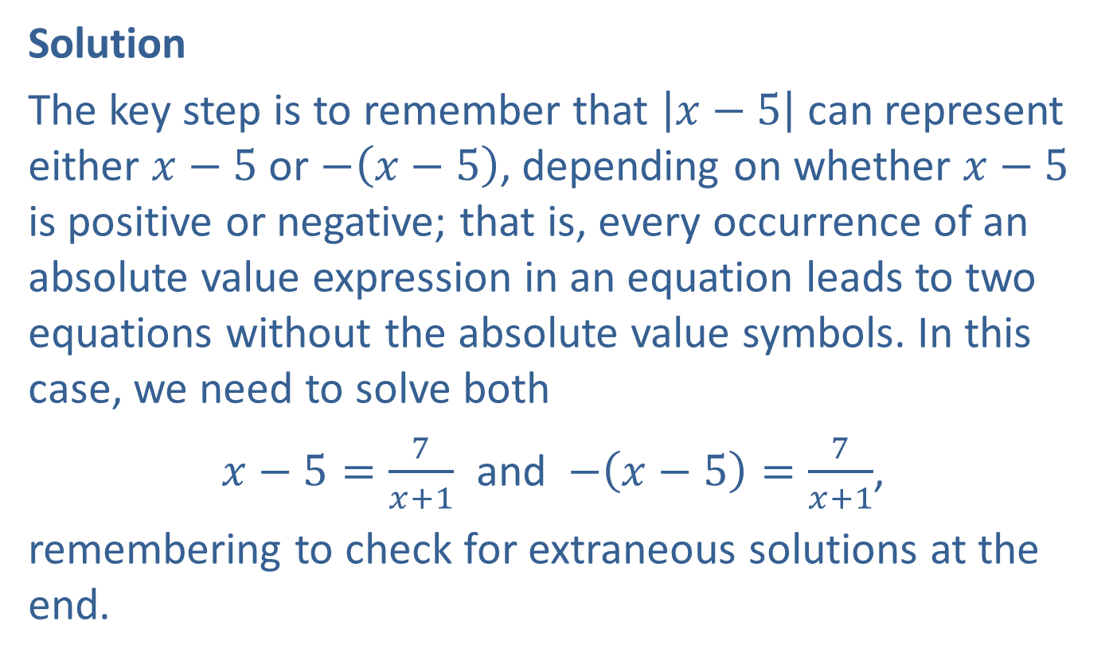
Example 2: Solving an Absolute Value Rational Equation (cont.)
Solution
The key step is to remember that $\left|x−5\right|$ can represent either $x−5$ or $−\left(x−5\right)$, depending on whether $x−5$ is positive or negative; that is, every occurrence of an absolute value expression in an equation leads to two equations without the absolute value symbols. In this case, we need to solve both
$x−5=\frac{7}{x+1}$ and $−\left(x−5\right)=\frac{7}{x+1}$,
remembering to check for extraneous solutions at the end.

Slide 8
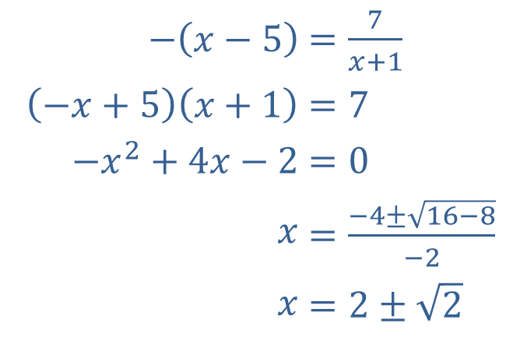
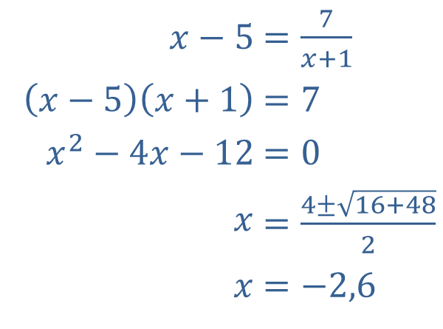
Example 2: Solving an Absolute Value Rational Equation (cont.)
We will carry out the solutions of the two equations in parallel, as the steps are the same.
​
​$x−5$ | ​$=\frac{7}{x+1}$
​$\left(x−5\right)\left(x+1\right)$ | ​$=7$
​$x^{2}−4x−12$ | ​$=0$
​$x$ | ​$=\frac{4±\sqrt{16+48}}{2}$
​$x$ | ​$=−2,6$
​$−\left(x−5\right)$ | ​$=\frac{7}{x+1}$
​$\left(−x+5\right)\left(x+1\right)$ | ​$=7$
​$−x^{2}+4x−2$ | ​$=0$
​$x$ | ​$=\frac{−4±\sqrt{16−8}}{−2}$
​$x$ | ​$=2±\sqrt{2}$

Slide 9
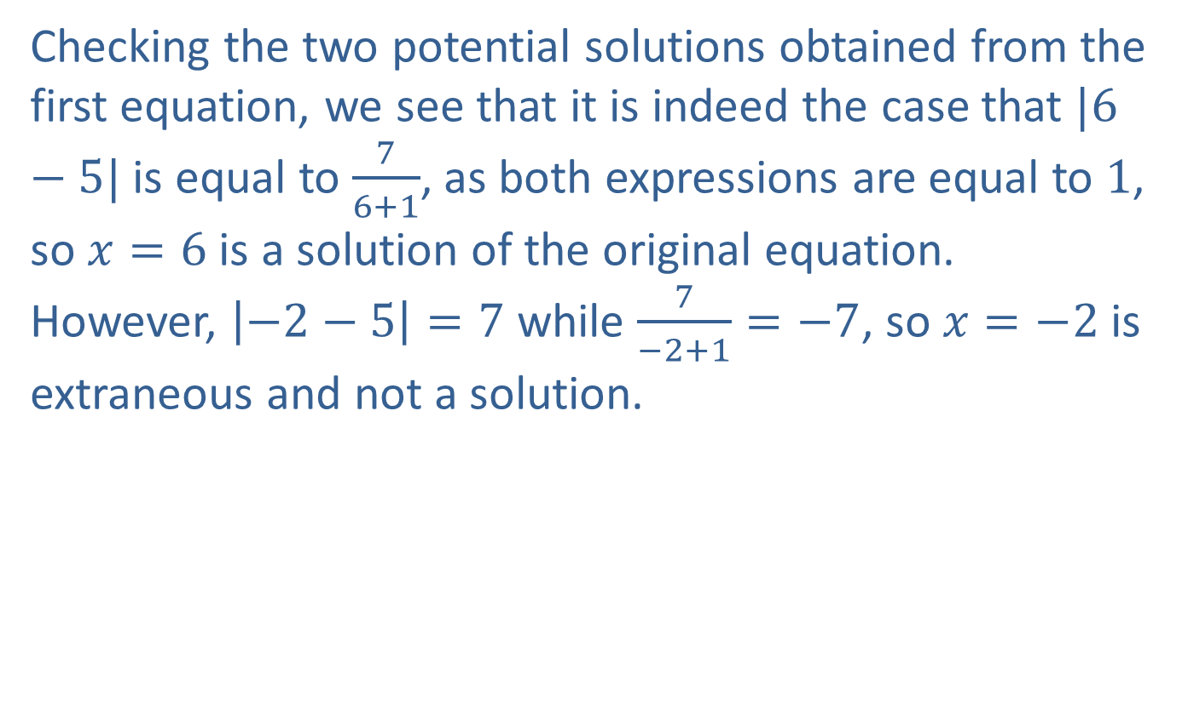
Example 2: Solving an Absolute Value Rational Equation (cont.)
Checking the two potential solutions obtained from the first equation, we see that it is indeed the case that $|6−5|$ is equal to $\frac{7}{6+1}$, as both expressions are equal to 1, so $x=6$ is a solution of the original equation. However, $\left|−2−5\right|=7$ while $\frac{7}{−2+1}=−7$, so $x=−2$ is extraneous and not a solution.

Slide 10
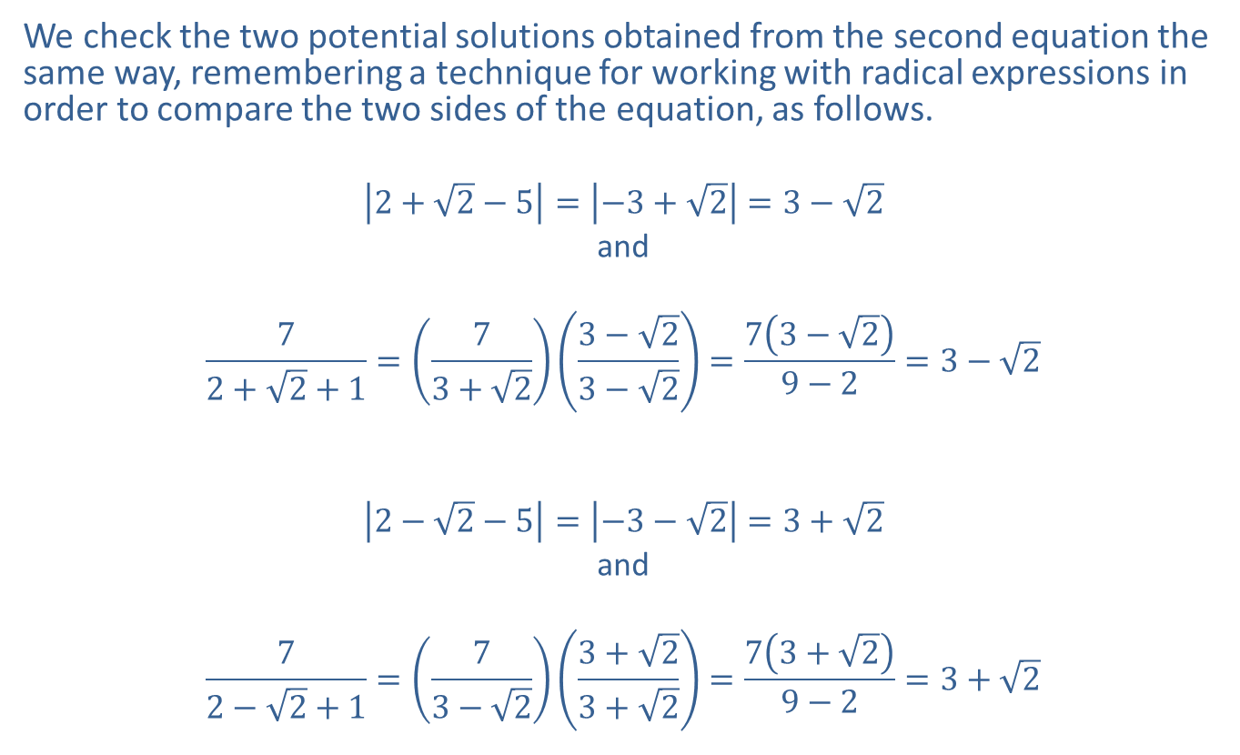
Example 2: Solving an Absolute Value Rational Equation (cont.)
We check the two potential solutions obtained from the second equation the same way, remembering a technique for working with radical expressions in order to compare the two sides of the equation, as follows.
$$\left|2+\sqrt{2}−5\right|=\left|−3+\sqrt{2}\right|=3−\sqrt{2}$$
and
$$\frac{7}{2+\sqrt{2}+1}=\left(\frac{7}{3+\sqrt{2}}\right)\left(\frac{3−\sqrt{2}}{3−\sqrt{2}}\right)=\frac{7\left(3−\sqrt{2}\right)}{9−2}=3−\sqrt{2}$$
$$\left|2−\sqrt{2}−5\right|=\left|−3−\sqrt{2}\right|=3+\sqrt{2}$$
and
$$\frac{7}{2−\sqrt{2}+1}=\left(\frac{7}{3−\sqrt{2}}\right)\left(\frac{3+\sqrt{2}}{3+\sqrt{2}}\right)=\frac{7\left(3+\sqrt{2}\right)}{9−2}=3+\sqrt{2}$$

Slide 11
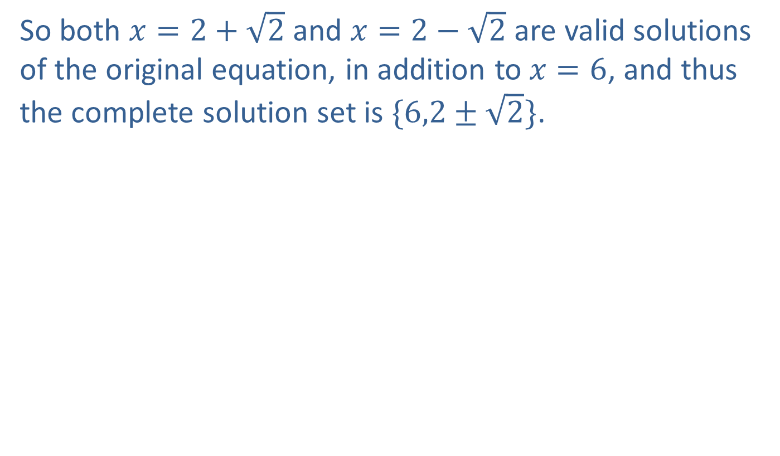
Example 2: Solving an Absolute Value Rational Equation (cont.)
So both $x=2+\sqrt{2}$ and $x=2−\sqrt{2}$ are valid solutions of the original equation, in addition to $x=6$, and thus the complete solution set is $\{6,2±\sqrt{2}\}$.

Slide 12
Example 3: Filling a Pool
One hose can fill a swimming pool in 12 hours. The owner buys a second hose that can fill the pool at twice the rate of the first one. If both hoses are used together, how long does it take to fill the pool?

Slide 13
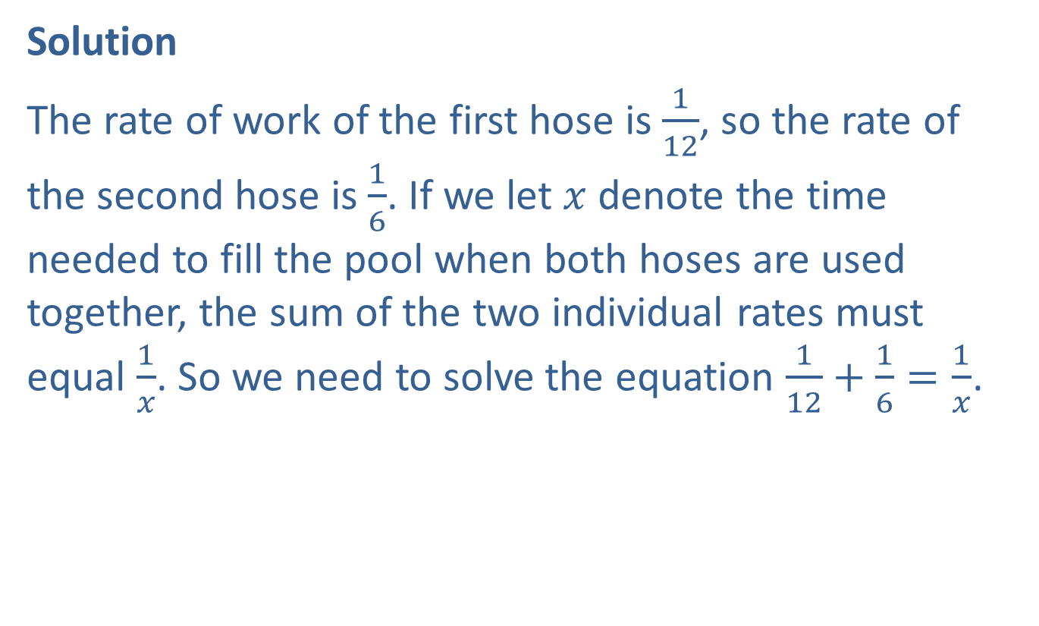
Example 3: Filling a Pool (cont.)
Solution
The rate of work of the first hose is $\frac{1}{12}$, so the rate of the second hose is $\frac{1}{6}$. If we let $x$ denote the time needed to fill the pool when both hoses are used together, the sum of the two individual rates must equal $\frac{1}{x}$. So we need to solve the equation $\frac{1}{12}+\frac{1}{6}=\frac{1}{x}$.

Slide 14
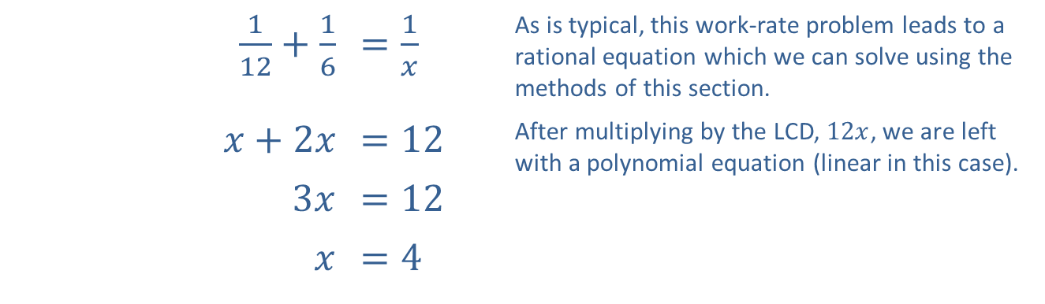
Example 3: Filling a Pool (cont.)
Thus, using both hoses, it will take 4 hours to fill the pool.
​$\frac{1}{12}+\frac{1}{6}$ | ​$=\frac{1}{x}$ | As is typical, this work-rate problem leads to a rational equation which we can solve using the methods of this section.
​$x+2x$ | ​$=12$ | After multiplying by the LCD, $12x$, we are left with a polynomial equation (linear in this case).
​$3x$ | ​$=12$
$$x$$ | ​$=4$

Slide 15
Example 4: Filling a Pool Poorly
The pool owner in Example 3 is a bit clumsy, and one day proceeds to fill his empty pool with the two hoses but accidentally turns on the pump that drains the pool also. Fortunately, the pump rate is slower than the combined rate of the two hoses, and the pool fills anyway, but it takes 10 hours to do so. How long does it take the pump to empty the pool?

Slide 16
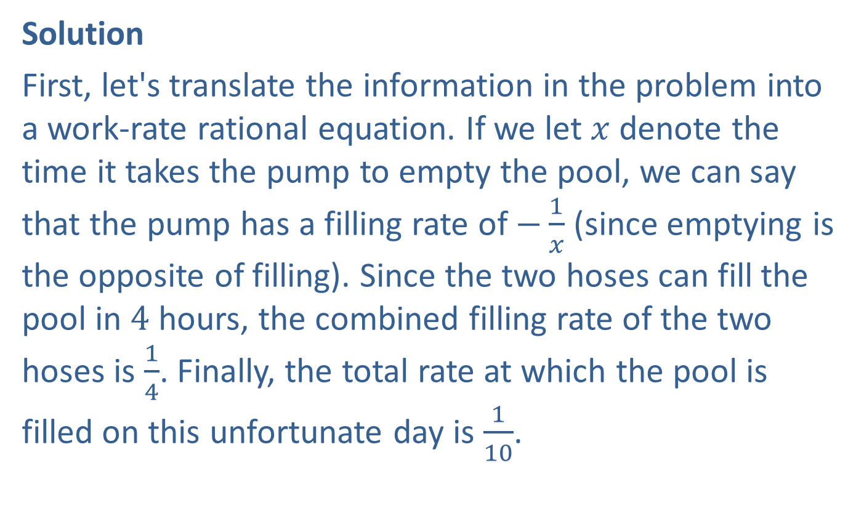
Example 4: Filling a Pool Poorly (cont.)
Solution
First, let's translate the information in the problem into a work-rate rational equation. If we let $x$ denote the time it takes the pump to empty the pool, we can say that the pump has a filling rate of $−\frac{1}{x}$ (since emptying is the opposite of filling). Since the two hoses can fill the pool in 4 hours, the combined filling rate of the two hoses is $\frac{1}{4}$. Finally, the total rate at which the pool is filled on this unfortunate day is $\frac{1}{10}$.

Slide 17
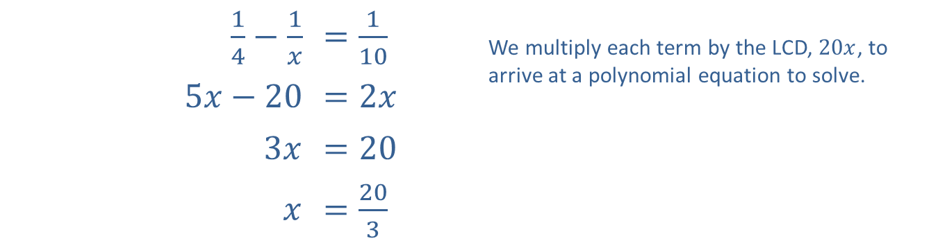

Example 4: Filling a Pool Poorly (cont.)
Again, the sum of the individual rates is equal to the combined rate, so the following rational equation reflects this situation.
Thus, working alone, the pump can empty the pool in $\frac{20}{3}$ hours, or 6 hours and 40 minutes.
​$\frac{1}{4}−\frac{1}{x}$ | ​$=\frac{1}{10}$ | We multiply each term by the LCD, $20x$, to arrive at a polynomial equation to solve.
​$5x−20$ | ​$=2x$
​$3x$ | ​$=20$
$$x$$ | ​$=\frac{20}{3}$

