Slide 1
Section 2.6
Radical Equations in One Variable

Slide 2
Radical Equations
A radical equation is an equation that has at least one radical expression containing a variable, while any nonradical expressions are polynomial terms.

Slide 3
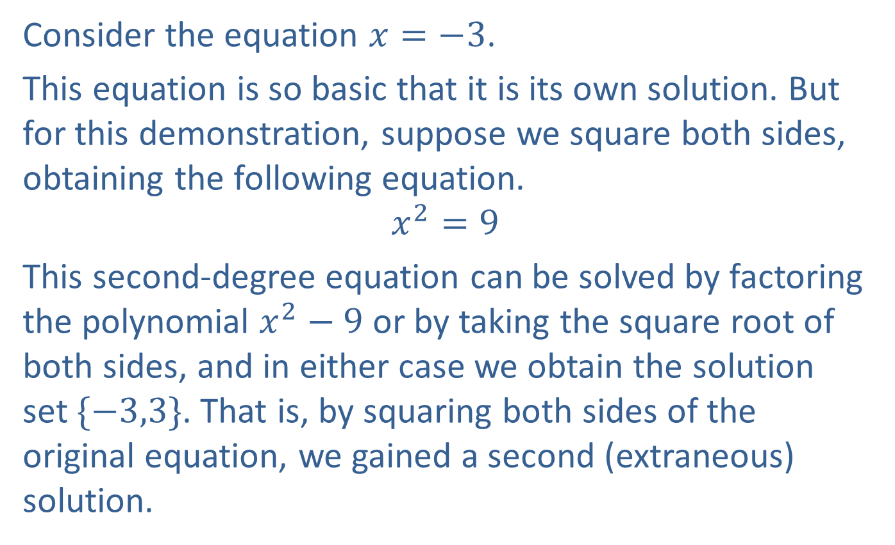
Example 1: Causing Extraneous Solutions
Consider the equation $x=−3$.
This equation is so basic that it is its own solution. But for this demonstration, suppose we square both sides, obtaining the following equation.
$$x^{2}=9$$
This second-degree equation can be solved by factoring the polynomial $x^{2}−9$ or by taking the square root of both sides, and in either case we obtain the solution set $\{−3,3\}$. That is, by squaring both sides of the original equation, we gained a second (extraneous) solution.

Slide 4
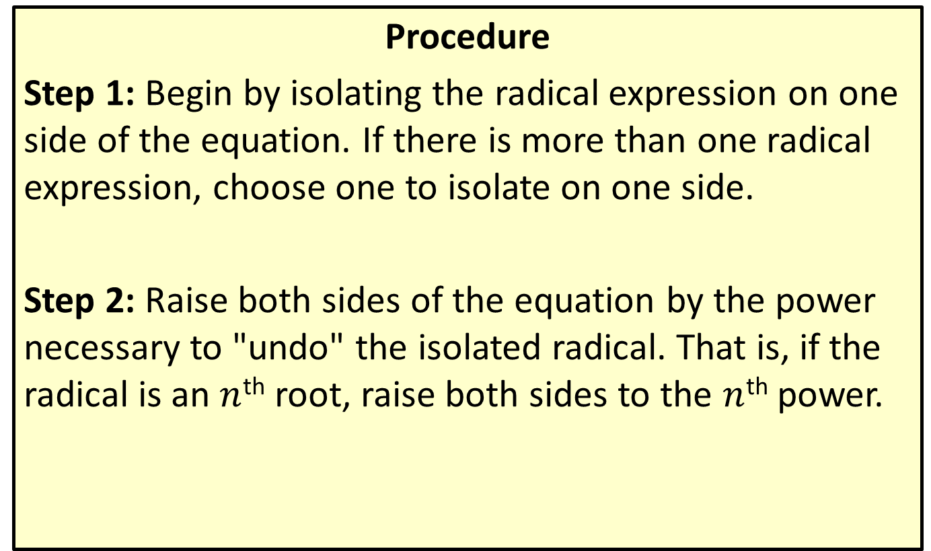
Solving Radical Equations
Procedure
Step 1: Begin by isolating the radical expression on one side of the equation. If there is more than one radical expression, choose one to isolate on one side.
Step 2: Raise both sides of the equation by the power necessary to "undo" the isolated radical. That is, if the radical is an $n$^{th} root, raise both sides to the $n$^{th} power.

Slide 5
Solving Radical Equations (cont.)
Step 3: If any radical expressions remain, simplify the equation if possible and then repeat steps 1 and 2 until the result is a polynomial equation. When a polynomial equation has been obtained, solve the equation using polynomial methods.
Step 4: Check your solutions in the original equation! Any extraneous solutions must be discarded.

Slide 6

Example 2: Radical Equations
Solve the radical equations.
​$\sqrt{1−x}−1=x$
​$\sqrt{x+1}+\sqrt{x+2}=1$
​$\sqrt[4]{x^{2}+8x+7}−2=0$

Slide 7
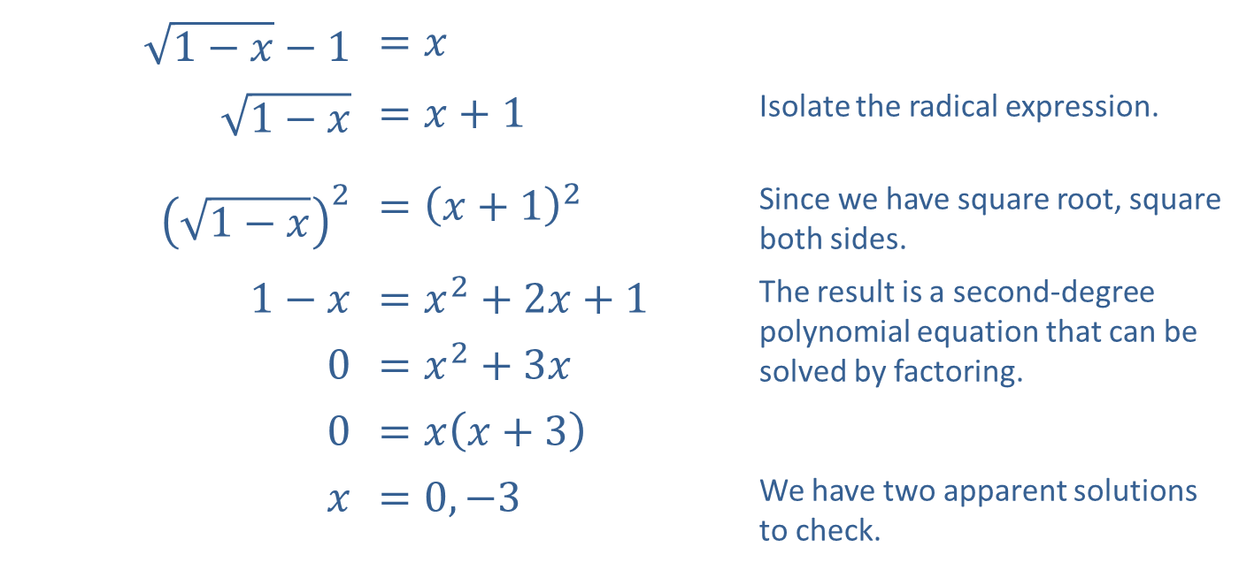
Example 2: Radical Equations (cont.)
Solution
​
​$\sqrt{1−x}−1$ | ​$=x$
​$\sqrt{1−x}$ | ​$=x+1$ | Isolate the radical expression.
​${\left(\sqrt{1−x}\right)}^{2}$ | ​$={\left(x+1\right)}^{2}$ | Since we have square root, square both sides.
​$1−x$ | ​$=x^{2}+2x+1$ | The result is a second-degree polynomial equation that can be solved by factoring.
​0 | ​$=x^{2}+3x$
​0 | ​$=x\left(x+3\right)$
$$x$$ | ​$=0,−3$ | We have two apparent solutions to check.

Slide 8

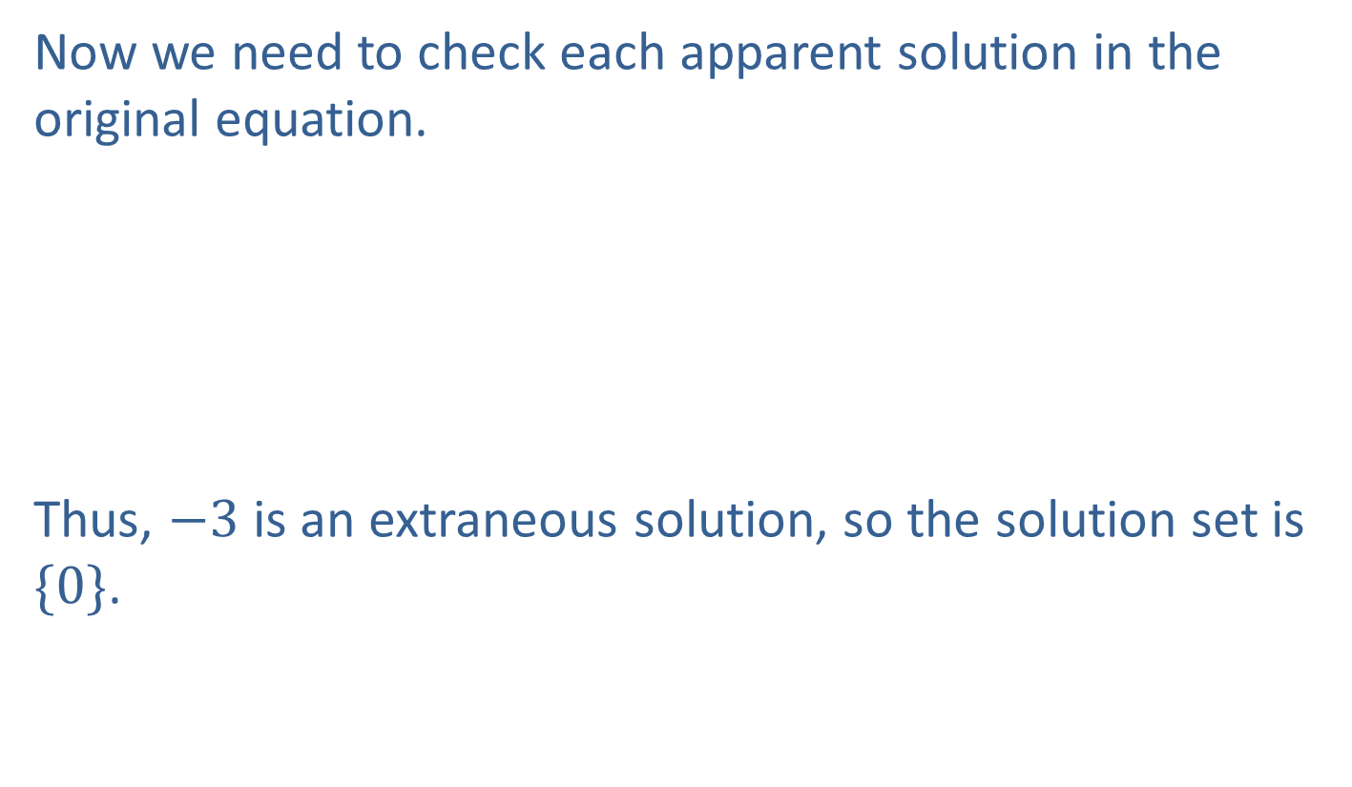
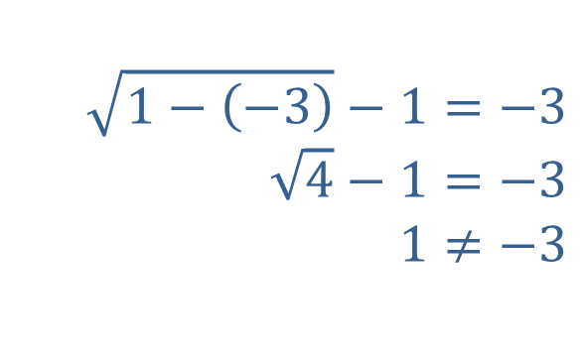
Example 2: Radical Equations (cont.)
​Now we need to check each apparent solution in the original equation.
​Thus, $−3$ is an extraneous solution, so the solution set is $\{0\}$.
​
$$\sqrt{1−0}−1=0 \\ \sqrt{1}−1=0 \\ 0=0$$
​
$$\sqrt{1−\left(−3\right)}−1=−3 \\ \sqrt{4}−1=−3 \\ 1≠−3$$
​

Slide 9
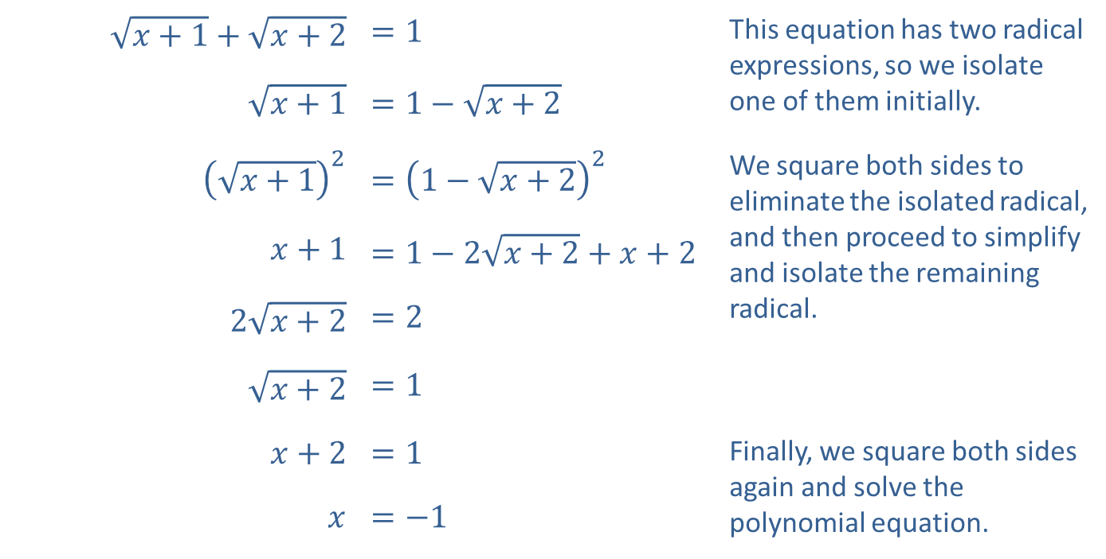
Example 2: Radical Equations (cont.)
​
​$\sqrt{x+1}+\sqrt{x+2}$ | ​$=1$ | This equation has two radical expressions, so we isolate one of them initially.
​$\sqrt{x+1}$ | ​$=1−\sqrt{x+2}$
​${\left(\sqrt{x+1}\right)}^{2}$ | ​$={\left(1−\sqrt{x+2}\right)}^{2}$ | We square both sides to eliminate the isolated radical, and then proceed to simplify and isolate the remaining radical.
​$x+1$ | ​$=1−2\sqrt{x+2}+x+2$
​$2\sqrt{x+2}$ | ​$=2$
​$\sqrt{x+2}$ | ​$=1$
​$x+2$ | ​$=1$ | Finally, we square both sides again and solve the polynomial equation.
$$x$$ | ​$=−1$

Slide 10


Example 2: Radical Equations (cont.)
​We check the apparent solution in the original equation.
Thus, the solution set is $\{−1\}$.
​
$$\sqrt{\left(−1\right)+1}+\sqrt{\left(−1\right)+2}=1 \\ \sqrt{0}+\sqrt{1}=1 \\ 1=1$$
​

Slide 11
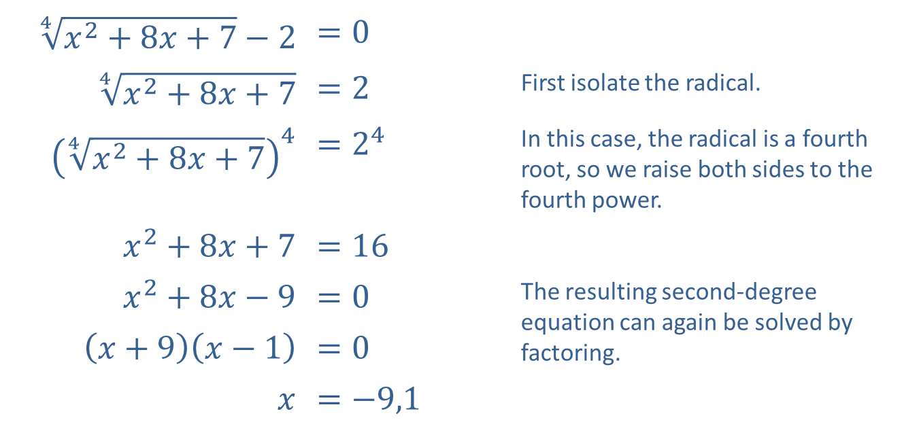
Example 2: Radical Equations (cont.)
​
​$\sqrt[4]{x^{2}+8x+7}−2$ | ​$=0$
​$\sqrt[4]{x^{2}+8x+7}$ | ​$=2$ | First isolate the radical.
​${\left(\sqrt[4]{x^{2}+8x+7}\right)}^{4}$ | ​$=2^{4}$ | In this case, the radical is a fourth root, so we raise both sides to the fourth power.
​$x^{2}+8x+7$ | ​$=16$
​$x^{2}+8x−9$ | ​$=0$ | The resulting second-degree equation can again be solved by factoring.
​$\left(x+9\right)\left(x−1\right)$ | ​$=0$
$$x$$ | ​$=−9,1$

Slide 12



Example 2: Radical Equations (cont.)
​Once again, we check the apparent solutions in the original equation.
​Both apparent solutions are actual solutions, so the solution set is $\{−9,1\}$.
​
$$\sqrt[4]{{\left(−9\right)}^{2}+8\left(−9\right)+7}−2=0 \\ \sqrt[4]{16}−2=0 \\ 2−2=0 \\ 0=0$$
​
$$\sqrt[4]{{\left(1\right)}^{2}+8\left(1\right)+7}−2=0 \\ \sqrt[4]{16}−2=0 \\ 2−2=0 \\ 0=0$$
​

Slide 13
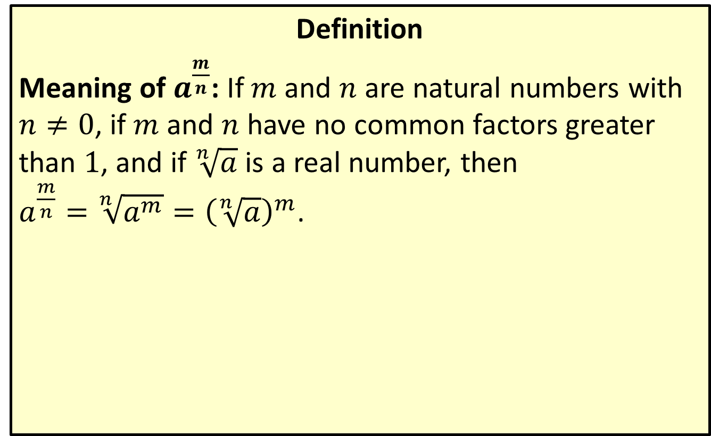
Positive Rational Number Exponents
Definition
Meaning of $a^{\frac{m}{n}}$: If $m$ and $n$ are natural numbers with $n≠0$, if $m$ and $n$ have no common factors greater than 1, and if $\sqrt[n]{a}$ is a real number, then
$a^{\frac{m}{n}}=\sqrt[n]{a^{m}}={\left(\sqrt[n]{a}\right)}^{m}$.

Slide 14

Example 3: Rational Exponents
Solve the following equations with rational exponents.
​$x^{\frac{2}{3}}−9=0$
​${\left(32x^{2}−32x+17\right)}^{\frac{1}{4}}=3$

Slide 15
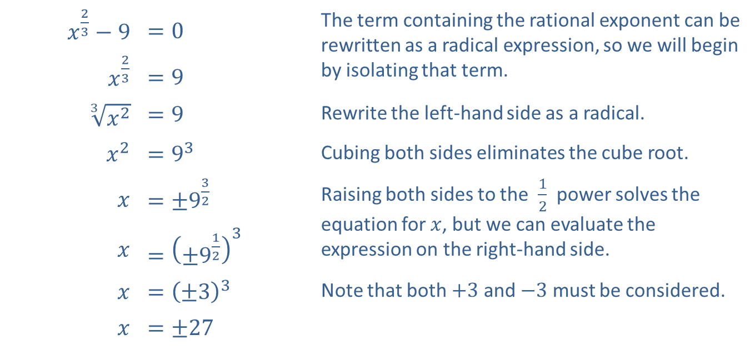
Example 3: Rational Exponents (cont.)
Solution
​
​$x^{\frac{2}{3}}−9$ | ​$=0$ | The term containing the rational exponent can be rewritten as a radical expression, so we will begin by isolating that term.
​$x^{\frac{2}{3}}$ | ​$=9$
​$\sqrt[3]{x^{2}}$ | ​$=9$ | Rewrite the left-hand side as a radical.
​$x^{2}$ | ​$=9^{3}$ | Cubing both sides eliminates the cube root.
$$x$$ | ​$=±9^{\frac{3}{2}}$ | Raising both sides to the $\frac{1}{2}$ power solves the equation for $x$, but we can evaluate the expression on the right-hand side.
$$x$$ | ​$={\left({±9}^{\frac{1}{2}}\right)}^{3}$
$$x$$ | ​$={\left(±3\right)}^{3}$ | Note that both $+3$ and $−3$ must be considered.
$$x$$ | ​$=±27$

Slide 16

Example 3: Rational Exponents (cont.)
​Plugging the values in, we see that ${\left(27\right)}^{\frac{2}{3}}=9$ and ${\left(−27\right)}^{\frac{2}{3}}=9$, so both are solutions to the original equation.
​

Slide 17
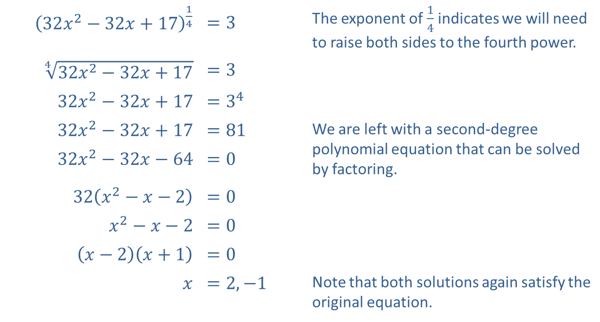
Example 3: Rational Exponents (cont.)
​${\left(32x^{2}−32x+17\right)}^{\frac{1}{4}}$ | ​$=3$ | The exponent of $\frac{1}{4}$ indicates we will need to raise both sides to the fourth power.
​$\sqrt[4]{32x^{2}−32x+17}$ | ​$=3$
​$32x^{2}−32x+17$ | ​$=3^{4}$
​$32x^{2}−32x+17$ | ​$=81$ | We are left with a second-degree polynomial equation that can be solved by factoring.
​$32x^{2}−32x−64$ | ​$=0$
​$32\left(x^{2}−x−2\right)$ | ​$=0$
​$x^{2}−x−2$ | ​$=0$
​$\left(x−2\right)\left(x+1\right)$ | ​$=0$
$$x$$ | ​$=2,−1$ | Note that both solutions again satisfy the original equation.
​

Slide 18
Example 3: Rational Exponents (cont.)
​Confirm, by substituting the solutions into the original equation, that both apparent solutions truly solve the equation with rational exponents.

Slide 19
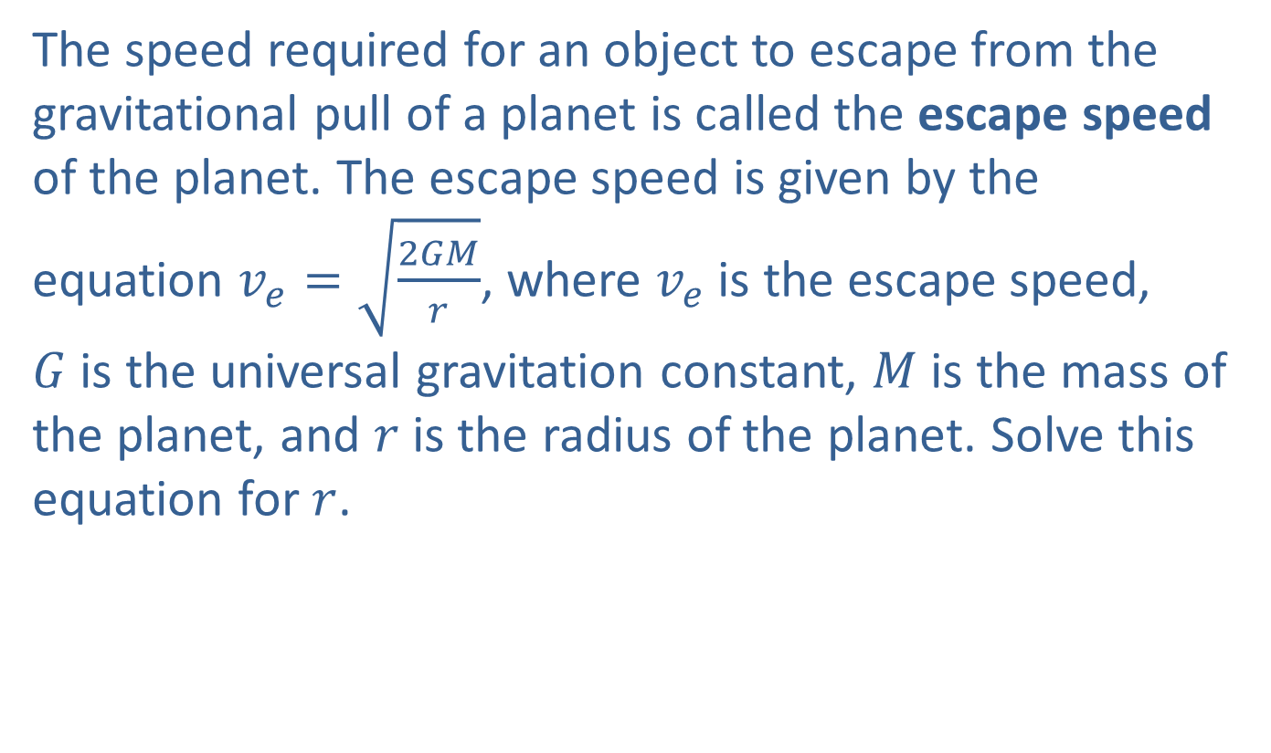
Example 4: Escape Speed
The speed required for an object to escape from the gravitational pull of a planet is called the escape speed of the planet. The escape speed is given by the equation $v_{e}=\sqrt{\frac{2GM}{r}}$, where $v_{e}$ is the escape speed,
$G$ is the universal gravitation constant, $M$ is the mass of the planet, and $r$ is the radius of the planet. Solve this equation for $r$.

Slide 20
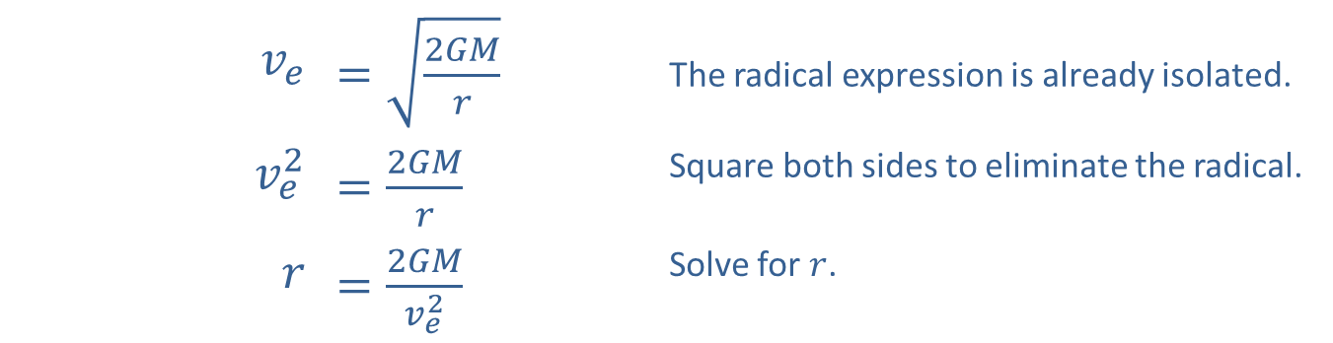
Example 4: Escape Speed (cont.)
Solution
We follow the same procedure for solving radical equations.
​$v_{e}$ | ​$=\sqrt{\frac{2GM}{r}}$ | The radical expression is already isolated.
​$v_{e}^{2}$ | ​$=\frac{2GM}{r}$ | Square both sides to eliminate the radical.
$$r$$ | ​$=\frac{2GM}{v_{e}^{2}}$ | Solve for $r$.

