Slide 1
Section 4.5
Variation and Multivariable Functions

Slide 2
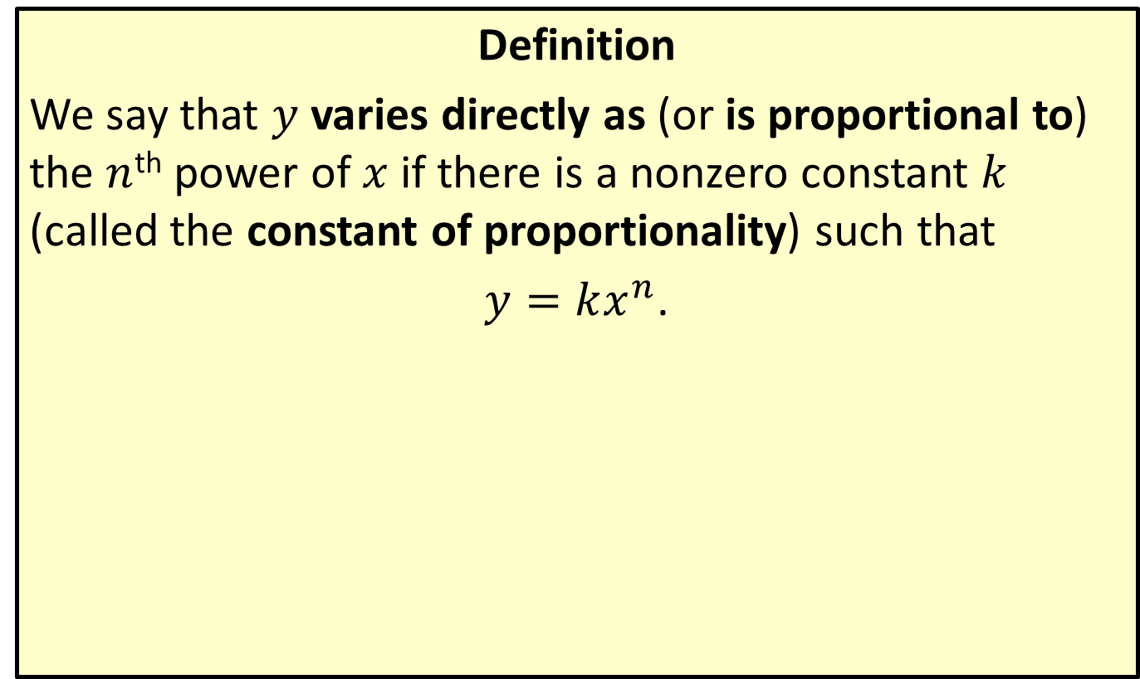
Direct Variation
Definition
We say that $y$ varies directly as (or is proportional to) the $n$^{th} power of $x$ if there is a nonzero constant $k$ (called the constant of proportionality) such that
$y=kx^{n}$.

Slide 3
Example 1: Direct Variation
Hooke's Law says that the force exerted on a spring varies directly with the distance that the spring is stretched. If a 5-pound weight suspended on a spring scale stretches the spring 2 inches, how far will a
13-pound weight stretch it?

Slide 4
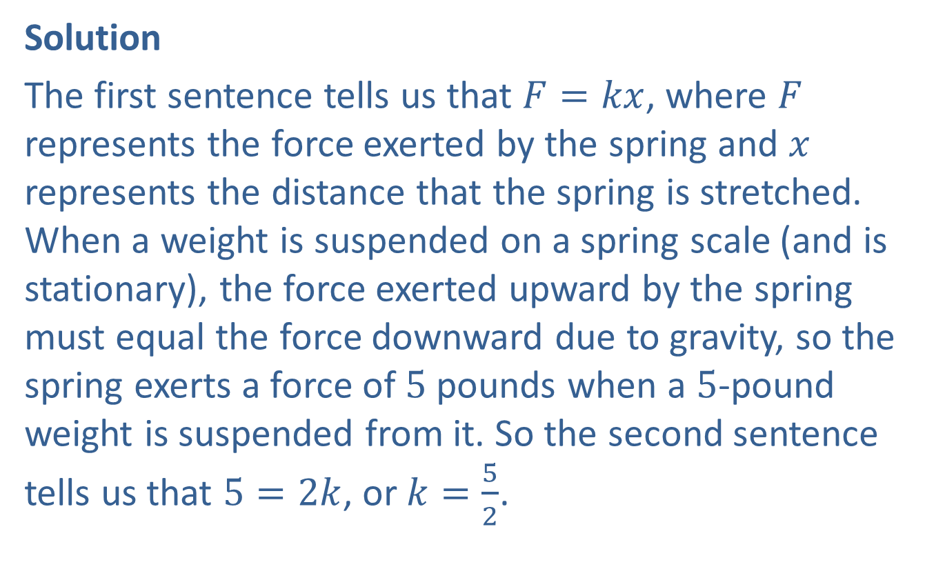
Example 1: Direct Variation (cont.)
Solution
The first sentence tells us that $F=kx$, where $F$ represents the force exerted by the spring and $x$ represents the distance that the spring is stretched. When a weight is suspended on a spring scale (and is stationary), the force exerted upward by the spring must equal the force downward due to gravity, so the spring exerts a force of 5 pounds when a 5-pound weight is suspended from it. So the second sentence tells us that $5=2k$, or $k=\frac{5}{2}$.

Slide 5
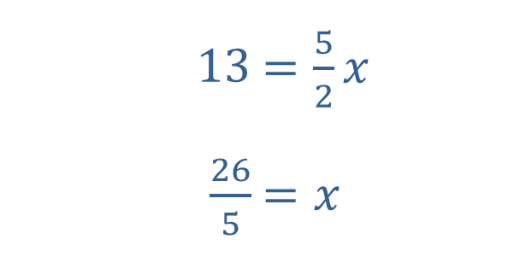

Example 1: Direct Variation (cont.)
We can now answer the question.
​
So the spring stretches $\frac{26}{5}=5.2$ inches when a 13-pound weight is suspended from it.
​$13$ | ​$=\frac{5}{2}x$
​$\frac{26}{5}$ | ​$=x$

Slide 6
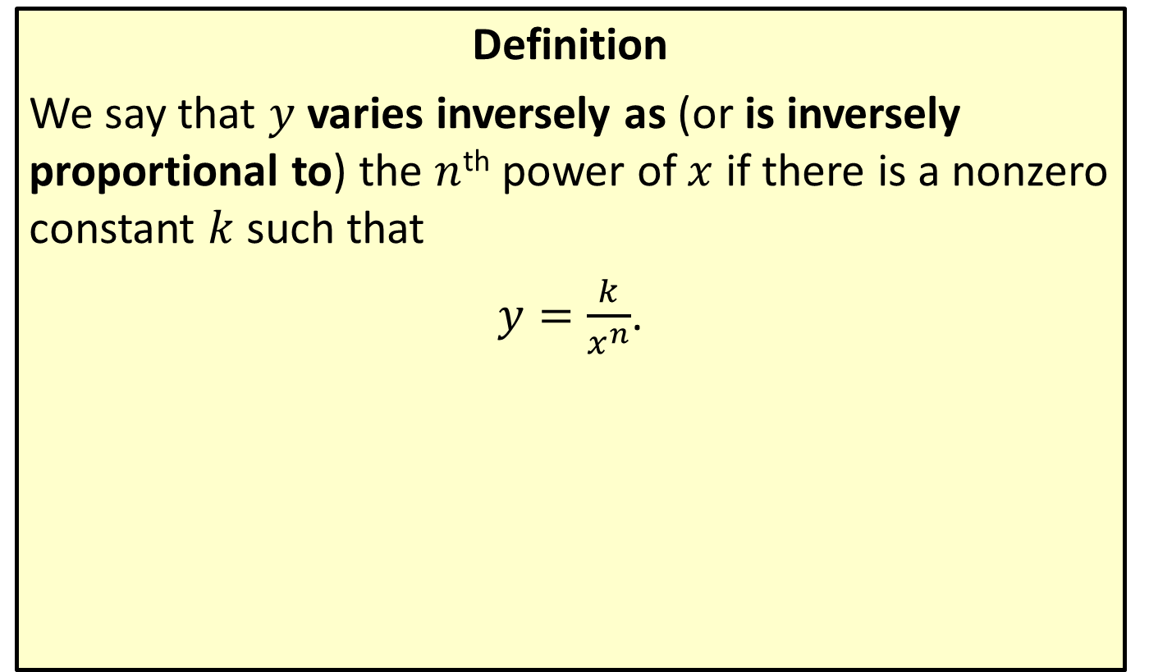
Inverse Variation
Definition
We say that $y$ varies inversely as (or is inversely proportional to) the $n$^{th} power of $x$ if there is a nonzero constant $k$ such that
$y=\frac{k}{x^{n}}$.

Slide 7
Example 2: Inverse Variation
The weight of a person, relative to Earth, is inversely proportional to the square of the person's distance from the center of Earth. Using a radius for Earth of 6370 kilometers, how much does a 180-pound man weigh when flying in a jet 9 kilometers above Earth's surface?

Slide 8
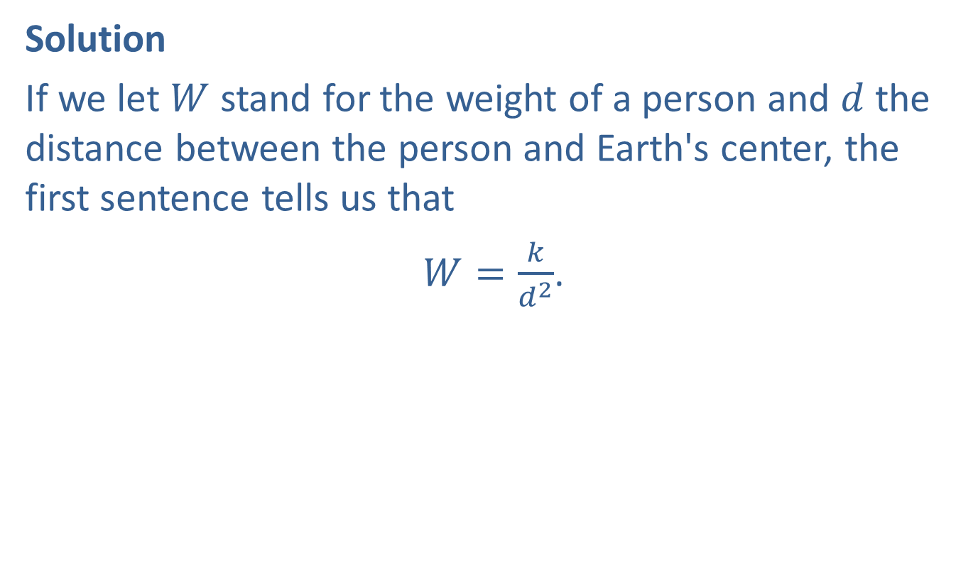
Example 2: Inverse Variation (cont.)
Solution
If we let $W$ stand for the weight of a person and $d$ the distance between the person and Earth's center, the first sentence tells us that
$W=\frac{k}{d^{2}}$.

Slide 9
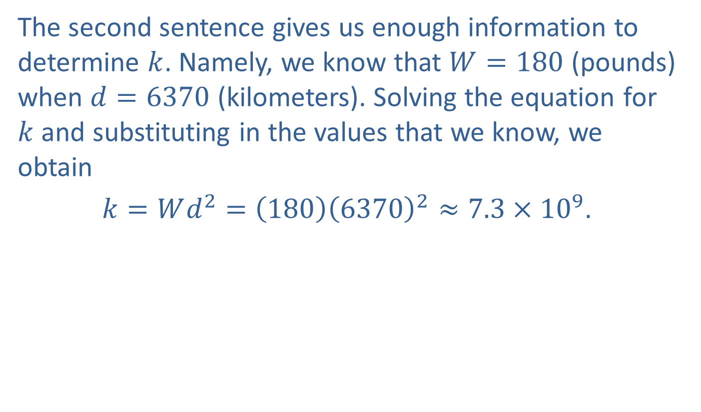
Example 2: Inverse Variation (cont.)
The second sentence gives us enough information to determine $k$. Namely, we know that $W=180$ (pounds) when $d=6370$ (kilometers). Solving the equation for $k$ and substituting in the values that we know, we obtain
$k=Wd^{2}=\left(180\right){\left(6370\right)}^{2}≈7.3×{10}^{9}$.

Slide 10
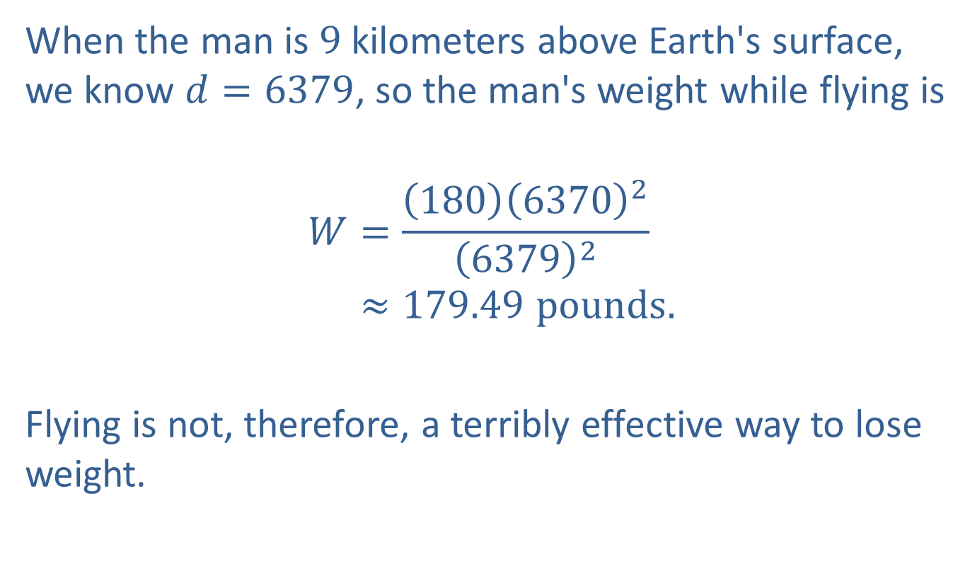
Example 2: Inverse Variation (cont.)
When the man is 9 kilometers above Earth's surface, we know $d=6379$, so the man's weight while flying is
𝑊=1806370263792𝑊≈179.49 pounds.
Flying is not, therefore, a terribly effective way to lose weight.

Slide 11
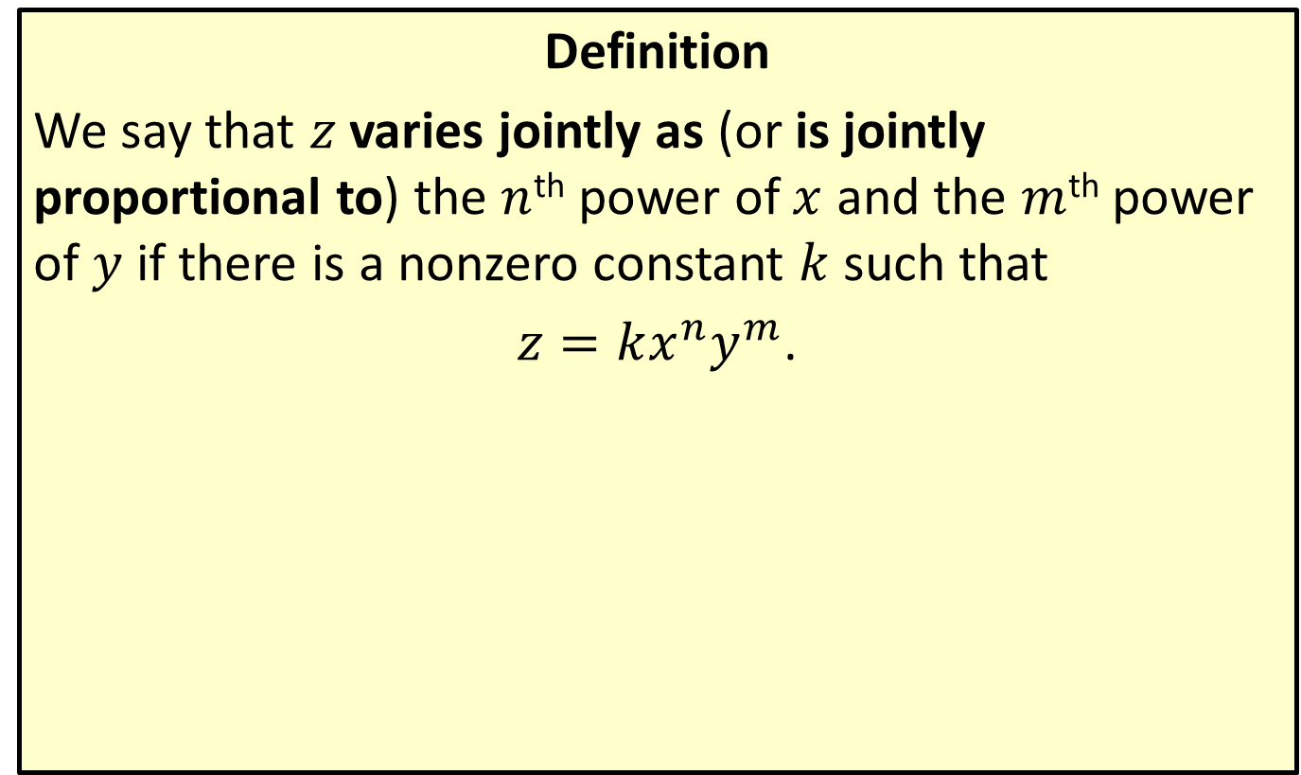
Joint Variation
Definition
We say that $z$ varies jointly as (or is jointly proportional to) the $n$^{th} power of $x$ and the $m$^{th} power of $y$ if there is a nonzero constant $k$ such that
$z=kx^{n}y^{m}$.

Slide 12
Example 3: Joint Variation
The volume of a right circular cylinder varies jointly as the height and the square of the radius. Express this relationship in equation form.

Slide 13
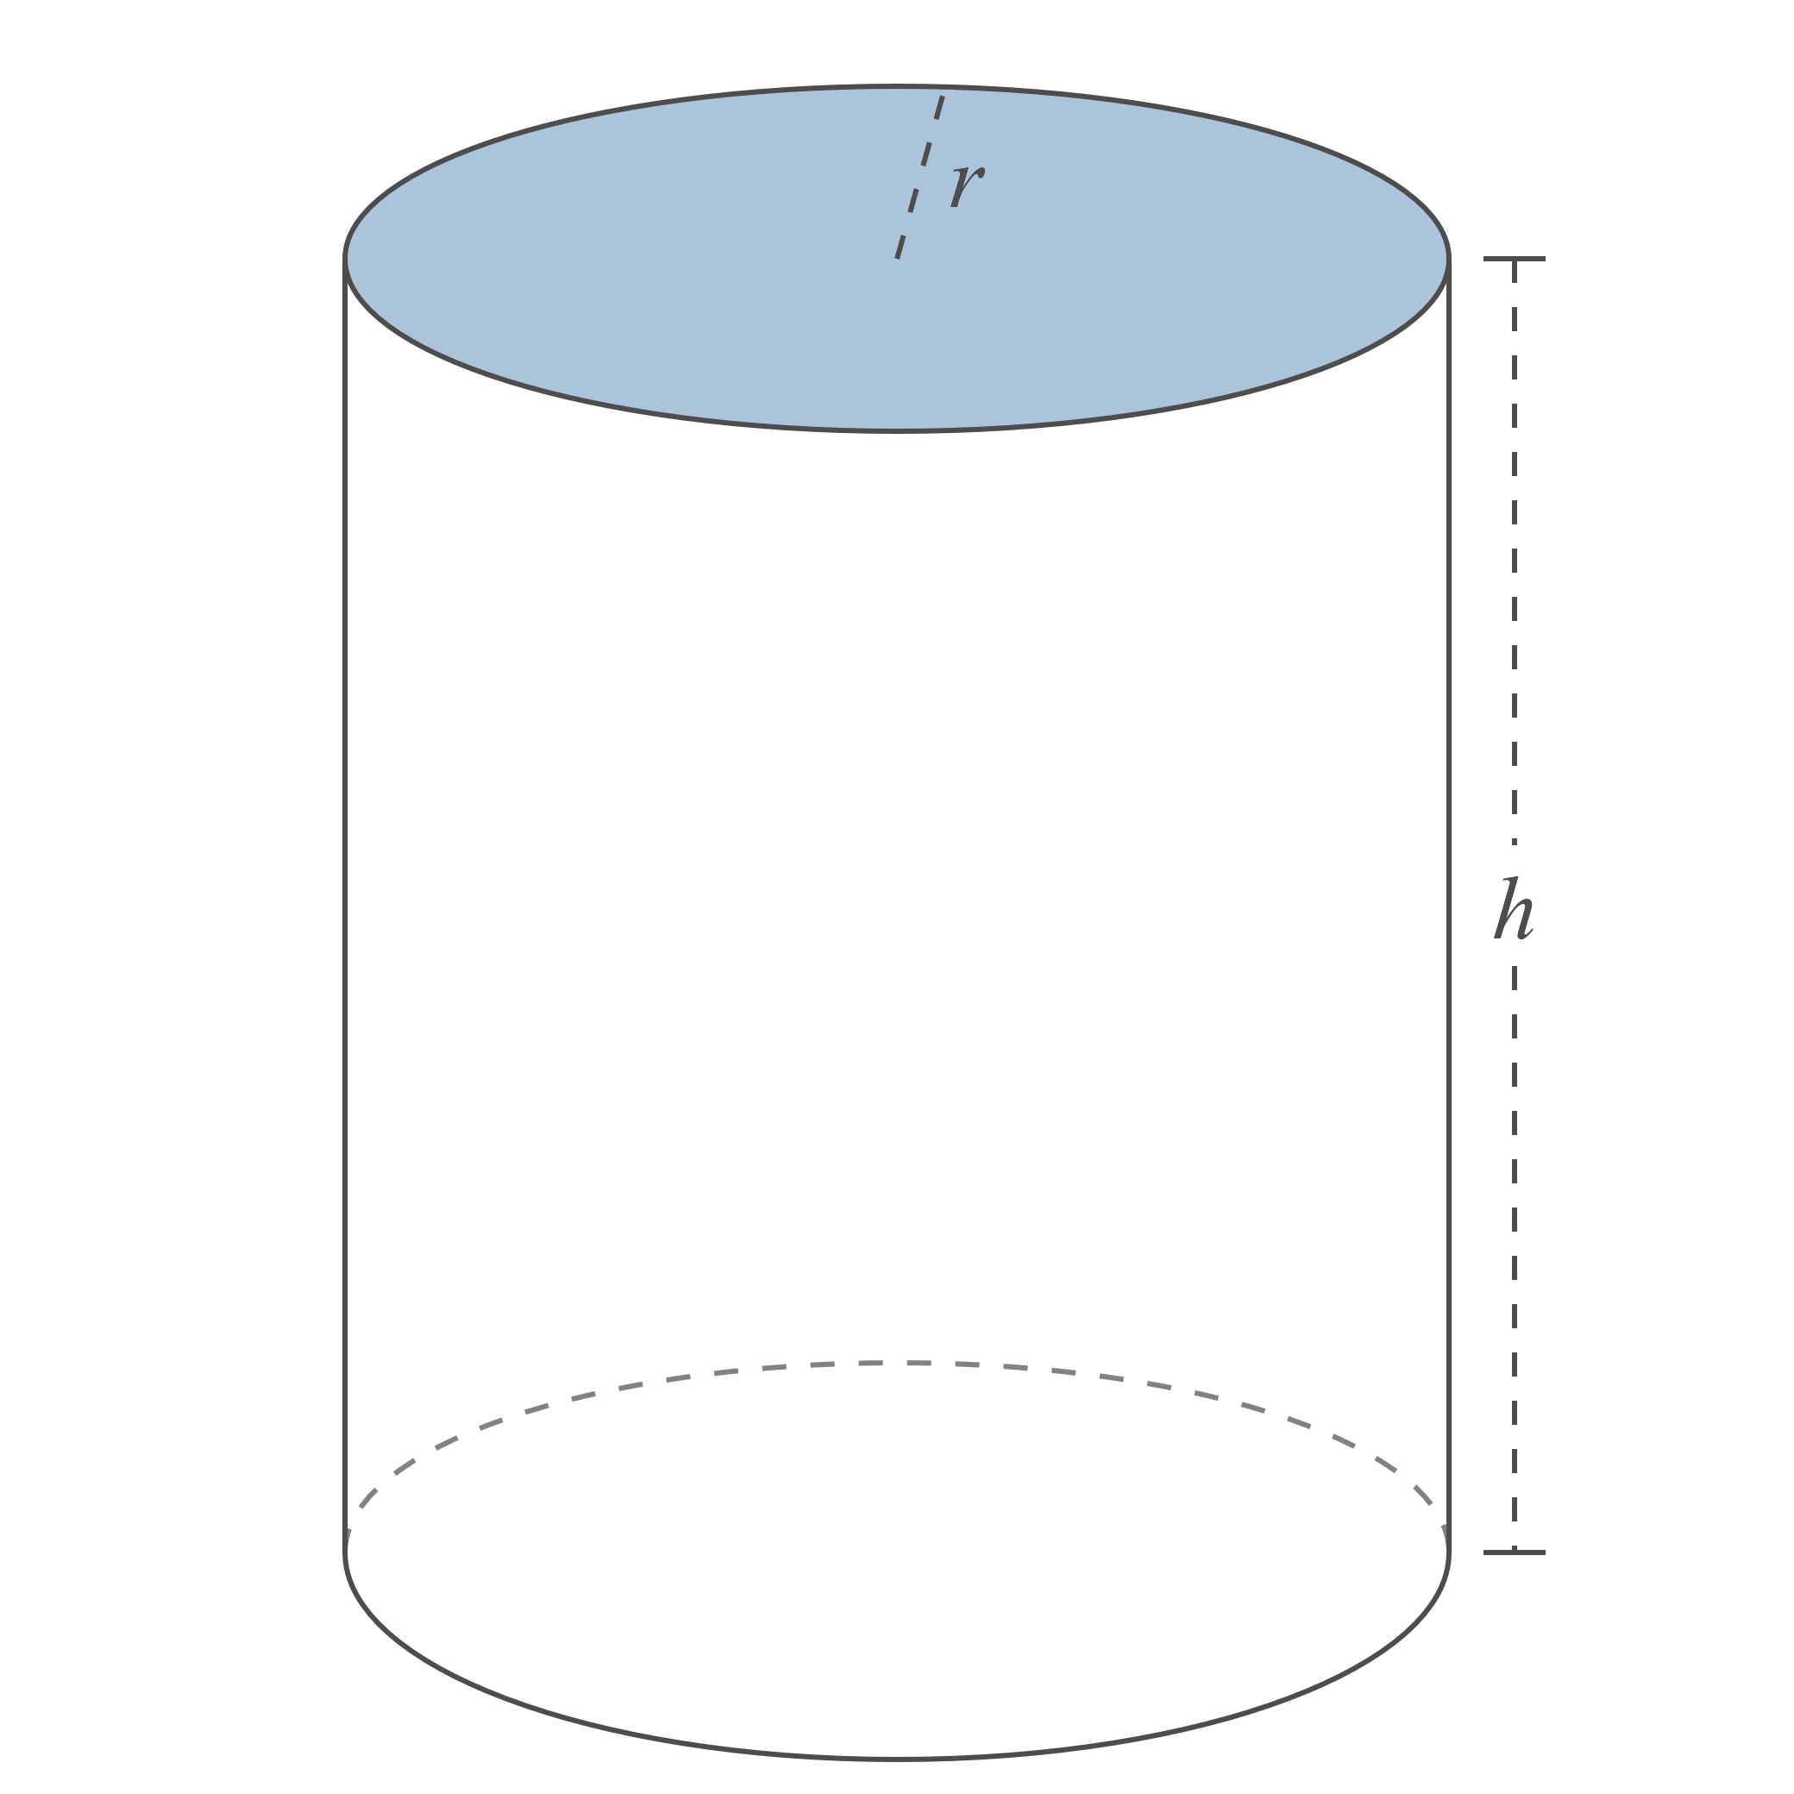
Example 3: Joint Variation (cont.)
Figure 3

Slide 14
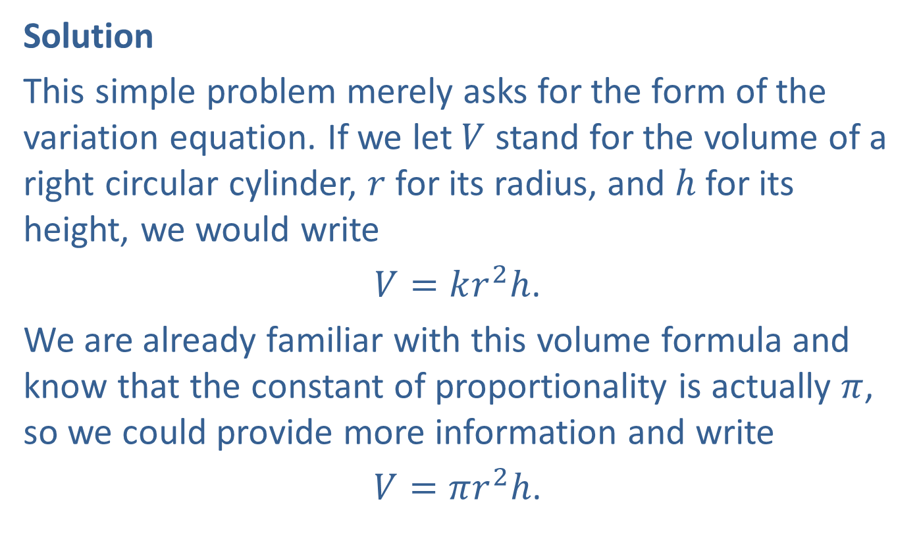
Example 3: Joint Variation (cont.)
Solution
This simple problem merely asks for the form of the variation equation. If we let $V$ stand for the volume of a right circular cylinder, $r$ for its radius, and $h$ for its height, we would write
$V=kr^{2}h$.
We are already familiar with this volume formula and know that the constant of proportionality is actually $π$, so we could provide more information and write
$V=πr^{2}h$.

Slide 15
Example 4: Finding the Force of Gravity
Determine the approximate force of gravitational attraction between Earth and the moon.

Slide 16
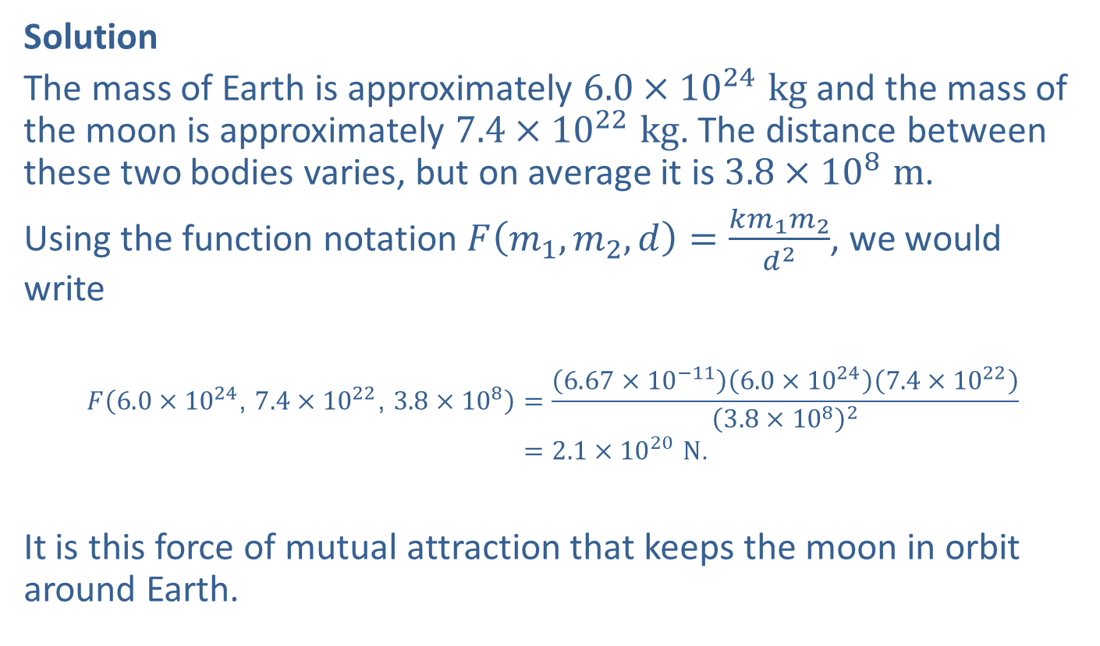
Example 4: Finding the Force of Gravity (cont.)
Solution
The mass of Earth is approximately $6.0×{10}^{24} kg$ and the mass of the moon is approximately $7.4×{10}^{22} kg$. The distance between these two bodies varies, but on average it is $3.8×{10}^{8} m$.
Using the function notation $F\left(m_{1},m_{2},d\right)=\frac{km_{1}m_{2}}{d^{2}}$, we would write
𝐹6.0×1024, 7.4×1022, 3.8×108=6.67×10−116.0×10247.4×10223.8×1082𝐹⁡6.0×1024, 7.4×1022, 3.8×108=2.1×1020 N.
It is this force of mutual attraction that keeps the moon in orbit around Earth.

