Slide 1
Section 4.6
Mathematical Models

Slide 2
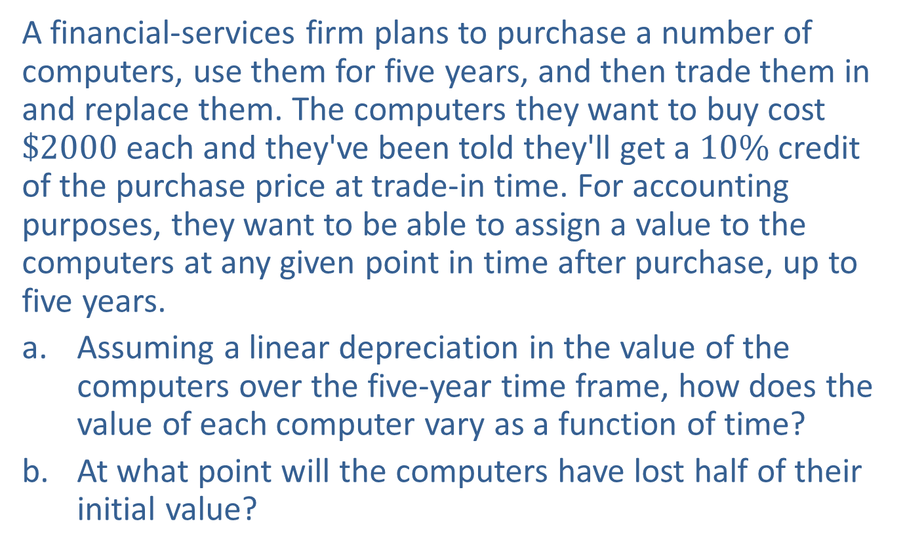
Example 1: Modeling the Value of Computers
A financial-services firm plans to purchase a number of computers, use them for five years, and then trade them in and replace them. The computers they want to buy cost $\$2000$ each and they've been told they'll get a $10\%$ credit of the purchase price at trade-in time. For accounting purposes, they want to be able to assign a value to the computers at any given point in time after purchase, up to five years.
​Assuming a linear depreciation in the value of the computers over the five-year time frame, how does the value of each computer vary as a function of time?
​At what point will the computers have lost half of their initial value?

Slide 3
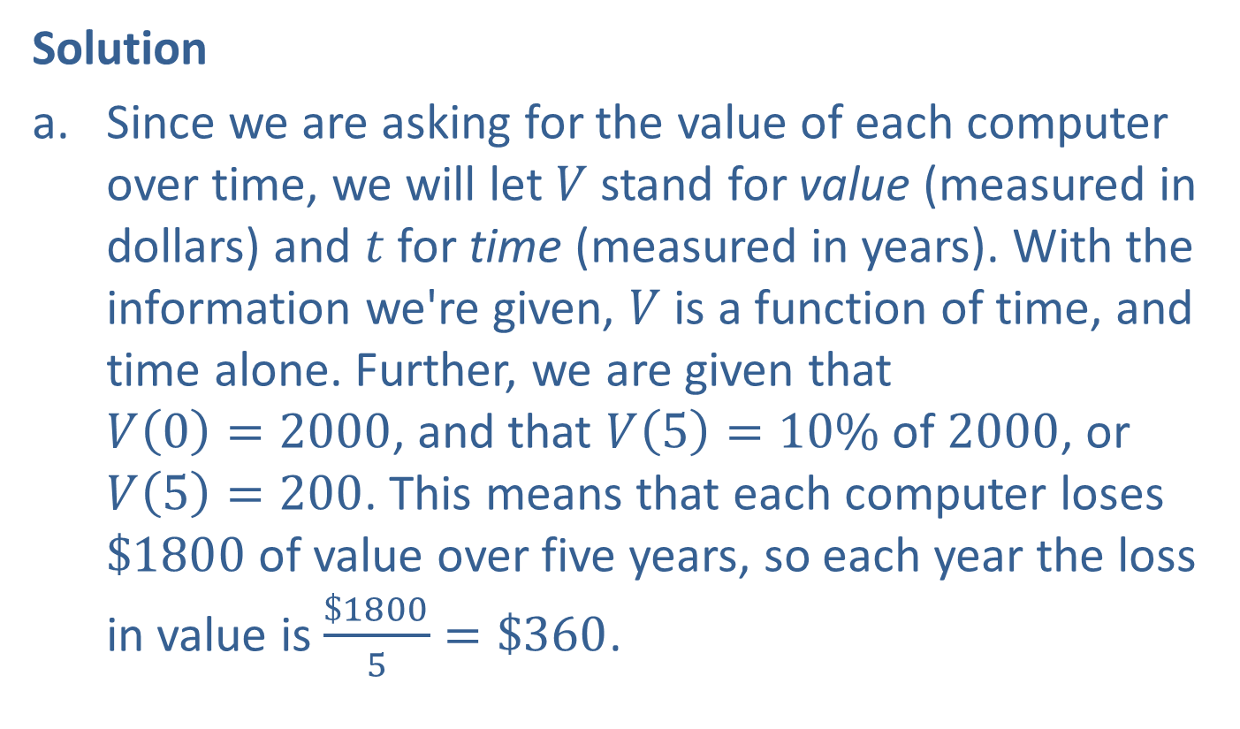
Example 1: Modeling the Value of Computers (cont.)
Solution
​Since we are asking for the value of each computer over time, we will let $V$ stand for value (measured in dollars) and $t$ for time (measured in years). With the information we're given, $V$ is a function of time, and time alone. Further, we are given that
$V\left(0\right)=2000$, and that $V\left(5\right)=10\% \text{of} 2000$, or $V\left(5\right)=200$. This means that each computer loses $\$1800$ of value over five years, so each year the loss in value is $\frac{\$1800}{5}=\$360$.

Slide 4
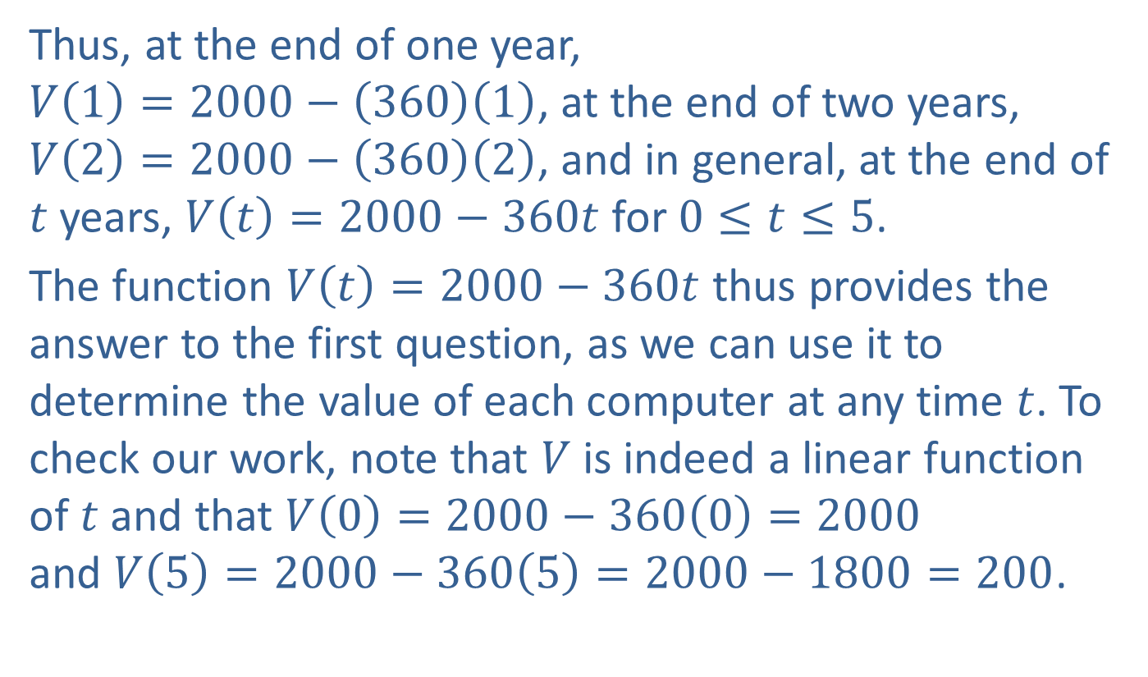
Example 1: Modeling the Value of Computers (cont.)
Thus, at the end of one year,
$V\left(1\right)=2000−\left(360\right)\left(1\right)$, at the end of two years, $V\left(2\right)=2000−\left(360\right)\left(2\right)$, and in general, at the end of $t$ years, $V\left(t\right)=2000−360t$ for $0≤t≤5$.
The function $V\left(t\right)=2000−360t$ thus provides the answer to the first question, as we can use it to determine the value of each computer at any time $t$. To check our work, note that $V$ is indeed a linear function of $t$ and that ​$V\left(0\right)=2000−360\left(0\right)=2000$
and $V\left(5\right)=2000−360\left(5\right)=2000−1800=200$.

Slide 5
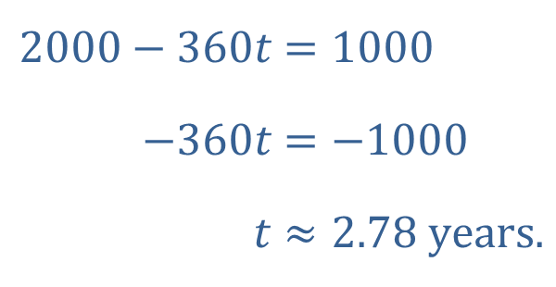
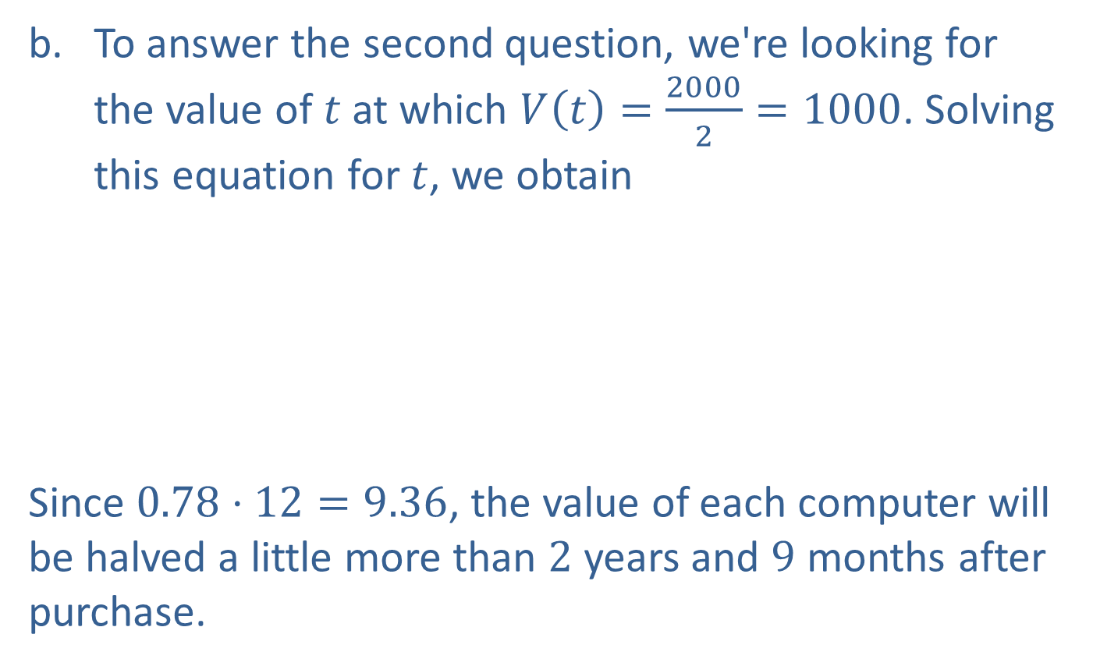
Example 1: Modeling the Value of Computers (cont.)
​To answer the second question, we're looking for the value of $t$ at which $V\left(t\right)=\frac{2000}{2}=1000$. Solving this equation for $t$, we obtain
​
​Since $0.78⋅12=9.36$, the value of each computer will be halved a little more than 2 years and 9 months after purchase.
​$2000−360t$ | ​$=1000$
​$−360t$ | ​$=−1000$
​$t$ | ​$≈2.78 \text{years}\text{.}$

Slide 6
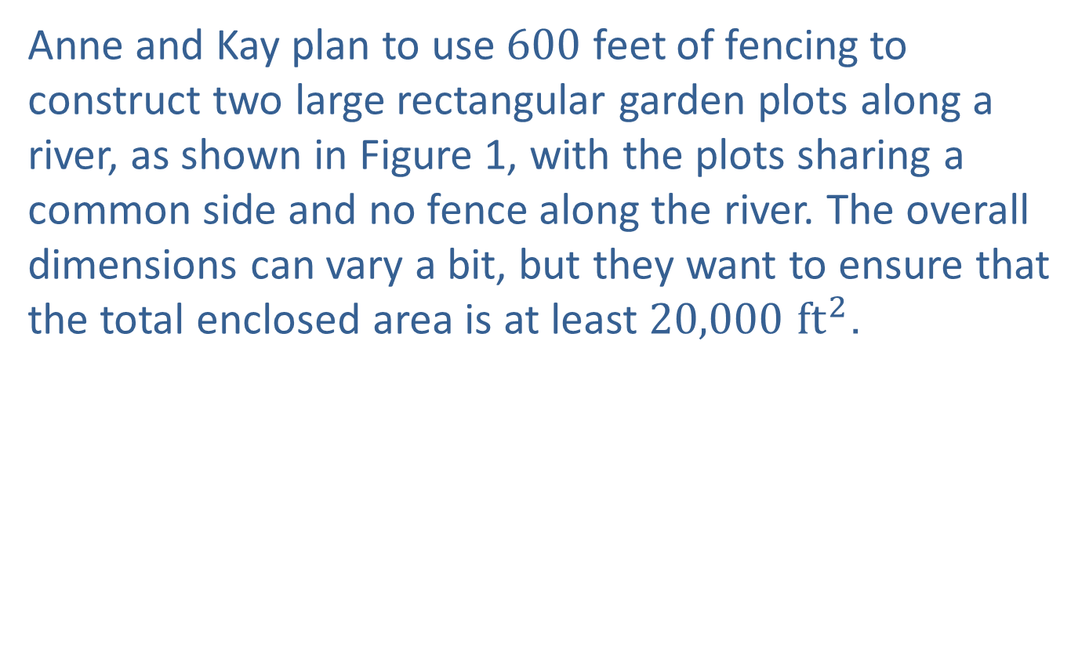
Example 2: Modeling the Area of Garden Plots
Anne and Kay plan to use 600 feet of fencing to construct two large rectangular garden plots along a river, as shown in Figure 1, with the plots sharing a common side and no fence along the river. The overall dimensions can vary a bit, but they want to ensure that the total enclosed area is at least $20,000{ ft}^{2}$.

Slide 7
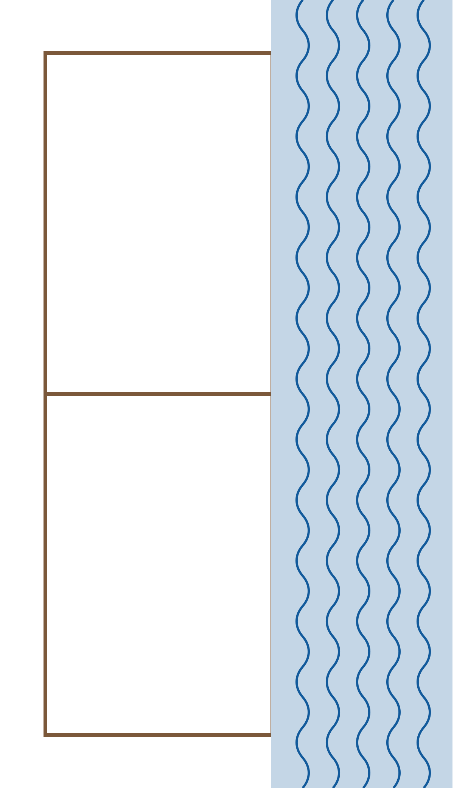
Example 2: Modeling the Area of Garden Plots (cont.)
Figure 1

Slide 8
Example 2: Modeling the Area of Garden Plots (cont.)
​Can this be done? If so, what are the bounds on the dimensions of the plots that will guarantee at least this much enclosed area?
​What is the maximum possible enclosed area?

Slide 9
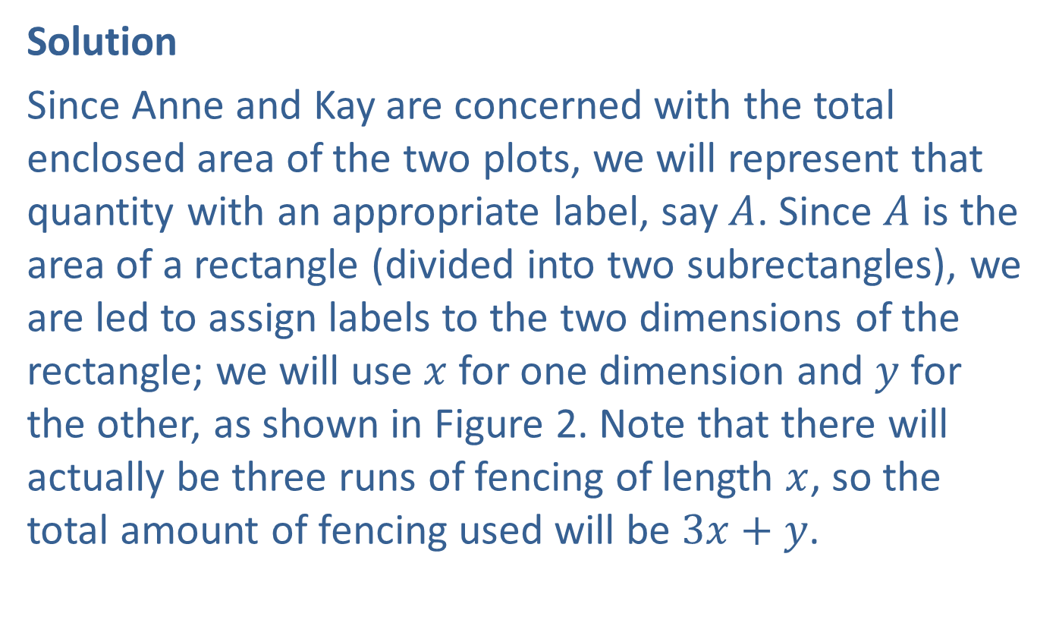
Example 2: Modeling the Area of Garden Plots (cont.)
Solution
Since Anne and Kay are concerned with the total enclosed area of the two plots, we will represent that quantity with an appropriate label, say $A$. Since $A$ is the area of a rectangle (divided into two subrectangles), we are led to assign labels to the two dimensions of the rectangle; we will use $x$ for one dimension and $y$ for the other, as shown in Figure 2. Note that there will actually be three runs of fencing of length $x$, so the total amount of fencing used will be $3x+y$.

Slide 10
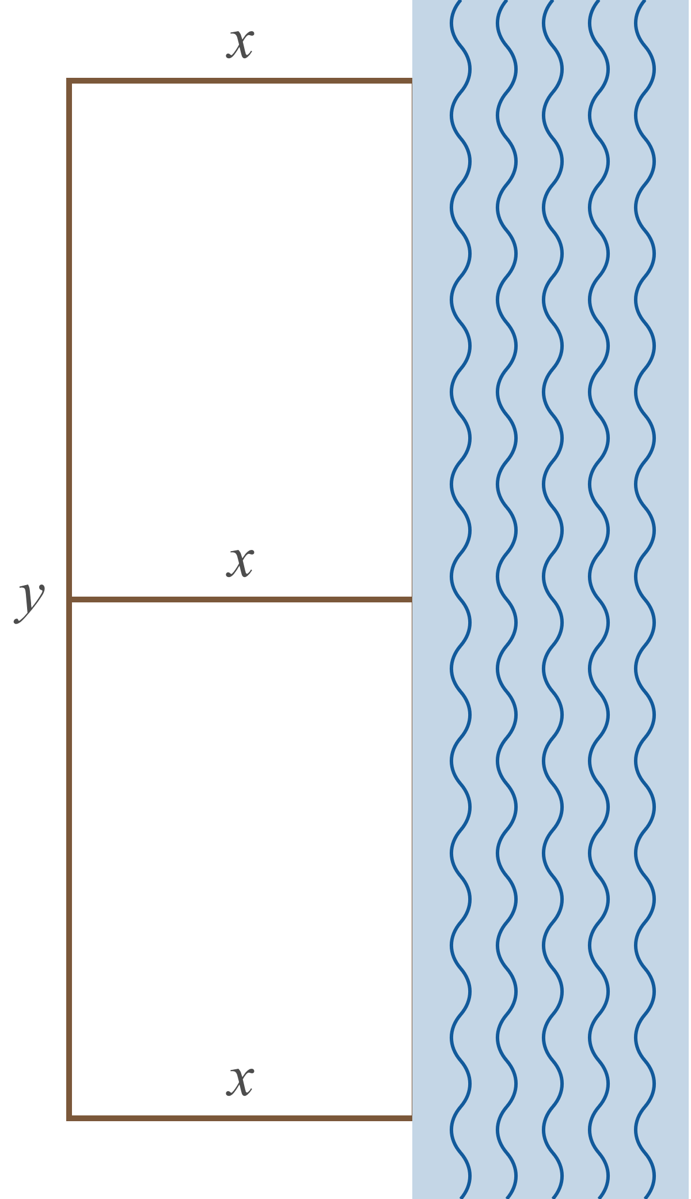
Example 2: Modeling the Area of Garden Plots (cont.)
Figure 2

Slide 11
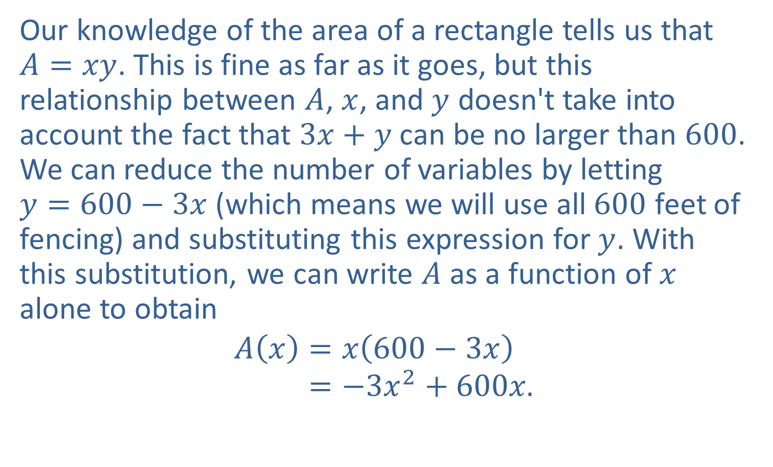
Example 2: Modeling the Area of Garden Plots (cont.)
Our knowledge of the area of a rectangle tells us that
$A=xy$. This is fine as far as it goes, but this relationship between $A$, $x$, and $y$ doesn't take into account the fact that $3x+y$ can be no larger than 600. We can reduce the number of variables by letting
$y=600−3x$ (which means we will use all 600 feet of fencing) and substituting this expression for $y$. With this substitution, we can write $A$ as a function of $x$ alone to obtain
𝐴𝑥=𝑥600−3𝑥𝐴𝑥=−3𝑥2+600𝑥.
​

Slide 12

Example 2: Modeling the Area of Garden Plots (cont.)
Note that the domain of $A$ (that is, the set of values for $x$ that make sense in this problem) is the interval $[0,200]$, with $A=0$ at both endpoints of the domain.

Slide 13
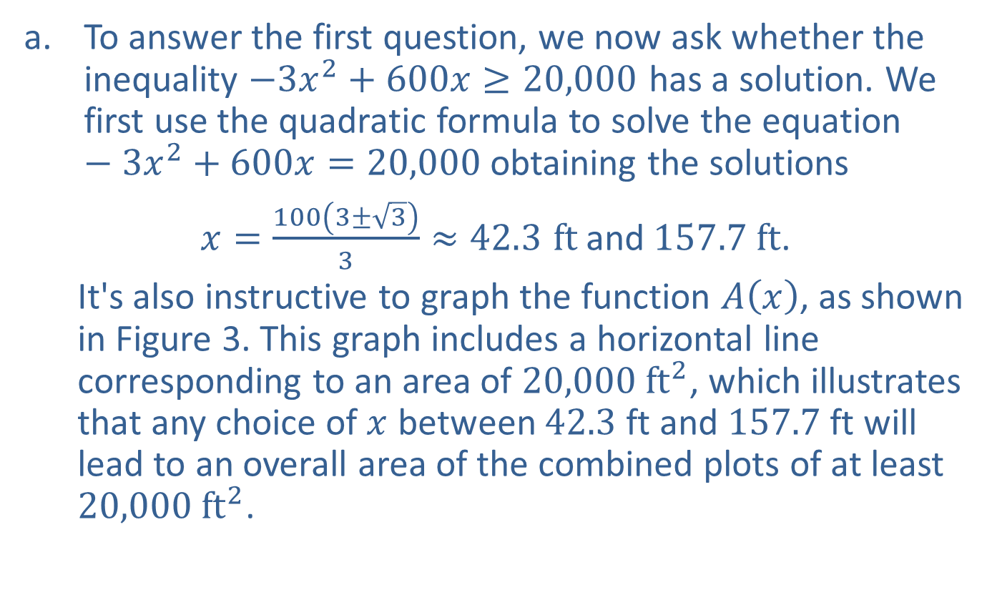
Example 2: Modeling the Area of Garden Plots (cont.)
​To answer the first question, we now ask whether the inequality $−3x^{2}+600x≥20,000$ has a solution. We first use the quadratic formula to solve the equation $−3x^{2}+600x=20,000$ obtaining the solutions
​$x=\frac{100\left(3±\sqrt{3}\right)}{3}≈42.3 ft \text{and} 157.7 ft$.
  It's also instructive to graph the function $A⁡\left(x\right)$, as shown in Figure 3. This graph includes a horizontal line corresponding to an area of $20,000 {ft}^{2}$, which illustrates that any choice of $x$ between 42.3 ft and 157.7 ft will lead to an overall area of the combined plots of at least $20,000 {ft}^{2}$.
​

Slide 14
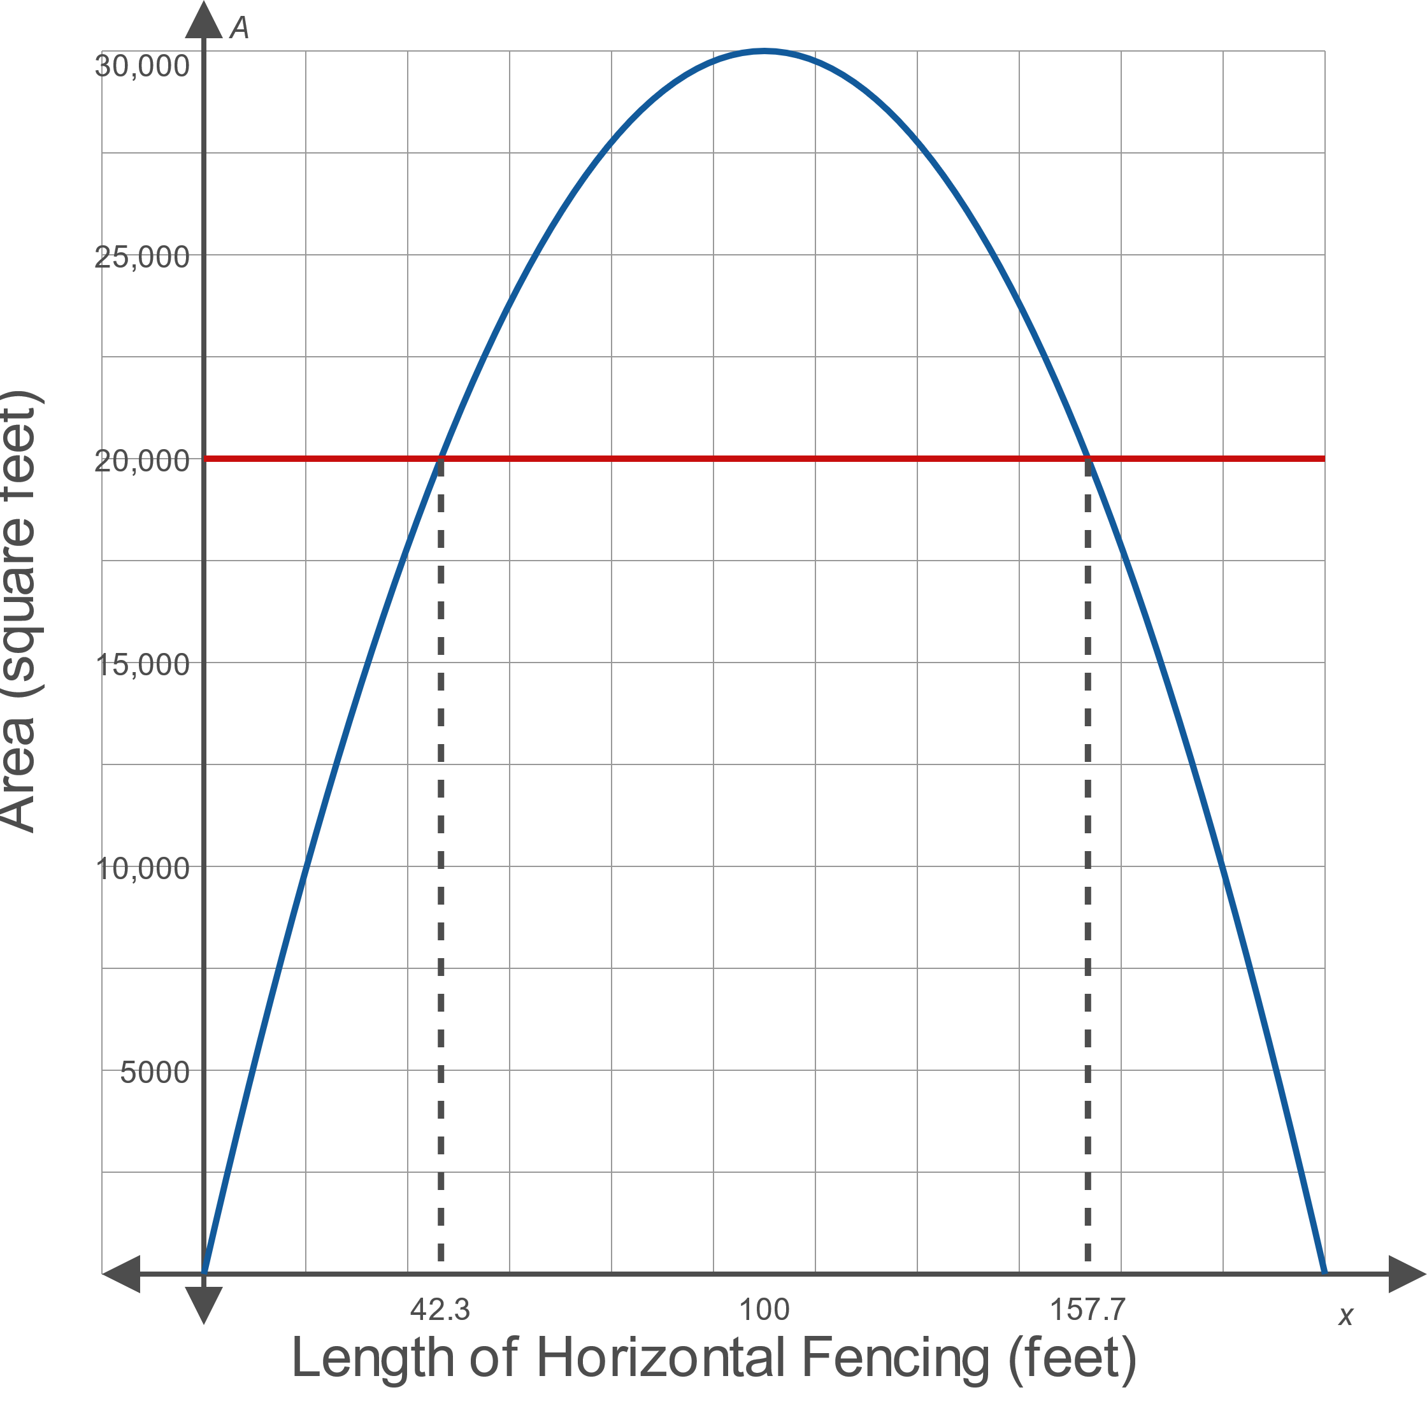
Example 2: Modeling the Area of Garden Plots (cont.)
Figure 3

Slide 15
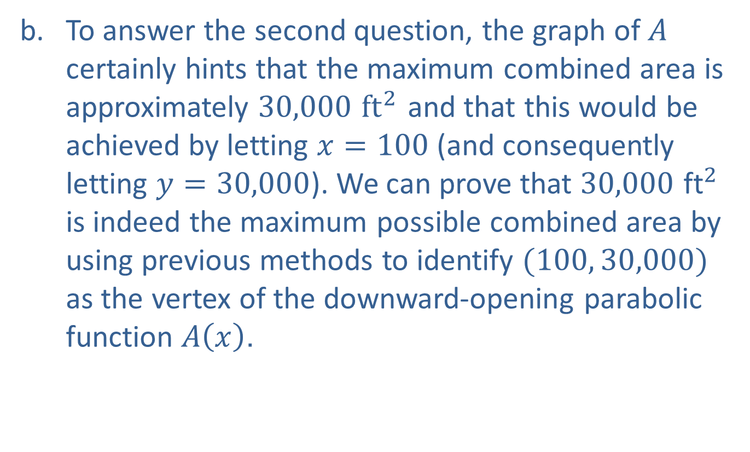
Example 2: Modeling the Area of Garden Plots (cont.)
​To answer the second question, the graph of $A$ certainly hints that the maximum combined area is approximately $30,000{ ft}^{2}$ and that this would be achieved by letting $x=100$ (and consequently letting $y=30,000$). We can prove that $30,000{ \text{ft}}^{2}$ is indeed the maximum possible combined area by using previous methods to identify $(100, 30,000)$ as the vertex of the downward-opening parabolic function $A⁡\left(x\right)$.

Slide 16
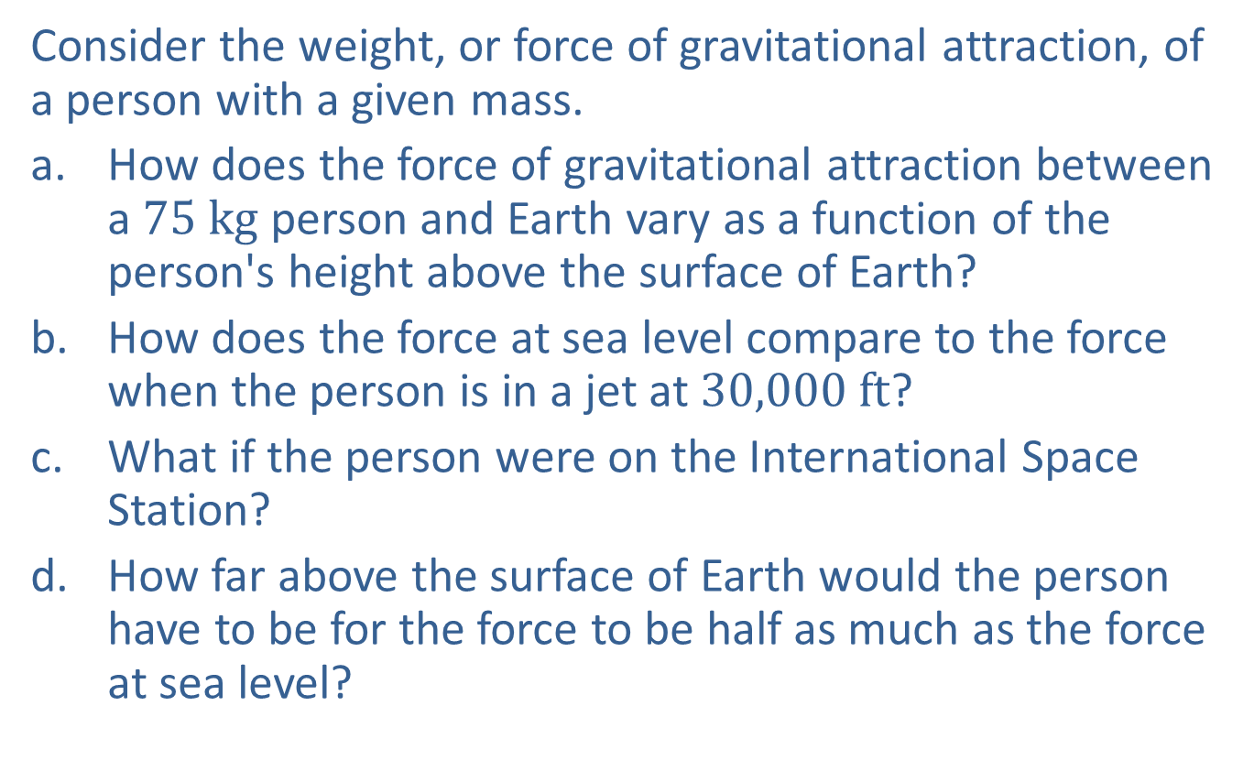
Example 3: Modeling the Weight of a Person with a Given Mass
Consider the weight, or force of gravitational attraction, of a person with a given mass.
​How does the force of gravitational attraction between a $75 kg$ person and Earth vary as a function of the person's height above the surface of Earth?
​How does the force at sea level compare to the force when the person is in a jet at $30,000 ft$?
​What if the person were on the International Space Station?
​How far above the surface of Earth would the person have to be for the force to be half as much as the force at sea level?

Slide 17
Example 3: Modeling the Weight of a Person with a Given Mass (cont.)
Solution
Unlike the formula for the area of a rectangle, it's likely that the force for gravitational attraction between two masses, and such information as the mass and radius of Earth and the height of the International Space Station, will need to be looked up. But all the details to model the requested force as a function of height are readily found.

Slide 18
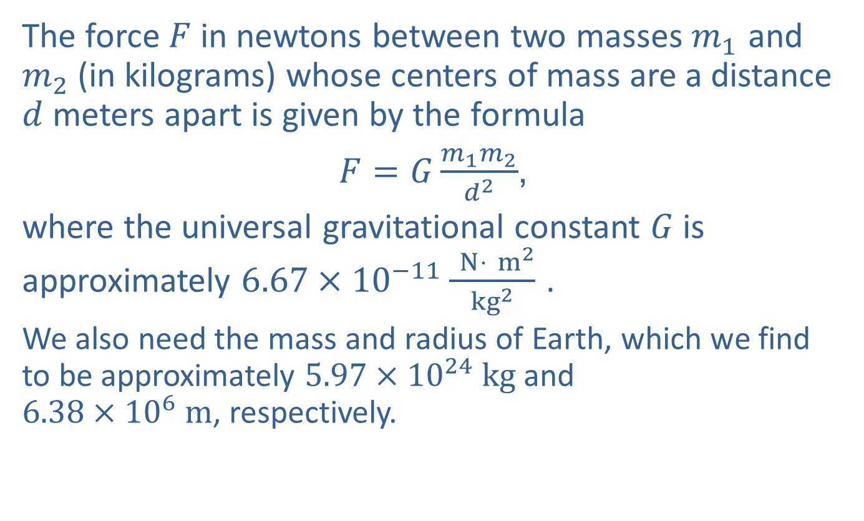
Example 3: Modeling the Weight of a Person with a Given Mass (cont.)
The force $F$ in newtons between two masses $m_{1}$ and $m_{2}$ (in kilograms) whose centers of mass are a distance $d$ meters apart is given by the formula
$F=G\frac{m_{1}m_{2}}{d^{2}}$,
where the universal gravitational constant $G$ is approximately $6.67×{10}^{−11}\frac{ N⋅{ m}^{2}}{{kg}^{2}}$ .
We also need the mass and radius of Earth, which we find to be approximately $5.97×{10}^{24} kg$ and
$6.38×{10}^{6} m$, respectively.
​

Slide 19
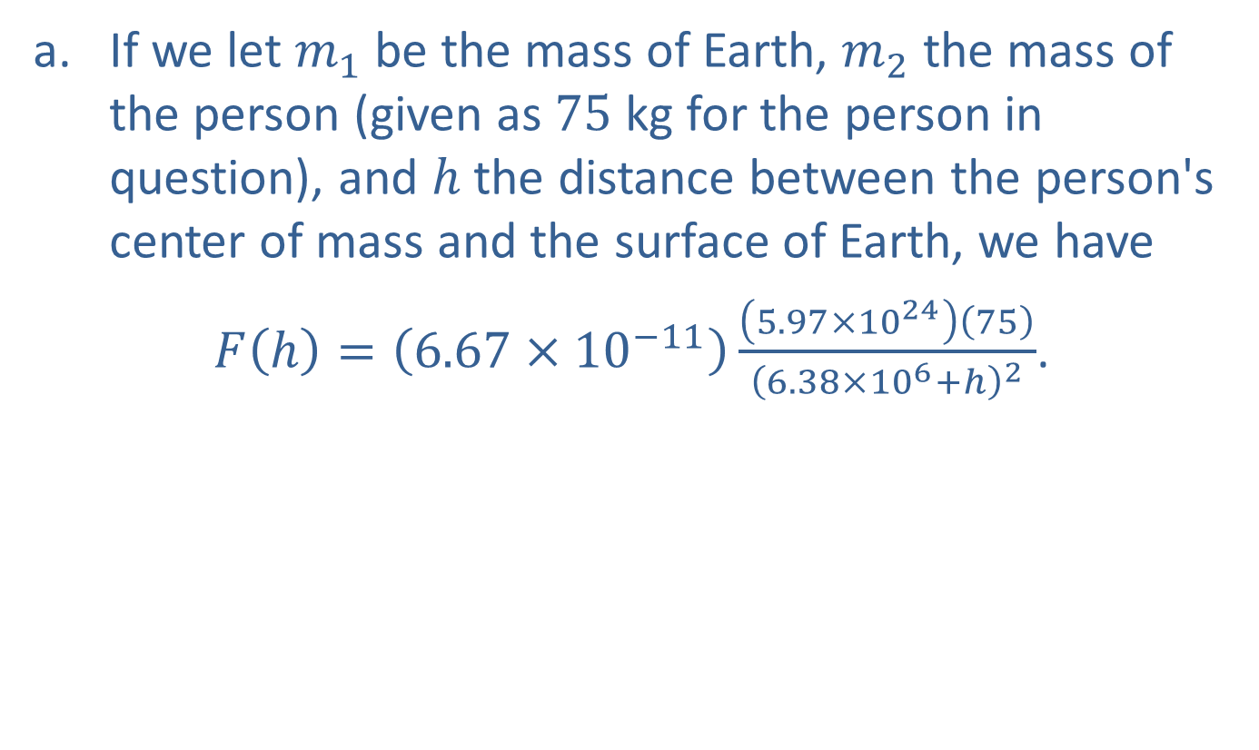
Example 3: Modeling the Weight of a Person with a Given Mass (cont.)
​If we let $m_{1}$ be the mass of Earth, $m_{2}$ the mass of the person (given as 75 kg for the person in question), and $h$ the distance between the person's center of mass and the surface of Earth, we have
​$F\left(h\right)=\left(6.67×{10}^{−11}\right)\frac{\left(5.97×{10}^{24}\right)\left(75\right)}{{\left(6.38×{10}^{6}+h\right)}^{2}}$.
​

Slide 20
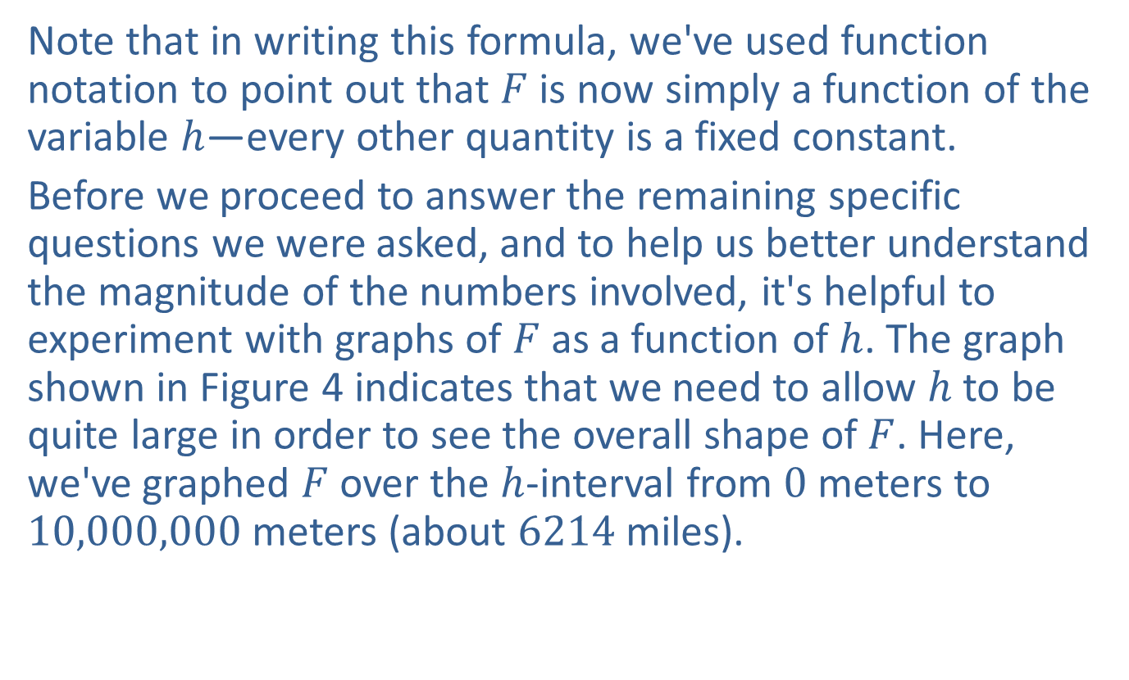
Example 3: Modeling the Weight of a Person with a Given Mass (cont.)
​Note that in writing this formula, we've used function notation to point out that $F$ is now simply a function of the variable $h$—every other quantity is a fixed constant.
​Before we proceed to answer the remaining specific questions we were asked, and to help us better understand the magnitude of the numbers involved, it's helpful to experiment with graphs of $F$ as a function of $h$. The graph shown in Figure 4 indicates that we need to allow $h$ to be quite large in order to see the overall shape of $F$. Here, we've graphed $F$ over the $h$-interval from 0 meters to 10,000,000 meters (about 6214 miles).
​

Slide 21
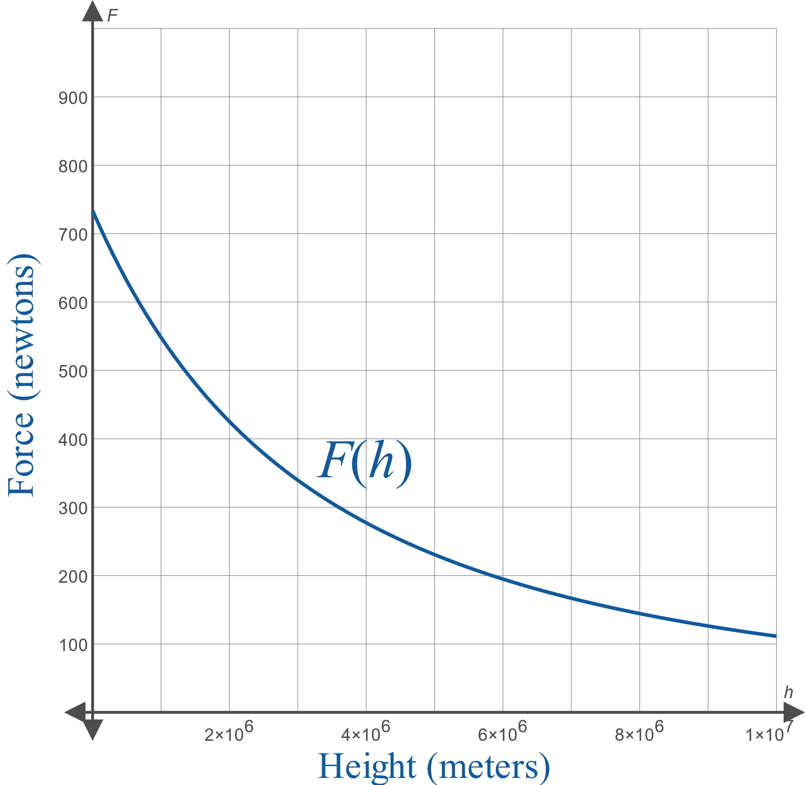
Example 3: Modeling the Weight of a Person with a Given Mass (cont.)
Figure 4

Slide 22

Example 3: Modeling the Weight of a Person with a Given Mass (cont.)
​Note that the force of attraction at sea level
($h=0 m$) is $F\left(0\right)≈734 N$ and the force of attraction at 30,000 feet (about $9144 m$) is $F\left(9144\right)=732 N$, or about $99.7\%$ of the sea-level force.

Slide 23

Example 3: Modeling the Weight of a Person with a Given Mass (cont.)
​The height of the International Space Station varies a bit, but we will use an average value of 248 miles, about 399,117 meters, to obtain
$F\left(399,117\right)≈650 N$, or about $88.6\%$ of the sea-level force.

Slide 24
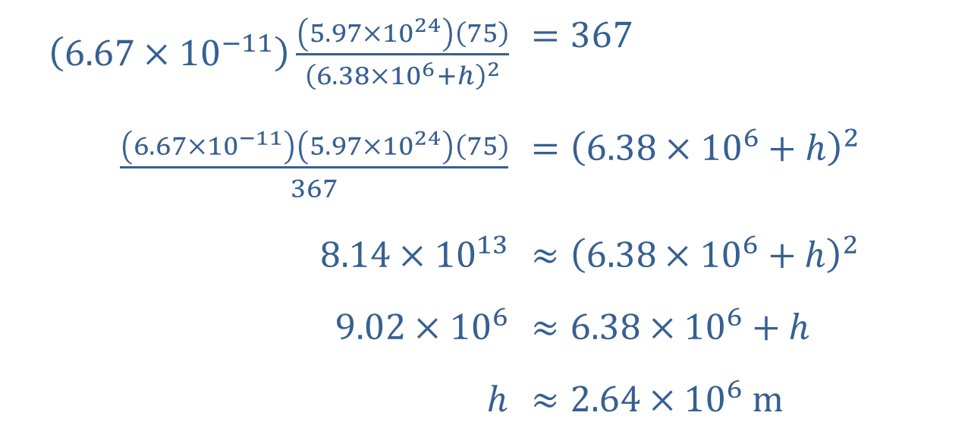

Example 3: Modeling the Weight of a Person with a Given Mass (cont.)
​To answer the final question, we solve the equation $F\left(h\right)=\frac{734}{2}=367$ as follows.
​
​$\left(6.67×{10}^{−11}\right)\frac{\left(5.97×{10}^{24}\right)\left(75\right)}{{\left(6.38×{10}^{6}+h\right)}^{2}}$ | ​$=367$
​$\frac{\left(6.67×{10}^{−11}\right)\left(5.97×{10}^{24}\right)\left(75\right)}{367}$ | ​$={\left(6.38×{10}^{6}+h\right)}^{2}$
​$8.14×{10}^{13}$ | ​$≈{\left(6.38×{10}^{6}+h\right)}^{2}$
​$9.02×{10}^{6}$ | ​$≈6.38×{10}^{6}+h$
​$h$ | ​$≈2.64×{10}^{6} m$

Slide 25

Example 3: Modeling the Weight of a Person with a Given Mass (cont.)
​Note that we omitted the negative root in the second-to-last step on the left side of the equation since the height cannot be negative. Putting this into context, this distance is about $41\%$ of the radius of Earth itself.

Slide 26
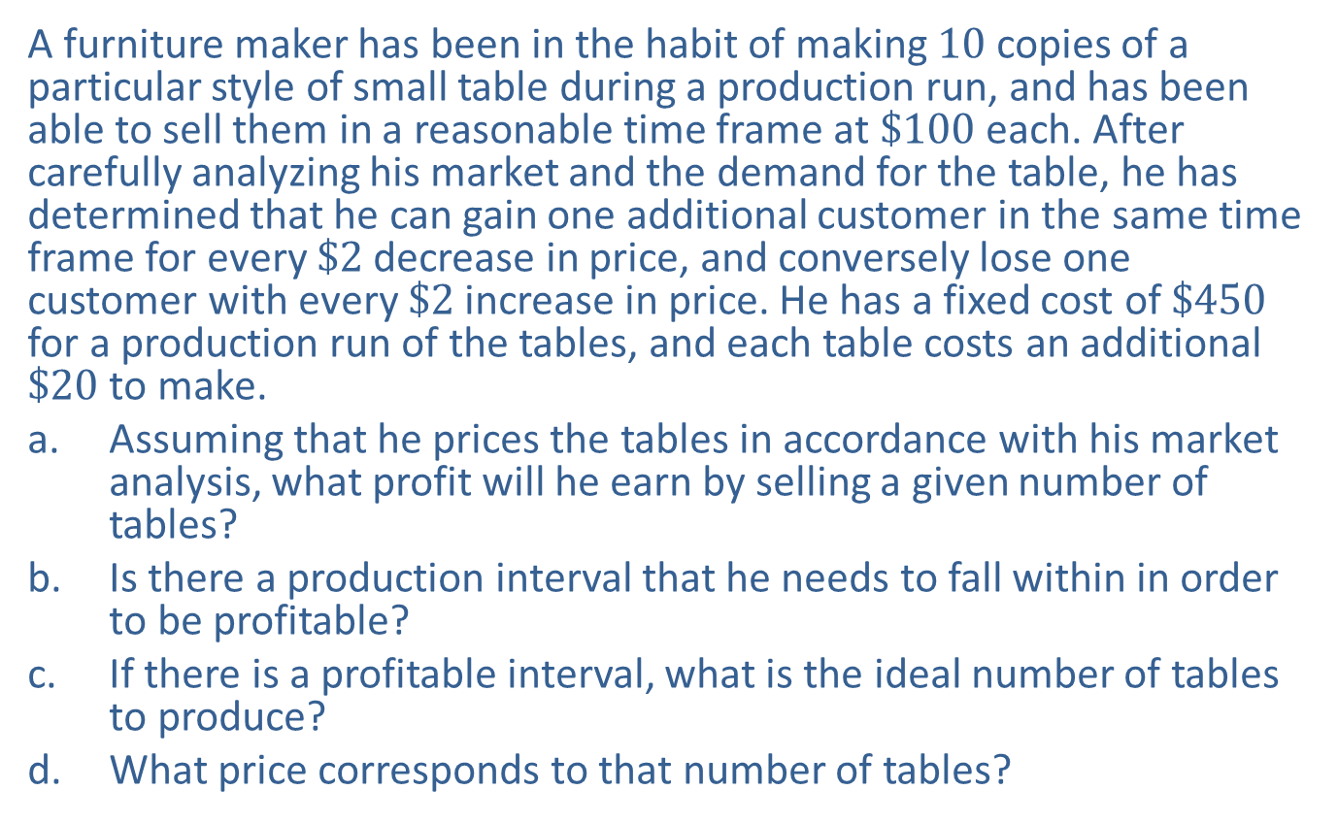
Example 4: Modeling Profit Earned from Selling Tables
A furniture maker has been in the habit of making 10 copies of a particular style of small table during a production run, and has been able to sell them in a reasonable time frame at $\$100$ each. After carefully analyzing his market and the demand for the table, he has determined that he can gain one additional customer in the same time frame for every $\$2$ decrease in price, and conversely lose one customer with every $\$2$ increase in price. He has a fixed cost of $\$450$ for a production run of the tables, and each table costs an additional $\$20$ to make.
​Assuming that he prices the tables in accordance with his market analysis, what profit will he earn by selling a given number of tables?
​Is there a production interval that he needs to fall within in order to be profitable?
​If there is a profitable interval, what is the ideal number of tables to produce?
​What price corresponds to that number of tables?

Slide 27
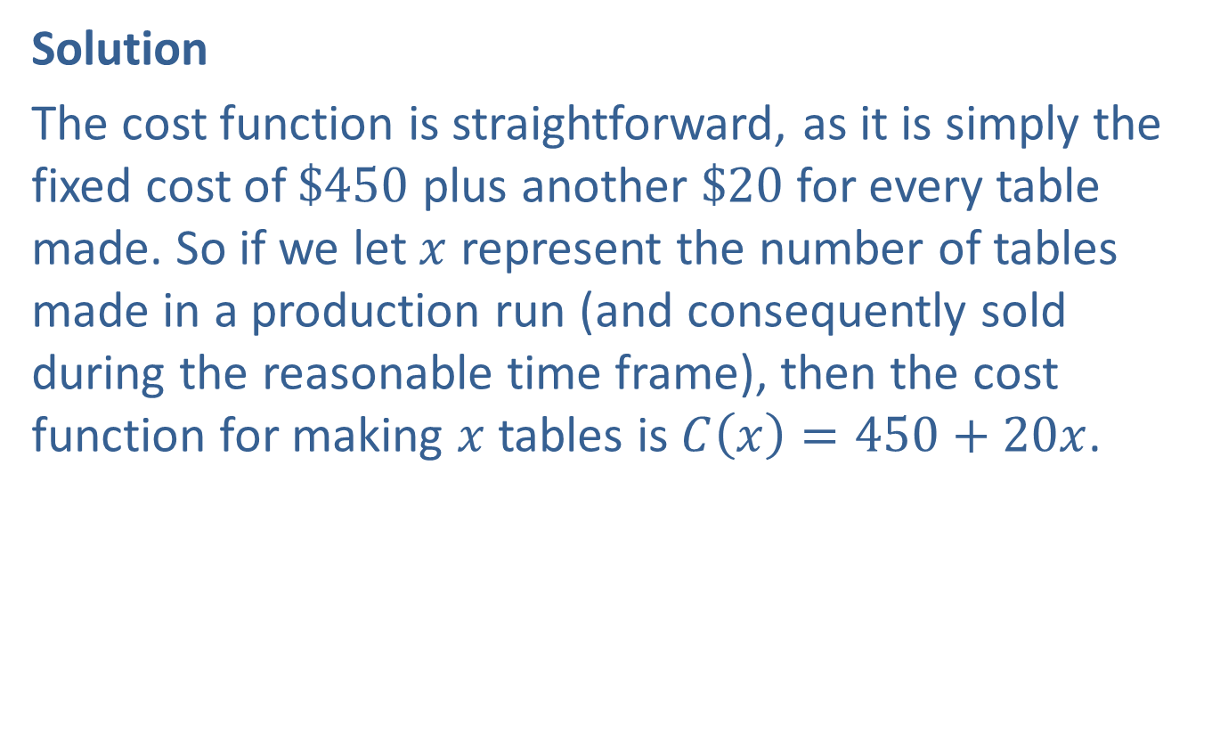
Example 4: Modeling Profit Earned from Selling Tables (cont.)
Solution
The cost function is straightforward, as it is simply the fixed cost of $\$450$ plus another $\$20$ for every table made. So if we let $x$ represent the number of tables made in a production run (and consequently sold during the reasonable time frame), then the cost function for making $x$ tables is $C\left(x\right)=450+20x$.

Slide 28
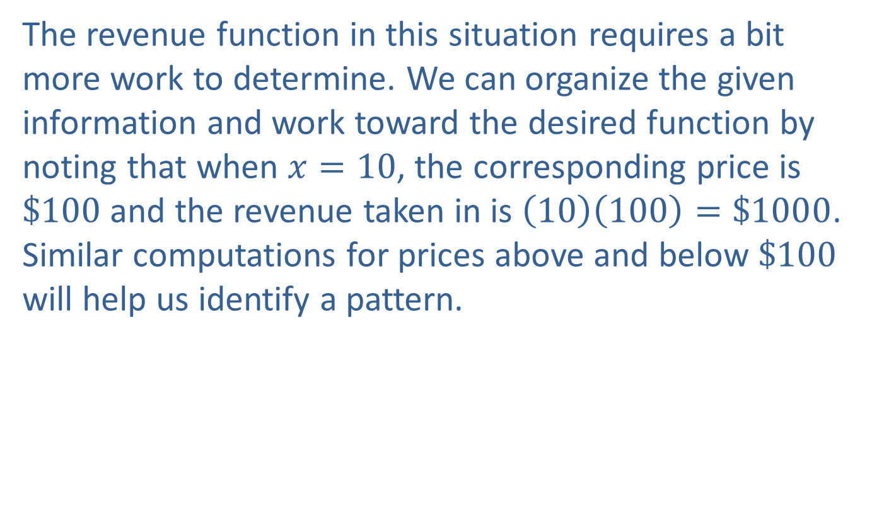
Example 4: Modeling Profit Earned from Selling Tables (cont.)
The revenue function in this situation requires a bit more work to determine. We can organize the given information and work toward the desired function by noting that when $x=10$, the corresponding price is $\$100$ and the revenue taken in is $\left(10\right)\left(100\right)=\$1000$. Similar computations for prices above and below $\$100$ will help us identify a pattern.

Slide 29
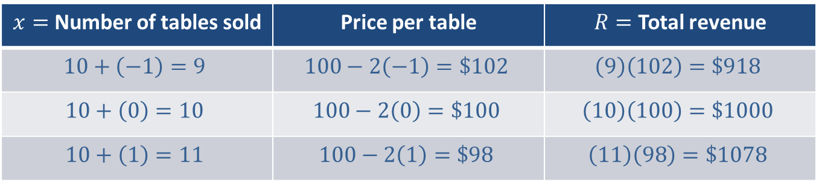
Example 4: Modeling Profit Earned from Selling Tables (cont.)
$x=$ Number of tables sold | Price per table | $R=$ Total revenue
$$10+\left(−1\right)=9$$ | $$100−2\left(−1\right)=\$102$$ | $$\left(9\right)\left(102\right)=\$918$$
$$10+\left(0\right)=10$$ | $$100−2\left(0\right)=\$100$$ | $$\left(10\right)\left(100\right)=\$1000$$
$$10+\left(1\right)=11$$ | $$100−2\left(1\right)=\$98$$ | $$\left(11\right)\left(98\right)=\$1078$$

Slide 30
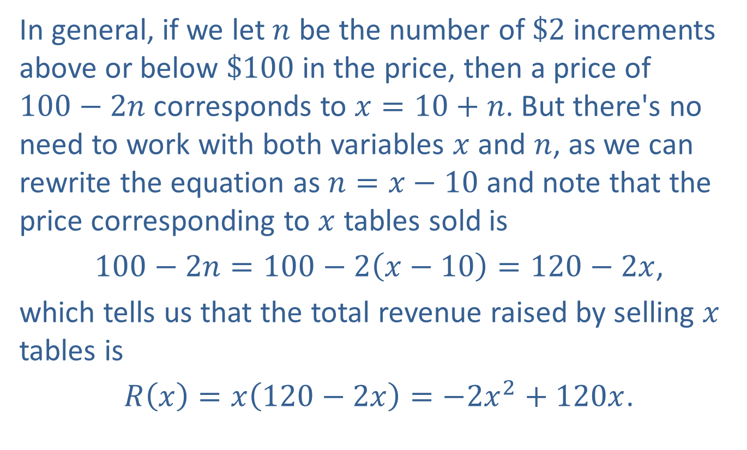
Example 4: Modeling Profit Earned from Selling Tables (cont.)
In general, if we let $n$ be the number of $\$2$ increments above or below $\$100$ in the price, then a price of
$100−2n$ corresponds to $x=10+n$. But there's no need to work with both variables $x$ and $n$, as we can rewrite the equation as $n=x−10$ and note that the price corresponding to $x$ tables sold is
$100−2n=100−2\left(x−10\right)=120−2x$,
which tells us that the total revenue raised by selling $x$ tables is
$R\left(x\right)=x\left(120−2x\right)=−2x^{2}+120x$.

Slide 31
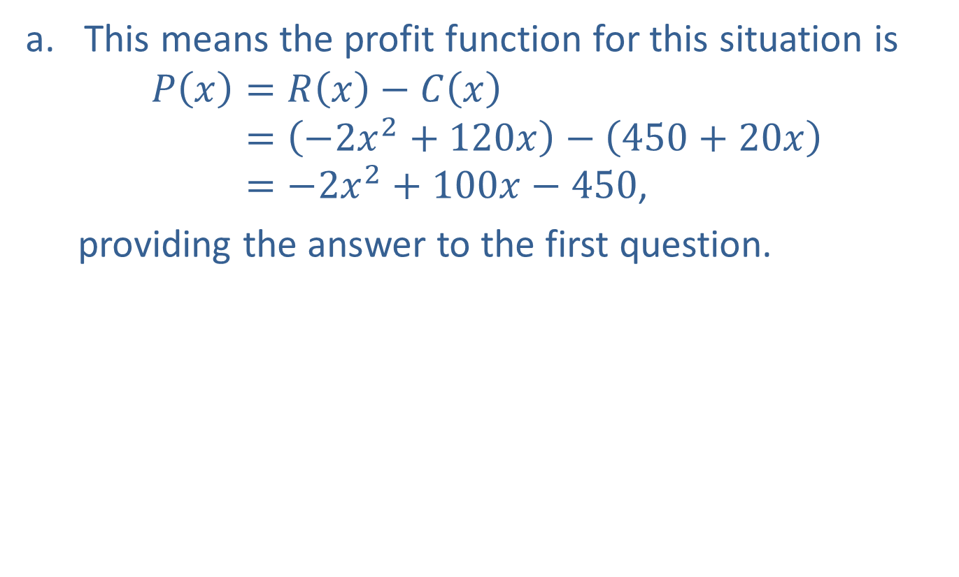
Example 4: Modeling Profit Earned from Selling Tables (cont.)
​This means the profit function for this situation is
𝑃𝑥=𝑅𝑥−𝐶𝑥𝑃⁡𝑥=−2𝑥2+120𝑥−450+20𝑥𝑃⁡𝑥=−2𝑥2+100𝑥−450,
  providing the answer to the first question.

Slide 32
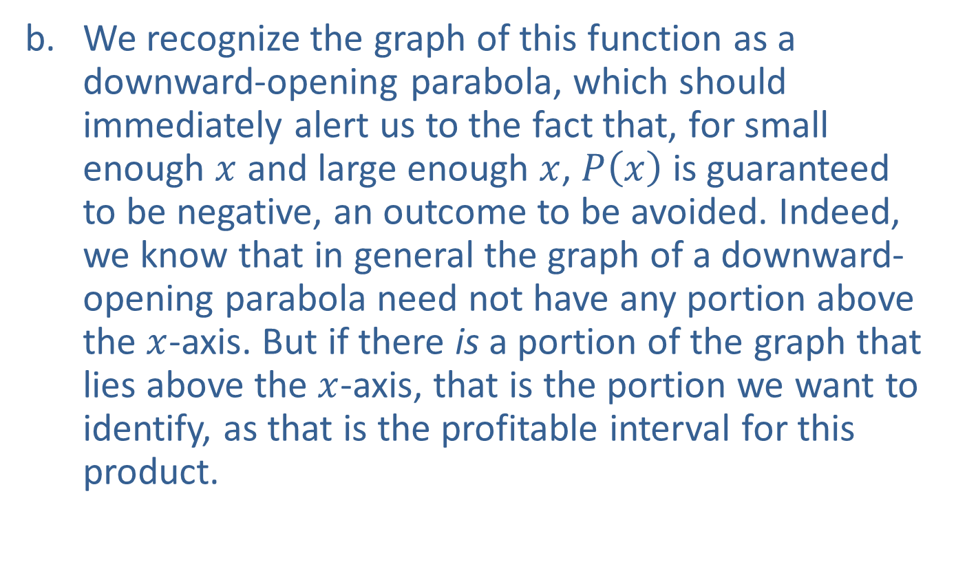
Example 4: Modeling Profit Earned from Selling Tables (cont.)
​We recognize the graph of this function as a downward-opening parabola, which should immediately alert us to the fact that, for small enough $x$ and large enough $x$, $P⁡\left(x\right)$ is guaranteed to be negative, an outcome to be avoided. Indeed, we know that in general the graph of a downward-opening parabola need not have any portion above the $x$-axis. But if there is a portion of the graph that lies above the $x$-axis, that is the portion we want to identify, as that is the profitable interval for this product.
​

Slide 33
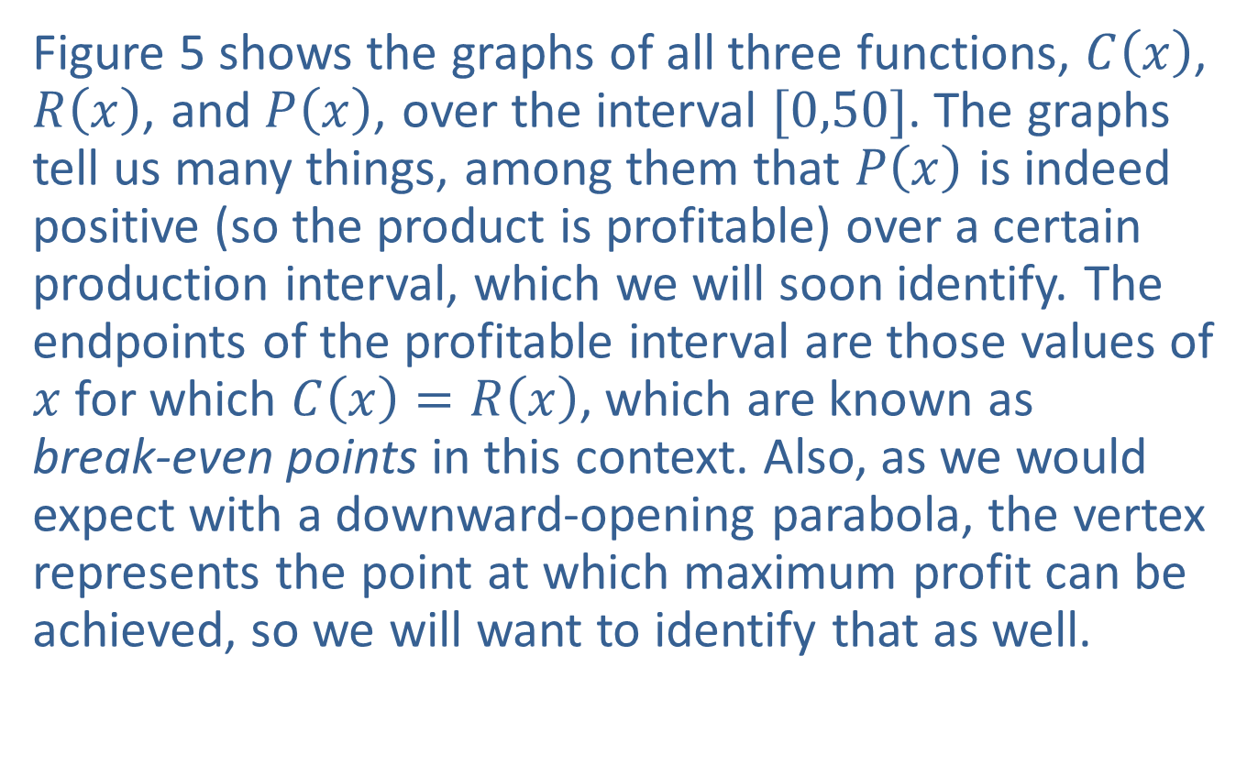
Example 4: Modeling Profit Earned from Selling Tables (cont.)
​Figure 5 shows the graphs of all three functions, $C⁡\left(x\right)$, $R⁡\left(x\right)$, and $P⁡\left(x\right)$, over the interval $[0,50]$. The graphs tell us many things, among them that $P⁡\left(x\right)$ is indeed positive (so the product is profitable) over a certain production interval, which we will soon identify. The endpoints of the profitable interval are those values of $x$ for which $C\left(x\right)=R\left(x\right)$, which are known as
break-even points in this context. Also, as we would expect with a downward-opening parabola, the vertex represents the point at which maximum profit can be achieved, so we will want to identify that as well.
​

Slide 34
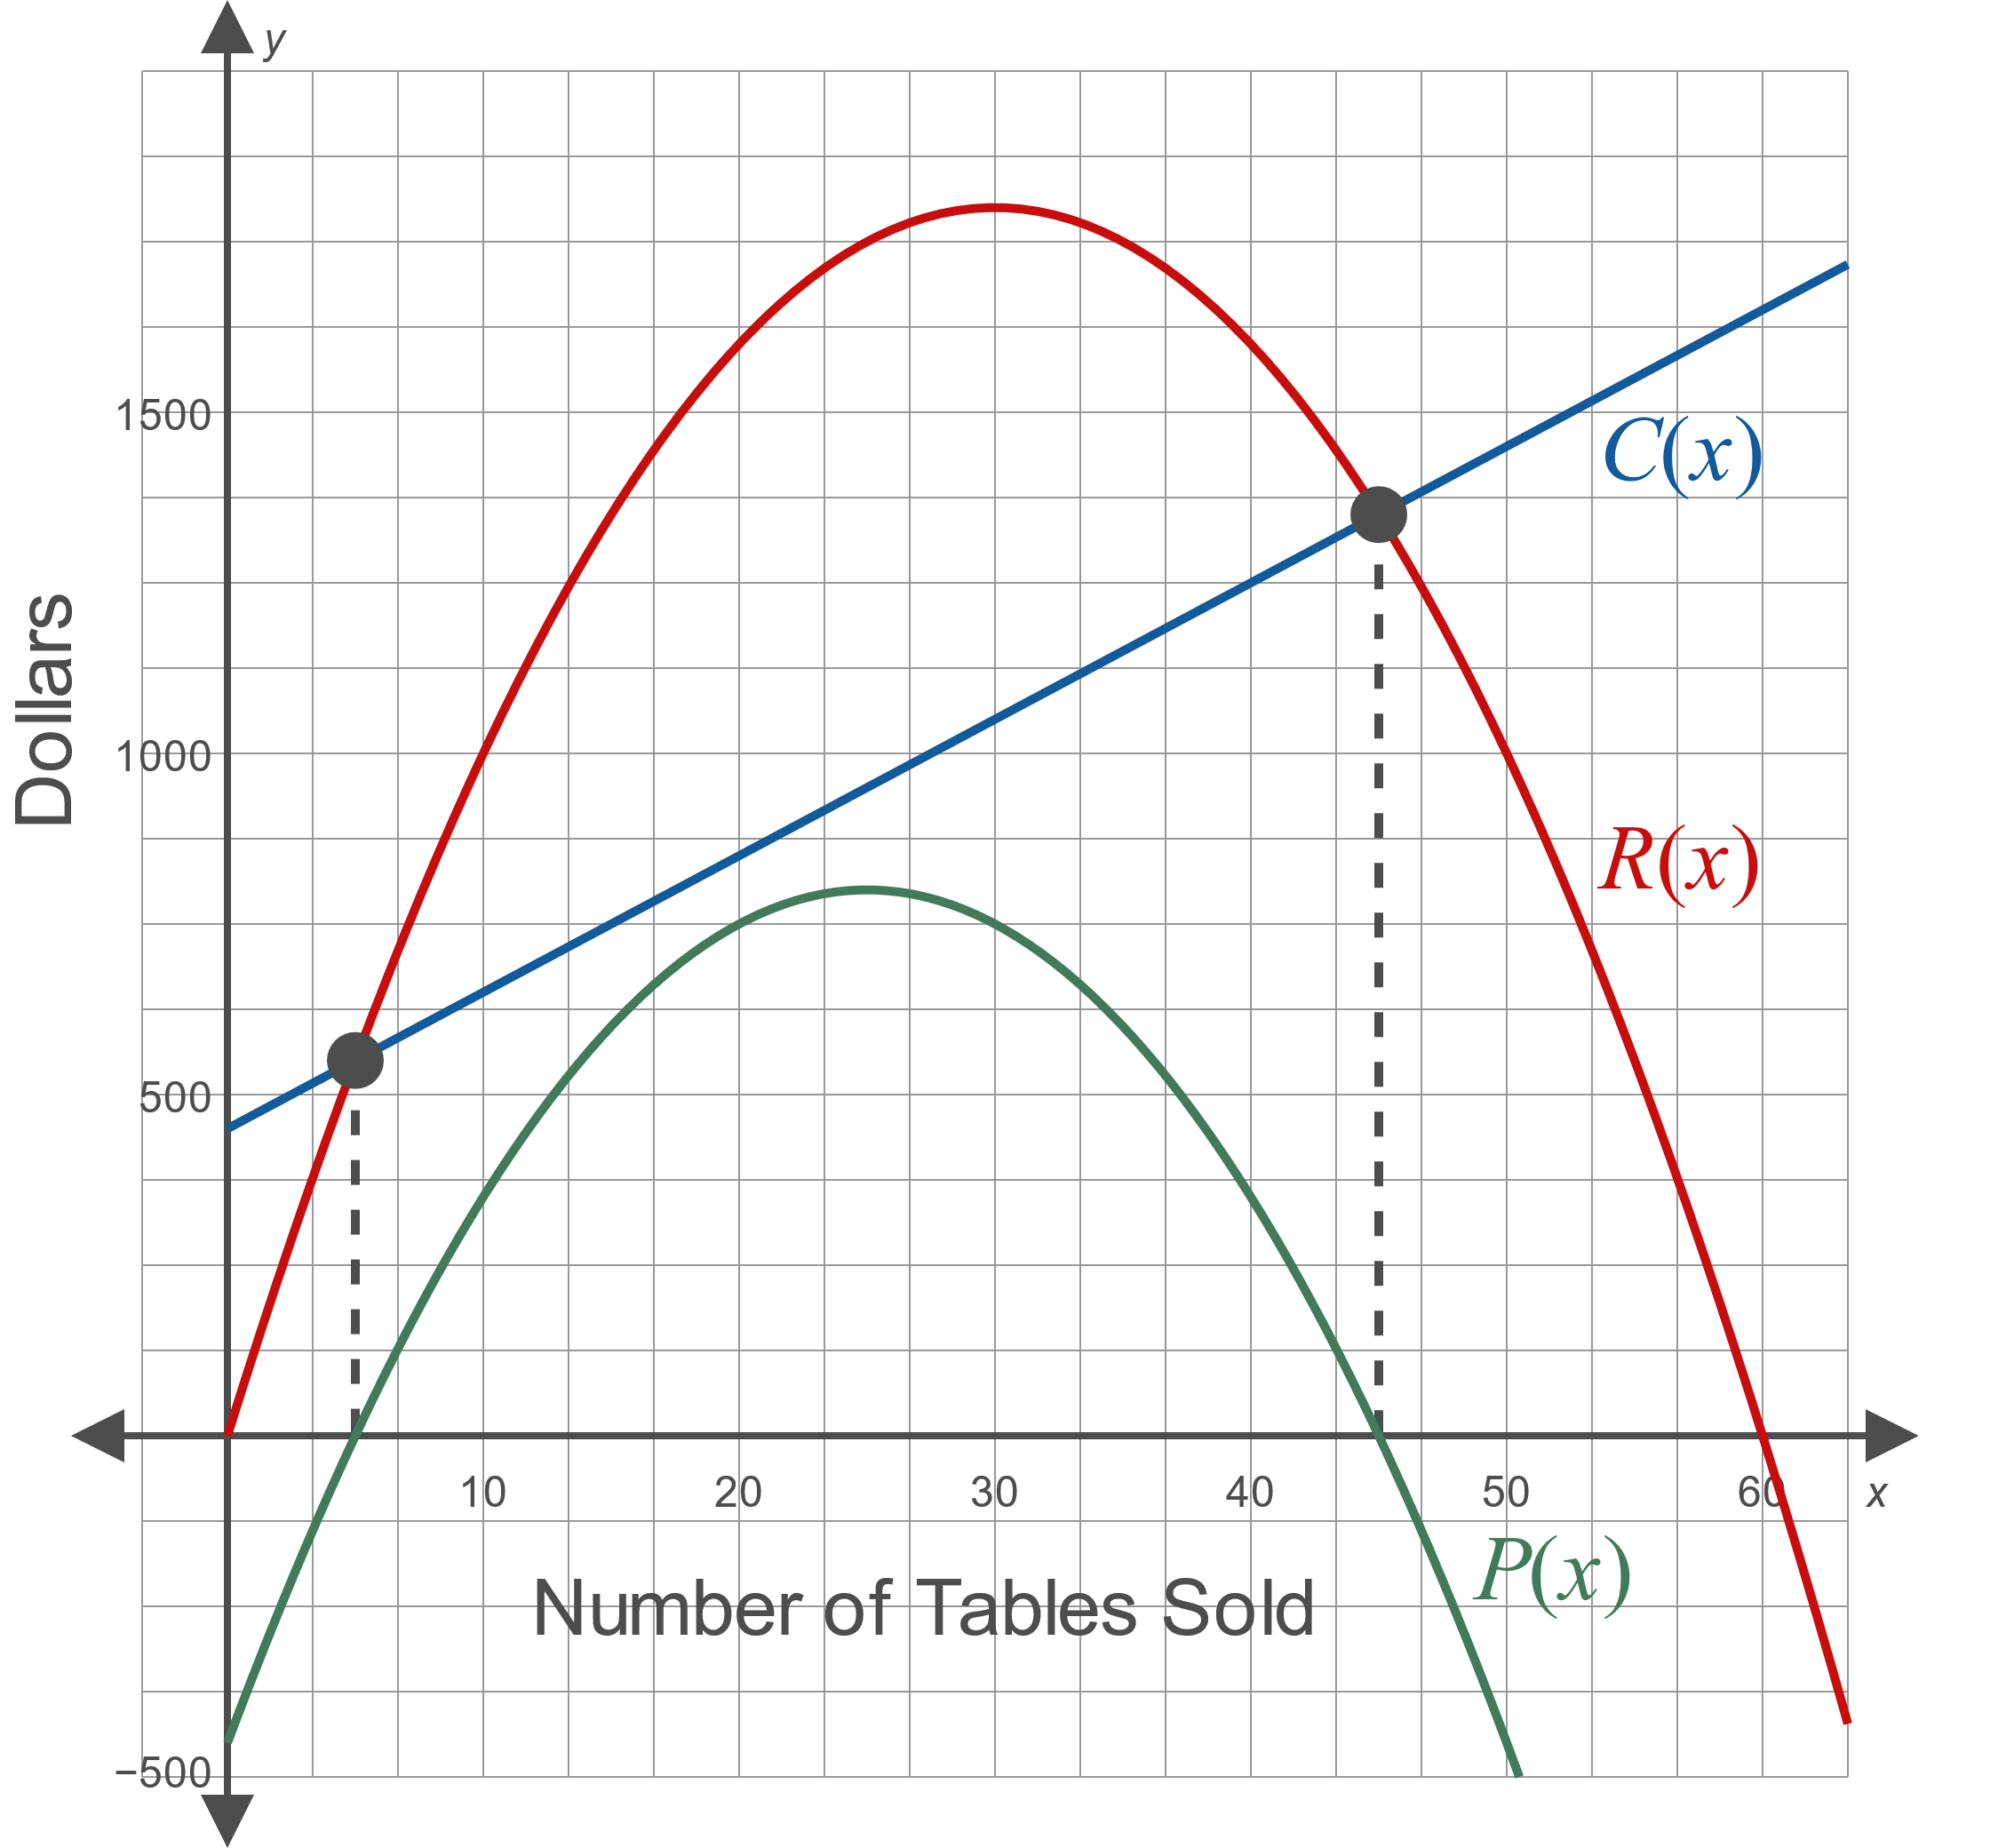
Example 4: Modeling Profit Earned from Selling Tables (cont.)
Figure 5

Slide 35
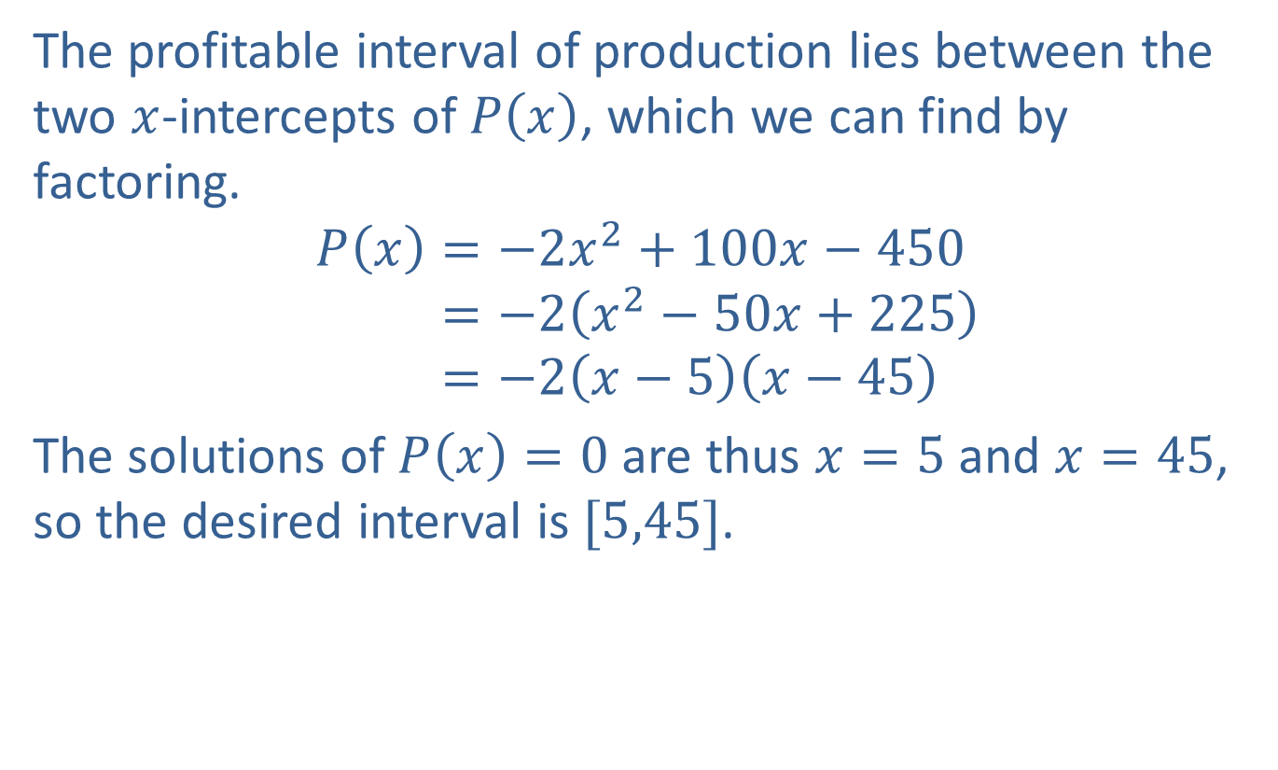
Example 4: Modeling Profit Earned from Selling Tables (cont.)
​The profitable interval of production lies between the two $x$-intercepts of $P⁡\left(x\right)$, which we can find by factoring.
𝑃𝑥=−2𝑥2+100𝑥−450𝑃⁡𝑥=−2𝑥2−50𝑥+225𝑃⁡𝑥=−2𝑥−5𝑥−45
​The solutions of $P\left(x\right)=0$ are thus $x=5$ and $x=45$, so the desired interval is $[5,45]$.

Slide 36
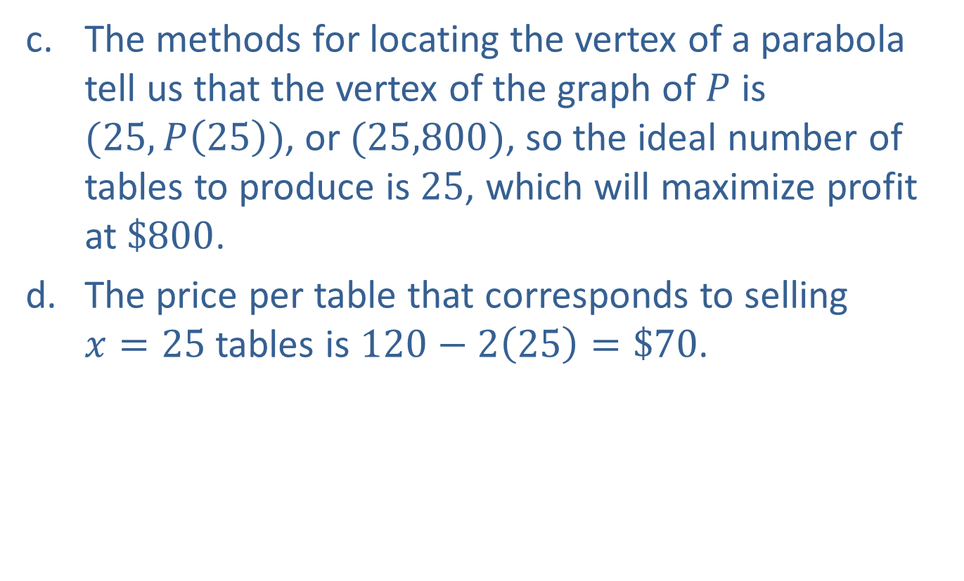
Example 4: Modeling Profit Earned from Selling Tables (cont.)
​The methods for locating the vertex of a parabola tell us that the vertex of the graph of $P$ is $(25,P\left(25\right))$, or $(25,800)$, so the ideal number of tables to produce is 25, which will maximize profit at $\$800$.
​The price per table that corresponds to selling
$x=25$ tables is $120−2\left(25\right)=\$70$.

