Slide 1
Section 5.3
Combining Functions

Slide 2
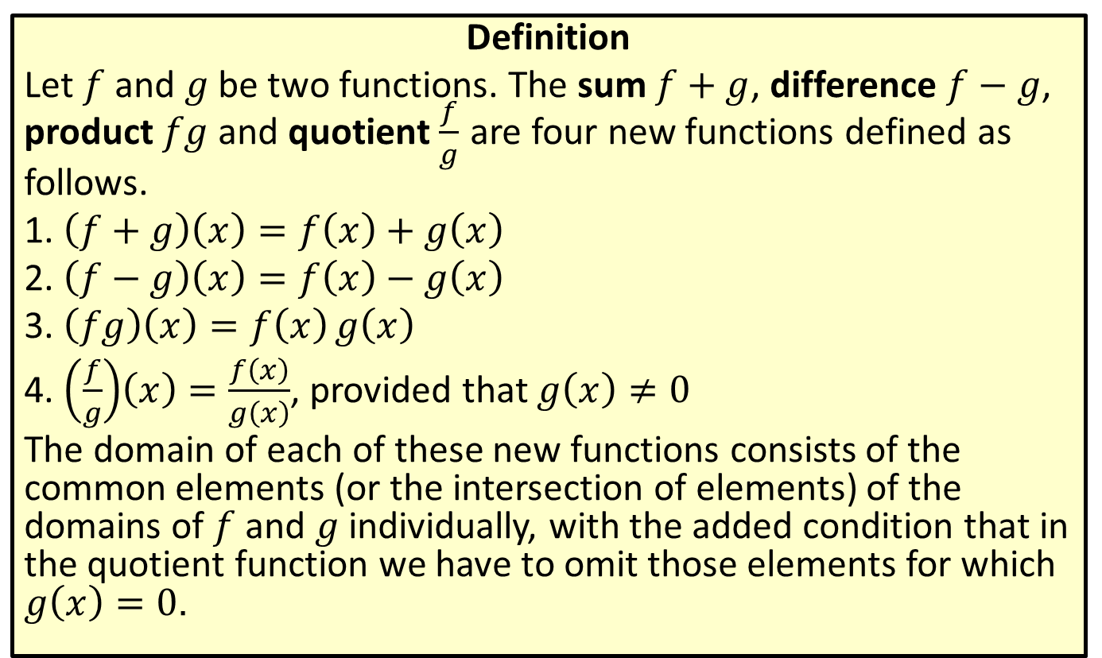
Addition, Subtraction, Multiplication and Division of Functions
Definition
Let $f$ and $g$ be two functions. The sum $f+g$, difference $f−g$, product $fg$ and quotient $\frac{f}{g}$ are four new functions defined as follows.
1. $\left(f+g\right)\left(x\right)=f\left(x\right)+g\left(x\right)$
2. $\left(f−g\right)\left(x\right)=f\left(x\right)−g\left(x\right)$
3. $\left(fg\right)\left(x\right)=f\left(x\right)g\left(x\right)$
4. $\left(\frac{f}{g}\right)\left(x\right)=\frac{f\left(x\right)}{g\left(x\right)}$, provided that $g\left(x\right)≠0$
The domain of each of these new functions consists of the common elements (or the intersection of elements) of the domains of $f$ and $g$ individually, with the added condition that in the quotient function we have to omit those elements for which $g\left(x\right)=0$.

Slide 3

Example 1: Combining Functions Arithmetically
Given that $f\left(−2\right)=5$ and $g\left(−2\right)=−3$, find $\left(f−g\right)⁡\left(−2\right)$ and $\left(\frac{f}{g}\right)⁡\left(−2\right)$.

Slide 4
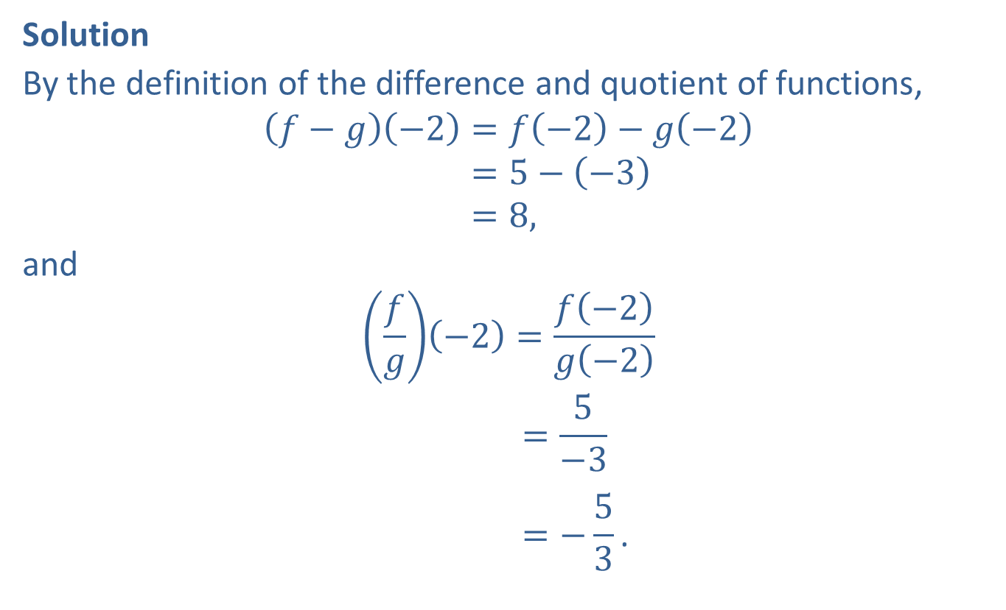
Example 1: Combining Functions Arithmetically (cont.)
Solution
By the definition of the difference and quotient of functions,
𝑓−𝑔−2=𝑓−2−𝑔−2𝑓−𝑔⁡−2=5−−3𝑓−𝑔⁡−2=8,
and
𝑓𝑔−2=𝑓−2𝑔−2𝑓𝑔⁡−2=5−3𝑓𝑔⁡−2=−53.

Slide 5

Example 2: Combining Functions Arithmetically
Given the two functions $f\left(x\right)=4x^{2}−1$ and $g\left(x\right)=\sqrt{x}$, find $\left(f+g\right)⁡\left(x\right)$ and $\left(fg\right)⁡\left(x\right)$.

Slide 6
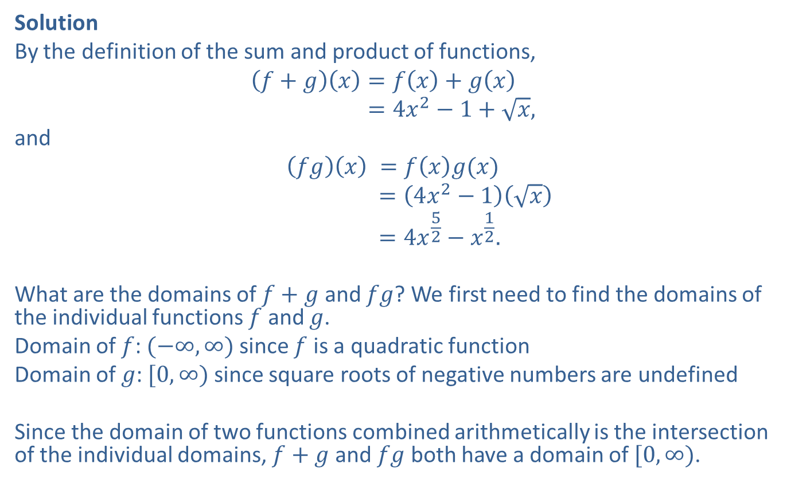
Example 2: Combining Functions Arithmetically (cont.)
Solution
By the definition of the sum and product of functions,
𝑓+𝑔𝑥=𝑓𝑥+𝑔𝑥𝑓+𝑔⁡𝑥=4𝑥2−1+𝑥,
and
$$\left(fg\right)\left(x\right) =f\left(x\right)g(x)$$
𝑓𝑔⁡𝑥 =4𝑥2−1𝑥𝑓𝑔⁡𝑥 =4𝑥52−𝑥12.
What are the domains of $f+g$ and $fg$? We first need to find the domains of the individual functions $f$ and $g$.
Domain of $f$: $(−∞,∞)$ since $f$ is a quadratic function
Domain of $g$: $[0,∞)$ since square roots of negative numbers are undefined
Since the domain of two functions combined arithmetically is the intersection of the individual domains, $f+g$ and $fg$ both have a domain of $[0,∞)$.

Slide 7

Example 3: Combining Functions Arithmetically
Given the graphs of $f$ and $g$ in Figure 1, determine the domain of $f+g$ and $\frac{f}{g}$ and evaluate $\left(f+g\right)⁡\left(1\right)$ and $\left(\frac{f}{g}\right)⁡\left(1\right)$.

Slide 8
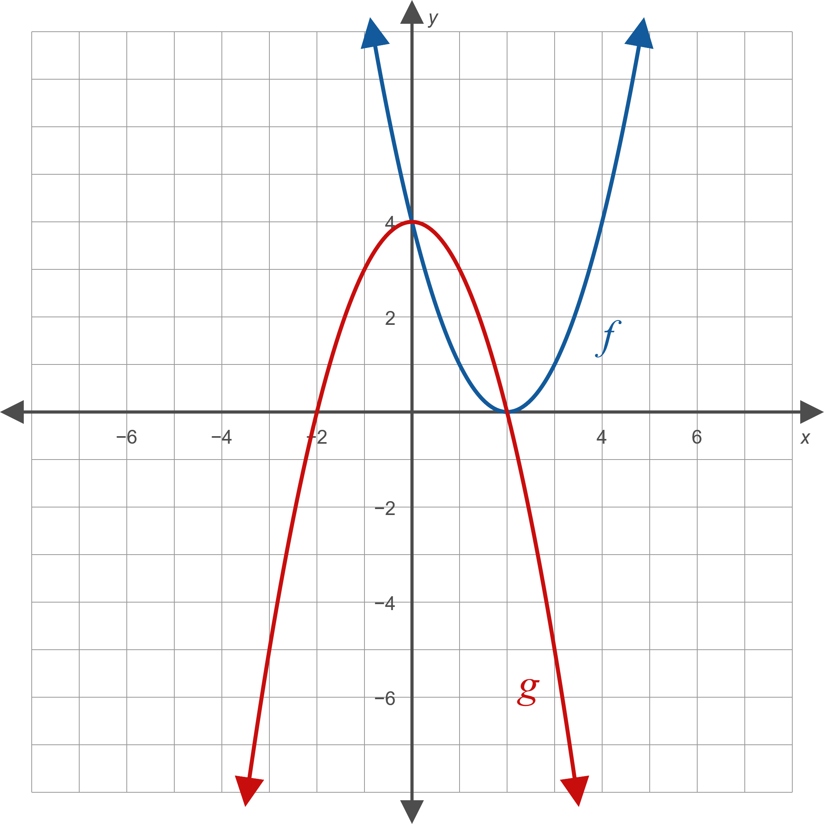

Example 3: Combining Functions Arithmetically (cont.)

Slide 9
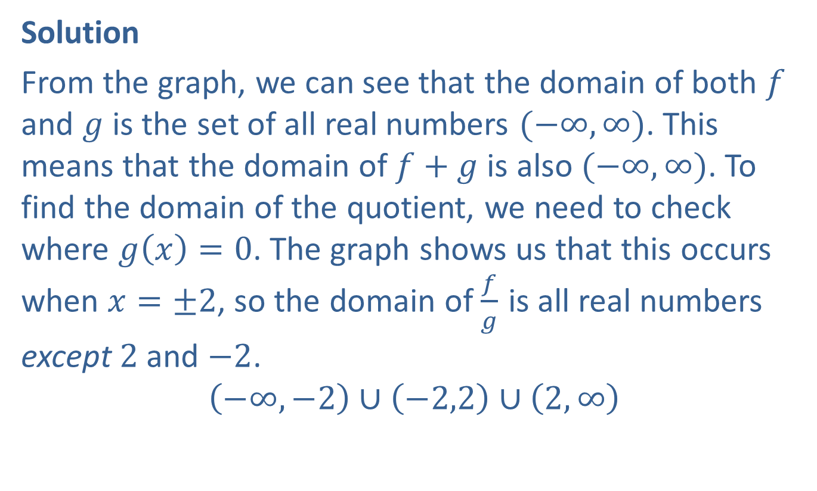
Example 3: Combining Functions Arithmetically (cont.)
Solution
From the graph, we can see that the domain of both $f$ and $g$ is the set of all real numbers $(−∞,∞)$. This means that the domain of $f+g$ is also $(−∞,∞)$. To find the domain of the quotient, we need to check where $g\left(x\right)=0$. The graph shows us that this occurs when $x=±2$, so the domain of $\frac{f}{g}$ is all real numbers except 2 and $−2$.
$$\left(−∞,−2\right)∪\left(−2,2\right)∪\left(2,∞\right)$$

Slide 10

Example 3: Combining Functions Arithmetically (cont.)
To evaluate the new functions, we need to find $f⁡\left(1\right)$ and $g⁡\left(1\right)$ using the graph.
We can see that $f\left(1\right)=1$ and $g\left(1\right)=3$, which means
$\left(f+g\right)\left(1\right)=1+3=4$ and $\left(\frac{f}{g}\right)\left(1\right)=\frac{1}{3}=\frac{1}{3}$.

Slide 11
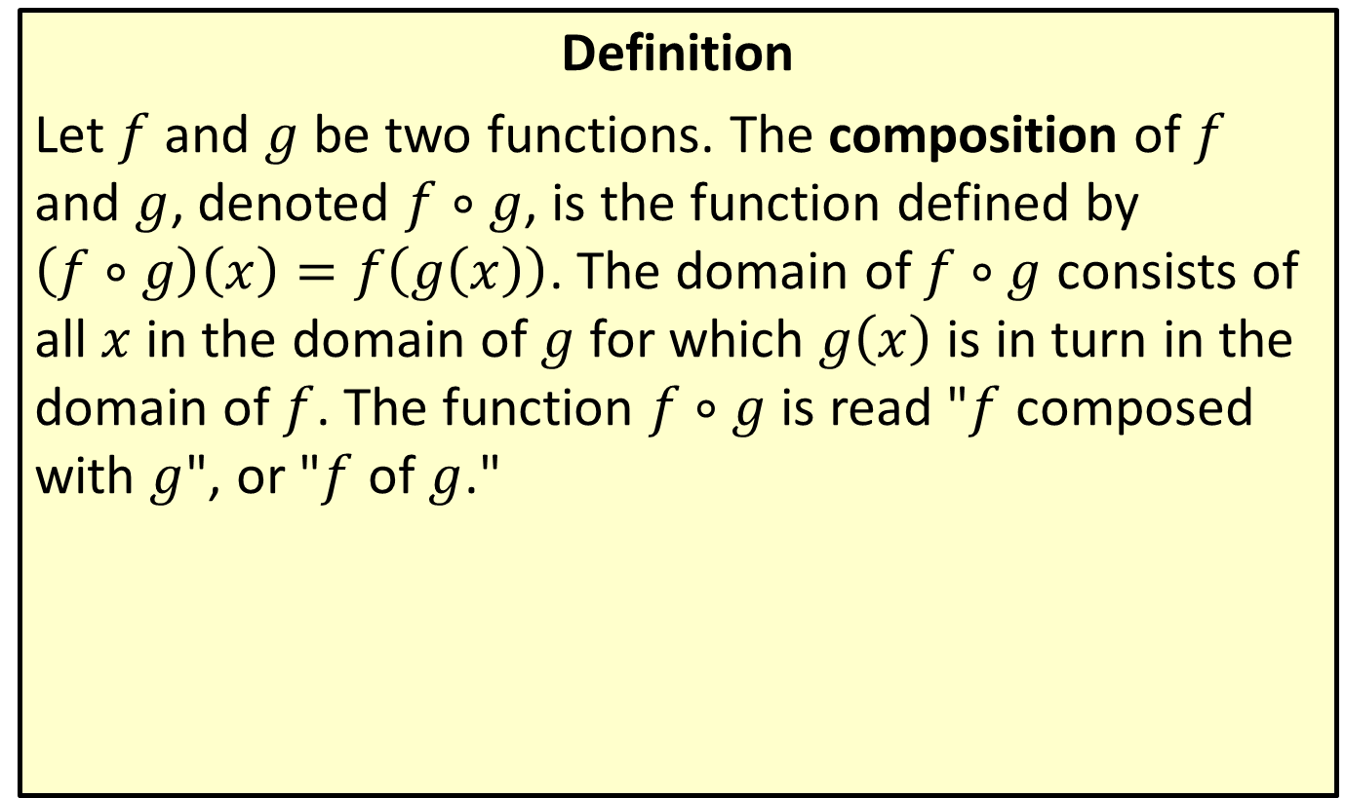
Composing Functions
Definition
Let $f$ and $g$ be two functions. The composition of $f$ and $g$, denoted $f∘g$, is the function defined by $\left(f∘g\right)\left(x\right)=f\left(g\left(x\right)\right)$. The domain of $f∘g$ consists of all $x$ in the domain of $g$ for which $g⁡\left(x\right)$ is in turn in the domain of $f$. The function $f∘g$ is read "$f$ composed with $g$", or "$f$ of $g$."

Slide 12
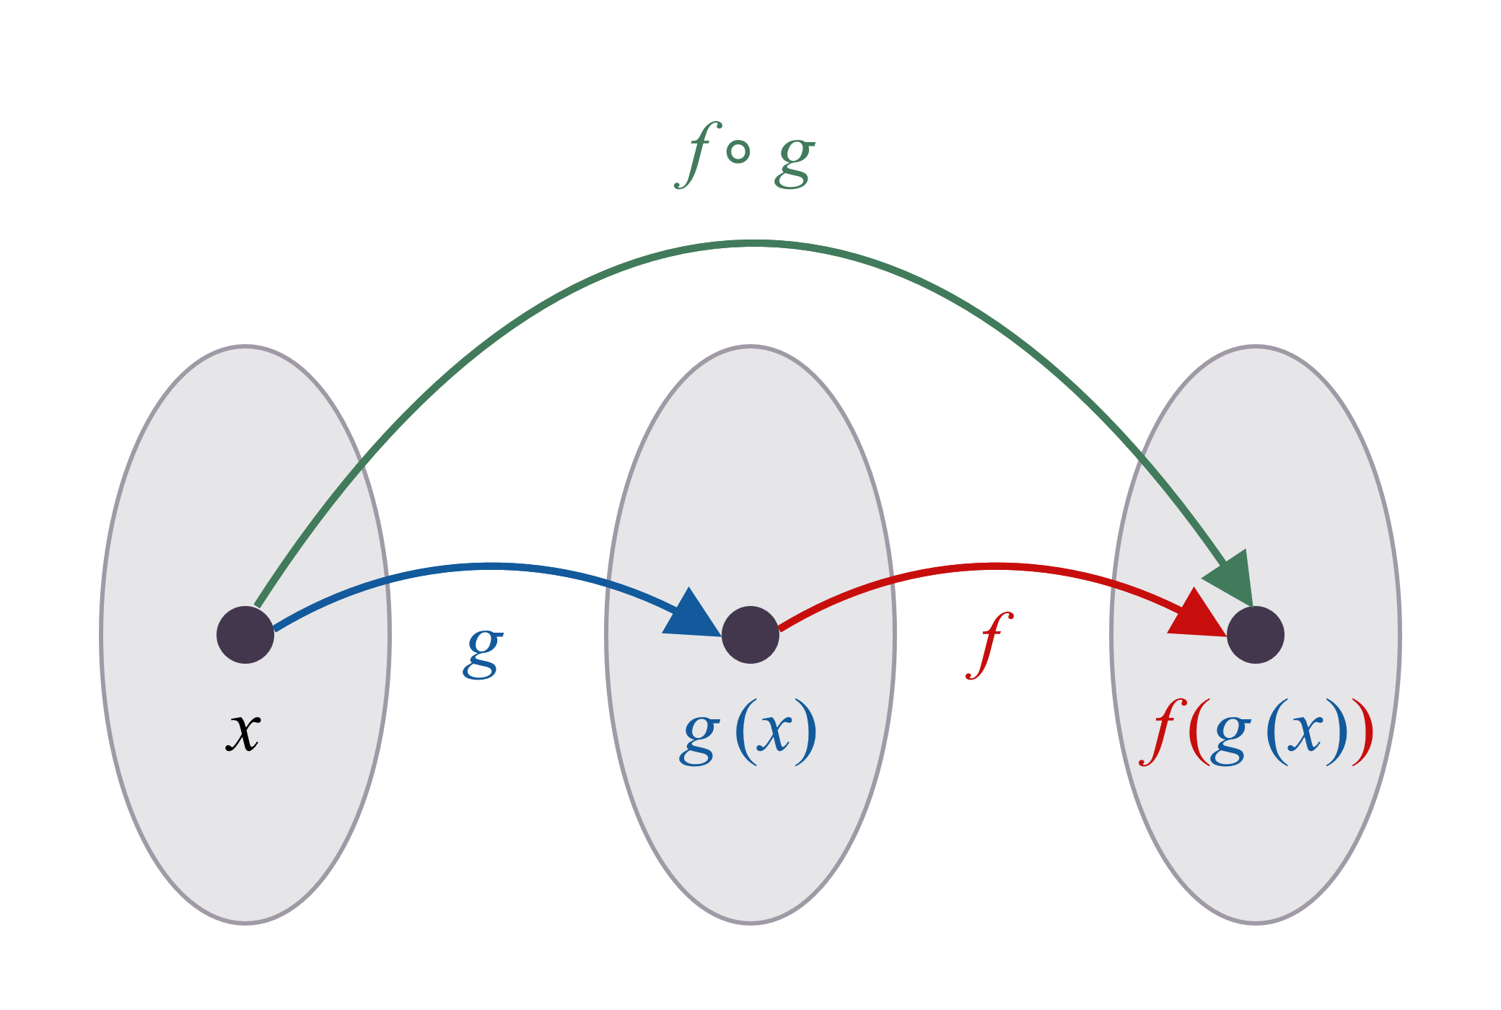
Figure 2: Composition of f and g

Slide 13
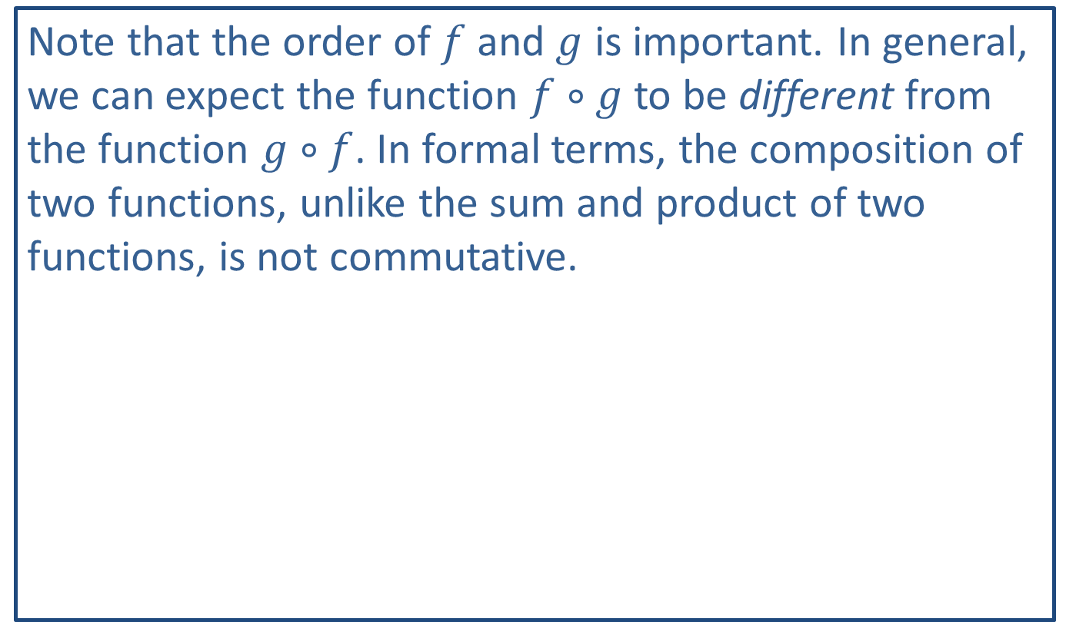
CAUTION!
Note that the order of $f$ and $g$ is important. In general, we can expect the function $f∘g$ to be different from the function $g∘f$. In formal terms, the composition of two functions, unlike the sum and product of two functions, is not commutative.

Slide 14

Example 4: Composing Functions
Given $f\left(x\right)=x^{2}$ and $g\left(x\right)=x−3$, find the following.
​$\left(f∘g\right)⁡\left(6\right)$
​$\left(g∘f\right)⁡\left(6\right)$
​$\left(f∘g\right)⁡\left(x\right)$
​$\left(g∘f\right)⁡\left(x\right)$

Slide 15
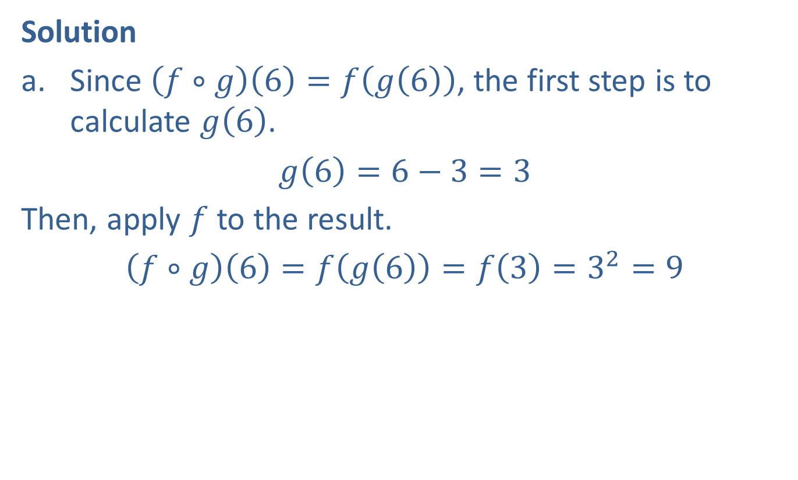
Example 4: Composing Functions (cont.)
Solution
​Since $\left(f∘g\right)\left(6\right)=f\left(g\left(6\right)\right)$, the first step is to calculate $g\left(6\right)$.
​$g\left(6\right)=6−3=3$
​Then, apply $f$ to the result.
​$\left(f∘g\right)\left(6\right)=f\left(g\left(6\right)\right)=f\left(3\right)=3^{2}=9$

Slide 16

Example 4: Composing Functions (cont.)
This time, we begin by finding $f⁡\left(6\right)$.
​$f\left(6\right)=6^{2}=36$
​Now, apply $g$ to the result.
​$g\left(f\left(6\right)\right)=g\left(36\right)=36−3=33$

Slide 17
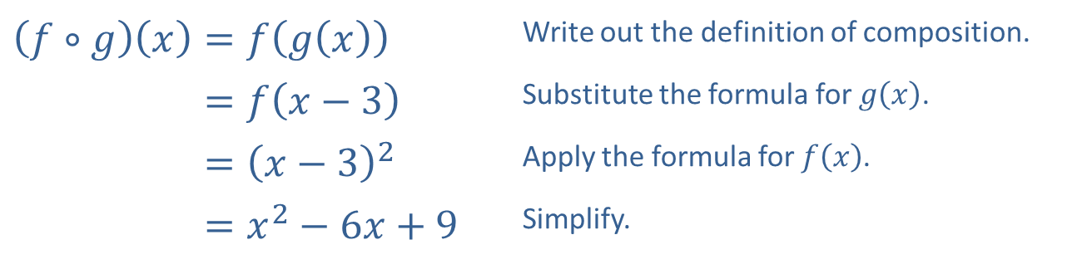

Example 4: Composing Functions (cont.)
​To find the formula for $f∘g$ we apply the definition of composition, then simplify.
​
​$\left(f∘g\right)\left(x\right)=f\left(g\left(x\right)\right)$ | Write out the definition of composition.
​𝑓∘𝑔⁡𝑥=𝑓𝑥−3 | Substitute the formula for $g⁡\left(x\right)$.
​𝑓∘𝑔⁡𝑥=𝑥−32 | Apply the formula for $f⁡\left(x\right)$.
​𝑓∘𝑔⁡𝑥=𝑥2−6𝑥+9 | Simplify.

Slide 18
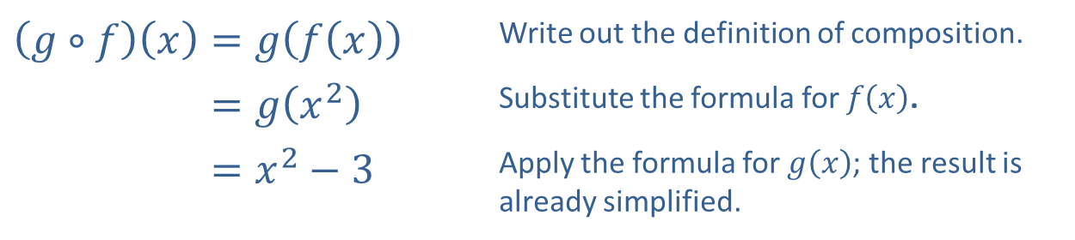

Example 4: Composing Functions (cont.)
​To find a formula for the function $g∘f$ we follow the same process.
​
​$\left(g∘f\right)\left(x\right)=g\left(f\left(x\right)\right)$ | Write out the definition of composition.
​𝑔∘𝑓⁡𝑥=𝑔𝑥2 | Substitute the formula for $f⁡\left(x\right)$.
​𝑔∘𝑓⁡𝑥=𝑥2−3 | Apply the formula for $g⁡\left(x\right)$; the result is already simplified.

Slide 19

Example 4: Composing Functions (cont.)
​Note that once we have found formulas $f∘g$ and $g∘f$ we can answer the first two parts by directly plugging into these formulas.
$$\left(f∘g\right)\left(6\right)=6^{2}−6\left(6\right)+9=9 \\ \left(g∘f\right)\left(6\right)=6^{2}−3=33$$

Slide 20
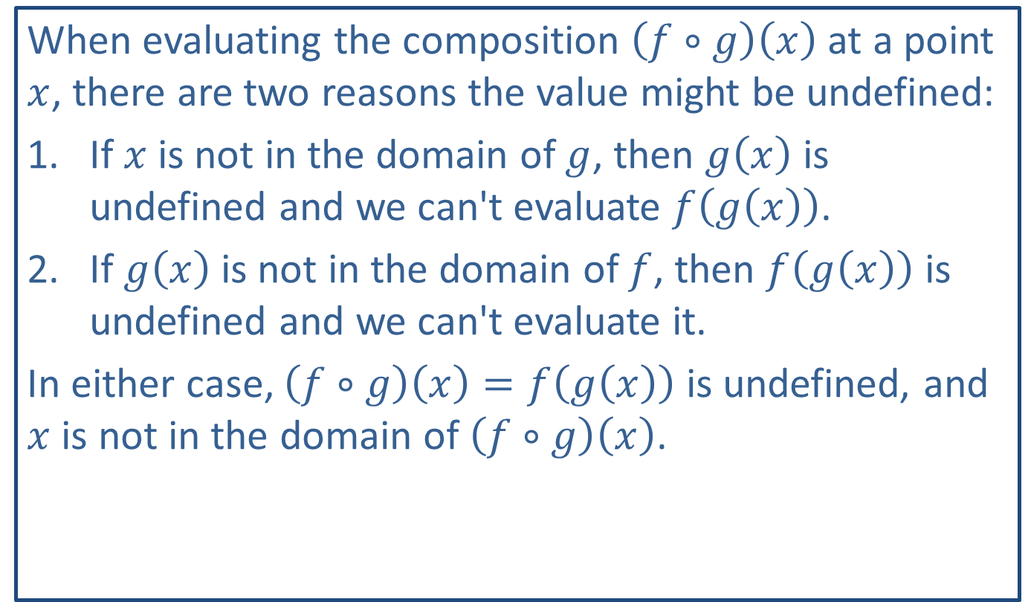
CAUTION!
When evaluating the composition $\left(f∘g\right)⁡\left(x\right)$ at a point $x$, there are two reasons the value might be undefined:
If ​$x$ is not in the domain of $g$, then $g⁡\left(x\right)$ is undefined and we can't evaluate $f⁡\left(g\left(x\right)\right)$.
If ​$g⁡\left(x\right)$ is not in the domain of $f$, then $f⁡\left(g\left(x\right)\right)$ is undefined and we can't evaluate it.
In either case, $\left(f∘g\right)\left(x\right)=f\left(g\left(x\right)\right)$ is undefined, and $x$ is not in the domain of $\left(f∘g\right)⁡\left(x\right)$.

Slide 21

Example 5: Domains of Compositions of Functions
Let $f\left(x\right)=\sqrt{x−5}$ and $g\left(x\right)=\frac{2}{x+1}$. Evaluate the following.
​$\left(f∘g\right)⁡\left(−1\right)$
​$\left(f∘g\right)⁡\left(1\right)$

Slide 22
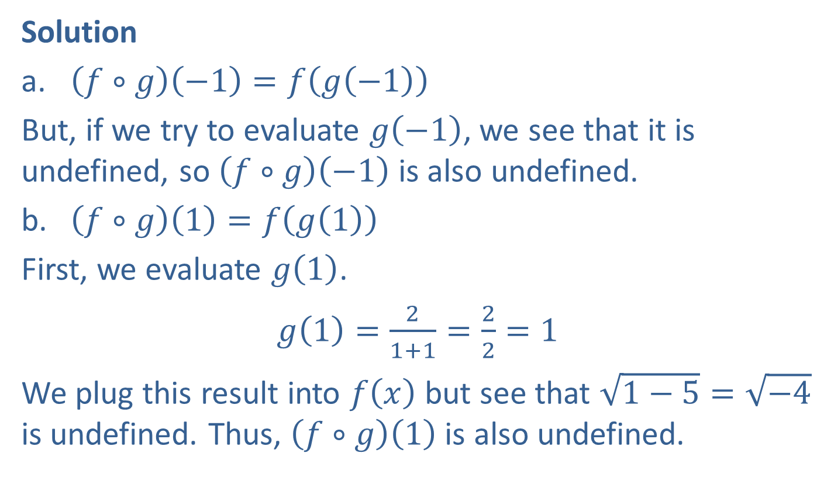
Example 5: Domains of Compositions of Functions (cont.)
Solution
​$\left(f∘g\right)\left(−1\right)=f\left(g\left(−1\right)\right)$
​But, if we try to evaluate $g⁡\left(−1\right)$, we see that it is undefined, so $\left(f∘g\right)⁡\left(−1\right)$ is also undefined.
​$\left(f∘g\right)\left(1\right)=f\left(g\left(1\right)\right)$
​First, we evaluate $g⁡\left(1\right)$.
​$g\left(1\right)=\frac{2}{1+1}=\frac{2}{2}=1$
​We plug this result into $f⁡\left(x\right)$ but see that $\sqrt{1−5}=\sqrt{−4}$ is undefined. Thus, $\left(f∘g\right)⁡\left(1\right)$ is also undefined.

Slide 23

Example 6: Domains of Compositions of Functions
Let $f\left(x\right)=x^{2}−4$ and $g\left(x\right)=\sqrt{x}$. Find formulas and state the domains for the following.
​$f∘g$
​$g∘f$

Slide 24
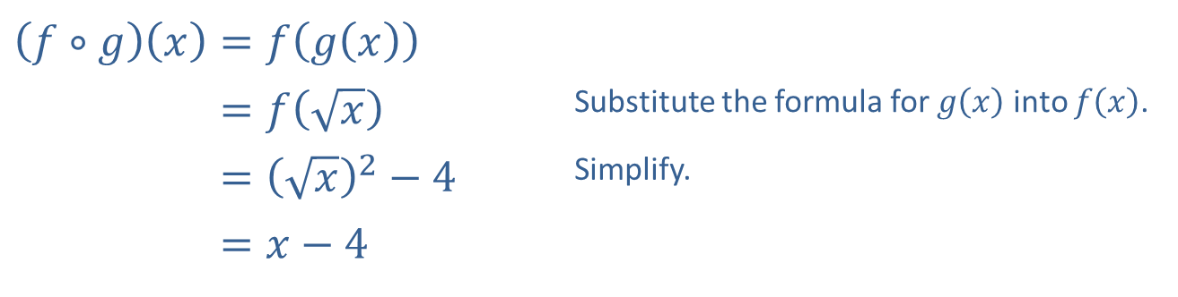
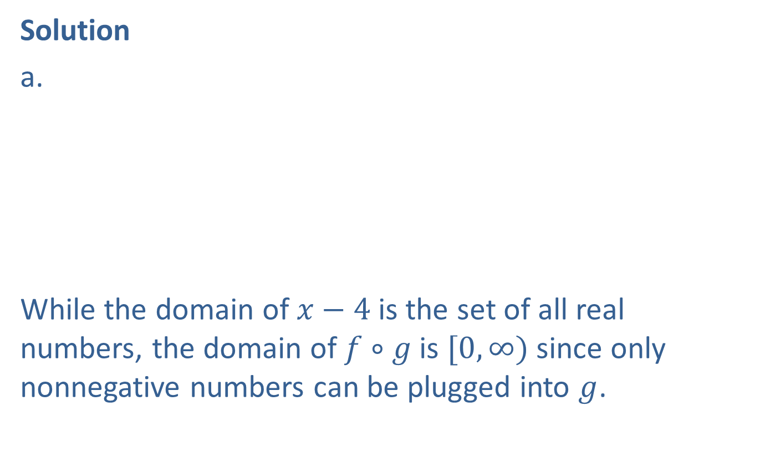
Example 6: Domains of Compositions of Functions (cont.)
Solution
​
​
While the domain of $x−4$ is the set of all real numbers, the domain of $f∘g$ is $[0,∞)$ since only nonnegative numbers can be plugged into $g$.
​$\left(f∘g\right)\left(x\right)=f\left(g\left(x\right)\right)$
​𝑓∘𝑔⁡𝑥=𝑓𝑥 | Substitute the formula for $g⁡\left(x\right)$ into $f⁡\left(x\right)$.
​𝑓∘𝑔⁡𝑥=𝑥2−4 | Simplify.
​𝑓∘𝑔⁡𝑥=𝑥−4

Slide 25
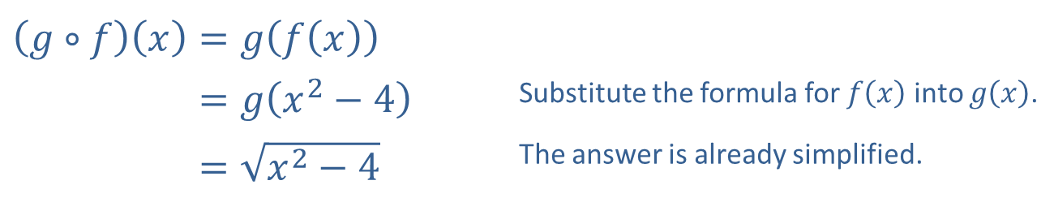

Example 6: Domains of Compositions of Functions (cont.)
b.
The domain of $g∘f$ consists of all $x$ for which $x^{2}−4≥0$, or $x^{2}≥4$. We can write this in interval form as $\left(−∞,−2\right]∪\left[2,∞\right)$.
​$\left(g∘f\right)\left(x\right)=g\left(f\left(x\right)\right)$
​𝑔∘𝑓⁡𝑥=𝑔𝑥2−4 | Substitute the formula for $f⁡\left(x\right)$ into $g⁡\left(x\right)$.
​𝑔∘𝑓⁡𝑥=𝑥2−4 | The answer is already simplified.

Slide 26

Example 7: Decomposing Functions
Decompose the function $f\left(x\right)=\left|x^{2}−3\right|+2$ into the following.
​a composition of two functions
​a composition of three functions

Slide 27
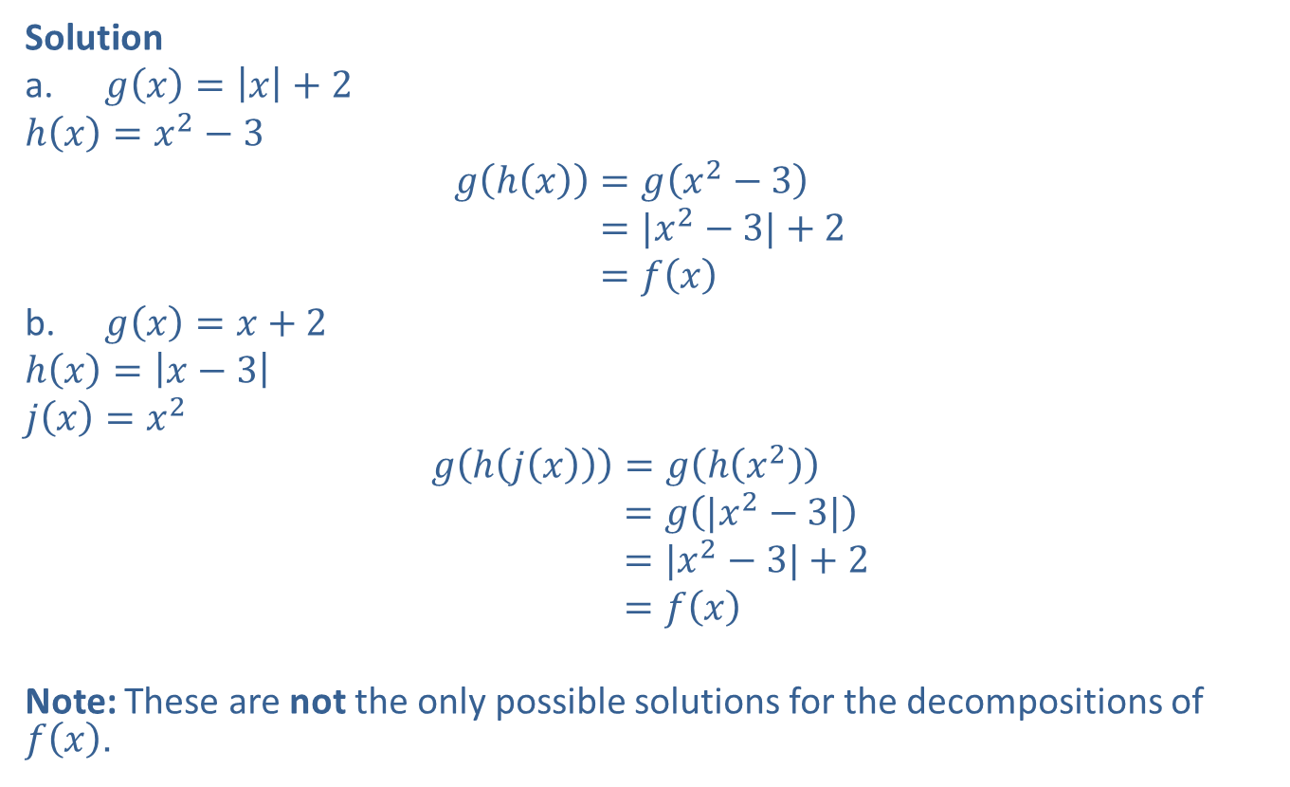
Example 7: Decomposing Functions (cont.)
Solution
​$g\left(x\right)=\left|x\right|+2$
​$h\left(x\right)=x^{2}−3$
𝑔h𝑥=𝑔𝑥2−3𝑔⁡h𝑥=|𝑥2−3|+2𝑔⁡h𝑥=𝑓𝑥
​$g\left(x\right)=x+2$
​$h\left(x\right)=\left|x−3\right|$
​$j\left(x\right)=x^{2}$
𝑔h𝑗𝑥=𝑔h𝑥2𝑔⁡h𝑖𝑥=𝑔|𝑥2−3|𝑔⁡h𝑖𝑥=|𝑥2−3|+2𝑔⁡h𝑖𝑥=𝑓𝑥
Note: These are not the only possible solutions for the decompositions of $f⁡\left(x\right)$.

